Slide 1
GridSphere: A Portal Framework
An Overview
Jason Novotny novotny@aei.mpg.de
Michael Russell russell@aei.mpg.de
Oliver Wehrens wehrens@aei.mpg.de
Albert Einstein Institute

Slide 2
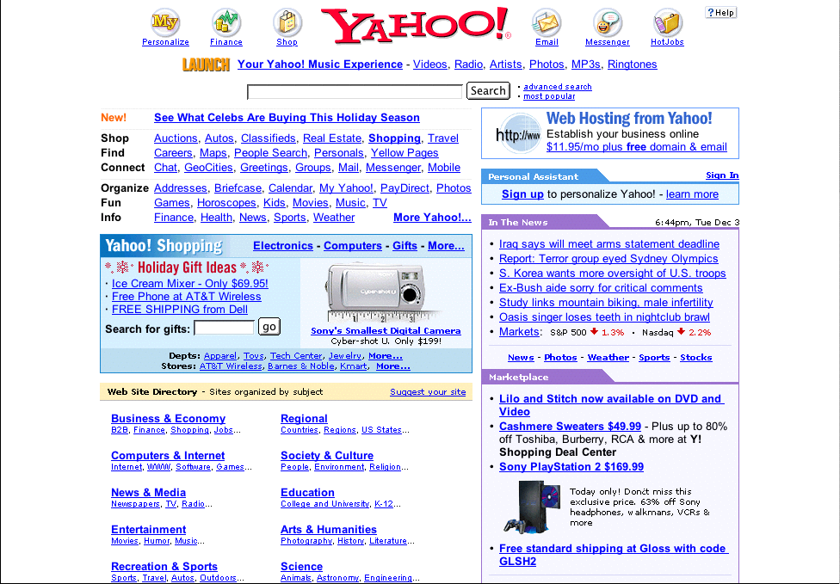

Introduction
Grid Portals build upon the familiar Web portal model, such as Yahoo or Amazon, to deliver the benefits of Grid computing to virtual communities of researchers and scientists, providing customizable, easy-to-use, singular access points to Grids.

Slide 3


The State of Grid Portals
A Portal is only as good as the underlying deployed infrastructure
Portlet development often involves debugging underlying middleware
Often difficult and hard to maintain glue code must be written connecting the portal to Grid services, due to lack of/evolving standards.
Most portals are stovepipe solutions that provide a complete solution with very little customization capabilities.
  Separation of presentation and login
  Generally hard coding of underlying Grid infrastructure details and the codebase
Lack of real usability has made it difficult to test and evaluate user interfaces.
Web application development still remains a tedious task with little in the way of reusable components, forcing developers to constantly “re-invent” the wheel.
Over 40 portal projects within the EU alone! Desperately need a framework for portal developoment

Slide 4


Early Grid Portal Projects
Grid-Port:
  Perl-based framework developed by Mary Thomas and Steve Mock at San-Diego Supercomputing Center (SDSC)
  Provides general Grid functionality using Globus
Grid Portal Development Toolkit (GPDK):
  Developed by Jason Novotny at Lawrence Berkeley National Laboratories (LBNL)
  Java Portal using Servlets/JSP allows developers to create customized portals with Globus functionality
Astrophysics Simulation Collaboratory (ASC):
  Developed by Michael Russell at University of Chicago, now lead by Greg Daues of National Super-Computing Alliance (NCSA)
  Java based application portal developed to support the needs of the numerical relativity community

Slide 5


GridSphere Portal Framework
We are combining the lessons we learned in the development of the Astrophysics Simulation Collaboratory, the precursor to the GridLab Project, and the Grid Portal Development Toolkit, one of the earliest and most widely used research projects within the Grid portal community.
Provides a “white-box” framework
  Framework users override base classes and “hook” methods
  Requires users to become familiar with core framework interfaces
  Core framework interfaces based on community standard API
Makes use of design patterns
  Provides solutions to commonly recurring software design problems
  Provides common language that makes code easier to read and understand
  MVC pattern used to separate logic from presentation

Slide 6

Portlets
The Portlet Java Specification Request (JSR-168) lays the foundation for a new open-standard for Web portal development frameworks.
Portlets define an API for building atomic, composable visual interfaces to Web content or service providers
A portlet provides a “mini-window” within a portal page. Multiple portlets can be composed in a portal page.
Portlets extend servlets. The idea being to reuse common method signatures.

Slide 7
Portlet Implementations
Still waiting for standardized Portlet API but implementations already exist:
  Jakarta Jetspeed
  IBM WebSphere
  Oracle i9AS Portal
  BEA WebLogic Portal 7.0 (?)
  GridSphere…
Why not Use Jetspeed?
  Performed an evaluation of Jetspeed 6/02/2002
  Code not very stable, too many dependencies that are all changing e.g. Turbine, ECS, etc.
  Large open-source projects have disadvantage that it can be difficult to provide changes
  Wanted to build Portlet implementation that could meet the needs of the Grid community

Slide 8
GridSphere Feature List
Portlet API implementation nearly fully compatible with IBM's WebSphere 4.2.
Support for the easy development and integration of "third-party portlets"
Higher-level model for building complex portlets using visual beans and the GridSphere User Interface (UI) tag library.
Flexible XML based portal presentation description can be easily modified to create customized portal layouts.
Built-in support for Role Based Access Control (RBAC) separating users into guests, users, admins and super users.
Sophisticated portlet service model that allows for creation of "user services", where service methods can be limited according to user rights.

Slide 9
GridSphere Feature List (cont.)
Persistence of data provided using Castor JDO for RDMS database support
Integrated Junit/Cactus unit tests for complete server side testing of portlet services including the generation of test reports.
Documentation uses DocBook for HTML & PDF output of guides and tutorials
GridSphere core portlets offer base functionality including login, logout, user and access control management.
Localization support in the Portlet API implementation and GridSphere core portlets support English, German, Czech, Polish, Hungarian and Greek.
Open-source and 100% free! :-)

Slide 10
Portlet Interfaces
Portlet API generally inherits from the Servlet API to provide greater functionality
Portlet, PortletAdapter, AbstractPortlet
  All portlets implement the portlet interfaces that define portlet lifecycle methods. Portlet developers subclass from AbstractPortlet
PortletConfig
  Provides portlet with its initial configuration
PortletRequest
  Encapsulates the a request sent by client
PortletResponse
  Represents response to client
PortletContext
  Defines portlets view of the portlet container in which portlet is runninng

Slide 11
PortletRequest additions
PortletData
  Contains user-specific persistent data
PortletSession
  Holds user-specific information needed to provide personalized view
PortletWindow
  Defines “window” in which portlet is displayed
PortletMode
  Defines “mode” in which portlet is operating
Client
  Defines the client device connecting to the portal.
User
  User defines the logged in user

Slide 12
Portlet Modes
View
  The standard view of a portlet on a Web page
Edit
  Allows portlet to capture user-specific parameterization, which leads to personalized view of the portlet
Help
  A portlet should provide online-help with this mode
Configure
  Allows a portlet to display its own configuration mode if required
  Generally, you want to restrict access to this mode

Slide 13
Portlet Life-Cycle
The GridSphere portlet container loads and instantiates portlet classes.
A application portlet is initialized with the init() method
A concrete portlet is created and destroyed with initConcrete() and destroyConcrete() methods.
If a user logs in or logs out, the login() and logout() methods are invoked
If a portlet is taken of service temporarily, say while administering it, the portlet container may finish the lifecycle before taking it out of service. Once the administering is done, it may be re-initialized.

Slide 14
Portlet template class
public class AnyPortlet extends AbstractPortlet {
public void init(PortletConfig config) {}
public void initConcrete(PortletSettings settings) {}
public void actionPerformed(ActionEvent event) {
// handle portlet actions
}
public void doView(PortletRequest req, PortletResponse res) {
// display view mode
}
public void doEdit(PortletRequest req, PortletResponse res) {
// display edit mode
}
public void doConfigure(PortletRequest req, PortletResponse res)
public void doHelp(PortletRequest req, PortletResponse res)
}

Slide 15
Portlet Deployment Descriptor
A Portlet Deployment Descriptor provides the portlet container with portlet configuration information
Defines a collection of portlet definitions as an XML schema e.g. portlets.xml
Each portlet definition must contain one application portlet definition and one or more concrete portlet definitions
Application portlet definition defines configuration information valid for a single portlet/servlet for all users
Concrete portlet definition provides parametrization information for application portlets.

Slide 16
Deployment Descriptor (cont)
Application Portlet Definition:
  <portlet-app id= portlet class name>
  <portlet-name>portlet name</portlet-name>
  <servlet-name>servlet name</servlet-name>
  <portlet-config>
  <param-name>name</param-name>
  <param-value>value</param-value>
  </portlet-config>
<allows>
<maximized/>
<minimized/>
<resizing/>
</allows>
</portlet-app>

Slide 17
Deployment Descriptor (cont)
Concrete Portlet Definition:
<concrete-portlet-app id= portlet class . # >
<context-param>
<param-name>name</param-name>
<param-value>value</param-value>
</context-param>
<concrete-portlet>
<portlet-name>Portlet Name</portlet-name>
<default-locale>en</default-locale>
<language locale="en_US">
<title>Portlet Title</title>
<description> Portlet Description</description>
</language>
<allowed-access visibility="PUBLIC">
<role>USER</role>
</allowed-access>
</concrete-portlet>
</concrete-portlet-app>

Slide 18
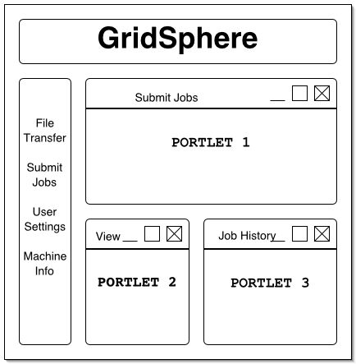
Layout & Presentation
GridSphere provides ability to define customized portal layout
Portlets exist within PortletFrame components
Uses event oriented programming model e.g. components can implement action listeners
GridSphere maintains a specific, customizable layout for each portal user

Slide 19
Portal Presentation
Portal uses header and double layer tabbed pane to organize content
Portal layout specified as XML schema:
<portlet-tab>
<title>Examples</title>
<portlet-tabbed-pane style="sub-menu">
<portlet-tab>
<title>Hello</title>
<portlet-panel>
<grid-layout>
<portlet-frame>
<portlet-class>org.gridlab.gridsphere.portlets.examples.HalloWelt.1</portlet-class>
</portlet-frame>
</grid-layout>
</portlet-panel>
</portlet-tab>
</portlet-tabbed-pane>
</portlet-tab>

Slide 20
Presentation Components
Layout component library similar to Java AWT or Swing
Basic layout components:
  PortletTabbedPane
  PortletTab
  PortletFrame
  PortletTitleBar
  PortletPanel
  PortletGridLayout
Some components act as containers for other components e.g. PortletPanel
Follows the Composite Design Pattern
Components are marshalled/unmarshalled to XML using Castor libraries

Slide 21
Presentation Tag Library
GridSphere provides value-added UI JSP tag library
Goal is to minimize HTML usage
  UI tags can provide platform independence e.g. support HTML and WML
Example tag usage in JSP:
  <%@ taglib uri="/portletUI" prefix=”ui" %>
  <%@ taglib uri="/portletAPI" prefix="portletAPI" %>
  <portletAPI:init/>
  <ui:form action="login">
  <ui:inputfield name="username" size="8" maxlength="20"/>
  <ui:passwordfield name="password" size="8" maxlength="20"/>
  </ui:form>

Slide 22
Presentation tags continued
Additonal “container” tags make it possible to quickly create interfaces that hide CSS/HTML from presentation design
<%@ taglib uri="/portletUI" prefix=”ui" %>
  <%@ taglib uri="/portletAPI" prefix="portletAPI" %>
  <portletAPI:init/>
<ui:panel>
<ui:errorframe beanId="editError"/>
<ui:frame>
<ui:tablerow>
<ui:tablecell width="50%">
<ui:actionlink action=“doSomething”/>
</ui:tablecell>
<ui:tablecell/>
</ui:tablerow>
</ui:frame>
  </ui:panel>

Slide 23
Visual Bean Model
For each visual tag, there is a visual bean counterpart that provides access to the visual component from the portlet.
A visual bean is obtained from a FormEvent object
public void doViewUserFiles(FormEvent event) throws PortletException {
log.debug("in LoginPortlet: doViewUser");
PortletRequest request = event.getPortletRequest();
User user = request.getUser();
ListBoxBean lb = event.getListBoxBean("filelist");
lb.clear();
String[] list = userStorage.getUserFileList(user);
…
}

Slide 24
Portlet Services
PortletService is the base interface for all portlet services.
PortletService classes define “reusable services” within the context of a Portal.
Portlets can obtain portlet service instances by calling the method PortletContext.getService.
PortletService instances are created by a PortletServiceFactory.
Similar to Portlets, PortletService objects are configured at initialization with a PortletServiceConfig object.

Slide 25
Portlet Service Security
Extended the service model to support “user services”
User service model allows services to provide capabilities that are specific to a users role
Portal security uses role based access control (RBAC) model
Groups contain Users which have Roles
Roles can be Guest, User, Admin, and Super
Currently, Users can have only one predefined role within a group but this can be extended in future releases
Group and role information available from the AccessControlManagerService

Slide 26
Portlet Services Descriptor
<portlet-services>
<service>
<name>Portlet Manager Service</name>
<user-required>true</user-required>
<description>Provides Administration Capabilities for Portlet Web Applications</description>
<interface>org.gridlab.gridsphere.services.core.registry.PortletManagerService</interface>
<implementation>org.gridlab.gridsphere.services.core.registry.impl.PortletManagerServiceImpl</implementation>
<service-config>
<param-name>coreContext</param-name>
<param-value>gsmanager, coreportlets, gridportlets, exampleportlets</param-value>
</service-config>
</service>
<service>
<name>Login Service</name>
<description>Provides Login Capabilities</description>
<interface>org.gridlab.gridsphere.services.core.user.LoginService</interface>
<implementation>org.gridlab.gridsphere.services.core.user.impl.LoginServiceImpl</implementation>
</service>

Slide 27
Persistence
GridSphere Framework includes basic support for persistent objects using PersistenceManager singleton
PersistenceManager uses open-source Castor libraries from Exolab which provides mechanisms for mapping objects to SQL and an object query language (OQL)
Using Castor, mappings from Java to SQL can be generated automatically (Castor “doclets”). We’ve integrated this in our build-process.
We developed build-target for automatically upgrading SQL data models in-step with Java class model (change-management is very important in a production environment!).
Plan on using JDO when open-source libraries become available

Slide 28
Third-party portlet development
GridSphere supports the notion of “plug-and-play” portlets
Requires Tomcat 4.1.18+ for dynamic servlet administration capabilities
Portlets are packaged as WAR (web application archive) files
WAR contains:
  Portlet.xml describing portlet capabilities
  Layout.xml describing layout configuration
  Portlet class files and associated JSP pages for presentation
Portlets can be deployed and administered dynamically at run-time by authorized users
Portlet web applications define groups in the GridSphere portal framework

Slide 29
Core Services
Portlet Manager Service
  Provides lifecycle methods to allow portlets to be installed, removed, initialized and destroyed by authorized users
Login Service
  Allows a User to be retrieved from a username and password
User Manager Service
  Add/Remove User Accounts
  Edit User Profiles
Access Control Service
  Add/Remove User Groups
  Add/Remove User Roles

Slide 30
Grid Services (the beginning)
Credential Manager Service
  Add/Remove allowed User Credentials
  Configure use of Credential Retrieval Service
Job Manager Service
  For listing, starting, migrating, stopping jobs.
Job Monitoring Service
  Specify what to monitor for any given job and archive related information.
File Transfer Service
  For managing and scheduling file transfers.
Data Manager Service
  Access to data replica catalogues.
  Describe data with meta-data.
Notification Service
  Define events to be notified about.
  Specify how to be notified about those events.

Slide 31
Core Portlets
Login Portlet
  Enables user to logon
  Pluggable authentication modules with which we provide suppor for database password and credential based logins.
Account Request Portlet
  Enables new users to request an account and existing users to modify their accounts
  Users may request to join one or more portlet groups.
User Management Portlet
  Enables admins to create and manage user accounts.
Access Control Manager Portlet
  Enables admins to add/remove users to/from groups, list all groups, assign roles to users, etc.

Slide 32
Core Portlets (continued)
Portlet Manager Portlet
  Enables admins to stop/restart portlet web applications
  Hopefully will allow admins to upload and deploy new portlet web applications on the fly
File Manager Portlet
  Provides temporary scratch space for users to use
  Upload files, download files, edit/delete files, etc
Subscription Portlet
  Allows users to add/remove portlets to their layout
  Currently under development

Slide 33
Grid Portlets
Credential Administrative Portlets
  Admins can specify what credentials are permitted for use.
  Admins can specify mappings between credential subjects and user accounts, as well as mappings to particular resources.
  Admins can view active credentials and their usage online.
Credential User Portlets
  Users may request new credential mappings to their accounts.
  Users may retrieve and refresh credentials for later use.
Resource Management Portlets
  Admins can specify and describe Grid resources.
  Provides tools for discovering resources on the Grid.
  Provides tools for tracking requests made to site admins for configuring or updating resources with software, etc.

Slide 34
Grid Portlets (continued)
Job Management Portlets
  Users can submit or migrate jobs, get job status and so forth.
  Provide access to job monitoring services where available.
  Online reservation for resources for job submission.
Data Management Portlets
  Provides users with tools for transfering and managing files.
  Online data catalogue and replica interface.
Monitoring Portlet
  Uses Monitoring service developed by WP-11 of GridLab project to obtain various sensor information from a chosen host
  E.g. load average, free disk space, network information

Slide 35
Conclusion
Grid computing has become too complex to continue to reinvent common solutions
Portals provide a usable high level environment for end users
The GridSphere portlet model supports the concept of Virtual Organizations and collaboration
Portlets provide reusable code that can be shared between various communities
Portlet developers can focus on delivering end functionality instead of low level details
GridSphere Project site http://www.gridsphere.org

Slide 36

References
Astrophysics Simulation Collaboratory Web site:
  http://www.ascportal.org
Grid Portal Development Toolkit:
  http://www.doesciencegrid.org/Projects/GPDK
Portlet Specification:
  http://www.jcp.org/en/jsr/detail?id=168
Jakarta JetSpeed:
  http://jakarta.apache.org/jetspeed
Castor Project:
  http://castor.exolab.org
Cactus Project:
  http://www.cactuscode.org
Globus Project:
  http://ww.globus.org
Jakarta JetSpeed Portlet Tutorial:
  http://www.bluesunrise.com/jetspeed-docs/JetspeedTutorial.htm
Oracle i9AS Portal:
  http://otn.oracle.com/products/iportal/
WebSphere Portal API:
  http://www7b.software.ibm.com/wsdd/zones/portal/portlet/4.1api/

