Slide 1
DATA LABS · 4 SESSIONS × 2 HOURS
Cassandra and DSE
A common foundation, then the application track.
Labs run on open-source Cassandra. DSE is explained, not labbed.
Data Labs
Cassandra Data Labs
Notes:
Open by naming the two phases and the rule of the room: same three-node cluster all week, DSE is discussion only. Full script lives in sessions/. This deck is the clock and the pictures. Import into Google Slides if you want a shared presenter file; speaker notes come with it.

Slide 2
Who this is for
Phase 1 — sessions 1 and 2
Developers
Platform engineers
SRE
Support
Goal: one architectural picture of Cassandra and of DSE.
Phase 2 — sessions 3 and 4
Development teams
Architects
Technical leads
Goal: schemas and drivers that stay fast.
Assumes the Phase 1 vocabulary.
Data Labs
Cassandra Data Labs
Notes:
If Phase 2 is a different group, spend the first 15 minutes of session 3 on placement (session 1, sections 4 and 5) and cut the optional clustering-order lab.

Slide 3
How a session runs
Teach from this deck. The lab steps are on the gold slides, in the block they illustrate.
Do not save the labs for a separate hour at the end.
Each session has one cut if you are behind. Take that cut. Do not drop the lab the next session needs.
The reference modules are extra. They are not a fifth session.
Full commands, when a slide abbreviates them: sessions/.
Data Labs
Cassandra Data Labs
Notes:
Point at the repo. Cluster start and reset are in the README. Session 1 creates lab_ks. Leave the cluster up between sessions if the room allows.

Slide 4
One cluster for every lab
Setting | This room
Nodes | cassandra-1, cassandra-2, cassandra-3
Datacenter | datacenter1
Snitch | GossipingPropertyFileSnitch
Keyspace | lab_ks · NetworkTopologyStrategy · RF 3
First table | events (user_id, event_time)
Client port | localhost:9042 on cassandra-1
RF 3 on three nodes means every partition has a replica on every node. Say that once. Session 2 depends on it.
Data Labs
Cassandra Data Labs
Notes:
SimpleStrategy is the wrong habit here because it ignores datacenters. If someone already created lab_ks with SimpleStrategy, drop it and recreate.

Slide 5
PHASE 1 · SESSION 1 · 2 HOURS
Common foundation
What it is, how DSE differs, and where a partition lives.
Session 1 · Common foundation
Cassandra Data Labs
Notes:
Audience is the whole room: developers, platform, SRE, support. Outcomes: when Cassandra fits, the four deployment choices, a running cluster, and getendpoints.

Slide 6
Session 1
0–15 What Cassandra is for, and when it is the wrong tool
15–35 OSS, DSE, HCD, Astra — DSE is talk only
35–70 Lab: cluster up, lab_ks, events
70–95 Masterless ring
95–120 Lab: any node coordinates, getendpoints
Session 1 · Common foundation
Cassandra Data Labs
Notes:
If you are behind, skip the optional describecluster at the end. Do not skip getendpoints. You leave able to say what the partition key controls.

Slide 7
Where it fits
A strong fit
Live reads and writes at high throughput.
Events, time series, catalogs, sessions, messaging metadata, IoT ingest.
No master. Consistency chosen per request.
Availability across node loss, when RF and the consistency level match.
A poor fit
Ad-hoc joins across arbitrary tables.
Multi-key transactions as the default model.
A small dataset with no availability need. Use SQL.
A warehouse. Export to one. Do not query like one.
Session 1 · Common foundation
Cassandra Data Labs
Notes:
LWT exists for a narrow compare-and-set. It is not a SQL transaction habit. You will show one in session 4, not today.

Slide 8
Four ways to run it
 | Who operates | Beyond CQL | In this room
OSS Cassandra | You | The database | Every lab
DSE | You, vendor build | Search, Analytics, Graph, ops tools | Explain only
HCD | You, on Kubernetes | Supported platform | Explain only
Astra DB | DataStax | Managed service | Explain only
Same CQL, same drivers, same partition rules. The difference is who runs the nodes and what else shares them.
Session 1 · Common foundation
Cassandra Data Labs
Notes:
DSE line most estates still run: 6.8 / 6.9 on a Cassandra 4.x core. A schema and a driver config that are correct here stay correct against DSE contact points.

Slide 9
DSE, without a DSE lab
Supported Cassandra you still operate. The ring, RF, consistency, CQL, and the storage engine match this cluster.
OpsCenter and Lifecycle Manager watch repair, backup, and metrics. Newer planes use Mission Control.
Auth, roles, and encryption are packaged, often with LDAP or Kerberos.
Search (Solr), Analytics (Spark), and Graph share the nodes. They change capacity. They do not replace the partition key.
A DSE node with those components on is not “Cassandra plus a logo.”
Session 1 · Common foundation
Cassandra Data Labs
Notes:
Do not open OpsCenter. Do not create a Search core. The point is that support and SRE can tell a Cassandra fact from a DSE product. Developers should hear that modeling does not change.

Slide 10
Two minutes, no cluster
Plain Cassandra
UN or DN, load, tokens.
Replication factor and the snitch.
A consistency level on the statement.
Hints, read repair, nodetool repair.
Only because it is DSE
OpsCenter repair service.
A Solr core on the node.
A Spark worker beside Cassandra.
Graph workloads on the same hosts.
Session 1 · Common foundation
Cassandra Data Labs
Notes:
Ask the room to sort a status page. UN is Cassandra. A Search core is DSE. Same question works for support tickets all year.

Slide 11
LAB · 35 MIN
Start the cluster and create lab_ks
From the repo root: docker compose up -d
nodetool status on cassandra-1 until three rows say UN.
cqlsh on cassandra-1. cluster_name is training-lab.
Create lab_ks with NetworkTopologyStrategy, datacenter1: 3.
Create events. user_id partitions. event_time clusters.
You should see DESCRIBE KEYSPACE lab_ks shows datacenter1: 3. Not SimpleStrategy.
Session 1 · Common foundation
Cassandra Data Labs
Notes:
Full CQL is the next slide and in sessions/01. If the keyspace already exists with SimpleStrategy, DROP KEYSPACE lab_ks and recreate. Heap is 1G per node; the room wants about 6 GB free.

Slide 12
The schema for the rest of the course
Snitch is already GossipingPropertyFileSnitch. Match it.
CREATE KEYSPACE lab_ks
WITH replication = {
'class': 'NetworkTopologyStrategy',
'datacenter1': 3 };
CREATE TABLE events (
user_id uuid,
event_time timestamp,
payload text,
PRIMARY KEY (user_id, event_time) );
Session 1 · Common foundation
Cassandra Data Labs
Notes:
user_id is the only thing that is hashed. event_time orders rows inside that partition. RF 3 and three nodes: every key lives on every node. Say it.

Slide 13
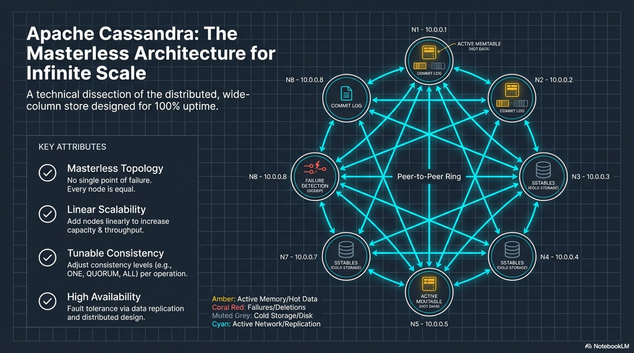
Notes:
No special node. Every node can coordinate. Commit log and memtable are local; the ring is the system. On DSE the ring works the same way. About 8 minutes, then the next two posters. Do not read every label.
Poster: assets/architecture-masterless.png

Slide 14
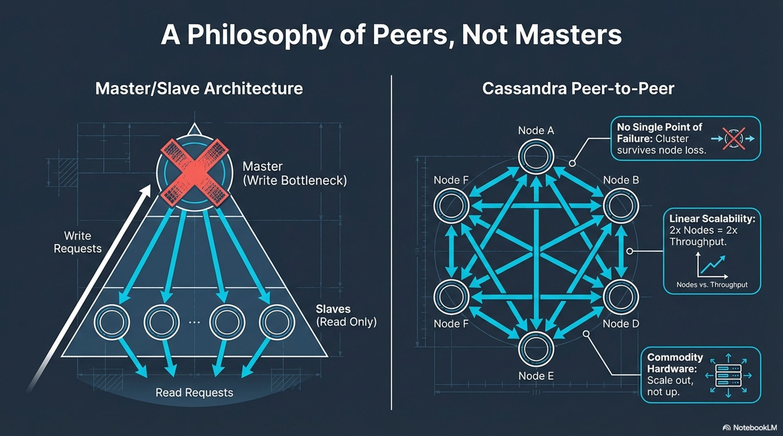
Notes:
Contrast with a primary: one writer is a bottleneck and a single failure. Scale by adding peers, not by buying a bigger master. One minute.
Poster: assets/architecture-peers-vs-master-slave.png

Slide 15
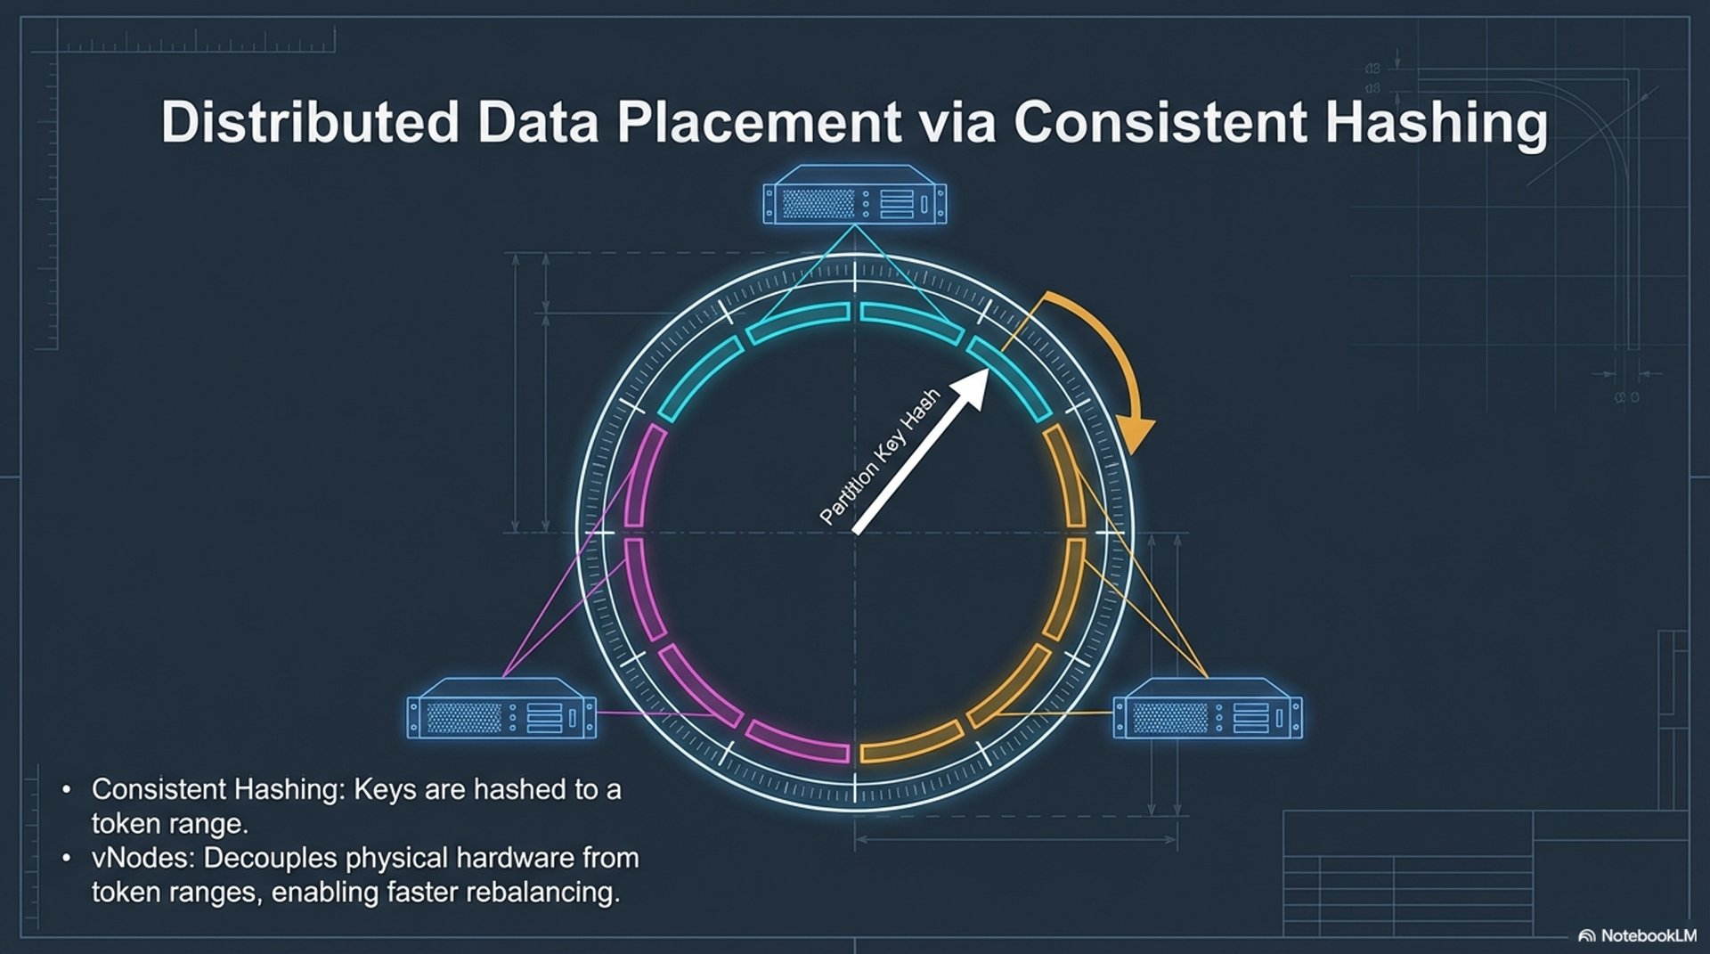
Notes:
Partition key hashes to a token. Replicas walk the ring from there. Vnodes are many small ranges per machine so membership changes move less data. NTS uses the snitch so replicas respect racks and DCs. SimpleStrategy does not.
Poster: assets/architecture-consistent-hashing-vnodes.png

Slide 16
LAB · 25 MIN
Any node coordinates. The key picks replicas.
cqlsh on cassandra-2. DESCRIBE TABLES. events is there.
Insert one row with a fixed user_id.
nodetool getendpoints lab_ks events <that-user_id>
Optional: nodetool describecluster. Name and partitioner only.
You should see Three addresses. In this lab that is the whole cluster. In production it is three of many, and a different key is a different three.
Session 1 · Common foundation
Cassandra Data Labs
Notes:
There is no primary to connect to. Drivers in session 4 still want a local DC and token-aware routing. That is load balancing, not a master. UUID for the demo is 123e4567-e89b-12d3-a456-426614174000 if you want everyone on the same key. Cut describecluster first.

Slide 17
One sentence before you break
Developer: the partition key is what gets hashed.
Platform: the keyspace names datacenter1 because that is the name the snitch reports.
SRE: there is no master. RF 3 is what survives a lost node, together with the consistency level.
Support: UN means up and normal. getendpoints answers “where is this key?”
Session 1 · Common foundation
Cassandra Data Labs
Notes:
Leave the cluster up. Next session stops cassandra-3 on purpose. If the room must reboot: docker compose stop, not down -v.

Slide 18
PHASE 1 · SESSION 2 · 2 HOURS
Consistency, topology, storage
How much agreement a request needs, and what a lost node actually does.
Session 2 · Consistency and storage
Cassandra Data Labs
Notes:
Requires lab_ks from session 1. You will trace one write, read the snitch, flush an SSTable, and stop a node. You will name repair. You will not run it.

Slide 19
Session 2
0–20 CAP and consistency levels
20–45 Lab: ONE versus QUORUM, one trace
45–65 Gossip, the snitch, multi-DC
65–80 Lab: describecluster and the snitch
80–100 Storage engine, and a flush
100–120 Lab: stop cassandra-3
Session 2 · Consistency and storage
Cassandra Data Labs
Notes:
If you are behind, skip the second trace. Do not skip the node-down lab. Tombstone and LWT labs are session 4.

Slide 20
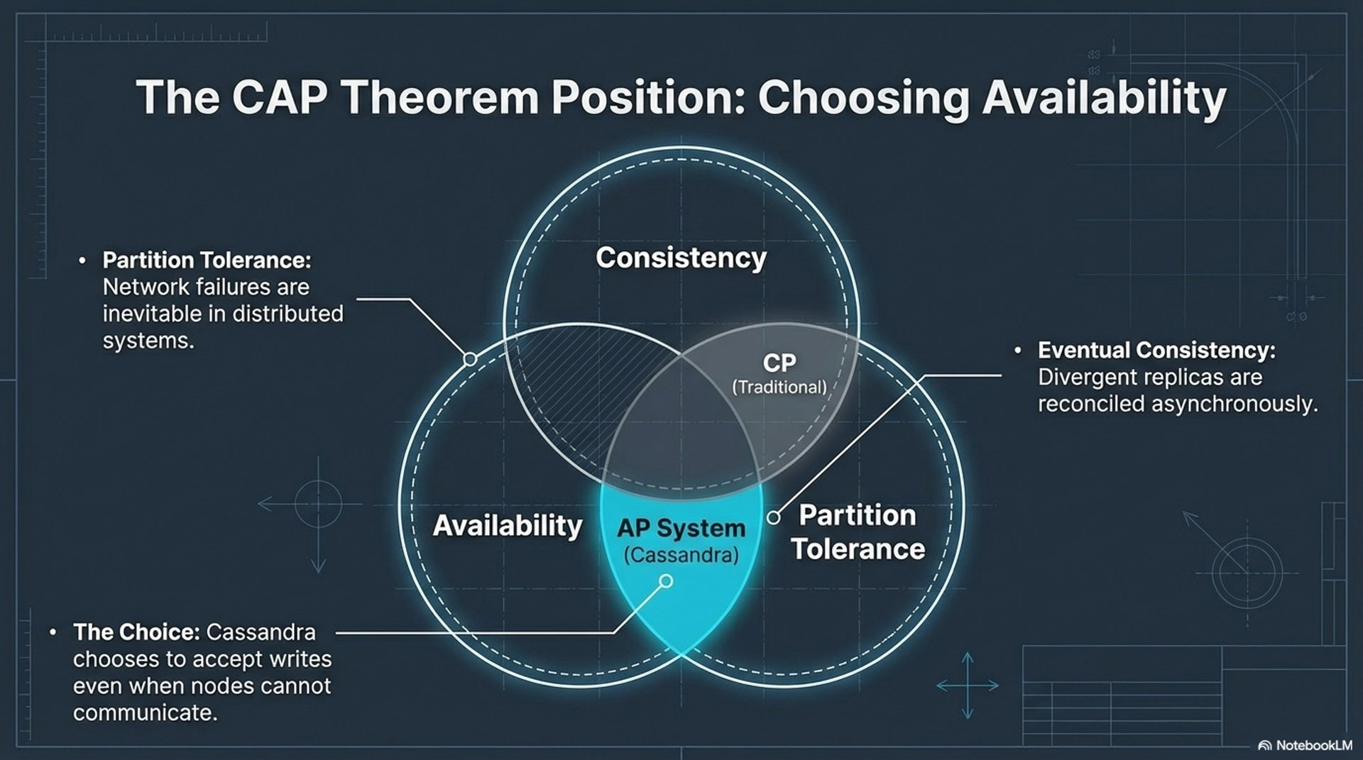
Notes:
Under a partition you do not get linearizability everywhere and an answer from every side. Cassandra keeps serving and lets the statement say how many replicas must agree. DSE uses the same levels. A Search query is not a consistency level.
Poster: assets/architecture-cap-theorem.png

Slide 21
What you actually ask for
Level | RF = 3, one DC | Use when
ONE | 1 replica | Latency first. Stale reads are acceptable.
QUORUM | 2 of 3 | Default for correctness in one DC.
LOCAL_QUORUM | Quorum in the coordinator’s DC | Production multi-DC. Same as QUORUM here.
ALL | Every replica | Rare. Any down replica fails the statement.
QUORUM read plus QUORUM write: the sets overlap, so a successful read sees the latest successful write. ONE plus ONE does not.
Session 2 · Consistency and storage
Cassandra Data Labs
Notes:
Write R + W > RF on the board if the poster did not. LOCAL_QUORUM is the level the driver will use in session 4.

Slide 22
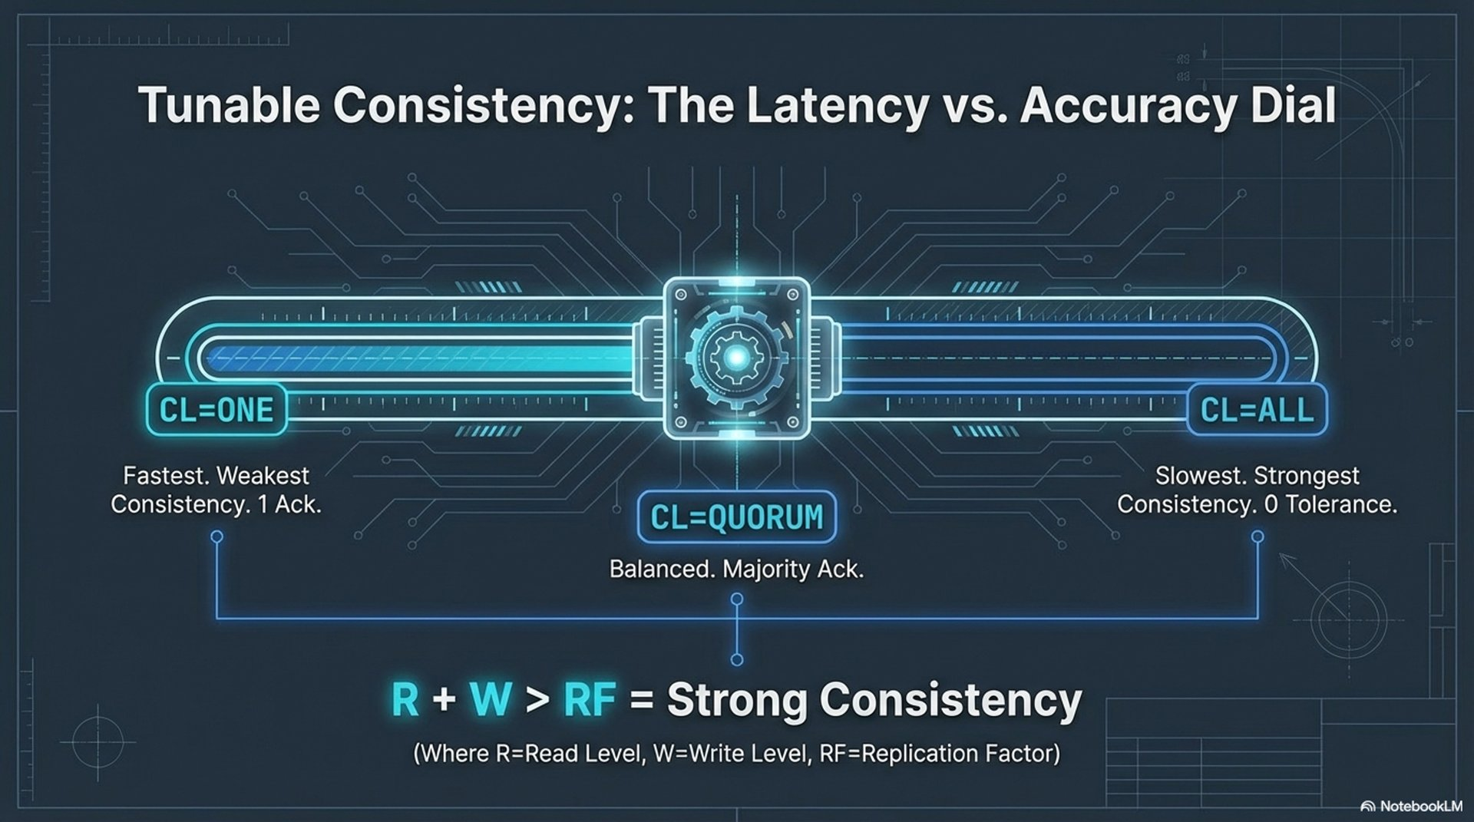
Notes:
Consistency is per statement, not a cluster mode. The healthy cluster hides the difference. The trace and the stopped node show it.
Poster: assets/architecture-tunable-consistency.png

Slide 23
LAB · 25 MIN
Feel a consistency level
CONSISTENCY ONE, then a small SELECT. Then QUORUM, same SELECT.
The cqlsh prompt shows the level. Both succeed while everyone is up.
TRACING ON. One INSERT at QUORUM. TRACING OFF.
Name the coordinator waiting for replica acknowledgements.
You should see A trace where the coordinator does not return at the first local write.
Session 2 · Consistency and storage
Cassandra Data Labs
Notes:
A second trace at ONE is the cut. user_id ending 174001, payload trace-quorum, is in the session file if you want a shared key. Put CONSISTENCY back to QUORUM before you leave the shell.

Slide 24
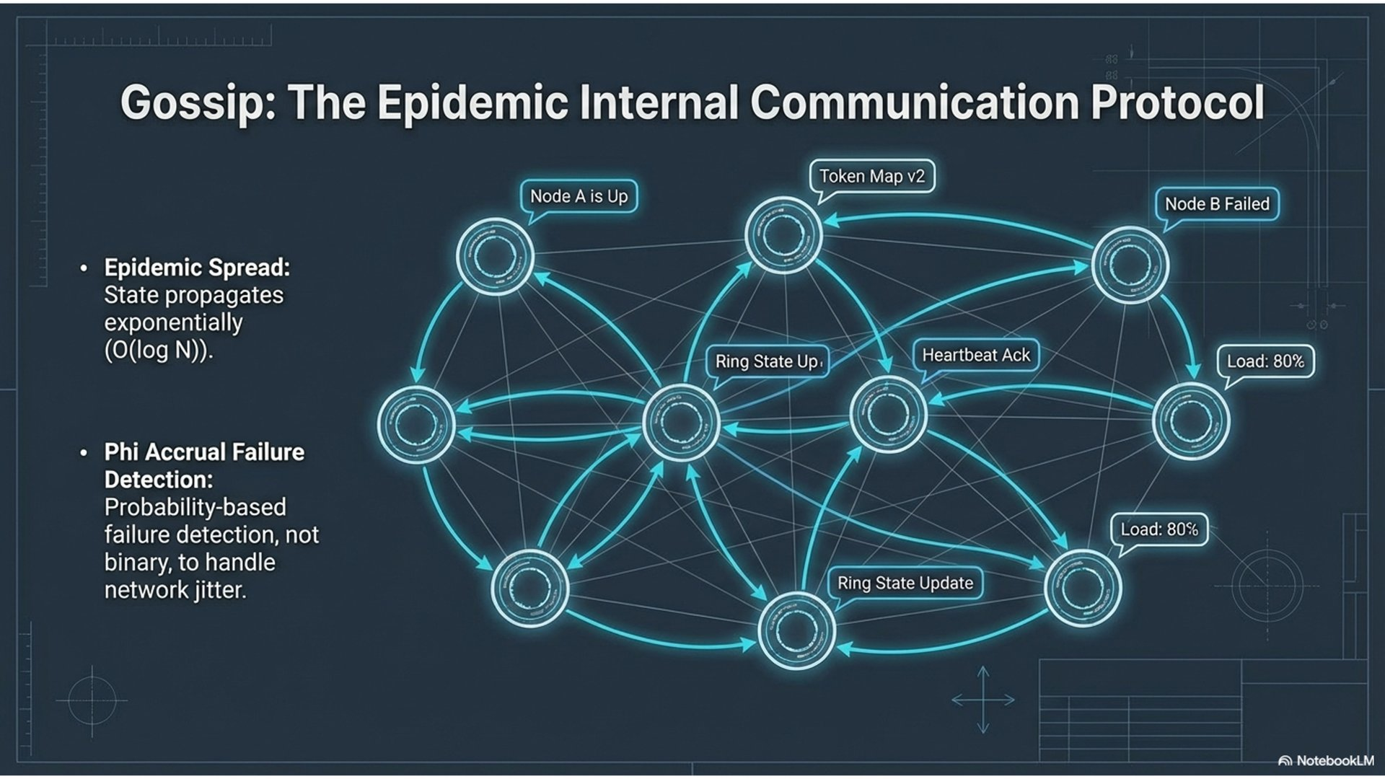
Notes:
Gossip is membership, health, schema, and the token map. It is not the data path. Phi accrual is why one delayed packet does not mark a node dead. The failure lab will wait on this. OpsCenter watches the same state. It does not replace it.
Poster: assets/architecture-gossip-failure-detection.png

Slide 25
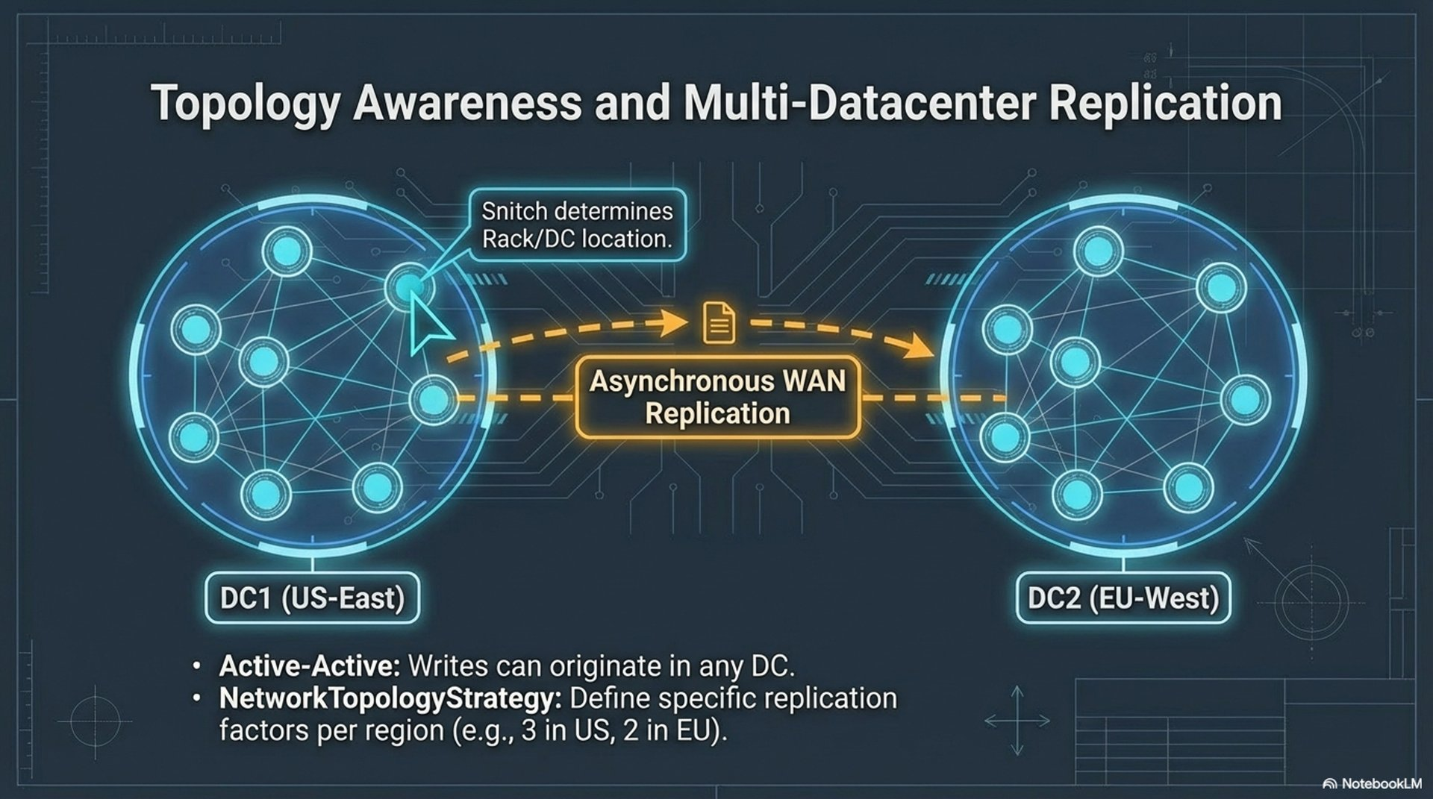
Notes:
The snitch maps rack and datacenter. NTS places replicas from that map. Clients use LOCAL_* so a request does not wait on the other region. This lab is one DC on purpose. The snitch is already the one you keep when a second DC appears. SimpleSnitch would throw that away.
Poster: assets/architecture-topology-multi-dc.png

Slide 26
LAB · 15 MIN
Name, partitioner, snitch
nodetool describecluster
nodetool gossipinfo | head -40
grep endpoint_snitch in cassandra.yaml on cassandra-1
You should see training-lab, Murmur3Partitioner, peer rows, GossipingPropertyFileSnitch.
Session 2 · Consistency and storage
Cassandra Data Labs
Notes:
failuredetector is optional. Ask why this single-DC lab still refuses SimpleSnitch and SimpleStrategy: the day you add a datacenter, the strategy and the snitch are already right. Answer belongs in one sentence from the room.

Slide 27
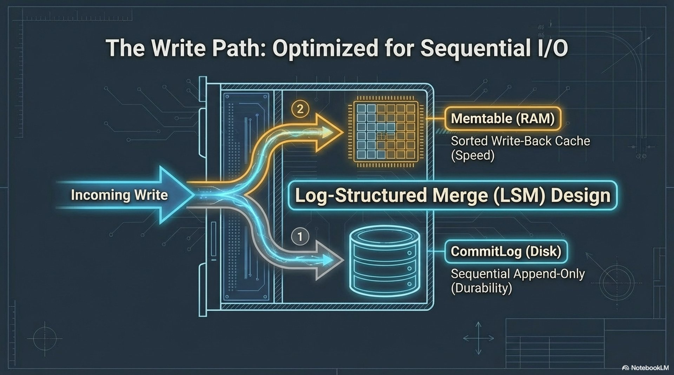
Notes:
Commit log for durability, memtable for the sorted buffer, flush to an immutable SSTable. Fast because it is sequential. Do not linger. Next poster is the read.
Poster: assets/architecture-storage-write-path-lsm.png

Slide 28
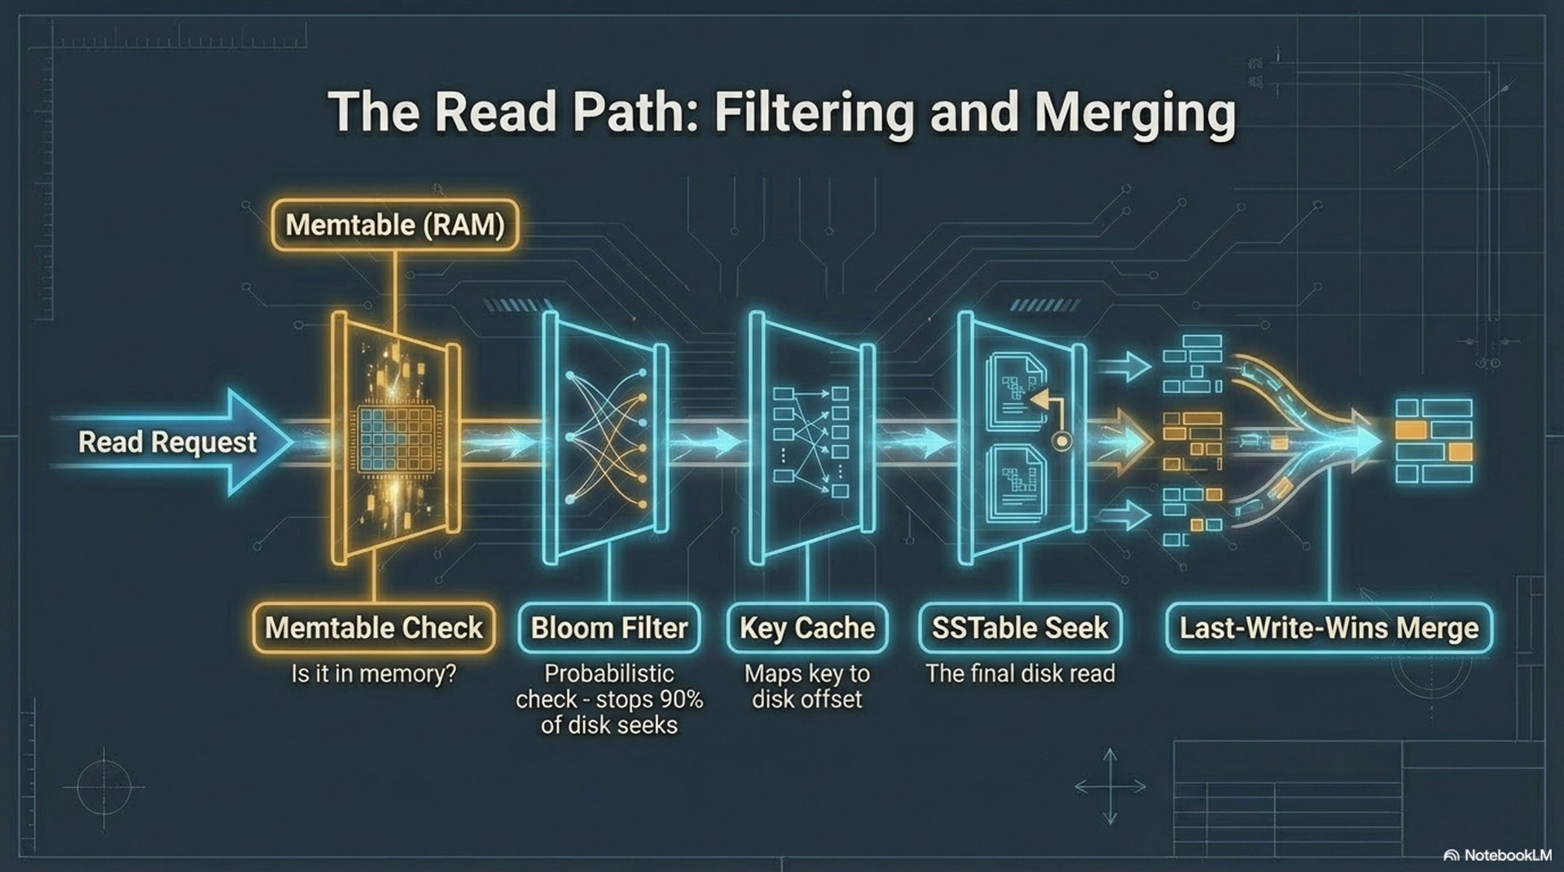
Notes:
Read merges memtable and SSTables. Bloom filters skip files. Last write wins by timestamp. Compaction exists so a read touches fewer files. Click the compaction poster only if you have a minute.
Poster: assets/architecture-storage-read-path.png

Slide 29
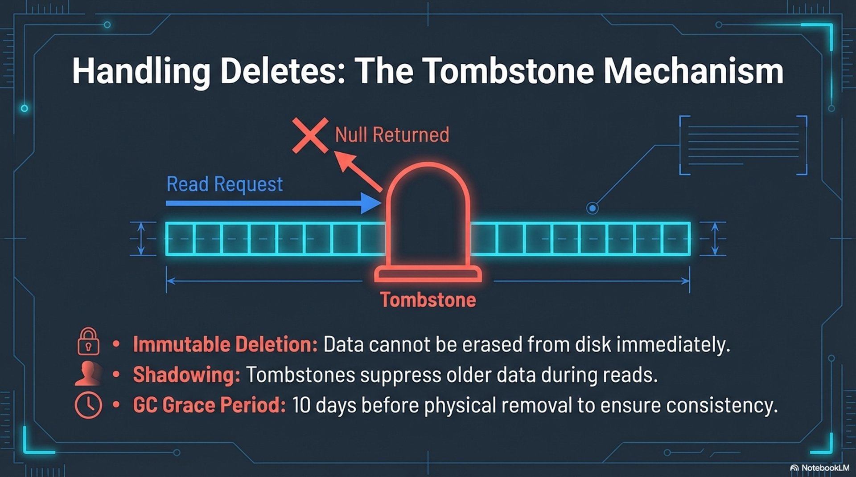
Notes:
A delete is a write. Say that, and say the lab is session 4. Do not run the delete today. gc_grace_seconds is why the marker stays: an offline replica still has to learn about it.
Poster: assets/architecture-storage-tombstones.png

Slide 30
LAB · 10 MIN
Flush a memtable
INSERT one events row, payload flush-lab.
nodetool flush lab_ks events on cassandra-1.
List the table directory under /var/lib/cassandra/data/lab_ks/.
You should see A file whose name ends in -Data.db. That is an SSTable.
Session 2 · Consistency and storage
Cassandra Data Labs
Notes:
This is the picture, on disk, on this node. Compaction stats are in the reference module. Skip them.

Slide 31
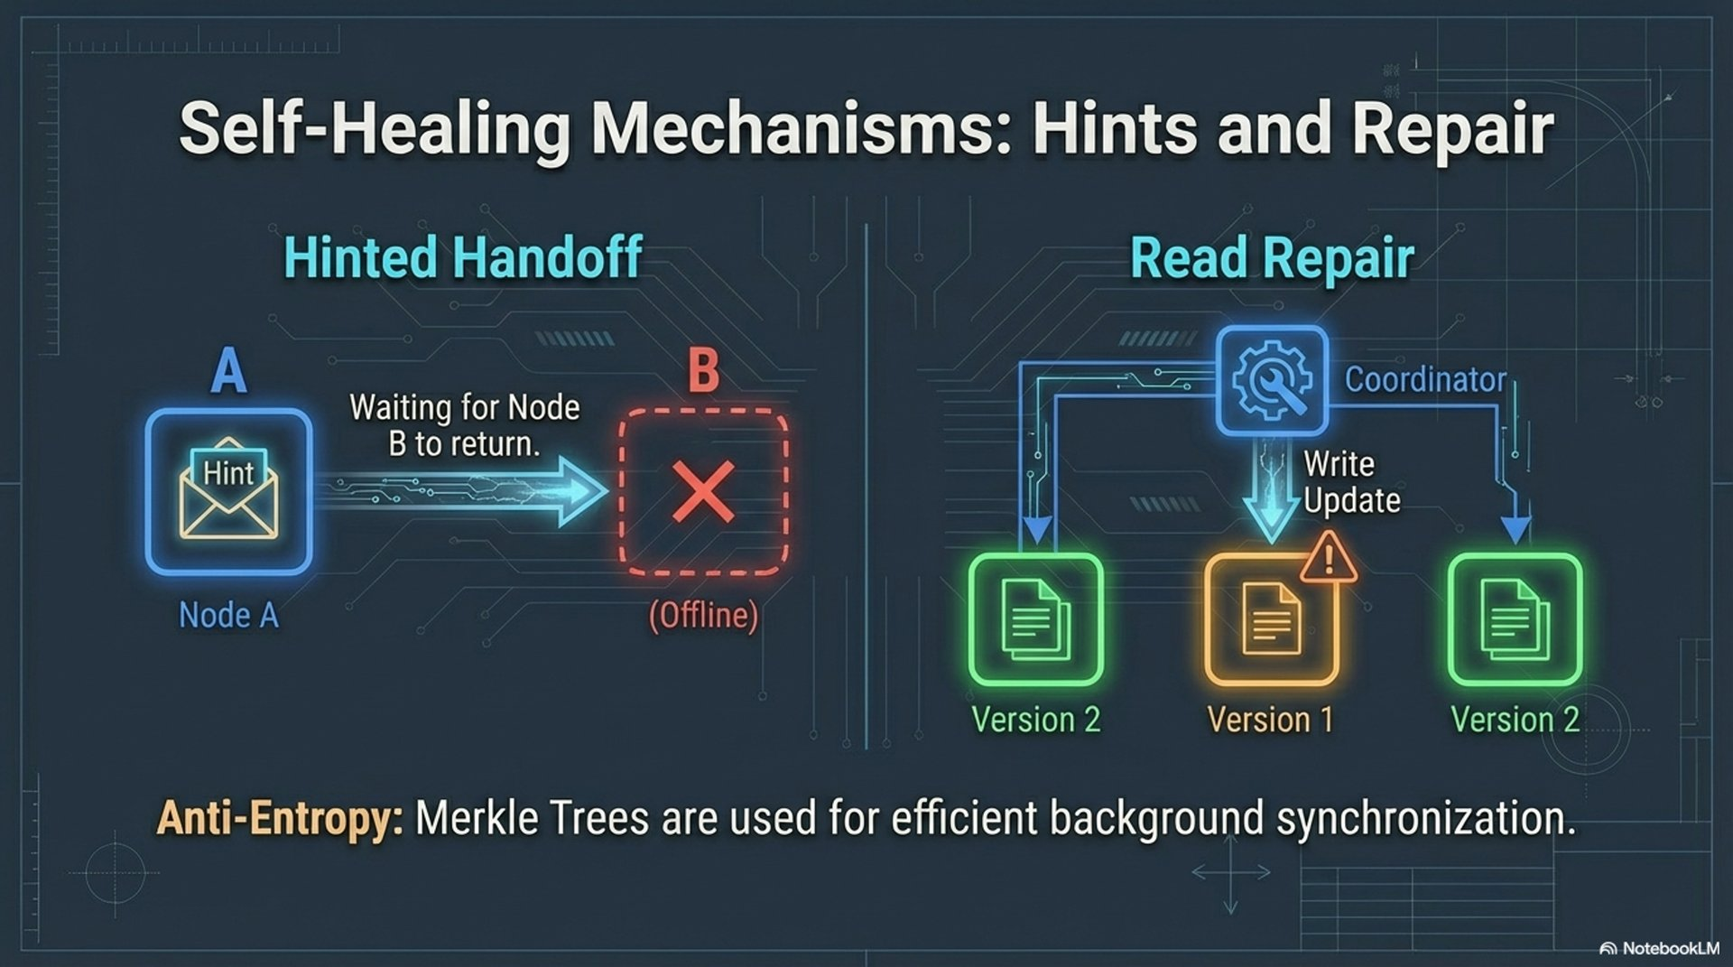
Notes:
Three ways replicas converge without the client doing the work: hinted handoff, read repair, and anti-entropy repair (nodetool repair -pr). You will see the hint directory. You will not run repair. DSE’s repair service schedules that third path. The mechanism is still repair.
Poster: assets/architecture-hints-repair.png

Slide 32
LAB · 20 MIN
Stop one node
docker compose stop cassandra-3. Wait until status shows it down.
CONSISTENCY ALL, then INSERT. It fails. ALL needs the down replica.
CONSISTENCY ONE, then INSERT. It succeeds.
List /var/lib/cassandra/hints/ on cassandra-1. Start cassandra-3. Wait for UN.
You should see A failed ALL, a successful ONE, and a hint file for the down replica. Replay can take a minute.
Session 2 · Consistency and storage
Cassandra Data Labs
Notes:
Every partition includes cassandra-3 because RF is 3. Hints are stored on the coordinator, not on the dead node. The first ALL may sit until the failure detector convicts the node. Set the shell back to QUORUM. Throwaway cluster only.

Slide 33
Three questions, no new commands
Why is there no master in this cluster?
What do quorum reads and quorum writes guarantee about overlap when RF is 3?
Name two ways replicas converge without the client reading.
Session 2 · Consistency and storage
Cassandra Data Labs
Notes:
Accept hints, read repair, or anti-entropy repair for the third. Phase 1 is done. Phase 2 does not operate gossip or failover. It uses this vocabulary.

Slide 34
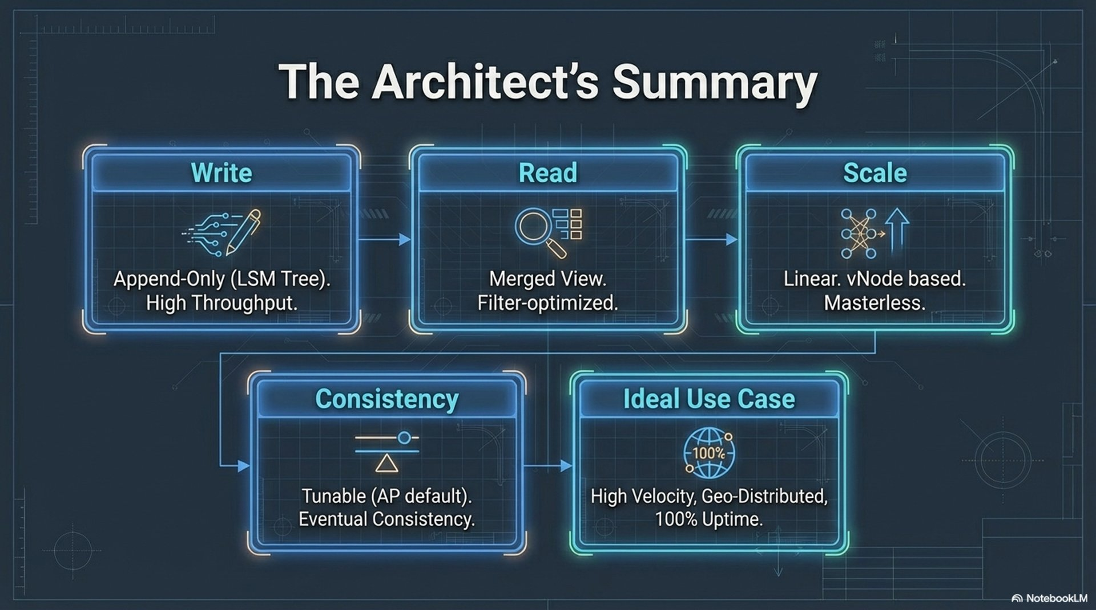
Notes:
Leave this up as people stand. If someone wants the repair command for later: nodetool repair -pr lab_ks. Not now.
Poster: assets/architecture-summary.png

Slide 35
PHASE 2 · SESSION 3 · 2 HOURS
Query-driven design
Each production query is a primary key. That partition stays bounded.
Session 3 · Query-driven design
Cassandra Data Labs
Notes:
Developers, architects, technical leads. If they missed Phase 1, do placement first and cut the optional DESC lab.

Slide 36
Session 3
0–20 The rule: one table per production query
20–40 Four steps, then the primary key
40–75 Lab: one partition, many rows, one range
75–95 Hot partitions and wide partitions
95–115 Lab: endpoints, and optional DESC order
115–120 Write one query on paper
Session 3 · Query-driven design
Cassandra Data Labs
Notes:
Cut the clustering-order lab first. Do not skip the range query. TTL is named here and labbed in session 4.

Slide 37
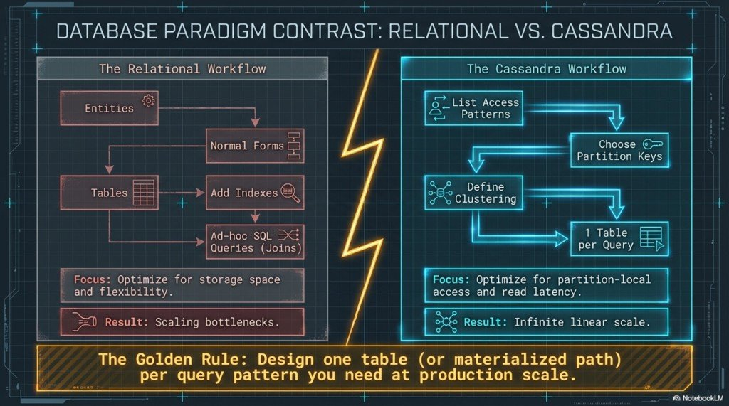
Notes:
Relational habit starts from entities and ends in joins. Cassandra habit starts from the queries. If you cannot write equality on the partition key plus an optional clustering range, in order, you do not have the query yet. Read the gold bar aloud.
Poster: assets/modeling-relational-vs-cassandra.png

Slide 38
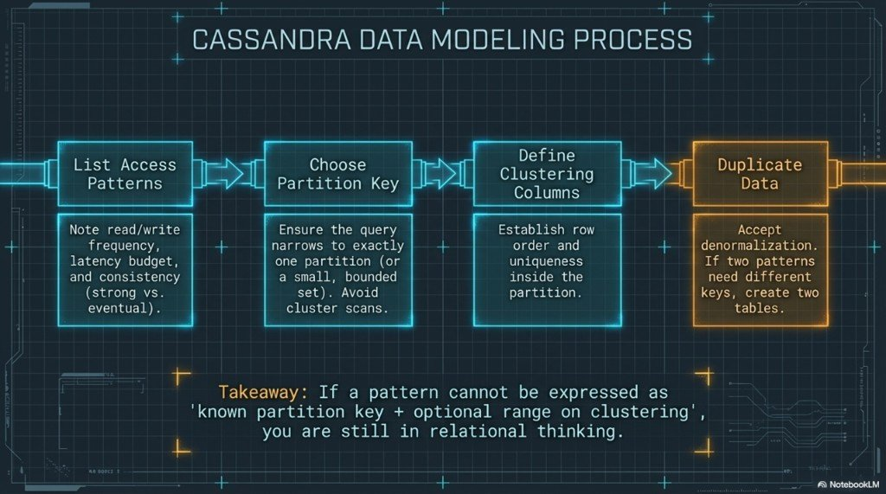
Notes:
1 access patterns, including whether the read must see the latest write. 2 partition key. 3 clustering. 4 another table when the second pattern needs a different partition key. Duplication is step 4, and session 4 writes both tables.
Poster: assets/modeling-four-step-process.png

Slide 39
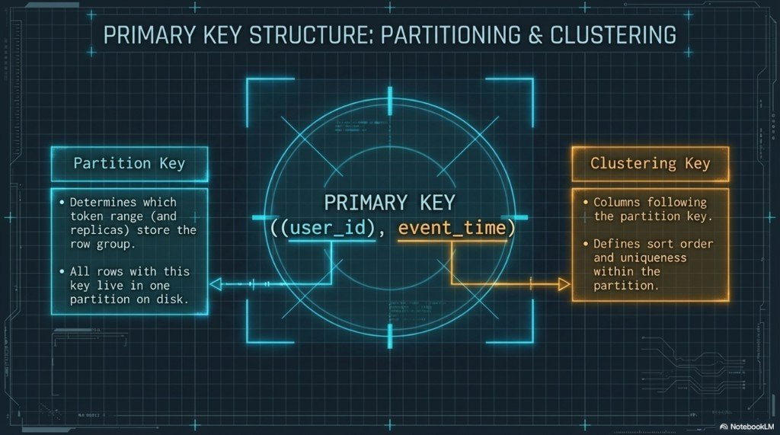
Notes:
The poster draws extra parentheses around user_id. The table we created is PRIMARY KEY (user_id, event_time): user_id partitions, event_time clusters. Extra parentheses mean a composite partition key, which is the next slide.
Poster: assets/modeling-primary-key-structure.png

Slide 40
Two ways to add a column to the key
Stops one user growing forever
PRIMARY KEY ((user_id, day), event_time)
user_id and day are hashed together.
One user’s history is many partitions.
The query must know the day.
Collects the whole day on one replica set
PRIMARY KEY (day, event_time)
Every writer for “today” hits one partition.
That is a hot key, not a model.
Session 4 uses (day, bucket) instead.
Session 3 · Query-driven design
Cassandra Data Labs
Notes:
Bucketing is how you keep a time query without a single hot partition. Do not let the room leave thinking PARTITION BY day is the lesson.

Slide 41
LAB · 35 MIN
One user, three times, one range
DESCRIBE TABLE events. Name the partition key before you insert.
Three rows, same user_id, event_time on two different days.
SELECT by user_id only. Rows come back in event_time order.
Add AND event_time > a timestamp in the middle. Two rows, not a scan of other users.
You should see A partition-scoped range. Equality on the partition key, then the clustering column, in that order.
Session 3 · Query-driven design
Cassandra Data Labs
Notes:
Shared user_id in the session file: 123e4567-e89b-12d3-a456-4266141740bb with morning, afternoon, and next-day payloads. A filter on payload is tomorrow’s anti-pattern. Do not demonstrate it yet.

Slide 42
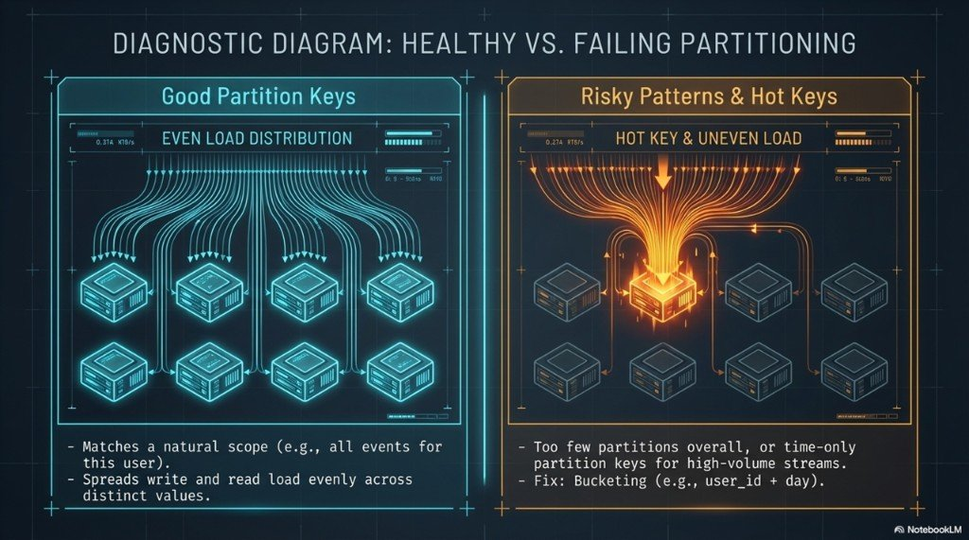
Notes:
RF and consistency do not spread a bad key. A hot partition is one key taking the traffic. Its replicas glow. The rest of the cluster looks idle. getendpoints will not save you in this three-node lab, because every key maps to every node. Say that before the lab.
Poster: assets/modeling-healthy-vs-hot-partitions.png

Slide 43
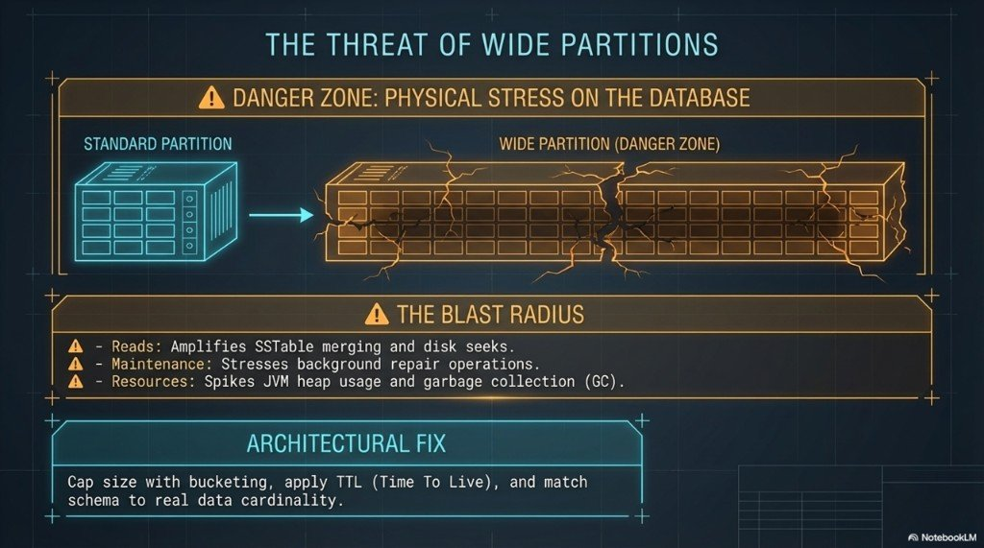
Notes:
Wide means huge rows or a huge payload under one key. Reads, repair, and compaction all pay. Mitigations to say out loud: bucket, TTL only when the product may forget the row, and honest cardinality. TTL becomes a tombstone. It is not free. Lab is next session.
Poster: assets/modeling-wide-partitions.png

Slide 44
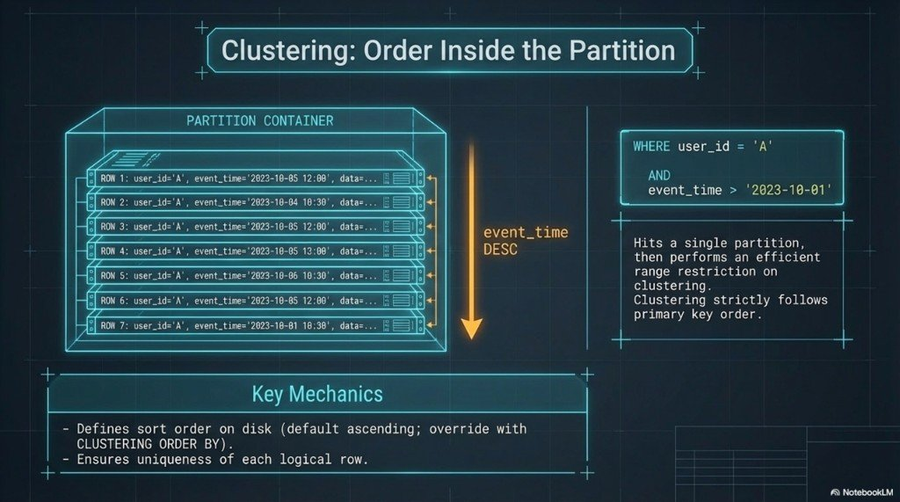
Notes:
Ranges are =, >, <, BETWEEN, in primary-key order. Sort order is chosen when you create the table. ORDER BY in the query does not invent a new order. Latest-first is CLUSTERING ORDER BY (event_time DESC).
Poster: assets/modeling-clustering-order.png

Slide 45
LAB · 20 MIN
Where the key lives. Optional DESC.
getendpoints for the user_id you just inserted.
Say which part of the key was hashed, and which part only ordered rows.
Optional: a tiny table with CLUSTERING ORDER BY (seq DESC). Read it.
2 comes back before 1. That is a schema choice.
You should see Three endpoints again. A second user id can map to the same three nodes here. Do not “fix” the model because of that.
Session 3 · Query-driven design
Cassandra Data Labs
Notes:
Cut the DESC table first. Full CREATE is in sessions/03 under dm_cluster_demo. Latest-first for a UI is the point of the optional lab, in one sentence.

Slide 46
On paper, five minutes
Write the CQL, not the prose.
The 20 latest events for one known user.
A passing answer restricts user_id with equality.
Latest-first needs CLUSTERING ORDER BY (event_time DESC), or the app reverses an ascending page and may read too much.
LIMIT 20 without the partition key is not an answer.
Session 3 · Query-driven design
Cassandra Data Labs
Notes:
Collect two answers if you have time. Tomorrow you build the second query, the one this table cannot serve: a slice of a day across users.

Slide 47
PHASE 2 · SESSION 4 · 2 HOURS
CQL, drivers, and the traps
Tombstones, TTL, a second table, and a driver that states its consistency.
Session 4 · CQL and drivers
Cassandra Data Labs
Notes:
Same audience. Requires the three rows from session 3. Still the open-source cluster. The driver settings are the ones you point at DSE.

Slide 48
Session 4
0–20 CQL the application actually sends
20–45 Lab: a delete tombstone, then TTL
45–70 Lab: second table, dual write
70–95 Lab: ALLOW FILTERING, then one LWT
95–120 Driver knobs, then the Python lab
Session 4 · CQL and drivers
Cassandra Data Labs
Notes:
If you are behind, skip the LWT. Do not skip TTL or the driver.

Slide 49
CQL looks like SQL and then refuses it
INSERT and UPDATE are upserts. Last write wins by timestamp. IF is the exception.
The partition key is equality. Clustering predicates come next, in order, with no gap.
There are no joins. The second query is a second table, and you write both.
A logged batch is not a bulk loader. An unlogged batch belongs to one partition.
Paging belongs in the driver. Prepare the statement. Set consistency on the statement.
Session 4 · CQL and drivers
Cassandra Data Labs
Notes:
Schema replication is RF. The driver chooses LOCAL_QUORUM or ONE per call. On DSE you use the same drivers. You change contact points and local DC, not the modeling rules. Types, collections, and counters are not this session.

Slide 50
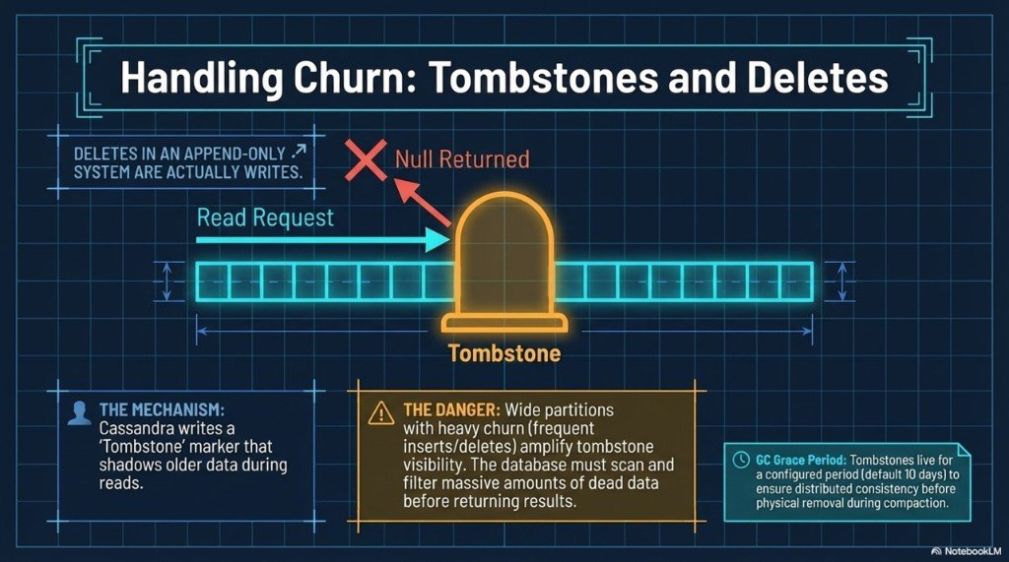
Notes:
The row disappears from SELECT. The SSTable is not edited in place. The marker stays for gc_grace_seconds, often 10 days, so a replica that was offline can still learn the delete. A partition full of dead rows is a slow partition.
Poster: assets/modeling-tombstones-deletes.png

Slide 51
TTL is a scheduled tombstone
Do not wait 60 seconds. TTL() is the countdown. Leave events without a default TTL.
CREATE TABLE ttl_demo (id text PRIMARY KEY, payload text);
INSERT INTO ttl_demo (id, payload)
VALUES ('short', 'gone-soon') USING TTL 60;
SELECT id, payload, TTL(payload)
FROM ttl_demo WHERE id = 'short';
Session 4 · CQL and drivers
Cassandra Data Labs
Notes:
When the countdown hits zero, Cassandra writes a tombstone and gc_grace applies again. TTL does not fix a hot key. If every row in one partition expires together, you scheduled a delete storm. Use it for sessions and ephemeral events, where the product may forget the row.

Slide 52
LAB · 25 MIN
Delete, then a countdown
INSERT a known events row. DELETE it by the full primary key. SELECT the partition.
The row is gone from the result. Disk was not punched.
Create ttl_demo. INSERT … USING TTL 60.
SELECT TTL(payload). It is a positive number under 60.
You should see A missing row, and a live cell that already knows when it will die.
Session 4 · CQL and drivers
Cassandra Data Labs
Notes:
Full DELETE coordinates are in sessions/04, user_id ending 174099, time 2020-06-01. Scratch table so the shared events rows stay. default_time_to_live is the same mechanism at table level. Mention it. Do not set it on events.

Slide 53
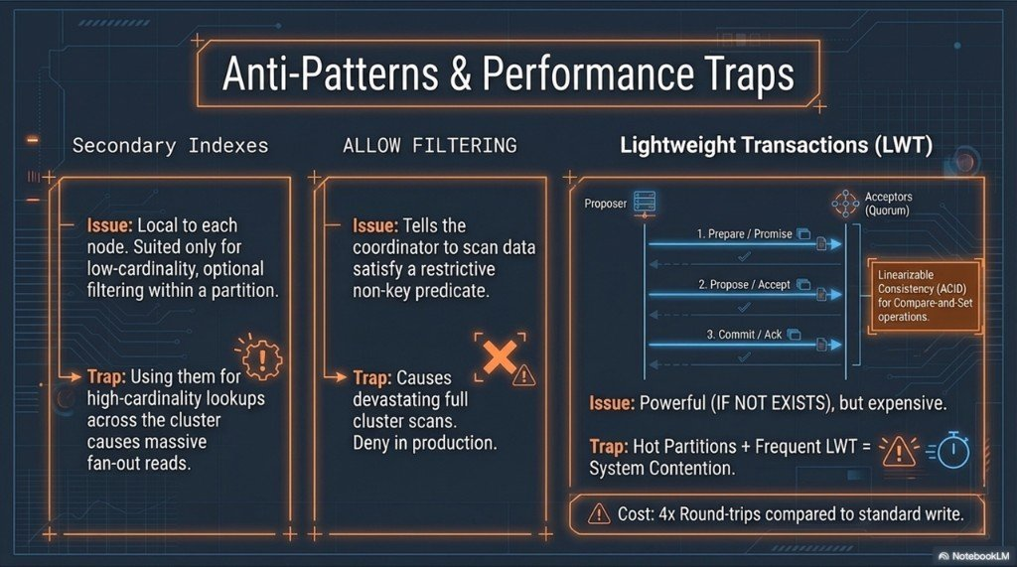
Notes:
The application writes both tables and has a story when the second write fails. Cassandra will not keep them aligned. A Search index on DSE is not a substitute for the table that serves the known query.
Poster: assets/modeling-denormalization-fan-out.png

Slide 54
A day is not a partition key
bucket is hash(user_id) % N in production. The lab uses 0. user_id is in the clustering key so one timestamp can hold two events.
CREATE TABLE events_by_day (
day text, bucket int, event_time timestamp,
user_id uuid, payload text,
PRIMARY KEY ((day, bucket), event_time, user_id)
) WITH CLUSTERING ORDER BY (event_time DESC, user_id ASC);
Session 4 · CQL and drivers
Cassandra Data Labs
Notes:
Query: WHERE day = ? AND bucket = ? LIMIT 20. The user history query stays on events. Same logical write, two statements. A logged batch across partitions is optional and expensive. Do not teach it as the importer.

Slide 55
LAB · 25 MIN
Write both tables
Create events_by_day as on the previous slide.
Insert one event into events and the same event into events_by_day.
Read it by user_id. Read it by day and bucket.
Say what the application does if the second insert fails.
You should see The same payload from both tables. Two queries, two partition keys.
Session 4 · CQL and drivers
Cassandra Data Labs
Notes:
Shared values in the session file: user …740bb, day 2025-04-01, bucket 0, payload dual-write. Ask who owns retry. The database does not.

Slide 56
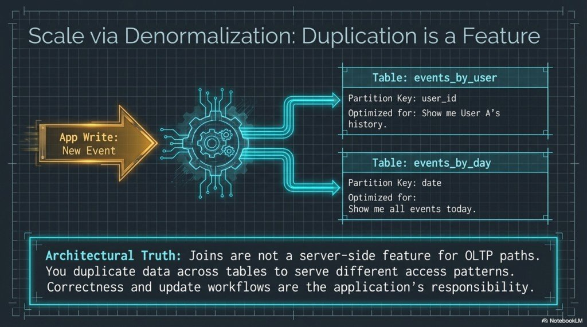
Notes:
The next lab makes the first query fail on purpose. ALLOW FILTERING makes it succeed on tiny data and scatter-gather on real data. A secondary index is not the design fix. SAI, the default index in Cassandra 5 and available in DSE, is more efficient and still is not a partition key you know in advance.
Poster: assets/modeling-anti-patterns.png

Slide 57
LAB · 25 MIN
The query the schema refused
SELECT by payload alone. It fails. The coordinator will not scan the cluster.
Add ALLOW FILTERING. It can succeed here because the table is tiny.
Do not CREATE INDEX to “fix” the hot path. Build a table whose key is the lookup.
Optional: one INSERT … IF NOT EXISTS, run twice. [applied] true, then false.
You should see A rejected query, a dangerous success, and — if you had time — a compare-and-set.
Session 4 · CQL and drivers
Cassandra Data Labs
Notes:
Skip LWT if the clock slipped. LWT is several round trips and it contends on a hot partition. It is not how you keep events and events_by_day in sync. Accord in Cassandra 5 is a different write path. We do not lab it, and it does not make a bad partition key cheap. Poster for LWT is next if you do the optional step.

Slide 58
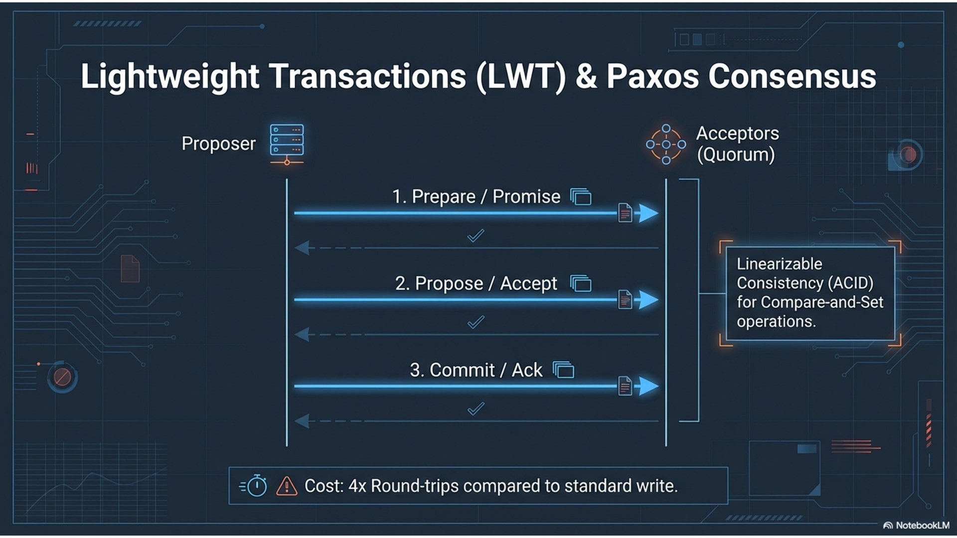
Notes:
Show this only if you ran the IF NOT EXISTS. Otherwise skip the slide. Paxos rounds are the cost. Idempotent writes and a spread-out key come first.
Poster: assets/architecture-lwt-paxos.png

Slide 59
The driver is where the rules become code
Knob | This lab | Why
Contact points | 127.0.0.1:9042 | Bootstrap only. The driver discovers the peers.
Load balancing | Token-aware, DC-aware, local DC datacenter1 | Prefer a replica in the local DC.
Consistency | LOCAL_QUORUM on the statement | The overlap rule from session 2.
Prepare | Insert and select by user_id | One parse. Bound values.
Fetch size | 100 in the script | Paging is the driver’s job.
Retries must not blindly repeat a non-idempotent write. Same driver against DSE. Change contact points and local_dc.
Session 4 · CQL and drivers
Cassandra Data Labs
Notes:
Do not invent a retry policy in the last ten minutes. Read the script with them. The policies are the lesson.

Slide 60
LAB · 25 MIN
One prepared write and the read after it
On the host: pip install cassandra-driver
python labs/driver_basics.py
Read the file while it runs. Find local_dc and LOCAL_QUORUM.
You should see payload=driver-lab and consistency=LOCAL_QUORUM. A missing lab_ks means session 1 did not finish.
Session 4 · CQL and drivers
Cassandra Data Labs
Notes:
The script inserts a random user_id and reads it back. It also prints release_version at LOCAL_ONE so a non-prepared statement is still explicit. If pip is blocked, walk the file on the projector. The lab is the settings, not the printout.

Slide 61
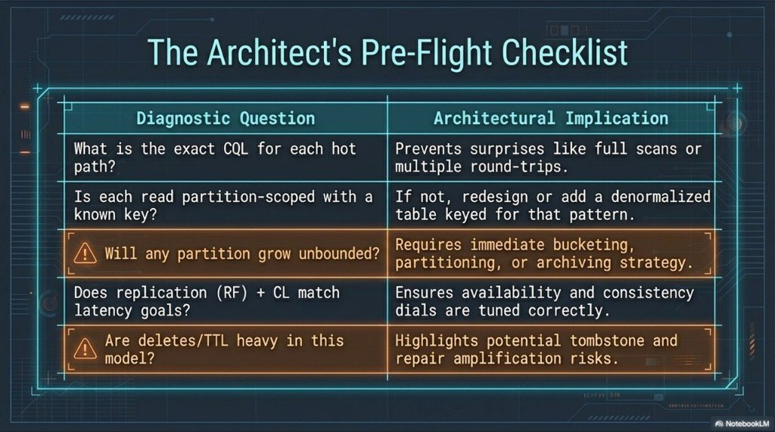
Notes:
Close on the checklist, answered for events and events_by_day. Exact CQL for each hot path. Every read partition-scoped. Which partition could grow without a bound, and what the bucket is. Where TTL or deletes churn. What the driver set for local DC and consistency.
Poster: assets/modeling-preflight-checklist.png

Slide 62
Left for later, on purpose
No OpsCenter, Search, Analytics, or Graph. DSE was session 1.
No repair drill and no multi-DC failover. Those stay in the reference modules.
No Accord lab. Cassandra 5 transactions do not replace this data model.
No index syntax drill. The hot path got a table.
Session 4 · CQL and drivers
Cassandra Data Labs
Notes:
Point people who want more at architecture/ and data-modeling/. Thank them. The deck can stay on the checklist poster if you prefer to end on the picture. This slide is the boundary of the eight hours.

Slide 63
DATA LABS
Same model on DSE.
Different contact points. Same partition key, same consistency, same driver.
The cluster you ran was the lesson.
Session 4 · CQL and drivers
Cassandra Data Labs
Notes:
End. Repo: sessions/ for the scripts, architecture/ and data-modeling/ for the long form, slides/cassandra-data-labs.pptx for this deck.

