Slide 1


Michele Allegra
Brain Controllability: mirage or reality?
Michele Allegra Brain controllability: mirage or reality? February 2021

Slide 2


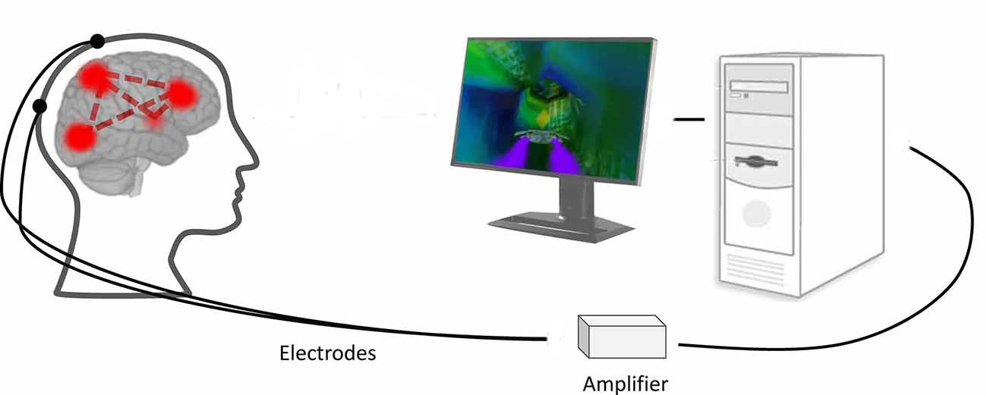
Towards brain control
Remote control of thoughts?
Manipulating brain activity through controlled external interventions (e.g. electric stimuli)
Design effective intervention paradigms using control theory
Michele Allegra Brain controllability: mirage or reality? February 2021

Slide 3
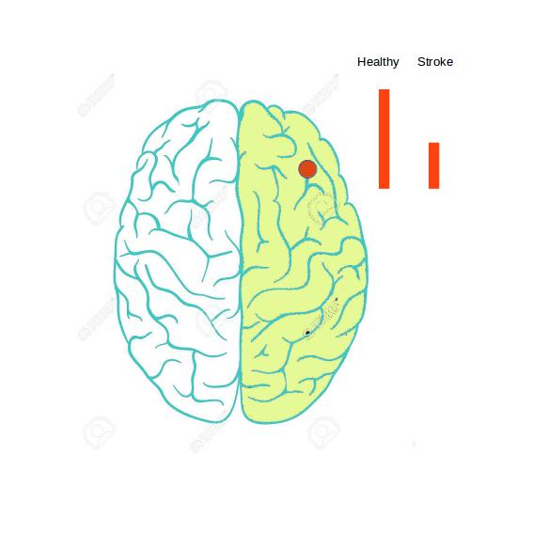
Towards brain control
Michele Allegra Brain controllability: mirage or reality? February 2021

Slide 4
Towards brain control
Michele Allegra Brain controllability: mirage or reality? February 2021

Slide 5
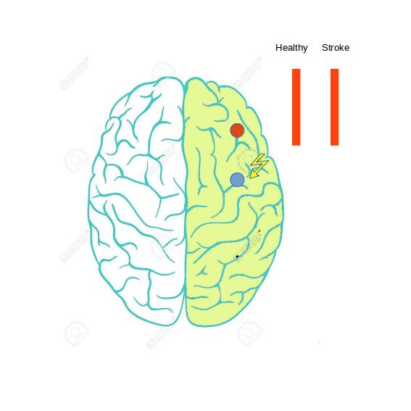
Towards brain control
Michele Allegra Brain controllability: mirage or reality? February 2021

Slide 6
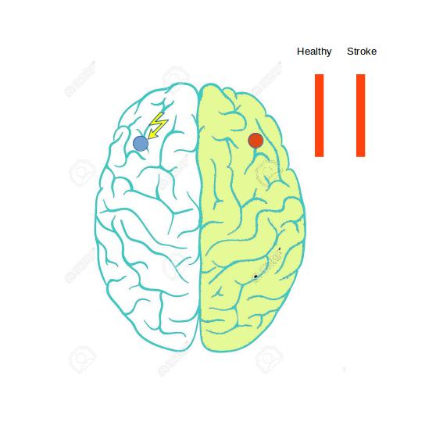
Towards brain control
Michele Allegra Brain controllability: mirage or reality? February 2021

Slide 7
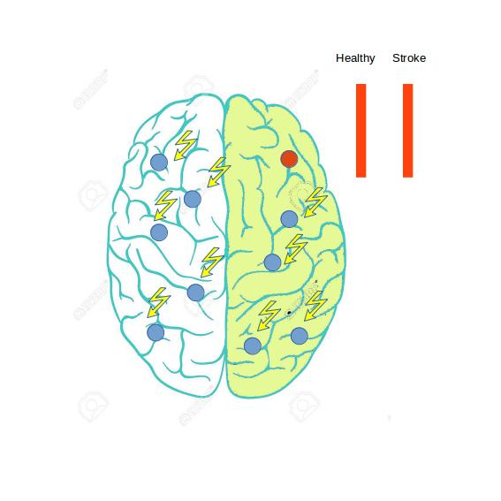
Towards brain control
Michele Allegra Brain controllability: mirage or reality? February 2021

Slide 8
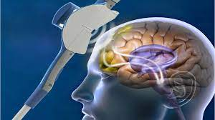
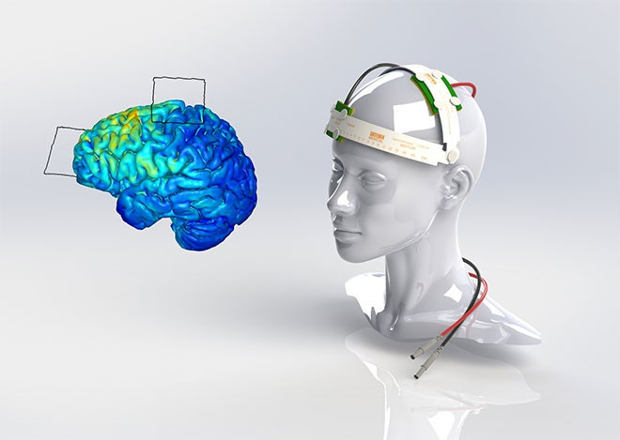
Towards brain control
Transcranial magnetic stimulation
Transcranial direct current stimulation
Michele Allegra Brain controllability: mirage or reality? February 2021

Slide 9
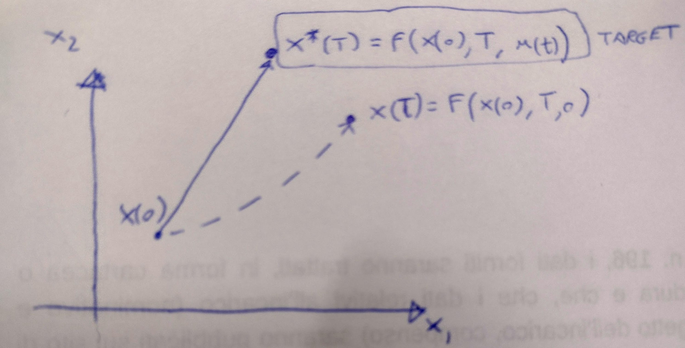
Control theory in engineering
Design external perturbations to control a system
x(t) state of the system at time t [vector]
u(t) external input [vector]
F: system dynamics, x(T) = F(x(0),T,u(t))
Invert relation to find u(t) = G(x(0),x*(T),T) to achieve target state x*(t)
Theory predicts when this can be done
By smartly harnessing the system’s intrinsic dynamics, we may control the whole system by acting only on (small) subsystem
Michele Allegra Brain controllability: mirage or reality? February 2021

Slide 10

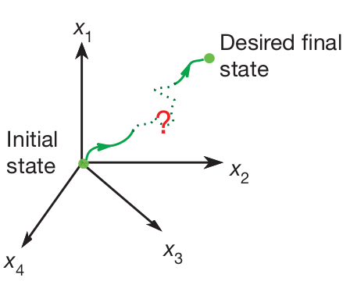
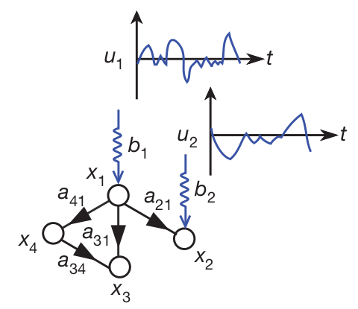
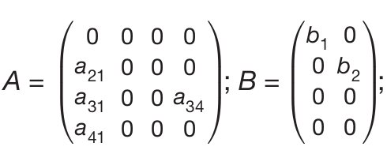
Linear Controllability
x(t) - state vector for N “network nodes” at time t
Dynamics is given by Linear Time Invariant(LTI) system:
A - (N,N) connectivity matrix
B - (N, r) input matrix with “r” being number of control nodes required to control the system.
Michele Allegra Brain controllability: mirage or reality? February 2021

Slide 11
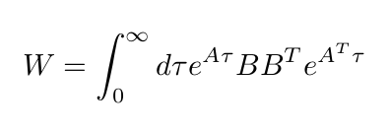
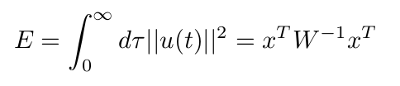


Linear Controllability
Can we drive the system towards any desired final state with a suitable choice of input signal vector u(t)?
Given A,B, algebraic condition on controllability Gramian: W>0
The minimum control energy to steer the system to target state is
In the worst case, energy is the minimum inverse eigenvalue of W
On average
Michele Allegra Brain controllability: mirage or reality? February 2021

Slide 12
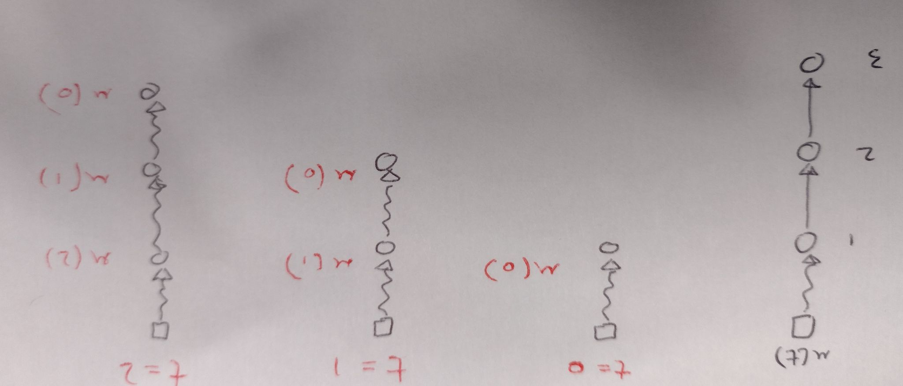
Linear Controllability
Given A, how should we select B (control nodes) such that the system is controllable?
Michele Allegra Brain controllability: mirage or reality? February 2021

Slide 13
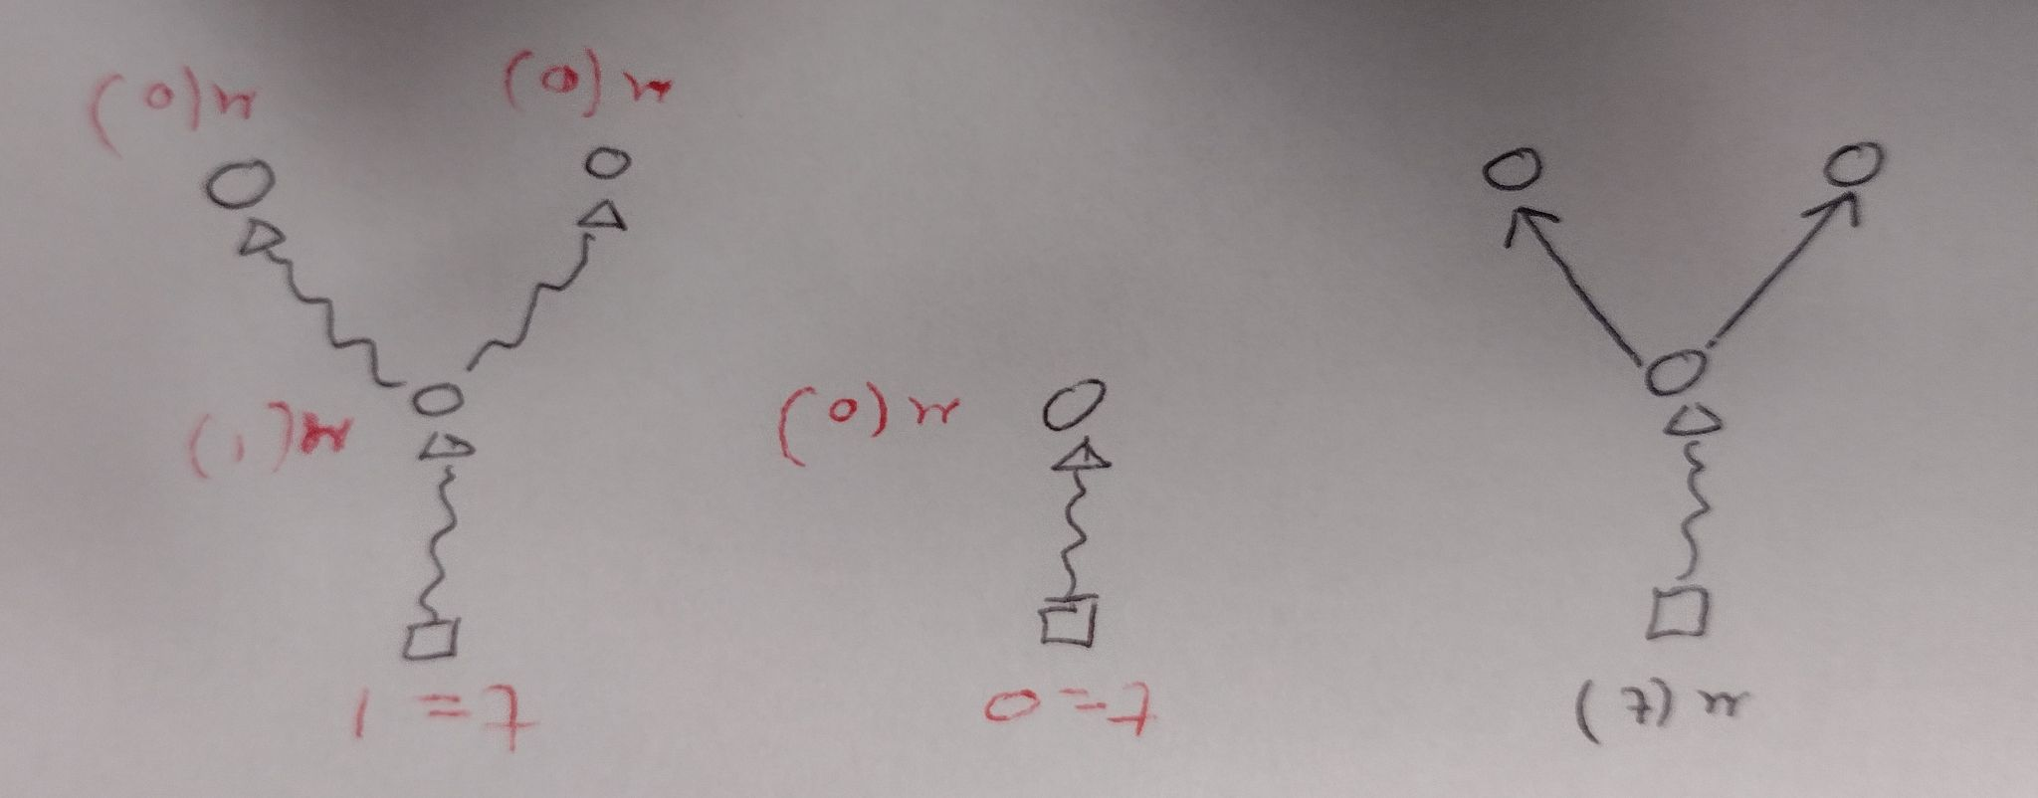
Linear Controllability
Given A, how should we select B (control nodes) such that the system is controllable?
Michele Allegra Brain controllability: mirage or reality? February 2021

Slide 14
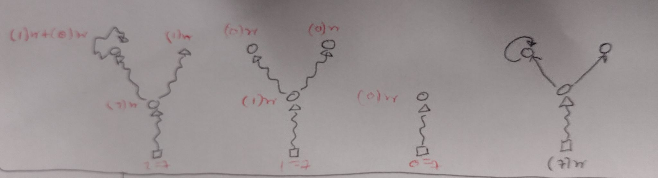
Linear Controllability
Given A, how should we select B (control nodes) such that the system is controllable?
Michele Allegra Brain controllability: mirage or reality? February 2021

Slide 15
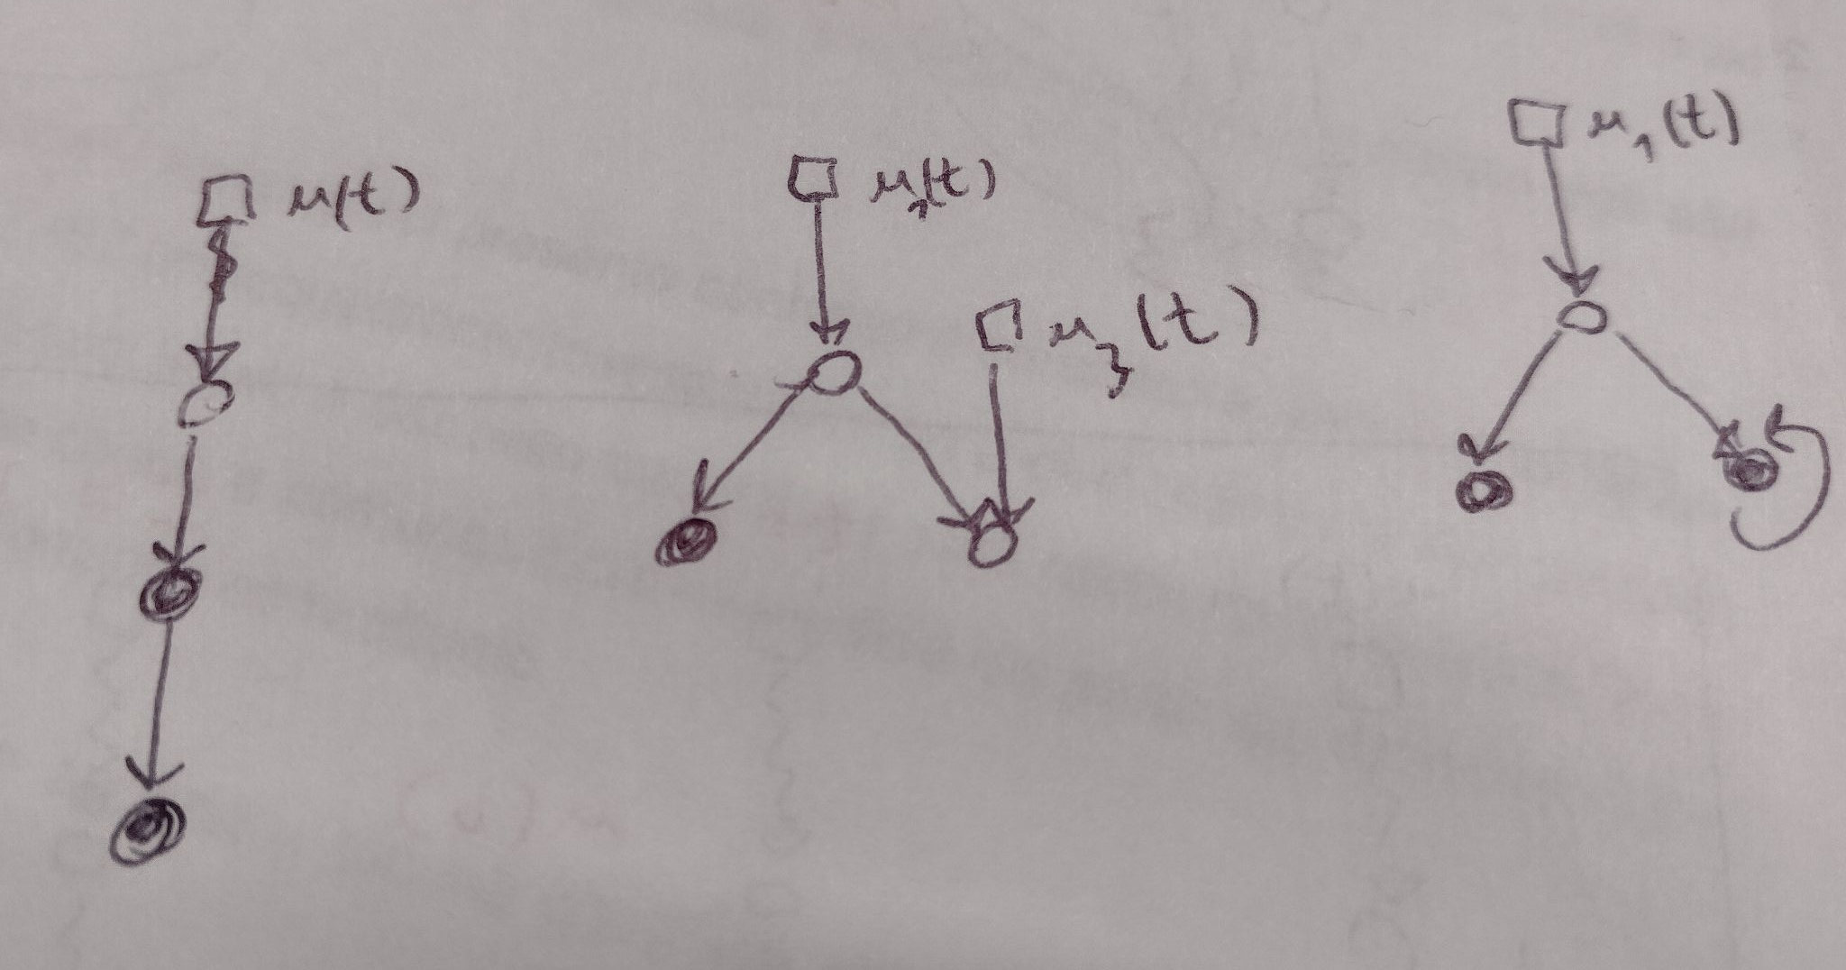
Linear Controllability
Given A, how should we select B (control nodes) such that the system is controllable?
Graph-theoretical criterion: control unmatched nodes
maximum matching: set of links with no common starting/ending points
Michele Allegra Brain controllability: mirage or reality? February 2021

Slide 16
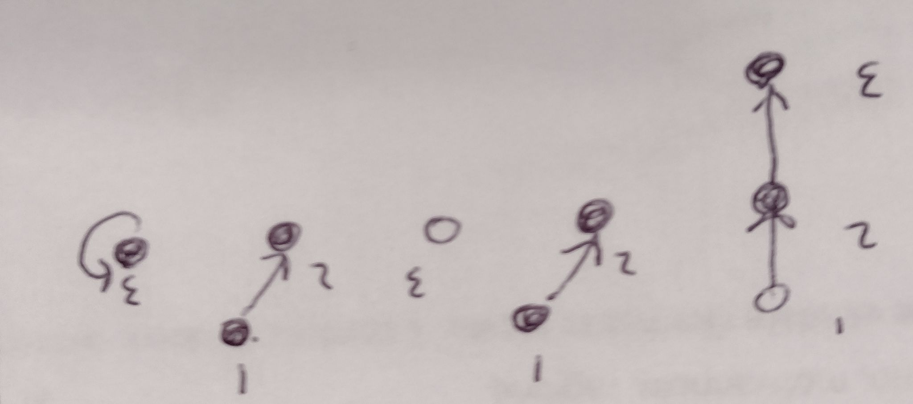
Linear Controllability
Given A, how should we select B (control nodes) such that the system is controllable?
Graph-theoretical criterion: control unmatched nodes
maximum matching: set of links with no common starting/ending points
Michele Allegra Brain controllability: mirage or reality? February 2021

Slide 17

Controlling the brain with a single node?
Resting-state fMRI recordings
N=243 ‘nodes’ (regions of Lausanne atlas)
x(t) activity vector (region time series from fMRI)
A structural connectivity matrix (from dTI)
B single-node input matrix
Repeat the procedure over each and every node
Michele Allegra Brain controllability: mirage or reality? February 2021

Slide 18



Controlling the brain with a single node?
W>0: brain networks are ‘theoretically controllable’ from a single node
they are practically uncontrollable: the control energy ||u²|| > 10²²
...it is hard to drive the system towards an arbitrary desired target states
Look at ‘average controllability’ inverse of average energy required for control (average over target states)
Look at ‘modal controllability’ ease of controlling slow modes of A
Michele Allegra Brain controllability: mirage or reality? February 2021

Slide 19
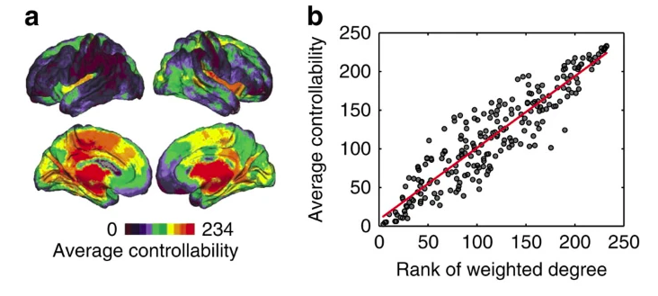
Controlling the brain with a single node?
Average controllability is larger when controlling hubs
Michele Allegra Brain controllability: mirage or reality? February 2021

Slide 20
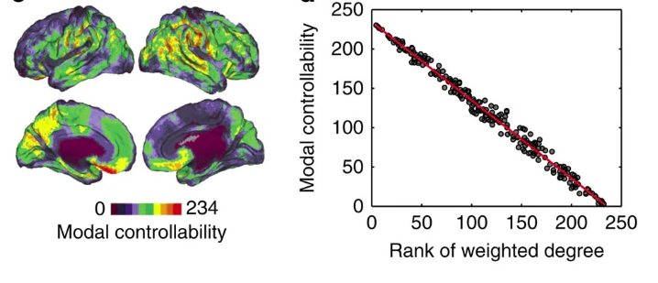
Controlling the brain with a single node?
Average controllability is larger when controlling peripheral nodes
Michele Allegra Brain controllability: mirage or reality? February 2021

Slide 21
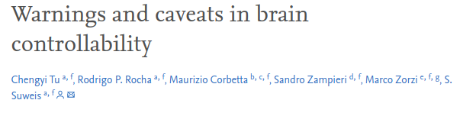

… Limitations with the framework
Limitation (1): choice of dynamic model
A = S structural connectivity matrix
This model is unstable and far from the actual dynamics!
the proper model requires a diagonal decay term …
Other limitations: noiseless dynamics, linear dynamics
Michele Allegra Brain controllability: mirage or reality? February 2021

Slide 22

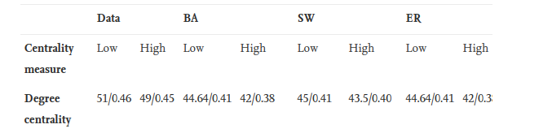
… Limitations with the framework
Limitation (2): the energy is extremely large
To have E_{min} < 10¹⁰ you need to control >45% of nodes …
Michele Allegra Brain controllability: mirage or reality? February 2021

Slide 23
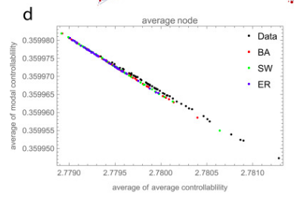
… Limitations with the framework
Limitation (3): the controllability/topology relation is not specific of brain networks
Michele Allegra Brain controllability: mirage or reality? February 2021

Slide 24
Using a ‘good’ dynamics
K. Kabbur, …, S. Suweis, A. Bertoldo, M. Allegra, in prep.
Use the best (linear) model of the data
A = EC Effective connectivity matrix
Sparse Dynamic Causal Modelling (spDCM) [Prando et al., NIMG 2021]
Multivariate Ornstein Uhlenbeck(MOU) model [Gilson et al., PLOS CB 2017]
EC is computed by best fit on data of each individual subject
Both models allow for asymmetric connections -> directed graph
More accurate description of dynamics and possibility to define unmatched nodes
Michele Allegra Brain controllability: mirage or reality? February 2021

Slide 25
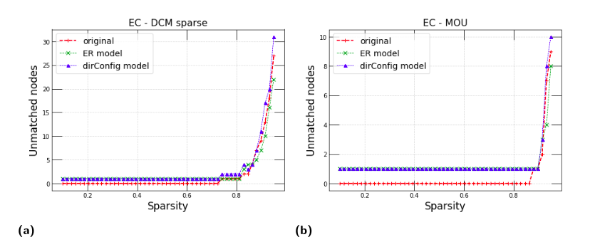
Single-node controllability (in theory)
K. Kabbur, …, S. Suweis, A. Bertoldo, M. Allegra, in prep.
All nodes are matched: the system is ‘theoretically controllable’ with a single node
EC networks are dense (40% sparsity)
All nodes are matched unless sparsity is very high
Michele Allegra Brain controllability: mirage or reality? February 2021

Slide 26
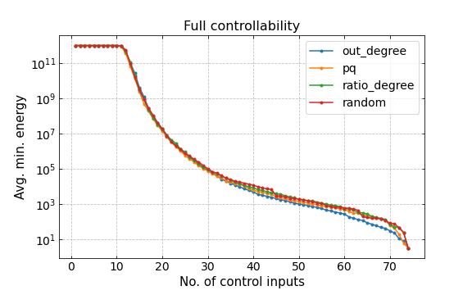
Many nodes are needed (in practice)
Full controllability requires to control at least 20% of nodes
K. Kabbur, …, S. Suweis, A. Bertoldo, M. Allegra, in prep.
Michele Allegra Brain controllability: mirage or reality? February 2021

Slide 27
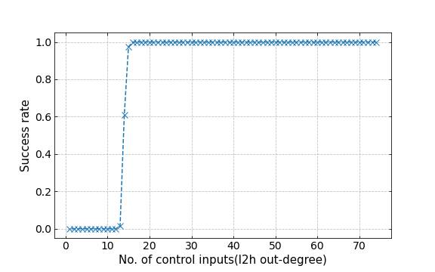
Many nodes are needed (in practice)
Unless 20% of nodes are controlled, control is numerically unstable
[Gie Sun and Adilson E. Motter, Phys. Rev. Lett. 110, 208701]
K. Kabbur, …, S. Suweis, A. Bertoldo, M. Allegra, in prep.
Michele Allegra Brain controllability: mirage or reality? February 2021

Slide 28
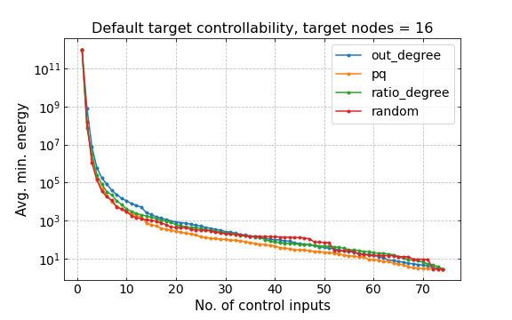
Restricting the target
If we aim to control a small subset of nodes, control energy significantly decreases
[Gao, Jianxi, et al. "Target control of complex networks." Nat. Comm. 5.1 (2014): 1-8.]
K. Kabbur, …, S. Suweis, A. Bertoldo, M. Allegra, in prep.
Michele Allegra Brain controllability: mirage or reality? February 2021

Slide 29
Restricting the target
If we aim to control a small subset of nodes, control energy significantly decreases
[Gao, Jianxi, et al. "Target control of complex networks." Nat. Comm. 5.1 (2014): 1-8.]
K. Kabbur, …, S. Suweis, A. Bertoldo, M. Allegra, in prep.
Michele Allegra Brain controllability: mirage or reality? February 2021

Slide 30
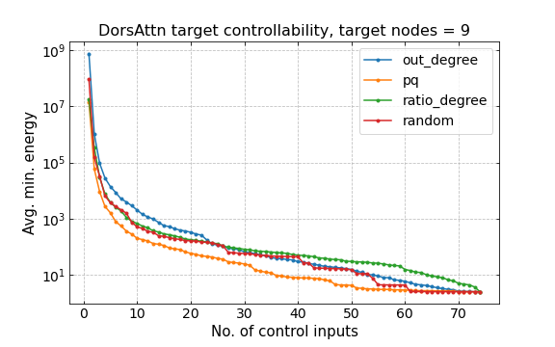
Restricting the target
If we aim to control a small subset of nodes, control energy significantly decreases
[Gao, Jianxi, et al. "Target control of complex networks." Nat. Comm. 5.1 (2014): 1-8.]
K. Kabbur, …, S. Suweis, A. Bertoldo, M. Allegra, in prep.
Michele Allegra Brain controllability: mirage or reality? February 2021

Slide 31
(pro-tempore) Conclusions
look for a paradigm to design controlled interventions on brain dynamics
“control theory” offers an interesting conceptual framework
Applying control theory requires appropriate modeling of dynamics (EC)
Qualitatively, results are robust w.r.t. choice of EC model
Controllability properties mainly depend on connection sparsity rather than other topological features.
Controlling brain’s activity globally by stimulating one or a few nodes appears practically unfeasible
Controlling a subsystem may be more affordable but still significantly hard
Michele Allegra Brain controllability: mirage or reality? February 2021

Slide 32
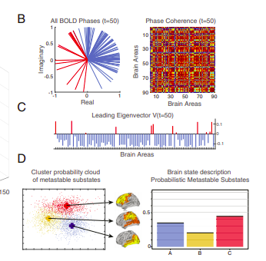
An alternative approach to control?
Can we exploit dimensionality reduction to define an easier control objective?
the target is not a “microstate” (activity state x*), but a “macrostate” (an activity regime with specific features)
E.g., try to control balance between dynamic connectivity patterns [Deco et al. PNAS 116.36 (2019): 18088-18097.]
The probabilities of different states determine “macrostate”
Michele Allegra Brain controllability: mirage or reality? February 2021

Slide 33
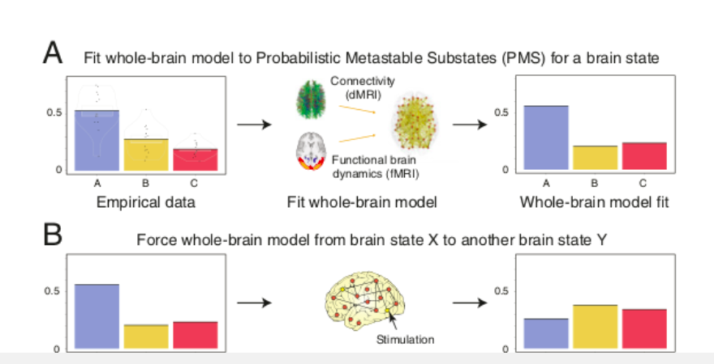
An alternative approach to control?
Can we exploit dimensionality reduction to define an easier control objective?
Michele Allegra Brain controllability: mirage or reality? February 2021

Slide 34







Acknowledgements
Karan Kabbur Hanumanthappa Manjunatha
Samir Suweis
Alessandra Bertoldo
Giorgia Baron
Michele Allegra Brain controllability: mirage or reality? February 2021

Slide 35


Acknowledgements
Thank you for your attention!!
michele.allegra@unipd.it
Michele Allegra Brain controllability: mirage or reality? February 2021

