Slide 1


Michele Allegra
Approaches to brain controllability
Michele Allegra Approaches to brain controllability SISSA June 2022

Slide 2
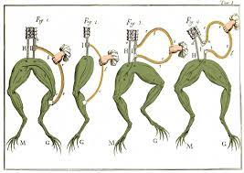
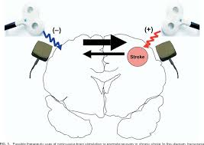

Outline
Where and how should we stimulate?
Michele Allegra Approaches to brain controllability SISSA June 2022

Slide 3
Outline
What is a good theoretical framework to design neuromodulation?
The network control theory approach
Some issues with the network control approach
Directions for alternatives: reduce dimensionality?
Michele Allegra Approaches to brain controllability SISSA June 2022

Slide 4
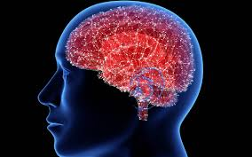
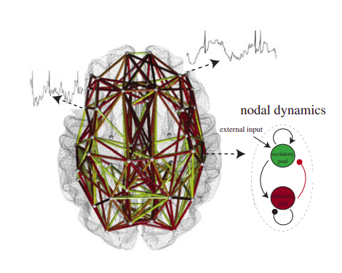
Requirements for targeted neuromodulation
In vivo system
design perturbation
implement it in the system
measure system
model dynamics
In silico model
Michele Allegra Approaches to brain controllability SISSA June 2022

Slide 5
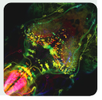
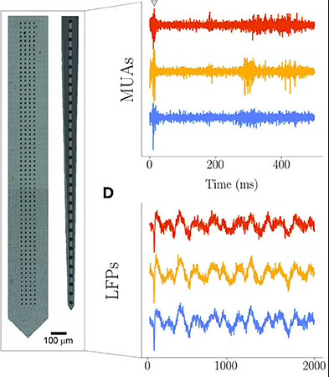
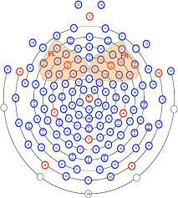
Measure: improved recording techniques are becoming available
Michele Allegra Approaches to brain controllability SISSA June 2022

Slide 6
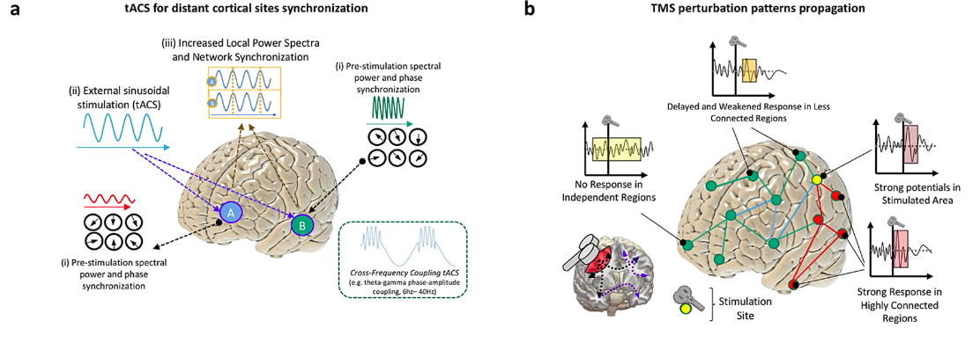
Implement: improved stimulation techniques are becoming available
Michele Allegra Approaches to brain controllability SISSA June 2022

Slide 7
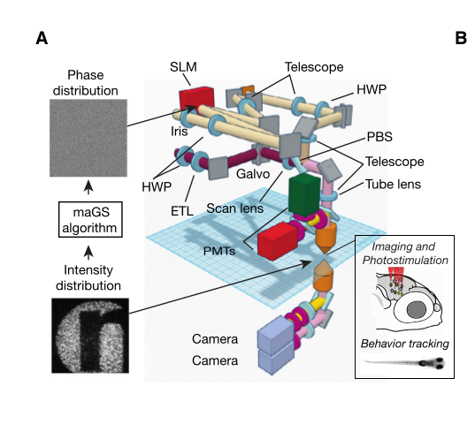
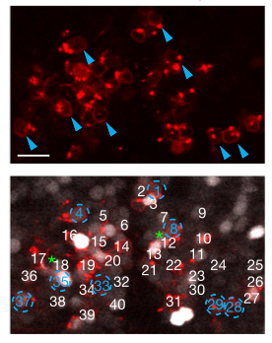
Implement: improved stimulation techniques are becoming available
Dal Maschio, M., Donovan, J. C., Helmbrecht, T. O., & Baier, H. (2017). Linking neurons to network function and behavior by two-photon holographic optogenetics and volumetric imaging. Neuron, 94(4), 774-789.
Michele Allegra Approaches to brain controllability SISSA June 2022

Slide 8

Towards targeted modulations
(i) measurement
(ii) modeling
(iii) design
(iv) application
What is a good theoretical framework to design neuromodulation?
Michele Allegra Approaches to brain controllability SISSA June 2022

Slide 9
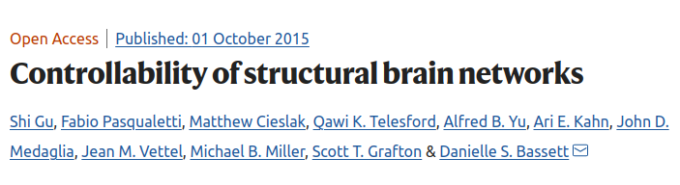
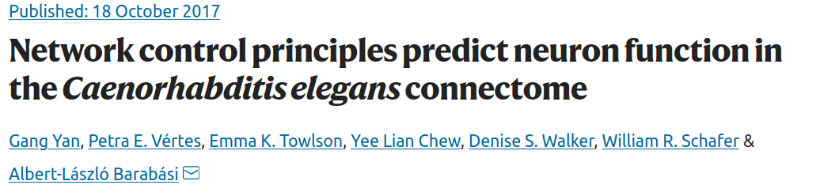
Control of large-scale brain activity
Brain control theory
model: linear model based on structural connectome
design: use classical (linear) control theory
implement: use neuromodulation (not even at proof-of-principle stage)
Michele Allegra Approaches to brain controllability SISSA June 2022

Slide 10

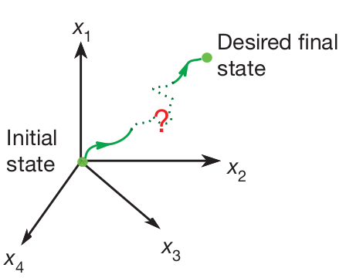
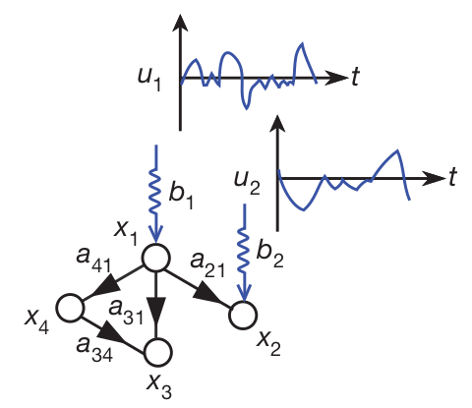
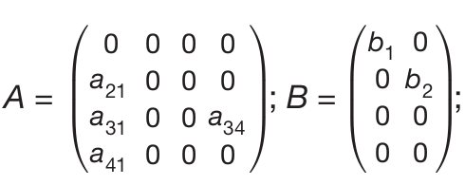
Network control theory
x(t) - state vector for N “network nodes” at time t
Dynamics is given by Linear Time Invariant(LTI) system:
A - (N,N) connectivity matrix
B - (N, r) input matrix with “r” being number of control nodes required to control the system.
Michele Allegra Approaches to brain controllability SISSA June 2022

Slide 11
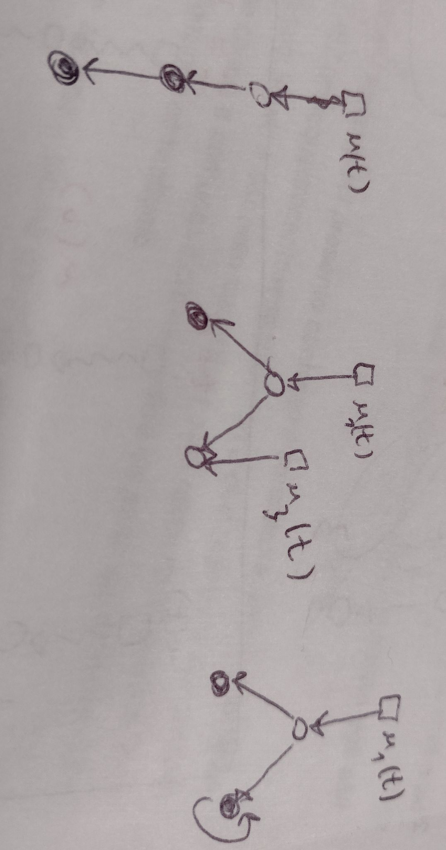

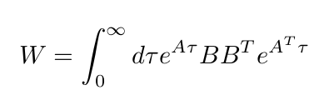
Network control theory
The design problem has a complete solution (in principle)
Graph-theoretical criterion
to select minimal B (control nodes):
unmatched nodes controlled
with independent inputs
Algebraic criterion to select u (control signal)
with Gramian
Michele Allegra Approaches to brain controllability SISSA June 2022

Slide 12
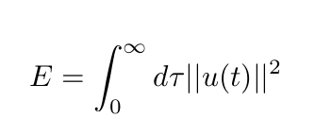


Network control theory
Control energy
Physical meaning: depends on experimental setting
Theoretical meaning: strength of stimulus-evoked vs intrinsic dynamics
E.g. for fMRI, |A|:1, E :1 means stimulus-evoked and intrinsic dynamics are comparable
Control energy is related to Gramian eigenvalues
Michele Allegra Approaches to brain controllability SISSA June 2022

Slide 13
Control of large-scale brain activity
N=243 ‘nodes’ (regions of atlas)
Model: linear model with dynamics = structural connectome
A structural connectivity matrix (from diffusion MRI)
B single-node input matrix
Repeat the procedure over each and every node
the brain is theoretically controllable from a single region
Michele Allegra Approaches to brain controllability SISSA June 2022

Slide 14

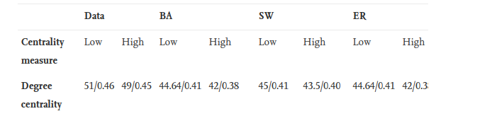
Theoretical vs pactical controllability
Tu, C., Rocha, R. P., Corbetta, M., Zampieri, S., Zorzi, M., & Suweis, S. (2018).
Warnings and caveats in brain controllability. NeuroImage, 176, 83-91.
1) W>0 (controllability in principle), but control energy is unfeasibly large
2) To have E_{min} < 10¹⁰ need to control >45% of nodes …
[scale of control input signal >> scale of normal activity fluctuations]
Michele Allegra Approaches to brain controllability SISSA June 2022

Slide 15
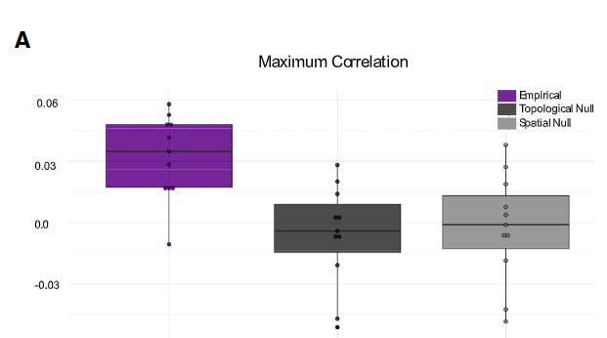
Control of large-scale brain activity
Stiso, J., Khambhati, A. N., Menara, T., Kahn, A. E., Stein, J. M., Das, S. R., ... & Bassett, D. S. (2019). White matter network architecture guides direct electrical stimulation through optimal state transitions. Cell reports, 28(10), 2554-2566.
Stimulation with tDCS, recording with EcoG, structure measurement by diffusion MRI
Target state associated to successful memory encoding
[subject-level power-based biomarkers of good memory encoding extracted with a multivariate classifier from ECoG data collected during a verbal memory task ]
Michele Allegra Approaches to brain controllability SISSA June 2022

Slide 16
Control of large-scale brain activity
Stiso, J., Khambhati, A. N., Menara, T., Kahn, A. E., Stein, J. M., Das, S. R., ... & Bassett, D. S. (2019). White matter network architecture guides direct electrical stimulation through optimal state transitions. Cell reports, 28(10), 2554-2566.
Stimulation with tDCS, recording with EcoG, structure measurement by dWI
Target state associated to successful memory encoding
[subject-level power-based biomarkers of good memory encoding extracted with a multivariate classifier from ECoG data collected during a verbal memory task ]
Michele Allegra Approaches to brain controllability SISSA June 2022

Slide 17
Whole-brain controllability through EC
K. Kabbur, …,M. Corbetta, S. Suweis, A. Bertoldo, M. Allegra, in preparation.
Improve modeling:
Use effective connectivity (EC) instead of structural connectivity
EC is directed and gives more accurate representation of dynamics
(e.g. much better fit of functional connectivity)
Sparse Dynamic Causal Modelling (spDCM) [Prando et al., NIMG 2021]
SpDCM infers dynamics (A) from observed fMRI activity
Michele Allegra Approaches to brain controllability SISSA June 2022

Slide 18
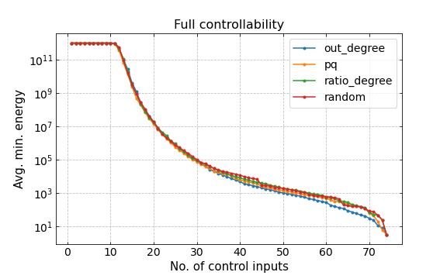
Controllability through EC
K. Kabbur, …, S. Suweis, A. Bertoldo, M. Allegra, in prep.
The overall picture is qualitatively consistent with the one obtained by SC
There are no unmatched nodes and in principle the system can be controlled by a single node (W>0)
In practice, control energy is very large, (>10¹⁰) unless at least 15% of nodes are controlled
Michele Allegra Approaches to brain controllability SISSA June 2022

Slide 19
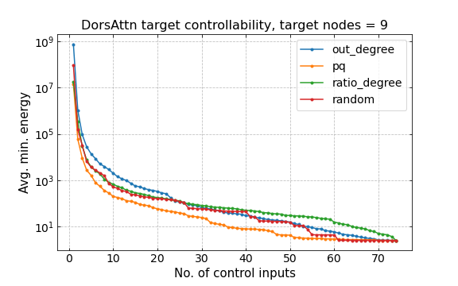
Controllability through EC
K. Kabbur, …, S. Suweis, A. Bertoldo, M. Allegra, in prep.
target controllability: we only wish to control only a subset of nodes [Gao, Jianxi, et al. "Target control of complex networks." Nat. Comm. 5.1 (2014): 1-8.]
the control energy required is significantly lower but still large
Michele Allegra Approaches to brain controllability SISSA June 2022

Slide 20
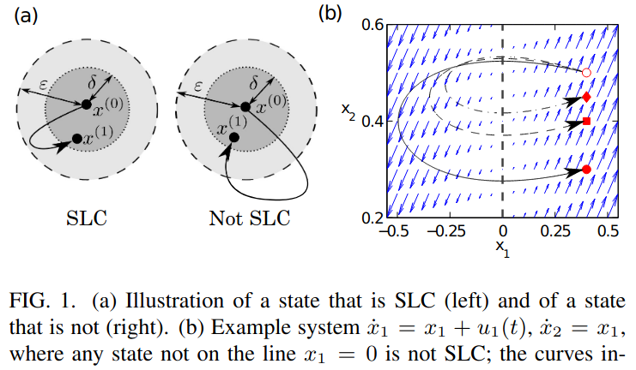
A theoretical issue
Gao, Sun, J., & Motter, A. E. (2013). Controllability transition and nonlocality in network control. Physical review letters, 110(20), 208701]
Trajectories are long and energy is large unless a significant fraction of nodes is controlled
Michele Allegra Approaches to brain controllability SISSA June 2022

Slide 21
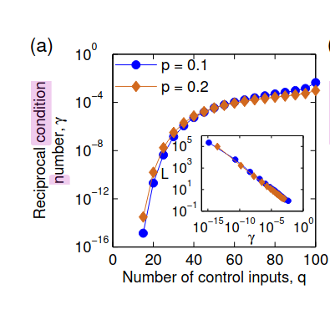
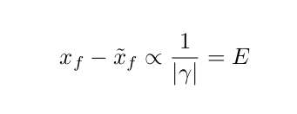
A theoretical issue
Gao, Sun, J., & Motter, A. E. (2013). Controllability transition and nonlocality in network control. Physical review letters, 110(20), 208701]
numerical error in final state is related to condition number = inverse of energy
Michele Allegra Approaches to brain controllability SISSA June 2022

Slide 22

linear controllability in a simpler animal model
(measurement) the connectome can be completely measured (~2000 connections)
(modeling) Due to exhaustive knowledge, the model is faithful
(implementation) we can perform well localized perturbations
However, controllability was used only to identify neurons that are necessary for muscle control, not to induce state
Michele Allegra Approaches to brain controllability SISSA June 2022

Slide 23
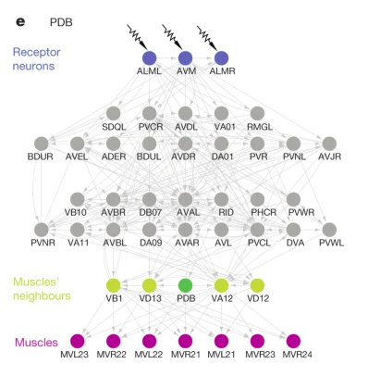
linear controllability in a simpler animal model
Yan, G., Vértes, P. E., Towlson, E. K., Chew, Y. L., Walker, D. S., Schafer, W. R., & Barabási, A. L. (2017). Network control principles predict neuron function in the Caenorhabditis elegans connectome. Nature, 550(7677), 519-523.
Linear controllability of C. Elegans (279 neurons)
Target controllability: try to identify neurons that directly control specific muscles
Linear control theory with SC predict which neurons are necessary for moving specific muscles
However, controllability with SC was used only to identify neurons that are necessary for muscle control
not used to induce specific movements via neuromodulation
Michele Allegra Approaches to brain controllability SISSA June 2022

Slide 24
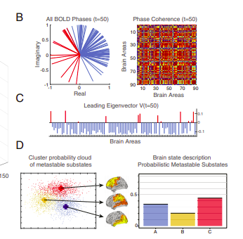
An alternative approach to control?
Can we exploit dimensionality reduction to address the controllability problem?
the target is not a “microstate” (activity state x*), but a “macrostate” (activity regime)
try to control balance between dynamic connectivity patterns
[Deco et al. PNAS 116.36 (2019): 18088-18097.]
The probabilities of different states determine “macrostate”
Michele Allegra Approaches to brain controllability SISSA June 2022

Slide 25
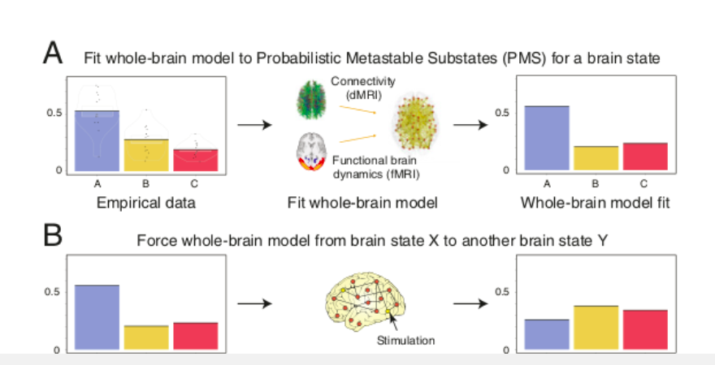
An alternative approach to control?
Can we exploit dimensionality reduction to define an easier control objective?
Michele Allegra Approaches to brain controllability SISSA June 2022

Slide 26
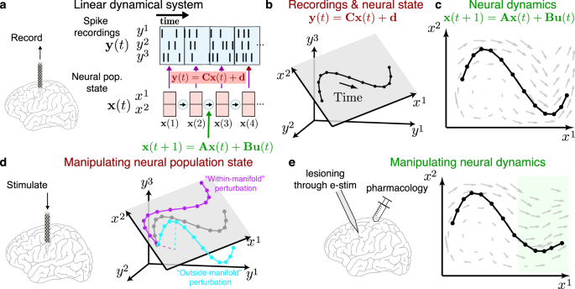
An alternative approach to control?
dynamics (approximately) unfolds on low-dimensional manifolds
can we try to control the key “directions” in neural space?
[Shenoy & Kao. Nat. Comm. 12.1 (2021): 1-5]
Michele Allegra Approaches to brain controllability SISSA June 2022

Slide 27
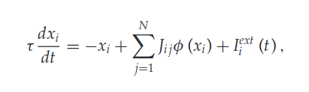
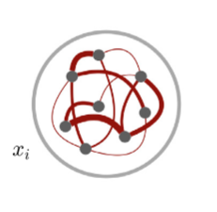
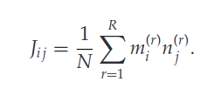
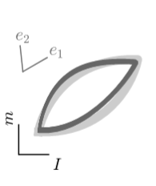
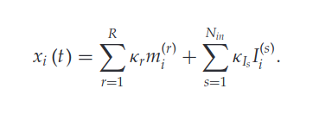
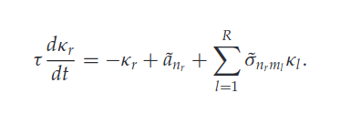
An alternative approach to control?
M Beiran, A Dubreuil, A Valente, F Mastrogiuseppe, S Ostojic
Neural Computation 33 (6), 1572-1615
high D
problem: control signal are applied locally (x), not on hidden degrees of freedom ()
low D
Michele Allegra Approaches to brain controllability SISSA June 2022

Slide 28
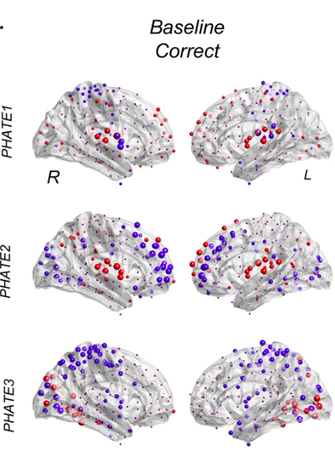
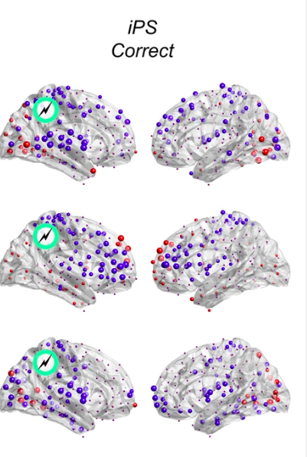
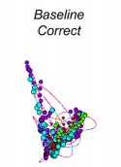
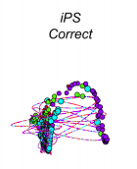
An alternative approach to control?
dynamics (approximately) unfolds on low-dimensional manifolds
can we try to control the key “directions” in neural space?
Iyer, K. K., Hwang, K., Hearne, L. J., Muller, E., D’Esposito, M., Shine, J. M., & Cocchi, L. (2022). Focal neural perturbations reshape low-dimensional trajectories of brain activity supporting cognitive performance. Nature communications, 13(1), 1-8.
Michele Allegra Approaches to brain controllability SISSA June 2022

Slide 29
Recap
“Controllability” of neural activity requires the ability to model the activity and to design external interventions
We need an appropriate theoretical paradigm to address the design problem
The simplest approach (linear modeling + classical linear controllability) is poorly effective for large networks
Possibly, improvements may be obtained by leveraging dimensionality reduction
In particular, we should try to manipulate global, hidden degrees of freedom
Michele Allegra Approaches to brain controllability SISSA June 2022

Slide 30

Michele Allegra Approaches to brain controllability SISSA June 2022

Slide 31








Acknowledgements
Karan Kabbur Hanumanthappa Manjunatha
Giorgia Baron
Alessandra Bertoldo
Samir Suweis
Maurizio Corbetta
Marco Dal Maschio
Michele Allegra Approaches to brain controllability SISSA June 2022

Slide 32






Acknowledgements
Michele Allegra Approaches to brain controllability SISSA June 2022
Sebastian Goldt

Slide 33
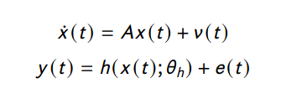
Sparse DCM
Prando, G., Zorzi, M., Bertoldo, A., Corbetta, M., Zorzi, M., & Chiuso, A. (2020). Sparse DCM for whole-brain effective connectivity from resting-state fMRI data. Neuroimage, 208, 116367.
Linear model + hemodynamics
ODE → finite difference equation (discretization)
Nonlinear hemodynamic response → linear response (linearization)
Bayesian inference with EM algorithm
Sparsity-inducing prior on connectivity
Michele Allegra Approaches to brain controllability SISSA June 2022

Slide 34
Linear controllability
Given directed A, Graph-theoretical criterion to select B (control nodes)
each unmatched node should be controlled with independent input
Control signal propagates along directed links
Only need to control “roots” of directed link chain
In principle we know which nodes to stimulate and how...
Michele Allegra Brain controllability: mirage or reality? February 2022

Slide 35
Control of large-scale brain activity
measure: diffusion MRI
system: N=243 ‘nodes’ (regions of Lausanne atlas)
x(t) activity vector (region time series from fMRI)
Model: linear model with dynamics = structural connectivity
A structural connectivity matrix (from diffusion MRI)
B single-node input matrix
Repeat the procedure over each and every node
Michele Allegra Approaches to brain controllability SISSA June 2022

Slide 36
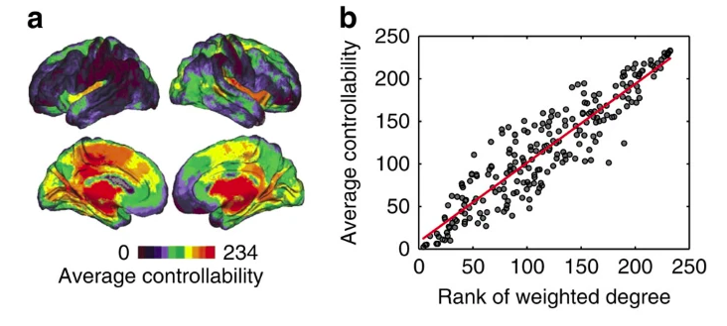
Control of large-scale brain activity
1) the brain is theoretically controllable from a single region (W>0)
2) when controlling one node “average energy” is proportional to node degree (# structural connections)
Michele Allegra Approaches to brain controllability SISSA June 2022

Slide 37
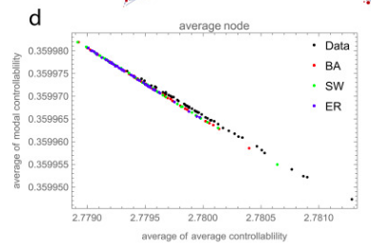
Limitations
the controllability/topology relation is not specific of brain networks
Michele Allegra Approaches to brain controllability SISSA June 2022

Slide 38
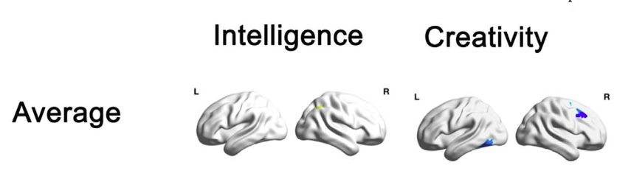
Control of large-scale brain activity
Kenett, Y. N., Medaglia, J. D., Beaty, R. E., Chen, Q., Betzel, R. F., Thompson-Schill, S. L., & Qiu, J. (2018). Driving the brain towards creativity and intelligence: A network control theory analysis. Neuropsychologia, 118
study on relation between controllability and intelligence (Raven test)
“We find that intelligence is related to the ability to “drive” the brain system into easy to reach neural states by the right inferior parietal lobe and lower integration abilities in the left retrosplenial cortex.”
… a node’s “ average controllability” is correlated with structural topological properties (degree) of the node, which may be the actual relevant feature
Michele Allegra Approaches to brain controllability SISSA June 2022

Slide 39
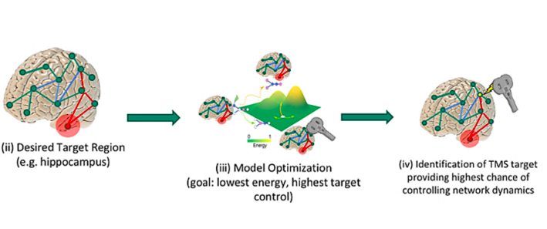
Target controllability through EC
K. Kabbur, …, S. Suweis, A. Bertoldo, M. Allegra, in prep.
target controllability: we only wish to control the state of a subset of nodes [Gao, Jianxi, et al. "Target control of complex networks." Nat. Comm. 5.1 (2014): 1-8.]
Michele Allegra Approaches to brain controllability SISSA June 2022

Slide 40
Target controllability through EC
K. Kabbur, …, S. Suweis, A. Bertoldo, M. Allegra, in prep.
target controllability: we only wish to control the state of a subset of nodes [Gao, Jianxi, et al. "Target control of complex networks." Nat. Comm. 5.1 (2014): 1-8.]
the control energy required is significantly lower but still large
Michele Allegra Approaches to brain controllability SISSA June 2022

Slide 41
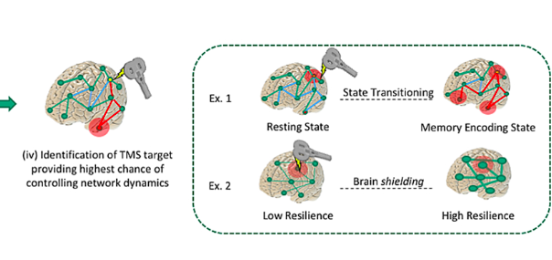
Limitations
Implementation:
do esisting non-invasive brain stimulation techniques (TMS, tDCS,tACS) conform to the model assumptions?
Can we implement well-localized stimulation?
Michele Allegra Approaches to brain controllability SISSA June 2022
Limitation (2): the energy is extremely large

Slide 42

Limitations
Modeling:
[Tu, C., Rocha, R. P., Corbetta, M., Zampieri, S., Zorzi, M., & Suweis, S. (2018). Warnings and caveats in brain controllability. NeuroImage, 176, 83-91.]
1) No dynamical information, only structural
2) the proper model requires a diagonal decay term …
3) structural connectivity from dTI is symmetric. Cannot exploit directionality
(in particular, cannot define unmatched inout nodes)
4) relation between “controllability” and structural degree is not specific to brain networks
Michele Allegra Approaches to brain controllability SISSA June 2022
Limitation (2): the energy is extremely large

Slide 43
Limitations
Modeling:
[Tu, C., Rocha, R. P., Corbetta, M., Zampieri, S., Zorzi, M., & Suweis, S. (2018). Warnings and caveats in brain controllability. NeuroImage, 176, 83-91.]
1) No dynamical information, only structural
2) the proper model requires a diagonal decay term …
3) structural connectivity from dTI is symmetric. Cannot exploit directionality
(in particular, cannot define unmatched inout nodes)
4) relation between “controllability” and structural degree is not specific to brain networks
Michele Allegra Approaches to brain controllability SISSA June 2022
Limitation (2): the energy is extremely large

Slide 44
Issues with current controllability approach
Provided the linear model provides accurate description of dynamics, linear controllability theory solves the problem of designing targeted interventions
(measurement) neuroimaging may not provide an accurate enough representation of brain activity
(modeling) The linear model may not be accurate enough, and it is nontrivial to retrieve it from data (one should go beyond structural connectivity)
(design) due to the size of the system, controlling the whole system requires very large amount of energy
(implementation) in practice, we have o easy means of performing well-localized perturbations
Michele Allegra Approaches to brain controllability SISSA June 2022

Slide 45
linear controllability in a simpler animal model
Advantages of animal model:
(measurement) the connectome can be completely measured (~2000 connections)
(modeling) Due to exhaustive knowledge, the model is faithful
(implementation) we can perform well localized perturbations
However:
However, controllability with SC was used only to identify neurons that are necessary for muscle control
not used to induce specific movements via neuromodulation
Michele Allegra Approaches to brain controllability SISSA June 2022

Slide 46
Issues with current controllability approach
Provided the linear model provides accurate description of dynamics, linear controllability theory solves the problem of designing targeted interventions
(measurement) neuroimaging may not provide an accurate enough representation of brain activity
(modeling) The linear model may not be accurate enough, and it is nontrivial to retrieve it from data (one should go beyond structural connectivity)
(design) due to the size of the system, controlling the whole system requires very large amount of energy
(implementation) in practice, we have o easy means of performing well-localized perturbations
Michele Allegra Approaches to brain controllability SISSA June 2022

