Slide 1

Intrinsic dimension estimation and neural activity
Michele Allegra Intrinsic dimension and neural activity May 2022

Slide 2
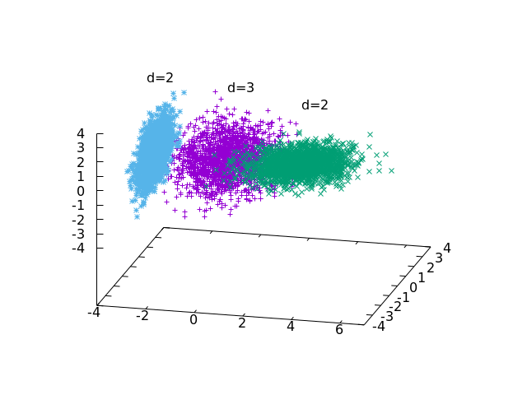
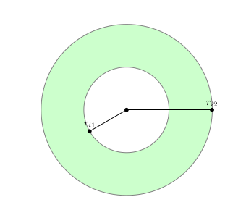
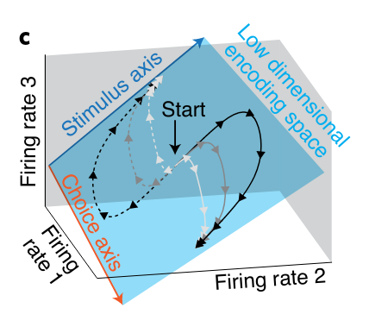
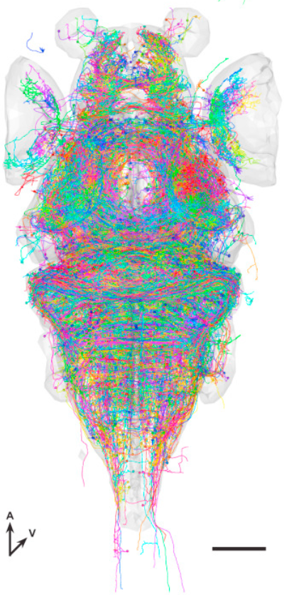
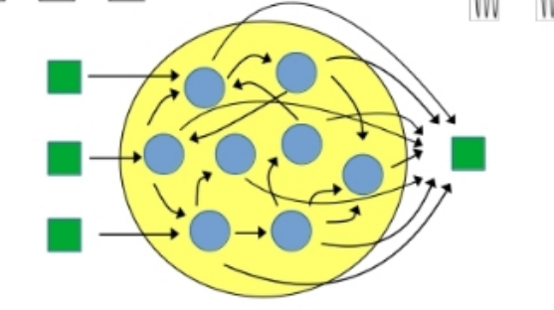
Overview
Michele Allegra Bayesian estimation of the intrinsic dimension of data ISBA 2021
Intrinsic dimension estimation:
the two-NN approach
The case of variable ID
Low-dimensional neural codes
Some ideas for future work

Slide 3



Intrinsic dimension
Data are defined in a space with D variables
Generally, the data lie on hypersurface of lower dimension d << D
This dimension is called the intrinsic dimension
Michele Allegra Intrinsic dimension and neural activity May 2022

Slide 4




ID estimation: projective approach
Project D-dimensional data into lower dimension d :
Try different d and evaluate for each a “loss function”
measures the “data loss” occurring in the projection. Examples:
preservation of original distance relations
preservation of original covariance matrix
ID estimate based on tradeoff between dimensionality reduction and data loss
Problem (1): Computationally burdensome (search for optimal projection for each d)
Problem (2): robust ID estimates only if has large gap as a function of d
if no gap, the estimation can be rather arbitrary
Michele Allegra Intrinsic dimension and neural activity May 2022

Slide 5
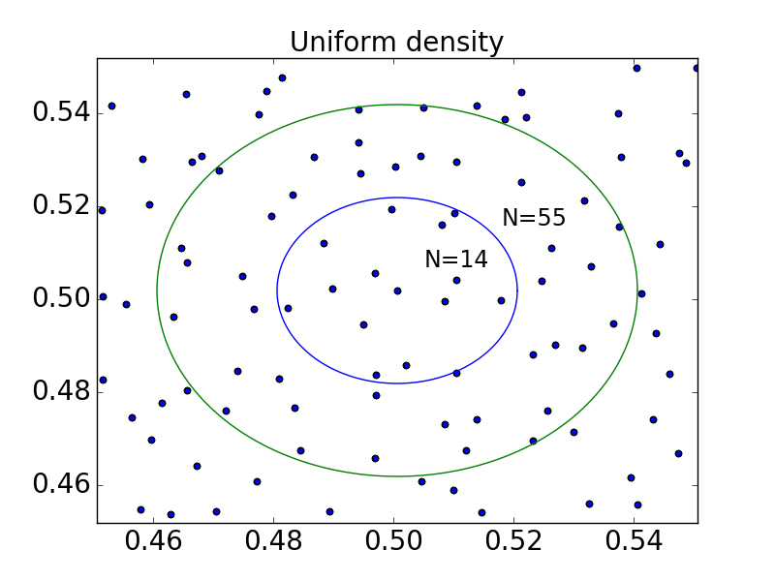
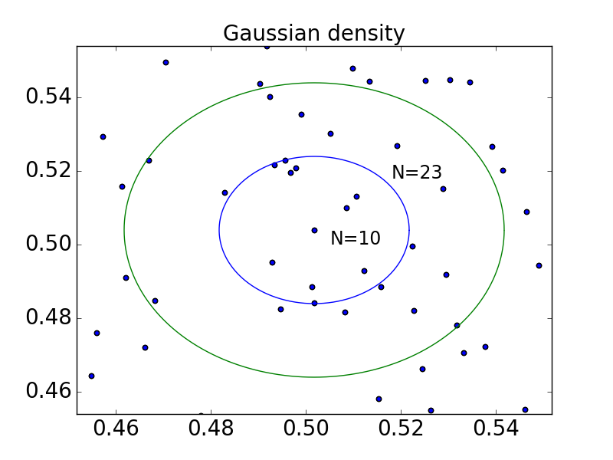
ID estimation: scaling approach
Data are sampled from a distribution ρ(X)
distances follow scaling laws that depend on ρ, d
Example: “correlation dimension” (Grassberger & Procaccia, PRL 50, 1983):
The number of nearest neighbors at distance <ε from point i scales as Ni(ε)~ρε^{d}
estimate d with simple linear fit.
ρ should not have large variations, or the scaling is violated (and estimation fails)
Michele Allegra Intrinsic dimension and neural activity May 2022

Slide 6
ID estimation: TWO-NN
E Facco, M D’Errico, A Rodriguez, A Laio, Scientific Reports 7, 12140. (2017)
TWO-NN: estimating the ID in case of (strongly) variable density
Two weak assumptions:
H1) the data points xi are independent samples from a distribution ρ(x).
H2) local uniformity: ρ(x) ~ const. in the region containing the first 2 neighbors of xi
ri1,ri2 distances of 1st and 2nd neighbor of point i
μi=ri2/ri1 follows Pareto distribution: P(μ)=dμ^{-d}
the distribution of μ depends only on d
Michele Allegra Intrinsic dimension and neural activity May 2022

Slide 7
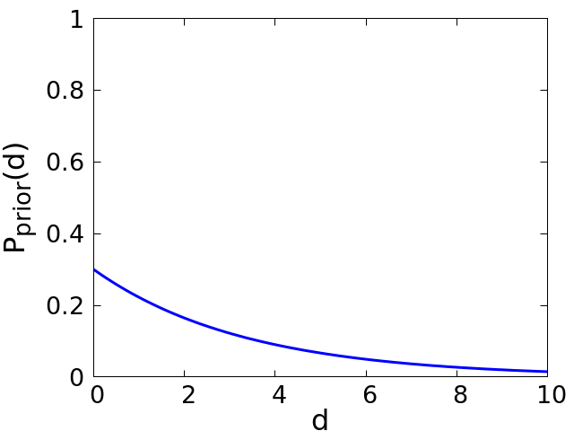
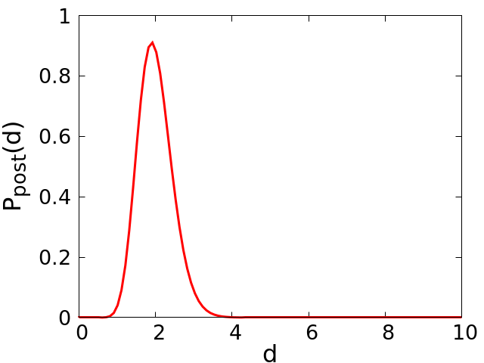
ID estimation: TWO-NN
assume Pprior(d)~Gamma(a,b)
μi=ri2/ri1 follows a Pareto distribution: L(μ|d) ~ Par(d)
given the {μi}, Ppost(d) ~ Gamma(a+N,b+N<log μ>)
d estimate: posterior average <d>post= (a+N)/(b+N<log μ>) ~ 1/<log μ>
data {μi}
Michele Allegra Intrinsic dimension and neural activity May 2022

Slide 8
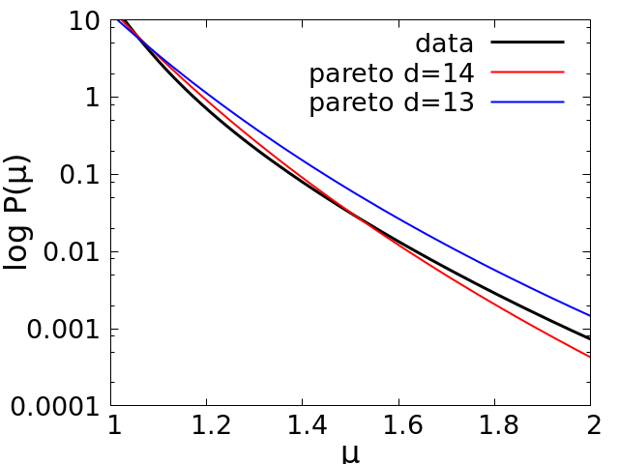
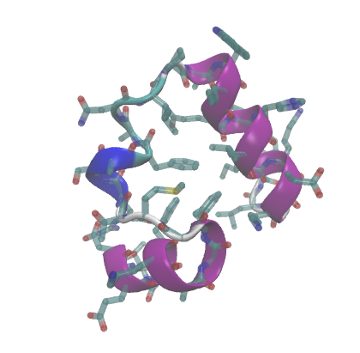
The problem of multiple IDs
N ~ 32,000 configurations M=32 coordinates
the empirical μ do not
well fit a Pareto
What if d is not uniform?
the data may lie on several manifolds, each with different intrinsic dimension
Michele Allegra Intrinsic dimension and neural activity May 2022

Slide 9

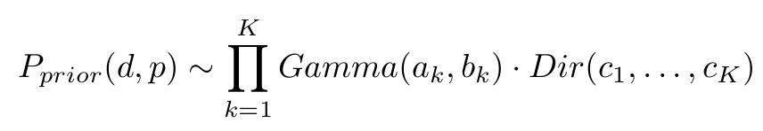


Extending TWO-NN to multiple IDs
[M. Allegra, E. Facco, F. Denti, A. Laio and A. Mira, Scientific Reports 10,16449 (2020)
Assume the points lie on K «manifolds» with different IDs d=d1,…,dK
The distribution of {μ} is simply a mixture of Pareto distributions (with mixing parameters p=p1,…,pK)
Introduce latent variables Z=Z1,…,ZN, manifold membership of each point
Estimate jointly d,p,Z by Gibbs Sampling of the posterior distribution
Michele Allegra Intrinsic dimension and neural activity May 2022

Slide 10
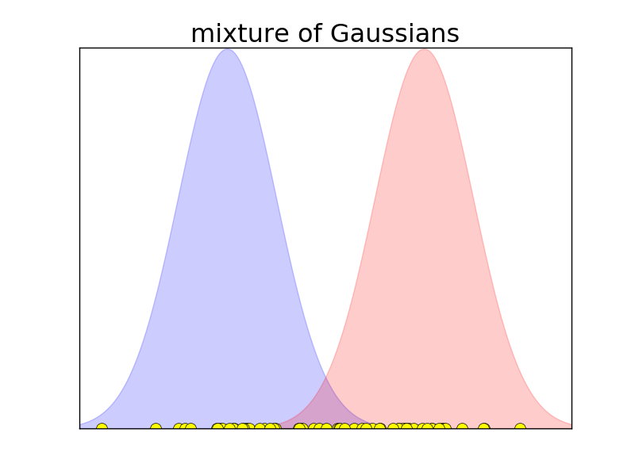
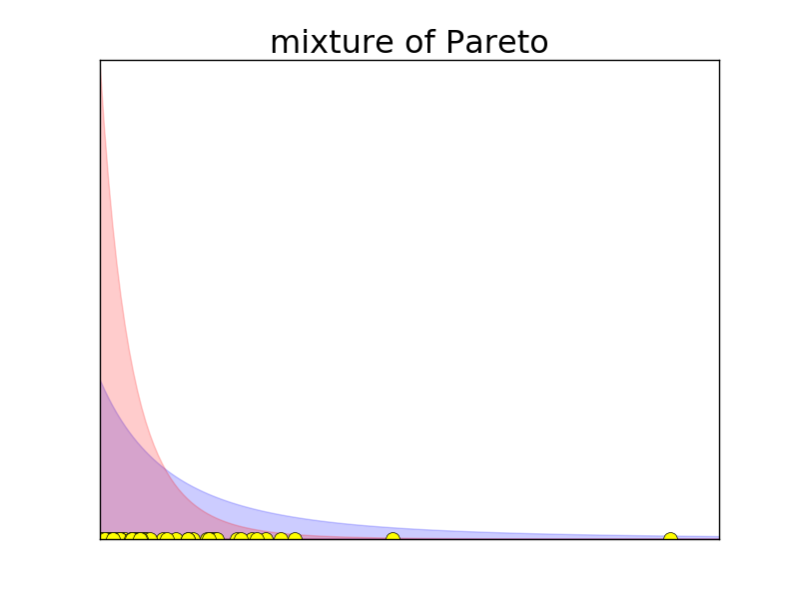
Extending TWO-NN to multiple IDs
Problem is correctly estimating Z
Z are easy to assign only if mixture components are largely non-overlapping
But Pareto distributions with different d are highly overlapping!
The Z assigment is not reliable
Michele Allegra Intrinsic dimension and neural activity May 2022

Slide 11


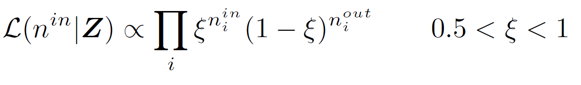

Extending TWO-NN to multiple IDs
Let the neighborhood of point i be defined by its first q neighbors
# neighbors with same Z as i
# neighbors with different Z
We get non-uniform neighborhoods: >
One more assumption: neighborhoods must be approximately uniform
Enforce with additional term in the likelihood:
ξ : propensity of neighbors to be in the same manifold
Michele Allegra Intrinsic dimension and neural activity May 2022

Slide 12
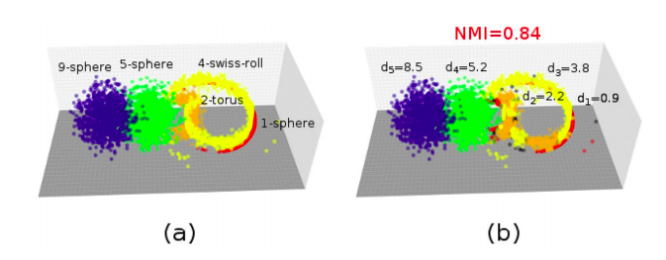
Heterogeneous ID algorithm (Hidalgo)
[M. Allegra, E. Facco, F. Denti, A. Laio and A. Mira, Scientific Reports 10,16449 (2020)
Find regions (manifolds) of different ID in the data
Works also for nonlinear and topologically complex manifolds
E.g. circle in d=1, swiss roll in d=4, torus d=2, sphere d=5, sphere d=9
Michele Allegra Intrinsic dimension and neural activity May 2022

Slide 13

Real example: phase space of folding protein
simulation of unfolding/refolding protein
for each of the N ~ 32,000 configurations, D=32 coordinates
We find four manifolds,
three with low dimensions d=11.8,d=12.9, d=13.2
one with high dimension d=22.9
Which configurations are assigned to the different manifolds?
Consider q=fraction of native contacts (=degree of folding)
Michele Allegra Intrinsic dimension and neural activity May 2022

Slide 14
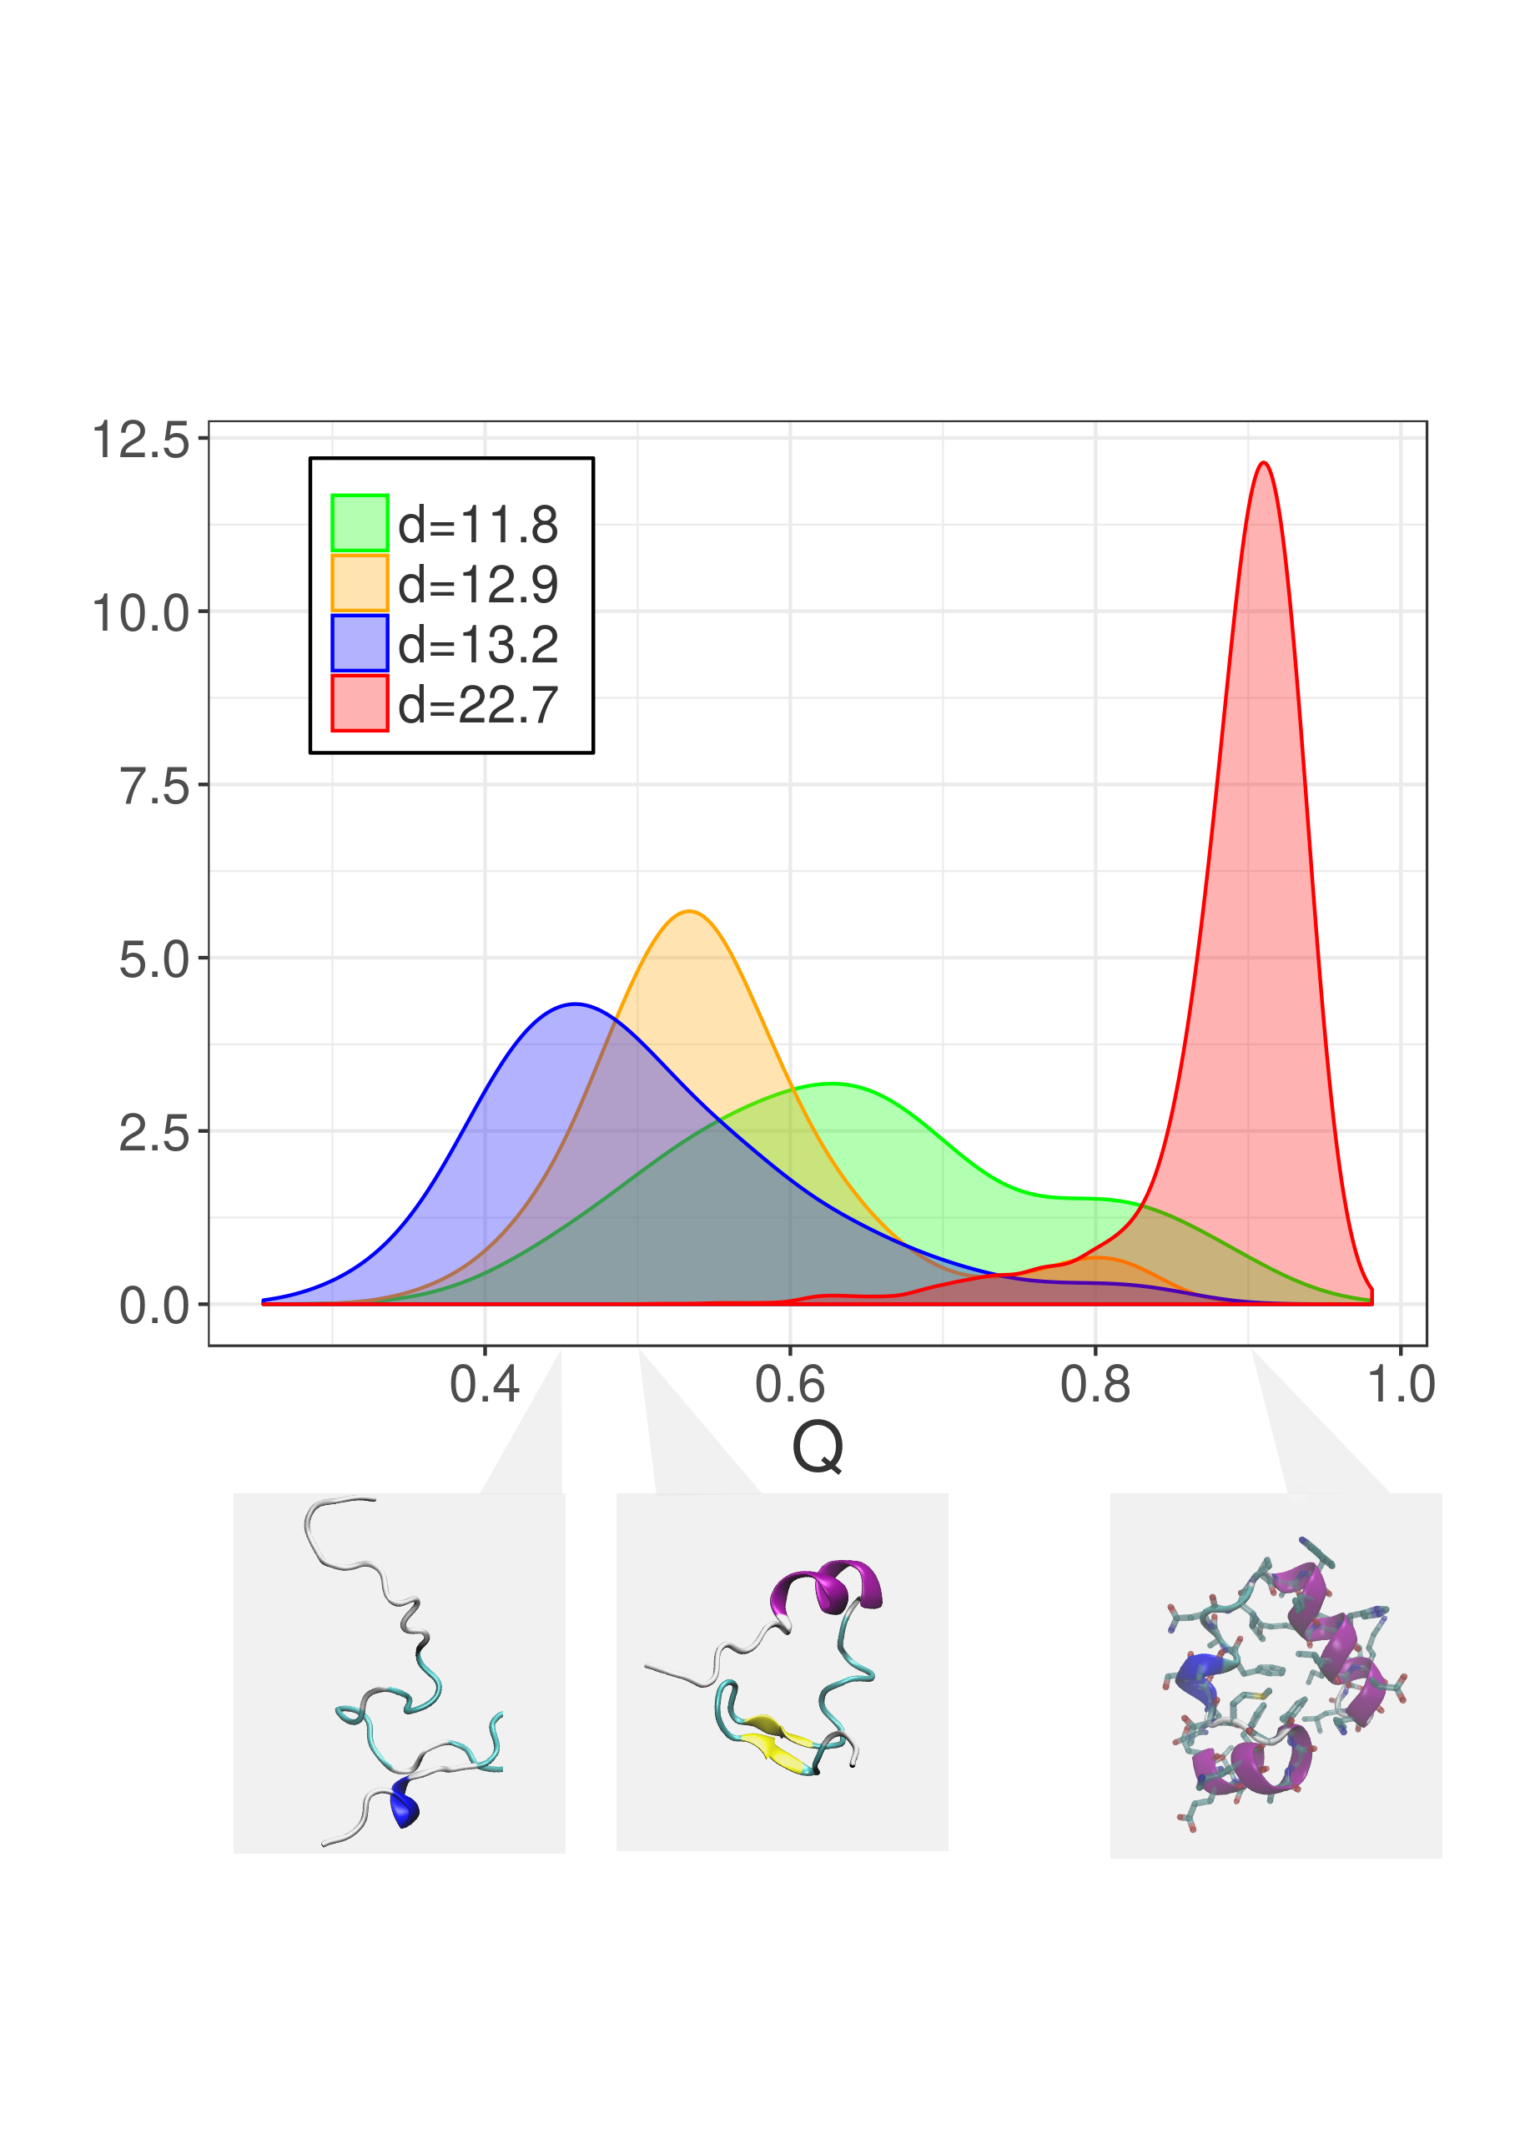
Example: phase space of folding protein
Folded configurations are in the high-dimensional manifolds
The local ID is able to discriminate between folded and unfolded configurations
The effective # of phase space directions the system can explore varies in the two states
Michele Allegra Intrinsic dimension and neural activity May 2022

Slide 15
Conclusions first part
Michele Allegra Bayesian estimation of the intrinsic dimension of data ISBA 2021
We developed a Bayesian approach for intrinsic dimension (ID) estimation
Our method rests on quite weak assumptions (local uniformity of density and dimension)
We find regions of different local ID in the data
In real data, we find large variations of the ID, highlighting relevant structure in the data
An R implementation is freely available in the R package intRinsic

Slide 16
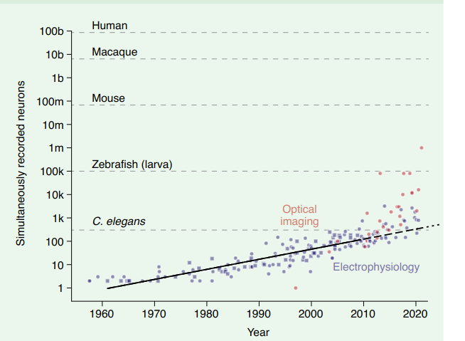
The advent of large-scale neural recordings
Moore-like increase in the amount of simultaneously recorded neurons
Urai, A. E., Doiron, B., Leifer, A. M., & Churchland, A. K. (2022). Large-scale neural recordings call for new insights to link brain and behavior. Nature neuroscience, 1-9.
Michele Allegra Intrinsic dimension and neural activity May 2022

Slide 17
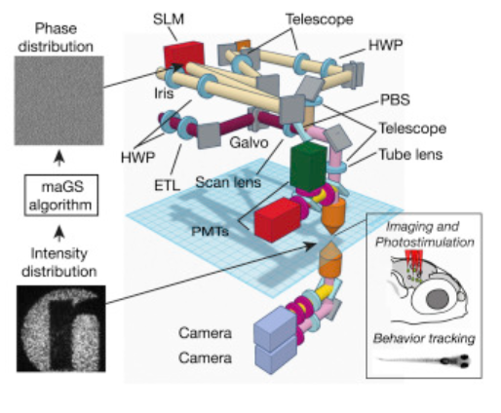
The advent of large-scale neural recordings
Optical recordings through fluorescence imaging
Dal Maschio, M., Donovan, J. C., Helmbrecht, T. O., & Baier, H. (2017). Linking neurons to network function and behavior by two-photon holographic optogenetics and volumetric imaging. Neuron, 94(4), 774-789.
Michele Allegra Intrinsic dimension and neural activity May 2022

Slide 18
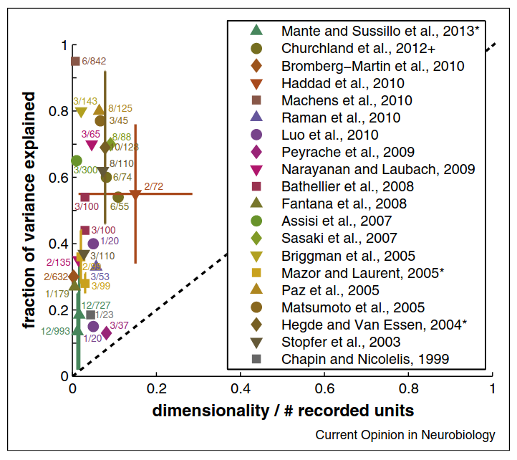
Low dimensionality of neural codes
In many experiments the intrinsic dimension is much smaller than the number of recorded neurons
Gao, P., & Ganguli, S. (2015). On simplicity and complexity in the brave new world of large-scale neuroscience. Current opinion in neurobiology, 32, 148-155.
Michele Allegra Intrinsic dimension and neural activity May 2022

Slide 19
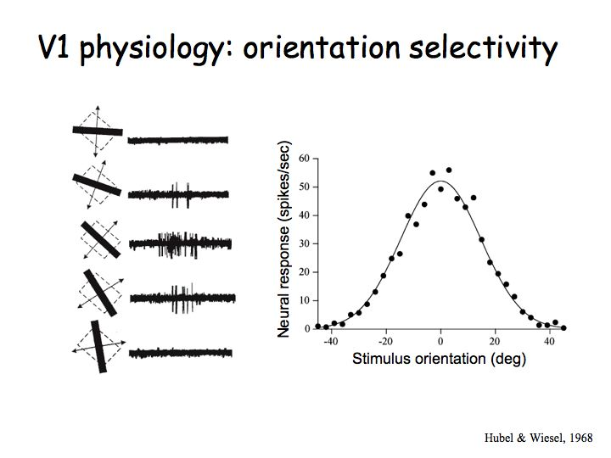
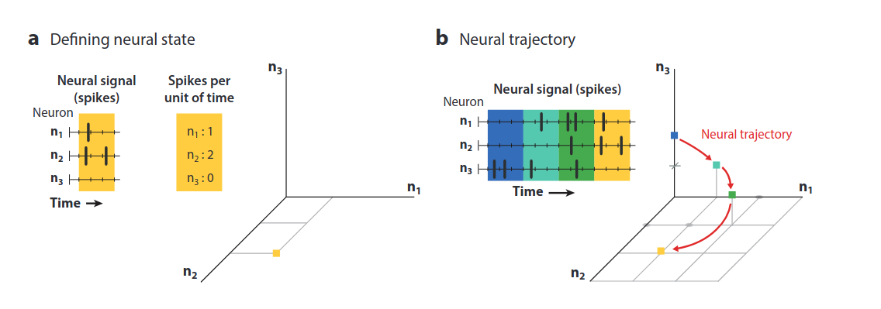
Computation through neural population dynamics
Neuron code: single neurons represent and process specific features (‘selectivity’)
Information processing is performed through trajectories in neural space
Vyas, S., Golub, M. D., Sussillo, D., & Shenoy, K. V. (2020). Computation through neural population dynamics. Annual Review of Neuroscience, 43, 249-275.
Michele Allegra Intrinsic dimension and neural activity May 2022

Slide 20
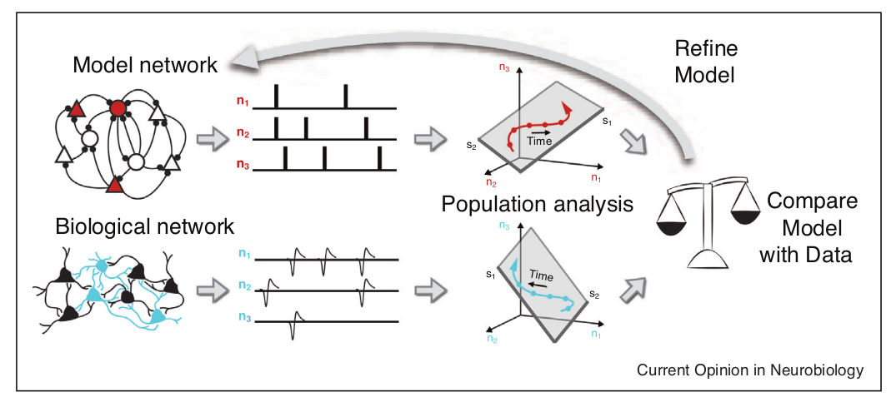
Computation through neural population dynamics
The dimensionality depends on the computational structure of the task and can be predicted through artificial recurrent neural networks
Williamson, R. C., Doiron, B., Smith, M. A., & Byron, M. Y. (2019). Bridging large-scale neuronal recordings and large-scale network models using dimensionality reduction. Current opinion in neurobiology, 55, 40-47..
Convergence between biological and artificial network at the level of low-dimensional dynamics
Michele Allegra Intrinsic dimension and neural activity May 2022

Slide 21
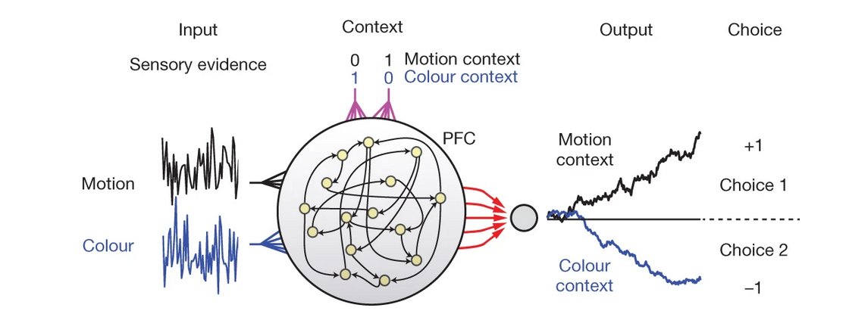
Artificial neural network models
Maass, W., Natschlager, T. & Markram, H. Real-time computing without stable states: a new framework for neural computation based on perturbations. Neural Comput. 14, 2531–2560 (2002).
Mante, V., Sussillo, D., Shenoy, K. V., & Newsome, W. T. (2013). Context-dependent computation by recurrent dynamics in prefrontal cortex. nature, 503(7474), 78-84.
[The artificial neural network models can be thought of as models of a sufficiently downstream areas where decision making occurs]
Michele Allegra Intrinsic dimension and neural activity May 2022

Slide 22
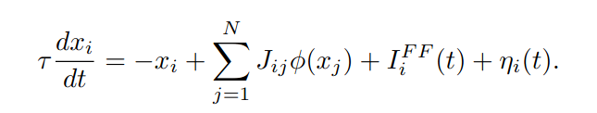
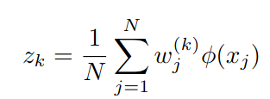

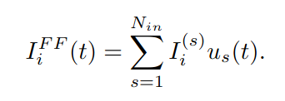
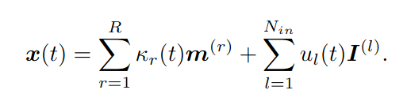
What determines the dimensionality of neural code?
1) The minimum dimensionality is determined by task computational structure
Intrinsic connectivity and input patterns determine the dimensionality in recurrent neural networks
Dubreuil, A., Valente, A., Beiran, M., Mastrogiuseppe, F., & Ostojic, S. (2020). Complementary roles of dimensionality and population structure in neural computations. Biorxiv.
Beiran, M., Dubreuil, A., Valente, A., Mastrogiuseppe, F., & Ostojic, S. (2021). Shaping dynamics with multiple populations in low-rank recurrent networks. Neural computation, 33(6), 1572-1615.
dynamics
readout
low rank connectivity
d=R+Nin
Michele Allegra Intrinsic dimension and neural activity May 2022

Slide 23
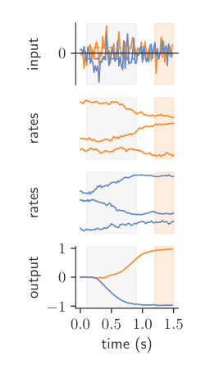
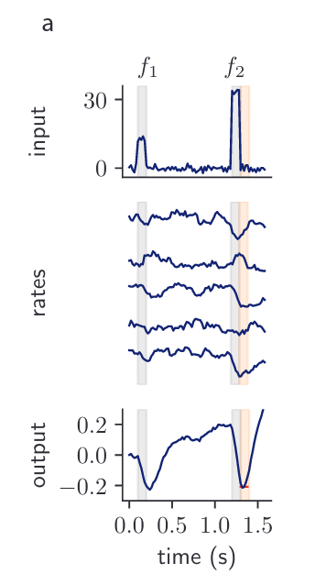
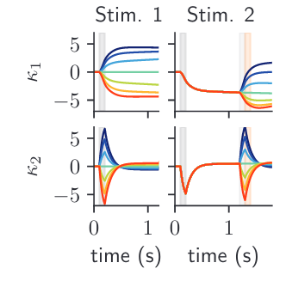
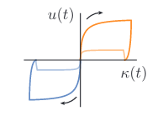
What determines the dimensionality of neural code?
1) The minimum dimensionality is determined by task computational structure
The dimensionality depends on task complexity
Perceptual decision making d=2
Parametric working memory d=3
Dubreuil, A., Valente, A., Beiran, M., Mastrogiuseppe, F., & Ostojic, S. (2020). Complementary roles of dimensionality and population structure in neural computations. Biorxiv.
Michele Allegra Intrinsic dimension and neural activity May 2022

Slide 24
What determines the dimensionality of neural code?
2) Dimensionality is related to readout simplicity
Rigotti, M., Barak, O., Warden, M. R., Wang, X. J., Daw, N. D., Miller, E. K., & Fusi, S. (2013). The importance of mixed selectivity in complex cognitive tasks. Nature, 497(7451), 585-590.
In principle a space of dimension can store Nc = 2^{d} binary inputs
M inputs could be stored in d ~ log2M
However, if d ~ M each input becomes easily readable
Even if final readout is low-dimensional, partial steps may require higher dimensionality for easy readout by downstream neurons
Michele Allegra Intrinsic dimension and neural activity May 2022

Slide 25
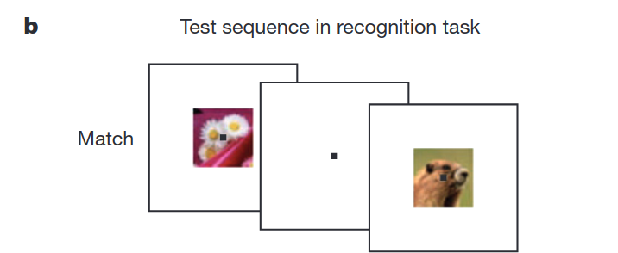
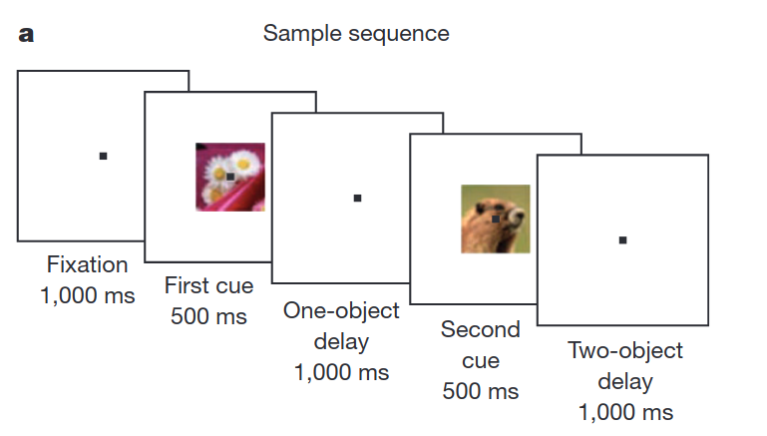
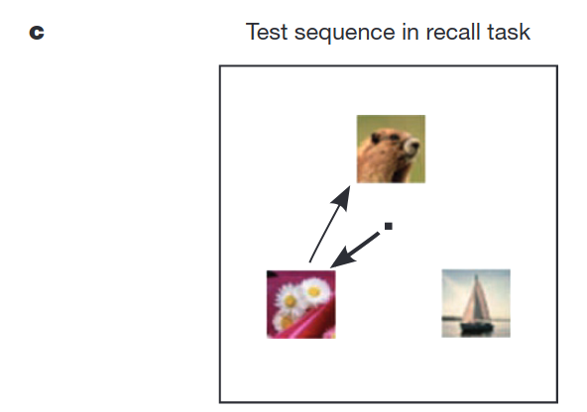
What determines the dimensionality of neural code?
Rigotti, M., Barak, O., Warden, M. R., Wang, X. J., Daw, N. D., Miller, E. K., & Fusi, S. (2013). The importance of mixed selectivity in complex cognitive tasks. Nature, 497(7451), 585-590.
Delayed match-to-sample task with recall/readout
Conditions: Stim1 (4) x Stim(3) x task type(2)
Michele Allegra Intrinsic dimension and neural activity May 2022

Slide 26
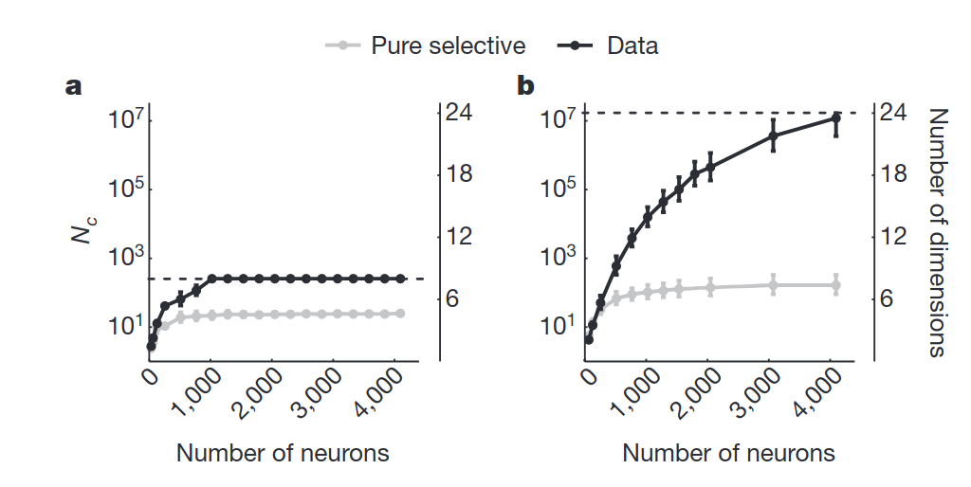
What determines the dimensionality of neural code?
Rigotti, M., Barak, O., Warden, M. R., Wang, X. J., Daw, N. D., Miller, E. K., & Fusi, S. (2013). The importance of mixed selectivity in complex cognitive tasks. Nature, 497(7451), 585-590.
Conditions: Stim1 (4) x Stim(3) x task type(2)
In principle d=5 is sufficient to encode condition
d=8 if linear responses to each stimulus (linear selectivity)
neural activity has dimension d=24
Michele Allegra Intrinsic dimension and neural activity May 2022

Slide 27
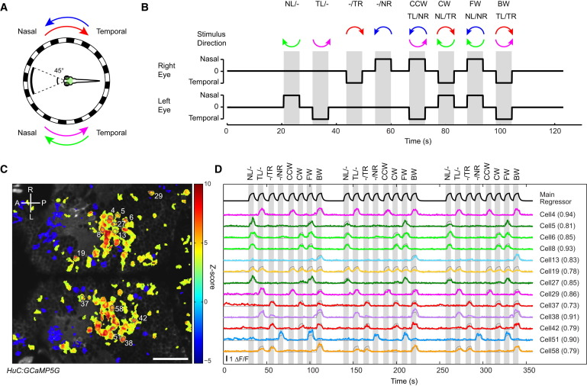
Dimension of neuron activity in zebrafish
Dimensionality is related to readout
Kubo, F., Hablitzel, B., Dal Maschio, M., Driever, W., Baier, H., & Arrenberg, A. B. (2014). Functional architecture of an optic flow-responsive area that drives horizontal eye movements in zebrafish. Neuron, 81(6), 1344-1359.
Michele Allegra Intrinsic dimension and neural activity May 2022

Slide 28
Second part: program sketch
Michele Allegra Bayesian estimation of the intrinsic dimension of data ISBA 2021
Collect whole-brain neural activity of D. rerio during visuomotor task
Compute ID of neural activity and its spatial variations across regions
Compare temporal ID variations across task/rest and investigate whether ID modulates task performance
Replicate task in recurrent neural network
Compare ID in biological network and in artificial network
...

Slide 29






Acknowledgements
Alex Rodriguez
Alessandro Laio
Elena Facco
Elena Facco
Antonietta Mira
Marco Dal Maschio
Pietro Rotondo
Michele Allegra Intrinsic dimension and neural activity May 2022

Slide 30





Acknowledgements
Sebastian Goldt
Michele Allegra Intrinsic dimension and neural activity May 2022

Slide 31
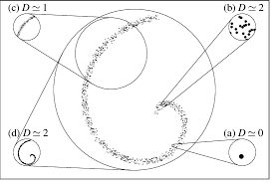
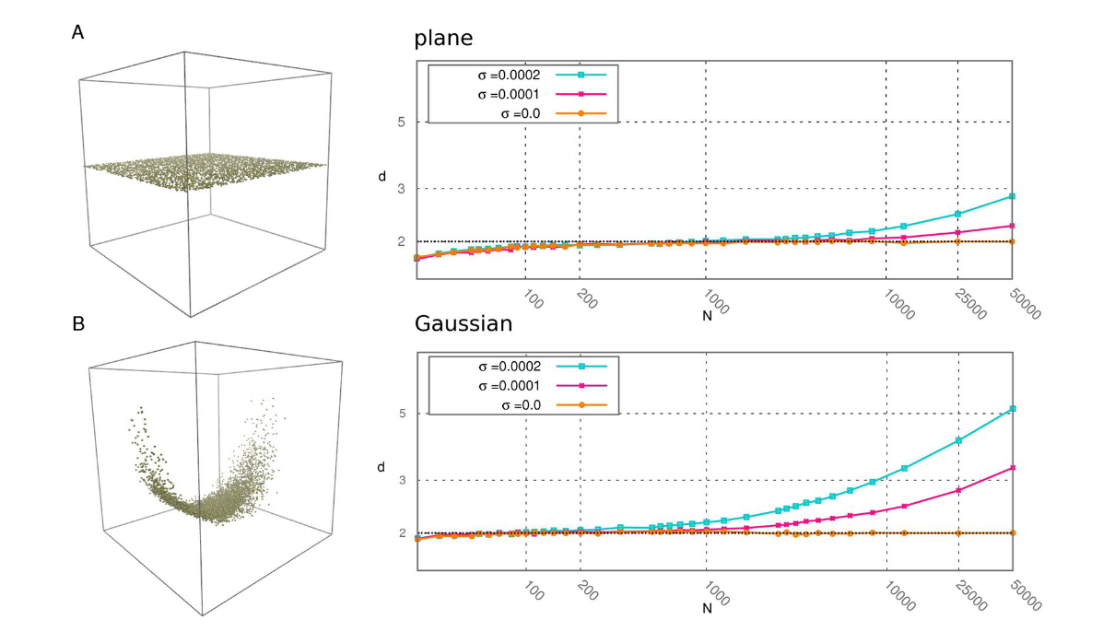
ID estimation: scale dependence
Michele Allegra Intrinsic dimension and neural activity May 2022

