Slide 1
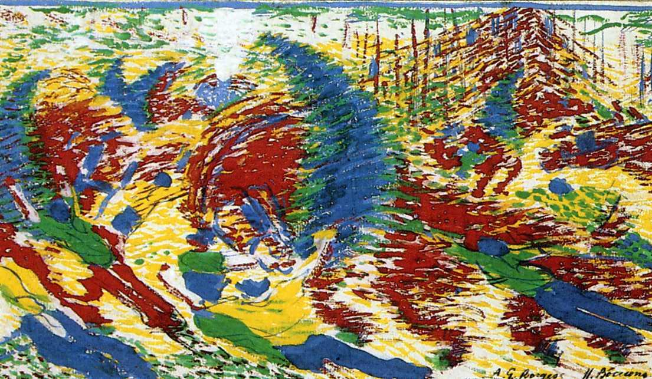
Dynamic connectivity clusters reflect progressive learning and fast strategy shifts
Michele Allegra Dynamic connectivity clusters AMU January 2018
Michele Allegra

Slide 2
Outline of the talk
Michele Allegra Dynamic connectivity clusters AMU January 2018
CDPC: A method to find connectivity clusters in fMRI
              Density Peak Clustering (DPC): the basics
              Applying DPC to fMRI: Coherence DPC
An application of CDPC to a task with two strategies
              Clustering frequency
              Effects of learning and strategy-switching

Slide 3

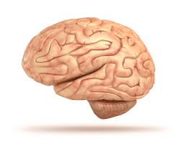

Identifying short-term activity patterns
Michele Allegra Dynamic connectivity clusters AMU January 2018
Original idea: identify brain activity patterns associated to non-non-repeatable cognitive events
Example: find brain areas co-activated in finding solution of complex problem
Goal: be able to identify patterns in fMRI data with high accuracy in short time windows (<30 s )

Slide 4
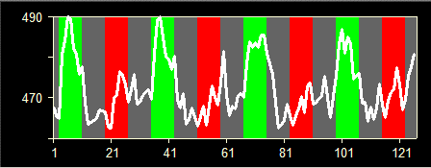
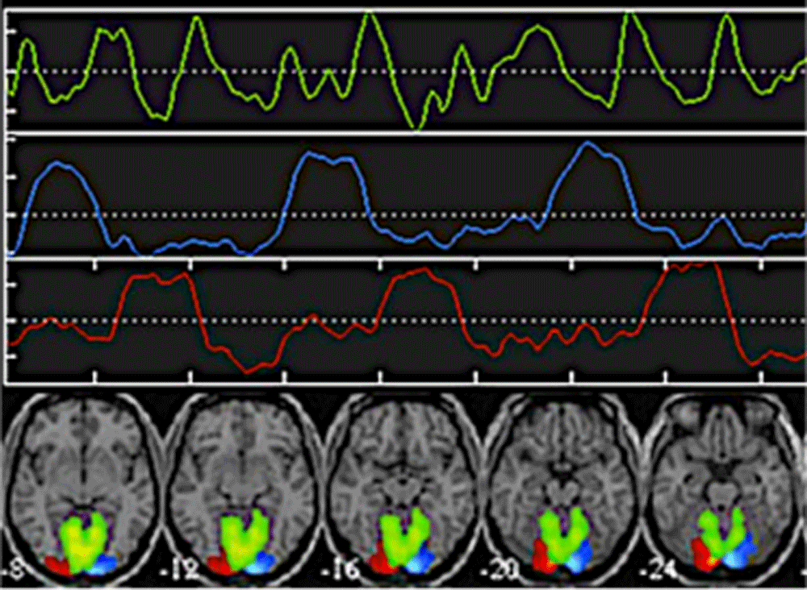
Identifying short-term activity patterns
Michele Allegra Dynamic connectivity clusters AMU January 2018
Supervised methods (GLM) need many repetitions and well-defined model (design matrix)
Unsupervised methods (ICA) may need long windows for reliable source identification
Try Density Peak Clustering, developed within our group [A Rodriguez, A Laio, Science 344, 1492 (2014)]
Idea: cluster BOLD time series of different voxels, finding groups of voxels with similar BOLD time-series (connectivity clusters)

Slide 5


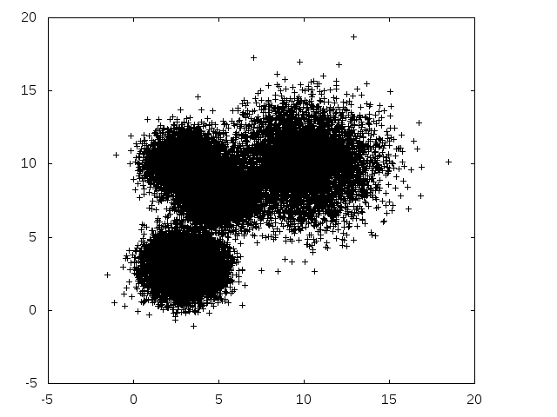
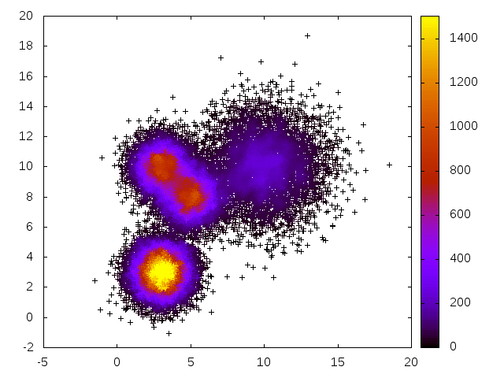
DPC(1): density-based clustering
Michele Allegra Dynamic connectivity clusters AMU January 2018
start from a metric dij that defines distances
reconstruct density around each data point i
[density = probability density from which data are sampled]
count # of points in ball or radius ε centered at i
.
density ρ

Slide 6
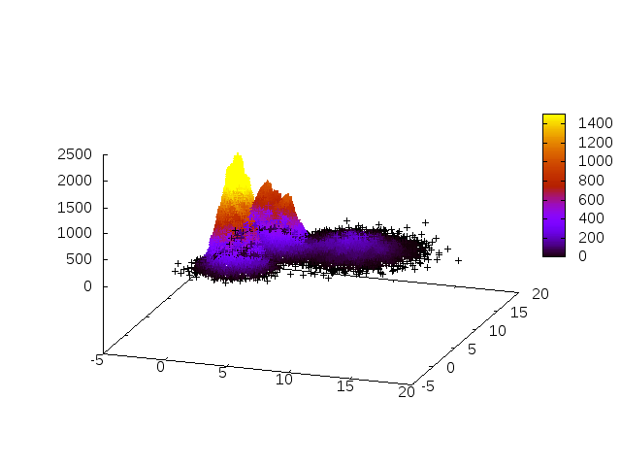
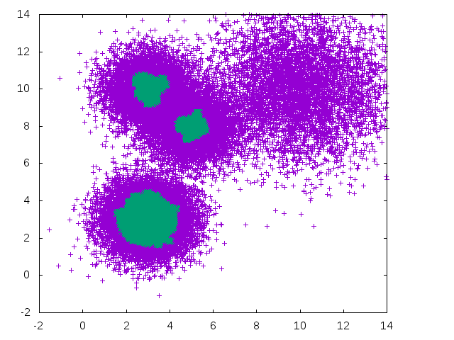
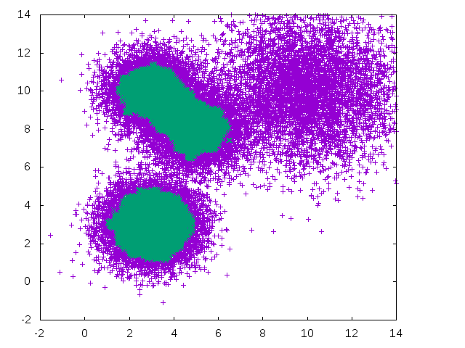
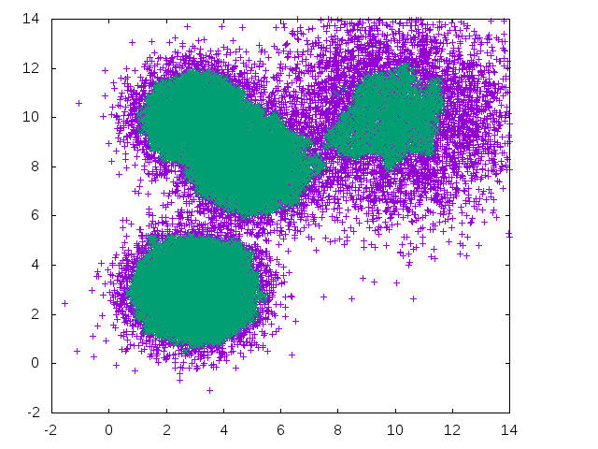
DPC(2): Density-based clustering
Michele Allegra Dynamic connectivity clusters AMU January 2018
Reconstruct the density
Standard algorithms (dbscan) identify clusters as disconnected regions of “high density”
What is high? Results depend on the chosen density threshold!
Cannot resolve structures at different density scales

Slide 7


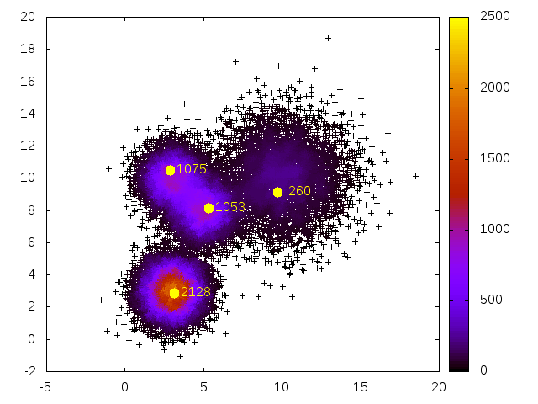
DPC (3): finding peaks
Michele Allegra Dynamic connectivity clusters AMU January 2018
Instead, one can associate a cluster to each density peak
Density peaks are local maxima in the density
Density peaks are far from any point with higher density
Compute for all points min distance from point at higher density
Peak are outliers in “decision graph”

Slide 8
DPC (4): assigning points
Michele Allegra Dynamic connectivity clusters AMU January 2018
Points are assigned to peaks by following a path of increasing density leading to one of the peaks.
Jump from one point to nearest point with higher density

Slide 9
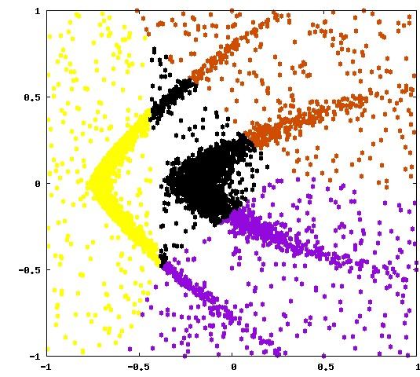
DPC (5): assigning points
Michele Allegra Dynamic connectivity clusters AMU January 2018
.
Non density-based clustering methods (e.g. K-means) typically assign point to nearest center, and can only find roughly spherical clusters
Density-based clustering methods allow to retrieve clusters of arbitrary shape
K-means
DPC

Slide 10
DPC (6): pros and cons
Michele Allegra Dynamic connectivity clusters AMU January 2018
Density peak clustering: a new clustering method
[Rodriguez and Laio, Science 2014]
Advantages:
Computationally cheap (no optimization involved)
Works well in high dimension (no embedding required, only distances)
Automatically finds number of relevant clusters
Finds clusters of arbitrary shape
Disadvantages:
Requires many data points (>100)
One free parameter (ε) [solved in improved version, but higly nontrivial!]
.

Slide 11
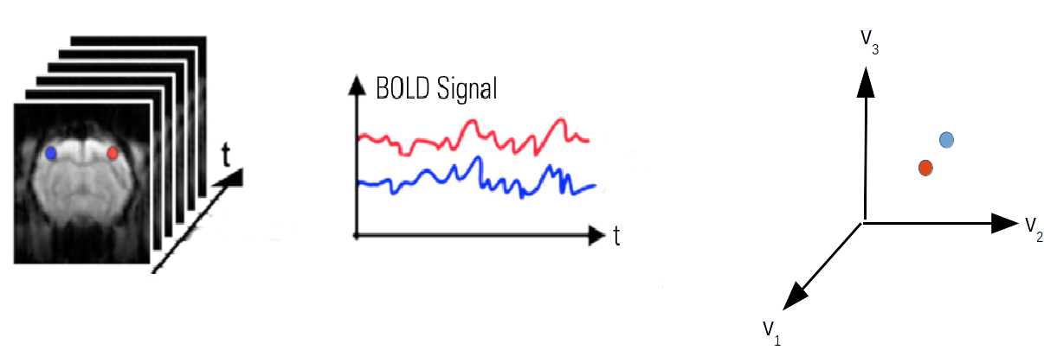
Applying DPC to fMRI
Allegra et al., Hum Brain Mapp 2017
Michele Allegra Dynamic connectivity clusters AMU January 2018
apply DPC in the space of BOLD time series
consider window of T frames
to each voxel corresponds a BOLD time series of T values, v1, v2, …, vT
consider T-dimensional space of time-series
each voxel time series is a point in this space
a cluster in this space is group of coherent voxels, i.e. with similar BOLD
we call such clustering Coherence Density Peak Clustering (CDPC)

Slide 12

CDPC: finding a metric
Michele Allegra Dynamic connectivity clusters AMU January 2018
first, we need a metric dij to define the distance between BOLD signals of voxels i and j.
simplest candidate: Euclidean metric
remove average and normalize amplitude

Slide 13
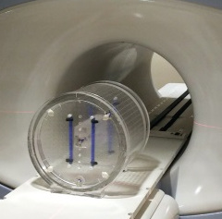

CDPC: filtering noise
Michele Allegra Dynamic connectivity clusters AMU January 2018
Where do we “cut” clusters? Can we use a lower threshold on ρ?
Problem: applying the method on imaging phantom, we find high values of ρ (comparable to real data) Noise can be (highly) coherent
in real images strong coherence between spatially close voxels, in phantom no (sparse coherence)
Consider small sphere Si around each voxel i and compute “number of coherent neighbor voxels”
ni is low for phantom, high for real images

Slide 14

CDPC: filtering noise
Michele Allegra Dynamic connectivity clusters AMU January 2018
Assumption: coherence in a task induces coherence among small (possibly disconnected) regions, not isolated voxels
Let n0 be max ni found in phantom: use this as treshold on ni
Only voxels with ni > n0 are considered in the computation of ρ and assigned to clusters
This (empirical) noise filter removes spurious clusters in phantom and simulated data affected by high noise

Slide 15
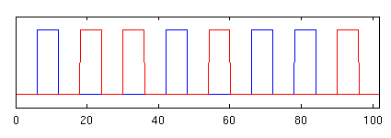


Simple validation of CDPC: motor experiment
Michele Allegra Dynamic connectivity clusters AMU January 2018
First test in motor experiment (alternative trials left/right clenching, visually cued)
Can we reconstruct activity patterns in single trials?
Apply CDPC to short time windows (~12 volumes, ~20 s) corresponding to single clenching trials

Slide 16
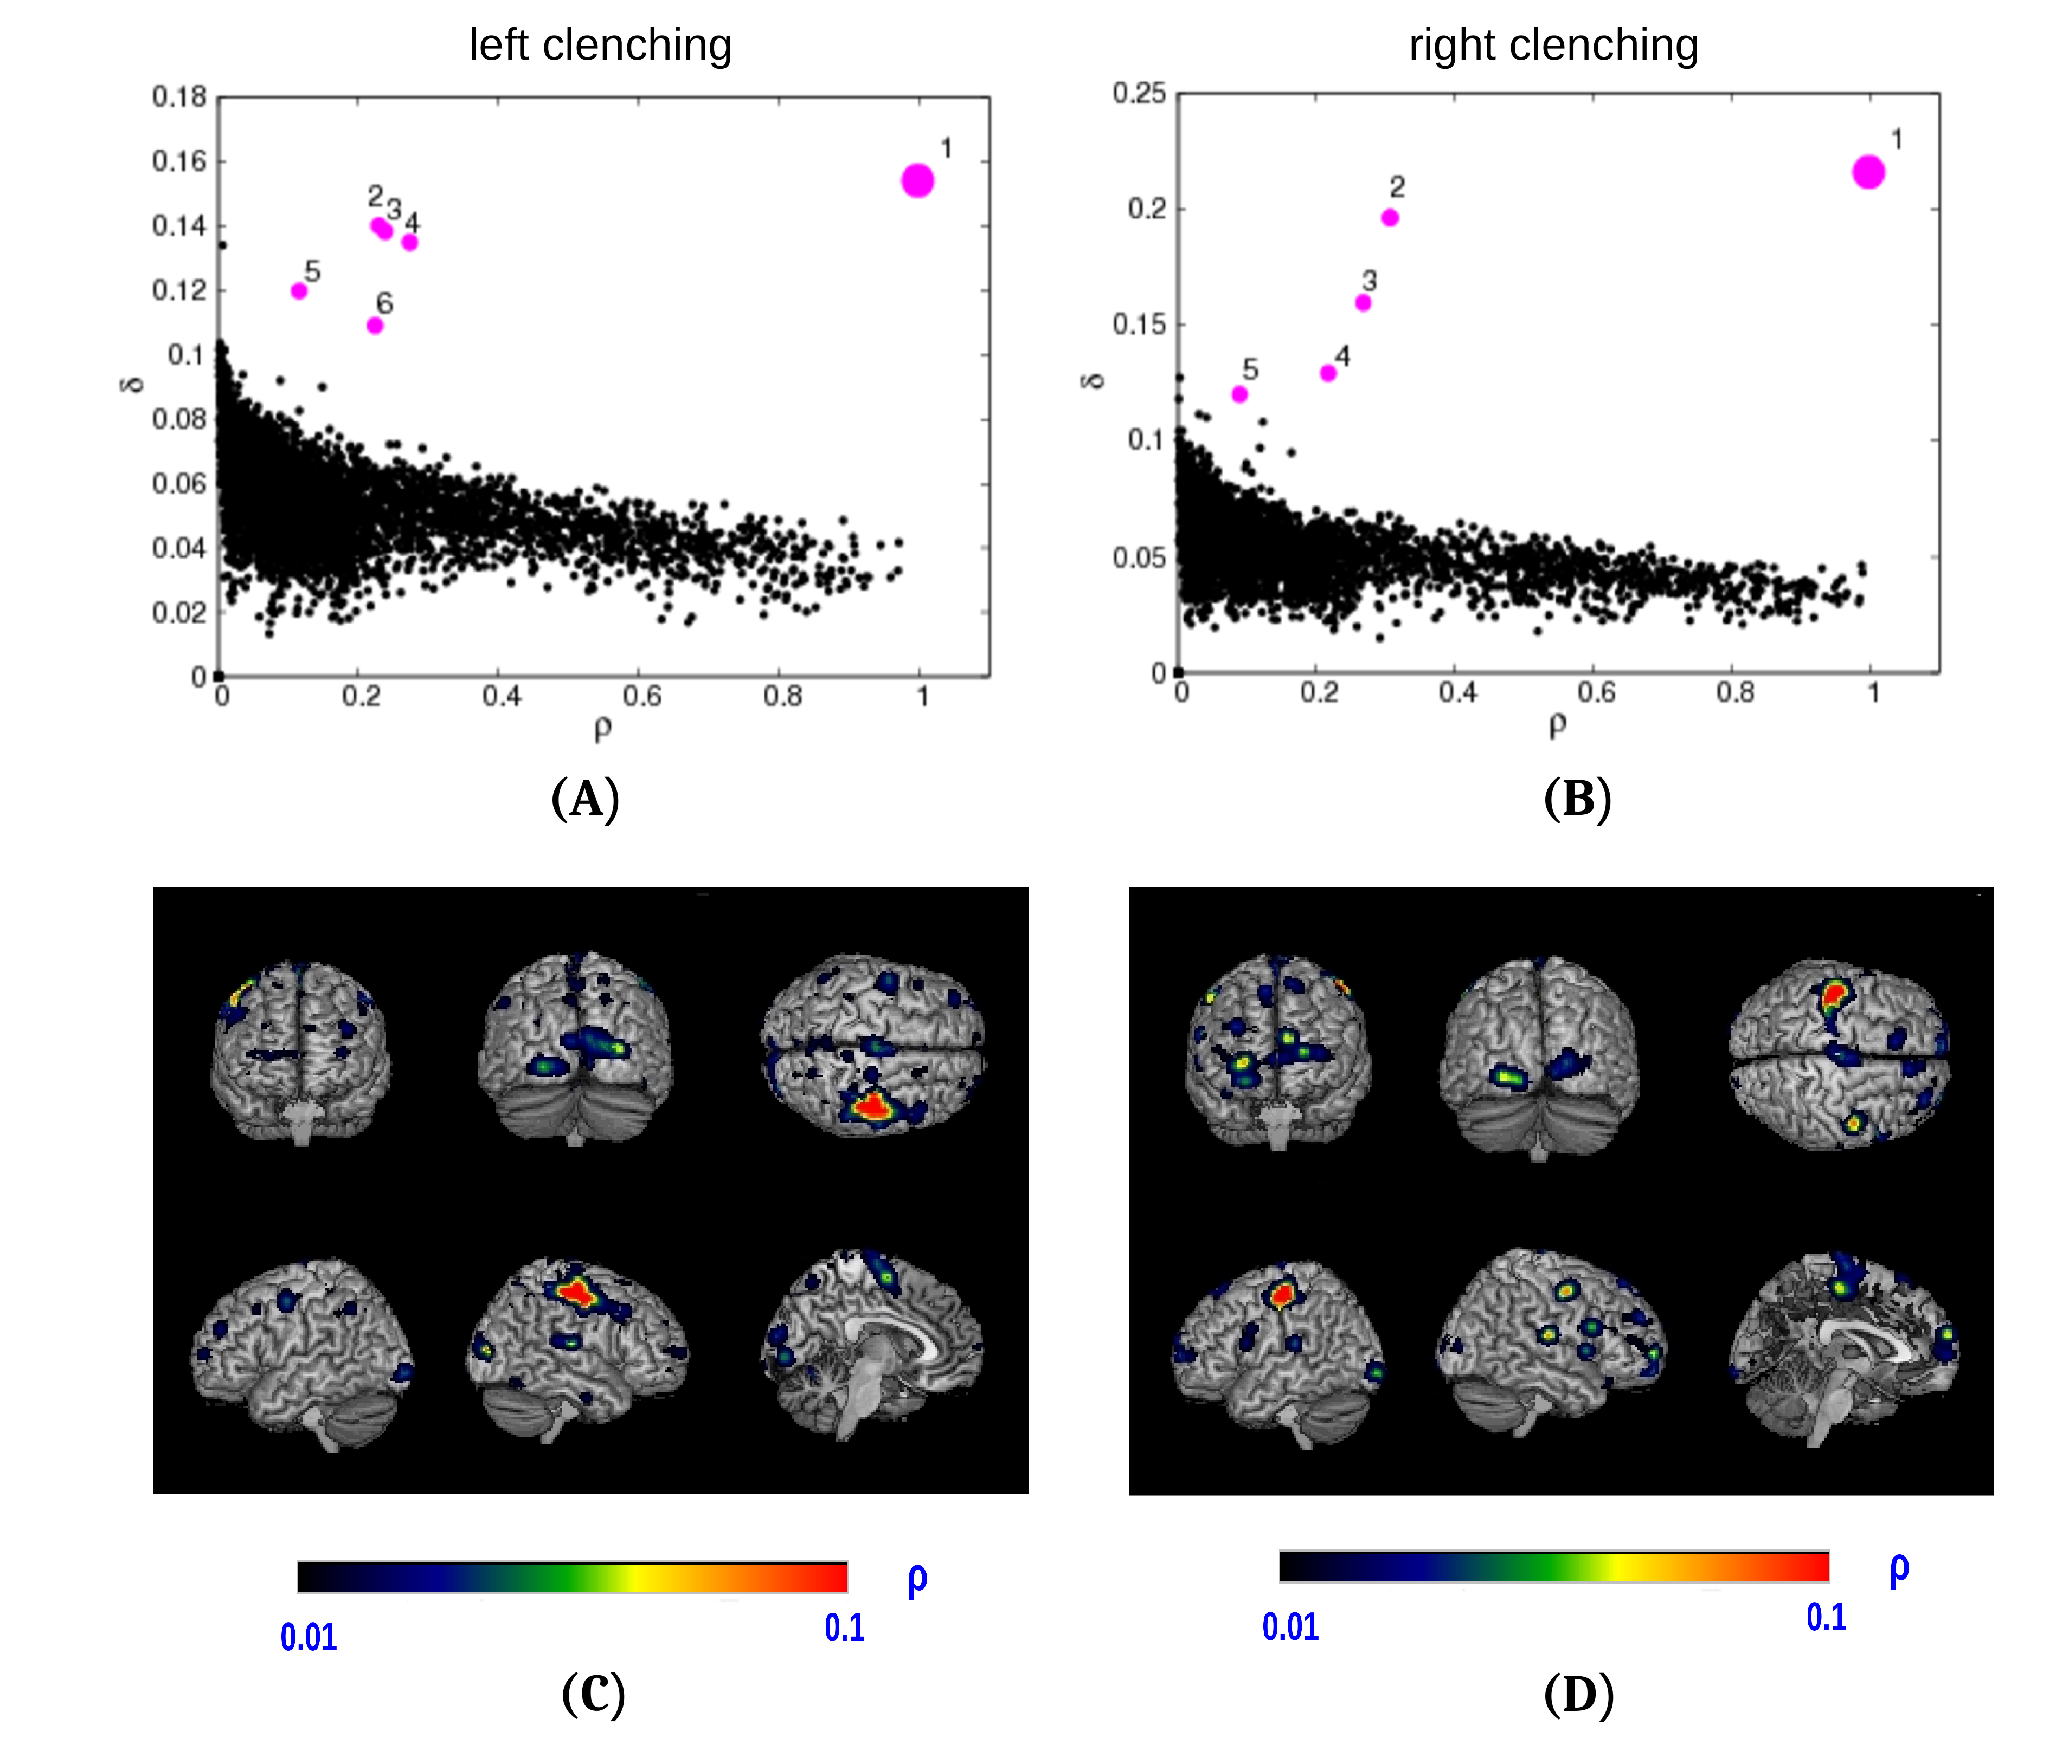
Simple validation of CDPC: motor experiment
Michele Allegra Dynamic connectivity clusters AMU January 2018
In window corresponding to left/right clenching trial we find main cluster including right/left motor cortex
The cluster also includes part of occipital cortex (clenching was visually cued)

Slide 17
Simple validation of CDPC: motor experiment
M. Allegra et al., Hum Brain Mapp 38 (3), 1421 (2017)
Michele Allegra Dynamic connectivity clusters AMU January 2018
Results:
Proof-of-principle of coherent pattern detection in single trials
Accurate retrieval of coherent patterns, little noise even in single subjects and short time windows
Results are consistent over subjects
Limitations:
No null model to perform inference on clustering results
Two free parameters (ni and ε)

Slide 18
Many windows together: clustering frequency map
Michele Allegra Dynamic connectivity clusters AMU January 2018
With CDPC we can in principle retrieve connectivity in single trials
Looking at several time windows we can track dynamic connectivity in a task
Apply CDPC on running windows of ~20 s (scans 1-12,2-13,...)
This allows to detect transient coherence, different from global coherence over all windows

Slide 19

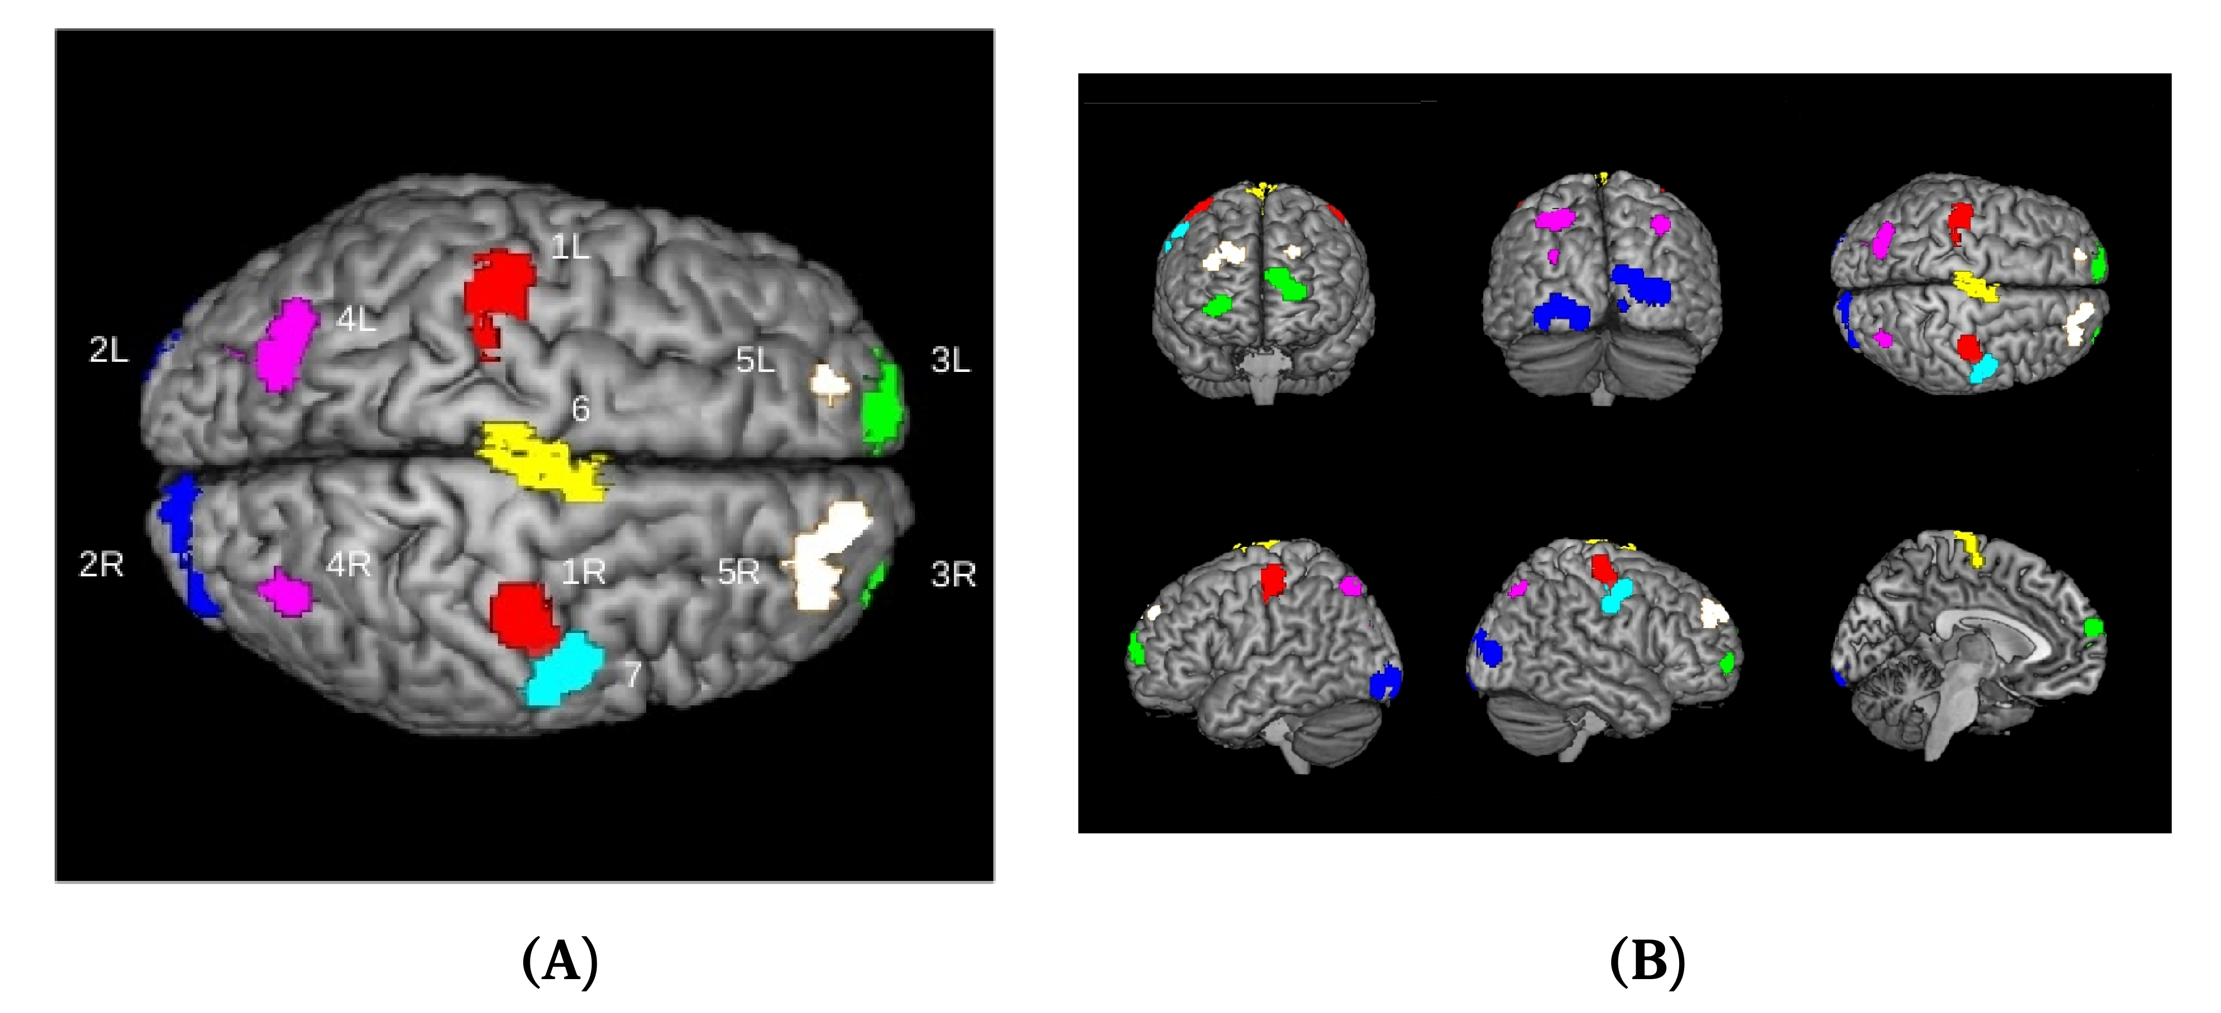
Many windows together: clustering frequency map
Michele Allegra Dynamic connectivity clusters AMU January 2018
Hypothesis: a brain area participating to the task will be often involved in coherent clusters
Put together many windows: Clustering frequency map
# windows where voxel i is clustered
High-Φ regions for the motor experiment reflect areas involved in the task: motor, parietal, visual, frontal

Slide 20
Applying CDPC to more complex experiments
Michele Allegra Dynamic connectivity clusters AMU January 2018
Q1: by means of the clustering frequency map Φ, can we find areas involved in a task?
If yes, CDPC may be used to find task-relevant areas without supervision
Q2: for a task with several sessions, can we track variations in the functional response by looking at how Φ varies in different sessions?
If yes, CDPC may be used to track learning and task-switching effects
A: we try to apply CDPC to a task where there is both progressive learning and a sudden behavioral shift,
re-analysis of paper by NW Schuck et al. Neuron 86.1 (2015): 331

Slide 21
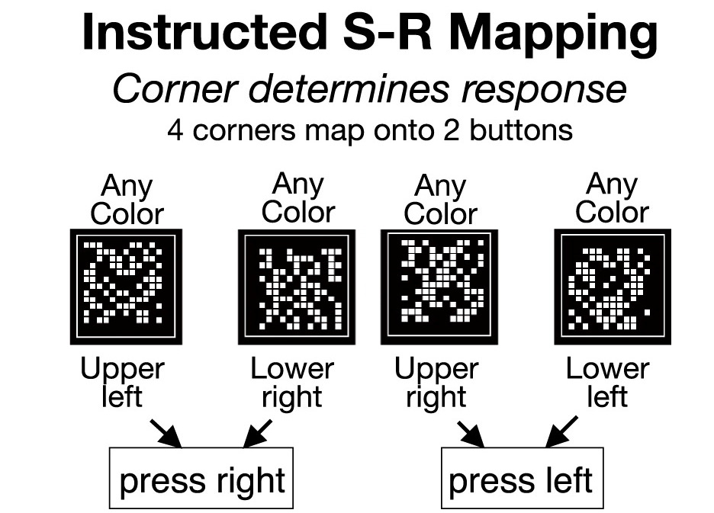
A task with two strategies
Michele Allegra Dynamic connectivity clusters AMU January 2018
At each trial, subjects are shown a cloud of dots inside a square
Visual stimulus has two features: corner (position of dots closer to one corner of the square) and color (color of dots, rd or green)
“Judge in which corner of the frame the little squares are. The squares are colored and can be either red or green”

Slide 22
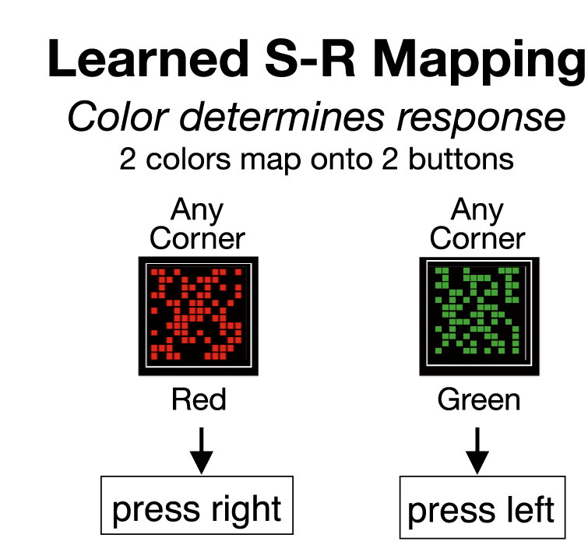
A task with two strategies
Michele Allegra Dynamic connectivity clusters AMU January 2018
There are 12 runs of 5 min each; in each run, ~180 trials
Instructed S-R mapping requires effort: 4-2 mapping, conflict when corner is contralateral to button
without telling participants, starting from third run a perfect color-corner correlation is introduced, so that UL/LR are always red and UR/LL always green
Then an alternative, cheaper strategy based on color becomes possible

Slide 23


A task with two strategies
Michele Allegra Dynamic connectivity clusters AMU January 2018
11/36 subjects (“color users”) spontaneously realize correlation and switch to color strategy in the mid of the experiment
The switch can be identified with a temporal resolution of 0.5 run (1 block) based on several behavioral markers, e.g. drop in RT, drop in error rate, ...
25/36 subjects (“corner users”) continue to rely on corner information, and are told about the correlation before last two runs

Slide 24
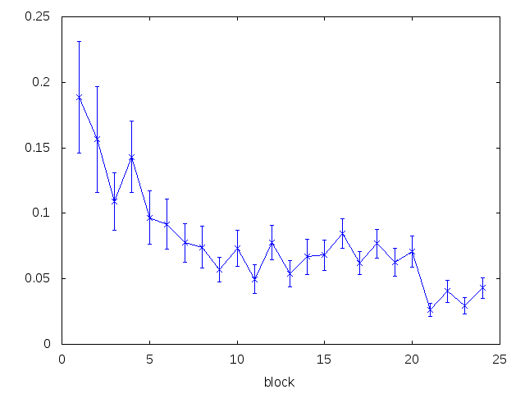
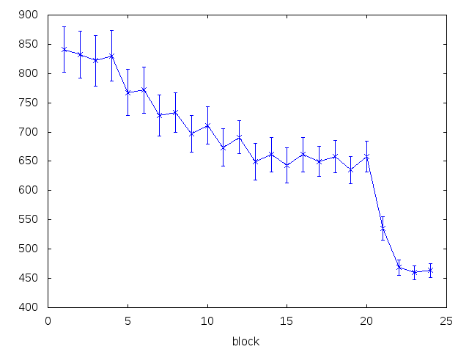
A task with two strategies
Michele Allegra Dynamic connectivity clusters AMU January 2018
Both color and corner users exhibit learning effects:
Progressive drop in RT and error rate in corner phase
Sudden drop in RT and error rate in the (spontaneous or instructed) switch to color phase
error rate
mean reaction times

Slide 25
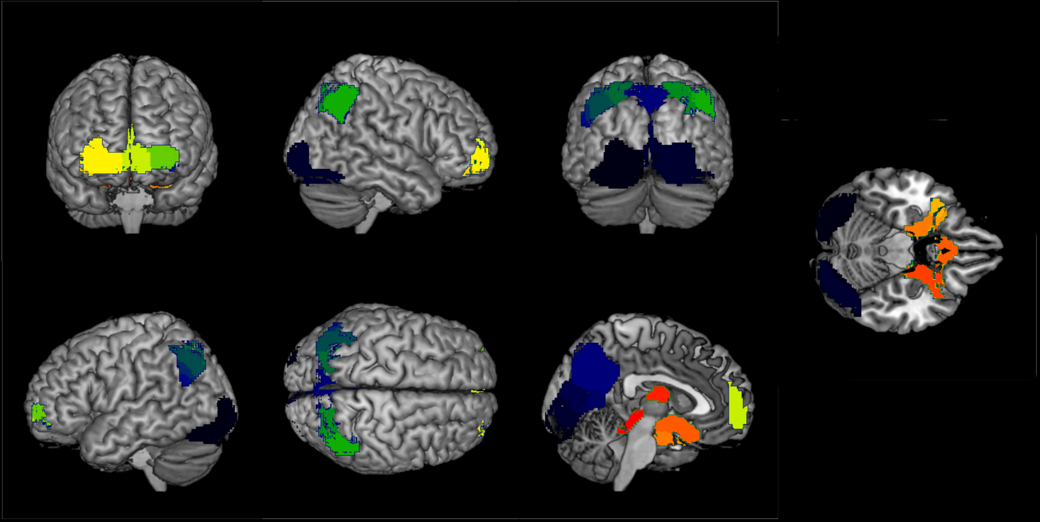
CDPC results (1): average Φ
Michele Allegra Dynamic connectivity clusters AMU January 2018
Allegra et al., in preparation (2018)
we compute Φ for gray matter voxels and use max value found as cutoff for Φ map
we obtain set of “high-Φ regions” comprising occipital, parietal, and frontal regions, plus deep region in temporal lobe

Slide 26
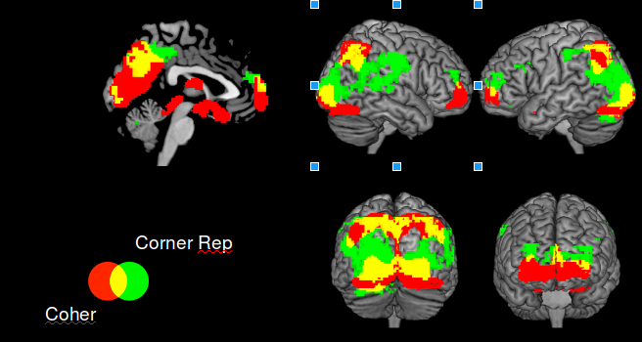
CDPC results (1): average Φ
Michele Allegra Dynamic connectivity clusters AMU January 2018
Original work (Schuck et al.) focused on corner and color encoding areas (mVPA)
high-Φ regions (found completely without supervision) largely overlap with regions found by mVPA (highly supervised)

Slide 27
CDPC results (2): changes in Φ
Michele Allegra Dynamic connectivity clusters AMU January 2018
how does Φ vary with run?
increase in Φ when subject is performing corner strategy, sudden decrease followed by increase after transition to color
effect concentrated in parietal cortex and precuneus

Slide 28
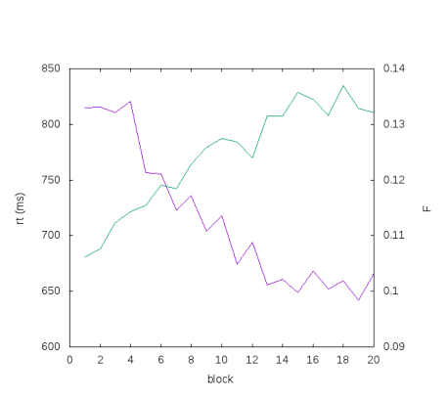
CDPC results (2): changes in Φ
Michele Allegra Dynamic connectivity clusters AMU January 2018
During incremental learning in corner phase, increase in in parietal and precuneus
Φ increase is correlated with decrease in RT

Slide 29
CDPC results (2): changes in Φ
Michele Allegra Dynamic connectivity clusters AMU January 2018
During instructed switch to color, sudden decrease in Φ in parietal and precuneus
Same effect in spontaneous switch, although much weaker (lower stats?)

Slide 30


CDPC: coherence networks
Michele Allegra Dynamic connectivity clusters AMU January 2018
Clustering frequency Φ represents average involvement of voxel in the clusters (any clusters)
Given pair of voxels, how often are they in the same cluster?
Compute “frequency of co-clusterization” for pair of voxels
Average over pair of regions A,B:
use high-Φ regions
This gives a pairwise network structure representing the average short-term connectivity between two regions

Slide 31
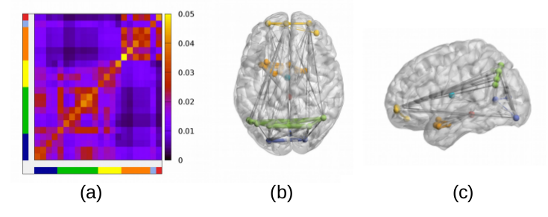
CDPC: coherence networks
Michele Allegra Dynamic connectivity clusters AMU January 2018
Strong links between parietal, occipital and frontal
Deep regions are isolated

Slide 32
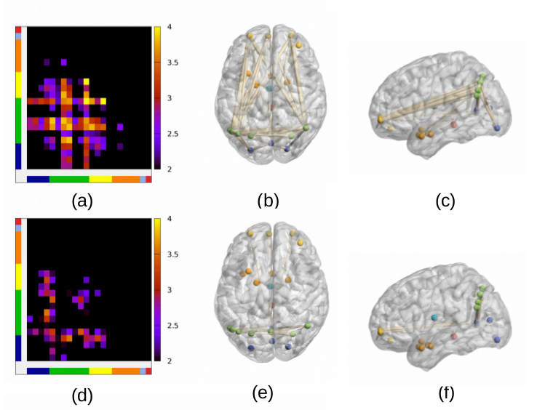
CDPC: coherence networks
Michele Allegra Dynamic connectivity clusters AMU January 2018
Increase in parietal-parietal links, frontal-parietal links during incremental learning

Slide 33
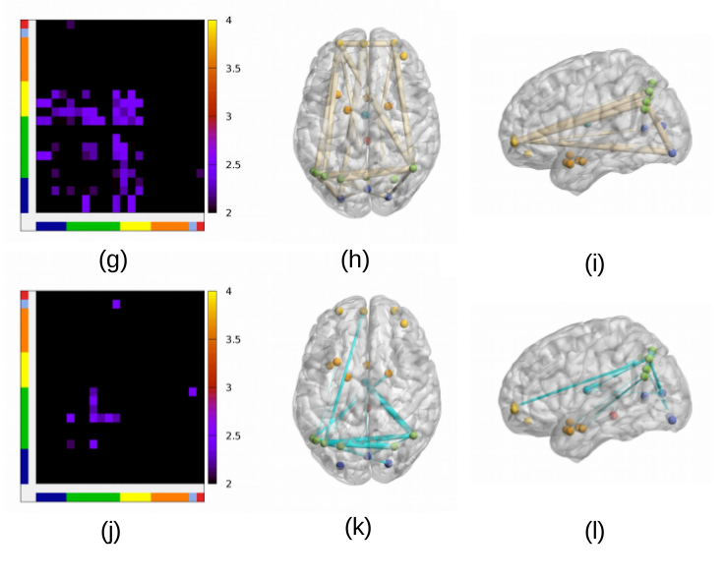
CDPC: coherence networks
Michele Allegra Dynamic connectivity clusters AMU January 2018
Decrease in parietal-parietal links, frontal-parietal links during strategy switch

Slide 34
Global summary:
Michele Allegra Dynamic connectivity clusters AMU January 2018
We developed CDPC, an fMRI analysis method based on the recently introduced Density Peak Clustering
The method can find groups of voxels with similar activation time series even in sort windows and single subjects
CDPC can be used with sliding windows approach to find a clustering frequency map (Φ) that represents areas that are recurrently involved in coherent patters in a task
CDPC is promising tool to find task-relevant regions in fully unsupervised way
Variations of Φ can be related to incremental learning and sudden
behavioral shifts in a task with two strategies
Task-relevant areas seem to become more synchronized during incremental learning, while such synchronization is disrupted by the strategy change

Slide 35
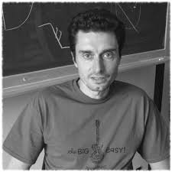
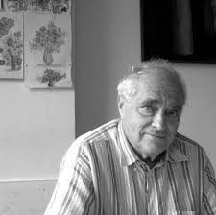


Acknowledgments
Michele Allegra Dynamic connectivity clusters AMU January 2018
Alessandro Laio
Daniele Amati
Shima Seyed-Allaei
Carlo Reverberi

Slide 36
Contact: micheleallegra85@gmail.com
Michele Allegra Dynamic connectivity clusters AMU January 2018

Slide 37
Michele Allegra Dynamic connectivity clusters AMU January 2018

Slide 38
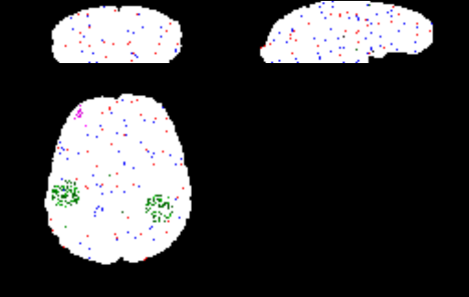
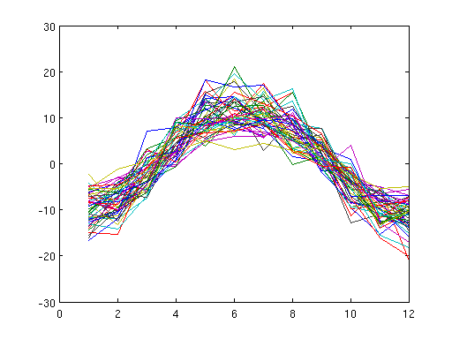
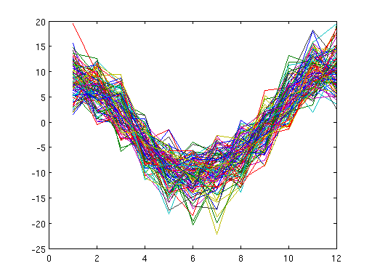
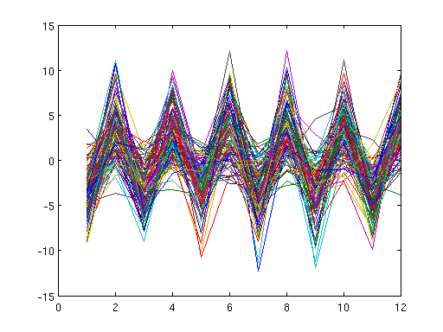
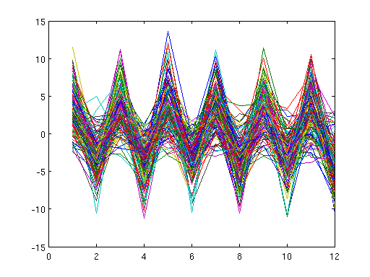
CDPC: simulation
Michele Allegra Dynamic connectivity clusters AMU January 2018
Two real clusters plus noise
Cluster 3
signal
Cluster 4
signal
Cluster 1
noise
Cluster 2
noise

Slide 39
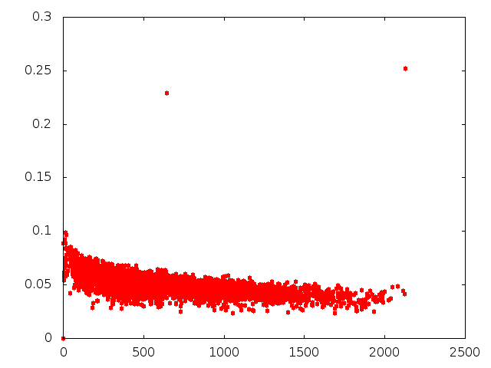
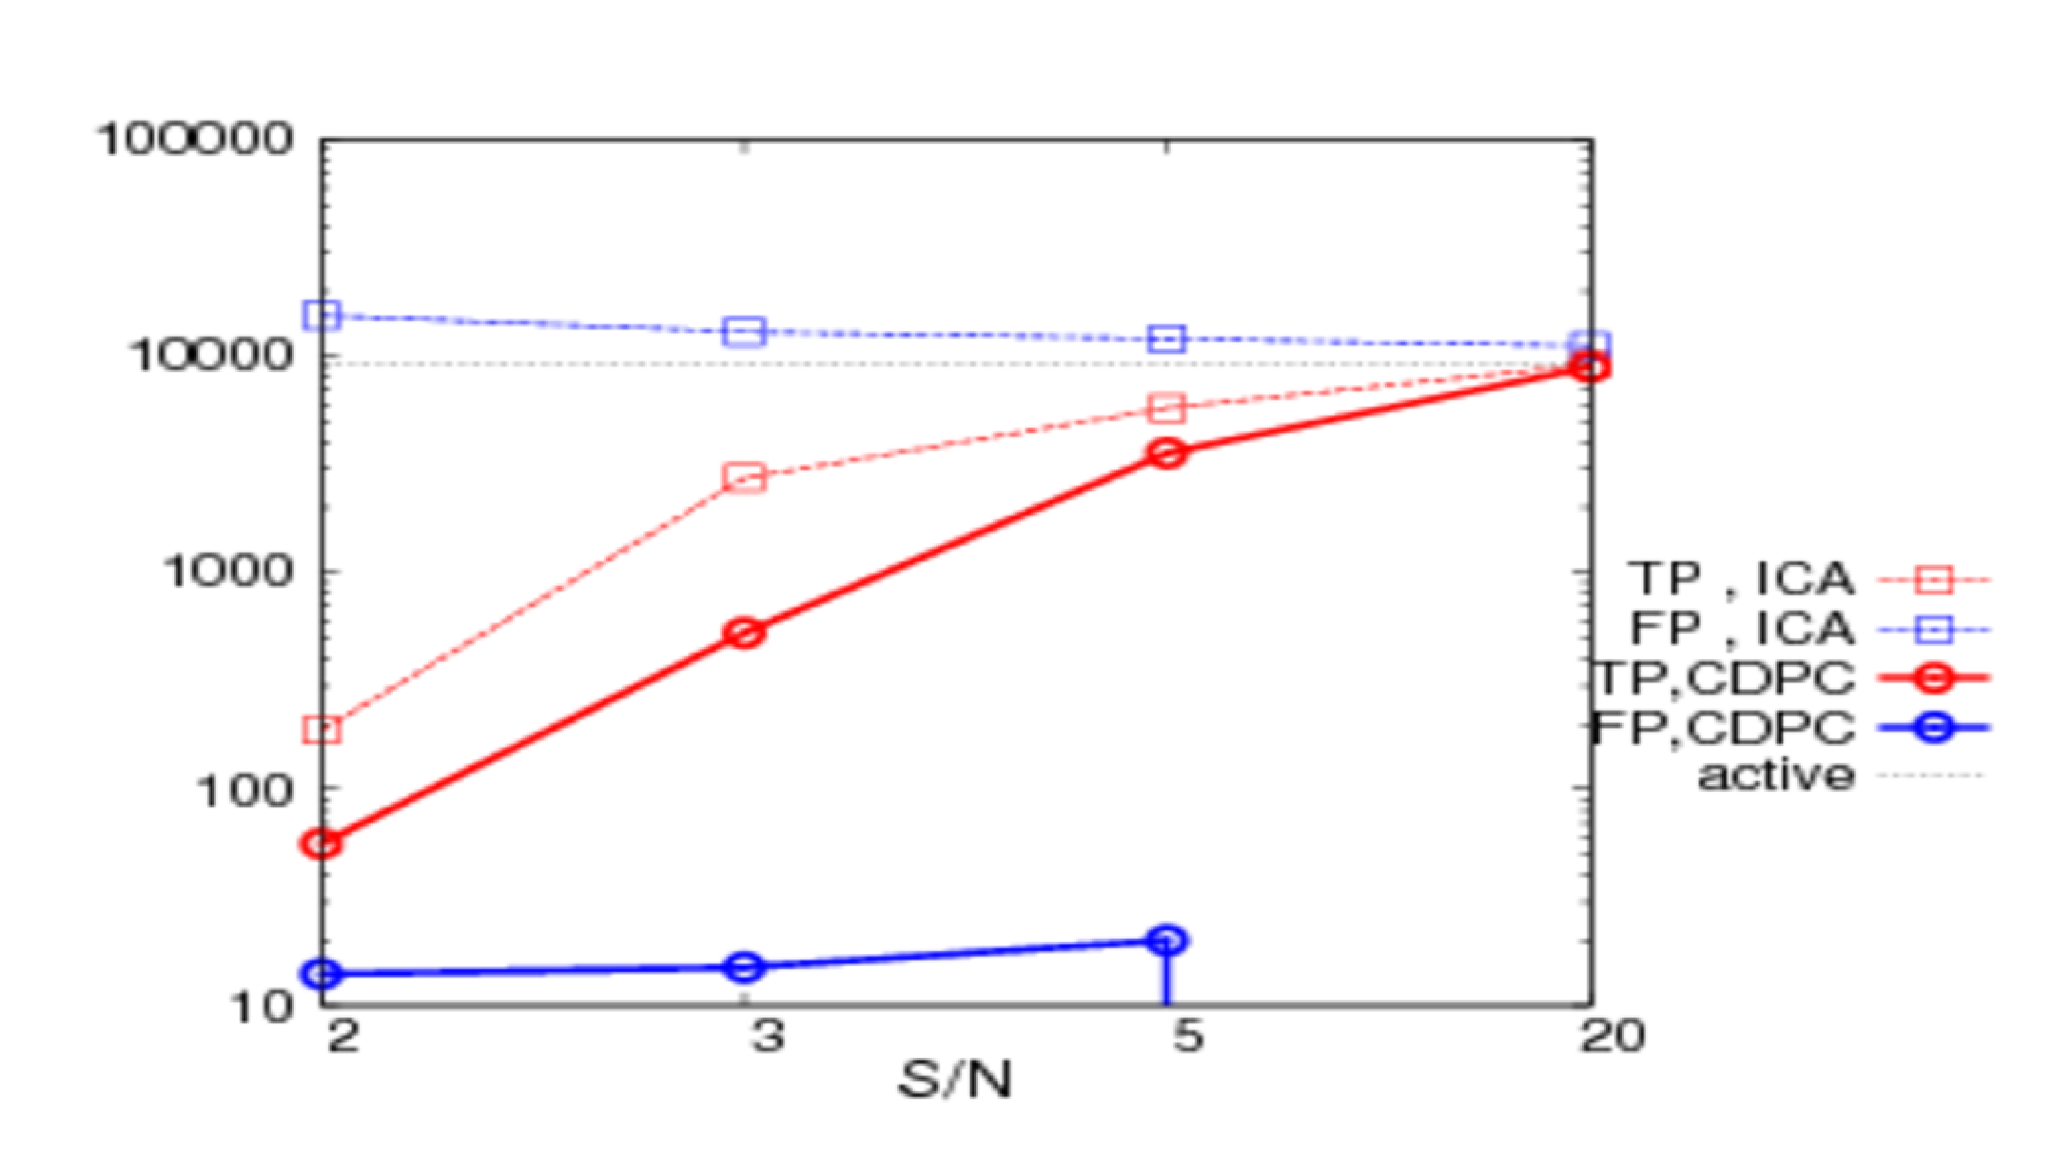
CDPC: simulation
Michele Allegra Dynamic connectivity clusters AMU January 2018
No noise filter
After noise filter
Comparison with ICA

Slide 40
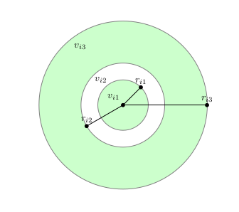



Density Estimation: PAk
Michele Allegra Dynamic connectivity clusters AMU January 2018
K-nearest-neighbor: Assume ρ ≈ const in small region around each point
For each point i, consider its k nearest neighbors at
distances
density= k/volume of sphere containing the k points
Two problems:
1) what is right k?
2) what is right d?

Slide 41
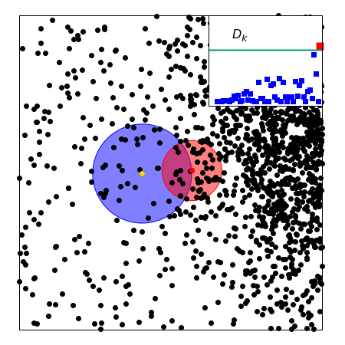
Density Estimation: Pak
Michele Allegra Dynamic connectivity clusters AMU January 2018
what is right k?
k too small: large error in the estimate
k too large: density is not constant over V
Solution:
Adapt k to each point so that the constant density assumption always holds
Pointwise Adaptive k-NN (PAk) estimator
A Rodriguez, M D’Errico, E Facco, A Laio, JPC (2018)

Slide 42
Density Estimation: PAk
Michele Allegra Charting high-dimensional data spaces SISSA January 2018
K-nearest-neighbor: Assume ρ ≈ const in small region around each point
For each point i, consider its k nearest neighbors at
distances
density= k/volume of sphere containing the k points
Two problems:
1) what is right k?
2) what is right d?

Slide 43
Density Estimation: PAk
Michele Allegra Charting high-dimensional data spaces SISSA January 2018
what is right k?
k too small: large error in the estimate
k too large: density is not constant over V
Solution:
Adapt k to each point so that the constant density assumption always holds
Pointwise Adaptive k-NN (PAk) estimator

