Slide 1

Michele Allegra
The intrinsic dimension of the data (and its use)
Michele Allegra The intrinsic dimension of the data and its use CINaM, November 2019

Slide 2
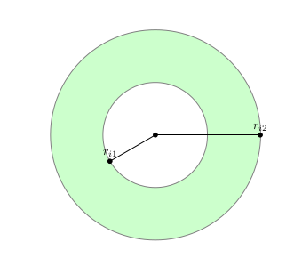



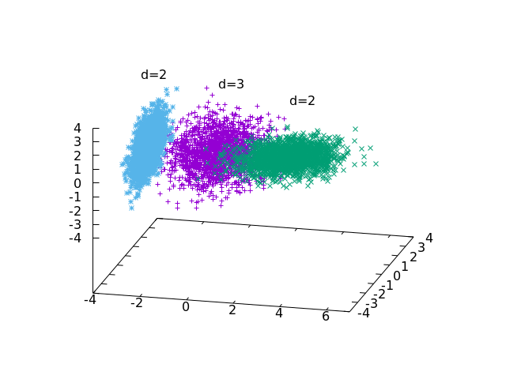

Overview
Michele Allegra The intrinsic dimension of the data and its use CINaM, November 2019
The intrinsic dimension of a dataset
The TWO-NN approach for ID estimation
The case of variable ID
Applications: molecular dynamics
and density estimation

Slide 3
Intrinsic dimension
Michele Allegra The intrinsic dimension of the data and its use CINaM, November 2019
Data are defined in a space with D variables
However, the data lie on hypersurface of lower (Euclidean) dimension d < D
This dimension is called intrinsic dimension

Slide 4
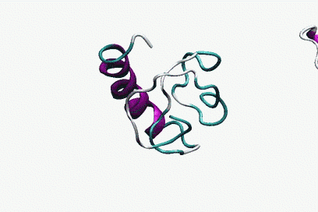
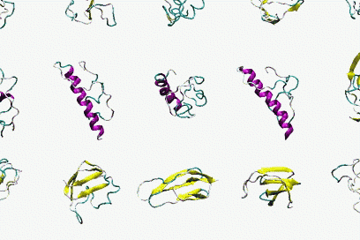
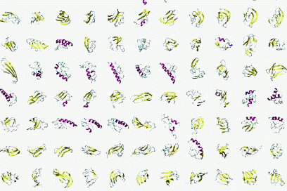
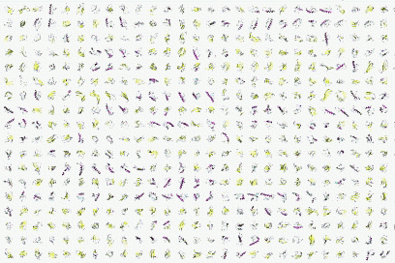


Intrinsic dimension
The state of a molecule is described by 6N variables
Michele Allegra The intrinsic dimension of the data and its use CINaM, November 2019
6xN
Due to soft and hard constraints, the system “moves” only in some phase space directions
Independent directions are d << 6N

Slide 5

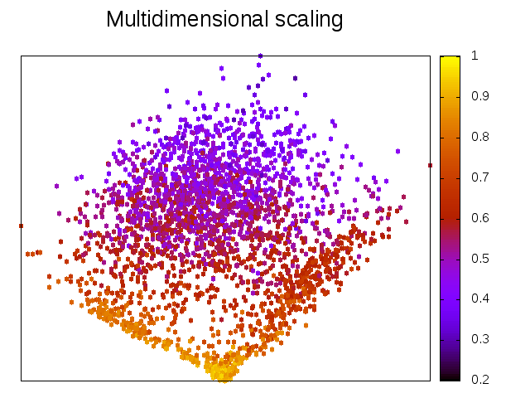
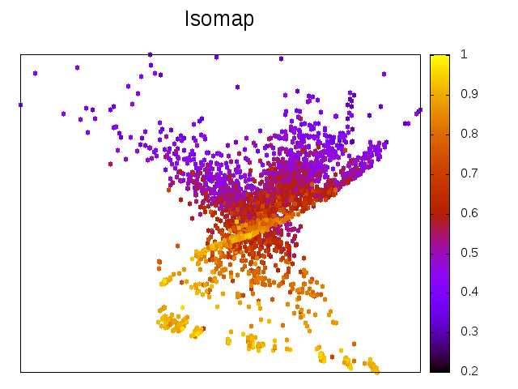
Example: phase space landscape of folding protein
We can try to project the data in 2D with several methods
Fraction of native contacts
The resulting maps can be quantitatively (and qualitatively) inaccurate
Michele Allegra The intrinsic dimension of the data and its use CINaM, November 2019
consider a MD of unfolding/refolding villing headpiece
for each of the N ~ 32000 configurations, D=32 dihedral angles.

Slide 6




ID estimation: projective approach
Michele Allegra The intrinsic dimension of the data and its use CINaM, November 2019
Project D-dimensional data into lower dimension d :
Try different d and evaluate for each a “loss function”
measures the “data loss” occurring in the projection. Examples:
preservation of original distance relations
preservation of original covariance matrix
ID estimate based on tradeoff between dimensionality reduction and data loss
Problem (1): Computationally burdensome (search for optimal projection for each d)
Problem (2): robust ID estimates only if has large gap as a function of d
if no gap, the estimation can be rather arbitrary

Slide 7

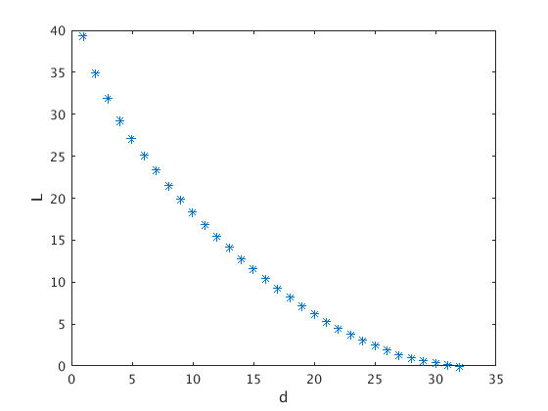
ID estimation: projective approach
Michele Allegra The intrinsic dimension of the data and its use CINaM, November 2019
Example: Principal Component Analysis (PCA)
Projects data onto linear subspace spanned by first d eigenvalues of
covariance matrix. Loss:
On the villin headpiece simulation:
How can one select an appropriate d?

Slide 8
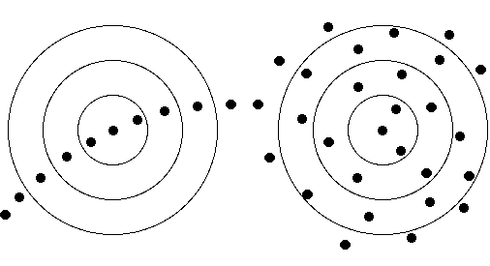
ID estimation: statistical approach
Michele Allegra The intrinsic dimension of the data and its use CINaM, November 2019
assumes that the data are sampled from a distribution with density ρ(X)
distances between points in the dataset follow a scaling law that depends
on ρ(X) and d
If the dependence on ρ(X) could be removed, then d could be estimated from
the scaling
Example: correlation dimension (Grassberger & Procaccia, PRL 50, 1983)
        The number of nearest neighbors at distance <ε from point i scales as
        If ρ(X) is constant, Ni(ε)~ρε^{d}
        d can be estimated with simple linear fit
However, when ρ(Xi) is variable the estimation can fail
        Ni(ε)~ρ(Xi)ε^{d}

Slide 9
ID estimation: TWO-NN
Michele Allegra The intrinsic dimension of the data and its use CINaM, November 2019
E Facco, M D’Errico, A Rodriguez, A Laio, Scientific Reports 7, 12140 (2017)
Assume that the density is locally constant and use local scaling (Levina & Bickel, Adv. Neu. Inf. Proc. Sys. 2005)
TWO-NN: estimating the ID in case of (strongly) variable density
Make two broad assumptions:
H1) the data points xi are independent samples from a density ρ(x).
H2) local uniformity: ρ(x) ~ const. in the region containing the first 2 neighbors of xi
ri1,ri2 distances of 1st and 2nd neighbor of point i
μi=ri2/ri1 follows a Pareto distribution: P(μ)=dμ^{-d}
The distribution of μ depends only on d

Slide 10
ID estimation: TWO-NN
Michele Allegra The intrinsic dimension of the data and its use CINaM, November 2019
1) Poisson sampling (valid id N is large)
P(n points in A) = (ρVA)^{n}(1-ρVA)^{N-n} ~ (ρVA)^{n}/n! exp(-ρVA)
2) Consider first two neighbors of i and hyperspherical shells Si1 and Si2
with volumes Vi1 and Vi2
3) Derive probability density of the shell volumes from Poisson sampling
P(Vi1>V)=P(0 points in Si1)= exp(-ρV) → P(Vi1≤V)=1-exp(-ρV) → f(Vi1) = ρ exp(-ρVi1)
4) Derive probability of μi=ri2/ri1
f(Vi1,Vi2)=ρ² exp(-ρVi1-ρVi2) → f(Vi2/Vi1)=1/(1+Vi2/Vi1)²
(Vi2/Vi1)=(ri2/ri1)^{d}-1 → f(ri2/ri1)=d/(ri2/ri1)^{d+1}
Si2
Si1

Slide 11
ID estimation: TWO-NN
Michele Allegra The intrinsic dimension of the data and its use CINaM, November 2019
ri1,ri2 distances of 1st and 2nd neighbor of point i
μi=di2/di1 follows a Pareto distribution: P(μ)=dμ^{-d}
Fit the empirical cumulative distribution of the μi with F(μ)=1-μ^{-d}
Linear fit on log(1-F(μ))=-d logμ
fit log(1-Femp(μ)) with -d logμ

Slide 12
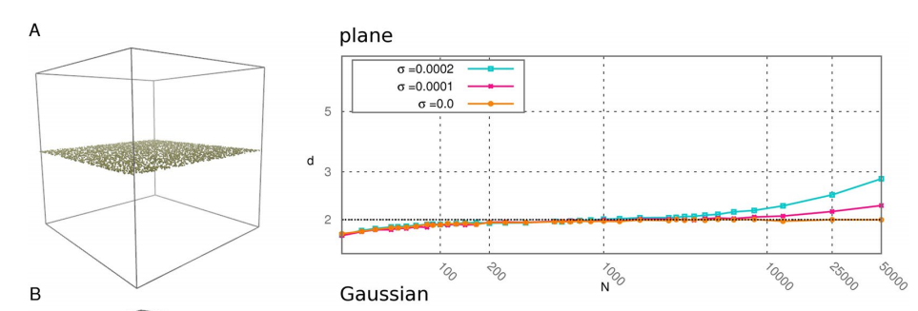
ID estimation: TWO-NN
Michele Allegra The intrinsic dimension of the data and its use CINaM, November 2019
The ID can depend on the scale at which we look at the system!
Explore different scales by decimating the data
The “effective” dimension is stable across wide range of scales

Slide 13
Michele Allegra The intrinsic dimension of the data and its use CINaM, November 2019
Application: dimensionality reduction
TWO-NN yields only an estimate of the intrinsic dimension
It does not yield a scheme for dimensionality reduction
(explicit parametrization in terms of low-dimensional set of coordinates
However, the ID estimate given by TWO-NN can be used
To select proper target dimension in dimensionality reduction methods
Project D-dimensional data into lower dimension d:

Slide 14
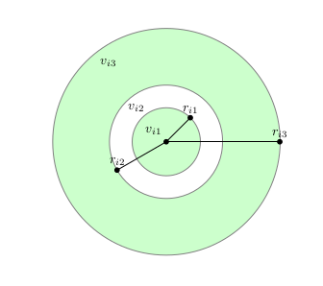



Michele Allegra The intrinsic dimension of the data and its use CINaM, November 2019
Application: density estimation
Rodriguez, A., d’Errico, M., Facco, E., & Laio, A. (2018) JCTC 14(3), 1206-1215.
K-nearest-neighbor estimate: assume ρ ≈ const in small region around each point
●
For each point i, consider its k nearest neighbors at
distances
●
density= k/volume of sphere containing the k points
What is right d? The intrinsic dimension of the manifold!
(… then optimize k locally)

Slide 15
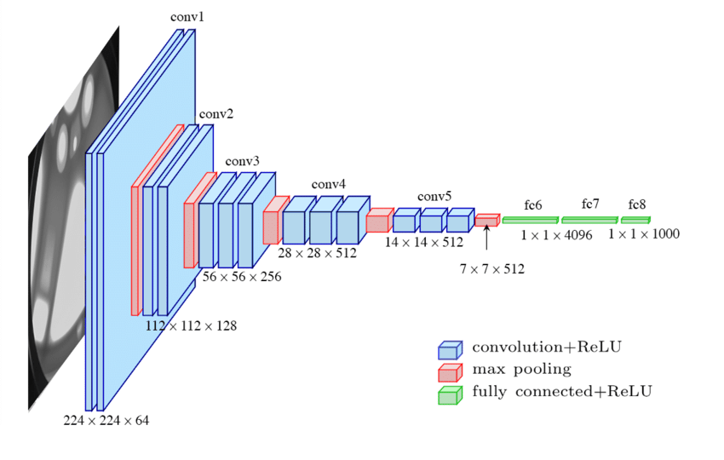
Michele Allegra The intrinsic dimension of the data and its use CINaM, November 2019
Application: dimension of data in neural networks
Ansuini, Alessio, et al. arXiv preprint arXiv:1905.12784 (2019).
Deep neural networks transform
their inputs across m
ultiple processing layers.
What are the geometrical properties
of the representations learned?
Representations should be relatively low-dimensional
Intuitively the dimension should decrease in successive layers
(the NN progressively eliminates irrelevant features)

Slide 16
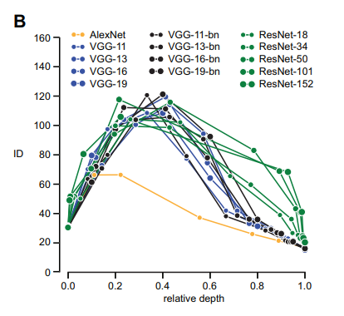
Michele Allegra The intrinsic dimension of the data and its use CINaM, November 2019
Application: dimension of data in neural networks
Ansuini, Alessio, et al. arXiv preprint arXiv:1905.12784 (2019).
Synthetic data-set of 1440 images of 40 objects
Train deep neural networks with different architectures (generally ~10⁶ units)
Representations are low dimensional (ID <100)
The ID first increases, then decreases as
function of the layer (depth)
The NN first eliminates “gross” features that
effectively dominate the ID at a large scale
Then NN progressively reduces “finer” features that
are irrelevant for prediction

Slide 17
The problem of multiple IDs
Michele Allegra The intrinsic dimension of the data and its use CINaM, November 2019
the data may lie on several manifolds, each with different ID
the data may lie on several manifolds, each with different ID
Simple example: just merge two datasets with different ID
Is this an artificial oddity or a common situation?

Slide 18

Extending TWO-NN to multiple IDs
Michele Allegra The intrinsic dimension of the data and its use CINaM, November 2019
TWO-NN assumptions:
H1) the data points xi are independent samples from a density ρ(x).
H2) local uniformity: ρ(x) ~ const. in the region containing the first 2 neighbors of xi
Additional assumption:
H3) the distribution ρ(x) has support on K manifolds with different IDs d=d1,…,dK
Under H1), H2), H3) the distribution of μ is simply a mixture of Pareto distributions

Slide 19




Extending TWO-NN to multiple IDs
Michele Allegra The intrinsic dimension of the data and its use CINaM, November 2019
Estimate parameters p,d with Bayesian approach
Fix
Compute posterior distribution
Average
to sample the posterior, we must introduce latent variables Z=Z1,…,ZK
manifold membership of each point
Estimate jointly d,p,Z by Gibbs Sampling of the posterior distribution

Slide 20
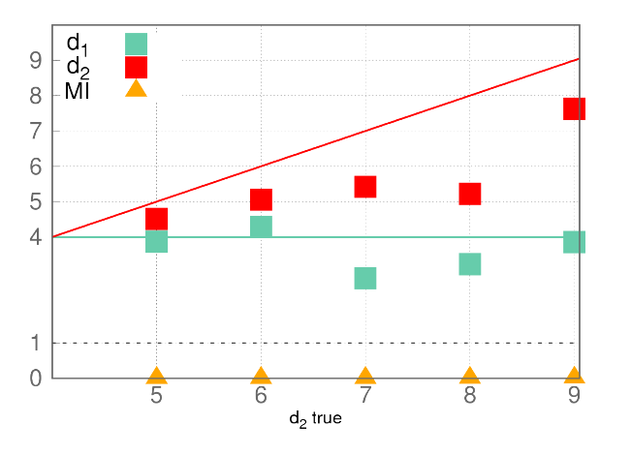
Extending TWO-NN to multiple IDs
Michele Allegra The intrinsic dimension of the data and its use CINaM, November 2019
Little problem: this approach does not work!
Two manifolds of dimension d1=4 and d2=5,..,9 (Gaussian ρ)
estimation of d1 and d2 is inaccurate
estimation of Z is completely wrong
(mutual information MI between true and estimated membership Z is 0)

Slide 21
Extending TWO-NN to multiple IDs
Michele Allegra The intrinsic dimension of the data and its use CINaM, November 2019
What is the problem?
Z are easy to assign only if mixture components are largely non-overlapping
But Pareto distributions with different d are highly overlapping!
The Z assigment is not reliable

Slide 22


Extending TWO-NN to multiple IDs
Michele Allegra The intrinsic dimension of the data and its use CINaM, November 2019
Let the neighborhood of point i be defined by its first q neighbors
# neighbors with same Z as i
# neighbors with diffferent Z
We get non-uniform neighborhoods: >
Problem in correctly estimating Z!
One more assumption:
H4) the manifolds have a small intersection:
neighborhoods must be approximately uniform
We enforce this through additional term in the likelihood
Probability that two neighbors are in the same manifold

Slide 23


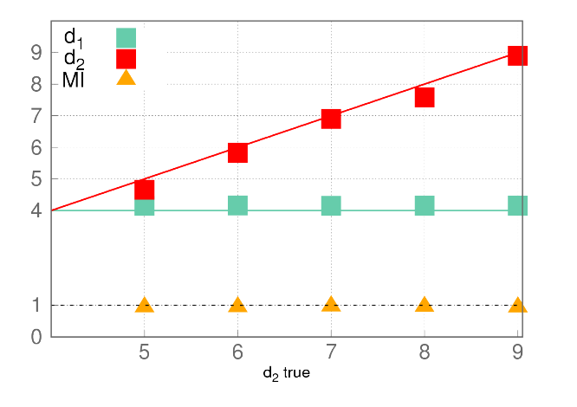

Extending TWO-NN to multiple IDs
Michele Allegra The intrinsic dimension of the data and its use CINaM, November 2019
We enforce uniform neighborhoods through additional term in the likelihood
Now we get uniform neighborhoods and correct estimates!
Probability that two neighbors are in the same manifold

Slide 24
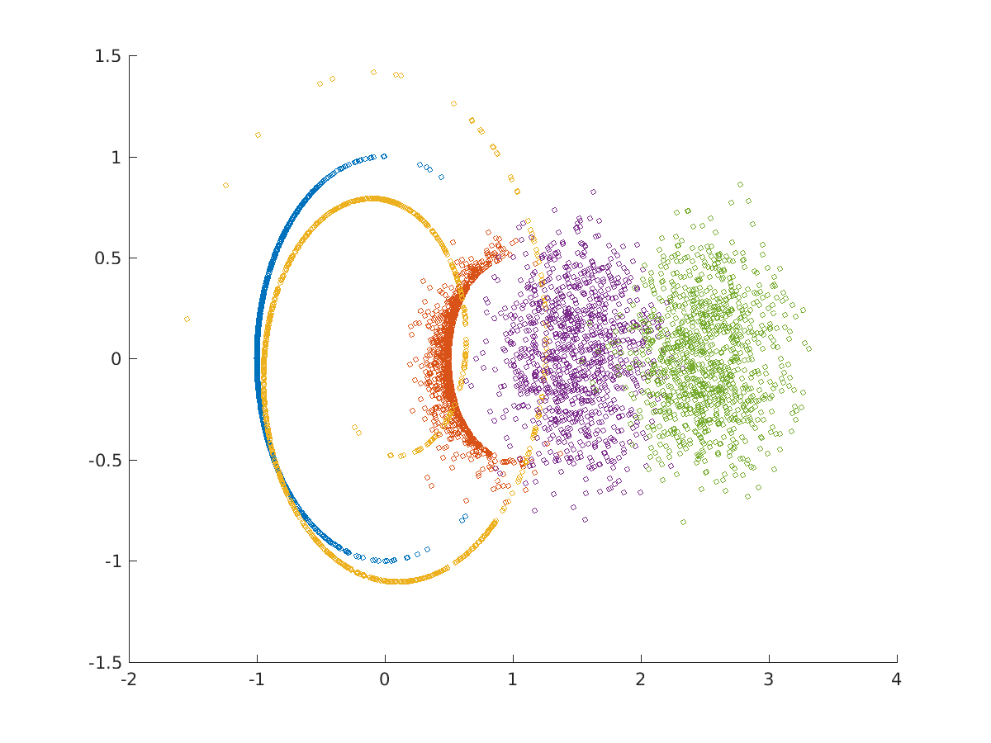
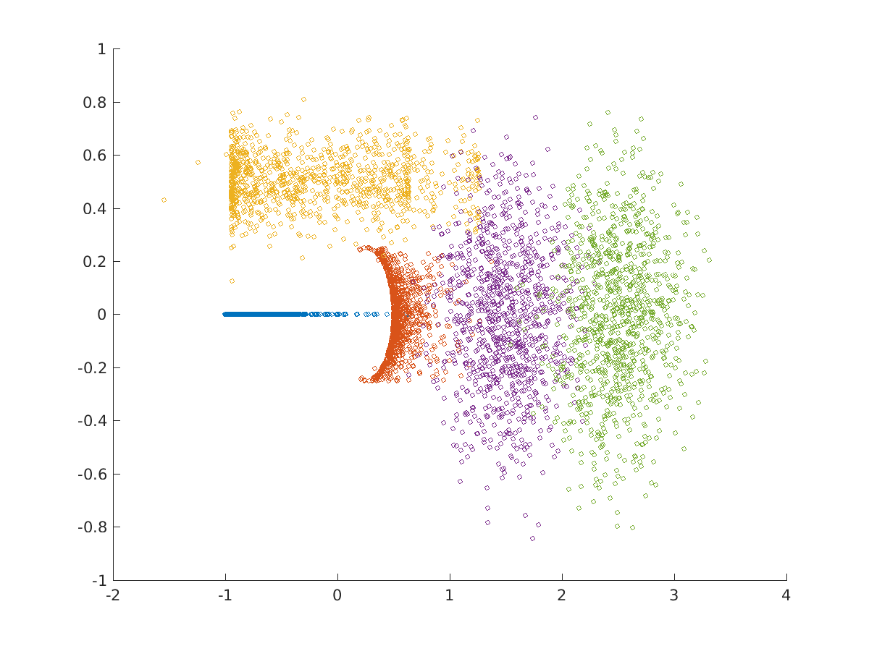
Heterogeneous ID algorithm (Hidalgo)
Michele Allegra The intrinsic dimension of the data and its use CINaM, November 2019
Find regions (manifolds) of different ID in the data
Works also for nonlinear and topologically complex manifolds
E.g. circle in d=1, swiss roll in d=4, torus d=2, sphere d=5, sphere d=9
M Allegra, E Facco, A Laio and A Mira, arXiv:1902.10459 (2019)

Slide 25
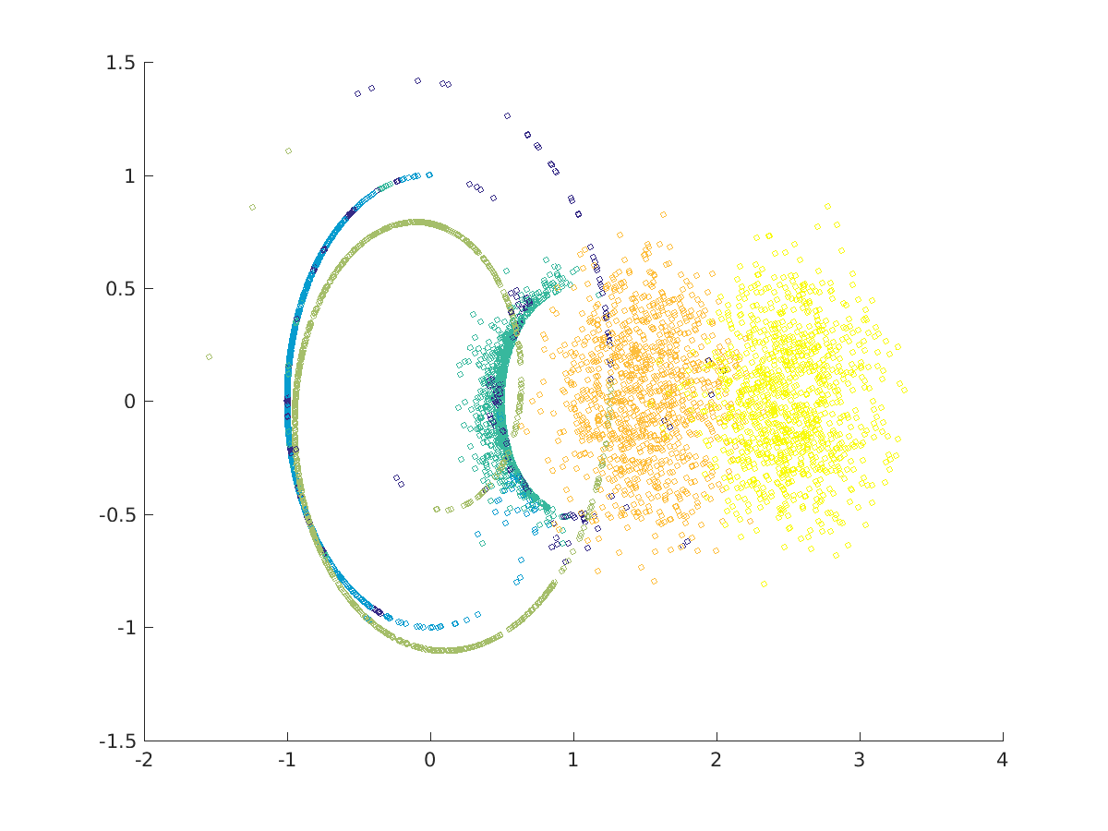
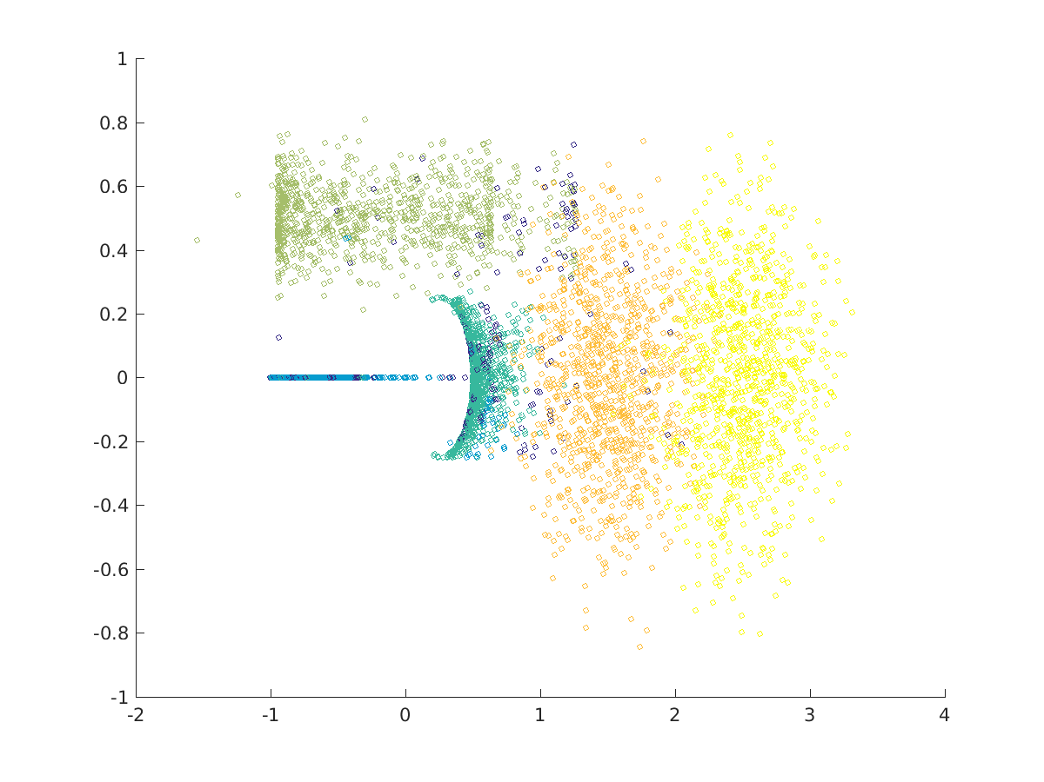
Heterogeneous ID algorithm (Hidalgo)
Michele Allegra The intrinsic dimension of the data and its use CINaM, November 2019
Find regions (manifolds) of different ID in the data
Works also for nonlinear and topologically complex manifolds
Circle d=1, swiss roll in d=4, torus d=2, sphere d=5, sphere d=9
Estimated dimensions 0.9,2.0,4.1,5.2,8.5
M Allegra, E Facco, A Laio and A Mira, arXiv:1902.10459 (2019)

Slide 26
Real example: phase space of folding protein
Michele Allegra The intrinsic dimension of the data and its use CINaM, November 2019
consider a simulation of unfolding/refolding villing headpiece
for each of the N ~ 32,000 configurations, D=32 dihedral angles.
We find four manifolds,
three with low dimensions d=11.8,d=12.9, d=13.2
one with high dimension d=22.9
Which configurations are assigned to the different manifolds?
Consider q=fraction of native contacts (=degree of folding)

Slide 27
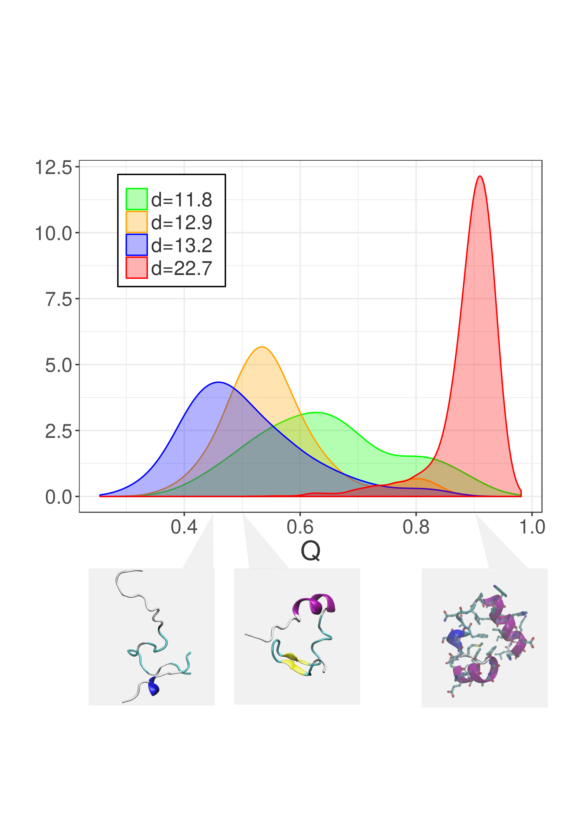
Example: phase space of folding protein
Michele Allegra The intrinsic dimension of the data and its use CINaM, November 2019
Folded configurations are in the high-dimensional manifolds
The local ID is able to discriminate between folded and unfolded configurations
The effective # of phase space directions the system can explore varies in the two states

Slide 28
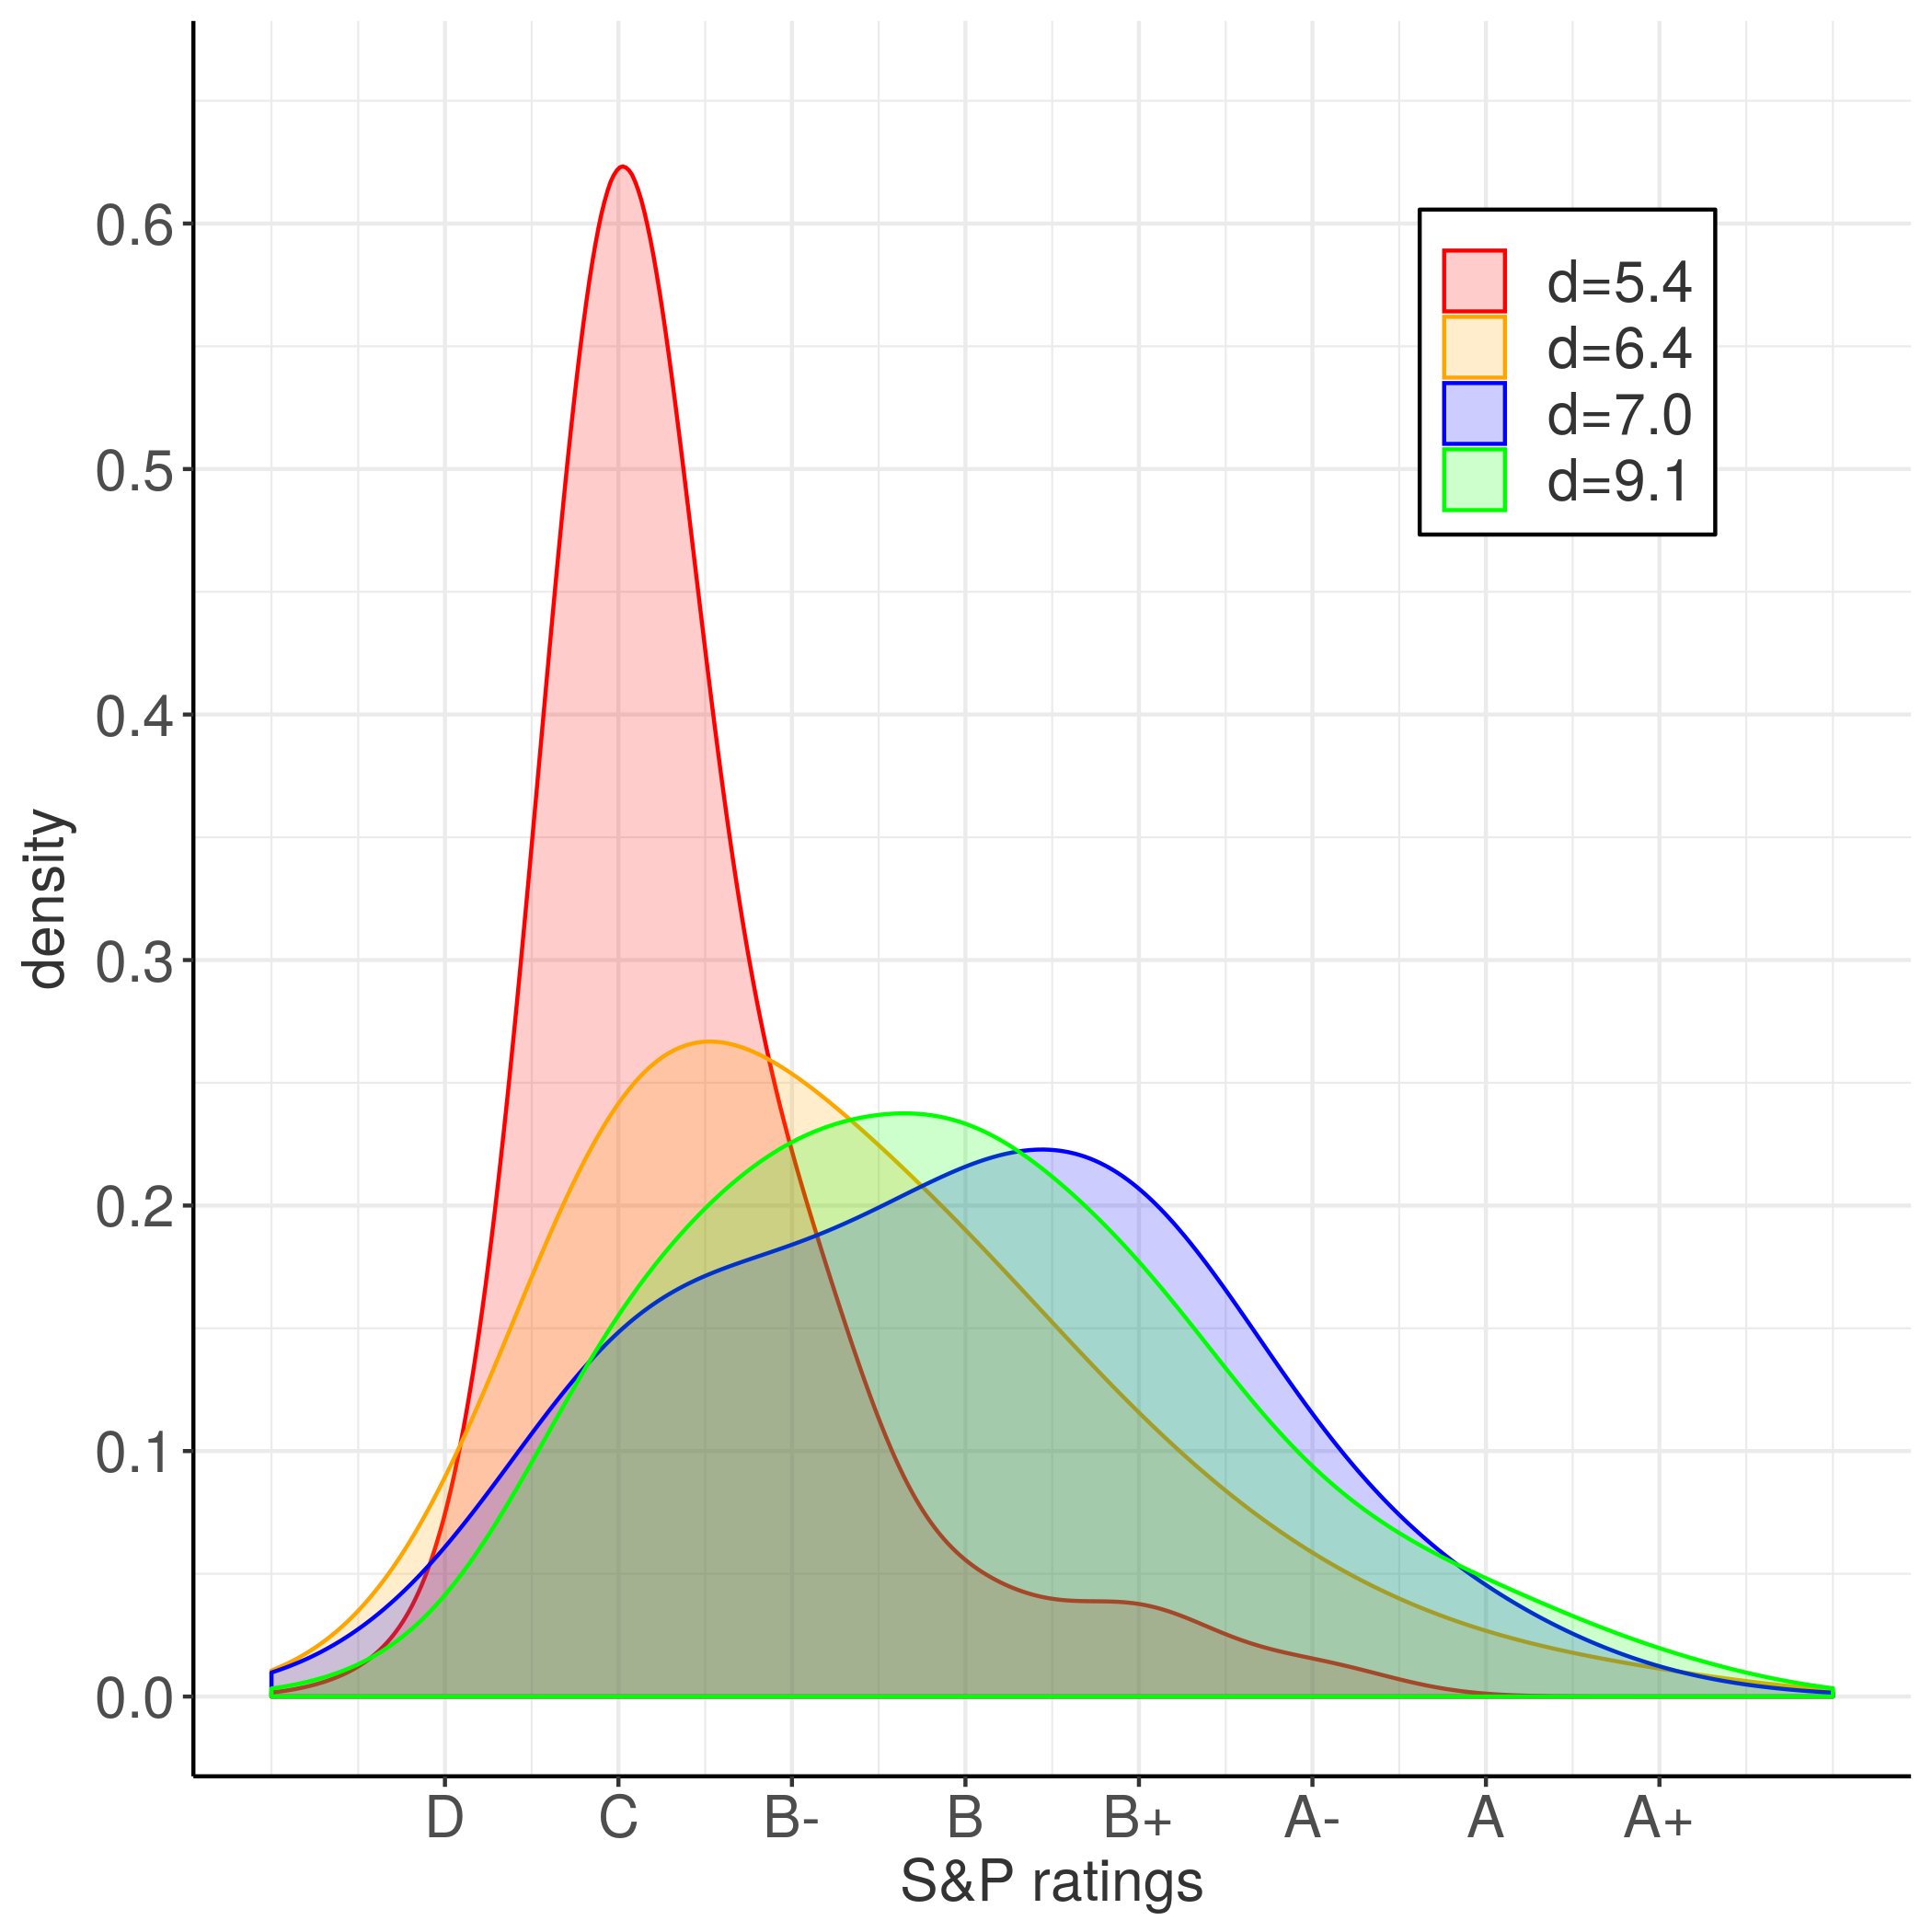
Example: companies balance sheets
Michele Allegra The intrinsic dimension of the data and its use CINaM, November 2019
consider D=38 balance sheet variables for N=8000 companies
We find four manifolds with dimensions d=5.4,d=6.4,d=7.0, d=9.1
Consider the financial risk of the companies assigned to different manifolds
Companies with higher risk are preferentially assigned to low dimensional manifolds!

Slide 29
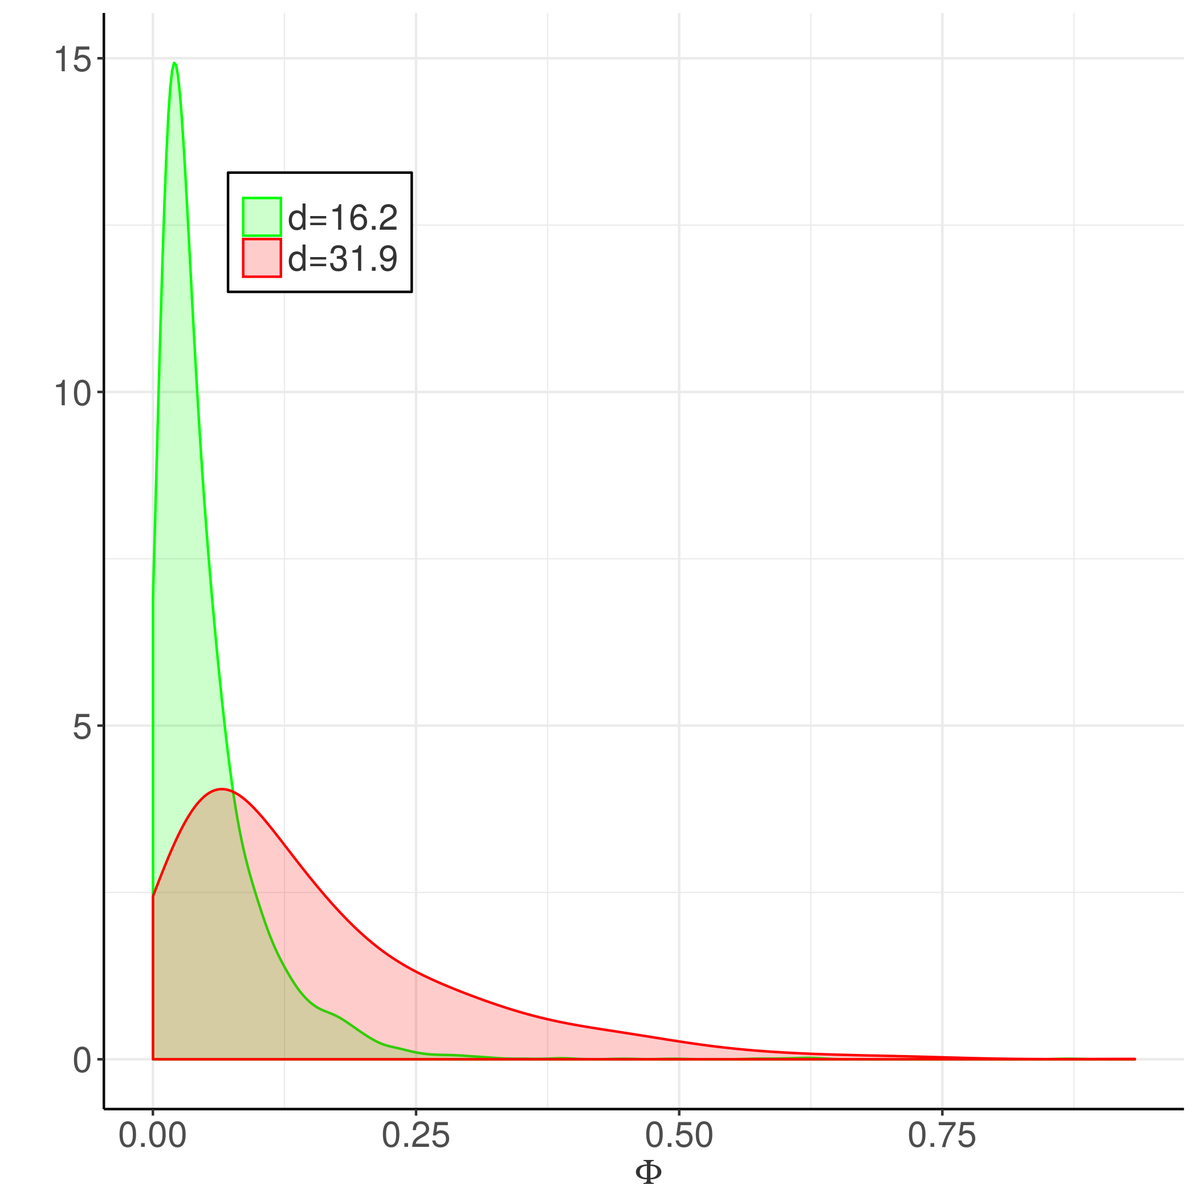
Example: brain imaging time series
Michele Allegra The intrinsic dimension of the data and its use CINaM, November 2019
Consider 202 fMRI images of the brain during visuospatial task
N=40,000 brain voxels; for each voxel, BOLD time series with D=202 points
We find two manifolds with dimensions d=31.9, d=16.1
Consider Φ, “clustering frequency”, measuring how many times a voxel participates to transient coherent patterns
Voxels with high Φ involvement are preferentially assigned to the high dimensional manifolds
Φ is related to task involvement

Slide 30
Conclusions
Michele Allegra The intrinsic dimension of the data and its use CINaM, November 2019
TWO-NN is an efficient estimator of the intrinsic dimension (ID) of the data
TWO-NN can cope with (large) density variations in the dataset
The ID can be used to improve density estimation
The ID can be used to characterize the global topology of data
We extended TWO-NN, to the case where the ID is variable in a single dataset
In real data, we find large variations of the ID, highlighting relevant structure in the data

Slide 31




Acknowledgments
Michele Allegra The intrinsic dimension of the data and its use CINaM, November 2019
Alessandro Laio
Antonietta Mira
Elena Facco
Alex Rodriguez

Slide 32


Michele Allegra The intrinsic dimension of the data and its use CINaM, November 2019
Thanks for the invitation!
Claudio Attaccalite
Thank you for your attention!!

Slide 33
ID estimation: projective approach
Michele Allegra The intrinsic dimension of the data and its use CINaM, November 2019
Project D-dimensional data into lower dimension d :
Try different d and evaluate for each a “loss function”
measures the “data loss” occurring in the projection.
preservation of original distance relations
preservation of original covariance matrix
d is “estimated” from tradeoff between dimension reduction and data loss
Problem (1): Computationally burdensome (search for optimal projection for each d)
Problem (2): robust ID estimates only if has large gap as a function of d
if no gap, the estimation can be rather arbitrary

Slide 34
Example: companies balance sheets
Michele Allegra The intrinsic dimension of the data and its use CINaM, November 2019
consider D=38 balance sheet variables for N=8000 companies
We find four manifolds with dimensions d=5.4,d=6.4,d=7.0, d=9.1
Consider the financial risk of the companies assigned to different manifolds
Companies with higher risk are preferentially assigned to low dimensional manifolds!

Slide 35
ID estimation: projective approach
Michele Allegra The intrinsic dimension of the data and its use CINaM, November 2019
Example: Principal Component Analysis (PCA)
Prjoects data onto linear subspace spanned by first d eigenvalues of
covariance matrix X^{T}X. Loss:
Typical data:
How can one select an appropriate d?

Slide 36
ID estimation: TWO-NN
Michele Allegra The intrinsic dimension of the data and its use CINaM, November 2019
E Facco, M D’Errico, A Rodriguez, A Laio, Scientific Reports 7, 12140. (2017)
points are sampled independently
ρ constant over region A
n=# of points in a region A
n follows Poisson law P(n)=(ρV)^{n}/n! exp(-ρV)
Consider hypersheprical shells defined by first
and second neighbor of a point
f(vi1,vi2)= exp(-ρvi2) dvi1 dvi2
derive f(ri1,ri2)
derive f(ri2/ri1)

Slide 37
Is the ID uniform?
Michele Allegra The intrinsic dimension of the data and its use CINaM, November 2019
Sometimes the model fails...
1) the density is strongly varying even on the scale of the first two neighbors
2) the dimension is not uniform in the dataset

Slide 38
Intrinsic dimension
Michele Allegra The intrinsic dimension of the data and its use CINaM, November 2019
K-nearest-neighbor density= k/volume of sphere containing the k points:
what is right d?
Knowing the right D is important to find appropriate target dimension in dimensional reduction
Also important in density estimation

