Slide 1
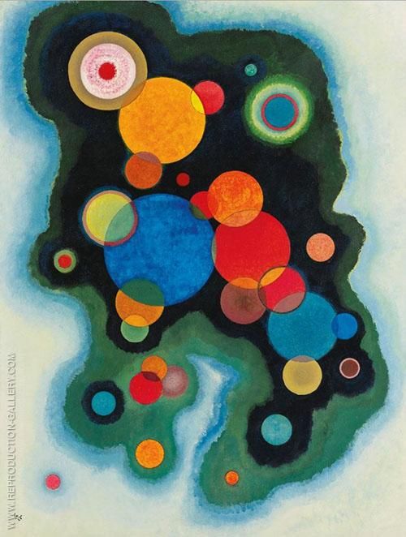
Michele Allegra
Clustering by the local intrinsic dimension
Michele Allegra Clustering by the local intrinsic dimension ML4MS workshop, May 2019

Slide 2

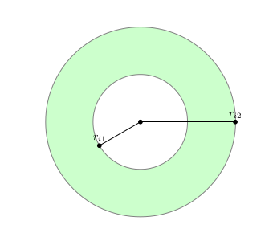


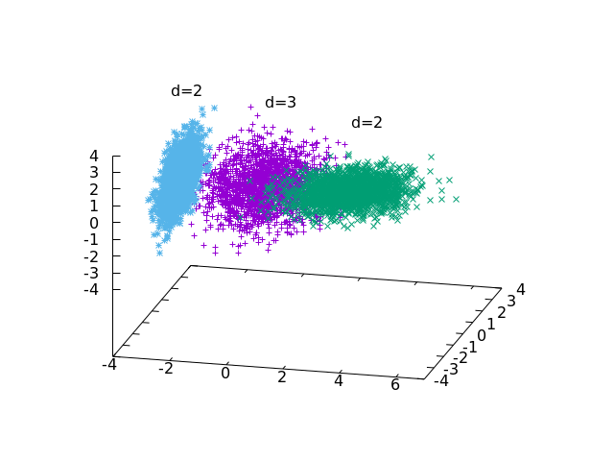

Overview
Michele Allegra Clustering by the local intrinsic dimension ML4MS workshop, May 2019
The intrinsic dimension of a dataset
The TWO-NN approach for ID estimation
The case of variable ID
Application to a molecular dynamics trajectory

Slide 3
Intrinsic dimension
Michele Allegra Clustering by the local intrinsic dimension ML4MS workshop, May 2019
Data are defined in a space with D variables
However, the data lie on hypersurface of lower dimension d < D
This dimension is called intrinsic dimension

Slide 4
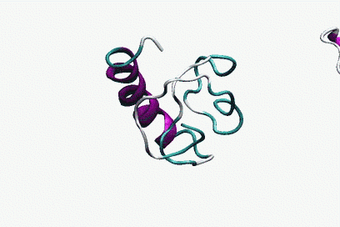
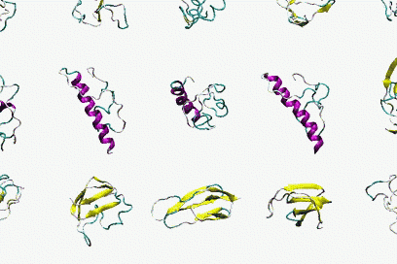
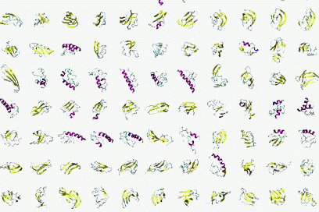
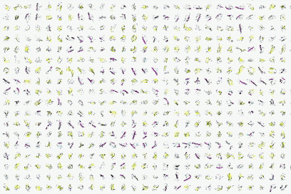


Intrinsic dimension
The state of a molecule is described by 6N variables
Michele Allegra Clustering by the local intrinsic dimension ML4MS workshop, May 2019
6xN
Due to soft and hard constraints, the system “moves” only in some phase space directions
Independent directions are d << 6N

Slide 5


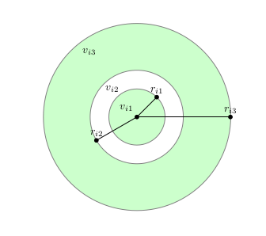
Intrinsic dimension
Michele Allegra Clustering by the local intrinsic dimension ML4MS workshop, May 2019
K-nearest-neighbor density= k/volume of sphere containing the k points:
what is right d?
Knowing the right D is important to find appropriate target dimension in dimensional reduction
Also important in density estimation

Slide 6
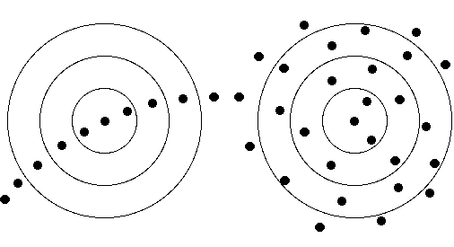
ID estimation
Michele Allegra Clustering by the local intrinsic dimension ML4MS workshop, May 2019
Data are sampled from a distribution with density ρ(X)
If ρ(X) is onstant, distances between points in the dataset follow scaling laws that depend only on d
Example: correlation dimension (Grassberger and Procaccia, PRL 50 (5), 346, 1983)
        # of points at distance < ε from point i is
        Ni(ε)~ρ(X)ε^{d}
        If ρ(X) is constant, we have simple scaling and d can be estimated via linear fit
        when ρ(X) is variable, the scaling is violated, estimation fails dramatically

Slide 7
ID estimation: TWO-NN
Michele Allegra Clustering by the local intrinsic dimension ML4MS workshop, May 2019
E Facco, M D’Errico, A Rodriguez, A Laio, Scientific Reports 7, 12140. (2017)
TWO-NN: estimating the ID in case of (strongly) variable density
Make two broad assumptions:
H1) the data points xi are independent samples from a density ρ(x).
H2) local uniformity: ρ(x) ~ const. in the region containing the first 2 neighbors of xi
ri1,ri2 distances of 1st and 2nd neighbor of point i
μi=di2/di1 follows a Pareto distribution: P(μ)=dμ^{-d}
The distribution of μ depends only on d

Slide 8
ID estimation: TWO-NN
Michele Allegra Clustering by the local intrinsic dimension ML4MS workshop, May 2019
ri1,ri2 distances of 1st and 2nd neighbor of point i
μi=di2/di1 follows a Pareto distribution: P(μ)=dμ^{-d} → F(μ)=1-μ^{-d}
Fit the empirical cumulative distribution of the μi and estimate d
Equivalently, linear fit on log(1-F(μ))=-d logμ
fit Femp(μ) with 1-μ^{-d}
fit log(1-Femp(μ)) with -d logμ

Slide 9
The problem of multiple IDs
Michele Allegra Clustering by the local intrinsic dimension ML4MS workshop, May 2019
the data may lie on several manifolds, each with different ID
the data may lie on several manifolds, each with different ID
Simple example: just merge two datasets with different ID
Is this an artificial oddity or a common situation?

Slide 10

Extending TWO-NN to multiple IDs
Michele Allegra Clustering by the local intrinsic dimension ML4MS workshop, May 2019
TWO-NN assumptions:
H1) the data points xi are independent samples from a density ρ(x).
H2) local uniformity: ρ(x) ~ const. in the region containing the first 2 neighbors of xi
Additional assumption:
H3) the distribution ρ(x) has support on K manifolds with different IDs d=d1,…,dK
Under H1), H2), H3) the distribution of μ is simply a mixture of Pareto distributions

Slide 11




Extending TWO-NN to multiple IDs
Michele Allegra Clustering by the local intrinsic dimension ML4MS workshop, May 2019
Estimate parameters p,d with Bayesian approach
Fix
Compute posterior distribution
Average
to sample the posterior, we must introduce latent variables Z=Z1,…,ZK
manifold membership of each point
Estimate jointly d,p,Z by Gibbs Sampling of the posterior distribution

Slide 12
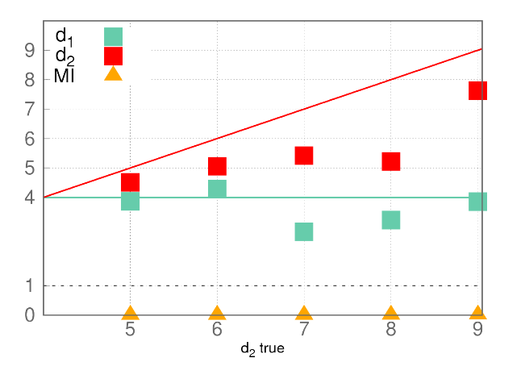
Extending TWO-NN to multiple IDs
Michele Allegra Clustering by the local intrinsic dimension ML4MS workshop, May 2019
Little problem: this approach does not work!
Two manifolds of dimension d1=4 and d2=5,..,9 (Gaussian ρ)
estimation of d1 and d2 is inaccurate
estimation of Z is completely wrong
(mutual information MI between true and estimated membership Z is 0)

Slide 13
Extending TWO-NN to multiple IDs
Michele Allegra Clustering by the local intrinsic dimension ML4MS workshop, May 2019
What is the problem?
Z are easy to assign only if mixture components are largely non-overlapping
But Pareto distributions with different d are highly overlapping!
The Z assigment is not reliable

Slide 14


Extending TWO-NN to multiple IDs
Michele Allegra Clustering by the local intrinsic dimension ML4MS workshop, May 2019
Let the neighborhood of point i be defined by its first q neighbors
# neighbors with same Z as i
# neighbors with diffferent Z
We get non-uniform neighborhoods: >
Problem in correctly estimating Z!
One more assumption:
H4) the manifolds have a small intersection:
neighborhoods must be approximately uniform
We enforce this through additional term in the likelihood
Probability that two neighbors are in the same manifold

Slide 15


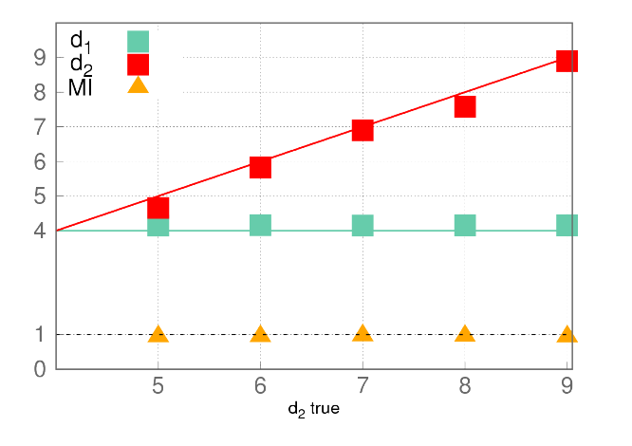

Extending TWO-NN to multiple IDs
Michele Allegra Clustering by the local intrinsic dimension ML4MS workshop, May 2019
We enforce uniform neighborhoods through additional term in the likelihood
Now we get uniform neighborhoods and correct estimates!
Probability that two neighbors are in the same manifold

Slide 16
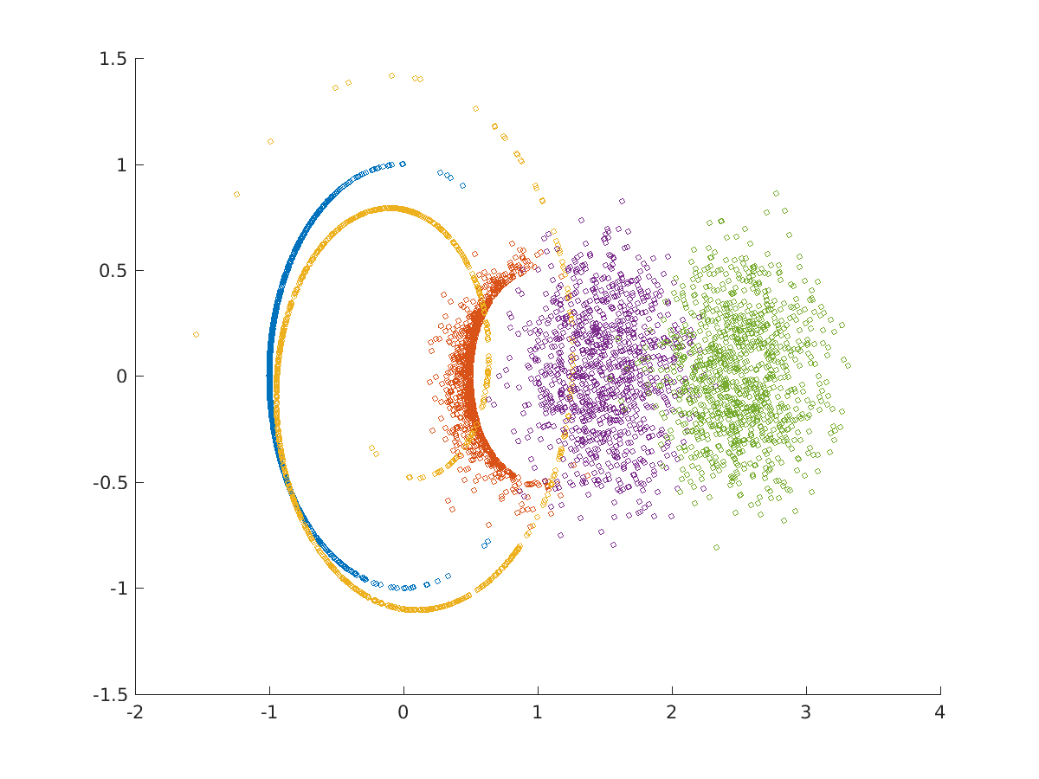
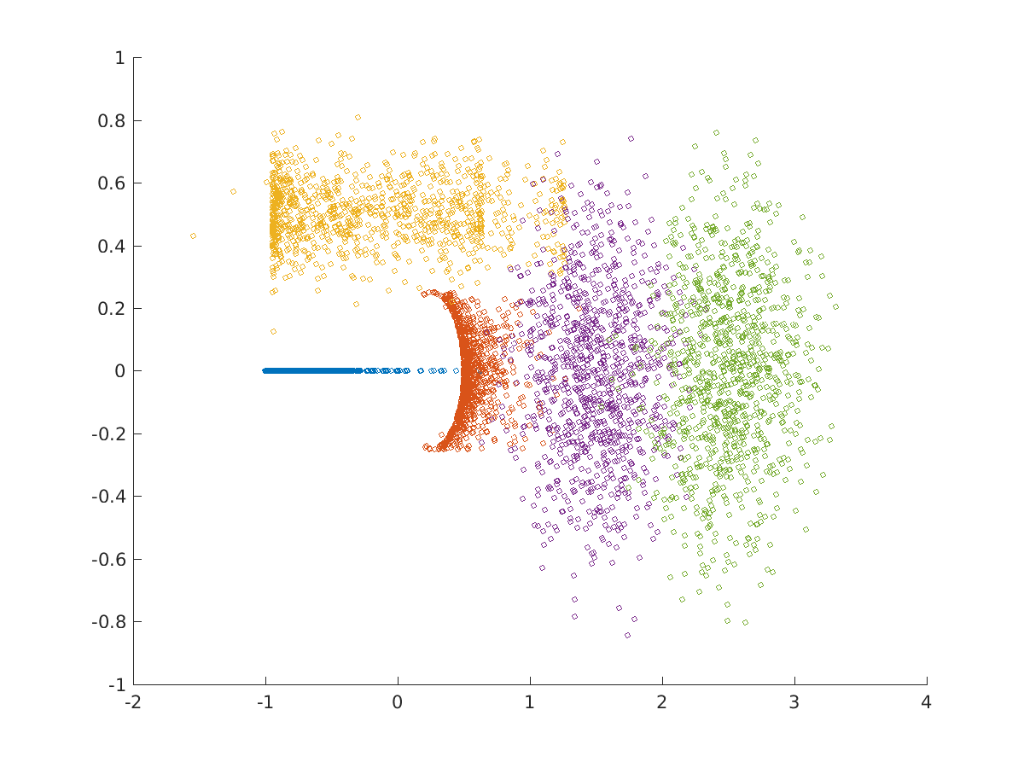
Heterogeneous ID algorithm (Hidalgo)
Michele Allegra Clustering by the local intrinsic dimension ML4MS workshop, May 2019
Find regions (manifolds) of different ID in the data
Works also for nonlinear and topologically complex manifolds
E.g. circle in d=1, swiss roll in d=4, torus d=2, sphere d=5, sphere d=9
M Allegra, E Facco, A Laio and A Mira, arXiv:1902.10459 (2019)

Slide 17
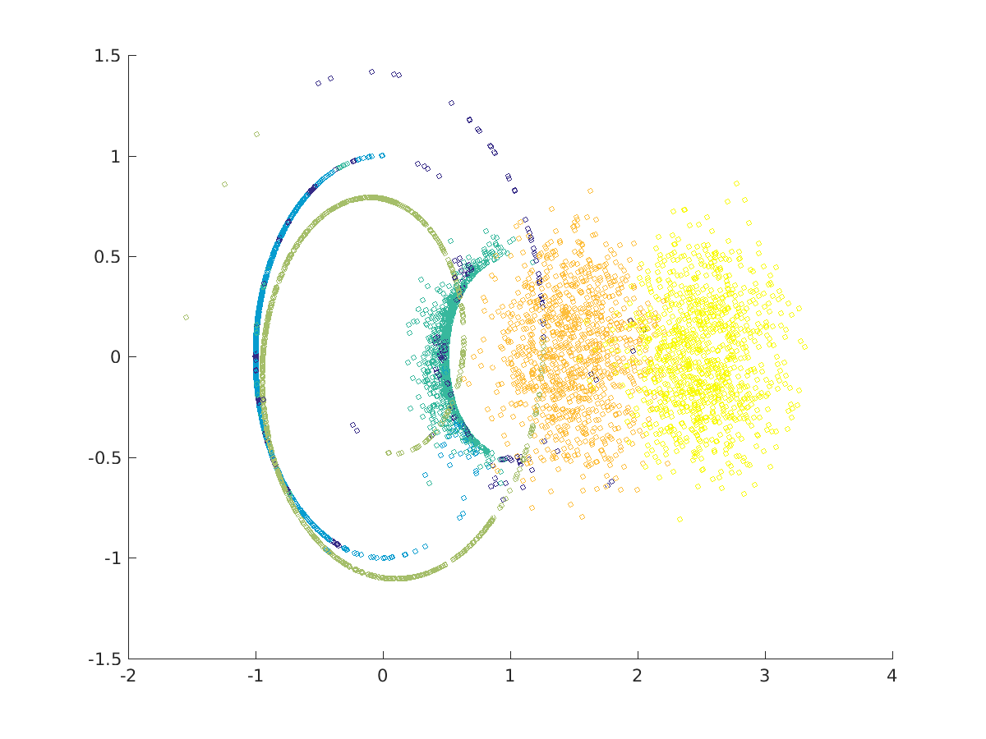
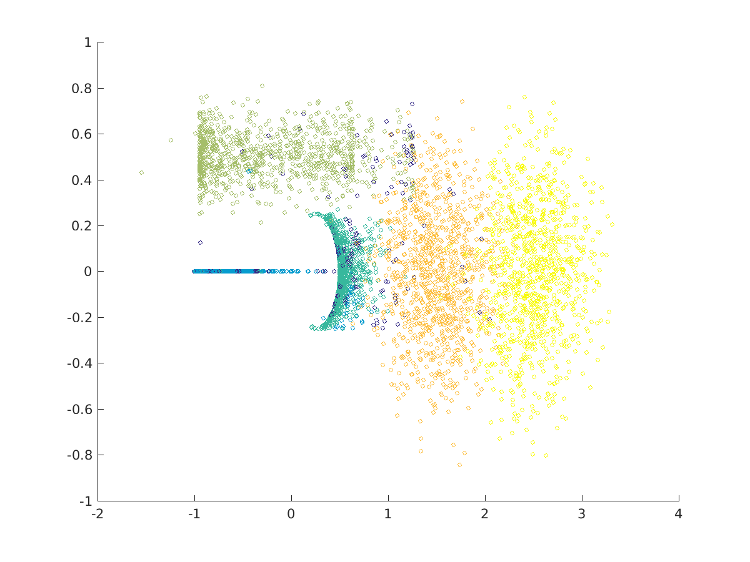
Heterogeneous ID algorithm (Hidalgo)
Michele Allegra Clustering by the local intrinsic dimension ML4MS workshop, May 2019
Find regions (manifolds) of different ID in the data
Works also for nonlinear and topologically complex manifolds
Circle d=1, swiss roll in d=4, torus d=2, sphere d=5, sphere d=9
Estimated dimensions 0.9,2.0,4.1,5.2,8.5
M Allegra, E Facco, A Laio and A Mira, arXiv:1902.10459 (2019)

Slide 18
Real example: phase space of folding protein
Michele Allegra Clustering by the local intrinsic dimension ML4MS workshop, May 2019
consider a simulation of unfolding/refolding villing headpiece
for each of the N ~ 32,000 configurations, D=32 dihedral angles.
We find four manifolds,
three with low dimensions d=11.8,d=12.9, d=13.2
one with high dimension d=22.9
Which configurations are assigned to the different manifolds?
Consider q=fraction of native contacts (=degree of folding)

Slide 19
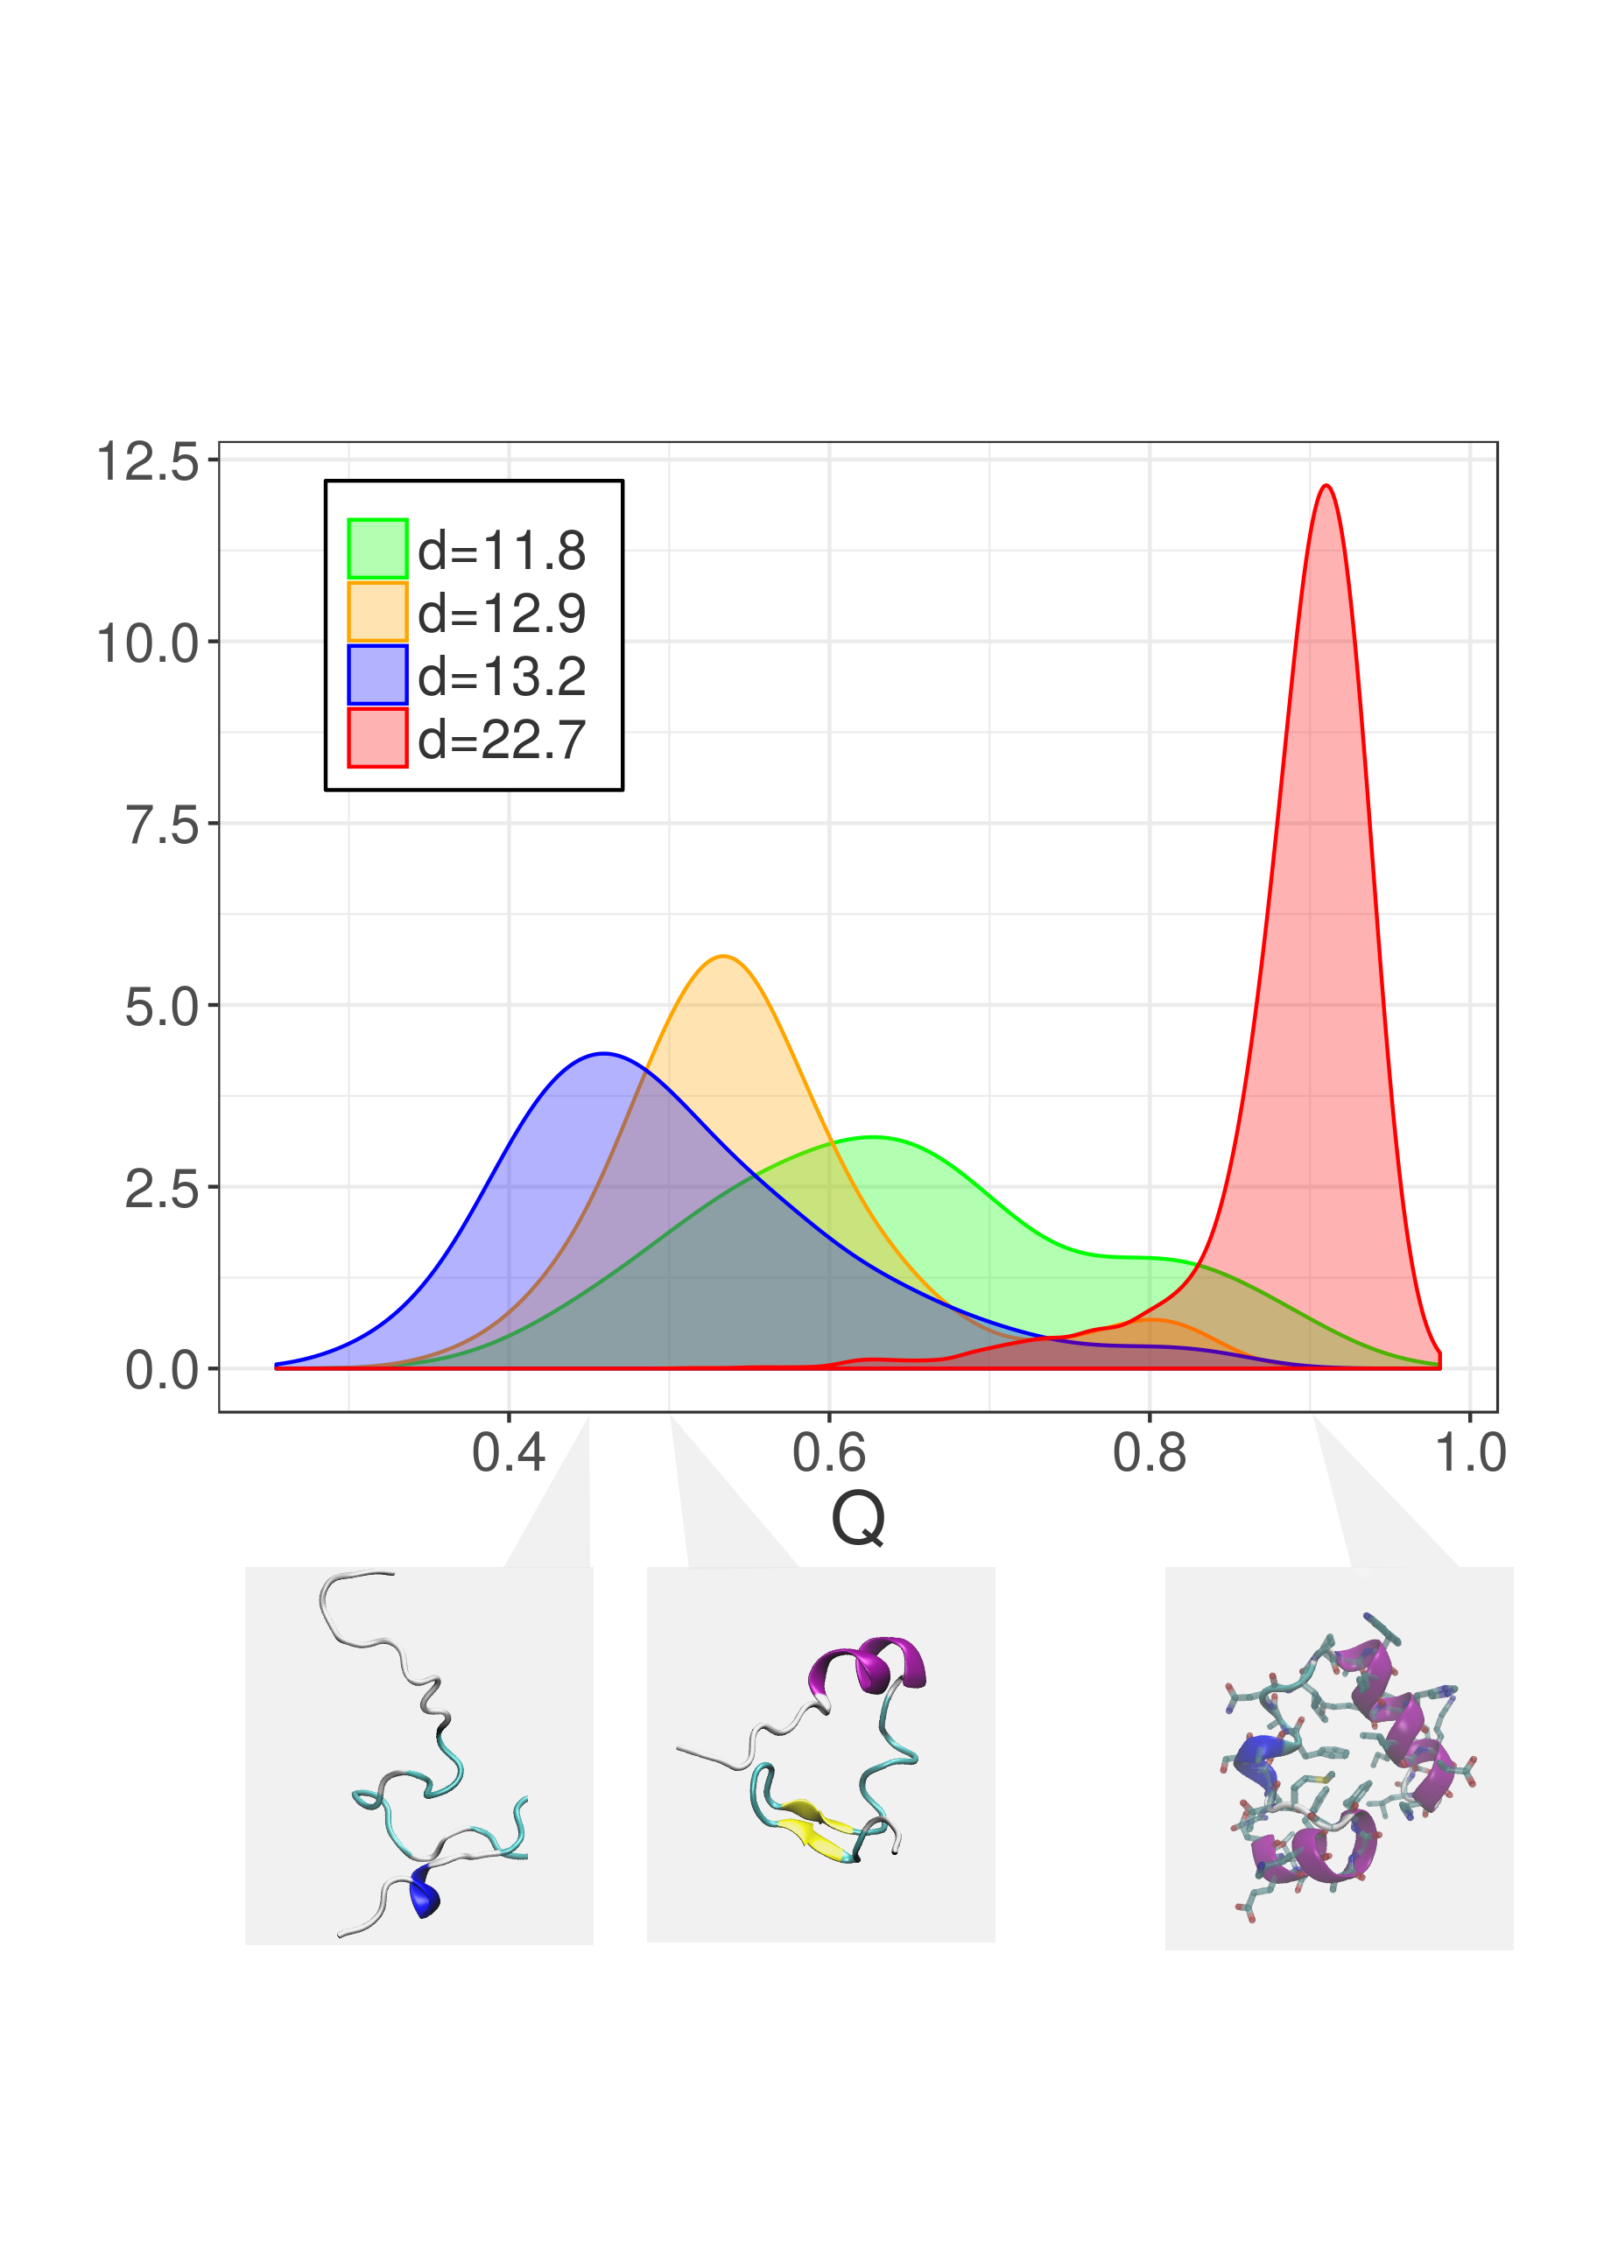
Example: phase space of folding protein
Michele Allegra Clustering by the local intrinsic dimension ML4MS workshop, May 2019
Folded configurations are in the high-dimensional manifolds
The local ID is able to discriminate between folded and unfolded configurations
The effective # of phase space directions the system can explore varies in the two states

Slide 20
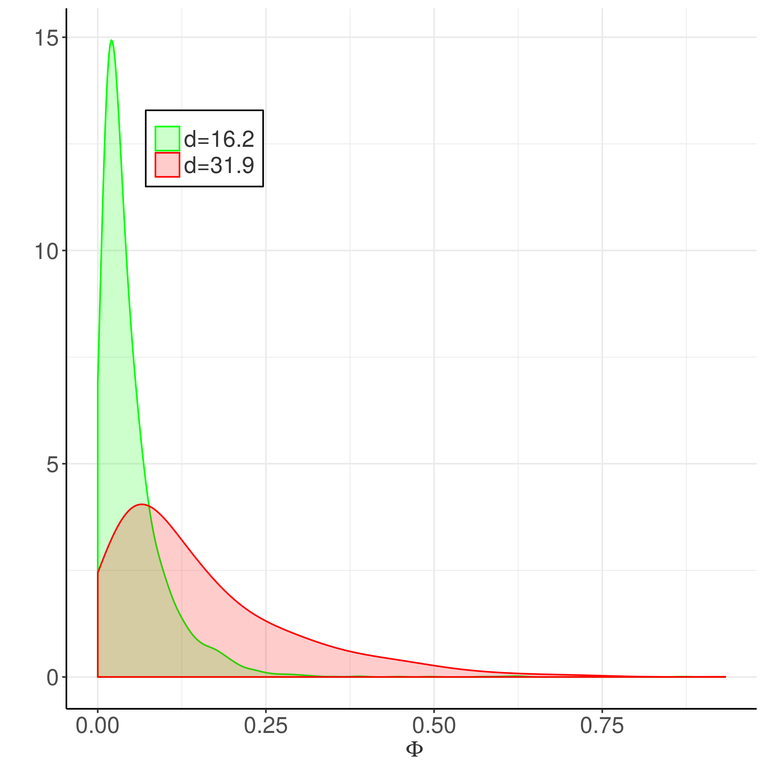
Example: brain imaging time series
Michele Allegra Clustering by the local intrinsic dimension ML4MS workshop, May 2019
Consider 202 fMRI images of the brain during visuospatial task
N=40,000 brain voxels; for each voxel, BOLD time series with D=202 points
We find two manifolds with dimensions d=31.9, d=16.1
Consider Φ, “clustering frequency”, measuring how many times a voxels participates to transient coherent patterns
Companies with high Φ involvement are preferentially assigned to the high dimensional manifolds
Φ is related to task involvement

Slide 21
Conclusions
Michele Allegra Clustering by the local intrinsic dimension ML4MS workshop, May 2019
We extended a recently developed ID estimator, TWO-NN, to the case where the ID is variable in a single dataset
The method rests on quite weak assumptions (local uniformity of density and dimension)
We find regions of different local ID in the data
In real data, we find large variations of the ID, highlighting relevant structure in the data
ID estimation is not just a preliminary step, but can highlight structure in the data

Slide 22



Acknowledgments
Michele Allegra Clustering by the local intrinsic dimension ML4MS workshop, May 2019
Alessandro Laio
Antonietta Mira
Elena Facco

Slide 23


Michele Allegra Clustering by the local intrinsic dimension ML4MS workshop, May 2019
Thanks for the invitation!
Aldo Glielmo
Thank you for your attention!!

Slide 24




ID estimation: projective approach
Michele Allegra Clustering by the local intrinsic dimension ML4MS workshop, May 2019
Project D-dimensional data into lower dimension d :
Try different d and evaluate for each a “loss function”
measures the “data loss” occurring in the projection.
preservation of original distance relations
preservation of original covariance matrix
d is “estimated” from tradeoff between dimension reduction and data loss
Problem (1): Computationally burdensome (search for optimal projection for each d)
Problem (2): robust ID estimates only if has large gap as a function of d
if no gap, the estimation can be rather arbitrary

Slide 25
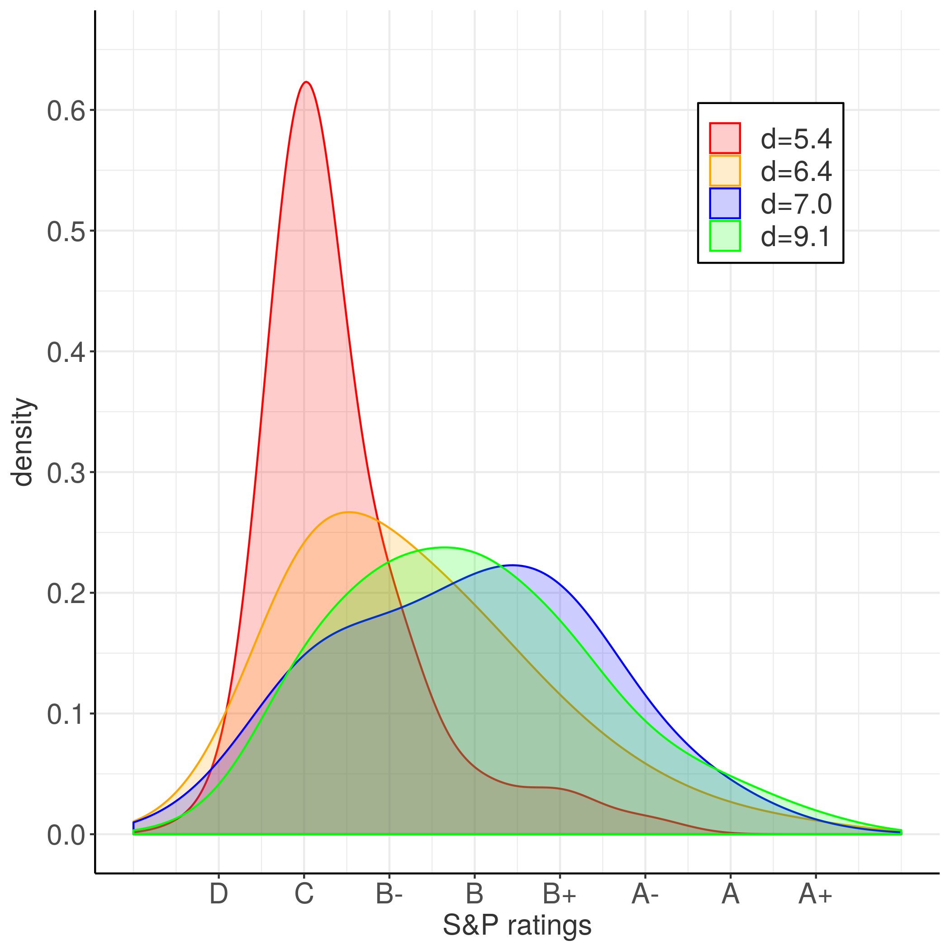
Example: companies balance sheets
Michele Allegra Clustering by the local intrinsic dimension ML4MS workshop, May 2019
consider D=38 balance sheet variables for N=8000 companies
We find four manifolds with dimensions d=5.4,d=6.4,d=7.0, d=9.1
Consider the financial risk of the companies assigned to different manifolds
Companies with higher risk are preferentially assigned to low dimensional manifolds!

Slide 26

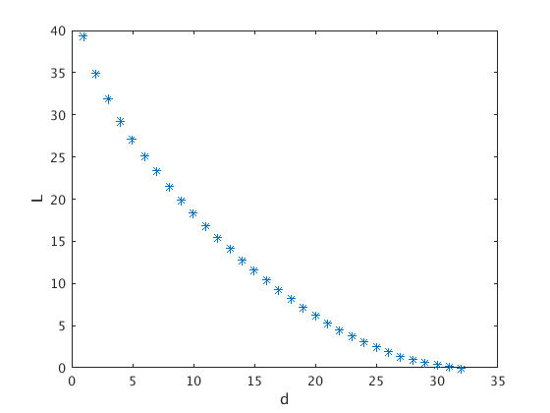
ID estimation: projective approach
Michele Allegra Clustering by the local intrinsic dimension ML4MS workshop, May 2019
Example: Principal Component Analysis (PCA)
Prjoects data onto linear subspace spanned by first d eigenvalues of
covariance matrix X^{T}X. Loss:
Typical data:
How can one select an appropriate d?

Slide 27
ID estimation: TWO-NN
Michele Allegra Clustering by the local intrinsic dimension ML4MS workshop, May 2019
E Facco, M D’Errico, A Rodriguez, A Laio, Scientific Reports 7, 12140. (2017)
points are sampled independently
ρ constant over region A
n=# of points in a region A
n follows Poisson law P(n)=(ρV)^{n}/n! exp(-ρV)
Consider hypersheprical shells defined by first
and second neighbor of a point
f(vi1,vi2)= exp(-ρvi2) dvi1 dvi2
derive f(ri1,ri2)
derive f(ri2/ri1)

Slide 28
Is the ID uniform?
Michele Allegra Clustering by the local intrinsic dimension ML4MS workshop, May 2019
Sometimes the model fails...
1) the density is strongly varying even on the scale of the first two neighbors
2) the dimension is not uniform in the dataset

