Slide 1
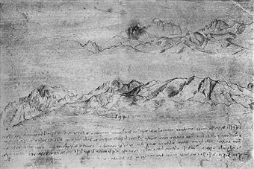
RECONSTRUCTING HIGH DIMENSIONAL PROBABILITY LANDSCAPES
Michele Allegra High-dimensional probability landscapes CECAM June 2018

Slide 2

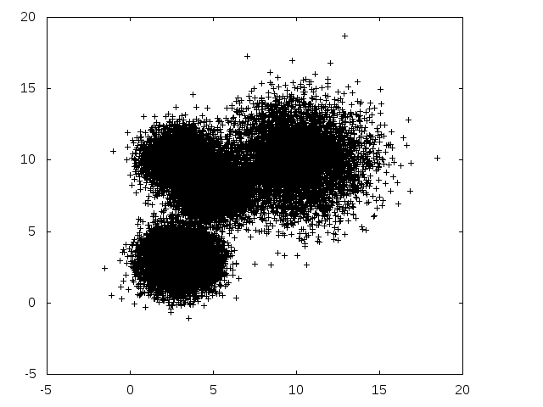
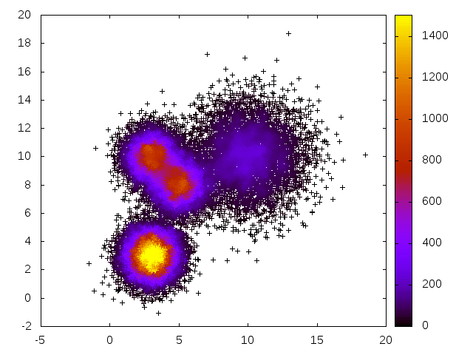


Reconstructing complex landscapes in phase space
Phase spaces of complex physical systems are high-dimensional
In D=2, one can easily produce a density map
In large D, one can try to project data in dimension d=2 : the “data loss” measured by preservation of distance relations: when the space is high-dimensional, usually high loss!
Michele Allegra High-dimensional probability landscapes CECAM June 2018
How to reconstruct the probability density?
How to compactly describe its salient features?

Slide 3

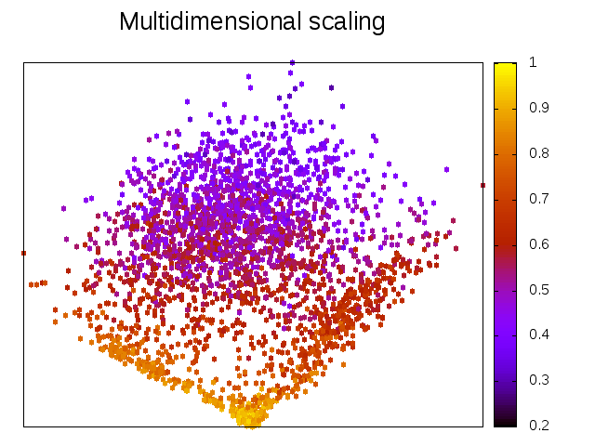
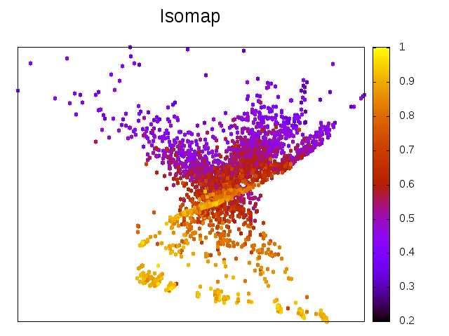
Example: phase space landscape of folding protein
We can try to project the data in 2D with several methods
The resulting maps are quantitatively (and qualitatively) inaccurate
Michele Allegra High-dimensional probability landscapes CECAM June 2018
consider a MD of unfolding/refolding villing headpiece
for each of the N ~ 32000 configurations, D=32 dihedral angles.

Slide 4
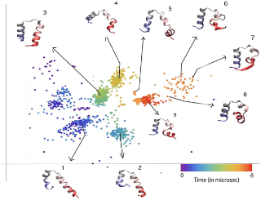

Reconstructing probability landscapes
Michele Allegra High-dimensional probability landscapes CECAM June 2018
From molecular dynamics...
...to general data
characterize complex free energy landscapes
characterize structures in complex data spaces

Slide 5

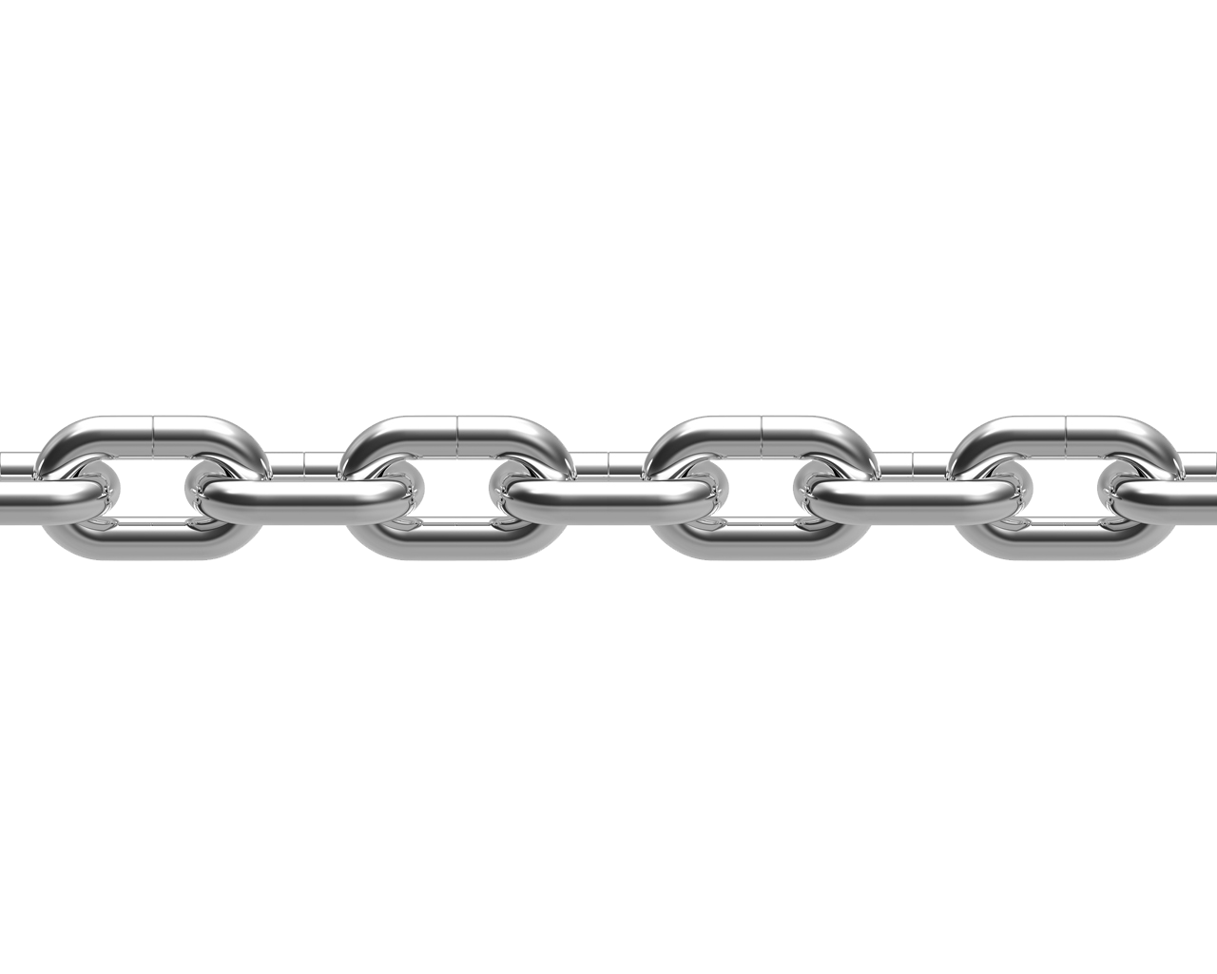

An intrusion into data analysis
Michele Allegra High-dimensional probability landscapes CECAM June 2018
From physics
to data analysis
A chain of methodological developments
A toolkit of methods
DPC
PaK
TWO-NN
Hidalgo

Slide 6
Density peak clustering
Michele Allegra High-dimensional probability landscapes CECAM June 2018
DPC
A novel clustering approach
Can we reconstruct the topography of
a high-dimensional probability distribution?

Slide 7

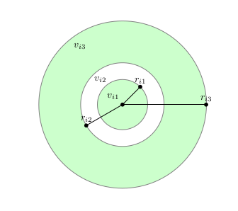



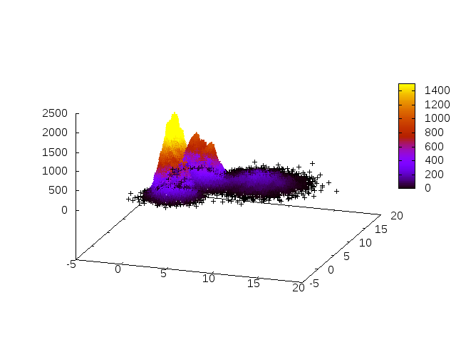
Density peak clustering
Michele Allegra High-dimensional probability landscapes CECAM June 2018
Data can be thought of as samples of a density distribution
Reconstruct the probability density of the data with proper density estimator
K-nearest-neighbor: Assume ρ ≈ const in small region around each point
For each point i, consider its k nearest neighbors at
distances
density= k/volume of sphere containing the k points

Slide 8
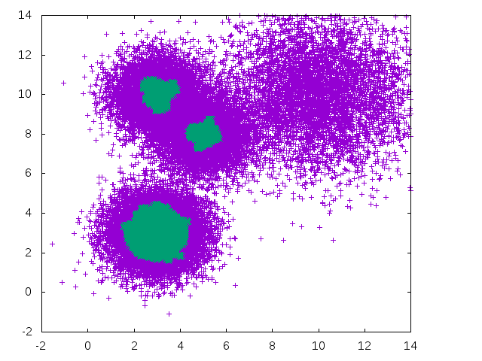
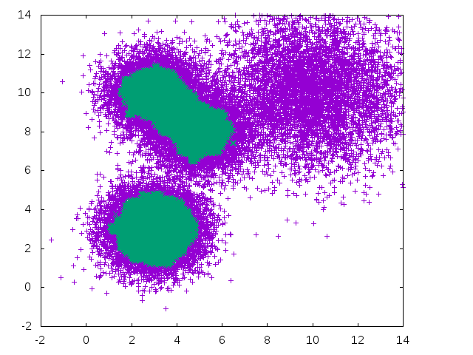
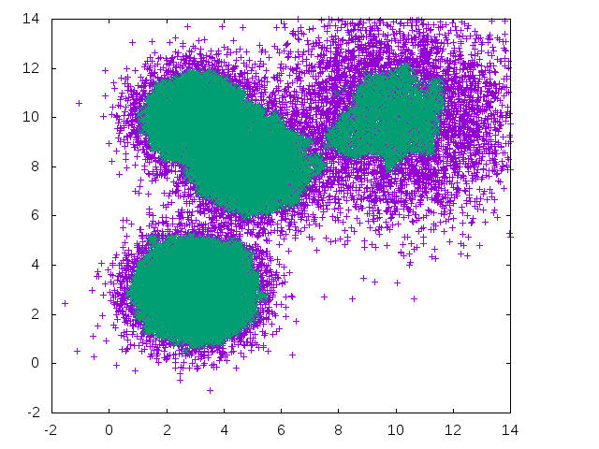
Density-based clustering
Michele Allegra High-dimensional probability landscapes CECAM June 2018
Reconstruct the probability density of the data
Then look for disconnected regions of high density
What is high? Results depend on the chosen density threshold
Cannot resolve features at different density scalesl

Slide 9
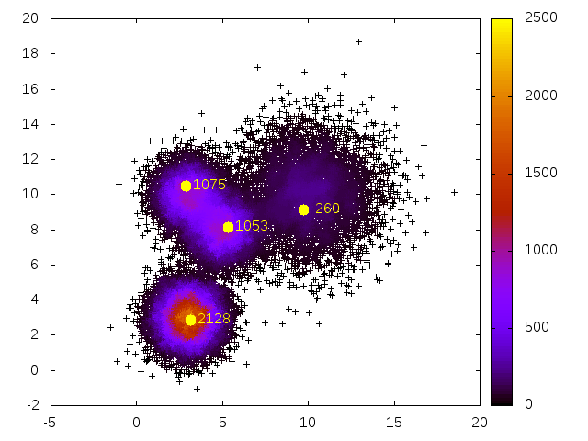


Density Peak Clustering: the topography of data
Michele Allegra High-dimensional probability landscapes CECAM June 2018
A Rodriguez, A Laio, Science 344, 1492 (2014)
Characterize a density distribution by finding its maxima and saddle points
Look for density peaks, i.e. local maxima in the density
Original algorithm: density peaks are far from any point with higher density
Compute for all points min distance from point at higher density
Peak are outliers in decision graph

Slide 10
Density-peak clustering
Michele Allegra High-dimensional probability landscapes CECAM June 2018
Points are assigned to peaks by following a path of increasing density leading to one of the peaks.
One jumps from a point to a point with higher density

Slide 11
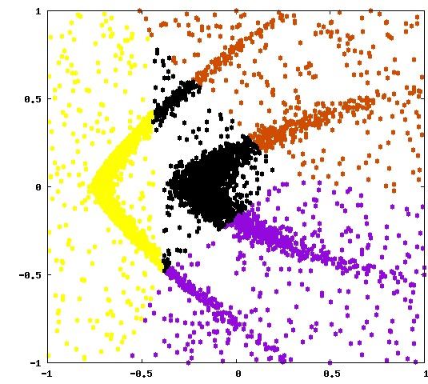
Density-peak clustering
Michele Allegra High-dimensional probability landscapes CECAM June 2018
A Rodriguez, A Laio, Science 344, 1492 (2014)
.
Points are assigned to clusters by following a path of increasing density leading to one of the peaks.
This assignation rule allows to retrieve clusters of arbitrary shape
K-means
DPC

Slide 12
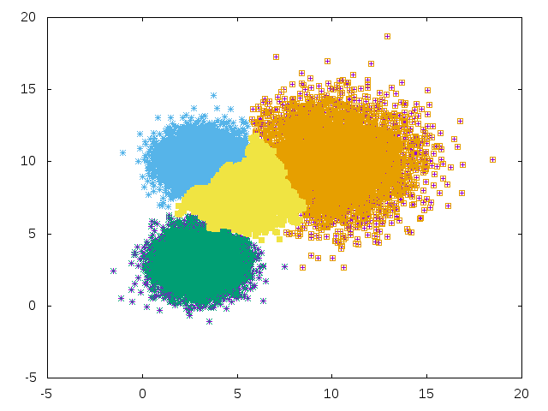
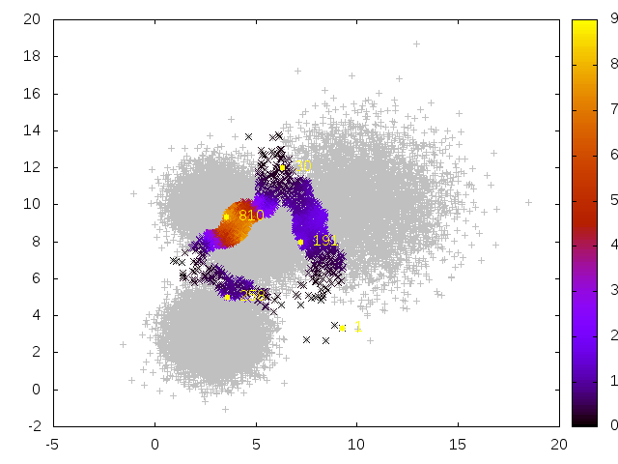
Density-peak clustering
Michele Allegra High-dimensional probability landscapes CECAM June 2018
M d'Errico, E Facco, A Laio, A Rodriguez, arXiv:1802.10549 (2018)
After assigning points to peaks, find border points: their neighborhood
Contains points assigned to different clusters
Saddle points are density maxima maxima on the borders between peaks

Slide 13
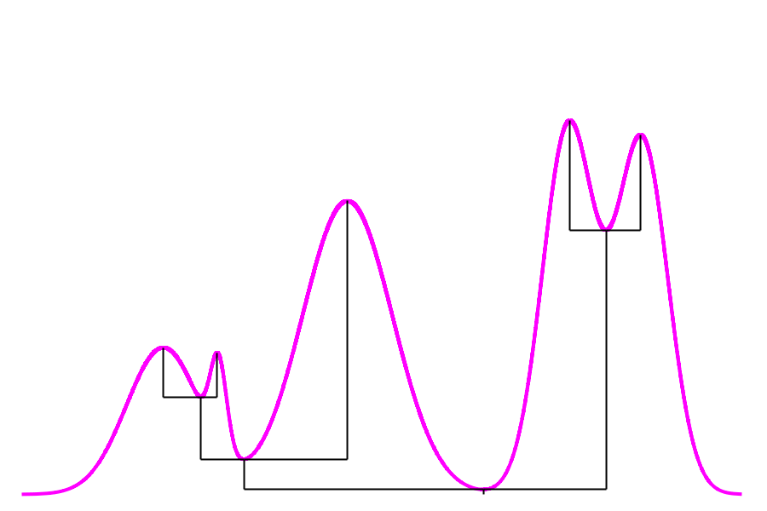
Density-peak clustering
Michele Allegra High-dimensional probability landscapes CECAM June 2018
Find hierarchical structure
Peaks with high saddle point between them are “subpeaks” of larger peak
Retrieve such hierarchical structure with single linkage algorithm:
rank saddle points by their density values
loop over saddle points and merge two peaks at each step

Slide 14
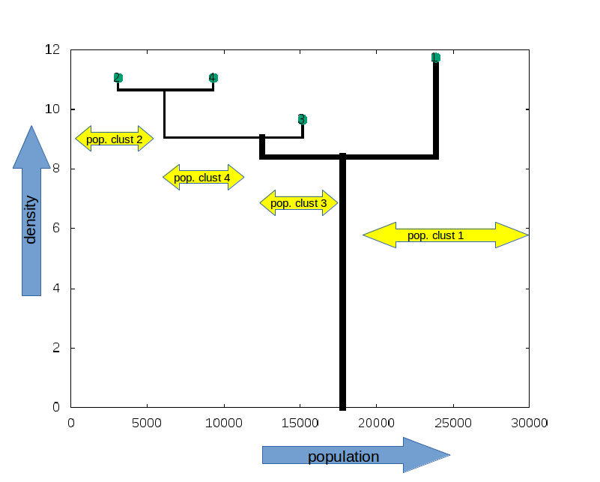
Density-peak clustering
Michele Allegra High-dimensional probability landscapes CECAM June 2018
A compact representation of the probability density: density dendrogram
Information about the size and density of the peaks, and their (hierarchical) relations

Slide 15
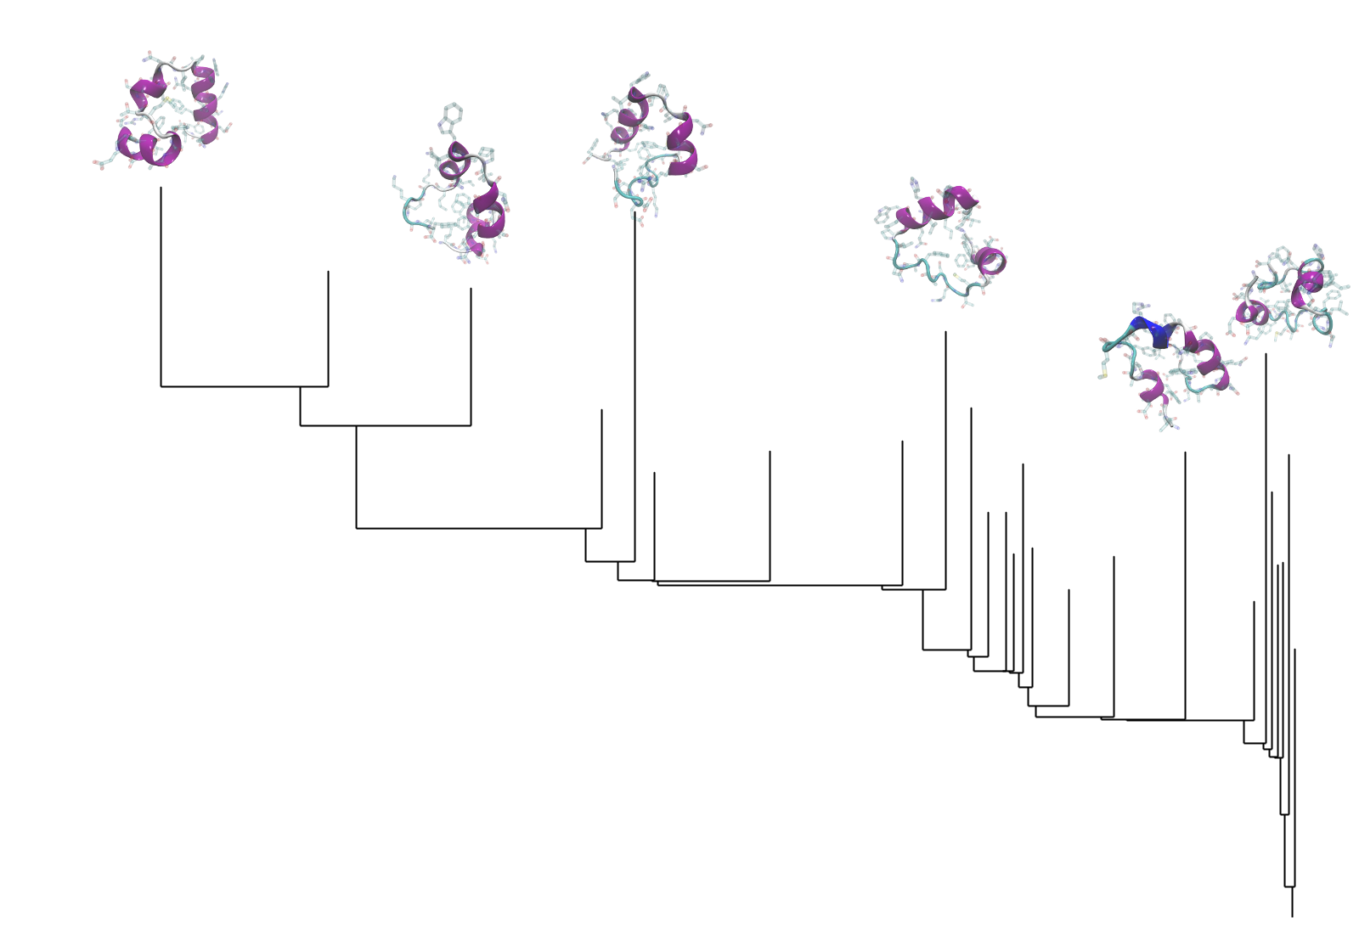
Density-peak clustering
Michele Allegra High-dimensional probability landscapes CECAM June 2018
A compact representation of the probability density: density dendrogram

Slide 16
The problem of density estimation
Michele Allegra High-dimensional probability landscapes CECAM June 2018
Original DPC had two one key problem: dependency on free parameter k
Fixed k leads to inaccurate ρ and δρ , hence wrong assessment of the statistical significance of the clusters
This problem can be solved by means of improved density estimation technique
DPC
DPC
PAk

Slide 17
Density Estimation: PAk
Michele Allegra High-dimensional probability landscapes CECAM June 2018
A Rodriguez, M D’Errico, E. Facco and A Laio, JCTC 14 (3), 1206 (2017)
DPC
PAk
A novel parameter free density estimation approach

Slide 18


What is the right k?
Michele Allegra High-dimensional probability landscapes CECAM June 2018
Bias – variance tradeoff:
k too small: large error in the estimate
k too large: density is not constant over V
consider point i and neighboring point j
If the density at i and j is different (M1):
If the density at i and j is the same (M2):

Slide 19
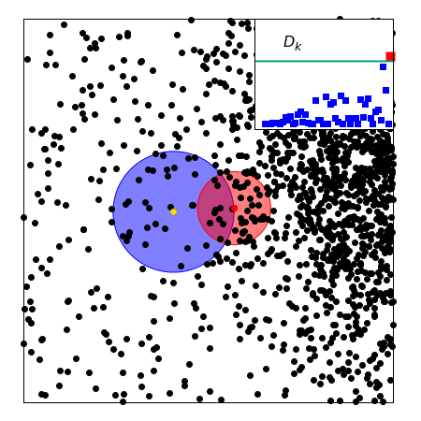


Pointwise Adaptive k-NN
Michele Allegra High-dimensional probability landscapes CECAM June 2018
Compare M1 (same ρ) and M2 (different ρ,ρ’) for point i and its neighbors j
start from first neighbor, then second ….
for each j , maximise
perform likelihood ratio test to compare M1,M2
stop when D is large, i.e. M2 is significantly
more likely (p < 10⁻⁷)

Slide 20



What is the right d?
Michele Allegra High-dimensional probability landscapes CECAM June 2018
The data actually lie on hypersurface of lower dimension than D
the density should be evaluated on this hypersurface
need good ID estimator!

Slide 21
Intrinsic dimension Estimation: TWO-NN
Michele Allegra High-dimensional probability landscapes CECAM June 2018
DPC
Pak
TWO-NN
A novel intrinsic dimension estimator

Slide 22


ID estimation: projective approach
Michele Allegra High-dimensional probability landscapes CECAM June 2018
Project D-dimensional data into lower dimension d :
Try different d and evaluate for each a “loss function”
measures the “data loss” occurring in the projection. Examples:
preservation of original distance relations
preservation of original covariance matrix
tradeoff between dimension reduction and data loss
Problem (1): Computationally burdensome (search for optimal projection for each d)
Problem (2): robust ID estimates only if has large gap as a function of d
if no gap, the estimation can be rather arbitrary

Slide 23

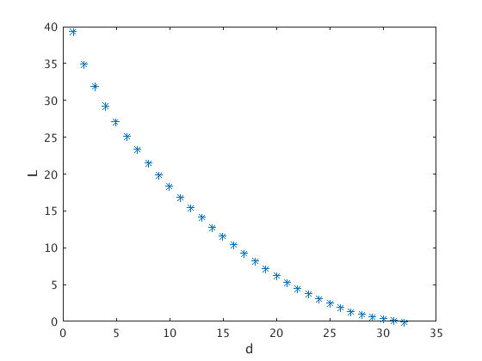
ID estimation: projective approach
Michele Allegra High-dimensional probability landscapes CECAM June 2018
Example: Principal Component Analysis (PCA)
Prjoects data onto linear subspace spanned by first d eigenvalues of
covariance matrix. Loss:
on the villin headpiece simulation:
How can one select an appropriate d?

Slide 24


ID estimation: statistical approach
Michele Allegra High-dimensional probability landscapes CECAM June 2018
assumes that the data are sampled from a distribution with density
distances between points in the dataset follow a scaling law that depends
on and d
If the dependence on can be removed, then d can be estimated from
the scaling
Example: correlation dimension
        The number of points at distance from point i scales as
        If is constant,
        d can be estimated with simple linear fit
However, when is variable the estimation fails dramatically

Slide 25


ID estimation: TWO-NN
Michele Allegra High-dimensional probability landscapes CECAM June 2018
E Facco, M D’Errico, A Rodriguez, A Laio, Scientific Reports 7, 12140. (2017)
In principle, one should evaluate simultaneously both d and !
TWO-NN idea: decouple the estimation problem by finding suitable function
of the distances that depends only on d
Assumption: is constant on the scale of the first two neighbors
Then if are distances from 1st and 2nd neighbor of point i,
their ratio follows a Pareto distribution:
depends only on d, not on !
Collect the for each point. Fit their emprical distribution and estimate d
The ID is inferred from the collectively

Slide 26
ID estimation: TWO-NN
Michele Allegra High-dimensional probability landscapes CECAM June 2018
E Facco, M D’Errico, A Rodriguez, A Laio, Scientific Reports 7, 12140. (2017)
In principle, one should evaluate simultaneously both d and !
TWO-NN idea: decouple the estimation problem by finding suitable function
of the distances that depends only on d
Assumption: is constant on the scale of the first two neighbors
Then if are distances from 1st and 2nd neighbor of point i,
their ratio follows a Pareto distribution:
depends only on d, not on !
Collect the for each point. Fit their emprical distribution and estimate d
The ID is inferred from the collectively

Slide 27
Reconstruction of a probability landscape
Reconstruction of a probability landscape
Reconstruction of a probability landscape
Michele Allegra High-dimensional probability landscapes CECAM June 2018
DPC
Pak
TWO-NN
We reconstruct a probability density, its intrinsic dimension, and its peaks in a high-dimensional space.
The reconstruction of the density effectively
takes place in a low-dimensional space,
without the need of collective variables

Slide 28

The problem of multiple IDs
Michele Allegra High-dimensional probability landscapes CECAM June 2018
If the fit is not good, it means the model fails
1) the density is strongly varying even on the scale of the first two neighbors
2) the dimension is not uniform in the dataset
The data may lie on several manifolds , each with different ID
How to deal with this heterogeneous ID case?

Slide 29
Heterogeneous ID: Hidalgo
Michele Allegra High-dimensional probability landscapes CECAM June 2018
DPC
Pak
TWO-NN
Hidalgo
A method to discrimimate regions of different ID in a data set

Slide 30




Hidalgo
Michele Allegra High-dimensional probability landscapes CECAM June 2018
H1) data sampled from manifolds of different ID
H2) ρ is uniform on scale of the first neighbors
Under H1), H2) one can still predict the expected distribution of the
Assume point sampled from with different probablities
mixture of Pareto distributions
The likelihood of the data is
Then we can again estimate
K fixed by trying increasing values in [1,Kmax] and performing a model selection test
e.g. likelihood ratio test

Slide 31







Hidalgo
Michele Allegra High-dimensional probability landscapes CECAM June 2018
To estimate parameters, fix inferential approach
A) frequentist:
B) Bayesian
    Fix
    Compute mean
Because of the sum over k, hard to work with
Introduce latent variables : manifold membership of each point
Likelihood is seen as marginal over
Estimate jointly
Heterogeneous ID algorithm (hidalgo)

Slide 32
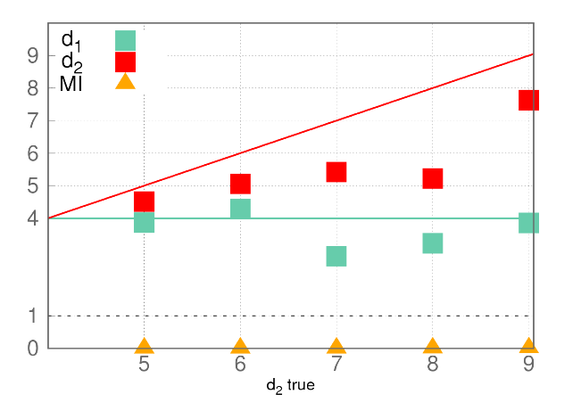
Hidalgo
Michele Allegra High-dimensional probability landscapes CECAM June 2018
Problem: this approach does not work!
Two manifolds of dimension
d1=4 and d2=5,..,9
(Gaussian ρ)
estimation of d1 and d2 is inaccurate
estimation of Z is completely wrong
Why?
Pareto distributions with different d
are highly overlapping
The Z assignation is based only on the μ
of each point
Difficult to assing Z if μ value is not predictive

Slide 33




Hidalgo
Michele Allegra High-dimensional probability landscapes CECAM June 2018
We get non-uniform neighborhoods
Neighboring points have different Z
We must assume that the manifolds are separated, with at most
a (small) intersection
This implies that the neighborhoods must be approximately uniform
We enforce this through additional term in the likelihood
Let the neighborhood of point i be defined by its first q neighbors
# neighbors with same Z as i # neighbors with diffferent Z
Parameter that controls degree of uniformity

Slide 34


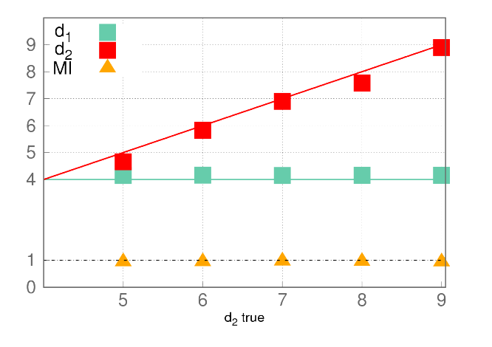
Hidalgo
Michele Allegra High-dimensional probability landscapes CECAM June 2018
We enforce uniform neighborhoods through additional term in the likelihood
Now we get correct estimates of both d,p and Z

Slide 35
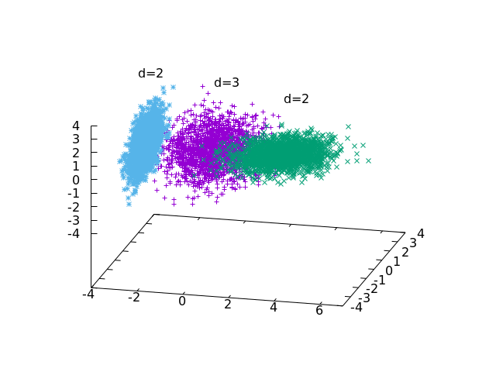
Hidalgo
Michele Allegra High-dimensional probability landscapes CECAM June 2018
M Allegra, E Facco, A Laio and A Mira, in prep. (2018)
We achieve a global topological description of the data space
Divide space into regions of uniform intrinsic dimension
Using the information on the Z, the different d could be used for a more
Precise density computation

Slide 36
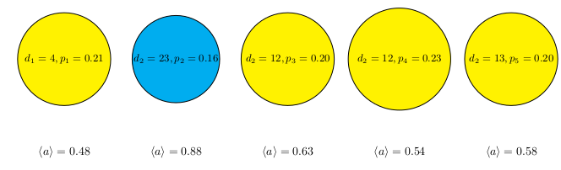
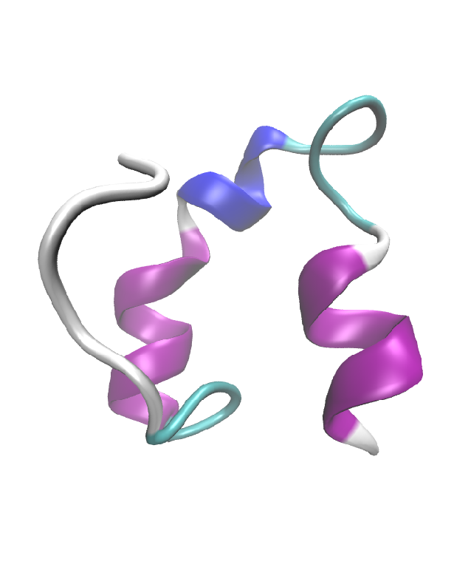
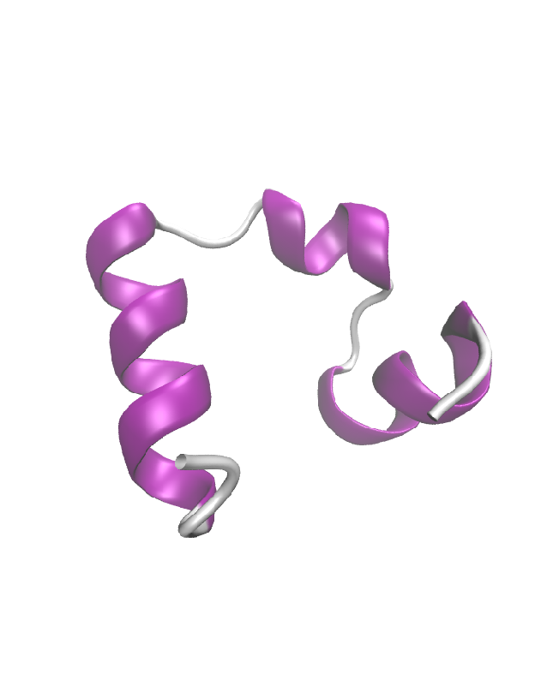
Hidalgo
Michele Allegra High-dimensional probability landscapes CECAM June 2018
Villin example
The folded state is recognized from its higher ID
We can identify it just with topological information

Slide 37
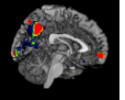

Charting high dimensional data spaces
Michele Allegra High-dimensional probability landscapes CECAM June 2018
A chain of methodological developments
A toolkit of methods
DPC
PAk
TWO-NN
Hidalgo
A lot of applications...
Molecular dynamics
Brain Imaging
Protein classification

Slide 38
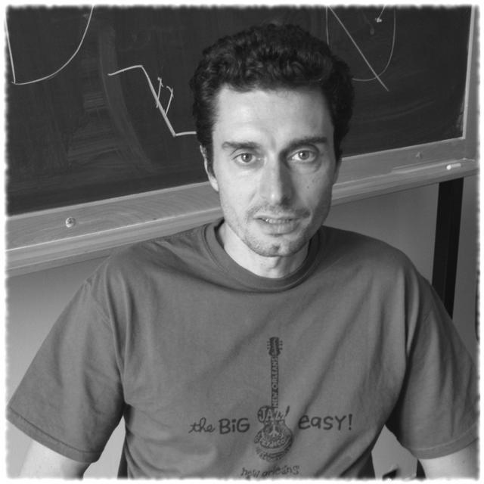
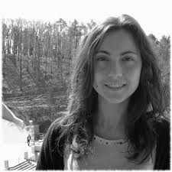


Acknowledgments
Michele Allegra High-dimensional probability landscapes CECAM June 2018
Alessandro Laio
Maria D’Errico
Elena Facco
Alex Rodriguez

Slide 39
Thank you for your attention!!
Michele Allegra High-dimensional probability landscapes CECAM June 2018

