Slide 1

DATA CLASSIFICATION BASED ON THE LOCAL INTRINSIC DIMENSION
Michele Allegra Data classification based on the intrinsic dimension USI April 2018

Slide 2
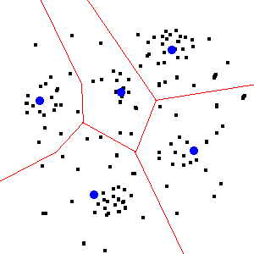



classification and intrinsic dimension
Michele Allegra Data classification based on the intrinsic dimension USI April 2018
Classification
hard in high dimension (many variables): computational problems, sampling issues...
# of independent directions of variation can be lower:
intrinsic dimension (ID)
Accounting for ID can improve classification schemes

Slide 3
Our journey: from classification to intrinsic dimension and back
Michele Allegra Data classification based on the intrinsic dimension USI April 2018
We started with a classification problem (clustering algorithm)
This required accurate ID estimation
We developed a method to estimate the ID
We realized than often the ID is not constant within a dataset
This in turn allows for rough, topologically-based data classification

Slide 4

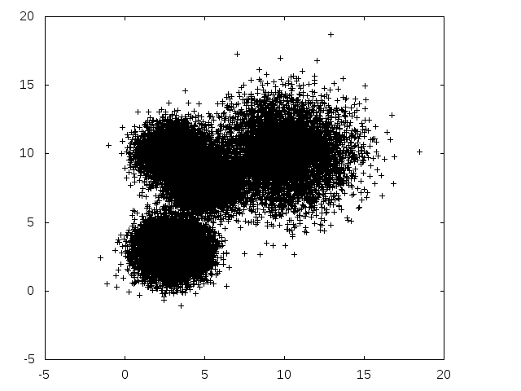
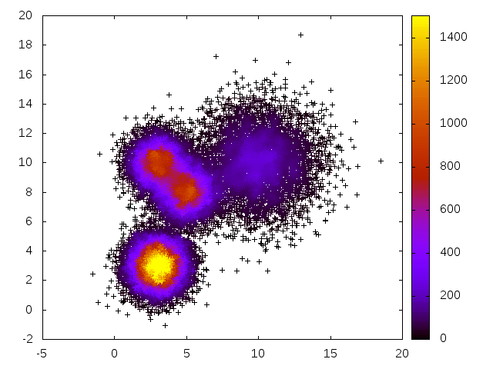
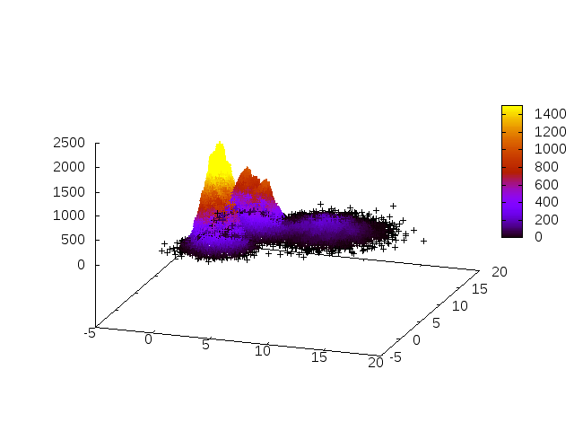
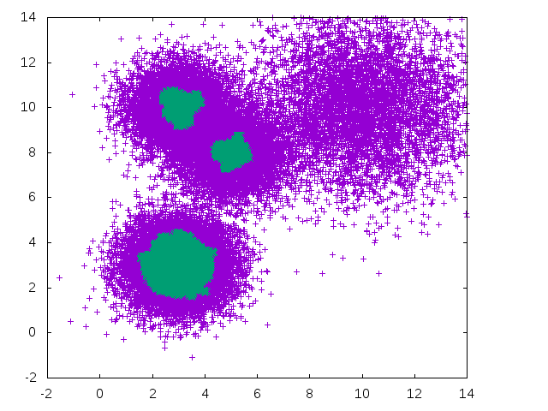
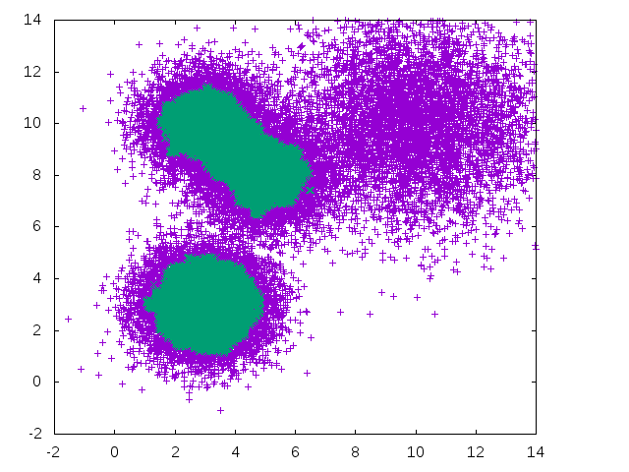
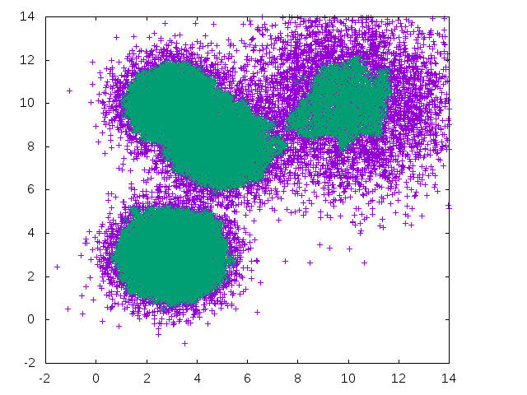
Density-based clustering
Michele Allegra Data classification based on the intrinsic dimension USI April 2018
Reconstruct the probability density of the data
Then look for disconnected regions of high density
What is high? Results depend on the chosen density threshold
Cannot resolve features at different density scalesl

Slide 5
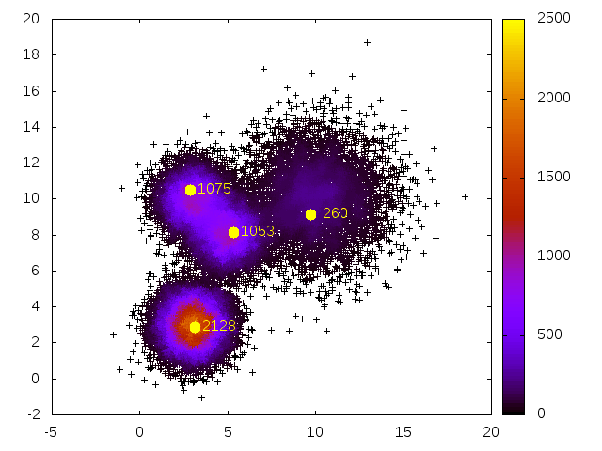


Density Peak Clustering
Michele Allegra Data classification based on the intrinsic dimension USI April 2018
A Rodriguez, A Laio, Science 344, 1492 (2014)
M d'Errico, E Facco, A Laio, A Rodriguez, arXiv:1802.10549 (2018)
Cluster around density peaks, i.e. local maxima in the density
Original algorithm: density peaks are far from any point with higher density
Compute for all points min distance from point at higher density
Peak are outliers in decision graph

Slide 6
Density-peak clustering
Michele Allegra Data classification based on the intrinsic dimension USI April 2018
Points are assigned to peaks by following a path of increasing density leading to one of the peaks.
One jumps from a point to a point with higher density

Slide 7
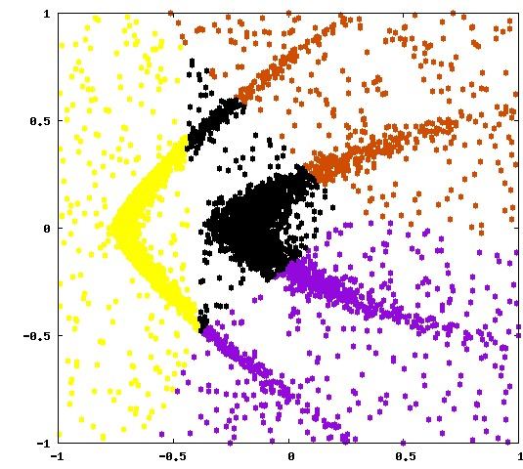
Density-peak clustering
Michele Allegra ISI 2017 Short-term coherent pattern detection in fMRI
A Rodriguez, A Laio, Science 344, 1492 (2014)
M d'Errico, E Facco, A Laio, A Rodriguez, arXiv:1802.10549 (2018)
.
Points are assigned to clusters by following a path of increasing density leading to one of the peaks.
This assignation rule allows to retrieve clusters of arbitrary shape
K-means
DPC

Slide 8
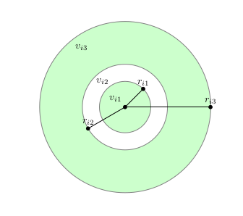



Density estimation
Michele Allegra Data classification based on the intrinsic dimension USI April 2018
Data can be thought of as samples of a density distribution
Reconstruct the probability density of the data with proper density estimator
K-nearest-neighbor: Assume ρ ≈ const in small region around each point
For each point i, consider its k nearest neighbors at
distances
density= k/volume of sphere containing the k points

Slide 9
Density Estimation: PAk
Michele Allegra Data classification based on the intrinsic dimension USI April 2018
A Rodriguez, M D’Errico, E Facco, A Laio, JCTC (2018)
K-nearest-neighbor: Assume ρ ≈ const in small region around each point
For each point i, consider its k nearest neighbors at
distances
density= k/volume of sphere containing the k points
Two problems:
1) what is right k?
2) what is right d?

Slide 10
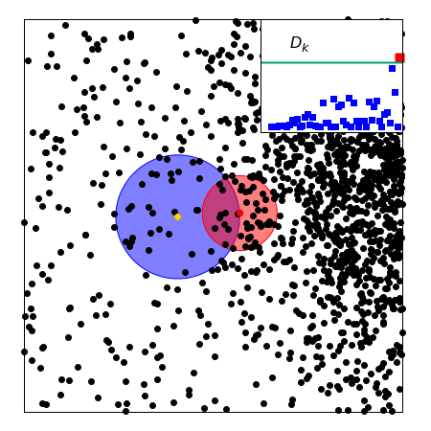
Density Estimation: PAk
Michele Allegra Data classification based on the intrinsic dimension USI April 2018
what is right k?
k too small: large error in the estimate
k too large: density is not constant over V
Solution:
Adapt k to each point so that the constant density assumption always holds
Pointwise Adaptive k-NN (PAk) estimator

Slide 11
Intrinsic dimension
Michele Allegra Data classification based on the intrinsic dimension USI April 2018
Problem 2): what is right d?
The data actually lie on hypersurface of lower dimension than D
The density should be evaluated on this hypersurface

Slide 12
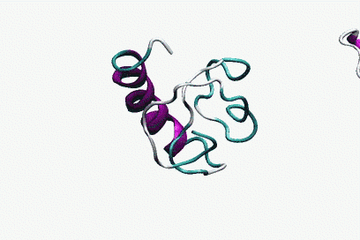
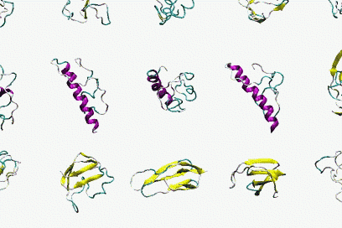
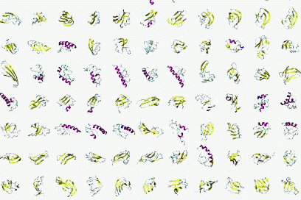
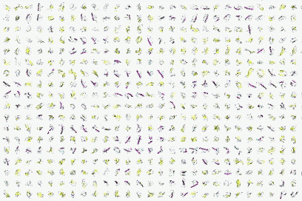


Intrinsic dimension
Example: molecular dynamics
Michele Allegra Data classification based on the intrinsic dimension USI April 2018
3xN
3xN

Slide 13
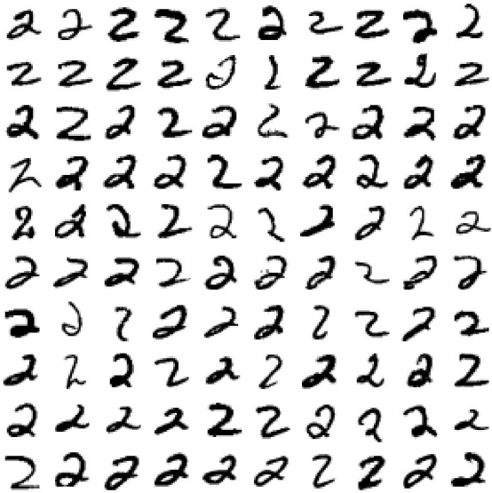
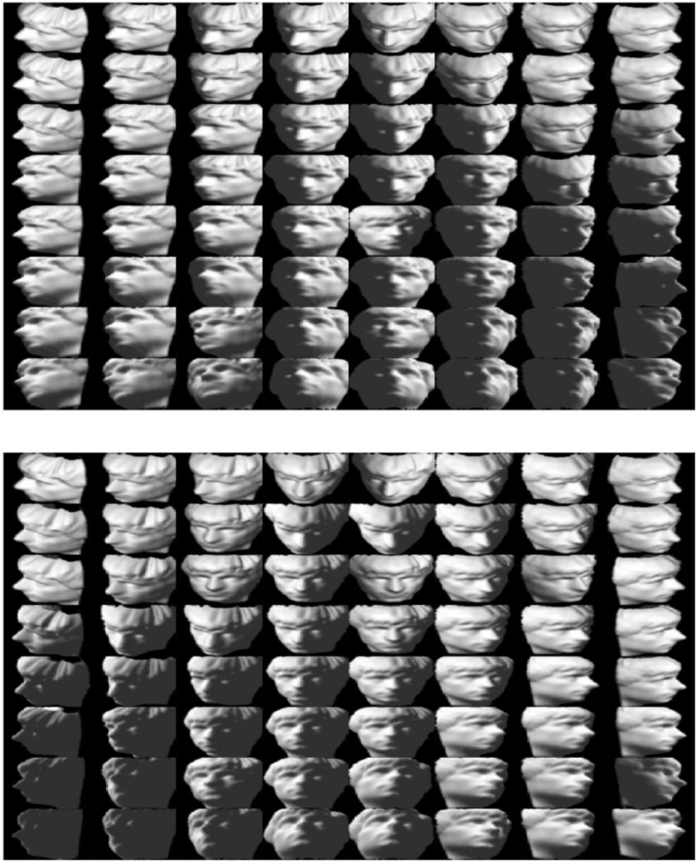
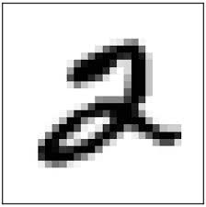
Intrinsic dimension
Example: images
Michele Allegra Data classification based on the intrinsic dimension USI April 2018
64x64
20x20

Slide 14




ID estimation: projective approach
Michele Allegra Data classification based on the intrinsic dimension USI April 2018
Project D-dimensional data into lower dimension d :
Try different d and evaluate for each a “loss function”
measures the “data loss” occurring in the projection. Examples:
preservation of original distance relations
preservation of original covariance matrix
tradeoff between dimension reduction and data loss
Problem (1): Computationally burdensome (search for optimal projection for each d)
Problem (2): robust ID estimates only if has large gap as a function of d
if no gap, the estimation can be rather arbitrary

Slide 15

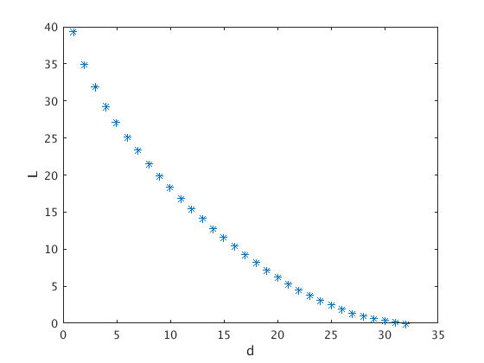
ID estimation: projective approach
Michele Allegra Data classification based on the intrinsic dimension USI April 2018
Example: Principal Component Analysis (PCA)
Prjoects data onto linear subspace spanned by first d eigenvalues of
covariance matrix. Loss:
on the villin headpiece simulation:
How can one select an appropriate d?

Slide 16


ID estimation: statistical approach
Michele Allegra Data classification based on the intrinsic dimension USI April 2018
assumes that the data are sampled from a distribution with density
distances between points in the dataset follow a scaling law that depends
on and d
If the dependence on can be removed, then d can be estimated from
the scaling
Example: correlation dimension
        The number of points at distance from point i scales as
        If is constant,
        d can be estimated with simple linear fit
However, when is variable the estimation fails dramatically

Slide 17


ID estimation: TWO-NN
Michele Allegra Data classification based on the intrinsic dimension USI April 2018
E Facco, M D’Errico, A Rodriguez, A Laio, Scientific Reports 7, 12140. (2017)
In principle, one should evaluate simultaneously both d and !
TWO-NN idea: decouple the estimation problem by finding suitable function
of the distances that depends only on d
Assumption: is constant on the scale of the first two neighbors
Then if are distances from 1st and 2nd neighbor of point i,
their ratio follows a Pareto distribution:
depends only on d, not on !
Collect the for each point. Fit their emprical distribution and estimate d
The ID is inferred from the collectively

Slide 18
ID estimation: TWO-NN
Michele Allegra Data classification based on the intrinsic dimension USI April 2018
E Facco, M D’Errico, A Rodriguez, A Laio, Scientific Reports 7, 12140. (2017)
In principle, one should evaluate simultaneously both d and !
TWO-NN idea: decouple the estimation problem by finding suitable function
of the distances that depends only on d
Assumption: is constant on the scale of the first two neighbors
Then if are distances from 1st and 2nd neighbor of point i,
their ratio follows a Pareto distribution:
depends only on d, not on !
Collect the for each point. Fit their emprical distribution and estimate d
The ID is inferred from the collectively

Slide 19



ID estimation: TWO-NN
Michele Allegra Data classification based on the intrinsic dimension USI April 2018
There are several ways of fitting:
One can fit the empirical cumulative distribution of with
Equivalently, linear fit on
If the model is satisfied, then the distribution of the is well fitted (check )

Slide 20

The problem of multiple IDs
Michele Allegra Data classification based on the intrinsic dimension USI April 2018
If the fit is not good, it means the model fails
1) the density is strongly varying even on the scale of the first two neighbors
2) the dimension is not uniform in the dataset
The data may lie on several manifolds , each with different ID
How to deal with this heterogeneous ID case?

Slide 21
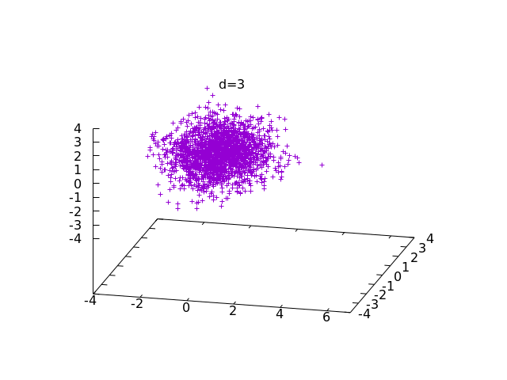
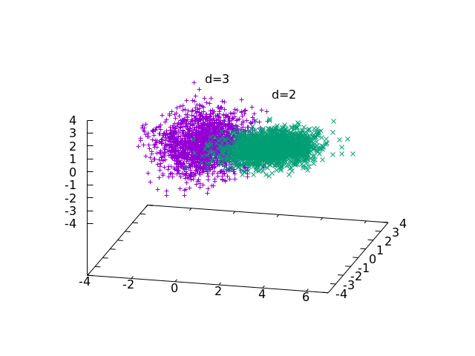
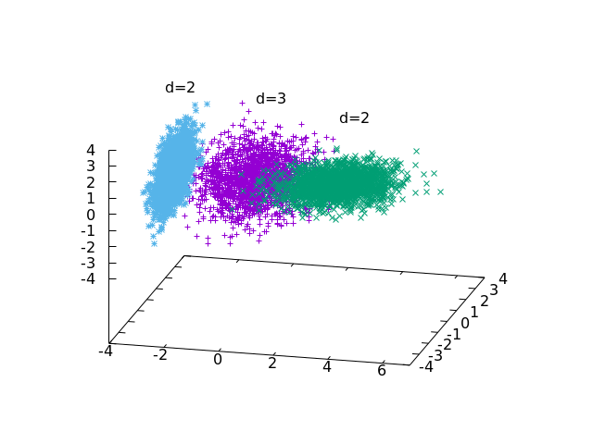
Heterogeneous ID
Michele Allegra Data classification based on the intrinsic dimension USI April 2018
he data may lie on several manifolds, each with different ID

Slide 22




Hidalgo
Michele Allegra Data classification based on the intrinsic dimension USI April 2018
H1) data sampled from manifolds of different ID
H2) ρ is uniform on scale of the first neighbors
Under H1), H2) one can still predict the expected distribution of the
Assume point sampled from with different probablities
mixture of Pareto distributions
The likelihood of the data is
Then we can again estimate
K is not estimated as a parameter
Fix K by trying increasing values in [1,Kmax] and performing a model selection test

Slide 23







Hidalgo
Michele Allegra Data classification based on the intrinsic dimension USI April 2018
To estimate parameters, fix inferential approach
A) frequentist:
B) Bayesian
    Fix
    Compute mean
Because of the sum over k, hard to work with
Introduce latent variables : manifold membership of each point
Likelihood is seen as marginal over
Estimate jointly
Heterogeneous ID algorithm (hidalgo)

Slide 24
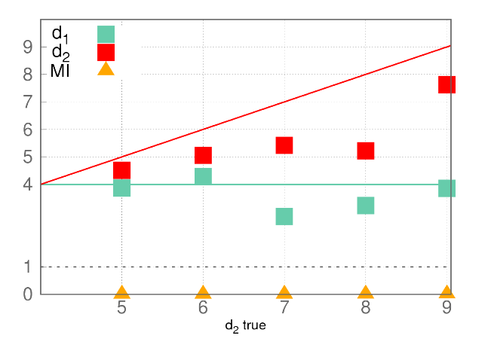
Hidalgo
Michele Allegra Data classification based on the intrinsic dimension USI April 2018
Problem: this approach does not work!
Two manifolds of dimension
d1=4 and d2=5,..,9
(Gaussian ρ)
estimation of d1 and d2 is inaccurate
estimation of Z is completely wrong
Why?
Pareto distributions with different d
are highly overlapping
The Z assignation is based only on the μ
of each point
Difficult to assing Z if μ value is not predictive

Slide 25




Hidalgo
Michele Allegra Data classification based on the intrinsic dimension USI April 2018
We get non-uniform neighborhoods
Neighboring points have different Z
We must assume that the manifolds are separated, with at most
a (small) intersection
This implies that the neighborhoods must be approximately uniform
We enforce this through additional term in the likelihood
Let the neighborhood of point i be defined by its first q neighbors
# neighbors with same Z as i # neighbors with diffferent Z
Parameter that controls degree of uniformity

Slide 26


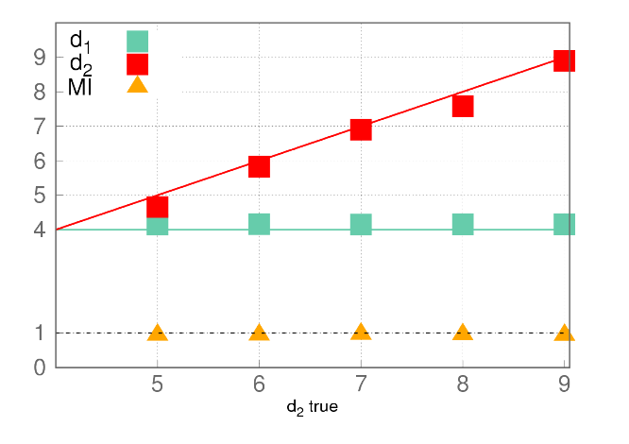
Hidalgo
Michele Allegra Data classification based on the intrinsic dimension USI April 2018
We enforce uniform neighborhoods through additional term in the likelihood
Now we get correct estimates of both d,p and Z

Slide 27
Hidalgo
Michele Allegra Data classification based on the intrinsic dimension USI April 2018
M Allegra, E Facco, A Laio and A Mira, in prep. (2018)
We achieve a global topological description of the data space
Divide space into regions of uniform intrinsic dimension

Slide 28

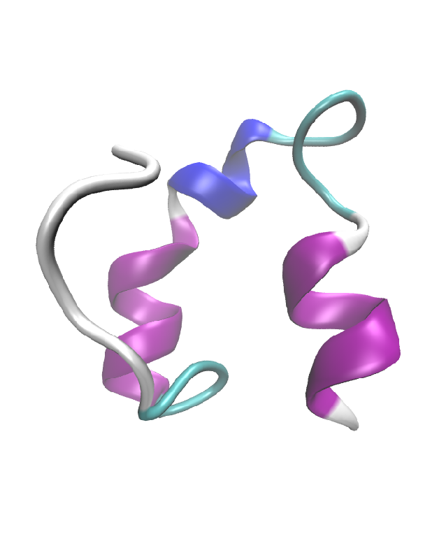
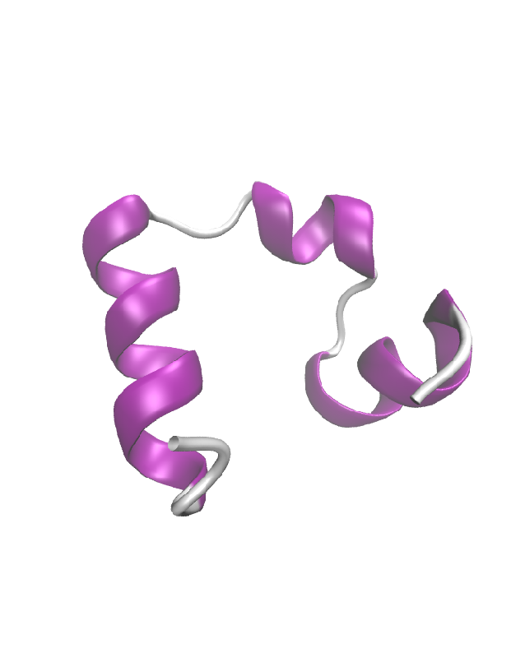
Hidalgo
Michele Allegra Data classification based on the intrinsic dimension USI April 2018
Example: molecular dynamics
Example: molecular dynamics
Example: molecular dynamics
consider a MD of unfolding/refolding villing headpiece
for each of the N ~ 32000 configurations, D=32 dihedral angles.
We find four manifolds
d=12 d=13 d=13 d=23
Q=0.53 Q=0.58 Q=0.64 Q=0.89 Fraction of native contacts
The folded state is recognized from its higher ID!

Slide 29
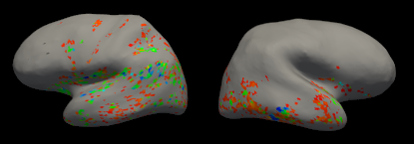
Hidalgo
Michele Allegra Data classification based on the intrinsic dimension USI April 2018
Example: fMRI time series
consider ~30000 time series corresponding to BOLD signal of each voxel in an fMRI experiment
for each of the N ~ 30000 time sieries, D=202 values
We find two manifolds: d=16, d=32
Red: high-ID voxels
Blue: “task-relevant” voxels
Green: intersection
Task-relevant voxels are in the manifold with higher ID
The low-dimensional manifold nostly includes “noise” voxels

Slide 30
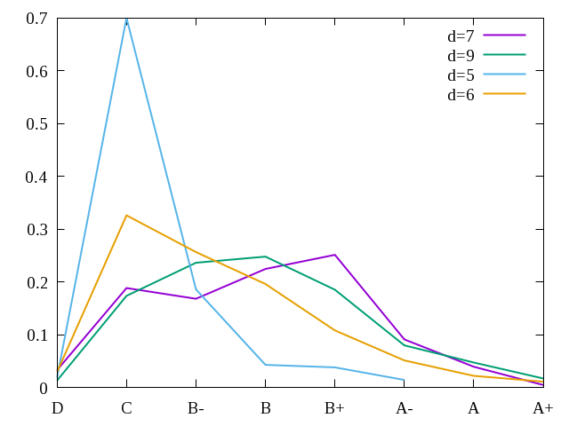
Hidalgo
Michele Allegra Data classification based on the intrinsic dimension USI April 2018
Example: firms from Compustat
consider ~8000 firms in the Compustat Database
for each of the firms, D=31 balance sheet variables
We find four manifolds: d=5, d=6, d=7, d=9
We compute S&P ratings for the different manifolds
Lower dimension tends to have lower ratings!

Slide 31
Data classification based on the intrinsic dimension
Michele Allegra Data classification based on the intrinsic dimension USI April 2018
The problem of clustering led us to the problem of density estimation;
the problem of density estimation led us to the problem of ID estimation
We developed a reliable ID estimator, TWO-NN, that limits the issue of density variations
We realized that often the ID is not constant in the dataset: we extended the statistical framework of TWO-NN to comply with this case
We developed Hidalgo, a method that finds groups of points (manifolds) of
different ID in the manifold
Applications of Hidalgo to real datasets reveal that the topological information given by the ID discriminates points differing in important features

Slide 32




Acknowledgments
Michele Allegra Data classification based on the intrinsic dimension USI April 2018
Alessandro Laio
Alex Rodriguez
Elena Facco
Antonietta Mira

Slide 33
Thank you for your attention!!
Michele Allegra Data classification based on the intrinsic dimension USI April 2018

Slide 34
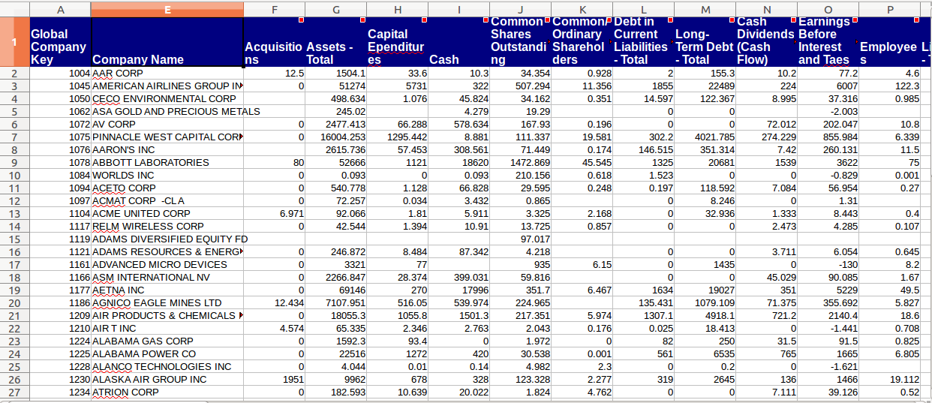
Charting complex landscapes in phase space
Michele Allegra Data classification based on the intrinsic dimension USI April 2018

Slide 35
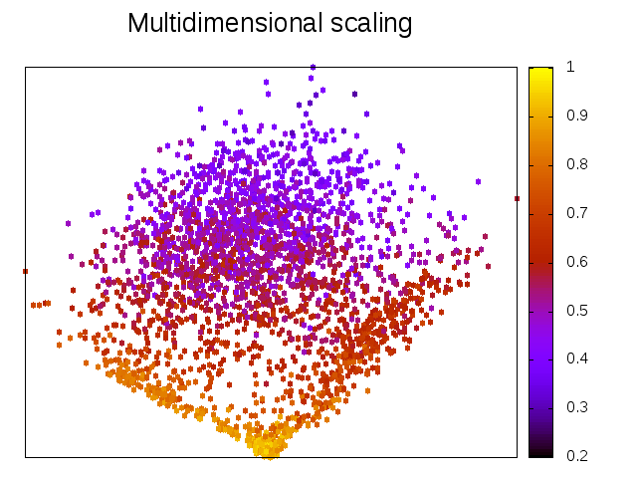
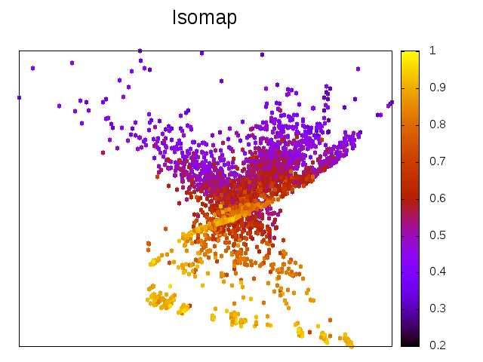
Example: phase space landscape of folding protein
We can try to project the data in 2D with several methods
The resulting maps are quantitatively (and qualitatively) inaccurate
Michele Allegra Data classification based on the intrinsic dimension USI April 2018
consider a MD of unfolding/refolding villing headpiece
for each of the N ~ 32000 configurations, D=32 dihedral angles.

Slide 36

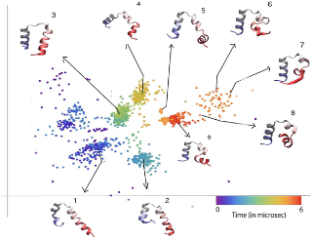

Charting complex data landscapes
Michele Allegra Data classification based on the intrinsic dimension USI April 2018
From molecular dynamics...
...to general data
characterize complex free energy landscapes
characterize structures in complex data spaces

Slide 37

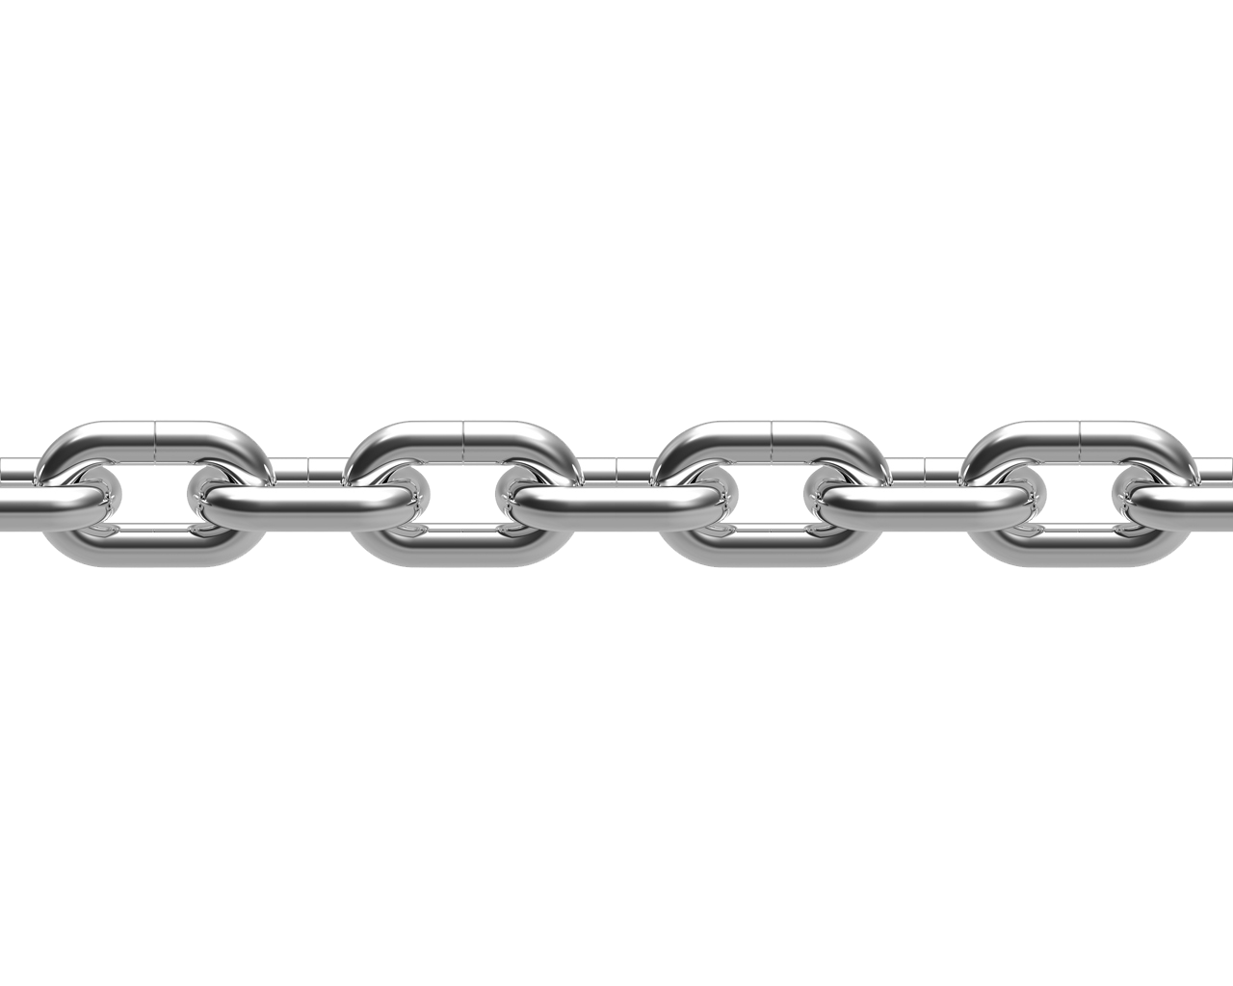

An intrusion into data analysis
Michele Allegra Data classification based on the intrinsic dimension USI April 2018
From physics
to data analysis
A chain of methodological developments
A toolkit of methods
DPC
PaK
TWO-NN
Hidalgo

Slide 38
Charting complex landscapes in phase space
Michele Allegra Data classification based on the intrinsic dimension USI April 2018

