Slide 1
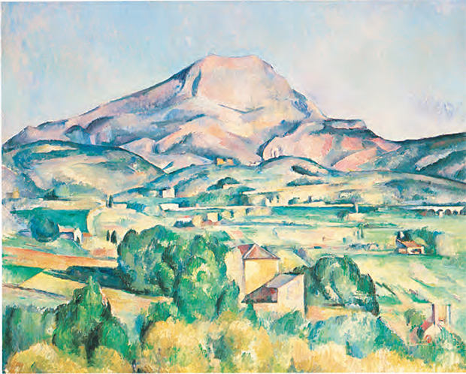
LOCAL MODELS FOR MULTIDIMENSIONAL PROBABILITY LANDSCAPES
Michele Allegra Local models for multidimensional probability landcapes SIS June 2018

Slide 2

Outline
Michele Allegra Local models for multidimensional probability landcapes SIS June 2018
Motivation: a rigorous basis for a clustering method
A local model of nearest-neighbor distances under the assumption of locally constant density
Density estimation
Intrinsic dimension estimation
An extension of the model for heterogeneous intrinsic dimension

Slide 3

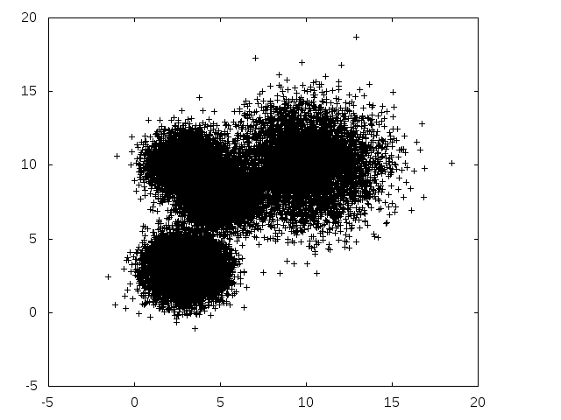
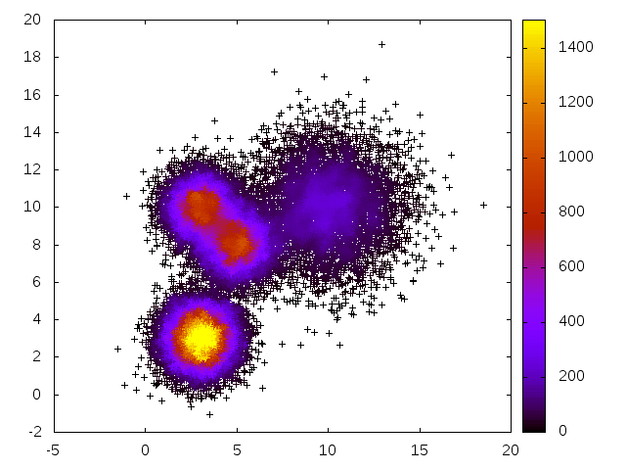
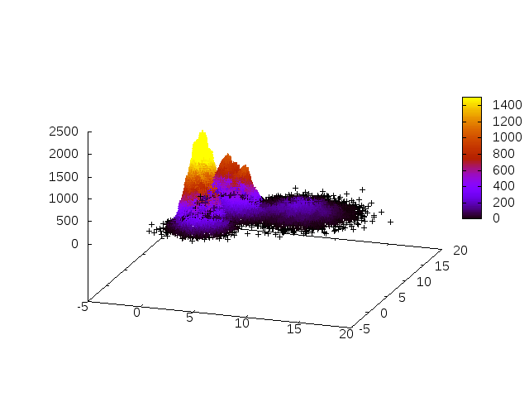
Density peak clustering
Michele Allegra Local models for multidimensional probability landcapes SIS June 2018
Find modes (peaks) of a density distribution
Reconstruct density around each point with ε-ball counting:
A Rodriguez, A Laio, Science 344, 1492 (2014)

Slide 4

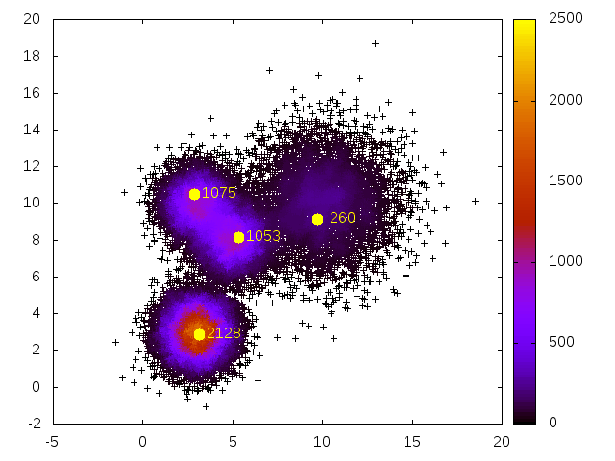
Density Peak Clustering
Michele Allegra Local models for multidimensional probability landcapes SIS June 2018
ρ maxima are far from points with lower ρ
Compute minimum distance from point at higher ρ
Peak are outliers in decision graph ρi vs δi

Slide 5
Density-peak clustering
Michele Allegra Local models for multidimensional probability landcapes SIS June 2018
Points are assigned to peaks by following a path of increasing density leading to one of the peaks.

Slide 6
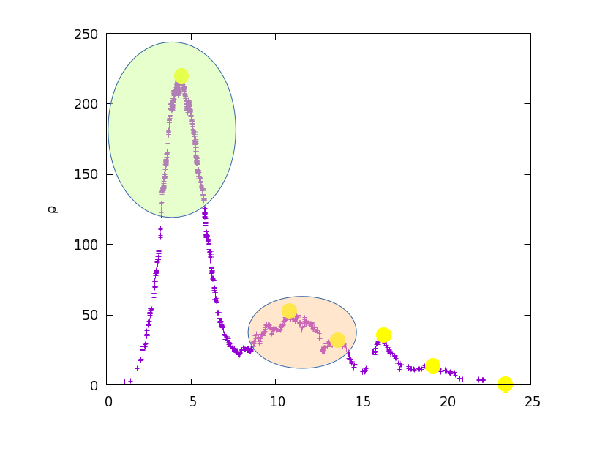
Validating DPC
Michele Allegra Local models for multidimensional probability landcapes SIS June 2018
“Significance” of the peaks?
Peaks or density fluctuations?

Slide 7
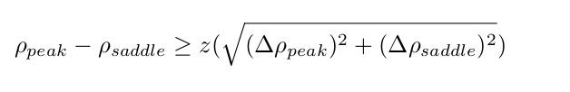
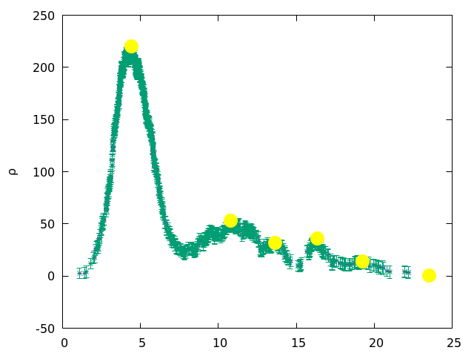
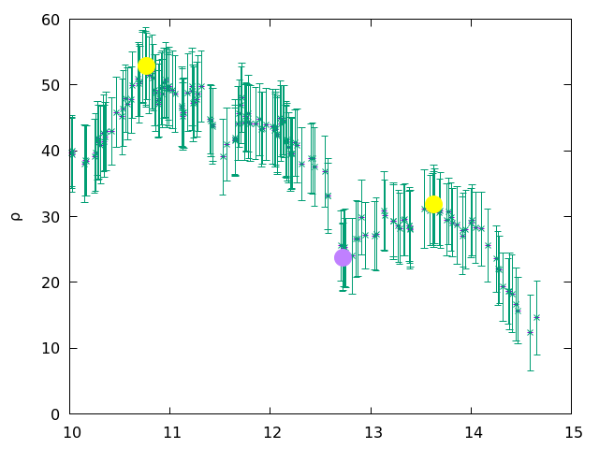
Validating DPC
Michele Allegra Local models for multidimensional probability landcapes SIS June 2018
Find peaks and saddle points
Compute error Δρ
Significance:

Slide 8

A local model for the data
Michele Allegra Local models for multidimensional probability landcapes SIS June 2018
No global model for the data
Only two broad assumptions:
H1) the data points xi are independent samples from a density ρ(x).
H2) local uniformity: for all xi, there exists (small) k such that ρ(x) ~ const. in the region containing the first k neighbors of xi
local model for the distribution of neighbor distances around each point
# points within a small region around each point follows Poisson process with parametric dependence on ρ

Slide 9

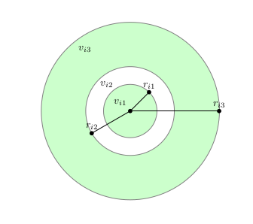

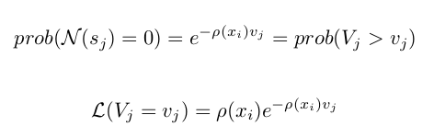

Estimating the density
Michele Allegra Local models for multidimensional probability landcapes SIS June 2018
k nearest neighbors of i at distances
hyperspherical shells Sj enclosed between neighbors
volumes
distribution of shell volumes Vj follows from Poisson process
Considering all volumes
Local model of NN distances depending on ρ

Slide 10
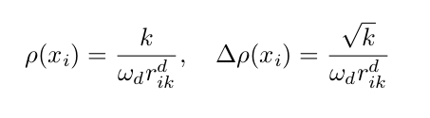
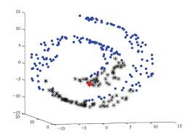
Estimating the density
Michele Allegra Local models for multidimensional probability landcapes SIS June 2018
By max likelihood estimate ρ and error Δρ
Two problems:
1) what is right k?
2) what is right d?
What is right k? increase k until local model fails
What is right d? Intrinsic dimension
The data lie on d-dimensional hypersurface
ρ should be evaluated on this hypersurface
[Rodriguez et al., JCTC 2017]

Slide 11
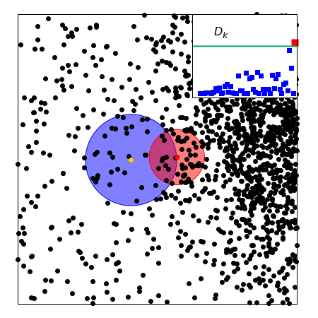


Pointwise Adaptive k-NN
Michele Allegra Local models for multidimensional probability landcapes SIS June 2018
A Rodriguez, M D’Errico, E. Facco and A Laio, JCTC 14 (3), 1206 (2017)
Compare M1 (same ρ) and M2 (different ρ,ρ’) for point i and its neighbors j
start from first neighbor, then second ….
for each j , maximise
perform likelihood ratio test to compare M1,M2
stop when D is large, i.e. M2 is significantly
more likely (p < 10⁻⁷)

Slide 12
Intrinsic dimension estimation
Michele Allegra Local models for multidimensional probability landcapes SIS June 2018
Problem 2): what is right d?
The data actually lie on hypersurface of lower dimension than D
the density should be evaluated on the hypersurface supporting the points
find good ID estimator!

Slide 13





ID estimation: TWO-NN
Michele Allegra Local models for multidimensional probability landcapes SIS June 2018
E Facco, M D’Errico, A Rodriguez, A Laio, Scientific Reports 7, 12140 (2017)
local model for k=2
distribution of ν is independent of ρ
under local model, distribution of μ depends only on d
ID can be inferred from the μ of all points collectively
This is independent of the estimates of ρ
(assuming ρ is constant over scale of first 2 neighbors)

Slide 14



ID estimation: TWO-NN
Michele Allegra Local models for multidimensional probability landcapes SIS June 2018
There are several ways of fitting:
One can fit the empirical cumulative distribution of with
Equivalently, linear fit on
If the model is satisfied, then the distribution of the is well fitted (check )

Slide 15

The problem of multiple IDs
Michele Allegra Local models for multidimensional probability landcapes SIS June 2018
If the fit is not good, it means the model fails
1) the density is strongly varying even on the scale of the first two neighbors
2) the dimension is not uniform in the dataset
The data may lie on several manifolds , each with different ID
How to deal with this heterogeneous ID case?

Slide 16





ID estimation: heterogeneous case
Michele Allegra Local models for multidimensional probability landcapes SIS June 2018
ID may not be uniform in the dataset!
H3) ρ(x) has support on the union of a finite number K of manifolds
with different intrinsic dimensions
M Allegra, E Facco, A Laio and A Mira, in prep. (2018)
Mixture model
Under H1), H2) one can still predict the expected distribution of the μ
mixture of Pareto distributions
The likelihood of the data is
Then we can again estimate

Slide 17
ID estimation: heterogeneous case
Michele Allegra Local models for multidimensional probability landcapes SIS June 2018
ID may not be uniform in the dataset!
H3) ρ(x) has support on the union of a finite number K of manifolds
with different intrinsic dimensions
M Allegra, E Facco, A Laio and A Mira, in prep. (2018)
Mixture model
Under H1), H2) one can still predict the expected distribution of the μ
mixture of Pareto distributions
The likelihood of the data is
Then we can again estimate

Slide 18




ID estimation: heterogeneous case
Michele Allegra Local models for multidimensional probability landcapes SIS June 2018
Introduce latent variables (manifold membership of each point)
Likelihood with latent variables
Estimate jointly
K fixed by trying increasing values in [1,Kmax] and performing a model selection test e.g. likelihood ratio test
Problem:
Pareto distributions with different d are highly overlapping
estimation of manifold membership fails
diagnostic: neighboring points have different Z

Slide 19




Hidalgo
Michele Allegra Local models for multidimensional probability landcapes SIS June 2018
H4) the first q neighbors of a point mostly belong to the same manifold
Probabilistic requirement on the Z of neighboring points
Ζ: be probability that a neighbour of i belong to same manifold as i
# neighbors with same Z as i
# neighbors with diffferent Z
additional term in the likelihood
Controls the degree of uniformity

Slide 20
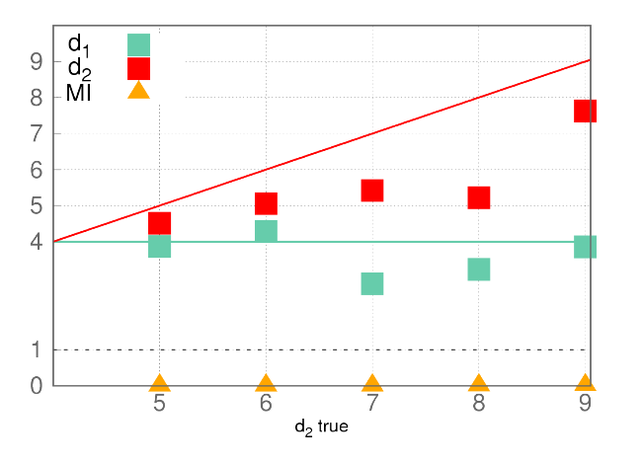
Hidalgo
Michele Allegra Local models for multidimensional probability landcapes SIS June 2018
Problem: this approach does not work!
Two manifolds of dimension
d1=4 and d2=5,..,9
(Gaussian ρ)
estimation of d1 and d2 is inaccurate
estimation of Z is completely wrong
Why?
Pareto distributions with different d
are highly overlapping
Difficult to assign a point based only on its ν

Slide 21
Hidalgo
Michele Allegra Local models for multidimensional probability landcapes SIS June 2018
We get non-uniform neighborhoods
Neighboring points have different Z
We must assume that the manifolds are separated, with at most
a (small) intersection
This implies that the neighborhoods must be approximately uniform
We enforce this through additional term in the likelihood
Let the neighborhood of point i be defined by its first q neighbors
# neighbors with same Z as i # neighbors with diffferent Z
Parameter that controls degree of uniformity

Slide 22

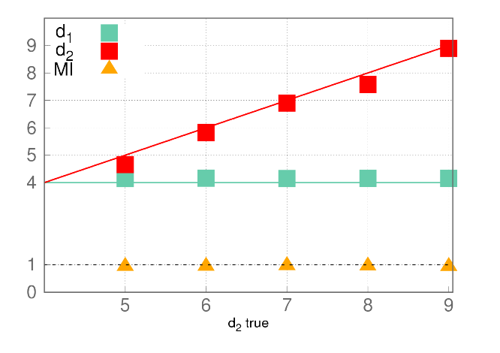
Hidalgo
Michele Allegra Local models for multidimensional probability landcapes SIS June 2018
We enforce uniform neighborhoods through additional term in the likelihood
Now we get correct estimates of both d,p and Z

Slide 23
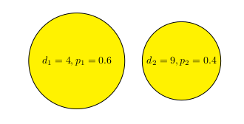
Hidalgo
Michele Allegra Local models for multidimensional probability landcapes SIS June 2018
We achieve a global topological description of the data space
Divide space into regions of uniform intrinsic dimension
We can represent the size and dimension of the manifolds with a diagram
More “essential” than the density dendrogram
Using the information on the Z, the different d could be used for a more
Precise density computation

Slide 24
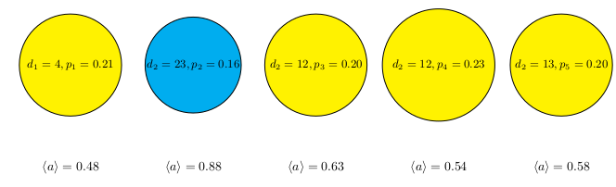
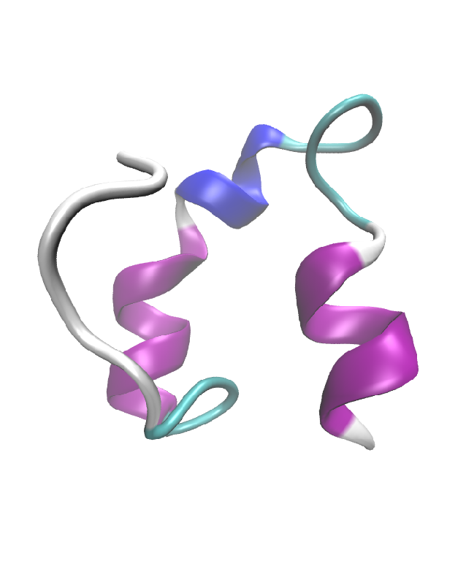
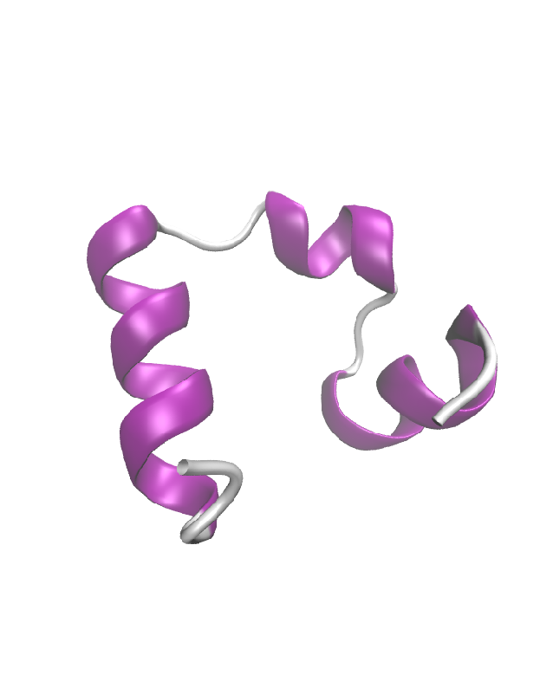
Hidalgo
Michele Allegra Local models for multidimensional probability landcapes SIS June 2018
Villin example
The folded state is recognized from its higher ID
We can identify it only with topological information

Slide 25



Two types of data analysis
Michele Allegra Local models for multidimensional probability landcapes SIS June 2018
Confirmatory analyis
Starts from assumed model for the data, given a priori
Uses statistics to verify whether the data fit the assumed model
Can be rigid: fail to exploit richness of the data
Exploratory analyis
Procedures (algorithms) to find structure in the data
Often, no formal evaluation of the results
Danger of falling into magical thinking
(seeing structures that are not there)

Slide 26
A possible compromise
Michele Allegra Local models for multidimensional probability landcapes SIS June 2018
We started with E.D.A. method (density peak clustering) with no statistical validation of results
for statistical validation, some assumption on the data was needed
we introduced minimal assumptions on the data, allowing to maintain high flexibility
as a result, we developed complex procedure to reconstruct probability density, its intrinsic dimension and peaks in high dimensional space

Slide 27

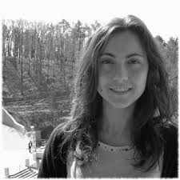



Acknowledgments
Michele Allegra Local models for multidimensional probability landcapes SIS June 2018
Alessandro Laio
Maria d’Errico
Elena Facco
Alex Rodriguez
Antonietta Mira

Slide 28

Hidalgo
Michele Allegra Local models for multidimensional probability landcapes SIS June 2018
Example: molecular dynamics
Example: molecular dynamics
Example: molecular dynamics
consider a MD of unfolding/refolding villing headpiece
for each of the N ~ 32000 configurations, D=32 dihedral angles.
We find four manifolds
d=12 d=13 d=13 d=23
Q=0.53 Q=0.58 Q=0.64 Q=0.89 Fraction of native contacts
The folded state is recognized from its higher ID!

