Slide 1

Michele Allegra #
A physicist and the brain exploratory analysis tools from physics to neuroscience
Michele Allegra A physicist and the brain Padova, May 2020
# Institut de Neurosciences de la Timone, Aix Marseille Université, CNRS, Marseille, France

Slide 2
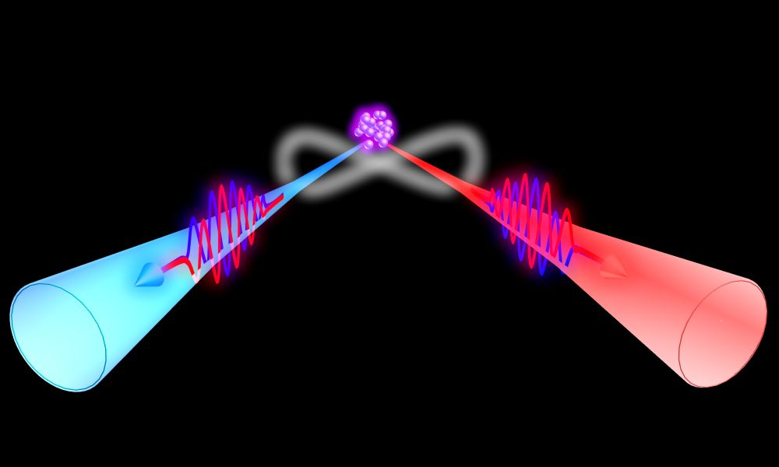
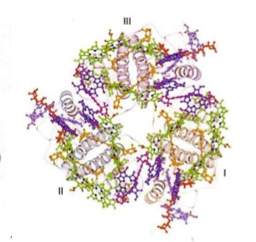
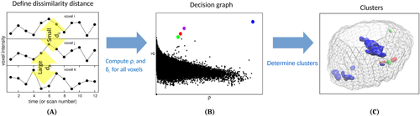
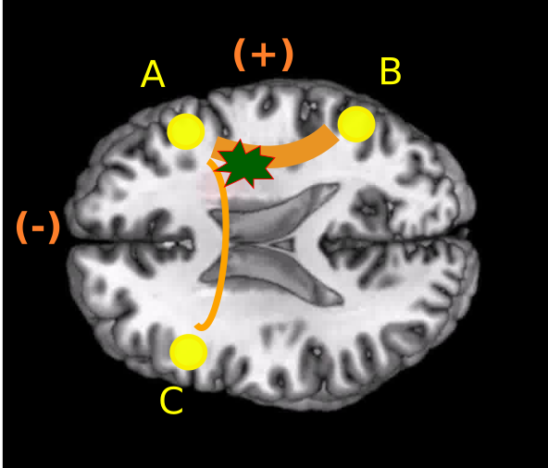
About myself
Michele Allegra A physicist and the brain Padova, May 2020
2011-2014 PhD in Physics, University of Turin and ISI, Turin (with P Giorda)
visiting MIT, Cambridge MA (with S Lloyd)
information loss in quantum systems interacting with macroscopic environment
Photons
M Allegra, P Giorda, MGA Paris, PRL 105 (10), 100503
Photosynthetic Trimer
M Allegra, P Giorda, S Lloyd, PRA 93 (4), 042312
2015-2017 Postdoc, SISSA, Trieste (with D Amati, A Laio)
Advanced clustering techniques and applications to fMRI
M Allegra, S Seyed‐Allaei, …., C Reverberi, A Laio, D Amati, HMB 38 (3), 1421-1437
M Allegra, S Seyed-Allaei, NW Schuck, D Amati, A Laio, C Reverberi, NeuroImage, 116854
2018-2020 Postdoc, Intitute Neurosciences Timone, CNRS, Marseille (with A Brovelli, M Corbetta)
Information transfer and brain dynamics in stroke
M Allegra, C Favaretto, .., M Corbetta, A Brovelli, in prep.

Slide 3
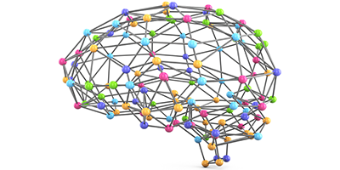
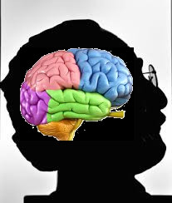

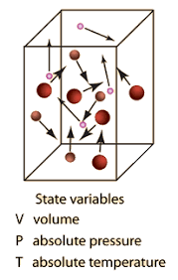
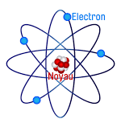
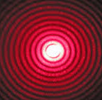

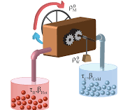
Physics of the brain?
Michele Allegra A physicist and the brain May 2020
Physics of the brain
A physicist’s brain
Abstact concepts are largely metaphorical George Lakoff, Metaphors we live by
        Galaxies are a gas
        Electrons are waves
        Black holes are a heat engine
Formalism Translation Intuition

Slide 4




Exploring dynamics from physics to neuroscience
Michele Allegra A physicist and the brain Padova, May 2020
Characterize brain dynamics
Ideas and formalism originally thought for chaotic sytems
Part 1: Information transfer and brain dynamics upon stroke [M. Allegra, C. Favaretto, M. Corbetta, A. Brovelli, in prep. (2020)]
        Measures of information transfer
        Post-stroke anomalies in information transfer
Part 2: the dimension of data and «attractors» of complex systems [M. Allegra, E. Facco, A. Laio and A. Mira, sub. (2020); arXiv:1902.10459 ]
        Estimates of the intrinsic dimension of data
        Possible applications on brain dynamics

Slide 5
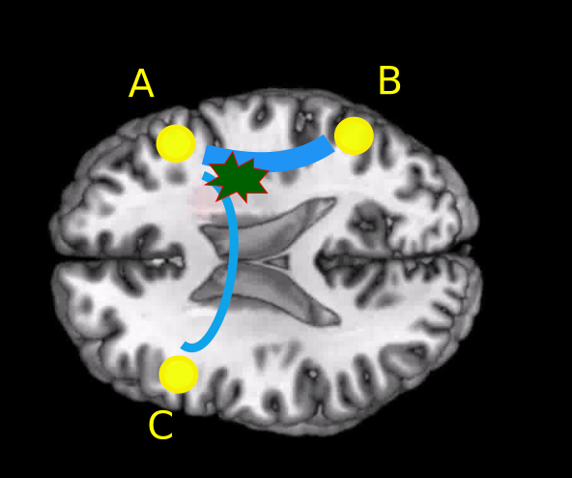
Brain dynamics upon stroke
Michele Allegra A physicist and the brain Padova, May 2020
Stroke induces focal lesions
Lesions are subortical and affects structural connections
Several areas cannot communicate information (disconnection syndrome)
How is information transfer perturbed in the brain after stroke?
From previous studies with functional connectivity [Siegel et al., PNAS 113.30 (2016)]
The two hemispheres are less synchronized with one another
The two hemispheres are more synchronized internally
Does this correspond to shifts in information transfer?

Slide 6

Information production
Michele Allegra A physicist and the brain Padova, May 2020
The concept of information production was born in the study of chaotic systems
[M. Falcioni, V. Loreto, A. Vulpiani. in The Kolmogorov legacy in physics, Springer].
FX→X
Xpast= Xt-1, Xt-2, …,Xt-L
Xt
Uncertainty of Xt = H(Xt ) [H=Shannon entropy]
prediction: Xpast gives information FX→X about Xt:
new information production: H(Xt|Xpast)
FX→X = H(Xt) –H(Xt|Xpast)

Slide 7

Information production in composite systems
Michele Allegra A physicist and the brain Padova, May 2020
Xpast
Xt
FX→Y
FX•∙Y
FY→X
Ypast
Yt
information produced jointly H(XtYt|XpastYpast) vs independently H(Xt|Xpast) + H(Yt|Ypast)
They differ, because X predicts information about Y and viceversa [T. Schreiber, Phys. Rev. Lett. 85, 461 (2001)]
Three terms explain the difference: FX→Y + FY→X + FX•∙Y
FY→X = H(Xt |Xpast )-H(Xt |XpastYpast ) information about Xt predicted exclusively in Ypast (and not Xpast) [reverse for FX→Y]
FX•∙Y = H(Xt |Xpast Ypast)-H(Xt |YtXpastYpast ) information about Xt predicted exclusively in Yt (and not Xpast,Ypast) [symmetric]

Slide 8
Information production in composite systems2
Michele Allegra A physicist and the brain Padova, May 2020
Xpast
Xt
FX→Y
FX•∙Y
FY→X
Ypast
Yt
FX→Y (or FY→X) was called transfer entropy by Shreiber [T. Schreiber, Phys. Rev. Lett. 85, 461, 2001)] directed information flow from X to Y (or Y to X)
FX∙Y was called instantaneous interaction by Geweke [J. Geweke, J. Am. Stat. Ass. 77.378 (1982)] «instantaneous» (∆t<1) information flow/sharing between X and Y
FX→Y FY→X coincide with notion of Granger causality for Gaussian systems [L. Barnett et al., Phys. Rev. Lett. 103, 238701 (2009)]

Slide 9
Michele Allegra A physicist and the brain Padova, May 2020
Xpast
FX→Y
Xt
FX•∙Y
FY→X
Ypast
Yt
FX→Y (or FY→X) was called transfer entropy by Shreiber [T. Schreiber, Phys. Rev. Lett. 85, 461, 2001)] directed information flow from X to Y (or Y to X)
FX∙Y was called instantaneous interaction by Geweke [J. Geweke, J. Am. Stat. Ass. 77.378 (1982)] «instantaneous» (∆t<1) information flow/sharing between X and Y
FX→Y FY→X coincide with notion of Granger causality for Gaussian systems [L. Barnett et al., Phys. Rev. Lett. 103, 238701 (2009)]

Slide 10
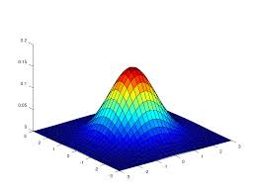
Covariance-based Granger causality
Michele Allegra A physicist and the brain Padova, May 2020
To estimate FX→Y , FY→X , and FX∙Y from data samples, we need to compute Shannon entropies of P(XtYt XpastYpast) and its marginal distributions
assume multivariate Gaussian, P=N(μ,Σ) [Σ=covariance matrix]
H = 1/2 log(det(Σ)) + const.
all entropies can be computed from Σ and its submatrices
covariance-based Granger causality measures
FX∙Y : Instantaneous Causality, IC
FX→Y , FY→X : Directed Causality, DC

Slide 11
Covariance-based Granger causality2
Michele Allegra A physicist and the brain Padova, May 2020
To estimate FX→Y , FY→X , and FX∙Y from data samples, we need to compute Shannon entropies of P(XtYt XpastYpast) and its marginal distributions
assume multivariate Gaussian, P=N(μ,Σ) [Σ=covariance matrix]
H = 1/2 log(det(Σ)) + const.
all entropies can be computed from Σ and its submatrices
covariance-based Granger causality measures
FX∙Y : Instantaneous Causality, IC
FX→Y , FY→X : Directed Causality, DC

Slide 12
Michele Allegra A physicist and the brain Padova, May 2020
Xpast
FX→Y
Xt
FX•∙Y
FY→X
Ypast
Yt
FX→Y (or FY→X) was called transfer entropy by Shreiber [T. Schreiber, Phys. Rev. Lett. 85, 461, 2001)] directed information flow from X to Y (or Y to X)
FX∙Y was called instantaneous interaction by Geweke [J. Geweke, J. Am. Stat. Ass. 77.378 (1982)] «instantaneous» (∆t<1) information flow/sharing between X and Y
FX→Y FY→X coincide with notion of Granger causality for Gaussian systems [L. Barnett et al., Phys. Rev. Lett. 103, 238701 (2009)]

