Slide 1

WAVEFEM
SOLVER
Finite elements and Newmark time integration
for the 2D wave equation
PROJECT 2 | NUMERICAL METHODS FOR PDE
Salvatore Mariano Librici · Rong Huang · Hirdesh Kumar · Mehdi Ghiasipour
01

Slide 2
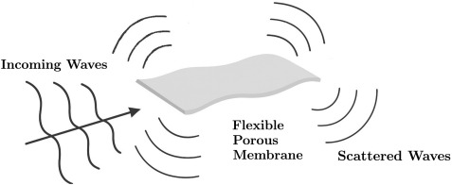
POLITECNICO DI MILANO | NMPDE PROJECT 2
What is a wave equation?
A wave equation models how a fixed membrane evolves over time in response to an initial displacement or an external force.
PHYSICAL QUESTION
How does the transverse displacement evolve while the boundary remains fixed?
NUMERICAL QUESTION
Can FEM and Newmark reproduce displacement, phase and mechanical energy accurately?
HPC QUESTION
Can distributed data ownership reduce runtime without changing the discretized problem?
WAVEFEM SOLVER | 02

Slide 3
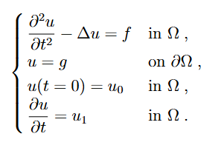
POLITECNICO DI MILANO | NMPDE PROJECT 2
Problem and objective
The two-dimensional wave equation is solved on the unit square
To simplify the mathematical formulation, we will assume:
• Homogeneous Dirichlet condition on the boundary
• The initial velocity displacement is set to 0
WAVEFEM SOLVER | 03

Slide 4
POLITECNICO DI MILANO | NMPDE PROJECT 2
From PDE to weak form
Testing with v and integrating by parts yields the weak form
The boundary condition is built into the trial and test space.
continuous problem
weak formulation
finite-dimensional system
WAVEFEM SOLVER | 04

Slide 5
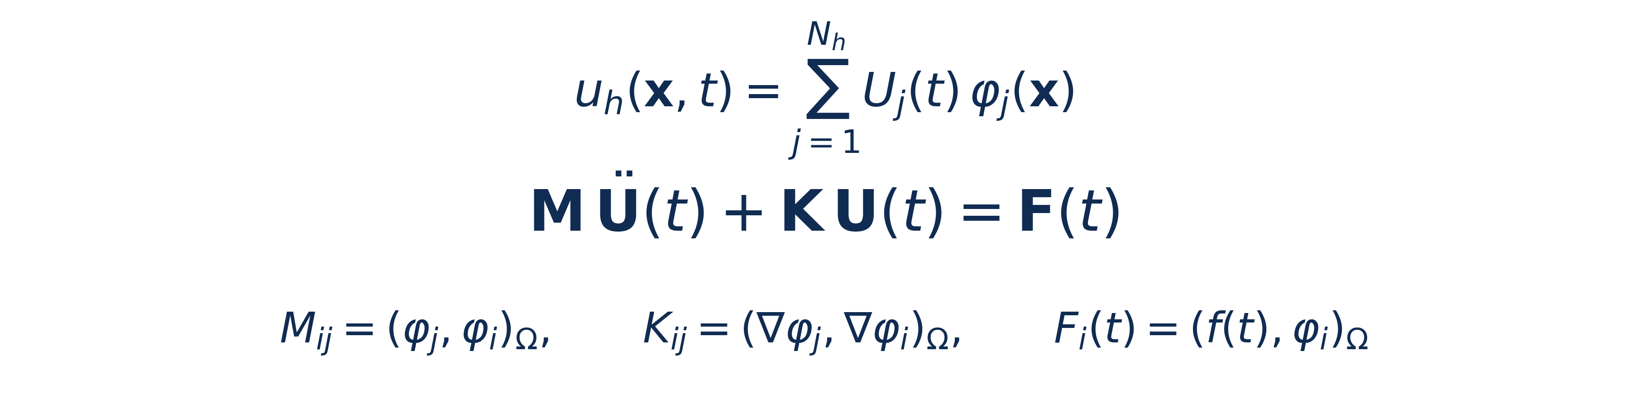
POLITECNICO DI MILANO | NMPDE PROJECT 2
Space discretization
The weak formulations are then discretized in space using the Galerkin method.
Both the numerical solution and the test functions belong to the same Q1 finite-element space.
Expanding the solution in the nodal basis produces the semi-discrete mechanical system forces through the spatial-gradient term, and F contains the external load.
Since the mesh and coefficients are fixed, M and K are assembled once and reused during time integration.
WAVEFEM SOLVER | 05

Slide 6
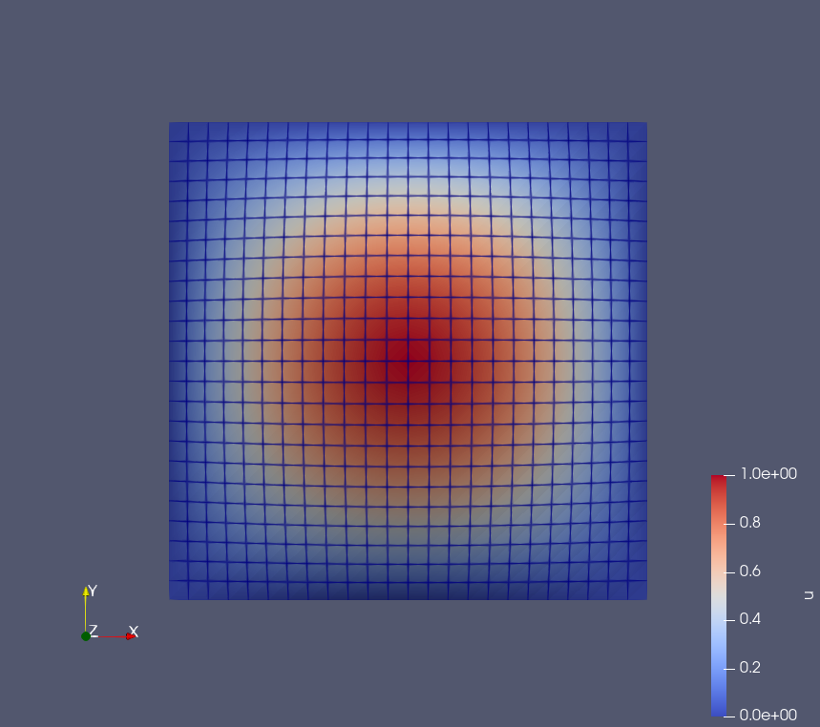
POLITECNICO DI MILANO | NMPDE PROJECT 2
Spatial discretization: Q1 on squares
We divided the domain in N^2 square cells
(N) cells are used along each coordinate direction.
Continuous bilinear Q1 functions are defined on the mesh.
Neighbouring cells share nodal values, ensuring continuity.
Increasing (N) refines the mesh and in theory improves spatial accuracy.
WAVEFEM SOLVER | 06

Slide 7
POLITECNICO DI MILANO | NMPDE PROJECT 2
Newmark average-acceleration method
Linear undamped problem: second-order accuracy, unconditional stability and no artificial damping.
WAVEFEM SOLVER | 07

Slide 8
POLITECNICO DI MILANO | NMPDE PROJECT 2
Assembly of the FEM system
local cell
M_e, K_e
local cell
M_e, K_e
global sparse
M and K
+
+ ...
Local cell contributions form the global sparse matrices
• The mesh, FE space and coefficients are time-independent.
• M and K are assembled once because their entries do not change.
• Reassembly at every step would repeat the same computation.
• Only the force, predictor and state vectors change with time.
WAVEFEM SOLVER | 08

Slide 9
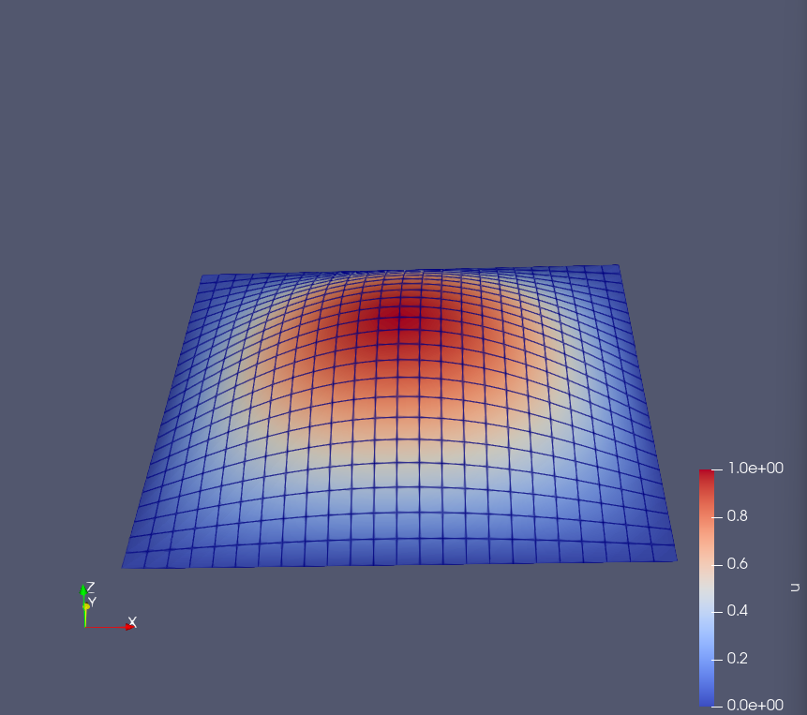
POLITECNICO DI MILANO | NMPDE PROJECT 2
Manufactured solution
To assess the convergence order of the solver in both space
and time we adopted a method of manufactured solution
We chose the following prescribed solution:
• Free case: omega = sqrt(2) pi, therefore f = 0
• Forced case: omega = pi, therefore f is nonzero
• The solution makes absolute L2 and H1 errors measurable
WAVEFEM SOLVER | 09

Slide 10
POLITECNICO DI MILANO | NMPDE PROJECT 2
Verification quantities
• We measure absolute L2 displacement error and H1-seminorm error using deal.II quadrature.
• Convergence study: compare final errors at the same T on successive meshes.
• Free case: energy should remain constant up to round-off.
• Forced case: external work changes the energy.
WAVEFEM SOLVER | 10

Slide 11
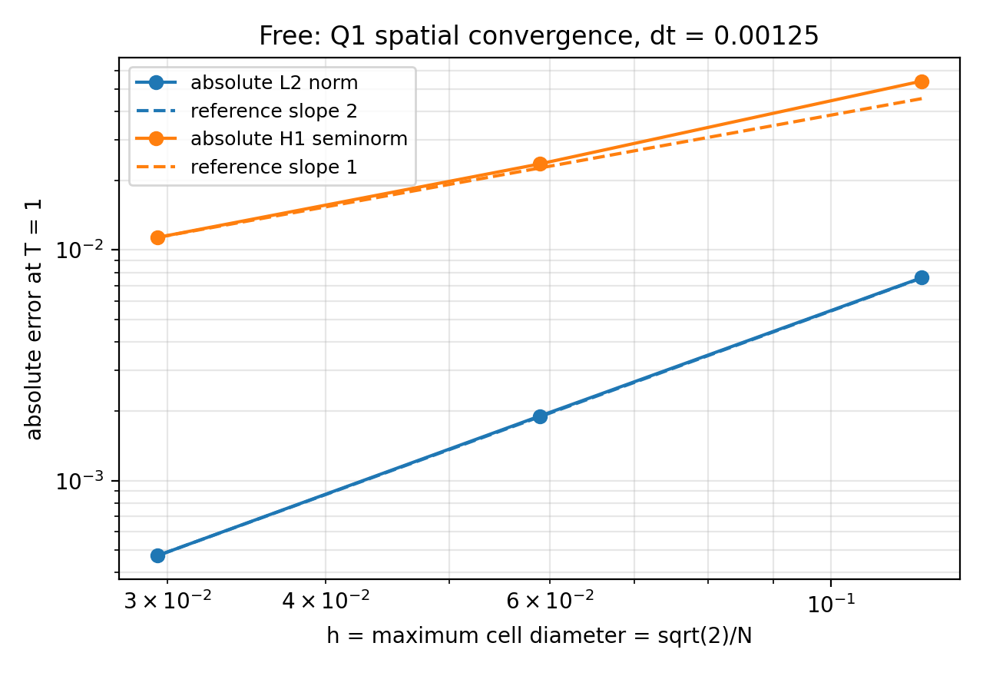
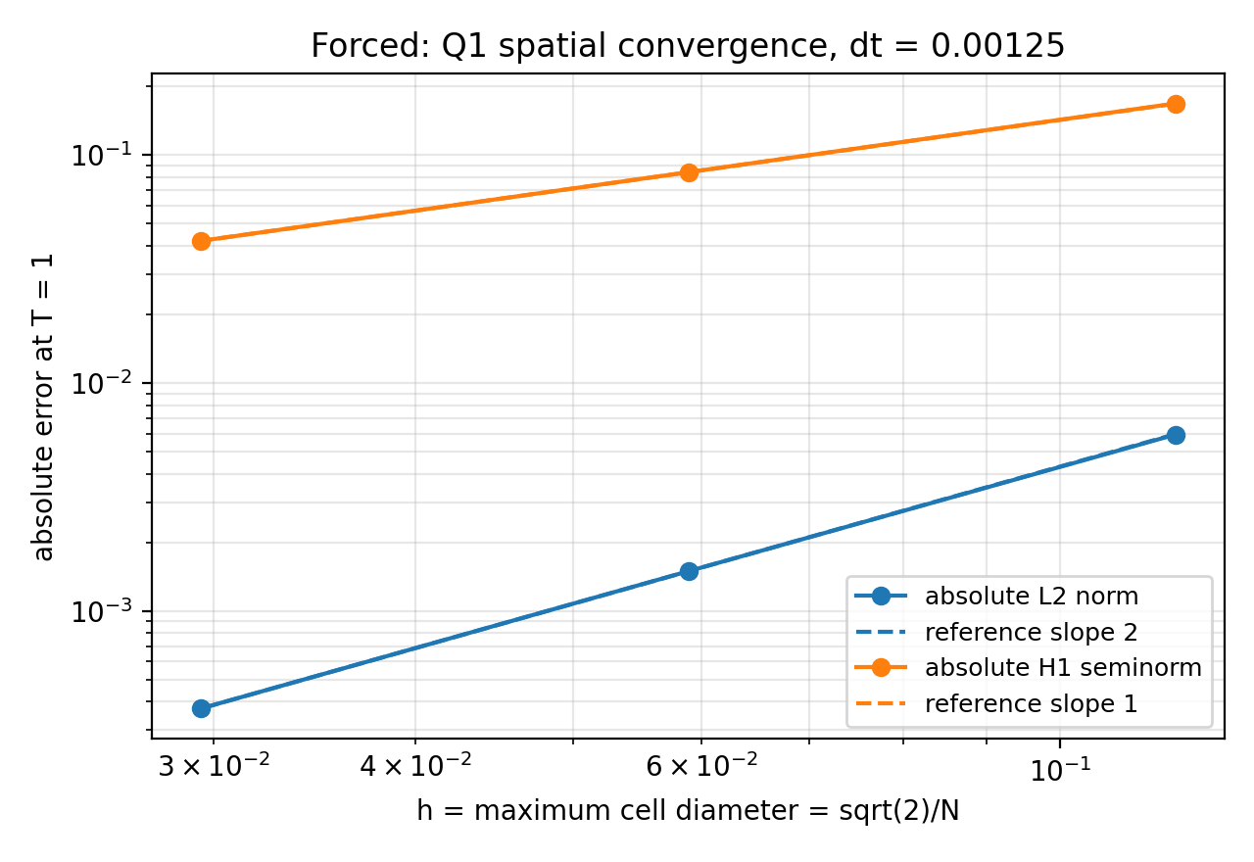
POLITECNICO DI MILANO | NMPDE PROJECT 2
Spatial convergence
Log-log slopes match Q1 theory: L2 approximately O(h^2), H1 approximately O(h).
Smaller h means a finer mesh; halving dt changes final errors by at most 0.87%, supporting spatial-error dominance.
WAVEFEM SOLVER | 11

Slide 12
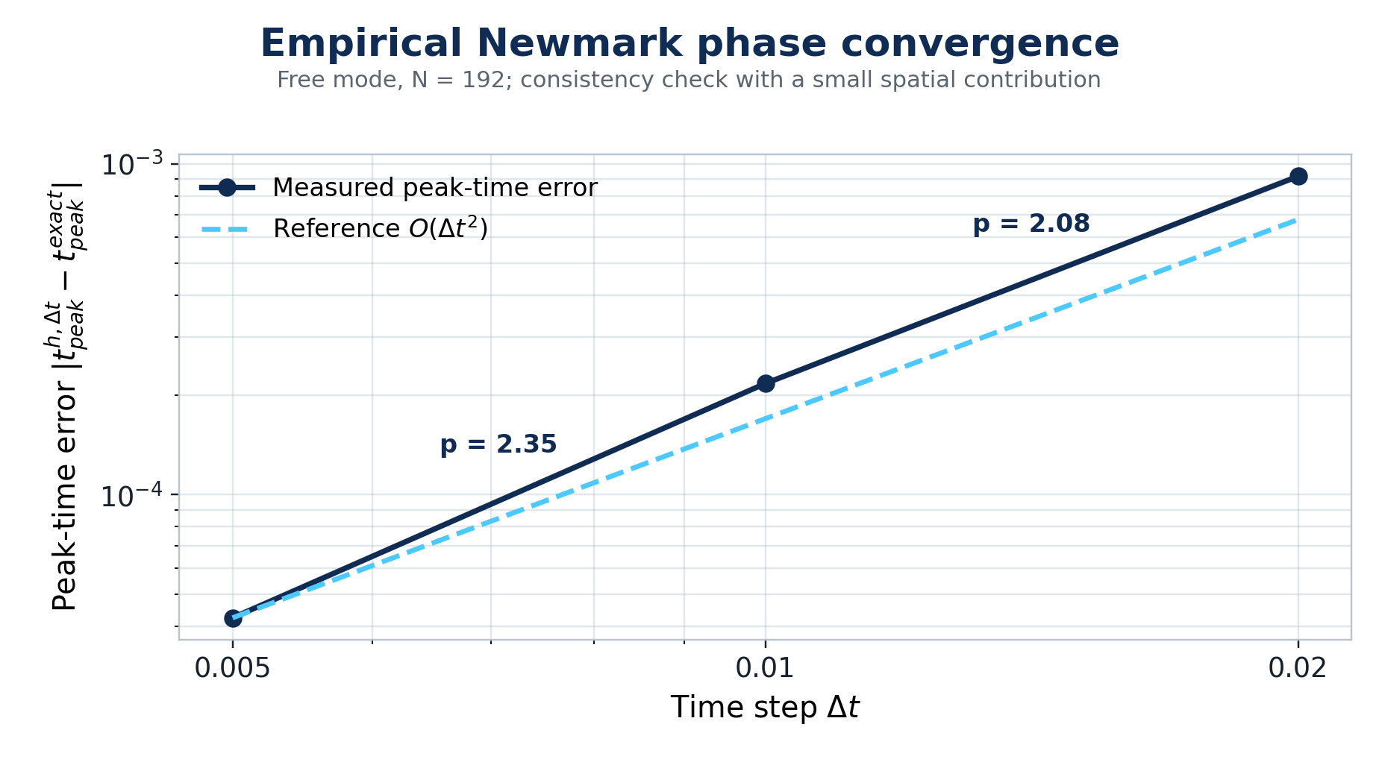
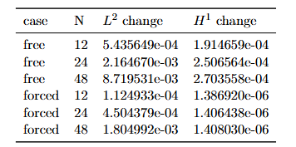
POLITECNICO DI MILANO | NMPDE PROJECT 2
Time convergence
The peak-time error decreases approximately quadratically with the time step, consistently with the second-order phase accuracy of the Newmark average- acceleration method.
WAVEFEM SOLVER | 12

Slide 13

POLITECNICO DI MILANO | NMPDE PROJECT 2
Energy: definition and expected balance
FREE CASE | f = 0
FORCED CASE | f != 0
No damping and no external work.
Expected result: the discrete mechanical energy remains constant.
With exact algebraic solves, average-acceleration Newmark preserves this free energy.
The forcing term performs work on the membrane.
Expected result: energy may increase or decrease.
A varying curve is physical behavior and
must not be described as numerical instability.
CODE DIAGNOSTIC
Energy is evaluated from the assembled M and K matrices.
For the free case, quantifies numerical drift.
Boundary entries of the displacement and velocity vectors are zero.
WAVEFEM SOLVER | 13

Slide 14
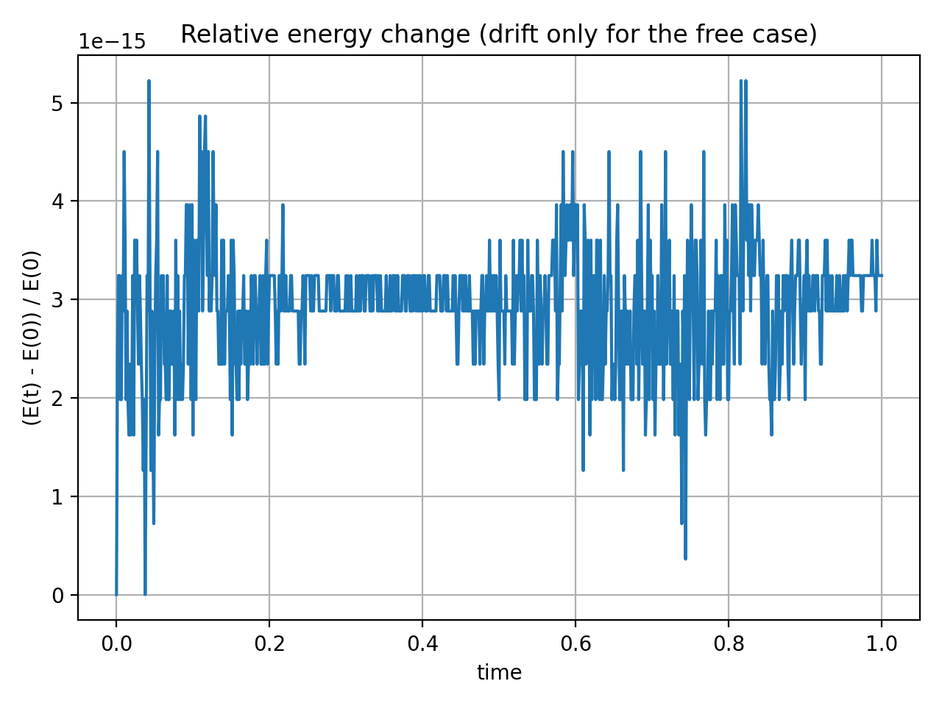
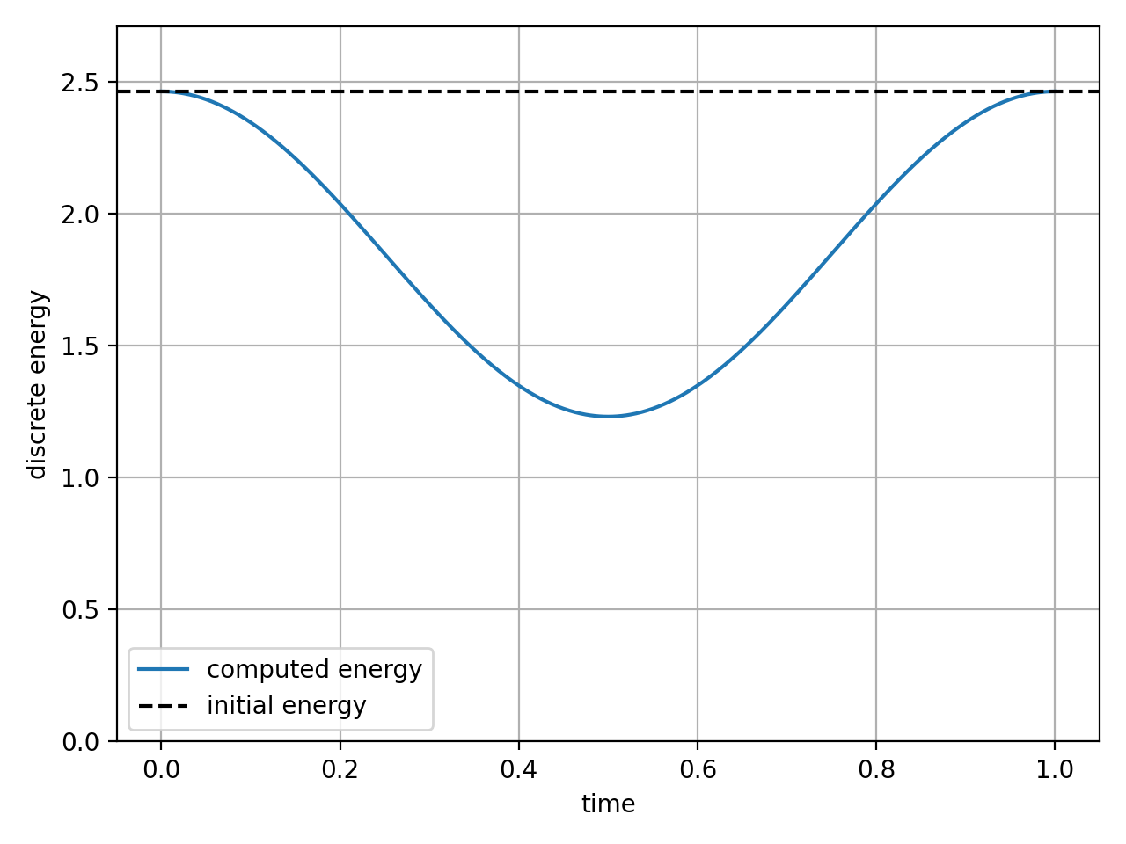
POLITECNICO DI MILANO | NMPDE PROJECT 2
Measured energy behaviour
FREE: RELATIVE ENERGY DRIFT
FORCED: f ≠ 0
Observed: relative drift stays below 5.23e-15, at round-off level.
Observed: the load removes and later returns energy:
2.465 -> 1.232 -> 2.465.
WAVEFEM SOLVER | 14

Slide 15
POLITECNICO DI MILANO | NMPDE PROJECT 2
Implementation architecture
The numerical design is common; data ownership and linear algebra change.
SHARED MODEL
Wave PDE | boundary and initial data | manufactured solution
COMMON NUMERICAL DESIGN
Q1 space | M/K assembly | Newmark update | linear solve | diagnostics
SEQUENTIAL BACKEND
MPI BACKEND
One process owns the full mesh and vectors.
Reference for verification and serial timing.
Mesh and Trilinos objects are distributed across ranks.
Global diagnostics use MPI reductions.
The discretization is unchanged; only storage, ownership and communication differ.
WAVEFEM SOLVER | 15

Slide 16
POLITECNICO DI MILANO | NMPDE PROJECT 2
Linear solver and preconditioner selection
• Symmetric Dirichlet elimination preserves an SPD effective matrix.
• CG exploits this structure with short recurrences and low memory.
• SSOR uses off-diagonal coupling; Jacobi is cheaper but diagonal-only.
Solver | Prec. | Mean iter./step | Solve ms
CG | SSOR | 6.00 | 29.87
CG | Jacobi | 1.00 | 5.66
GMRES | SSOR | 6.00 | 44.74
GMRES | Jacobi | 1.00 | 6.06
Forced Q1 benchmark: N=48, T=0.1, dt=0.005, 3 runs; solve ms is the median total over 20 steps.
All methods converged. The single sine mode exceptionally favours Jacobi, so this is not a general ranking.
WAVEFEM SOLVER | 16

Slide 17
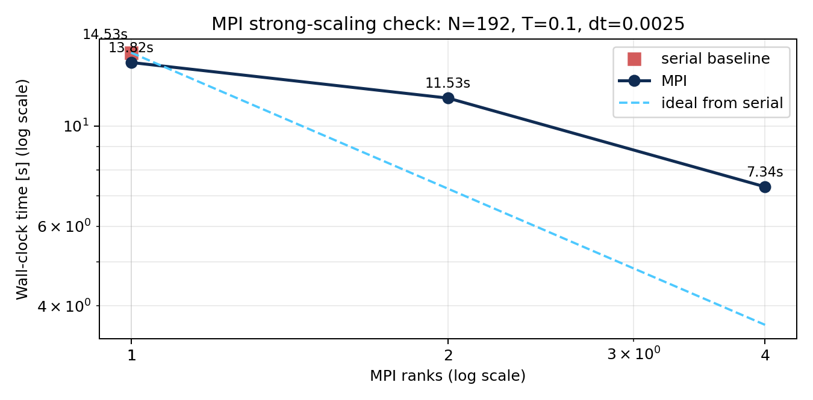
POLITECNICO DI MILANO | NMPDE PROJECT 2
MPI execution and scalability
Fixed problem size and output policy; the MPI rank count increases
SERIAL BASELINE
14.533 s
MPI-4
7.339 s
SPEEDUP
1.98x
EFFICIENCY
49.5%
Time loop: 13.82 s 11.53 s 7.34 s
(MPI-1 MPI-2 MPI-4)
Four ranks: 1.98x end-to-end speedup and 49.5% efficiency. Time-loop values isolate the update loop; backend differences and communication limit ideal scaling.
WAVEFEM SOLVER | 17

Slide 18
POLITECNICO DI MILANO | NMPDE PROJECT 2
Conclusions
A consistent numerical workflow
PDE weak form Q1 FEM M/K assembly
Newmark SPD solve verification visualization
• Space and Time refinement reproduces the expected L2 and H1 convergence rates.
• For the tested linear free wave, Newmark preserves energy without artificial damping.
• MPI provides measurable speedup, with backend differences and communication limiting efficiency.
WAVEFEM SOLVER | 18

