Slide 1
MASTER'S THESIS · BOCCONI UNIVERSITY
Imputation of Missing Data
in Financial Time Series
From reconstruction error to downstream decisions
CANDIDATE
SUPERVISOR
ACADEMIC YEAR
Michele Carlo Fanelli
Francesco Corielli
2025/2026
Notes:
Introduce the problem in one sentence: financial panels always have holes, and the way they are filled changes what any model built on them concludes. The talk follows the thesis: motivation, design, results, then the two downstream evaluations.

Slide 2
INTRODUCTION · MOTIVATION
Financial data is never fully observed
Where data goes missing
The usual fixes distort risk
What is left open
Order-book feeds drop quotes in bursts of cancellations
Trading halts when prices move too violently
OTC bond tenors go unquoted for days
Macro data arrive at mixed frequencies, with lags
Carrying the last price forward: stale prices bias betas (Scholes and Williams, 1977)
Dropping incomplete dates: unbiased only under MCAR, and much of the sample is lost
Filling with a constant: variances and correlations are damped, even under MCAR
Deep imputers assume MAR, usually implicitly through their masked training objective
Evaluation is almost always pointwise, RMSE or MAE on masked cells, which says little about the covariance structure
Aim of the thesis. Evaluate each imputation on its reconstruction accuracy and on the downstream model built on it, against the same model fitted on the complete panel.
Michele Carlo Fanelli · Bocconi University
2 / 15
Notes:
Gaps are everywhere in finance. The default fixes are not neutral: stale prices bias betas, deletion throws away data, a constant fill damps correlations. The literature mostly scores imputations cell by cell; this thesis scores them by what a user builds on the result.

Slide 3
INTRODUCTION · RESEARCH QUESTIONS
Four research questions
1
Mechanism or amount?
2
Do the deep imputers earn their cost?
What drives the damage, the share of missing data or the mechanism that produced it, at comparable shares?
Recurrent and diffusion models against classical likelihood and low-rank estimators, with training and sampling time counted.
3
Is pointwise accuracy a good proxy?
4
Do the rankings survive downstream?
Does a method that fills the holes accurately also preserve covariances, tails, marginals and temporal dependence?
Is the ordering given by reconstruction metrics the ordering given by decisions taken on the imputed panel?
CONTRIBUTIONS
Controlled testbed
Fifty S&P 500 stocks, three mechanisms at five severities, seven imputers in one framework.
Evaluation suite
Past reconstruction error: covariance, Value-at-Risk, Wasserstein, volatility clustering and leverage.
Downstream evaluations
Tangency portfolio and factor structure, ranking imputers against each other and an oracle.
Michele Carlo Fanelli · Bocconi University
3 / 15
Notes:
These four questions structure the results. Keep this slide short and come back to it at the end, where each question gets its answer.

Slide 4
METHODOLOGY · DATA AND DESIGN
A controlled experiment on a complete equity panel
1
Complete panel
2
Inject missingness
3
Impute
4
Evaluate
S&P 500 end-of-day prices, 1/1/2010 to 30/5/2026. Stocks with any missing price removed; 50 sampled across industries.
Three mechanisms, two MCAR and one MNAR, five levels each, matched on the expected share of missing cells.
Seven methods, from deletion to conditional diffusion, run on every corrupted panel.
Seven metrics against the true panel; two downstream models against an oracle fitted on it.
4125 × 50 panel
15 corrupted panels
105 runs (7 × 15)
7 metrics + 2 models
Returns, not prices
Offline reconstruction
Prices are positive, level dependent and non-stationary, so the panel is in daily log returns. A deleted return is a stylised missing price: a carried-forward price is a zero return, but the later catch-up return is not modelled.
Every method may use the full sample, including dates after the gap. The results describe reconstruction after the fact, not real-time filling.
Michele Carlo Fanelli · Bocconi University
4 / 15
Notes:
Start from a panel with no real missing data, delete entries under known rules, reconstruct, and compare with the truth. Returns rather than prices because prices are level dependent. Every method may use the full sample: this is reconstruction after the fact, not real-time filling.

Slide 5
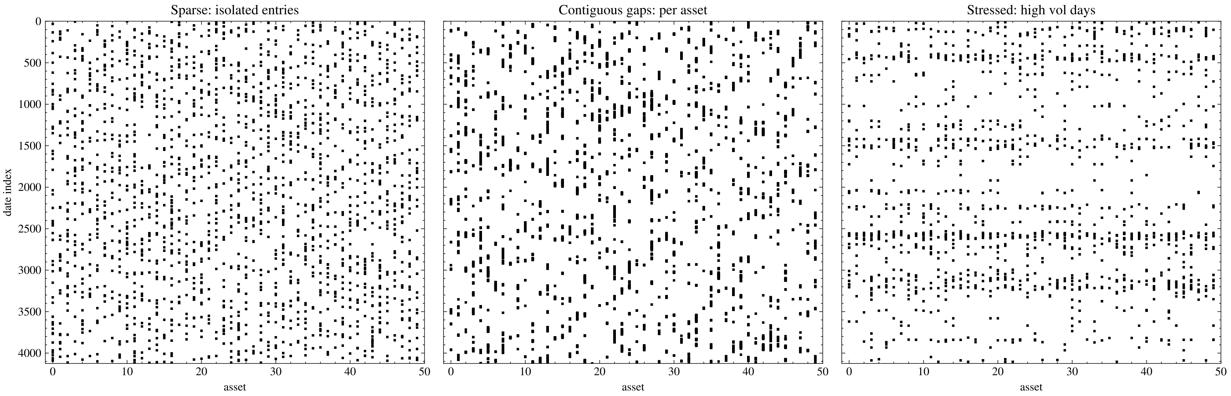
METHODOLOGY · MISSINGNESS INJECTION
Three mechanisms, matched on the share of missing cells
Sparse MCAR
Contiguous gaps MCAR
Stressed MNAR
Each cell is deleted independently with probability r.
n seed cells, each extended forward into a run with mean length ℓ trading days.
Dates at or above the p-quantile of the squared panel-average return lose each entry with probability h, other dates with r. The score is hidden from the imputer.
Expected share of missing cells |  | 0.1% | 1% | 5% | 10% | 30%
Sparse | r | 0.001 | 0.01 | 0.05 | 0.1 | 0.3
Gaps | (n, ℓ) | (20, 10) | (200, 10) | (1000, 10) | (1000, 20) | (2000, 30)
Stressed | (r, h, p) | (0, 0.1, 0.99) | (0.005, 0.5, 0.99) | (0.04, 0.2, 0.95) | (0.05, 0.5, 0.9) | (0.2, 1, 0.9)
Michele Carlo Fanelli · Bocconi University
5 / 15
Notes:
Sparse removes isolated cells, gaps remove runs within one asset, stressed removes entries preferentially on the most volatile dates, so deletions line up across assets. Levels are matched on the expected share, so any difference between patterns is due to the mechanism. The stressed score is never shown to the imputer, which makes the pattern non-ignorable.

Slide 6
METHODOLOGY · MODELS
Seven methods, from deletion to conditional diffusion
BASELINES
CLASSICAL
DEEP LEARNING
Deletion
Drop every date with a missing value (complete cases)
Little and Rubin (2019)
Zero
Fill with 0, as if the price were carried forward
KNN
Inverse-distance average over the k nearest dates
Troyanskaya et al. (2001)
Low-rank
Iterative truncated SVD: a q-factor reconstruction
Mazumder et al. (2010)
EM
Gaussian maximum likelihood, conditional-mean fill
Dempster et al. (1977)
BRITS
Bidirectional RNN blending history and cross-section
Cao et al. (2018)
CSDI
Conditional score-based diffusion; median of 32 draws
Tashiro et al. (2021)
EM fill: the conditional mean given the assets observed on the same date, which minimises the expected squared error
Michele Carlo Fanelli · Bocconi University
6 / 15
Notes:
Two baselines that the literature expects to fail, three classical estimators and two deep models. EM is the one to watch: its fill is the conditional expectation given the other assets on the same date, the fill that minimises the expected squared error under the Gaussian model.

Slide 7
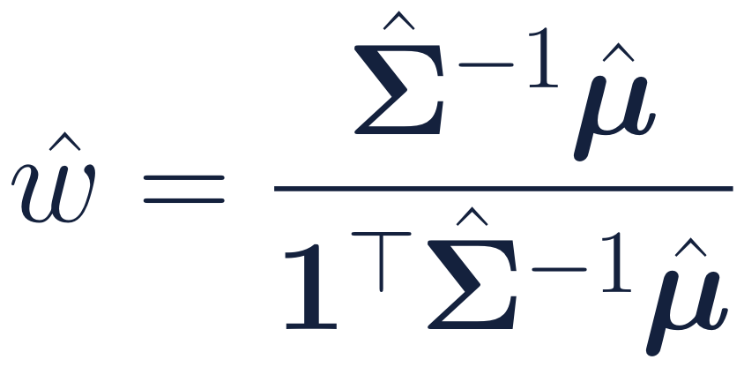
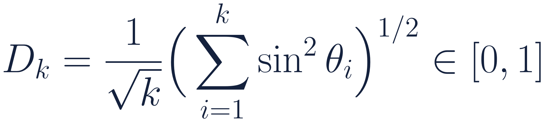
METHODOLOGY · EVALUATION
Evaluating the panel, not only the filled cells
Seven metrics, four families
Two downstream evaluations
Pointwise
MAE, RMSE imputed cells only
Tangency portfolio
fitted on each panel, evaluated on the true returns, compared with the oracle fitted on the complete panel (in sample)
Marginal
VaRErr 5% Value-at-Risk, per asset
WassErr Wasserstein distance of marginals
Second moment
CovErr relative Frobenius error of Σ
Factor structure
Variance shares of the principal components and the subspace distance
Temporal
AbsACFErr volatility clustering, 20 lags
LevErr leverage, corr(r_{t}, |r_{t+k}|)
The first five are invariant to permuting the dates; the temporal ones are not.
between the true and estimated leading eigenspaces
Michele Carlo Fanelli · Bocconi University
7 / 15
Notes:
Seven metrics in four families. Pointwise metrics look only at the filled cells, the others compare statistics of the whole panel, and the last two are the only ones that notice the order of the dates. The two downstream evaluations ask what a user would actually do with the panel.

Slide 8
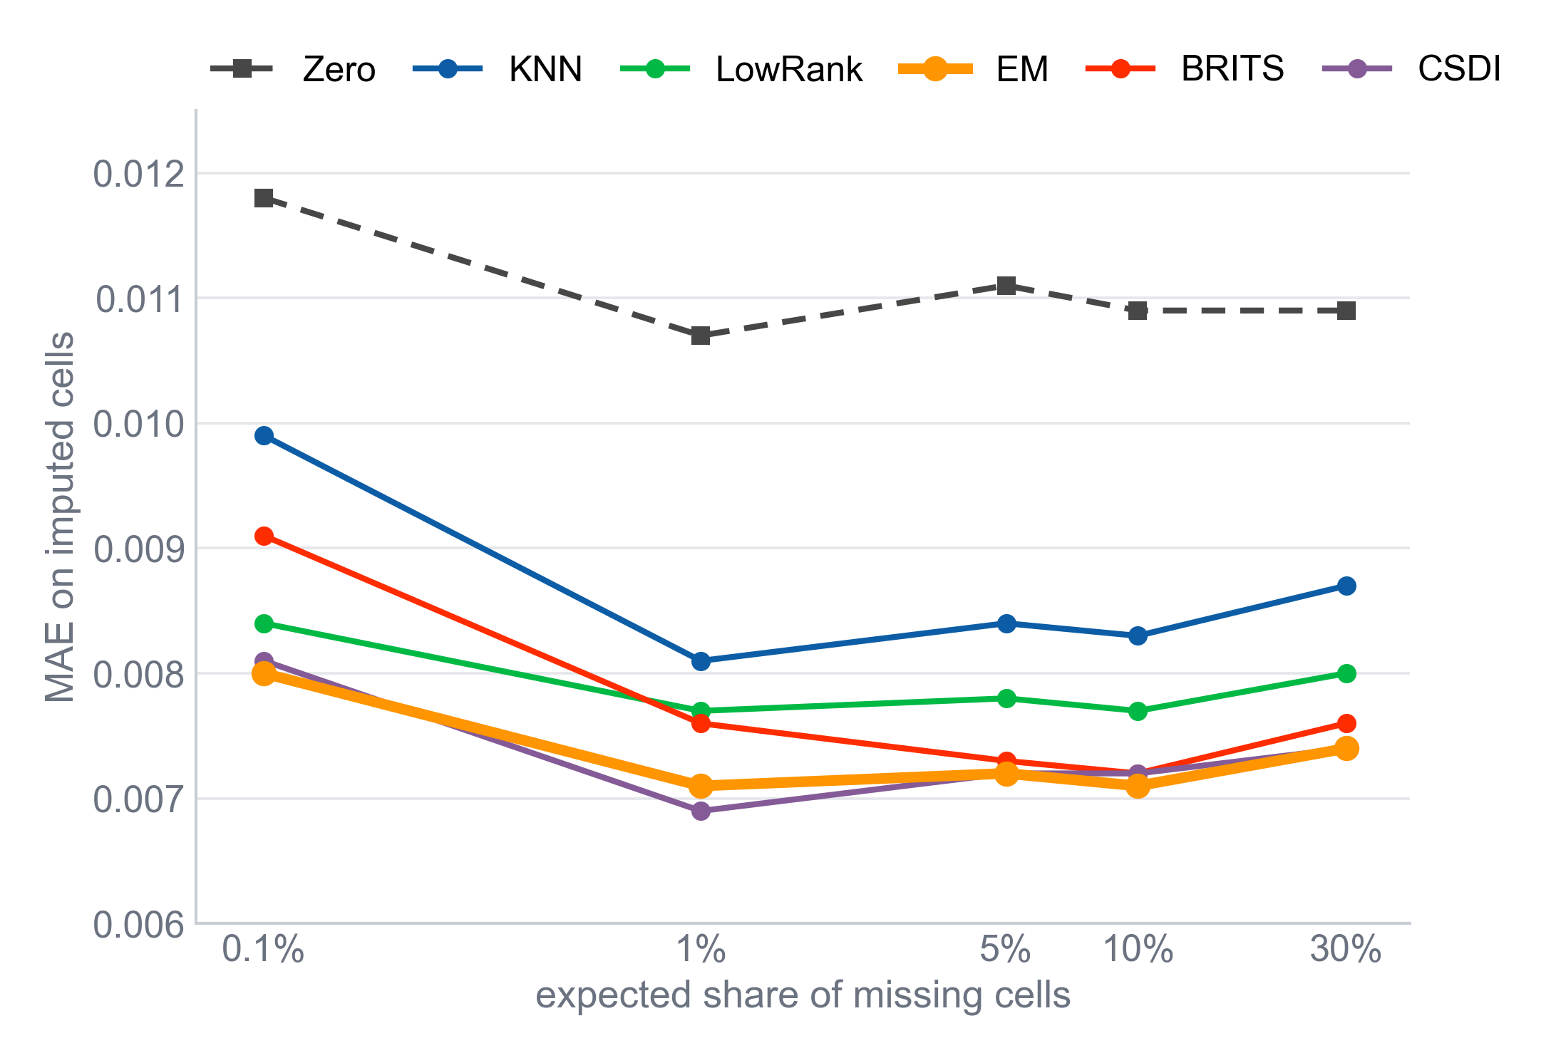
RESULTS · RECONSTRUCTION METRICS
Pointwise errors hit a floor at once, and EM sits on it
0.0071 to 0.0080
EM's MAE across all five sparse levels
Daily returns are close to serially uncorrelated: what can be known about a missing entry is carried by the other assets on the same date.
EM's conditional mean extracts exactly that.
The five conditional methods are separated in the third decimal; the extra capacity of BRITS and CSDI has little to act on.
The ranking is stable across patterns: EM is rarely beaten, and never by a wide margin.
Sparse pattern, MAE on the imputed cells, by expected share of missing cells (Table 3.1).
Michele Carlo Fanelli · Bocconi University
8 / 15
Notes:
Daily returns carry almost no serial information, so the best one can do for a missing entry is to read it off the other assets on the same date. EM does exactly that, so its pointwise error is flat and it is very hard to beat. The deep models have nothing extra to learn here.

Slide 9
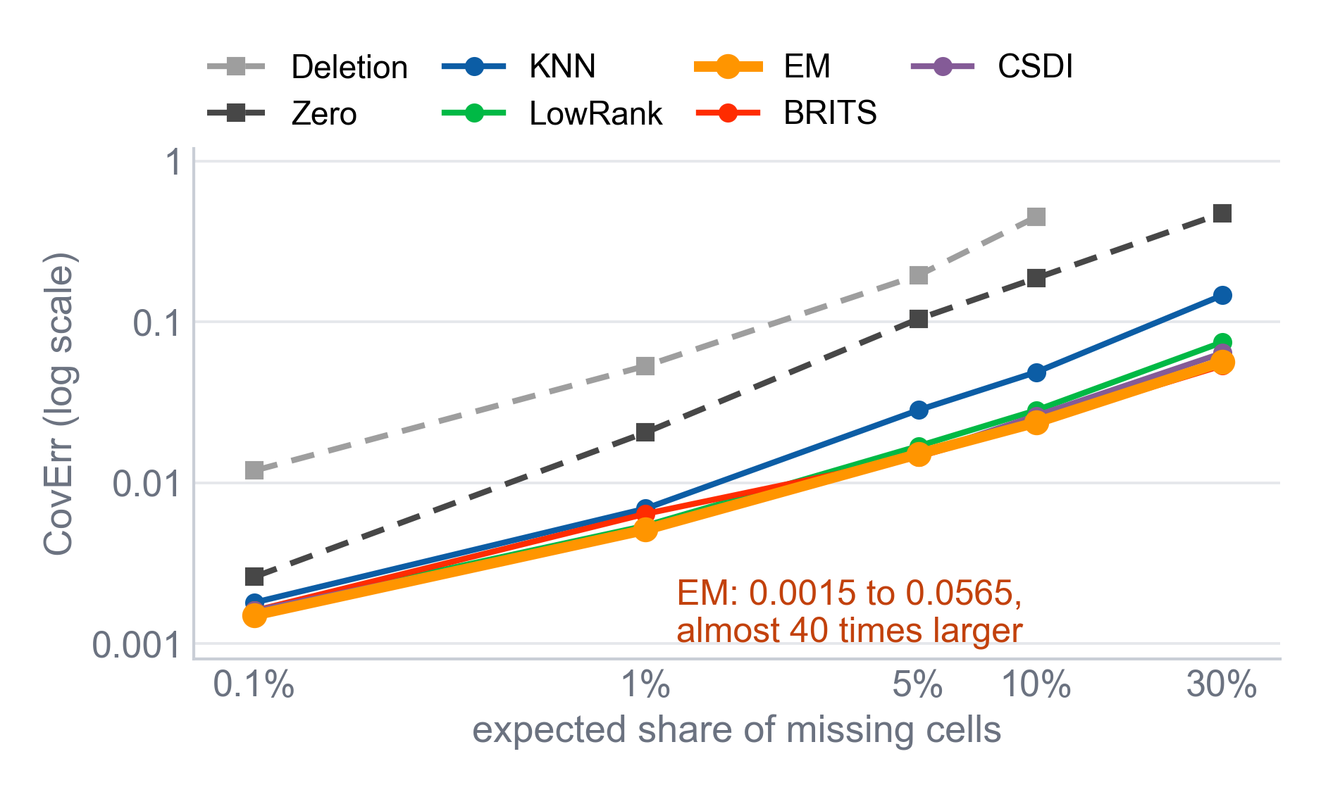
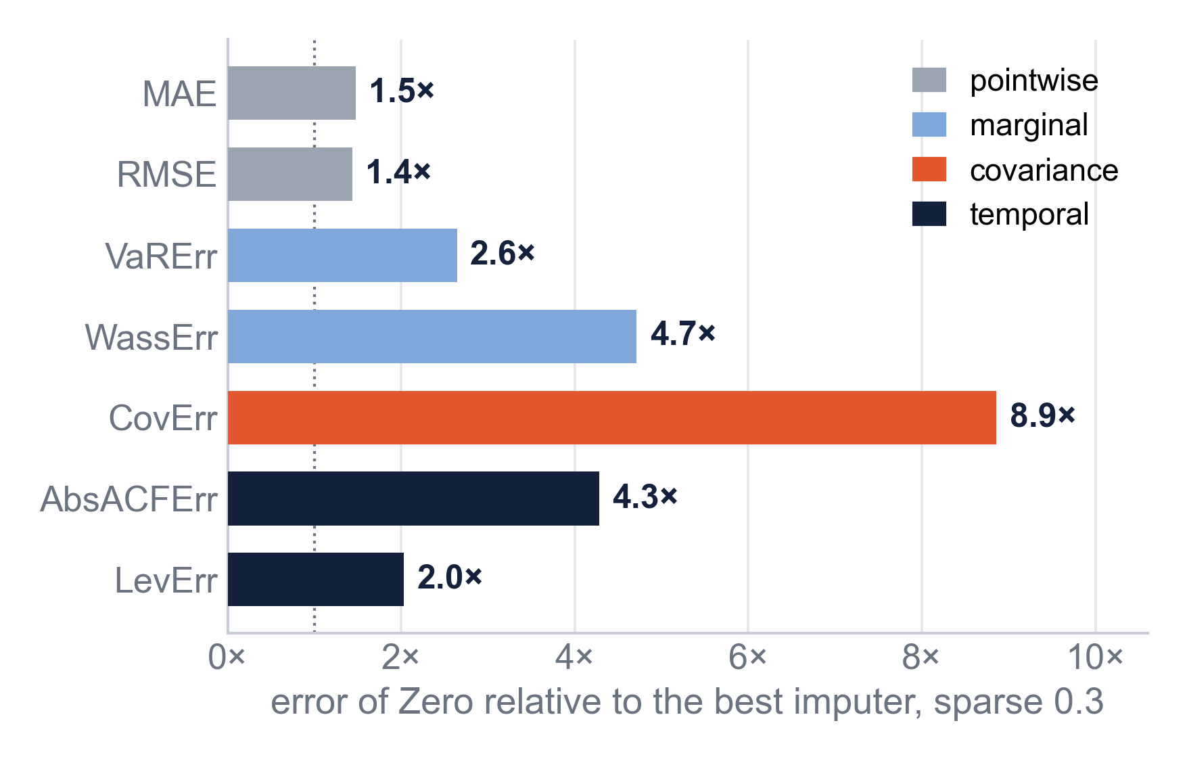
RESULTS · POINTWISE VERSUS STRUCTURAL
Accurate cells do not make an accurate panel
MAE averages over the filled cells, CovErr accumulates them over the panel: EM's CovErr grows almost 40-fold while its MAE stays flat.
At sparse 0.3, Zero's MAE is 1.5 times the best method's and its CovErr 8.9 times (ratios of the table values).
The best fill cell by cell is a conditional mean, less variable than the return it replaces: Low-rank loses to EM on MAE but beats it on CovErr at two stressed levels.
Michele Carlo Fanelli · Bocconi University
9 / 15
Notes:
Pointwise errors average over the filled cells, so they stay flat; the covariance error accumulates them, so it grows with the amount missing. Zero imputation shows the gap at its plainest: half again worse on MAE, nine times worse on covariance. Even among good methods the two families disagree: the best fill cell by cell damps the second moment most.

Slide 10
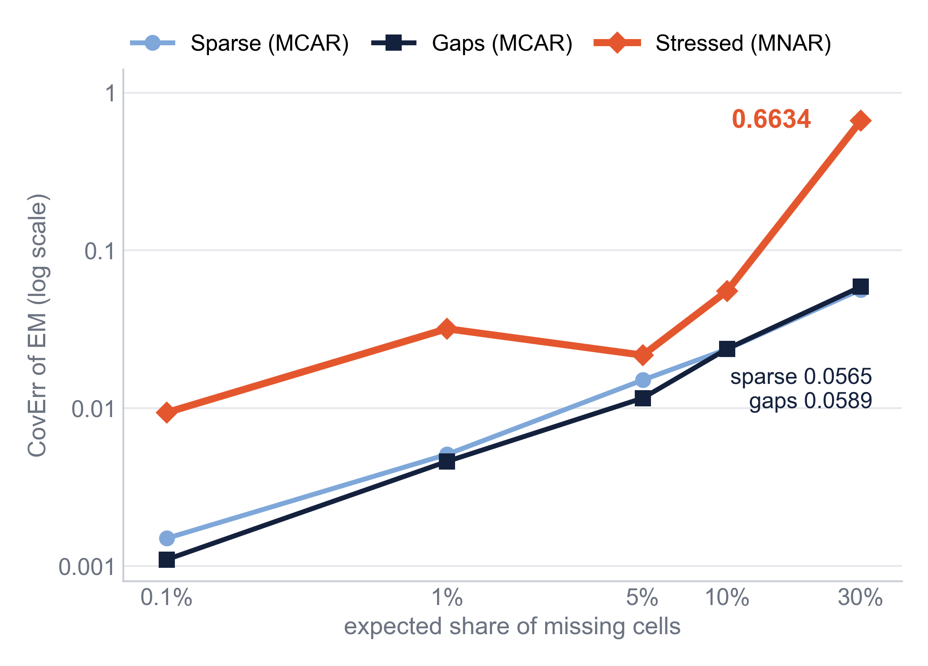
RESULTS · MISSINGNESS PATTERNS
The mechanism matters more than the amount
EM COVERR AT MATCHED SHARES
Sparse
Gaps
Stressed
about 10%
0.0237
0.0238
0.0554
about 30%
0.0565
0.0589
0.6634
The two MCAR patterns are nearly interchangeable: with 49 other assets observed on each date, breaking the time axis costs a cross-sectional imputer little.
Stressed deletions are aligned by date. They remove the conditioning set, and what they remove are the largest returns.
BRITS falls behind where deletions are most extreme: MAE 0.0301 against EM's 0.0133 at (0, 0.1, 0.99).
At (0.2, 1, 0.9) the ranking compresses: CovErr between 0.648 and 0.663 for every surviving model.
EM, covariance error by pattern at matched shares (Tables 3.1 to 3.3).
Michele Carlo Fanelli · Bocconi University
10 / 15
Notes:
Read the tables across at matched shares. Sparse and gaps are almost the same, because on every date the other assets are still there. The stressed pattern removes exactly those dates, and the returns it removes are the largest ones, so the error sits in the target and no model capacity fixes it.

Slide 11
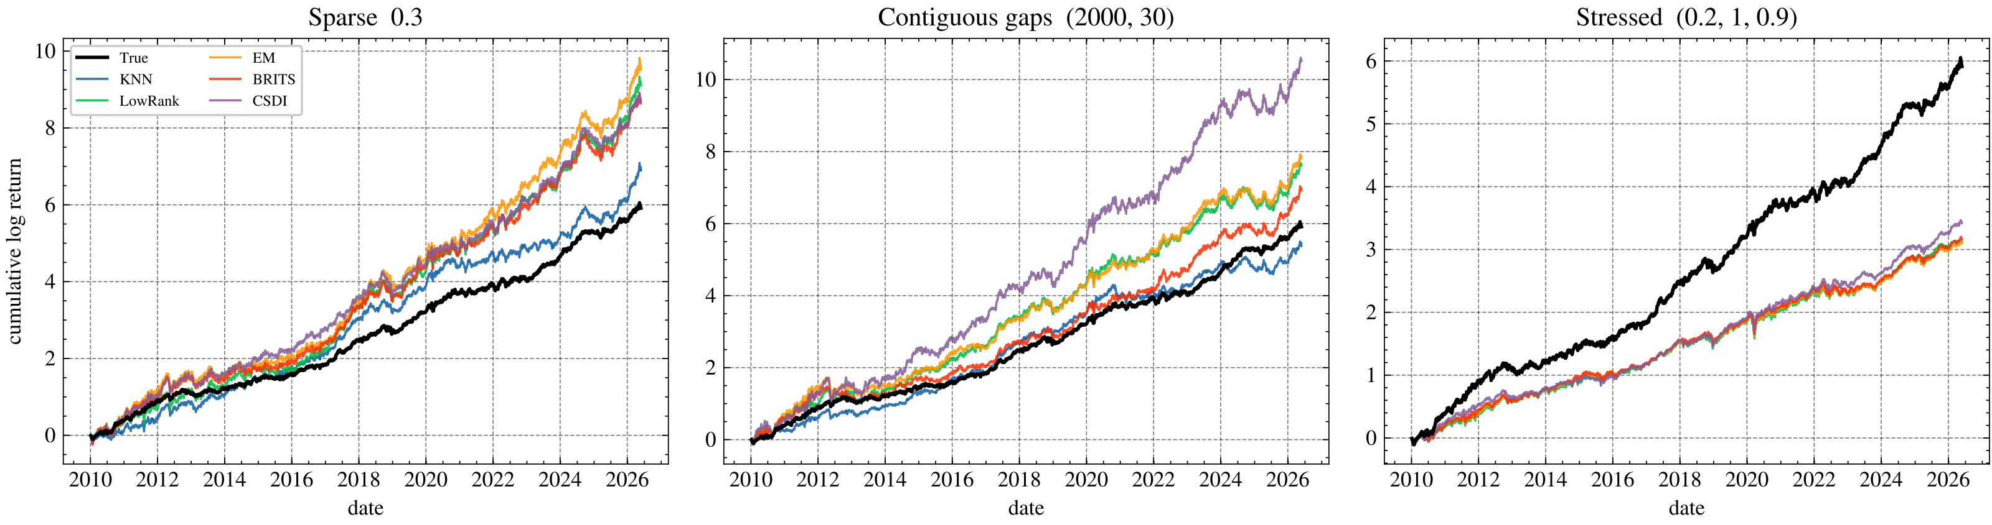
RESULTS · DOWNSTREAM EVALUATION
Downstream I: the portfolio amplifies the distortion
Oracle
Heavy MCAR
Heavy MNAR
Who fails
Complete panel, annualised: mean 0.361, variance 0.049, Sharpe 1.636.
Variance rises from 0.049 to as much as 0.29 and L¹ weight distances reach 14: the inverted covariance over-leverages.
The imputers never see the volatility; their portfolios end at little more than half of the oracle's cumulative return.
EM and Low-rank are never the worst. BRITS: Sharpe 1.30 against EM's 1.51 at (0.05, 0.5, 0.9).
In-sample diagnostic of reconstruction fidelity, not investment performance. Deletion: Sharpe near zero at sparse 0.1; its covariance is singular at the heavy levels.
Michele Carlo Fanelli · Bocconi University
11 / 15
Notes:
The tangency portfolio inverts the covariance, so small distortions turn into large positions. Under random missingness the imputed portfolios take on far more risk than the oracle; under stressed missingness they never see the volatility and fall short. This is an in-sample diagnostic of fidelity, not a performance claim.

Slide 12
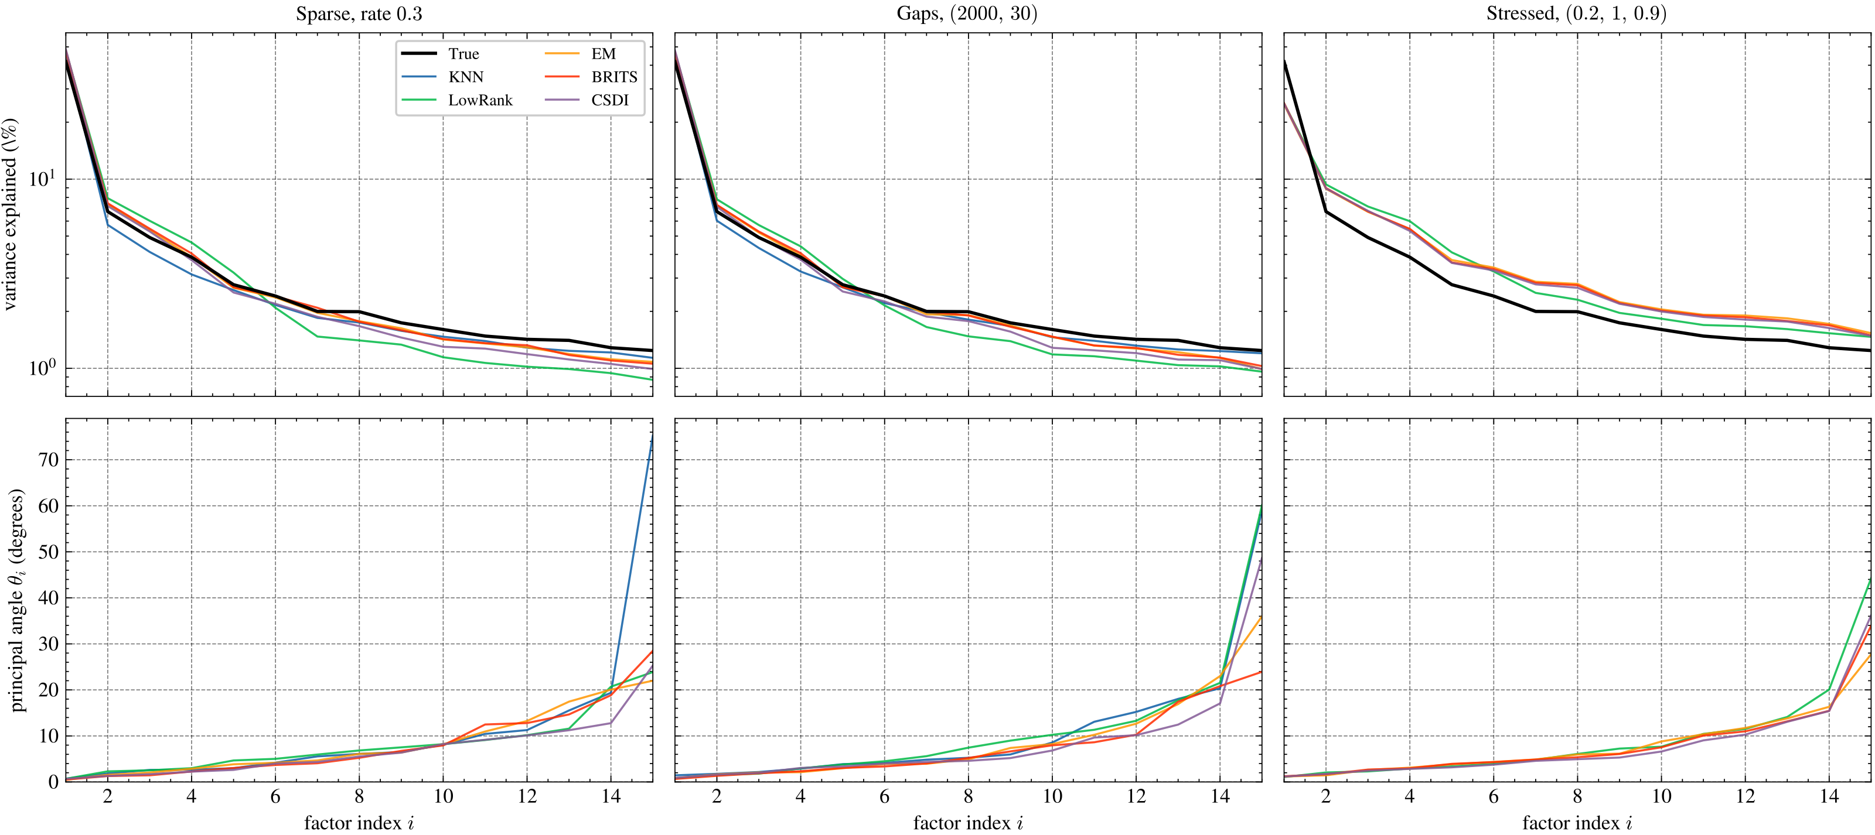
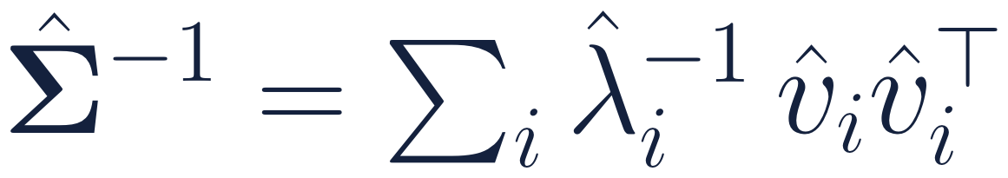
RESULTS · DOWNSTREAM EVALUATION
Downstream II: a robust market factor, a fragile subspace
D₁ < 0.026
Market direction at sparse 0.3: under 1.5 degrees
6 to 18×
Larger D₅: the five-factor subspace, 0.14 to 0.39
41.74% → 48.5%
First-factor share at sparse 0.3: every conditional imputer raises it, to between 45.6% and 48.5%
10 of 15
Top: variance share of the first 15 components (log scale). Bottom: ordered principal angles between the 15-factor subspaces, not per-factor errors. Heaviest level of each pattern.
Levels where Low-rank has the largest D₅, although it imposes a factor structure
≈ 25%
The portfolio loads most on the trailing directions, the ones the imputations recover worst. Its error maximisation is the factor distortion seen through an inverse.
First-factor share at (0.2, 1, 0.9), for all four methods that can be evaluated
Michele Carlo Fanelli · Bocconi University
12 / 15
Notes:
The first principal component is almost indestructible. The five-factor subspace is not, and the misalignment sits in one direction of it. Point imputations make the panel look more like its own factor model. Low-rank is worst on exactly the evaluation that might be expected to favour it. Last line: the portfolio inverse loads on the directions recovered worst, which ties the two evaluations together.

Slide 13
RESULTS · COMPUTATIONAL COST
The deep models did not earn their cost
1 s
1 h
4 h
70 h
EM
BRITS
CSDI
All neural training
about one second to fill a 4125 × 50 panel
just under an hour of training per panel (10,000 epochs)
just under four hours of training per panel, then about 24 minutes of sampling
roughly seventy hours for the 15 levels, four fifths of it on CSDI
CSDI matches EM's accuracy at about four orders of magnitude more computation, and BRITS falls behind at two stressed levels.
Single Apple Mac mini (M4, 16 GB), CPU-only PyTorch. Small networks: about 120,000 parameters for BRITS and 47,000 for CSDI. Times are approximate, as reported in Section 3.3 of the thesis.
Michele Carlo Fanelli · Bocconi University
13 / 15
Notes:
All of this ran on a single consumer machine with small networks, so the costs come from the algorithms. EM needs about a second; CSDI needs hours of training and twenty-four minutes of sampling per panel, for a reconstruction that is not better.

Slide 14
CONCLUSION · SUMMARY
Answers to the four questions
1
Mechanism or amount?
2
Do the deep imputers earn their cost?
The mechanism, in this experiment. Under MCAR the methods hold with 30% missing; under stressed MNAR they break at far smaller shares, and at the heaviest level no method separates.
Not here. EM is rarely beaten; CSDI matches it at four orders of magnitude more cost; BRITS falls behind at two stressed levels.
3
Is pointwise accuracy a good proxy?
4
Do the rankings survive downstream?
Poor. Zero's MAE is 1.5 times the best and its CovErr about 9 times. Conditional fills inflate the first factor, from 41.7% to as much as 48.5%, which no pointwise metric registers.
Largely, and the exceptions are informative. Low-rank: accurate cells, worst five-factor subspace at 10 of 15 levels. Deletion: inefficient in the tables, unstable portfolios downstream.
Score an imputation against the use it is put to.
Michele Carlo Fanelli · Bocconi University
14 / 15
Notes:
Go back to the four questions. The single message to leave with the committee is the last line: an imputation should be judged by the use it is put to, because reconstruction error is least informative exactly where the choice of method matters.

Slide 15
CONCLUSION · LIMITATIONS AND FUTURE WORK
Limitations and future work
LIMITATIONS
FUTURE WORK
One panel: fifty liquid large caps, daily, one period, one run per configuration
Injected missingness; the stressed pattern is a stylised MNAR that mixes the selection rule with date-aligned deletion
Gaussian EM without the Student-t refinement; both downstream models read the covariance; the portfolio is in sample
Offline setting: BRITS and CSDI use observations after the gap
Causal imputation with only past data, to measure the cost of filling in real time
Downstream tests beyond the second moment: VaR backtests, hedging, trading rules
Multiple imputation: let the decision see the spread of the CSDI draws
Larger cross sections, other frequencies and asset classes, real gaps
Thank you
Michele Carlo Fanelli · Bocconi University
15 / 15
Notes:
Be upfront about the limits: one panel, one run, injected missingness, Gaussian EM, offline setting. The natural next step is the causal version of the problem, where only the past may be used.

Slide 16
BACKUP
Evaluation scores under sparse missingness (Table 3.1; best per level in bold)
Model | MAE | RMSE | CovErr | VaRErr | WassErr | AbsACFErr | LevErr
Level 0.001
Deletion | -- | -- | 0.0119 | 0.0001 | 0.0001 | 0.0101 | 0.0114
Zero | 0.0118 | 0.0194 | 0.0026 | 0.0000 | 0.0000 | 0.0009 | 0.0008
KNN | 0.0099 | 0.0168 | 0.0018 | 0.0000 | 0.0000 | 0.0006 | 0.0005
LowRank | 0.0084 | 0.0152 | 0.0016 | 0.0000 | 0.0000 | 0.0005 | 0.0004
EM | 0.0080 | 0.0147 | 0.0015 | 0.0000 | 0.0000 | 0.0005 | 0.0004
BRITS | 0.0091 | 0.0158 | 0.0016 | 0.0000 | 0.0000 | 0.0005 | 0.0004
CSDI | 0.0081 | 0.0151 | 0.0016 | 0.0000 | 0.0000 | 0.0005 | 0.0004
Level 0.01
Deletion | -- | -- | 0.0532 | 0.0005 | 0.0004 | 0.0247 | 0.0334
Zero | 0.0107 | 0.0161 | 0.0205 | 0.0001 | 0.0001 | 0.0035 | 0.0027
KNN | 0.0081 | 0.0123 | 0.0069 | 0.0001 | 0.0000 | 0.0019 | 0.0017
LowRank | 0.0077 | 0.0117 | 0.0054 | 0.0000 | 0.0000 | 0.0016 | 0.0015
EM | 0.0071 | 0.0109 | 0.0051 | 0.0000 | 0.0000 | 0.0015 | 0.0014
BRITS | 0.0076 | 0.0116 | 0.0064 | 0.0001 | 0.0000 | 0.0017 | 0.0016
CSDI | 0.0069 | 0.0107 | 0.0050 | 0.0000 | 0.0000 | 0.0015 | 0.0014
Level 0.05
Deletion | -- | -- | 0.1951 | 0.0019 | 0.0012 | 0.1334 | 0.0515
Zero | 0.0111 | 0.0167 | 0.1044 | 0.0005 | 0.0006 | 0.0132 | 0.0073
KNN | 0.0084 | 0.0127 | 0.0283 | 0.0003 | 0.0002 | 0.0047 | 0.0045
LowRank | 0.0078 | 0.0118 | 0.0169 | 0.0002 | 0.0001 | 0.0045 | 0.0041
EM | 0.0072 | 0.0113 | 0.0151 | 0.0002 | 0.0002 | 0.0044 | 0.0039
BRITS | 0.0073 | 0.0113 | 0.0145 | 0.0002 | 0.0002 | 0.0043 | 0.0040
CSDI | 0.0072 | 0.0112 | 0.0149 | 0.0002 | 0.0002 | 0.0051 | 0.0041
Model | MAE | RMSE | CovErr | VaRErr | WassErr | AbsACFErr | LevErr
Level 0.1
Deletion | -- | -- | 0.4492 | 0.0091 | 0.0051 | -- | --
Zero | 0.0109 | 0.0163 | 0.1872 | 0.0011 | 0.0011 | 0.0276 | 0.0111
KNN | 0.0083 | 0.0125 | 0.0487 | 0.0007 | 0.0004 | 0.0090 | 0.0067
LowRank | 0.0077 | 0.0116 | 0.0282 | 0.0004 | 0.0003 | 0.0072 | 0.0058
EM | 0.0071 | 0.0110 | 0.0237 | 0.0005 | 0.0003 | 0.0068 | 0.0056
BRITS | 0.0072 | 0.0111 | 0.0238 | 0.0005 | 0.0003 | 0.0068 | 0.0057
CSDI | 0.0072 | 0.0111 | 0.0261 | 0.0004 | 0.0003 | 0.0077 | 0.0057
Level 0.3
Deletion | -- | -- | -- | -- | -- | -- | --
Zero | 0.0109 | 0.0161 | 0.4749 | 0.0037 | 0.0033 | 0.0638 | 0.0201
KNN | 0.0087 | 0.0129 | 0.1467 | 0.0024 | 0.0014 | 0.0173 | 0.0118
LowRank | 0.0080 | 0.0119 | 0.0749 | 0.0014 | 0.0007 | 0.0170 | 0.0105
EM | 0.0074 | 0.0112 | 0.0565 | 0.0017 | 0.0009 | 0.0150 | 0.0099
BRITS | 0.0076 | 0.0114 | 0.0536 | 0.0015 | 0.0008 | 0.0149 | 0.0101
CSDI | 0.0074 | 0.0113 | 0.0641 | 0.0014 | 0.0008 | 0.0203 | 0.0112

Slide 17
BACKUP
Evaluation scores under contiguous-gap missingness (Table 3.2; best per level in bold)
Model | MAE | RMSE | CovErr | VaRErr | WassErr | AbsACFErr | LevErr
Level (20, 10)
Deletion | -- | -- | 0.0103 | 0.0001 | 0.0001 | 0.0033 | 0.0033
Zero | 0.0121 | 0.0184 | 0.0027 | 0.0000 | 0.0000 | 0.0003 | 0.0002
KNN | 0.0096 | 0.0144 | 0.0016 | 0.0000 | 0.0000 | 0.0002 | 0.0001
LowRank | 0.0087 | 0.0123 | 0.0010 | 0.0000 | 0.0000 | 0.0002 | 0.0001
EM | 0.0079 | 0.0117 | 0.0011 | 0.0000 | 0.0000 | 0.0001 | 0.0001
BRITS | 0.0078 | 0.0112 | 0.0010 | 0.0000 | 0.0000 | 0.0001 | 0.0001
CSDI | 0.0079 | 0.0115 | 0.0009 | 0.0000 | 0.0000 | 0.0001 | 0.0001
Level (200, 10)
Deletion | -- | -- | 0.1492 | 0.0010 | 0.0004 | 0.0243 | 0.0158
Zero | 0.0107 | 0.0156 | 0.0222 | 0.0001 | 0.0001 | 0.0037 | 0.0015
KNN | 0.0082 | 0.0121 | 0.0065 | 0.0001 | 0.0000 | 0.0016 | 0.0012
LowRank | 0.0078 | 0.0118 | 0.0061 | 0.0001 | 0.0000 | 0.0015 | 0.0012
EM | 0.0072 | 0.0109 | 0.0046 | 0.0001 | 0.0000 | 0.0014 | 0.0011
BRITS | 0.0073 | 0.0111 | 0.0049 | 0.0001 | 0.0000 | 0.0015 | 0.0011
CSDI | 0.0072 | 0.0109 | 0.0049 | 0.0001 | 0.0000 | 0.0015 | 0.0011
Level (1000, 10)
Deletion | -- | -- | 0.1825 | 0.0017 | 0.0010 | 0.1135 | 0.0493
Zero | 0.0104 | 0.0152 | 0.0785 | 0.0004 | 0.0005 | 0.0155 | 0.0048
KNN | 0.0080 | 0.0118 | 0.0224 | 0.0003 | 0.0002 | 0.0059 | 0.0032
LowRank | 0.0074 | 0.0108 | 0.0137 | 0.0002 | 0.0001 | 0.0048 | 0.0029
EM | 0.0069 | 0.0103 | 0.0116 | 0.0002 | 0.0001 | 0.0049 | 0.0028
BRITS | 0.0070 | 0.0104 | 0.0116 | 0.0002 | 0.0001 | 0.0049 | 0.0028
CSDI | 0.0069 | 0.0103 | 0.0114 | 0.0002 | 0.0001 | 0.0051 | 0.0027
Model | MAE | RMSE | CovErr | VaRErr | WassErr | AbsACFErr | LevErr
Level (1000, 20)
Deletion | -- | -- | 0.8524 | 0.0087 | 0.0042 | 0.1872 | 0.1681
Zero | 0.0110 | 0.0163 | 0.1716 | 0.0010 | 0.0010 | 0.0354 | 0.0068
KNN | 0.0085 | 0.0127 | 0.0487 | 0.0007 | 0.0004 | 0.0117 | 0.0049
LowRank | 0.0078 | 0.0119 | 0.0310 | 0.0004 | 0.0003 | 0.0088 | 0.0046
EM | 0.0073 | 0.0114 | 0.0238 | 0.0005 | 0.0003 | 0.0083 | 0.0044
BRITS | 0.0074 | 0.0114 | 0.0241 | 0.0005 | 0.0003 | 0.0082 | 0.0045
CSDI | 0.0073 | 0.0115 | 0.0328 | 0.0004 | 0.0003 | 0.0095 | 0.0044
Level (2000, 30)
Deletion | -- | -- | 1.4799 | 0.0104 | 0.0100 | -- | --
Zero | 0.0108 | 0.0161 | 0.4324 | 0.0028 | 0.0027 | 0.0908 | 0.0143
KNN | 0.0085 | 0.0128 | 0.1378 | 0.0018 | 0.0011 | 0.0277 | 0.0090
LowRank | 0.0080 | 0.0120 | 0.0820 | 0.0010 | 0.0006 | 0.0218 | 0.0083
EM | 0.0073 | 0.0113 | 0.0589 | 0.0012 | 0.0007 | 0.0212 | 0.0079
BRITS | 0.0074 | 0.0114 | 0.0555 | 0.0011 | 0.0006 | 0.0187 | 0.0082
CSDI | 0.0074 | 0.0115 | 0.0896 | 0.0010 | 0.0007 | 0.0265 | 0.0091

Slide 18
BACKUP
Evaluation scores under stressed missingness (Table 3.3; best per level in bold)
Model | MAE | RMSE | CovErr | VaRErr | WassErr | AbsACFErr | LevErr
Level (0, 0.1, 0.99)
Deletion | -- | -- | 0.2813 | 0.0009 | 0.0004 | 0.0582 | 0.0200
Zero | 0.0552 | 0.0640 | 0.0676 | 0.0001 | 0.0001 | 0.0115 | 0.0070
KNN | 0.0202 | 0.0285 | 0.0229 | 0.0000 | 0.0000 | 0.0034 | 0.0029
LowRank | 0.0158 | 0.0220 | 0.0116 | 0.0000 | 0.0000 | 0.0025 | 0.0020
EM | 0.0133 | 0.0187 | 0.0094 | 0.0000 | 0.0000 | 0.0021 | 0.0017
BRITS | 0.0301 | 0.0385 | 0.0253 | 0.0000 | 0.0000 | 0.0046 | 0.0036
CSDI | 0.0163 | 0.0226 | 0.0175 | 0.0000 | 0.0000 | 0.0027 | 0.0022
Level (0.005, 0.5, 0.99)
Deletion | -- | -- | 0.2960 | 0.0010 | 0.0005 | 0.0687 | 0.0268
Zero | 0.0321 | 0.0463 | 0.2238 | 0.0005 | 0.0003 | 0.0483 | 0.0172
KNN | 0.0161 | 0.0261 | 0.0991 | 0.0001 | 0.0001 | 0.0168 | 0.0095
LowRank | 0.0129 | 0.0200 | 0.0279 | 0.0000 | 0.0001 | 0.0078 | 0.0067
EM | 0.0118 | 0.0189 | 0.0319 | 0.0000 | 0.0001 | 0.0077 | 0.0065
BRITS | 0.0122 | 0.0197 | 0.0401 | 0.0000 | 0.0001 | 0.0082 | 0.0069
CSDI | 0.0136 | 0.0233 | 0.0751 | 0.0000 | 0.0001 | 0.0132 | 0.0087
Level (0.04, 0.2, 0.95)
Deletion | -- | -- | 0.5325 | 0.0043 | 0.0018 | 0.1079 | 0.0491
Zero | 0.0143 | 0.0219 | 0.2254 | 0.0010 | 0.0007 | 0.0375 | 0.0143
KNN | 0.0092 | 0.0141 | 0.0562 | 0.0003 | 0.0002 | 0.0092 | 0.0067
LowRank | 0.0083 | 0.0125 | 0.0253 | 0.0002 | 0.0001 | 0.0068 | 0.0052
EM | 0.0077 | 0.0117 | 0.0217 | 0.0002 | 0.0001 | 0.0062 | 0.0048
BRITS | 0.0078 | 0.0118 | 0.0231 | 0.0002 | 0.0001 | 0.0064 | 0.0049
CSDI | 0.0078 | 0.0122 | 0.0374 | 0.0002 | 0.0001 | 0.0078 | 0.0061
Model | MAE | RMSE | CovErr | VaRErr | WassErr | AbsACFErr | LevErr
Level (0.05, 0.5, 0.9)
Deletion | -- | -- | 0.6318 | 0.0056 | 0.0023 | 0.1230 | 0.0630
Zero | 0.0174 | 0.0249 | 0.5125 | 0.0030 | 0.0017 | 0.0843 | 0.0244
KNN | 0.0103 | 0.0161 | 0.1602 | 0.0010 | 0.0004 | 0.0258 | 0.0124
LowRank | 0.0091 | 0.0139 | 0.0483 | 0.0004 | 0.0002 | 0.0110 | 0.0091
EM | 0.0084 | 0.0130 | 0.0554 | 0.0008 | 0.0003 | 0.0107 | 0.0087
BRITS | 0.0106 | 0.0162 | 0.2083 | 0.0015 | 0.0006 | 0.0256 | 0.0126
CSDI | 0.0086 | 0.0137 | 0.0542 | 0.0008 | 0.0003 | 0.0165 | 0.0109
Level (0.2, 1, 0.9)
Deletion | -- | -- | -- | -- | -- | -- | --
Zero | 0.0149 | 0.0219 | 0.7677 | 0.0070 | 0.0042 | 0.1201 | 0.0333
KNN | -- | -- | -- | -- | -- | -- | --
LowRank | 0.0137 | 0.0212 | 0.6525 | 0.0062 | 0.0029 | 0.1111 | 0.0316
EM | 0.0134 | 0.0210 | 0.6634 | 0.0065 | 0.0031 | 0.1112 | 0.0315
BRITS | 0.0136 | 0.0214 | 0.6480 | 0.0063 | 0.0025 | 0.1069 | 0.0299
CSDI | 0.0134 | 0.0210 | 0.6559 | 0.0064 | 0.0028 | 0.1065 | 0.0298

Slide 19
BACKUP
Optimal portfolio at every level (Tables 3.4 to 3.6; best Sharpe in bold)
 | Sparse |  |  |  |  | Contiguous gaps |  |  |  |  | Stressed
Expected share | 0.1% | 1% | 5% | 10% | 30% | 0.1% | 1% | 5% | 10% | 30% | 0.1% | 1% | 5% | 10% | 30%
Sharpe ratio (true 1.636)
KNN | 1.635 | 1.623 | 1.569 | 1.490 | 1.279 | 1.635 | 1.627 | 1.575 | 1.500 | 1.186 | 1.619 | 1.565 | 1.542 | 1.418 | --
LowRank | 1.635 | 1.624 | 1.565 | 1.529 | 1.253 | 1.635 | 1.627 | 1.593 | 1.560 | 1.225 | 1.629 | 1.606 | 1.586 | 1.494 | 1.195
EM | 1.634 | 1.625 | 1.567 | 1.531 | 1.259 | 1.635 | 1.628 | 1.596 | 1.549 | 1.250 | 1.631 | 1.612 | 1.587 | 1.506 | 1.207
BRITS | 1.634 | 1.625 | 1.572 | 1.542 | 1.226 | 1.635 | 1.629 | 1.588 | 1.555 | 1.276 | 1.620 | 1.602 | 1.593 | 1.304 | 1.212
CSDI | 1.635 | 1.626 | 1.580 | 1.527 | 1.279 | 1.635 | 1.628 | 1.589 | 1.542 | 1.186 | 1.630 | 1.566 | 1.580 | 1.508 | 1.281
L¹ weight distance to the oracle
KNN | 0.30 | 1.11 | 2.92 | 4.07 | 8.43 | 0.16 | 0.87 | 2.24 | 4.31 | 6.52 | 1.13 | 2.50 | 3.16 | 4.64 | --
LowRank | 0.29 | 1.08 | 3.01 | 3.33 | 12.21 | 0.11 | 0.84 | 1.91 | 3.14 | 9.14 | 0.76 | 1.58 | 2.09 | 3.50 | 5.30
EM | 0.30 | 1.03 | 3.06 | 3.40 | 13.76 | 0.10 | 0.84 | 1.77 | 3.40 | 10.17 | 0.60 | 1.44 | 2.00 | 3.45 | 5.22
BRITS | 0.33 | 0.94 | 2.81 | 3.10 | 12.61 | 0.10 | 0.73 | 1.99 | 3.20 | 7.50 | 1.20 | 1.78 | 1.91 | 4.49 | 5.43
CSDI | 0.30 | 1.02 | 2.89 | 3.03 | 11.33 | 0.11 | 0.79 | 1.97 | 3.52 | 14.48 | 0.66 | 2.91 | 2.62 | 3.50 | 5.22
Annualised mean (true 0.361)
KNN | 0.362 | 0.358 | 0.373 | 0.351 | 0.422 | 0.363 | 0.363 | 0.372 | 0.380 | 0.329 | 0.347 | 0.328 | 0.359 | 0.346 | --
LowRank | 0.362 | 0.360 | 0.391 | 0.375 | 0.556 | 0.362 | 0.365 | 0.369 | 0.386 | 0.465 | 0.356 | 0.353 | 0.365 | 0.359 | 0.191
EM | 0.362 | 0.361 | 0.391 | 0.377 | 0.581 | 0.362 | 0.363 | 0.371 | 0.379 | 0.478 | 0.356 | 0.353 | 0.370 | 0.359 | 0.189
BRITS | 0.362 | 0.359 | 0.384 | 0.371 | 0.528 | 0.362 | 0.362 | 0.369 | 0.358 | 0.423 | 0.345 | 0.349 | 0.369 | 0.243 | 0.193
CSDI | 0.362 | 0.361 | 0.396 | 0.373 | 0.531 | 0.362 | 0.364 | 0.374 | 0.381 | 0.643 | 0.360 | 0.375 | 0.392 | 0.354 | 0.209
Annualised variance (true 0.0488)
KNN | 0.0491 | 0.0486 | 0.0564 | 0.0554 | 0.1086 | 0.0492 | 0.0497 | 0.0557 | 0.0644 | 0.0767 | 0.0459 | 0.0439 | 0.0543 | 0.0597 | --
LowRank | 0.0490 | 0.0492 | 0.0625 | 0.0603 | 0.1970 | 0.0491 | 0.0503 | 0.0537 | 0.0612 | 0.1439 | 0.0477 | 0.0483 | 0.0529 | 0.0576 | 0.0255
EM | 0.0491 | 0.0493 | 0.0623 | 0.0607 | 0.2130 | 0.0491 | 0.0499 | 0.0539 | 0.0598 | 0.1460 | 0.0478 | 0.0480 | 0.0545 | 0.0568 | 0.0245
BRITS | 0.0492 | 0.0487 | 0.0597 | 0.0577 | 0.1852 | 0.0490 | 0.0494 | 0.0540 | 0.0529 | 0.1098 | 0.0452 | 0.0476 | 0.0536 | 0.0347 | 0.0255
CSDI | 0.0489 | 0.0492 | 0.0627 | 0.0597 | 0.1723 | 0.0489 | 0.0499 | 0.0555 | 0.0611 | 0.2937 | 0.0487 | 0.0572 | 0.0615 | 0.0551 | 0.0266

Slide 20
BACKUP
Factor structure at every level (Tables 3.7 to 3.9; best D₅ in bold)
 | Sparse |  |  |  |  | Contiguous gaps |  |  |  |  | Stressed
Expected share | 0.1% | 1% | 5% | 10% | 30% | 0.1% | 1% | 5% | 10% | 30% | 0.1% | 1% | 5% | 10% | 30%
Variance share of the first component (%) (true 41.74)
KNN | 41.76 | 41.87 | 42.28 | 43.00 | 45.62 | 41.75 | 41.90 | 42.29 | 42.93 | 44.63 | 41.31 | 39.81 | 41.68 | 40.27 | --
LowRank | 41.77 | 41.91 | 42.64 | 43.60 | 47.56 | 41.75 | 41.93 | 42.42 | 43.63 | 46.84 | 41.75 | 41.92 | 42.73 | 43.50 | 25.12
EM | 41.77 | 41.91 | 42.64 | 43.59 | 47.88 | 41.75 | 41.92 | 42.42 | 43.52 | 46.95 | 41.73 | 41.80 | 42.66 | 43.29 | 24.81
BRITS | 41.77 | 41.87 | 42.59 | 43.47 | 47.09 | 41.75 | 41.92 | 42.37 | 43.44 | 46.36 | 41.45 | 41.56 | 42.58 | 40.36 | 25.19
CSDI | 41.77 | 41.91 | 42.72 | 43.73 | 48.54 | 41.75 | 41.92 | 42.43 | 43.78 | 47.94 | 42.06 | 43.62 | 43.27 | 44.63 | 25.01
Variance share of the first five (%) (true 60.02)
KNN | 60.04 | 60.09 | 60.32 | 60.35 | 61.19 | 60.02 | 60.15 | 60.21 | 60.62 | 60.92 | 59.70 | 58.28 | 59.49 | 57.71 | --
LowRank | 60.06 | 60.26 | 61.37 | 62.56 | 69.35 | 60.03 | 60.26 | 61.07 | 62.50 | 67.76 | 60.12 | 60.67 | 61.36 | 63.34 | 51.75
EM | 60.06 | 60.22 | 61.19 | 62.05 | 67.16 | 60.03 | 60.24 | 60.88 | 62.14 | 66.09 | 60.07 | 60.14 | 61.03 | 61.77 | 49.58
BRITS | 60.05 | 60.16 | 61.14 | 61.96 | 66.74 | 60.03 | 60.24 | 60.84 | 62.08 | 65.70 | 59.73 | 59.92 | 60.96 | 59.06 | 50.00
CSDI | 60.06 | 60.22 | 61.18 | 62.03 | 67.28 | 60.03 | 60.24 | 60.85 | 62.22 | 66.31 | 60.23 | 61.24 | 61.34 | 62.49 | 49.66
Subspace distance D₁
KNN | 0.0006 | 0.0030 | 0.0082 | 0.0133 | 0.0252 | 0.0008 | 0.0034 | 0.0089 | 0.0179 | 0.0511 | 0.0106 | 0.0309 | 0.0169 | 0.0398 | --
LowRank | 0.0006 | 0.0026 | 0.0068 | 0.0100 | 0.0215 | 0.0004 | 0.0031 | 0.0053 | 0.0143 | 0.0375 | 0.0079 | 0.0180 | 0.0149 | 0.0268 | 0.1186
EM | 0.0005 | 0.0026 | 0.0062 | 0.0094 | 0.0152 | 0.0005 | 0.0021 | 0.0047 | 0.0097 | 0.0262 | 0.0063 | 0.0178 | 0.0126 | 0.0232 | 0.1148
BRITS | 0.0005 | 0.0034 | 0.0054 | 0.0100 | 0.0161 | 0.0004 | 0.0024 | 0.0046 | 0.0104 | 0.0252 | 0.0176 | 0.0203 | 0.0132 | 0.1407 | 0.1106
CSDI | 0.0006 | 0.0027 | 0.0062 | 0.0122 | 0.0211 | 0.0003 | 0.0028 | 0.0040 | 0.0158 | 0.0465 | 0.0088 | 0.0316 | 0.0170 | 0.0303 | 0.1141
Subspace distance D₅
KNN | 0.0051 | 0.0143 | 0.0364 | 0.0436 | 0.1434 | 0.0040 | 0.0117 | 0.0376 | 0.0525 | 0.1365 | 0.0276 | 0.1055 | 0.0680 | 0.1131 | --
LowRank | 0.0036 | 0.0195 | 0.0809 | 0.2551 | 0.3914 | 0.0033 | 0.0207 | 0.0334 | 0.1892 | 0.3291 | 0.0152 | 0.0555 | 0.0714 | 0.3293 | 0.3814
EM | 0.0040 | 0.0126 | 0.0440 | 0.1120 | 0.2039 | 0.0034 | 0.0117 | 0.0249 | 0.0550 | 0.1273 | 0.0145 | 0.0950 | 0.0327 | 0.0843 | 0.1343
BRITS | 0.0046 | 0.0154 | 0.0347 | 0.1034 | 0.2376 | 0.0029 | 0.0115 | 0.0270 | 0.0508 | 0.1177 | 0.0317 | 0.0900 | 0.0368 | 0.1219 | 0.1184
CSDI | 0.0041 | 0.0126 | 0.0323 | 0.1014 | 0.1954 | 0.0027 | 0.0100 | 0.0291 | 0.0453 | 0.1435 | 0.0160 | 0.1166 | 0.0383 | 0.0964 | 0.1340

