Slide 1
IAMS Change Management Implementation briefing Date: 8/16/18

Slide 2
OUTLINE
TERMS
BACKGROUND
CHANGE MANAGEMENT
CMB WAY-AHEAD

Slide 3
DEFINITIONS
Terms | Description
Baseline | A snapshot in time that provides a building block for subsequent development work. Listing of approved configuration items.
Change Management | A functional element of configuration management that involves the evaluation, coordination, approval/disapproval and implementation after formal establishment of the configuration identification.
Change Management Board (CMB) | A group of members responsible for evaluation and disposition of changes to configuration items. CMB has configuration control authority (CCA) over baseline items.
Modification Request (MR) | A CM form used to establish a baseline and to control changes to Configuration Items (CIs).
Product | An item that consist of one or more of the following: hardware, software, firmware, facilities, data, material, services, techniques, personnel, and process. (Reference: EIA 632, Processes for Engineering a System)

Slide 4
BACKGROUND
Change Management is currently not implemented on IAMS
Without Change Management important changes can be implemented with no formal record kept, changes such as:
What change was made
Why was the change made
Who requested the change
What products/components are affected by the change
What is the impact (i.e. schedule, resource, cost) of the proposed change

Slide 5
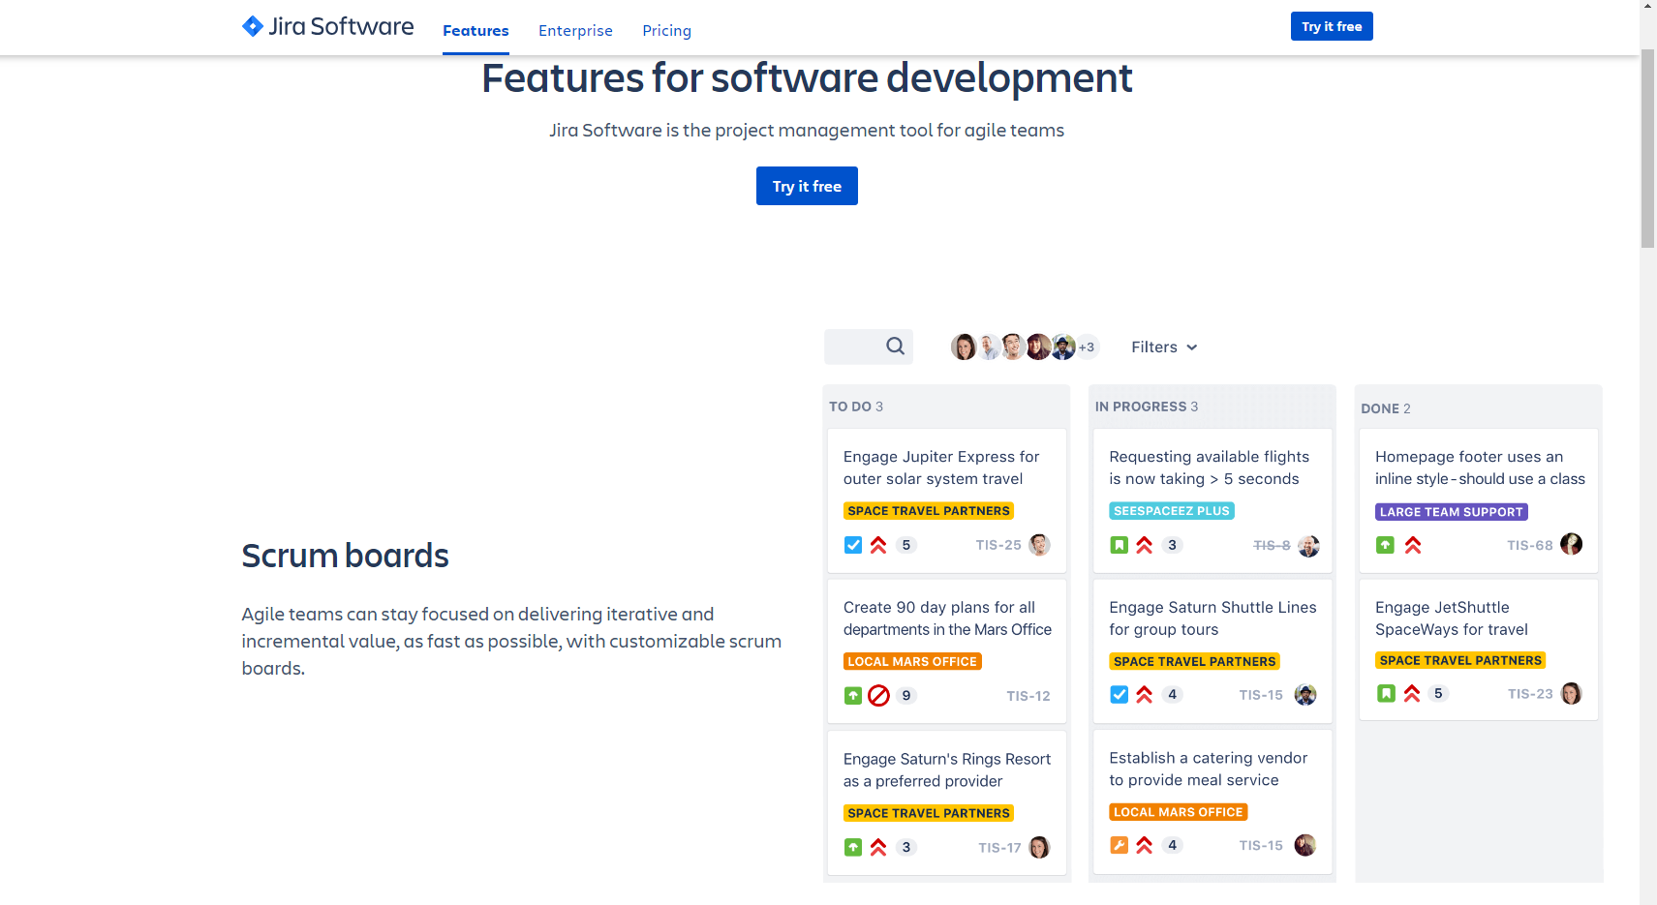
BACKGROUND (cont.)
JIRA is a Project Management tool for Agile teams, it’s not a Change Management tool

Slide 6
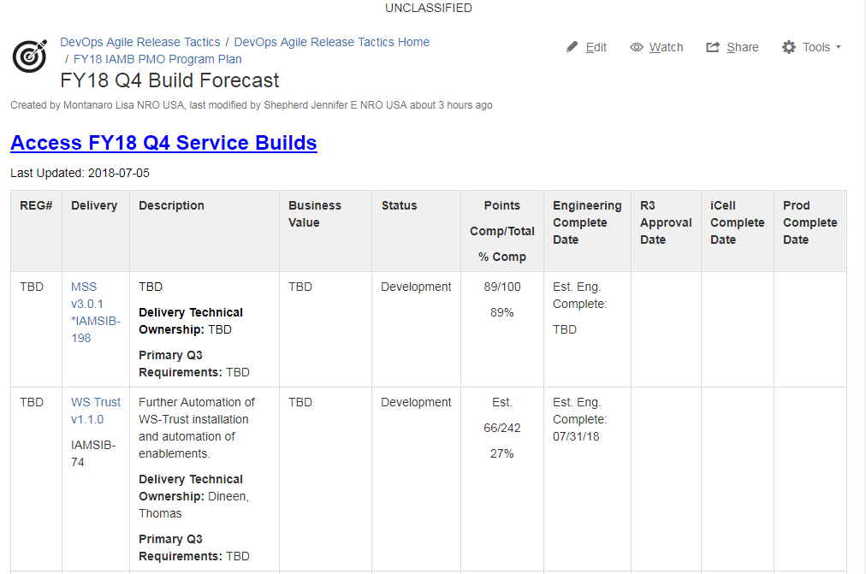
BACKGROUND (cont.)
The Fiscal Year Quarterly Build Forecast are project management artifacts

Slide 7
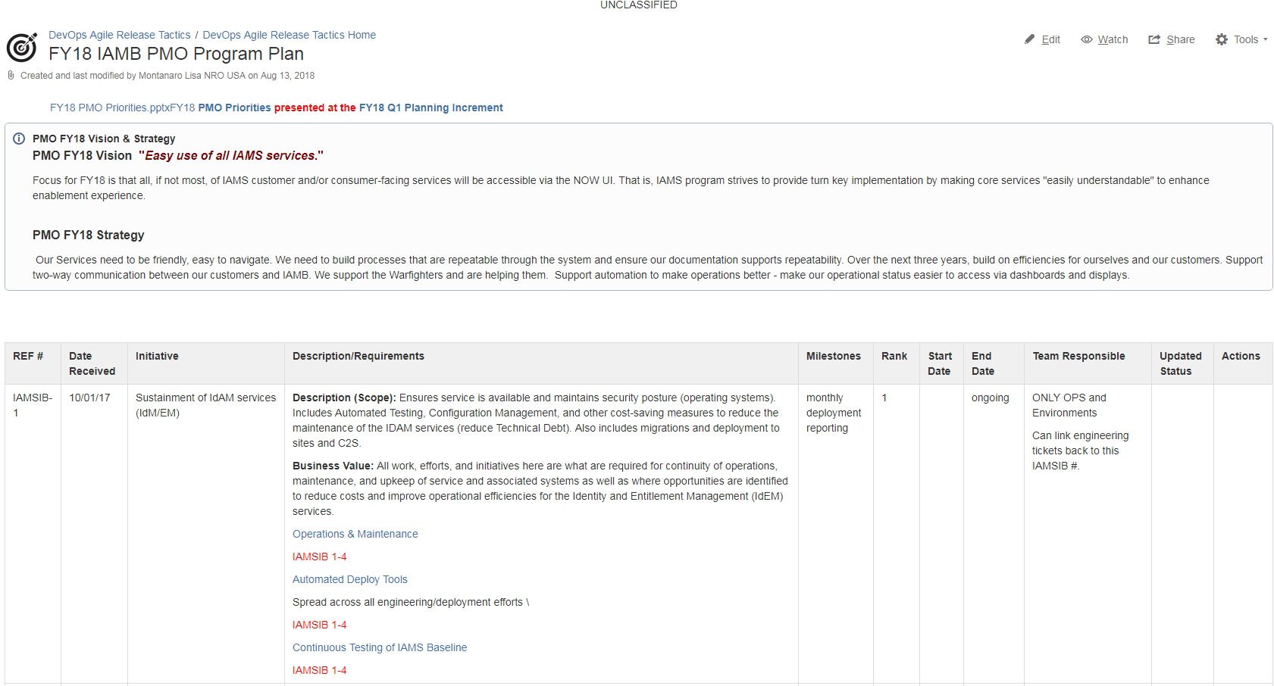
BACKGROUND (cont.)
The IAMB PMO Program Plan is a requirements artifact

Slide 8
BACKGROUND (cont.)
IN NUTSHELL:
JIRA is not a Change Management tool
The IAMB PMO Program Plan is not a CM artifact
The FY18 Quarterly Build Forecasts are not CM artifacts
The Regression Readiness Review (R3) Board is not a Change Management Board (CMB)

Slide 9
What is Change Management?
It’s the systematic evaluation of proposed changes to configuration items
It’s a major element of CM that formally establish baselines
It’s the gatekeeper for controlling changes to configuration items

Slide 10
What is Change Management?
(cont.)
A process to:
Understand impact(s)
Obtain informed consent (impact analysis)
Coordinate and communicate changes

Slide 11
What is Change Management?
(cont.)
Manages proposed changes via a common form:
Modification Request (MR)
Change Request (CR)
Engineering Change Proposal (ECP)
Request for Change (RFC)

Slide 12
Change Management Board (CMB) – Responsibilities
To maintain product integrity throughout the product’s lifecyle
Consistency is important in:
Chairman and Membership
Administration
Crisp conduct (all issues resolved prior to board)
CMB is not Technical Exchange Meeting
Clarity and promptness of Minutes and action item distribution
Timely follow-up of required actions

Slide 13
Change Management Board – Responsibilities (cont.)
Process Modification Request (MR)
Evaluate MRs for impact assessments
Disposition MRs (approve or disapprove)

Slide 14
Change Management Board (CMB) – Membership
CMB Role | Functional Area
Chair | PM
CMB Secretariat (Facilitator) | CM
Voting members | CALs
Voting member | OPS Lead
Non-voting member | Software Tester
Non-voting member | Release Manager
Non-voting member | Stakeholder

Slide 15
How does the CMB work?
A Modification Request form is completed and provided to CMB secretariat
CMB secretariat reviews MR for completion
CMB secretariat distributes MR package to CMB members for review, impact assessment and recommendations
CM distributes CMB Agenda
CMB meeting scheduled to review Agenda items
CMB disposition MR
Meeting minutes are prepared to convey approval/disapproval decisions from the Board

Slide 16
MR Form basics
Analysis
Priority
Is change compatible with Project Scope
Major change (require customer approval)
Minor change (impact internal or no baseline)
Decision
Approve or Reject
Identification
CM Tracking #
Submitter name
Date
Description
Justification
Benefits
Operation context
Impact to user(s)

Slide 17
BACKUP SLIDES

Slide 18
MR Form basics (cont.)
What is impacted
Real issue (hw, sw, doc, etc)
Effectivity
When does this change start/stop
Root cause
Estimate to complete

Slide 19
MR candidate – Scenario 1
MR submitted for a conf item (Prod Baseline)
MSS 3.0.1 Release
DSEE 1.3.0
DSEE 1.4.0
EGW 2.1.0
CRL Service 1.0.0
OpenPTK 2.0.0
Nagios 2.3.0
WFTrust 4.0.0
Targeted Environment: MSS

Slide 20
MR candidate – Scenario 2
MR submitted for a conf item (Stack Product)
EGW 2.1.0 Release
CRL Service 1.0.0
FTS 3.0.0
OpenPTK 2.0.0
PDP 2.1.0
SCIM 3.2.0
Targeted Environment(s):
MSS, IAMS C2S, IAMS CME

Slide 21
MR candidate – Scenario 3
MR submitted for a conf item (Stand-alone)
Omni v1.0
Targeted Environment(s):
IAMS C2S

Slide 22
Change Management Board (CMB) – Process Flow
CMB evaluates MR
CMB approve or Reject MR
MR Approved
Add CI to CM baseline
MR returned to submitter
MR Rejected

Slide 23
CMB Benefits
Improves:
Team communication
Provides product visibility
Maintains product integrity
Control changes
Decreases:
Rework
Confusion
Project risk

Slide 24
CMB Way-Ahead
Recommend baselining the IAMS Configuration Management Plan (CMP)

Slide 25
Question or Concerns
Suggestions ?
Comments ?
Recommendation ?

Slide 26
CMB and R3
Gap Analysis
CMB (Membership) | R3 Board (Membership) | Michele’s Comments
Chair | Chair | No change.
CMB Secretariat (Facilitator) | CMB Secretariat (Facilitator) | No change.
Voting members | Voting members | No change.
Voting member | Voting member | No change.
Non-voting member | Non-voting member | No change.
Non-voting member | Non-voting member | No change.
SETA (optional) | SETA | This is the only change btw board members

Slide 27
CMB and R3
Gap Analysis
CMB functions | R3 Board functions | Michele’s Comments
The CMB is initiated before Engineering work starts and remains engaged through the product lifecycle | The R3 process starts after Engineering work is completed . | The CMB enables planning upfront. Plan the work, work the plan.
Prior to Engineering work starting, all relevant project teams members review and approve proposed change(s). Upfront coordination enables RM to know when work starts, gives estimate deployment schedule, work priority, and cross team eval of cost, resource, security, schedule, and technical impacts. | Impact assessment done by Engineer and CAL (i.e. stovepipe). The R3 process ends after product is approved for promotion to high side network. | The R3 does not enable collective analysis (CALs, OPS, RM) to get on the same page before work begins or even during development work. For instance, if a product is withdrawn for whatever reason, there is no formal why to inform other project members. If a product is renamed, there is no formal why to learn the new name change. CM and RM need to know of product changes because Jim maintains a software listing of Products delivered to various customers and Lisa (RM) would need to remove the product from her Deployment plan. CM currently learns of changes through the grapevine, informally and it’s believed the RM learns of changes from looking at the quarterly build page and/or attending various meetings.

Slide 28
CMB and R3
Gap Analysis
CMB functions | R3 Board functions | Michele’s Comments
MR form: Formally establishes a Baseline and manages change to delivered software and documents. | R3: Does not establish baselines. | The MR form and its associated documentation tracks product changes (i.e. who, what, when, why,) throughout product lifecycle. The MR form traces requirement, software, and documentation in one central location.

Slide 29
CMB and R3
Gap Analysis
CMB functions | R3 Board functions | Michele’s Comments
 | R3 page: Establishes when the software and document is ready for review to move from Dev (network) to Prod (network) | The R3 no longer track product changes after R3 approval. For example, if an Install guide has errors detected on high side, a revised install guide (new product) does not go back to the R3 for approval. The R3 page formally tracks changes that Env personnel find in Regression environment. CM: Doc and Code are tracked via Pre-FAT and FAT folders. There is not a change form that maps to the approved product. Multiple copies of documents are found on Shared drive. The JIRA ticket has the R3 approval status for items boarded.

Slide 30
CMB and R3
Gap Analysis
CMB functions | R3 Board functions | Michele’s Comments
Status Accounting: Formal Meeting Minutes are prepared that reflect CMB approval of Modification Request and applicable discussions. Minutes are formally CM records. | Status Accounting: No R3 meeting minutes prepared. | R3 facilitator enters the board decisions in JIRA ticket. (approve or reject).

