Slide 1
Statistical Data Analysis
Project review
Team Members:
Gargiulo Michele
Marchesano Riccardo
Sabini Pietro
0622701137
0622701198
0622701112

Slide 2
Project Overview
We performed classification and regression on the same dataset. In particular, we performed:
Classification:
Using Python, Google Colab, Apache Spark & SKLearn (SciKit Learn)
Regression:
Using R, RStudio

Slide 3
The Dataset
The Dataset is extrapolated from a more general data which contains information about User Reviews for Long-distance trains from all over the world. The dataset contained information about each train line, the user review and info about the users which published the review, including their name and review content.
We performed some manual preprocessing on the dataset, which mainly consisted of removing the columns which we considered useless for our analysis, such as the reviewer’s name and the content of the review.
The following is a comprehensive list of the columns contained in the dataset we used, after the preprocessing:
ID (progressive numerical identifier)
company
class
comfort_score
service_score
food_score
enjoyment_score
station_score
internet_connection_score
expendiency_score
final_vote
approved

Slide 4
Pre-Processing
After the column removal, some more pre-processing operations were performed.
The “approved” column required the substitution of the values it contained: we had to replace the strings “true/false” in the dataset with numerical Boolean values, 1 for “true” and 0 for “false”
We removed all the rows which contained at least one missing data
The final dataset, which we provided on the GitHub repository, contains just under 80.000 rows and 12 variables.

Slide 5
R - Regression
The main goal was to predict the final_score of the user with respect to the regressors present in the dataset, that in our case are:
comfort_score
service_score
food_score
enjoyment_score
station_score
internet_connection_score
expendiency_score

Slide 6
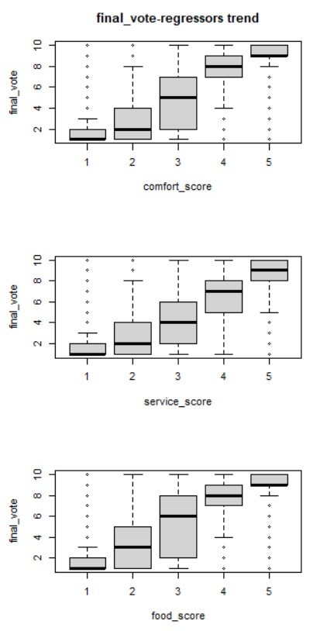
Multiple Regression (1 / 4)
This is the first regression we used.
We checked the trend between the final score (which was the dependent variable) and the regressors.
Such trend seems to be not linear, so probably a linear model will not be the best way to interpret the data.

Slide 7
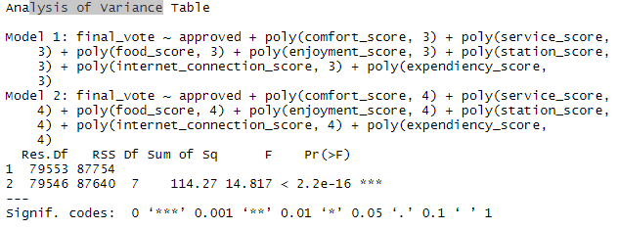
MULTIPLE REGRESSION (2 / 4)
Then we used the summary() function to analyze each model and the anova() function to compare two models at a time.

Slide 8
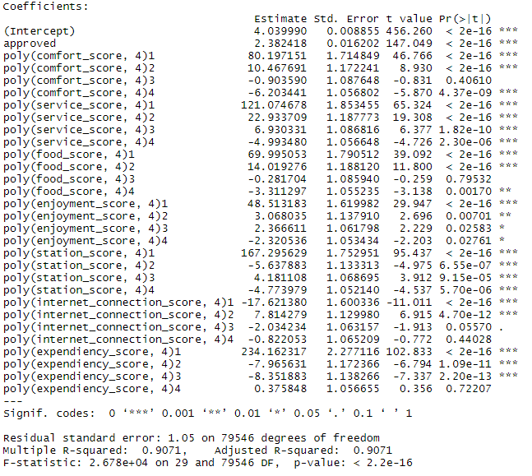
MULTIPLE REGRESSION (3 / 4)
Output of the summary functions:
The least significant predictors seem to be:
comfort_score
food_score
enjoyment_score
internet_connection_score

Slide 9
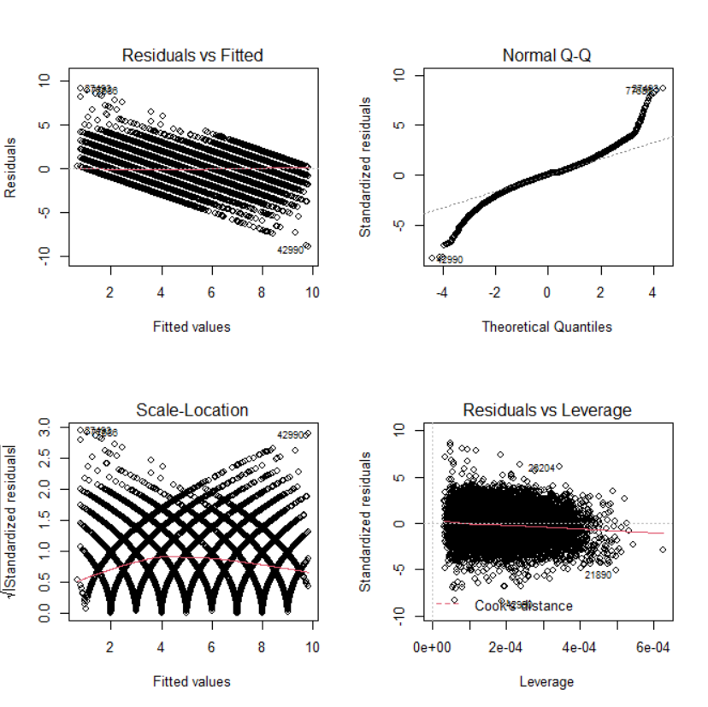
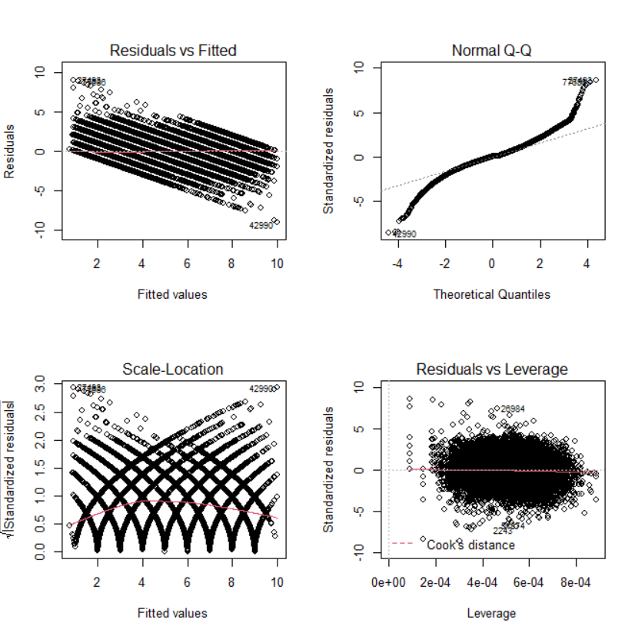
MULTIPLE REGRESSION (4 / 4)
The following diagnostic graphs were produced by using the output of the lm() function
For the linear transformation
For the poly-4 transformation

Slide 10
VALIDATION SET APPROACH (1 / 1)
We split the dataset in half, and we used the first part as a training set and the second one as a test set.
Each half contains about 40.000 samples.
Those are the values for the MSE found on each transformation type:
Transformation | MSE
Linear | 1.111269
Polynomial-2 | 1.095797
Polynomial-3 | 1.094223
Polynomial-4 | 1.093318
Logarithmic | 1.241137

Slide 11
RESAMPLING METHODS (1 / 2) K-FOLD CROSS VALIDATION
We split a part of the dataset in K parts, named folds
We set K = 10
9 folds out of 10 are used for training the model, while the remaining one is used as validation set
The process is repeated K times, so that each fold is used as a validation set exactly once
Those are the values for the MSE found on each transformation type:
Transformation | MSE
Linear | 1.120782
Polynomial-2 | 1.105092
Polynomial-3 | 1.103605
Polynomial-4 | 1.102377

Slide 12
RESAMPLING METHODS (2 / 2) BOOTSTRAP
We used the bootstrap in order to quantify the difference between the estimate of the standard error of each coefficient.
The difference is very small, and it means that the model interprets the data very well.
Coefficients | Standard Error Difference
intercepts | 0.0004565354
approved | -0.006183459
comfort_score | -0.0006145307
service_score | -0.0009786729
food_score | -0.0003997568
enjoyment_score | -0.0005182993
internet_connection_score | -0.0012441211
station_score | -0.0002897655
expendiency_score | -0.001459983

Slide 13
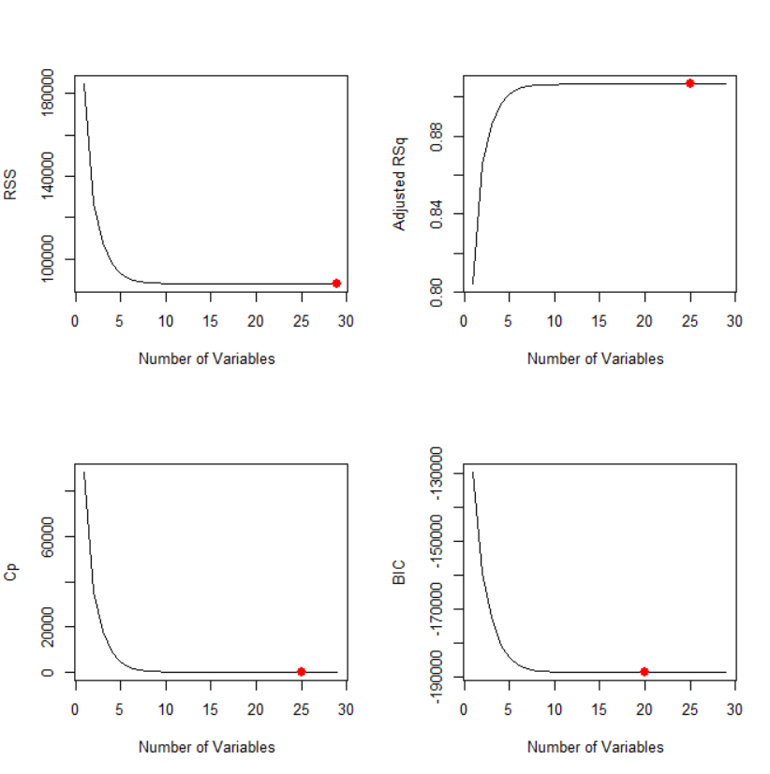
SUBSET SELECTION (1 / 4) BEST SUBSET SELECTION
Best Subsets compares all possible models using a specified set of predictors and displays the best-fitting models that contain one predictor, two predictors, and so on. The end result is a number of models and their summary statistics.
The criteria we have choosen for the model selection are RSS, Adjusted R², Mallow’s CP and BIC
RSS: minimum at 29 predictors
Adjusted R²: minimum at 25 predictors
BIC: minimum at 20 predictors
Mallow’s CP: minimum at 25 predictors

Slide 14
SUBSET SELECTION (2 / 4)
Now that we obtained the best model, we have to evaluate its performances. We decided to proceed with the validation set approach. We fitted the model on the training set and then the MSE was calculated upon the test set.
The following table provides the results for each transformation
Transformation | Predictors (based on BIC) | MSE
Linear | 8 | 1.106853
Polynomial-2 | 14 | 1.090448
Polynomial-3 | 17 | 1.089150
Polynomial-4 | 20 | 1.087880

Slide 15
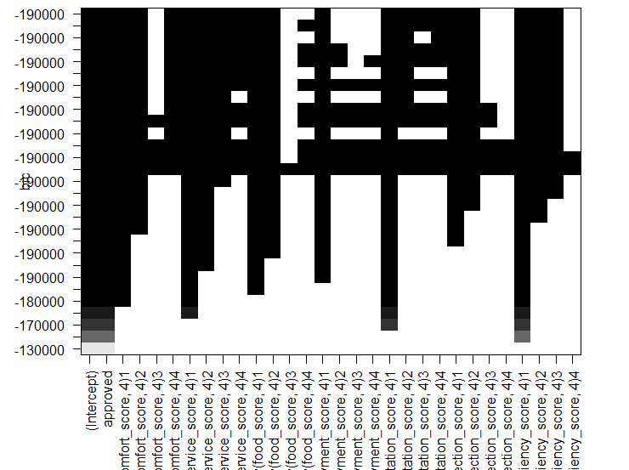
SUBSET SELECTION (3 / 4)
The transformation with minimum MSE is the polynomials-4
The BIC parameter selected a model with the minimum number of predictors across all other criteria.
It is interesting to see that the predictors not considered by all the subset selection approaches are comfort_score,
food_score,
enjoyment_score and internet_connection_score

Slide 16
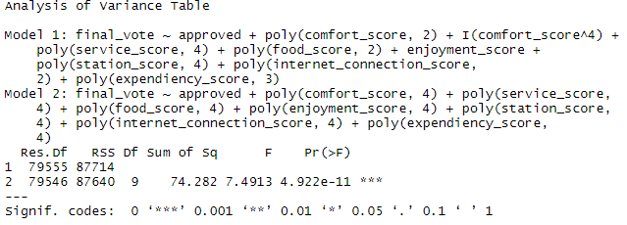
SUBSET SELECTION (4 / 4) FINAL CONSIDERATIONS
The suggested model to select in the one which minimizes the BIC criteria, because it provides the model with the least number of predictors.
This means that including in the model any predictor other than the ones provided by the BIC, does not make the model more accurate, but just makes the model more complex for almost the same performance. In order to avoid overfitting problems, simpler models should be used.

Slide 17
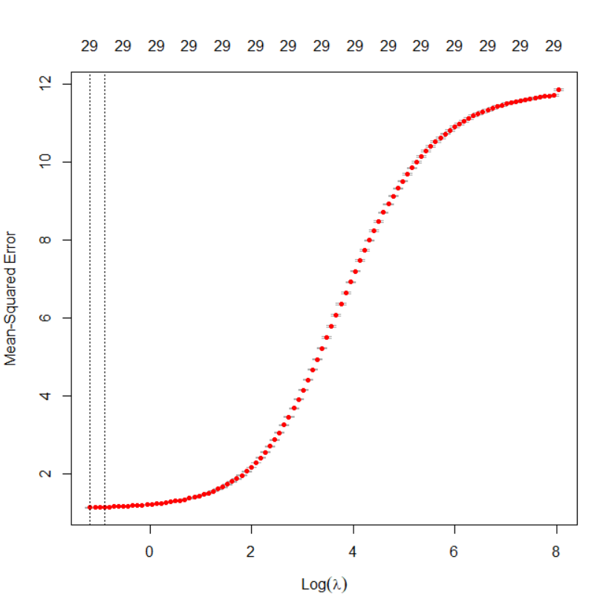
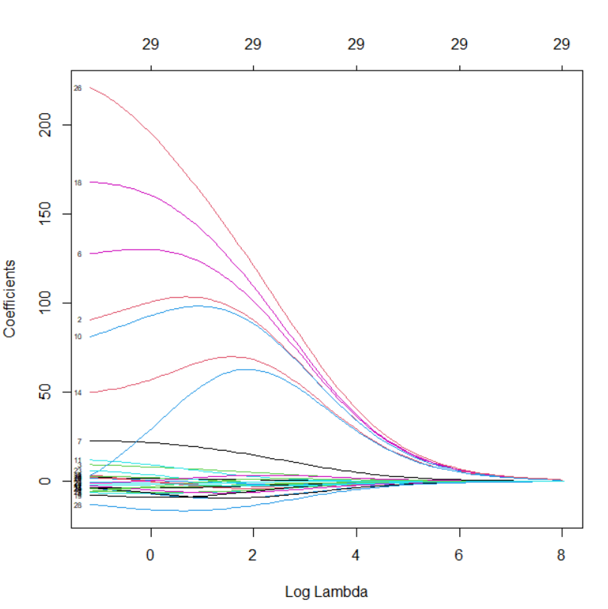

REGULARIZATION (1 / 4) RIDGE
Obviously, we had to test many parameters of λ. We performed a cross-validation over 100 possible values of λ, in a span ranging from ${10}^{−2}$ to ${10}^{10}$
Graph of the coefficients as a function of λ

Slide 18
REGULARIZATION (2 / 4) RIDGE
Results of the Ridge Regularization:
Transformation | MSE without regularization | MSE with regularization
Linear | 1.120782 | 1.128454
Polynomial-2 | 1.105092 | 1.113370
Polynomial-3 | 1.103605 | 1.112249
Polynomial-4 | 1.102377 | 1.111561
Ridge does not improve to the model’s performance compared to the model without ridge regularization

Slide 19
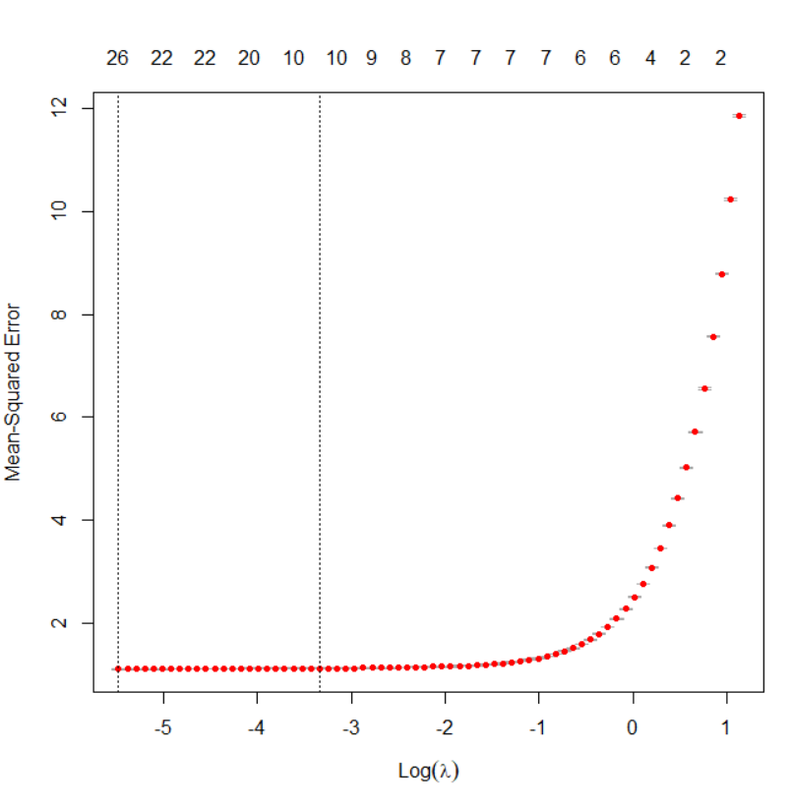
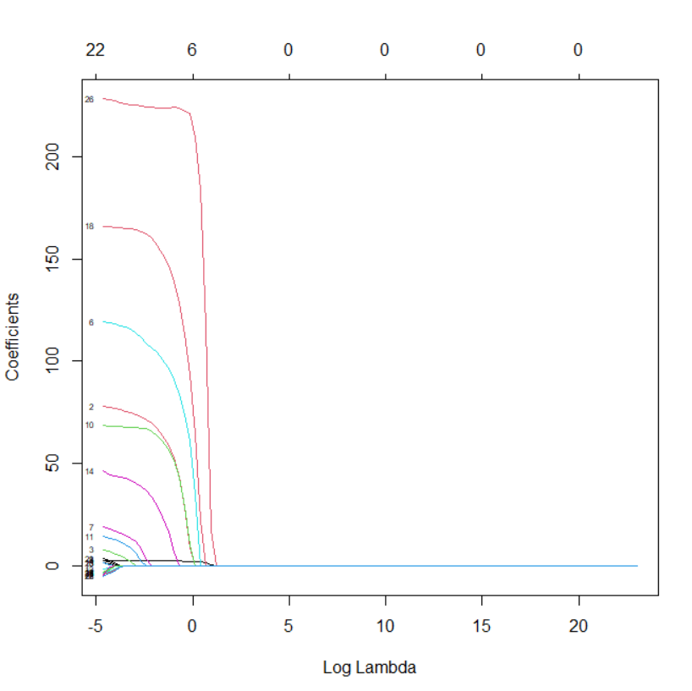
REGULARIZATION (3 / 4) LASSO
The following is the graph of the MSE as a function of λ:
Again, we provide a graph of the coefficients as a function of λ:

Slide 20
REGULARIZATION (4 / 4) LASSO
Unlike Ridge, Lasso brings some improvements in model performance. Lasso regularization works by bringing some coefficients to zero, so in the following table we provided information about how many are brought to zero.
The model provided by lasso is also much simples (because it contains less predictors), and thus is more interpretable.
Transormation | MSE w/o regularization | MSE w/ regularization | Predictors brought to 0
Linear | 1.120782 | 1.112508 | 1
Polynomial-2 | 1.105092 | 1.095790 | 0
Polynomial-3 | 1.103605 | 1.094215 | 4
Polynomial-4 | 1.102377 | 1.093314 | 7

Slide 21
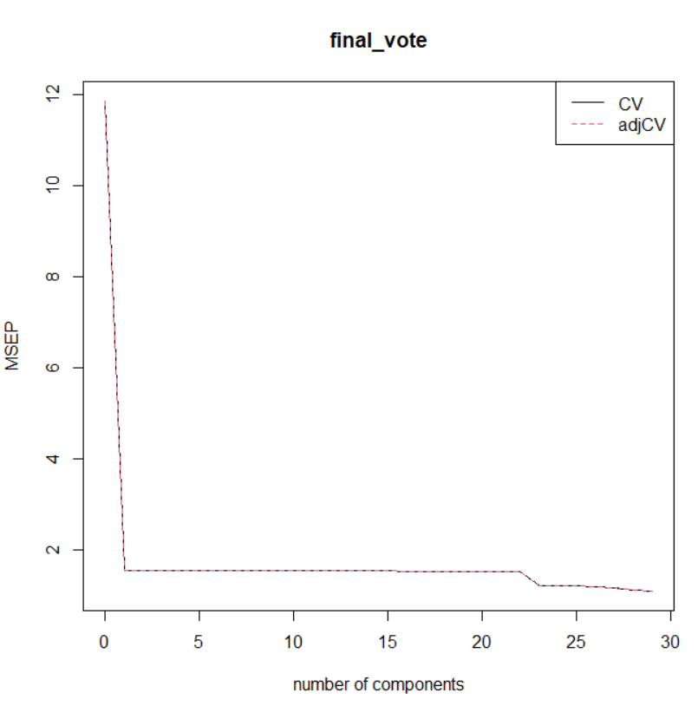
PCR & PLS (1 / 4)
The PCR procedure computes the MSE and the percentage of variance explained using N coefficients.
The minimum MSE is achieved by using all the predictors.
Using a 4th-order tranformation, the percentage of variance explained on the dependent variable is over 90% (considering all predictors)

Slide 22
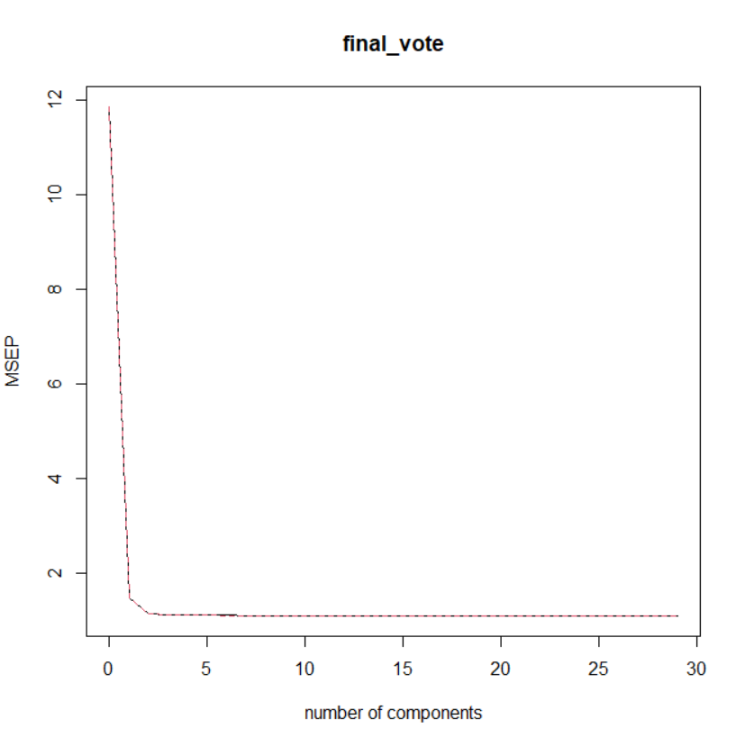
PCR & PLS (2 / 4)
The PLS provides the same outputs as the PCR (MSE and % of variance)
Transformation | Component number for the model at min MSE
Linear | 8 (out of 8)
Polynomial-2 | 14 (out of 15)
Polynomial-3 | 15 (out of 22)
Polynomial-4 | 12 (out of 29)

Slide 23
PCR & PLS (3 / 4)
Transformation | Number of Components | Min MSE
Linear | 7 | 1.111269
Polynomial-2 | 9 | 1.095797
Polynomial-3 | 11 | 1.094223
Polynomial-4 | 10 | 1.093318
We finally fitted the models on a training set and evaluated them on a test set.
We did the same for the models which had the maximum percentage of variance explained (PVE)
Transformation | Number of Components | Min MSE
Linear | 4 (out of 8) | 1.111270
Polynomial-2 | 9 (out of 15) | 1.095803
Polynomial-3 | 15 (out of 22) | 1.094214
Polynomial-4 | 10 (out of 29) | 1.093249

Slide 24
PCR & PLS (4 / 4)
PLS considered lower predictors than PCR
Using fewer predictors, the model explains more variance
Regarding the MSE, it is not much different than the values found through the use of Ridge and Lasso.

Slide 25
PYTHON – Pre-Analysis
Before applying the actual classification procedures, we analyzed some basic statistical properties of the data
The balancing of the dataset towards the classes:
approved train lines: 49.59%
not-approved train lines: 50.41%
Mean and variance of the features, for both approved and not-approved train lines

Slide 26
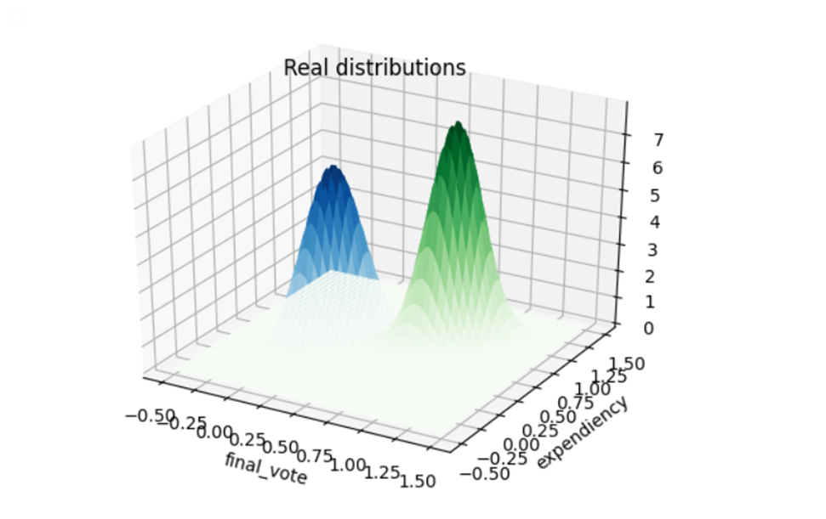
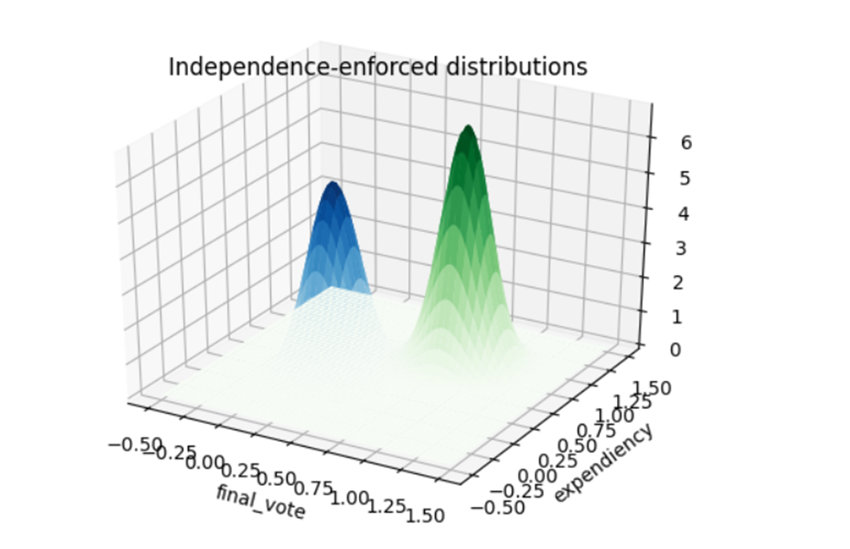
Synthetic Dataset
In order to obtain the synthetic data, we used a multivariate normal
We used the mean and covariance of the real dataset, considering only two features.
In such way, we were able to estimate the real dataset distribution
Get in an approximated way if the features and independent or not
The TOP graph is obtained from the real data
The BOTTOM graph is obtained from the synthetic data, setting the covariances both to zero
If the two graphs were more or less equal, we can conclude that the real covariance among those two features is also around zero, and so they are almost independent.

Slide 27
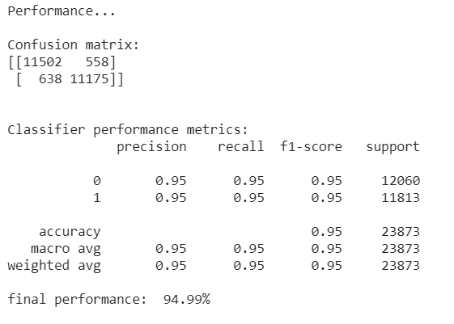
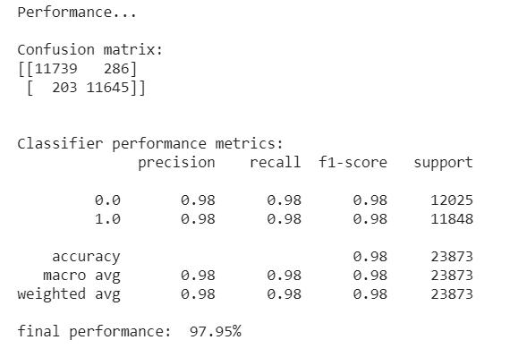
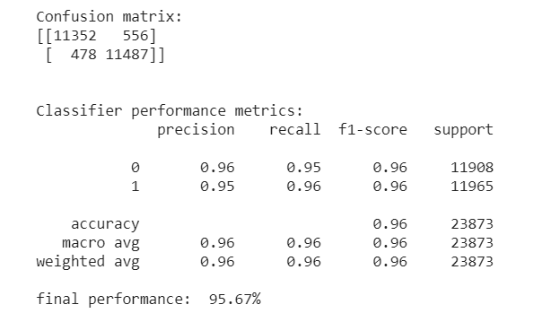
NAïVE BAYESIAN CLASSIFIER
This is the first approach that we tried.
Since the hypothesis of independence between the features seems to hold, we expect this classifier to perform really well
The most revelant features seem to be final_vote and expendiency

Slide 28
KNN (K-Nearest neighbors) (1 / 2)
While the KNN is implemented in the SKLearn library, we had to code some of it manually for use with Spark
In particular, we coded two functions
Euclidean_distance, to retrieve the distance between two points
K_nearest_neighbors, to get the K nearest neighbors given a data sample
Since we tried both sklearn and Spark on the synthetic dataset and the results were identical, we only used SKLearn on the real dataset.
KNN was implemented with:
expendiency and final_vote from the synthetic dataset
expendiency and final_vote from the real dataset
All features, one at a time
All features at once

Slide 29
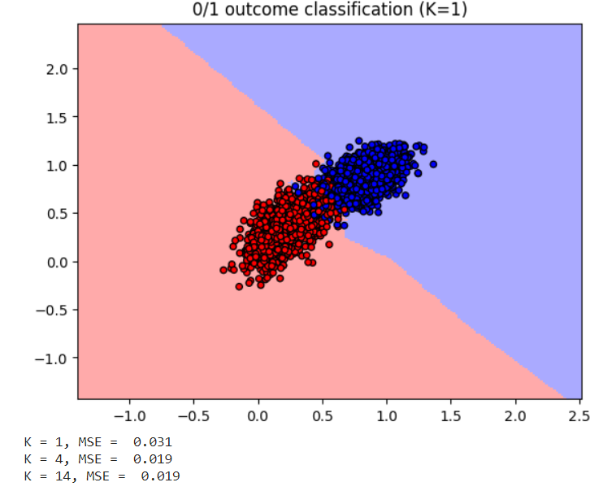
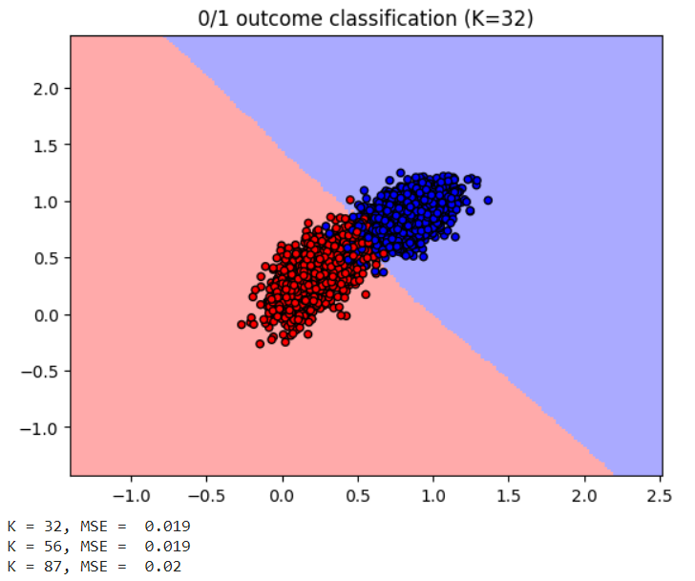
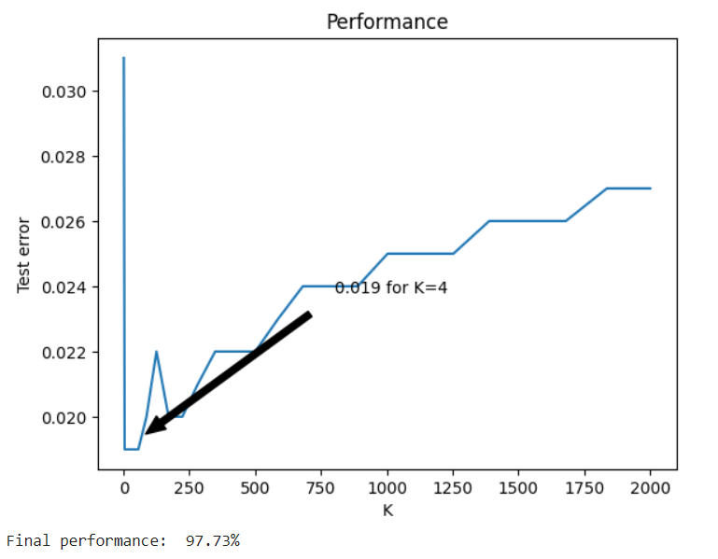
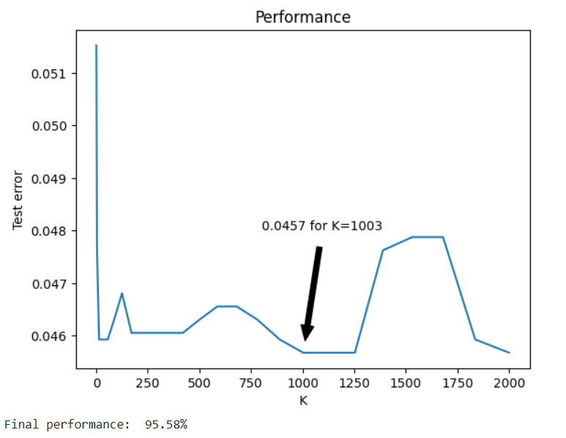
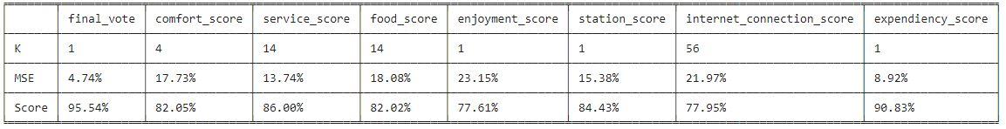
KNN (2 / 2)
The following graphs show a classification for two different values of K
The third graph on the right, shows how test error is related to increasing values of K
Different values of K on the real dataset:
The bottom graph shows the performances of different values of K on different features on the real dataset

Slide 30
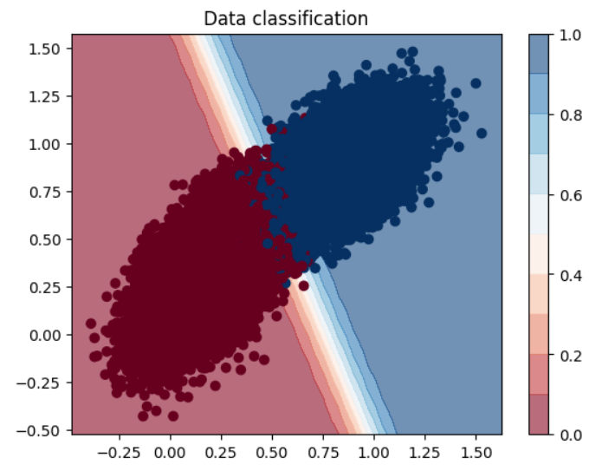
Logistic regression (1 / 2)
We tried this approach both with SKLearn and with Spark
In order to perform logistic regression on Spark, we had to code some functions used in the algorithm (sigmoid function, the cost function, etc.)
We compared the results, and the results are very similar

Slide 31
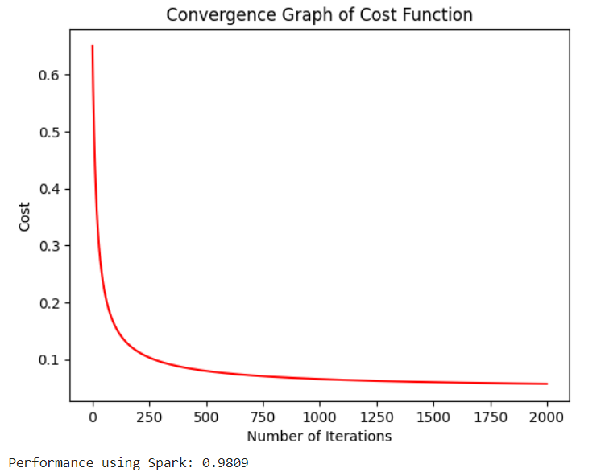
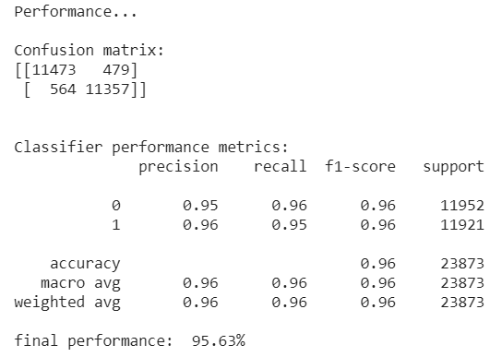
Logistic regression (2 / 2)
Let’s analyze the results of the regression.
We provided some graphs for the convergence of the cost function in relation to the learning rate
Higher learning rate values should provide fast convergence, but might get stuck into a non-global minimum
Lower learning rates might cause a slower convergence, but tends to find a better minimum

Slide 32
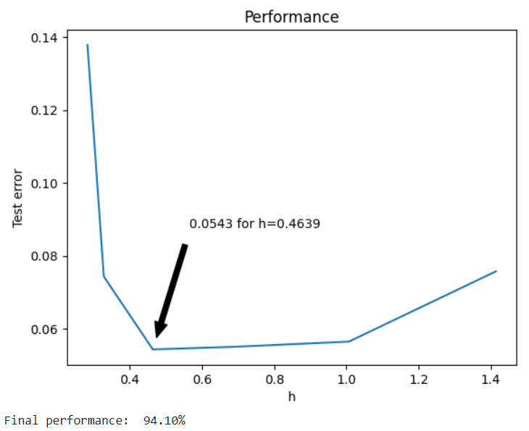
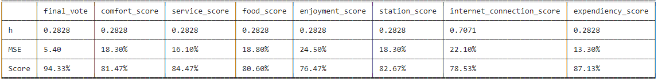
NAïVE KERNEL
Only implemented through Spark
We coded the distance() function to get the distance between 2 points
We also coded the get_neighbors() function, which retrieves all points that fall into a certain distance h from a given sample
Obviously, the algorithm was executed multiple times to find the best value of h

Slide 33
THANKS FOR YOUR ATTENTION
Gargiulo Michele
Marchesano Riccardo
Sabini Pietro

