Slide 1
Environmental Monitoring Systems Using IoT
MM
MI
GT

Slide 2


Introduction
How Environment impact our lifes?
The consequences of bad quality environment are:
Destruction of biodiversity
Scarcity of drinkable water
Disease
Infant mortality

Slide 3
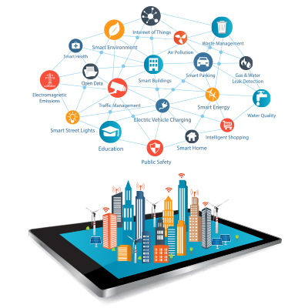
Introduction
Why we need an Environmental Monitoring System

Slide 4
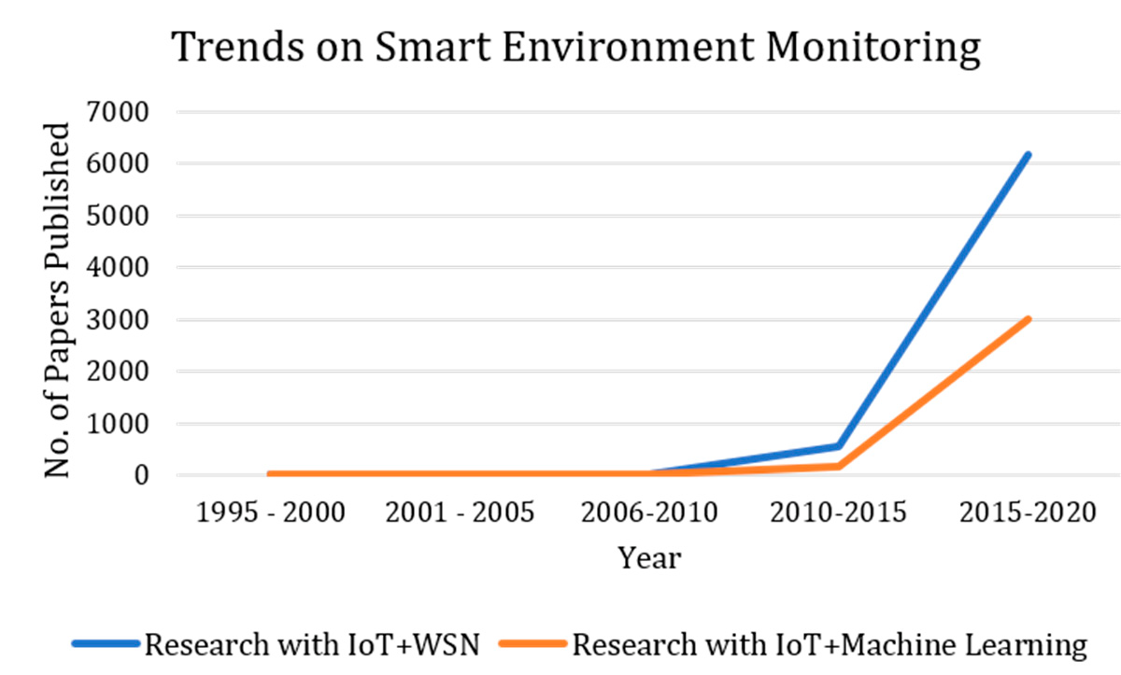
Background

Slide 5
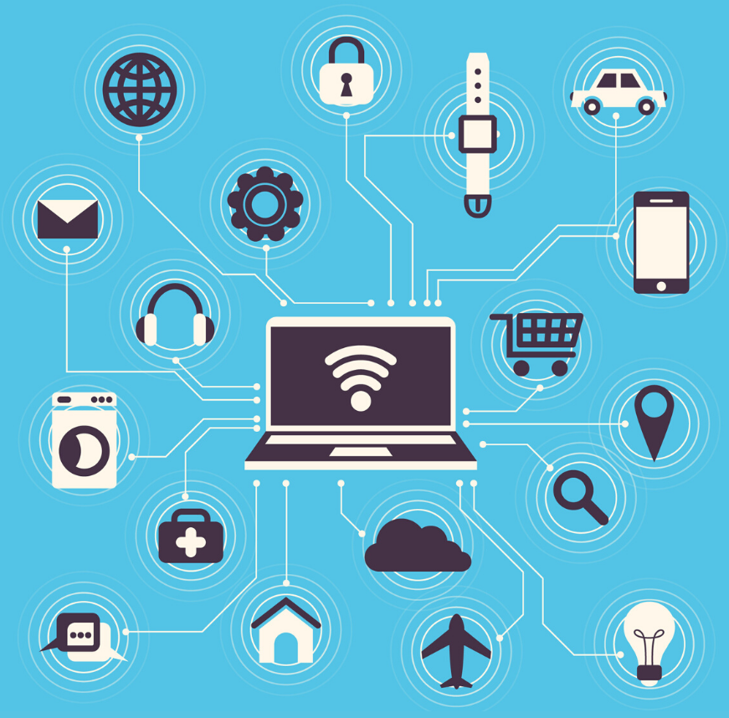
Background
General IoT architecture:
Sensors
Micro-controller
Actuators
Cloud

Slide 6
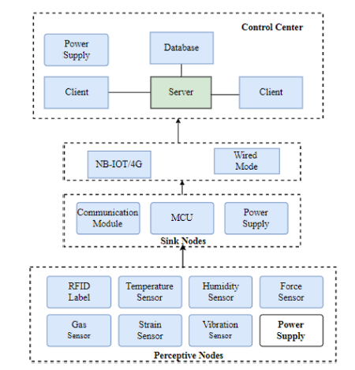
Background
Iot basic architecture

Slide 7
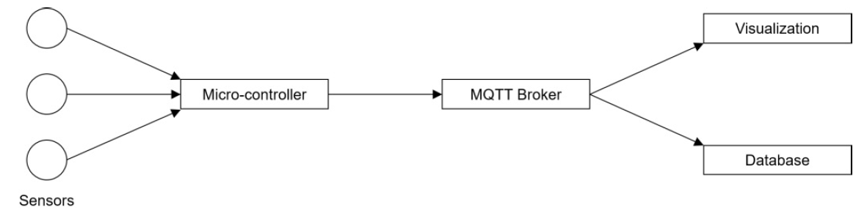
Background
Iot Basic architecture
Measuring nodes: Micro controllers with sensors
Message Broker: MQTT
Data Storage and Visualization

Slide 8
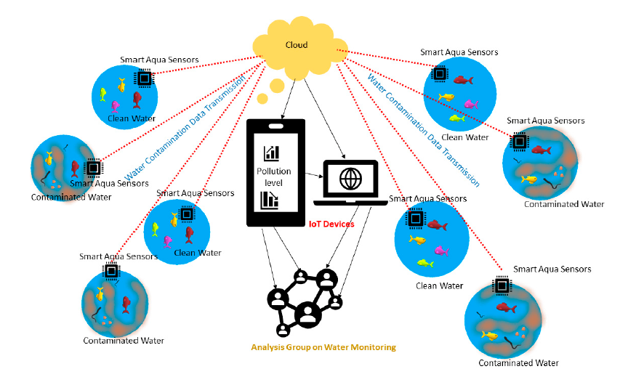
Existing Architecture
Smart environment monitoring system highlighting water contaminations and its monitoring using the cloud connecting internet of things (IoTs) and sensors.

Slide 9
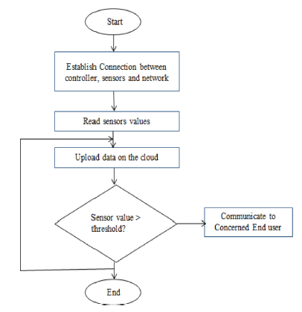
Existing Architecture
Other examples
Mukta
Konde and Deosarkar

Slide 10
Observations
The extensive studies brings out the following major observations for the discussion:
The research on SEM includes various purposes
The methods are divided in terms of sensory data used, machine learning methods used, IoT devices used, and types of sensors involved
The methods have been used for either classification or prediction

Slide 11
Problems
The studies reported for all purposes of systems do not have any common challenges and vary from application to application, but the major challenges observed are as follows:
There is problem of interoperability in the analysis of the data captured
Sample size is limited in many of the contributions.
Noisy data poses a challenge in analysis
The machine learning methods which have been employed for training the data and for classification
There is no robust approach of machine learning reported

Slide 12
Solutions
The above discussion and analysis helps us recommending the following for better, robust and smarter environment monitoring systems
A framework of machine learning methods needs to be developed.
A robust set of classification, prediction and forecasting models has to be designed
Suitable denoising methods are required to be implemented as pre-processing to the SEM major stages.
Data deduplication approaches and other methods are needed to deal with big data issues
SEM aims at sustainable development
Developing suitable standards and protocols that can make the data compatible for all acquisition and analysis systems.

Slide 13
Conclusion
Environmental pollution is a major threat to any country, as it affects health, economy and spoils bio- diversity.
Several studies have already proven that the environmental conditions in the production area strongly affect the human performance.
Combining the necessity to incorporate these conditions to realize further improvements of production systems with the current opportunities provided by IoT applications, the need for an IoT-based monitoring of environmental conditions has been shown.

