Slide 1
Lessons Learned in X Years of Parallel Programming
Michele Simionato
michele.simionato@globalquakemodel.org
EuroPython 2017 - Rimini

Slide 2
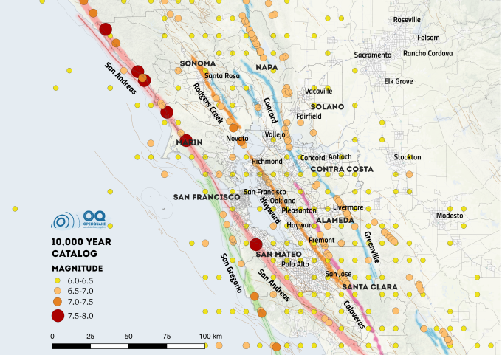

Slide 3






































OUR PARTNERS
Private Participants
Australia
Chile
Colombia
Germany
Italy
Japan
Nepal
USA
Public Participants
New Zealand
Norway
Switzerland
Taiwan
Turkey
United Kingdom
Venezuela
Project Partners
Associates

Slide 4



OpenQuake Engine
Project started by GEM in 2009
More than 6k commits/yrs
Around 300k lines of Python
It’s Open Source Software (under GNU AGPL3), hosted on public GitHub repos
Supports Python 2.7 and Python 3.5+
Pure Python code since version 2.2 (with small parts made in JavaScript and HTML)
Focus on scalability
CI on Travis and Jenkins
Notes:
<number>

