Slide 1

Demystifying decision forests

Slide 2

What is data science???

Slide 3





?

Slide 4

Answer
???
Data
Data
Question

Slide 5
difference?

Slide 6
customer data
ID | Credit score | House age | Years of employment | Credit card debt | Purchase year | Mortgage failure
37089 | 721 | 19 | 4 | 958 | 2003 | 0
57076 | 725 | 23 | 3 | 3603 | 2005 | 0
90649 | 730 | 11 | 6 | 5570 | 2009 | 0
20110 | 649 | 14 | 6 | 5243 | 2002 | 0
89640 | 761 | 17 | 6 | 5189 | 2008 | 0
94359 | 685 | 29 | 9 | 5315 | 2009 | 0
65832 | 727 | 15 | 6 | 6577 | 2006 | 1
62675 | 732 | 12 | 3 | 3601 | 2006 | 0
6158 | 704 | 21 | 5 | 3942 | 2000 | 0
20537 | 696 | 4 | 3 | 8665 | 2002 | 1
creditScore | houseAge | yearsEmploy | ccDebt | year | default | id

Slide 7



Slide 8
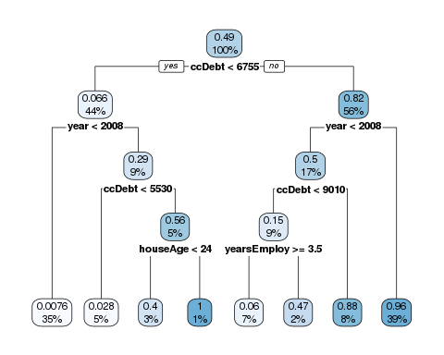

Slide 9
