Slide 1
Project Work in Machine Learning: M5 Competition
Michele Vece

Slide 2
Summary
M5 Competition Overview
01
Objective, organization and metric
02
Main challenges
Issues and solutions
Other solutions
03
Lessons learned from other participants
04
Proposed solution
Description of the solution

Slide 3
1.1: M5 Competition
Objective
Unit sales forecasting:
for each item in each store for the next 28 days
Organization
Historical sales:
days 1 - 1941
Files
Public leaderboard:
days 1914 - 1941
Metric
Private leaderboard:
days 1942 - 1969

Slide 4
1.2: M5 Competition
Objective
10 stores in 3 states (CA, WI, TX)
Organization
7 departments in 3 categories (HOBBIES, HOUSEHOLD, FOODS)
Files
3049 different products
Metric
3049 products x 10 stores x 28 days

Slide 5
1.3: M5 Competition
Objective
calendar:
dates the products are sold
Organization
sell price:
weekly price of products in each store
Files
sales train validation:
historical daily unit sales (until day 1914)
Metric
sales train evaluation:
historical daily unit sales (until day 1941)

Slide 6
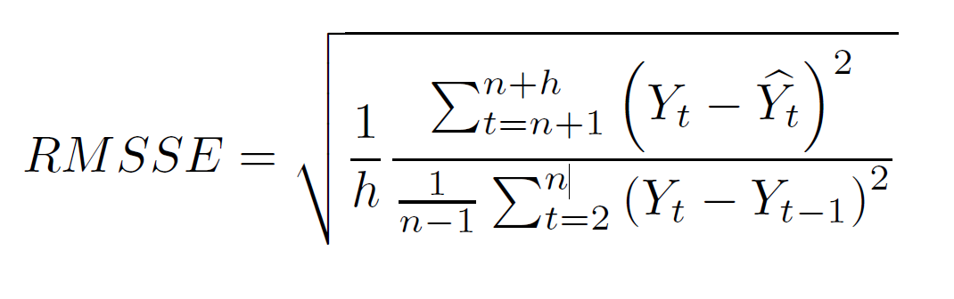
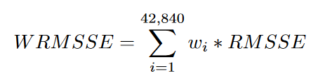
1.4: M5 Competition
Objective
WRMSSE:
Weighted Root Mean Scaled Squared Error
Organization
RMSE scaled wrt historical sales
Files
RMSSE weighted wrt cumulative actual dollar sales
Metric
12 aggregation leves:
Overall score is the average of 12 WRMSSEs

Slide 7
2: Main challenges
01
02
03
04
05
Amount of data
Cross correlation
Sales intermittency
Prediction Atomicity
Horizon, Recursion
Feature Engineering:
high-level features on aggregated data
divide in subsets
low-level features on each subset.
Model implementation:
divide in subsets
train a different model on each subset
Here:
Split data wrt state
FE
Split date wrt store
training
Similarities among different timeseries:
same store, different department
same department, different store
How to split data?
subsets that share some common behaviour may be separated
Are zero sales real?
out-of-stock
Solution n. 1:
predict sales
predict out-of-stock probability
Solution n. 2:
objective function that works well with non-negative right-skewed distributions
Atomicity:
product-level
daily basis
Error-prone:
easier to make errors than on aggregated data
Overall score:
takes into account errors at different levels of aggregation
General rule:
latest days have higher predictive power
Recursive data:
fresh data
may contain error
Non recursive data:
less recent
ground truth
3 models:
a model per all weeks
a model per each week
recursive model
Notes:
In feature engineering, one strategy may be first computing high-level features on aggregated data, then dividing data in subsets and computing low-level
features on each subset. In model implementation, instead, the main strategy consists in dividing data in subsets and training a different model on each subset.
Here, the adopted solution consists in splitting data according to the states before the feature engineering phase. After that, dataframes are further split
based on the store. Training is done on a per-store basis.

Slide 8
3: Other solutions
What have we learned?
Machine Learning
vs
Deep Learning
Cross learning
Objective function
Cross
Validation
ML preferred to DL
extensive use of LightGBM models;
exploit all the available information
lots of small models
focus on different aspects
last 28-day window(s) used as assessment
approximation of the post-sample accuracy;
tweedie loss preferred to RMSE
it suits better sales intermittency

Slide 9
4: Proposed solution
01
Preprocessing
Data Exploration
02
03
Feature Engineering
Model Implementation
04
Forecast

Slide 10
4.1: Preprocessing
Calendar
Sales
Prices
Dates 1 - 1969
Historical unit sales
date
wm_yr_wk
weekofmonth
weekofyear
dayofweek
dayofmonth
dayofyear
month, year
event_name_1
event_type_1
snap_CA
snap_TX
snap_WI
Prices for each item, store
id
item_id
dept_id
cat_id
store_id
state_id
d_1
…
d_1941
store_id
item_id
wm_yr_wk
sell_price

Slide 11
4.2: Data Exploration
Sales distribution
Unit sales grouped per state, store, category, department
different distributions
not uniform
Cross correlation
Similarities across same store or department
group/divide per store
group/divide per department
Seasonality
Unit sales per period and event
higher sales on weekends, on snap days, on some events, …
Autocorrelation
Discover useful lag values
lag 7 and its multiples
lag 30/31

Slide 12
4.3: Feature engineering
Prices
Sales (3)
Sales (1, 2)
Prices
Average sales
price_last_week
price_next_week
price_same_dept
price_mean
price_std
Recursive / Non recursive
avg_item_store
std_item_store
avg_item_state
avg_dept_store
avg_dept_state
avg_snap
avg_event
avg_weekofmonth
n_items
rolling_mean_ dayofweek
rolling_mean_7_28
rolling_mean_28_28
rolling_mean_28_90
rolling_mean_28_180
rolling_mean_28_465

Slide 13
4.4: Model implementation
Number of leaves
Early stopping
max #leaves of the tree
31 in almost all models
prevent overfitting
100 epochs on validation
LightGBM
Objective function
Learning rate
tweedie
variance power in [1.1, 1.5]
adaptive learning rate
from 0.1 to 0.05
Metric
Bagging
regression task
RMSE
speed up, prevent overfitting
sample 0.25 every 10 steps
Cross Validation
reuse validation as training
3 x 28 days

Slide 14
4.5: How recursive predictions work
Historical data
Forecast 1st week
data after preprocessing and feauture engineering
Use only hystorical data
Forecast 2nd week
Use updated data
Update data
Add new predictions and recompute recursive features
Forecast 3rd week
Use updated data
Forecast 4th week
Use updated data
End

Slide 15
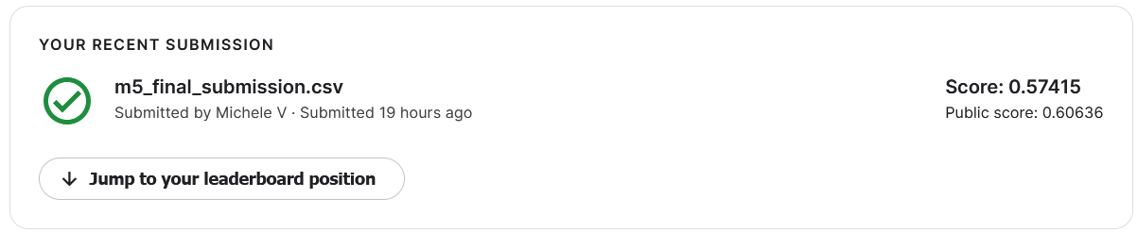
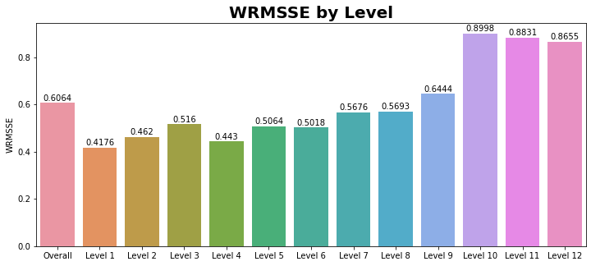
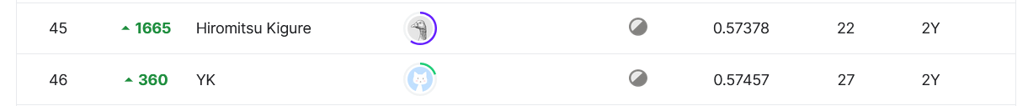
4.6: Submission and results
Leaderboard
top performing benchmark beated
similar private/public
WRMSSE decomposition
deterioration at lower aggregation level
Placement
46th place in the public leaderboard

