Slide 1
Agile Acceptance Testing with Fitnesse
Notes:
Start XpDays timer: 90’

Slide 2
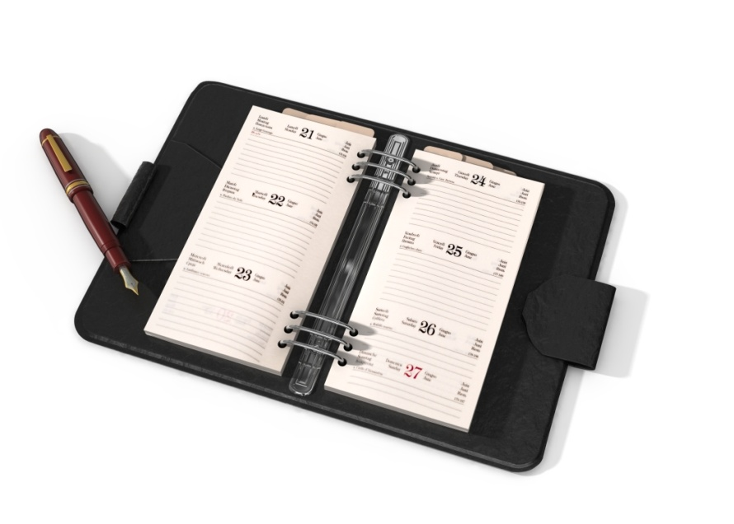
Agile Acceptance Testing with Fitnesse
What is FitNesse / Slim? (10’)
Setting up FitNesse – demo (10’)
Introduction to Snacks-R-Us (10’)
Iteration 1 (35’)
Iteration 2 (35’)
Integration in automated build (5’)
Iteration flow (5’)
What’s in it for you? (5’)
Retrospective (5’)
Notes:
Timeframe:120 mins
Don’t mind the timers we might use to help us keep our timings.

Slide 3
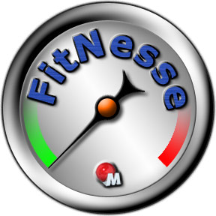
What is FitNesse?
FitNesse is a software development collaboration tool
FitNesse enables customers, testers, and programmers to learn what their software should do, and to automatically compare that to what it actually does do. It compares customers' expectations to actual results.
FitNesse is a software testing tool.
Collaboratively define Acceptance Tests -- web pages containing simple tables of inputs and expected outputs.
Run those tests and see the results (see Two Minute Example).
FitNesse is a wiki.
FitNesse is a web server.
http://fitnesse.org/FitNesse.UserGuide.OneMinuteDescription
Notes:
Our Business Case

Slide 4
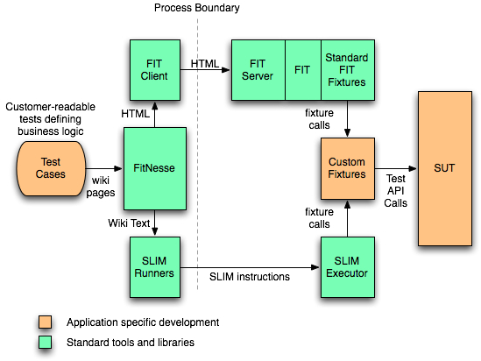
What is Slim?
Notes:
Our Business Case

Slide 5
Agile Acceptance Testing with Fitnesse
What is FitNesse / Slim? (10’)
Setting up FitNesse – demo (10’)
Introduction to Snacks-R-Us (10’)
Iteration 1 (35’)
Iteration 2 (35’)
Integration in automated build (5’)
Iteration flow (5’)
What’s in it for you? (5’)
Retrospective (5’)
Notes:
Timeframe:120 mins
Don’t mind the timers we might use to help us keep our timings.

Slide 6
Agile Acceptance Testing with Fitnesse
What is FitNesse / Slim? (10’)
Setting up FitNesse – demo (10’)
Introduction to Snacks-R-Us (10’)
Iteration 1 (35’)
Iteration 2 (35’)
Integration in automated build (5’)
Iteration flow (5’)
What’s in it for you? (5’)
Retrospective (5’)
Notes:
Timeframe:120 mins
Don’t mind the timers we might use to help us keep our timings.

Slide 7
A wonderful opportunity
Mr W. Fall, CEO of BDUF Development:
“Our developers are working 14 hours a day to get our latest project delivered on time.”
“We need an application where they can order pizza’s, beverages, snacks,... as their evening dinner! So they can work longer!”
Notes:
Our Business Case

Slide 8
An agile Approach
We agree with Mr W. Fall to make a very basic implementation and put it into production as soon as possible.
A few screen mockups...
(made with Balsamic)

Slide 9
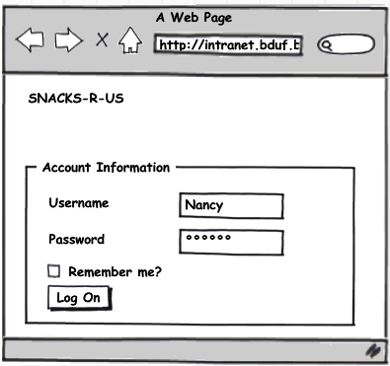
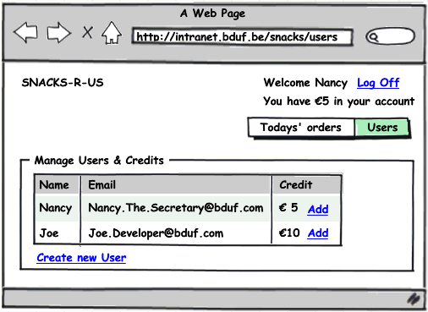
Manage Users & Credits
Notes:
Joe ‘Developer’ wants to order a sandwich.
Joe gives €10 to Nancy, who logs on and adds the credits to Joe’s account.

Slide 10
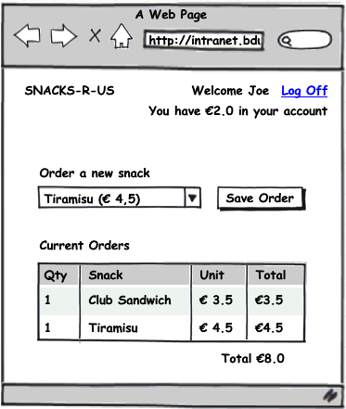
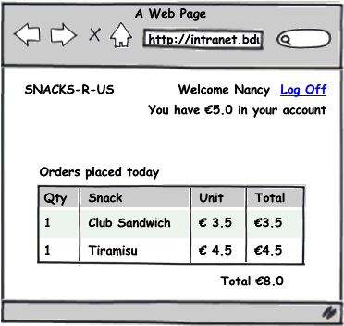
Order a snack & show orders
Notes:
Joe logs on and orders a Club Sandwich and a Tiramisu.
He has €2 credit left.
Nancy logs on again to print Today’s Orders.

Slide 11
Agile Acceptance Testing with Fitnesse
What is FitNesse / Slim? (10’)
Setting up FitNesse – demo (10’)
Introduction to Snacks-R-Us (5’)
Iteration 1 (35’)
Iteration 2 (35’)
Integration in automated build (5’)
Iteration flow (5’)
What’s in it for you? (5’)
Retrospective (5’)
Notes:
Timeframe:120 mins
Don’t mind the timers we might use to help us keep our timings.

Slide 12
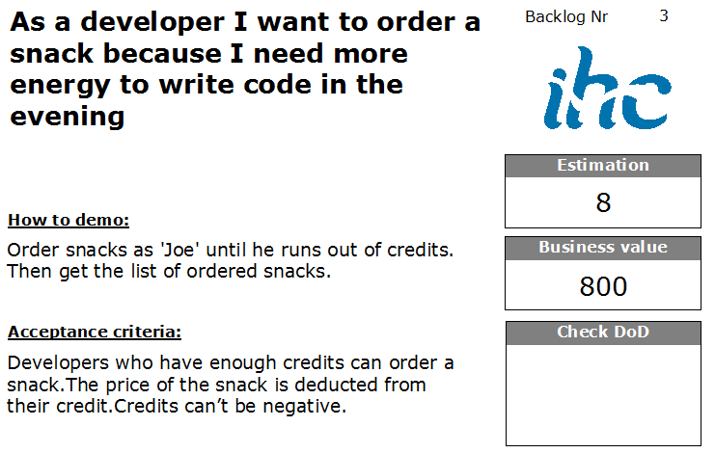
Notes:
In iteration 1, we will implement the first user story.
The user story will appear on our task board in this nice layout:
The user story itself described on top (as a – I want – because)
The customer described how he wants to see a demo of the functionality
The acceptance criteria are defined
The story is estimated in size (storypoints) and in business value. The combination of those define the priority.
Backlog Id for the backend planning system.
DoD checkbox where the team can check if the Definition-of-Done is met for this user story.
Iteration flow:
Specification Workshop
Implementation itself

Slide 13

Specification Workshop (5’)
Goal: Nail down the scope of the user stories with real world examples, which we all agree on.
Workshop Outputs:
Enough realistic examples to start working
Shared understanding of the domain
Some tips:
Involve the whole team
Don’t over complicate things
Also identify edge cases and negative paths
Stay focused on the user story!
Describe what, not how
Communicate intent, explain why
http://www.acceptancetesting.info/the-book/
Notes:
Specification Workshop:
- Quickly make groups of 4 people.
Hand the index card of the first user story to each group.
On the flip chart, write the template Given – When – Then
On the flip chart, give them also a kick-start example, so they know what’s expected from them
Title: Order a snack for a user with enough credit
Given: Joe is a user with €10 credit. Pizza Hawai is a snack costing €5,3.
When: Joe orders a Pizza Hawai.
Then: His order appears on the Todays Orders list, and his credit is now €4,7.
Groups get A4 paper and pens to write down their real world examples.
Projection Screens:
Pascal shows this slide
Michel starts a ZoomIt countdown timer of 5minutes ( after explaination and the groups are made)
Some good questions to kick it off:
- How do we verify that this thing we are going to write is implemented completely and correctly?
Can you give us a few examples?
Pretend it's magic and it's already delivered – how would you test it?

Slide 14
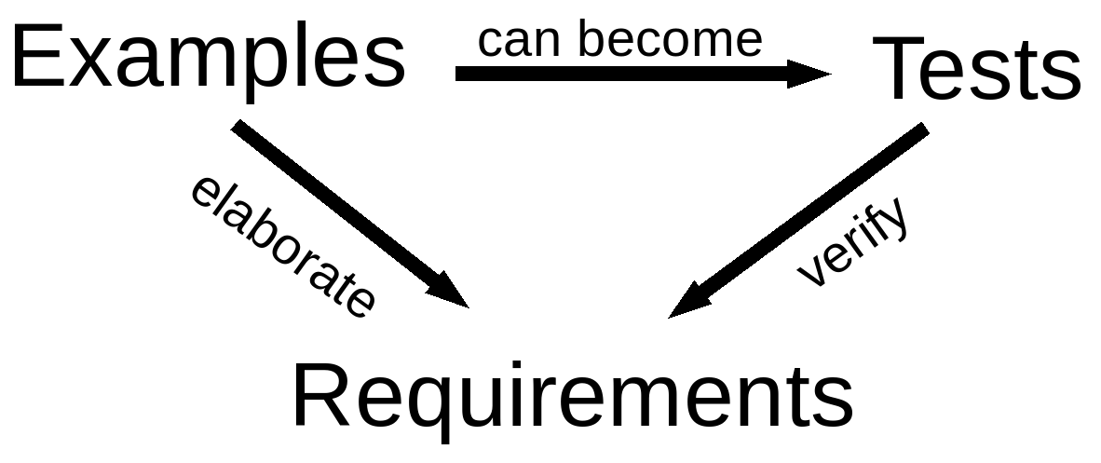
Executable specifications
Scope of the user story is nailed down with real world examples
Notes:
Lets turn those examples into executable specifications to verify that we have build the right code.
Elaborate -> to describe more in detail

Slide 15

Implement iteration 1 tests...
30’
Notes:
To get started, we will implement the example we wrote on the flipchart.
Title: Order a snack for a user with enough credit
Given: Joe is a user with €10 credit. Pizza Hawai is a snack costing €5,3.
When: Joe orders a Pizza Hawai.
Then: His order appears on the Todays Orders list, and his credit is now €4,7.
For the second example, you can propose one from your Specification Workshop, and come pair with us, to implement it.
Get a real world example from one of the groups (untill we run out of time):
Who thought about ordering a snack for a user which hasn’t enough credit?
Write / Clarify the example on the flip chart for the others
Who would like to pair up with us to implement this example?
At the end of the iteration, ask the audience if they accept the second test?
Is the credit checked for this user?
Is the todays orders list checked?
Technical:
Use SetUp to Import Namespaces.
Explain DoFixture
Explain ColumnFixture

Slide 16
Agile Acceptance Testing with Fitnesse
What is FitNesse / Slim? (10’)
Setting up FitNesse – demo (10’)
Introduction to Snacks-R-Us (10’)
Iteration 1 (35’)
Iteration 2 (35’)
Integration in automated build (5’)
Iteration flow (5’)
What’s in it for you? (5’)
Retrospective (5’)
Notes:
Timeframe:120 mins
Don’t mind the timers we might use to help us keep our timings.

Slide 17
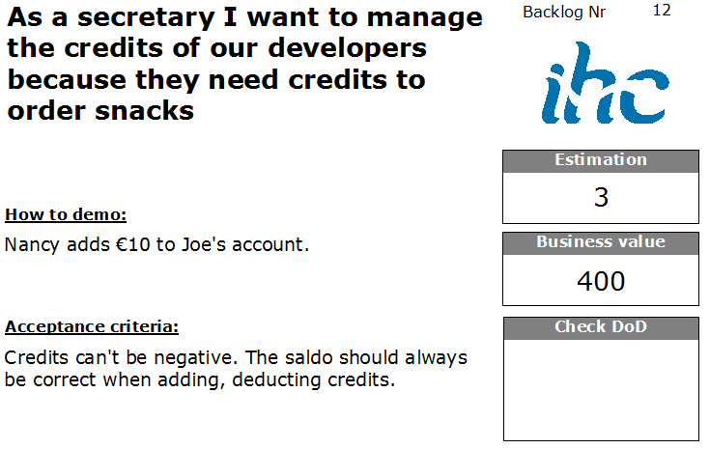

Slide 18
Specification Workshop (5’)
Goal: Nail down the scope of the user stories with real world examples, which we all agree on.
Workshop Outputs:
Enough realistic examples to start working
Shared understanding of the domain
Some tips:
Involve the whole team
Don’t over complicate things
Also identify edge cases and negative paths
Stay focused on the user story
Describe what, not how
Communicate intent, explain why
http://www.acceptancetesting.info/the-book/
Notes:
Specification Workshop:
- Same groups as 1st iteration.
Hand the index card of the second user story to each group.
No kick start example this time, they know the purpose.
Projection Screens:
Pascal shows this slide
Michel starts a ZoomIt countdown timer of 5minutes ( after explaination and the groups are made)
Some good questions to kick it off:
- How do we verify that this thing we are going to write is implemented completely and correctly?
Can you give us a few examples?
Pretend it's magic and it's already delivered – how would you test it?

Slide 19
Implement iteration 2 tests...
30’
Notes:
Optional: Finish first iteration, did the PO’s accept?:
First complete the second test for Ordering for Users with enough credit.
Get Todays orders
Check Users credit
Then organize FitNesse into 3 suites
Move both tests after acceptance by PO to the AcceptanceSuite.
Write new tests in the WorkInProgressSuite
Get a real world example from one of the groups (untill we run out of time):
Who thought about adding credits for a new user? / Who thought about the check that credits can’t be negative?
Write / Clarify the example on the flip chart for the others.
Who would like to pair up with us to implement this example?
Technical:
Show debugging options: Fitnesse.WaitASecond, GFlags
Explain ColumnFixture
Explain RowFixture
Explain DoFixture

Slide 20
Agile Acceptance Testing with Fitnesse
What is FitNesse / Slim? (10’)
Setting up FitNesse – demo (10’)
Introduction to Snacks-R-Us (10’)
Iteration 1 (35’)
Iteration 2 (35’)
Integration in automated build (5’)
Iteration flow (5’)
What’s in it for you? (5’)
Retrospective (5’)
Notes:
Timeframe:120 mins
Don’t mind the timers we might use to help us keep our timings.

Slide 21
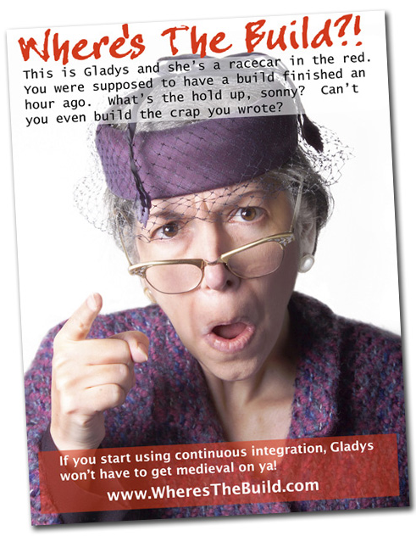

Slide 22
Agile Acceptance Testing with Fitnesse
What is FitNesse / Slim? (10’)
Setting up FitNesse – demo (10’)
Introduction to Snacks-R-Us (10’)
Iteration 1 (35’)
Iteration 2 (35’)
Integration in automated build (5’)
Iteration flow (5’)
What’s in it for you? (5’)
Retrospective (5’)
Notes:
Timeframe:120 mins
Don’t mind the timers we might use to help us keep our timings.

Slide 23
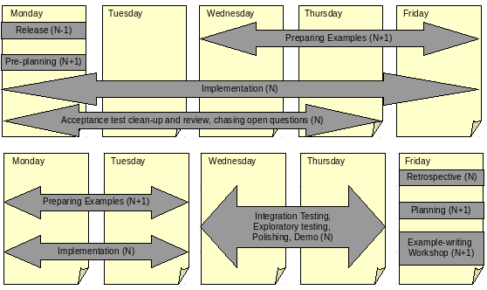
Iteration Flow (just a suggestion)
http://gojko.net/2008/09/17/fitting-agile-acceptance-testing-into-the-development-process/

Slide 24
Agile Acceptance Testing with Fitnesse
What is FitNesse / Slim? (10’)
Setting up FitNesse – demo (10’)
Introduction to Snacks-R-Us (10’)
Iteration 1 (35’)
Iteration 2 (35’)
Integration in automated build (5’)
Iteration flow (5’)
What’s in it for you? (5’)
Retrospective (5’)
Notes:
Timeframe:120 mins
Don’t mind the timers we might use to help us keep our timings.

Slide 25
What’s in it for you? ScrumMaster / Product Owner
Developers will actually read the specifications
They will understand the stuff correctly
They will not skip parts of the spec
You can track the development progress
Save time on acceptance/smoke testing

Slide 26
What’s in it for you? Developer
Requirements will be unambiguous and without functional gaps
Business analysts will really understand those special cases you mentioned
You will have automated tests to guide development
It will be easier to take-over and hand-over code

Slide 27
What’s in it for you? Tester / Business Analist
Finally stop those guys from making the same mistakes over and over
Avoid testing the same stuff all the time
Build quality in from the start
Verify business rules by a click on a button

Slide 28
Involve different roles for the best results
Customers or functional analysts typically think about the happy path
Developers focus on edge cases and alternative scenarios
Testers want to break / cheat the system

Slide 29
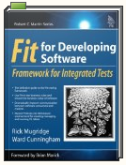

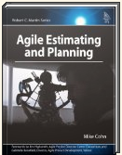
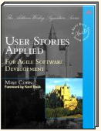
Resources
Books
On the web
http://fitnesse.org/
http://sourceforge.net/projects/fitlibrary/
http://gojko.net/
http://codebetter.com/blogs/ian_cooper/archive/2008/10/13/fitnesse-and-the-three-way.aspx
http://gojko.net/2008/09/17/fitting-agile-acceptance-testing-into-the-development-process/
Yahoo Group
http://tech.groups.yahoo.com/group/fitnesse/
Notes:
Download this slidedeck also from google code, url is on the hand-outs.
If you have any questions, our e-mail addresses are on the hand-outs to.

Slide 30

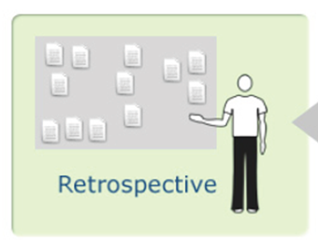
Stop
Keep
Stop
doing
Keep
doing
Start
Start
Doing
4ME
What’s in
it for you?
Notes:
Ask for feedback

Slide 31
Organising FitNesse:
3 Suites in Fitnesse
Prepared Test Suite – tests for next iterations
Work In Progress – doesn’t break the build
Acceptance Suite – breaks the build!
Notes:
Failing tests added to accepted ones. Alarm! Awereness!
Build should fail by regression tests, not by Work In Progress.
Ask the Audience:
Should we demo build integration?

Slide 32
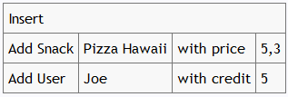
DoFixture:
Your own test language
Notes:
Add User John with credits...

Slide 33
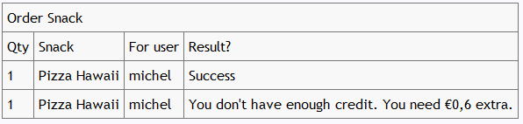
ColumnFixture:
Testing values Easily

Slide 34
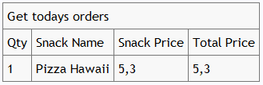
RowFixture:
Batch comparisons

Slide 35
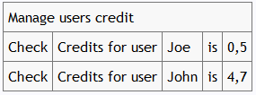
DoFixture:
Your own test language
Notes:
Check credits for User John is ...

