Slide 1
Agile Acceptance Testing with Fitnesse
Michel Grootjans
Pascal Mestdach

Slide 2





Agile Acceptance Testing with Fitnesse
Michel Grootjans
Enterprise Architect
http://www.linkedin.com/in/michelgrootjans
Blog: http://geekswithblogs.net/alternativedotnet/
michel.grootjans@ilean.be
Pascal Mestdach
Solution Architect
http://www.linkedin.com/in/pascalmestdach
Blog: http://pascalmestdach.blogspot.com/
pascal.mestdach@infohos.be
Download material:
On google code: http://code.google.com/p/agileacceptancetesting/
Checkout in svn: http://agileacceptancetesting.googlecode.com/svn/trunk
Notes:
Introduce ourselves.
Hand-out this as a reference A5 @ the end of the session.

Slide 3
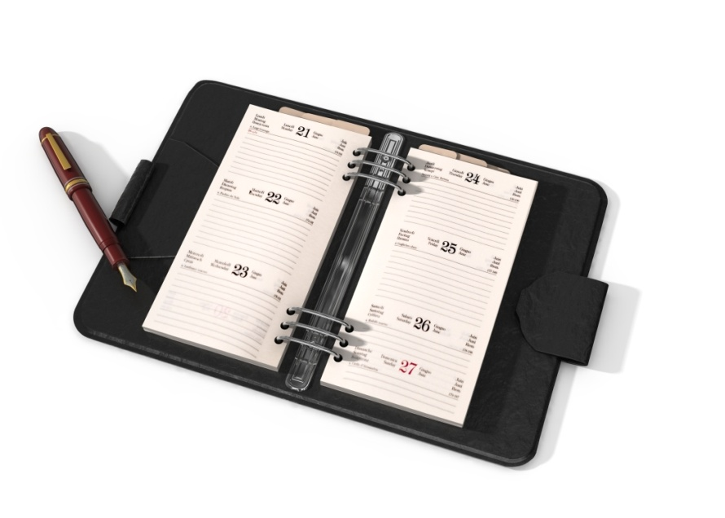
Agile Acceptance Testing with Fitnesse
Introduction (10’)
Iteration 1 (35’)
Iteration 2 (35’)
What’s in it for you? (5’)
Retrospective (5’)
Notes:
Timeframe: 90 mins
Don’t mind the ringing of the Pomodoro Timer. It’s there to help us keep our timings.

Slide 4
A wonderful opportunity
Mr W. Fall, CEO of BDUF Development:
“Our developers are working 14 hours a day to get our latest project delivered on time.”
“We need an application where they can order pizza’s, beverages, snacks,... as their evening dinner! So they can work longer!”
Notes:
Our Business Case

Slide 5
An agile Approach
We agree with Mr W. Fall to make a very basic implementation and put it into production as soon as possible.
A little sketch ☺
Notes:
Basic implementation -> sketch

Slide 6
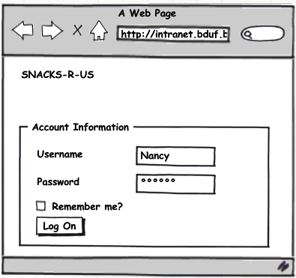
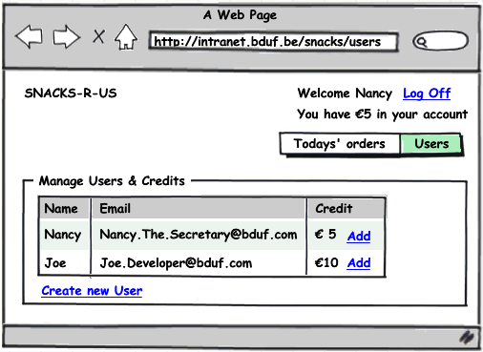
Manage Users & Credits
Notes:
Joe wants to order a sandwich.
Joe gives €10 to Nancy, who logs on and adds the credits to Joe’s account.

Slide 7
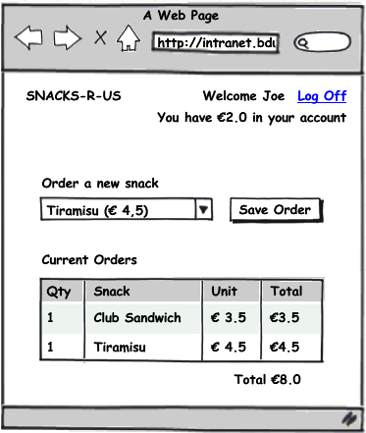
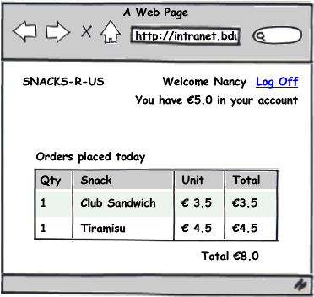
Order a snack & show orders
Notes:
Joe logs on and orders a Club Sandwich and a Tiramisu. He has €2 credit left.
Nancy logs on again to print Today’s Orders.

Slide 8
An agile Approach
We define a product backlog with estimated user stories for planning purposes.
We prioritize the product backlog together with Mr W. Fall.
An agreement is made to develop the 2 user stories, which provide the highest business value, in 2 iterations.

Slide 9
Agile Acceptance Testing with Fitnesse
Introduction (10’)
Iteration 1 (35’)
Iteration 2 (35’)
What’s in it for you? (5’)
Retrospective (5’)
Notes:
First Story to order snacks:
Implement 1st test: Order Snack for User With Insufficient Credit.
Hand out the translation of the Specification Workshop to Fitnesse tables of the first test.
Implement 2nd test: Order Snack for User With Enough Credit.
Without Get Today’s Orders. (RowFixture -> in iteration 2)
Without checking the credit. (Return Values in DoFixture – in iteration 2)
Use SetUp to Import Namespaces.
Explain DoFixture
Explain ColumnFixture
Ask the green/red question which PO’s accept the first test? And the second? (they didn’t get the fixture print-out of the second)
1st tests gets accepted by Product Owner.
2nd is not accepted -> not complete According to Acceptance Criteria on the User Story. (too bad ☹)

Slide 10
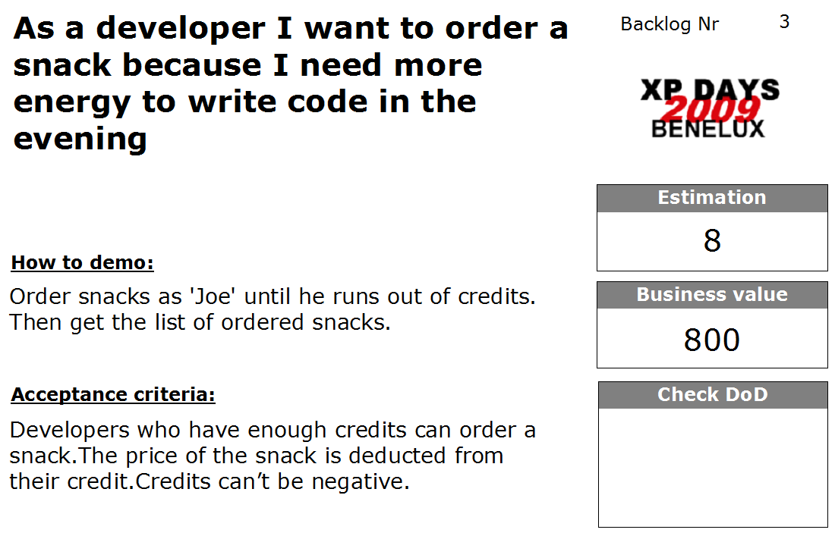

Slide 11
Specification Workshop (5’)
Goal: Nail down the scope of the user stories with real world examples, which we all agree on.
Workshop Outputs:
Enough realistic examples to start working
Shared understanding of the domain
Some tips:
Involve the whole team
Don’t over complicate things
Also identify edge cases and negative paths
Stay focused on the user story!
Describe what, not how
Communicate intent, explain why
http://www.acceptancetesting.info/the-book/
Notes:
Praktische zaken:
-Vooraleer we beginnen aan deze korte workshop vragen we wie er straks mee wil coderen op zijn eigen laptop.
-Deze personen vragen we hun laptop nu op te starten en de inhoud van de share te kopiëren naar hun laptop. (via GetLatest.bat)
- We vermelden dat we niets installeren op de mensen hun laptops gedurende de ganse sessie (enkel xcopy deployment)
De workshop zelf:
-Verdelen van de aanwezigen in groepjes van 4. (liefst heterogeen)
We delen een index card van beide stories uit aan elk groepje.
We delen ook een voorbeeld uit zodanig dat de deelnemers weten wat van hun verwacht wordt.
Op het ene scherm laten we deze slide zien. (Pascal)
Op de andere starten we de countdown timer van ZoomIt om 10 minuten wanneer de uitleg gedaan is en de groepjes gemaakt zijn. (Michel)
De mensen krijgen A4 papier en stiften ter beschikking om hun real world voorbeelden te noteren.
Some good questions to kick it off:
- How do we verify that this thing we are going to write is implemented completely and correctly?
Can you give us a few examples?
Pretend it's magic and it's already delivered – how would you test it?

Slide 12
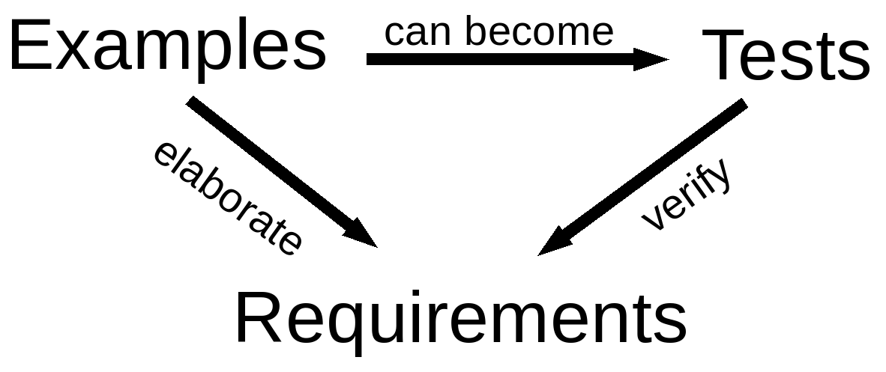
Executable specifications
Scope of the user story is nailed down with real world examples
Notes:
Lets turn those examples into executable specifications to verify that we have build the right code.
Elaborate -> to describe more in detail

Slide 13

Implement iteration 1 tests...
30’
Notes:
Een eenvoudige testcase uit de specification workshop toelichten aan de Flipchart voor de anderen

Slide 14
Agile Acceptance Testing with Fitnesse
Introduction (10’)
Iteration 1 (35’)
Iteration 2 (35’)
What’s in it for you? (5’)
Retrospective (5’)
Notes:
Second Story to manage credits:
First complete the second test for Ordering for Users with enough credit.
Get Todays orders
Check Users credit
Then organize FitNesse into 3 suites
move the first test to the AcceptanceSuite.
Move the second to the WorkInProgressSuite.
Implement ManageCredit User Story via Spreadsheet to Fitnesse
Let PO Accept. Green/Red?

Slide 15
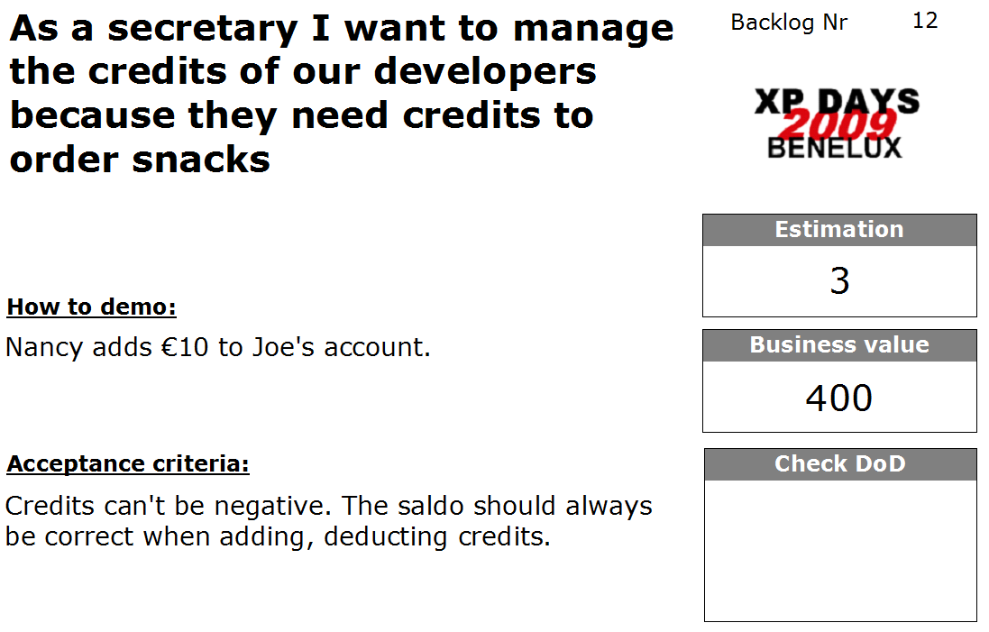

Slide 16
Specification Workshop (5’)
Goal: Nail down the scope of the user stories with real world examples, which we all agree on.
Workshop Outputs:
Enough realistic examples to start working
Shared understanding of the domain
Some tips:
Involve the whole team
Don’t over complicate things
Also identify edge cases and negative paths
Stay focused on the user story
Describe what, not how
Communicate intent, explain why
http://www.acceptancetesting.info/the-book/
Notes:
Praktische zaken:
-Vooraleer we beginnen aan deze korte workshop vragen we wie er straks mee wil coderen op zijn eigen laptop.
-Deze personen vragen we hun laptop nu op te starten en de inhoud van de share te kopiëren naar hun laptop. (via GetLatest.bat)
- We vermelden dat we niets installeren op de mensen hun laptops gedurende de ganse sessie (enkel xcopy deployment)
De workshop zelf:
-Verdelen van de aanwezigen in groepjes van 4. (liefst heterogeen)
We delen een index card van beide stories uit aan elk groepje.
We delen ook een voorbeeld uit zodanig dat de deelnemers weten wat van hun verwacht wordt.
Op het ene scherm laten we deze slide zien. (Pascal)
Op de andere starten we de countdown timer van ZoomIt om 10 minuten wanneer de uitleg gedaan is en de groepjes gemaakt zijn. (Michel)
De mensen krijgen A4 papier en stiften ter beschikking om hun real world voorbeelden te noteren.
Some good questions to kick it off:
- How do we verify that this thing we are going to write is implemented completely and correctly?
Can you give us a few examples?
Pretend it's magic and it's already delivered – how would you test it?

Slide 17
Implement iteration 2 tests...
30’
Notes:
Add User John with credits...

Slide 18
Agile Acceptance Testing with Fitnesse
Introduction (10’)
Iteration 1 (35’)
Iteration 2 (35’)
What’s in it for you? (5’)
Retrospective (5’)

Slide 19
What’s in it for you? ScrumMaster / Product Owner
Developers will actually read the specifications
They will understand the stuff correctly
They will not skip parts of the spec
You can track the development progress
Save time on acceptance/smoke testing

Slide 20
What’s in it for you? Developer
Requirements will be unambiguous and without functional gaps
Business analysts will really understand those special cases you mentioned
You will have automated tests to guide development
It will be easier to take-over and hand-over code

Slide 21
What’s in it for you? Tester / Business Analist
Finally stop those guys from making the same mistakes over and over
Avoid doing the same stuff all the time
Build quality in from the start
Verify business rules by a click on a button

Slide 22
Involve different roles for the best results
Customers or functional analysts typically think about the happy path
Developers focus on edge cases and alternative scenarios
Testers want to break / cheat the system

Slide 23
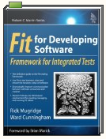


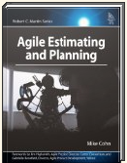
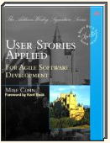
Resources
Books
On the web
http://fitnesse.org/
http://sourceforge.net/projects/fitlibrary/
http://gojko.net/
http://codebetter.com/blogs/ian_cooper/archive/2008/10/13/fitnesse-and-the-three-way.aspx
http://gojko.net/2008/09/17/fitting-agile-acceptance-testing-into-the-development-process/
Yahoo Group
http://tech.groups.yahoo.com/group/fitnesse/

Slide 24
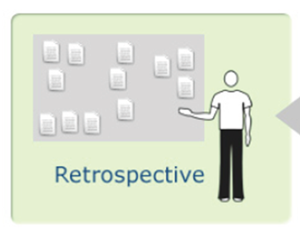

Slide 25
Organising FitNesse:
3 Suites in Fitnesse
Prepared Test Suite – tests for next iterations
Work In Progress – doesn’t break the build
Acceptance Suite – breaks the build!
Notes:
Rode testen toevoegen aan groenen
Groenen zijn geaccepteerd – alarm! Awereness!
Build should fail by regression tests, not by Work In Progress.
Ask the Audience:
Should we demo build integration?
Demo debugging with TestDriven.Net?

Slide 26
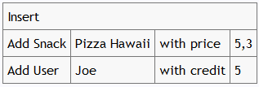
DoFixture:
Your own test language
Notes:
Add User John with credits...

Slide 27
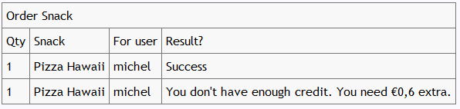
ColumnFixture:
Testing values Easily

Slide 28
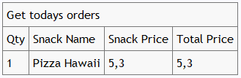
RowFixture:
Batch comparisons

Slide 29
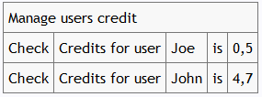
DoFixture:
Your own test language
Notes:
Check credits for User John is ...

