Slide 1
Agile Acceptance Testing with Fitnesse
Michel Grootjans
Pascal Mestdach

Slide 2




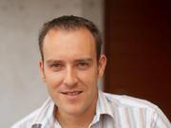
Agile Acceptance Testing with Fitnesse
Michel Grootjans
Enterprise Architect
http://www.linkedin.com/in/michelgrootjans
Blog: http://geekswithblogs.net/alternativedotnet/
michel.grootjans@ilean.be
Pascal Mestdach
Solution Architect
http://www.linkedin.com/in/pascalmestdach
Blog: http://pascalmestdach.blogspot.com/
pascal.mestdach@infohos.be
Download material:
On google code: http://code.google.com/p/agileacceptancetesting/
Checkout in svn: https://agileacceptancetesting.googlecode.com/svn/trunk

Slide 3
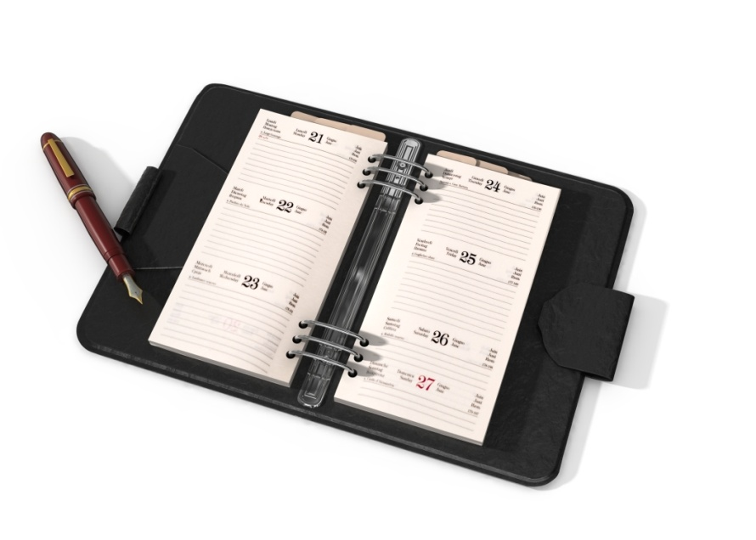
Agile Acceptance Testing with Fitnesse
Specification Workshop
Setup Fitnesse
Iteration 1
Iteration 2
What’s in it for you?

Slide 4
A wonderful opportunity
Mr W. Fall, CEO of BDUF Development:
“Our developers are working 14 hours a day to get our latest project delivered on time.”
“We need an application where they can order pizza’s, beverages, snacks,... as their evening dinner! So they can work longer!”

Slide 5
An agile Approach
We agree with Mr W. Fall to make a very basic implementation and put it into production as soon as possible.
A little sketch ☺
Notes:
Basic implementation -> sketch

Slide 6
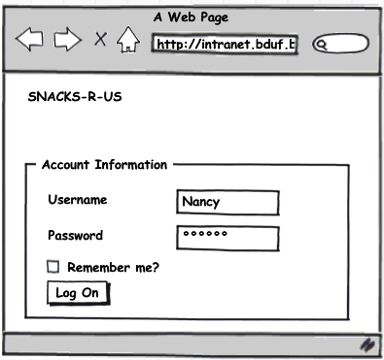
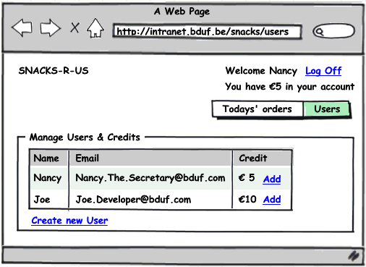
Manage Users & Credits

Slide 7
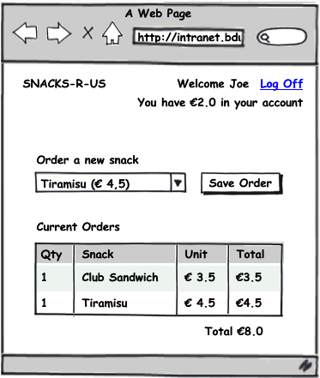
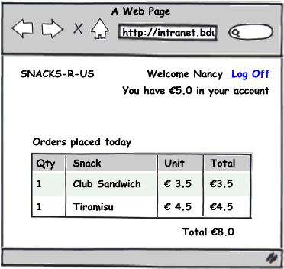
Order a snack & show orders

Slide 8
An agile Approach
We define a product backlog with estimated user stories for planning purposes.
We prioritize the product backlog together with Mr W. Fall.
An agreement is made to develop following user stories in the first iteration of 2 weeks:
Notes:
Basic implementation -> sketch

Slide 9
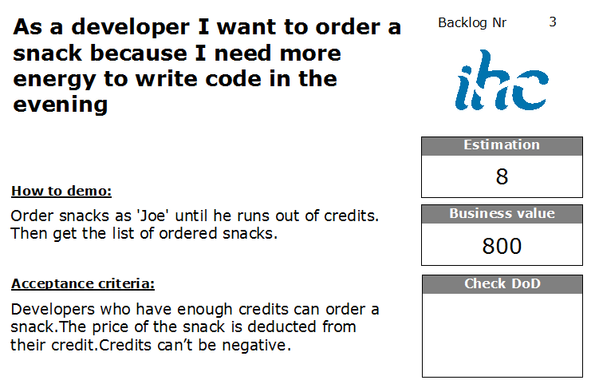

Slide 10
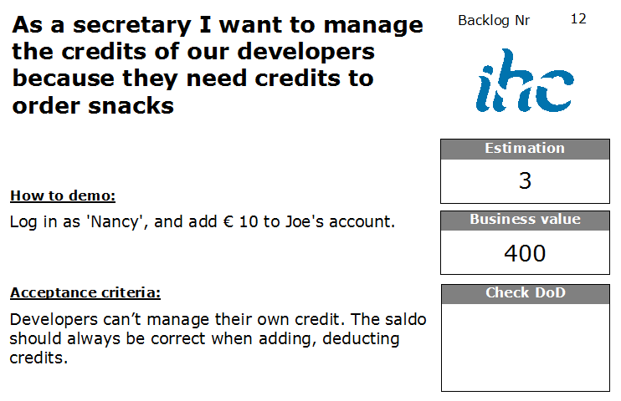

Slide 11
Specification Workshop (10’)
Goal: Nail down the scope of the user stories with real world examples, which we all agree on.
Workshop Outputs:
Enough realistic examples to start working
Shared understanding of the domain
Some tips:
Involve the whole team
Don’t over complicate things
Also identify edge cases and negative paths
Stay focused on the user story
Describe what, not how
Communicate intent, explain why
http://www.acceptancetesting.info/the-book/
Notes:
Praktische zaken:
-Vooraleer we beginnen aan deze korte workshop vragen we wie er straks mee wil coderen op zijn eigen laptop.
-Deze personen vragen we hun laptop nu op te starten en de inhoud van de share te kopiëren naar hun laptop.
De workshop zelf:
-Verdelen van de aanwezigen in groepjes van 5. (heterogeen)
We delen een index card van beide stories uit aan elk groepje.
We delen ook een voorbeeld uit zodanig dat de deelnemers weten wat van hun verwacht wordt.
Op het ene scherm laten we deze slide zien. (ook uitprinten en uitdelen voor iLean -> 1 projector)
Op de andere starten we de countdown timer van ZoomIt om 10 minuten wanneer de uitleg gedaan is en de groepjes gemaakt zijn.
De mensen krijgen A4 papier en stiften ter beschikking om hun real world voorbeelden te noteren.
Some good questions to kick it off:
- How do we verify that this thing we are going to write is implemented completely and correctly?
Can you give us a few examples?
Pretend it's magic and it's already delivered – how would you test it?

Slide 12
Did you notice?
Realistic examples make us think harder
Customers or functional analysts typically think about the happy path
Developers focus on edge cases and alternative scenarios
Testers want to break / cheat the system
So, Involve the whole team!

Slide 13
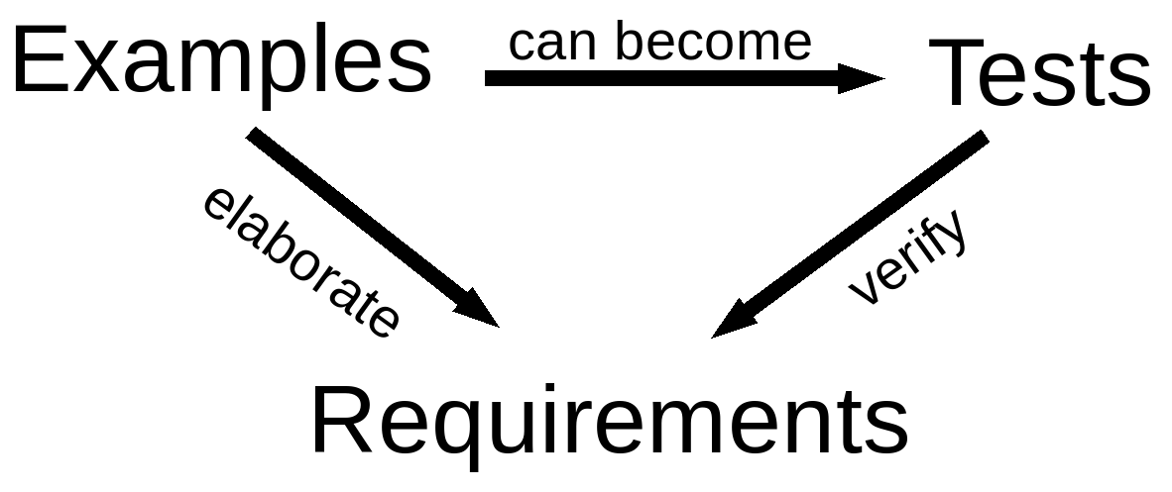
Executable specifications
Scope of the user story is nailed down with real world examples
Welcome FitNesse!
Notes:
Lets turn those examples into executable specifications to verify that we have build the right code.

Slide 14
Agile Acceptance Testing with Fitnesse
Specification Workshop
Setup Fitnesse
Iteration 1
Iteration 2
What’s in it for you?

Slide 15
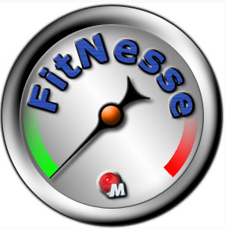
FitNesse Setup (1/3) Getting the sources
Latest version of FitNesse
http://fitnesse.org/FitNesseDevelopment.DownLoad
Unzip into a directory of your choice (f.e. d:\Fitnesse)
.Net 2.0 testrunner
http://sourceforge.net/projects/fitnessedotnet/
Unzip to d:\Fitnesse\Dotnet2
Java Runtime Environment
http://developers.sun.com/downloads/top.jsp

Slide 16
FitNesse Setup (2/3) Custmize run.bat / stop.bat
Customize port FitNesse is running on
Location of java.exe
Optional: disable versioning system
run.bat:
jre\bin\java -jar fitnesse.jar %1 %2 %3 %4 %5 -p 8888 –e 0
stop.bat:
jre\bin\java -cp fitnesse.jar fitnesse.Shutdown %1 %2 %3 %4 %5 –p 8888
Notes:
http://stackoverflow.com/questions/249580/how-do-i-add-fitnesse-pages-to-version-control

Slide 17
FitNesse Setup (3/3) Custmize Root page
http://localhost:888/?edit
!path classes
!path fitnesse.jar
!path dotnet2\*.dll
!define COMMAND_PATTERN {%m %p} !define TEST_RUNNER {dotnet2\FitServer.exe} !define PATH_SEPARATOR {;}

Slide 18
Agile Acceptance Testing with Fitnesse
Specification Workshop
Setup Fitnesse
Iteration 1
Iteration 2
What’s in it for you?
Notes:
1e test: Snack order zonder credit, credit toevoegen, snack orderen (columnFixture)
2e test: current orders opvragen (blanco) – order plaatsen (hergebruik bovenste fixture) – orders opvragen (rowfixture & setup: orders leegmaken+credits op 0)
Acceptatie door PO (iteratie gedaan)
3e test: credits afchecken, user credit geven, snack order, check credit (DoFixture)
Structuur in Wiki? Geaccepteerde testen falen? Move naar acceptance suite.
Integratie van Agile Acceptance Testing in iteratie.
4e test: inloggen van een user (ActionFixture)

Slide 19
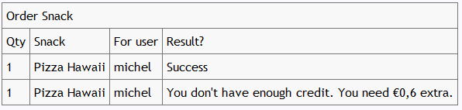
ColumnFixture:
Testing values Easily

Slide 20
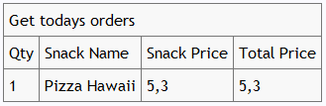
RowFixture:
Batch comparisons

Slide 21
Agile Acceptance Testing with Fitnesse
Specification Workshop
Setup Fitnesse
Iteration 1
Iteration 2
What’s in it for you?
Notes:
Automated Build (vroeger-> op einde iteratie)
CI Environment (evt te schrappen)

Slide 22

DoFixture:
Your own test language

Slide 23
Organising FitNesse:
3 Suites in Fitnesse
Prepared Test Suite – tests for next iterations
Work In Progress – doesn’t break the build
Acceptance Suite – breaks the build!
Notes:
Rode testen toevoegen aan groenen
Groenen zijn geaccepteerd – alarm! Awereness!
Build should fail by regression tests, not by Work In Progress.
Should we demo build integration? Ask the audience

Slide 24
Agile Acceptance Testing with Fitnesse
Specification Workshop
Setup Fitnesse
Iteration 1
Iteration 2
What’s in it for you?
Notes:
Automated Build (vroeger-> op einde iteratie)
CI Environment (evt te schrappen)

Slide 25
What’s in it for you? ScrumMaster / Product Owner
Developers will actually read the specifications
They will understand the stuff correctly
They will not skip parts of the spec
You can track the development progress
Save time on acceptance/smoke testing

Slide 26
What’s in it for you? Developer
Requirements will be unambiguous and without functional gaps
Business analysts will really understand those special cases you mentioned
You will have automated tests to guide development
It will be easier to take-over and hand-over code

Slide 27
What’s in it for you? Tester / Business Analist
Finally stop those guys from making the same mistakes over and over
Avoid doing the same stuff all the time
Build quality in from the start
Verify business rules by a click on a button

Slide 28
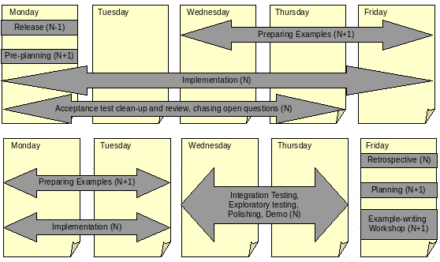
Iteration Flow (just a suggestion)
http://gojko.net/2008/09/17/fitting-agile-acceptance-testing-into-the-development-process/

Slide 29
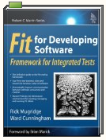


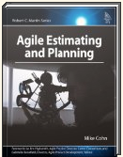
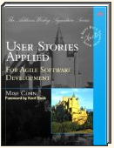
Resources
Books
On the web
http://fitnesse.org/
http://sourceforge.net/projects/fitlibrary/
http://gojko.net/
http://codebetter.com/blogs/ian_cooper/archive/2008/10/13/fitnesse-and-the-three-way.aspx
Yahoo Group
http://tech.groups.yahoo.com/group/fitnesse/

Slide 30
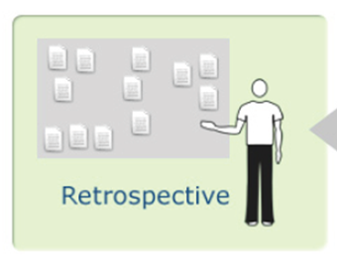
Questions?

