Slide 1

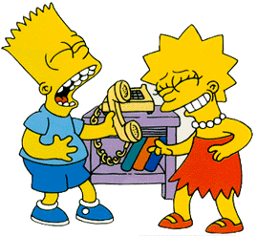
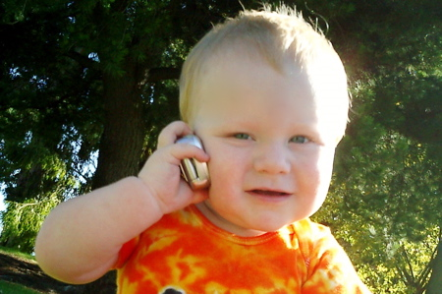
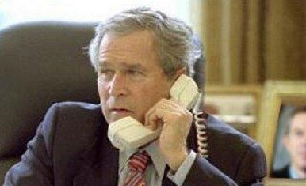
Applying agile.net to

Slide 2
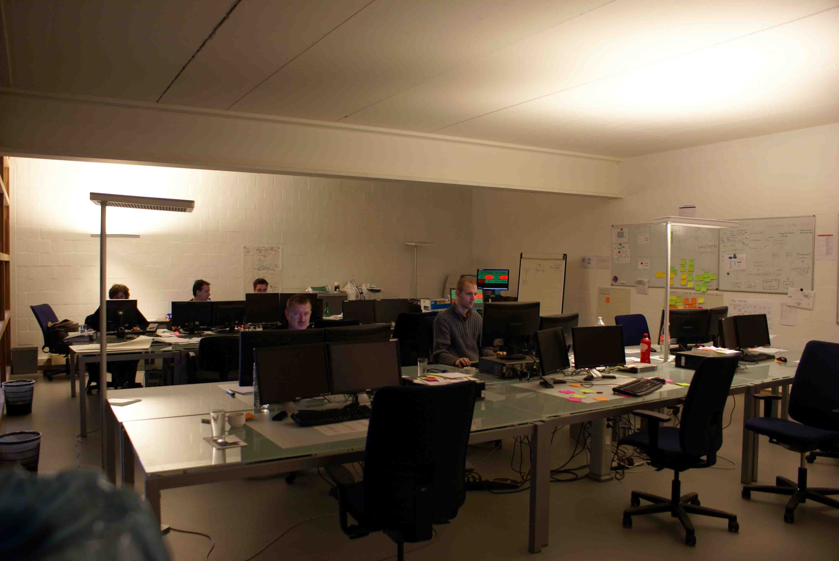
Artilium: Team Room

Slide 3
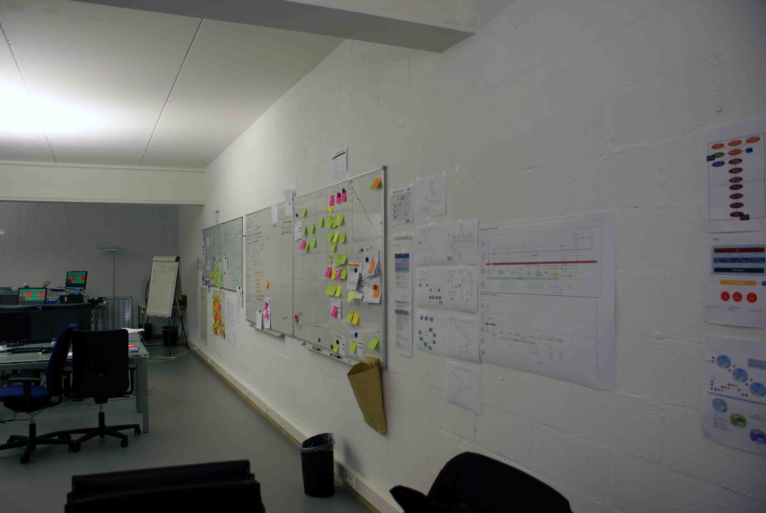
Artilium: Team Room

Slide 4
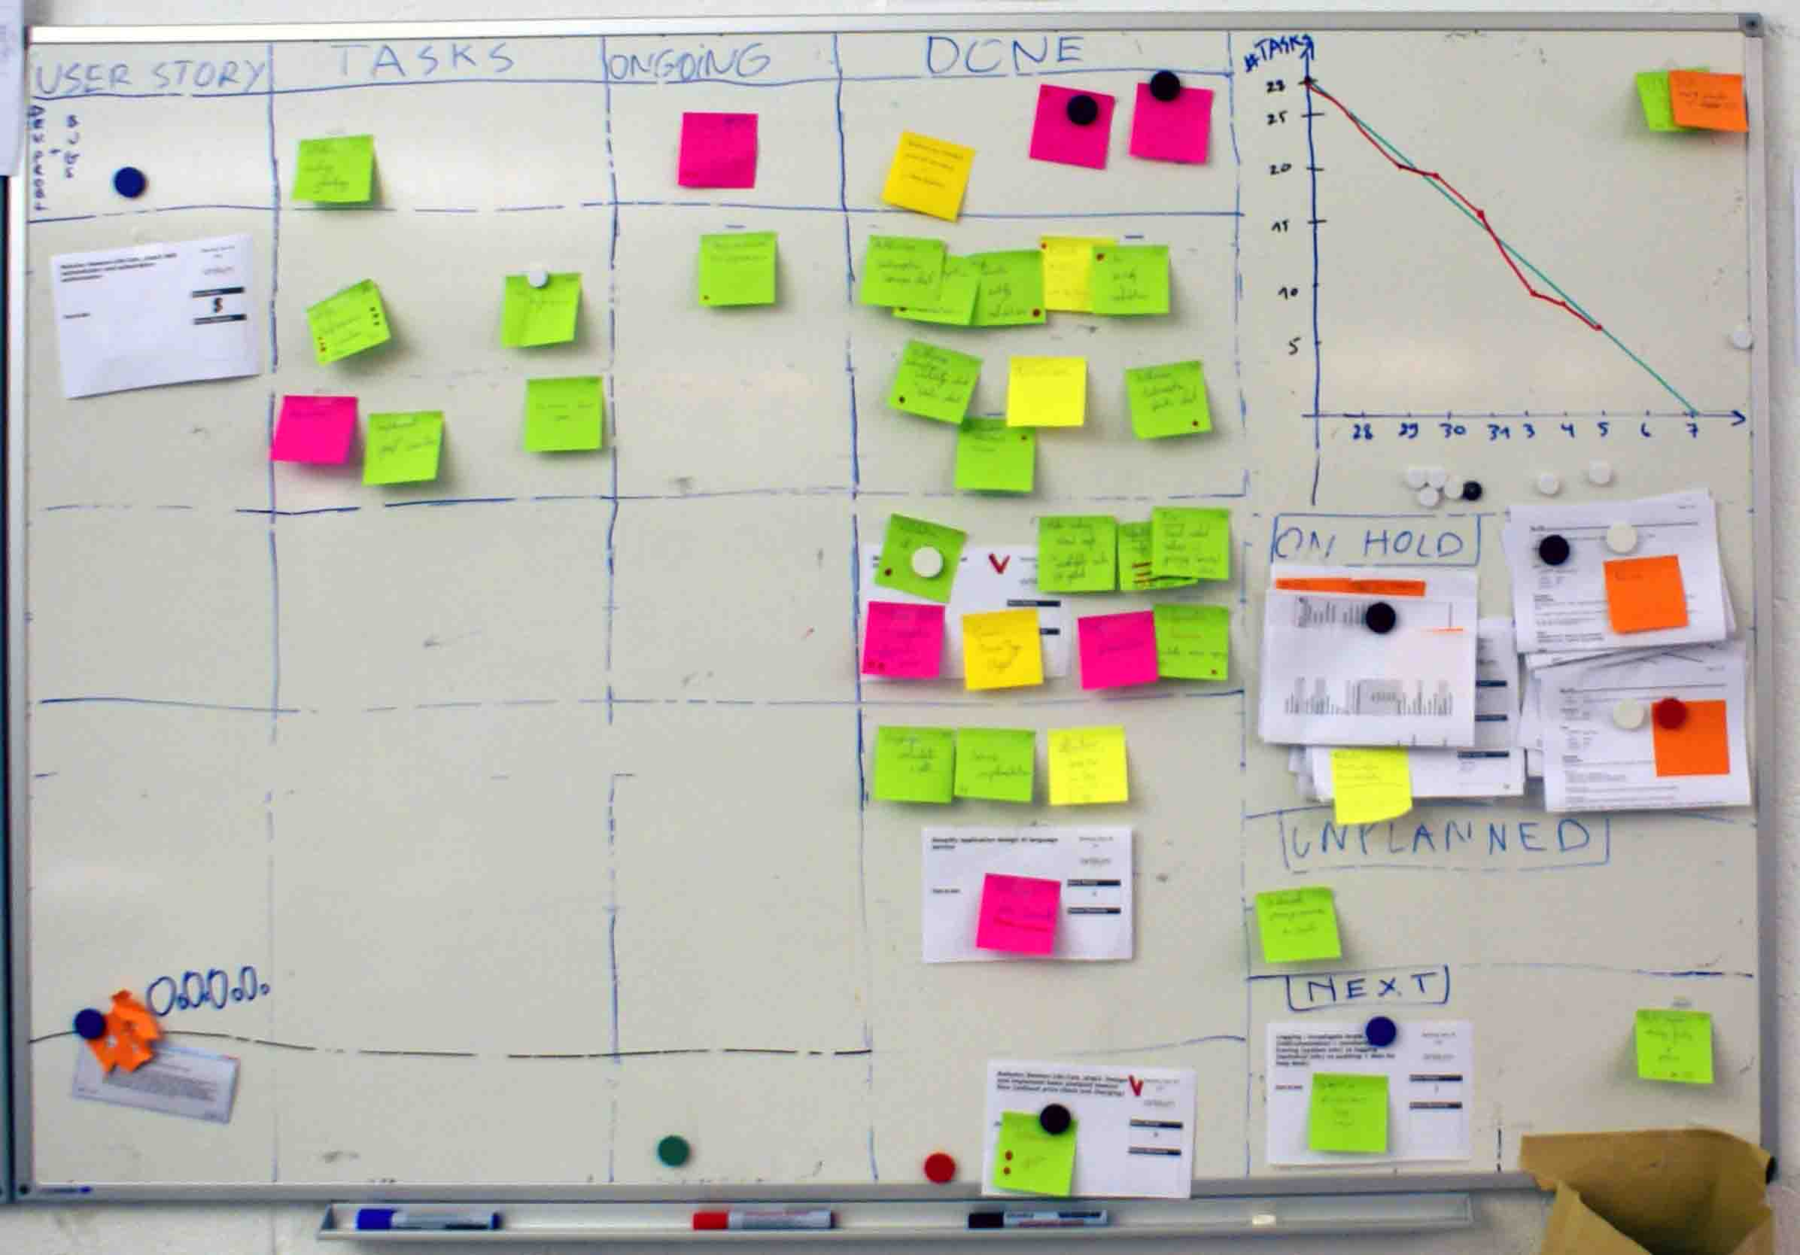
Artilium: Story Board

Slide 5
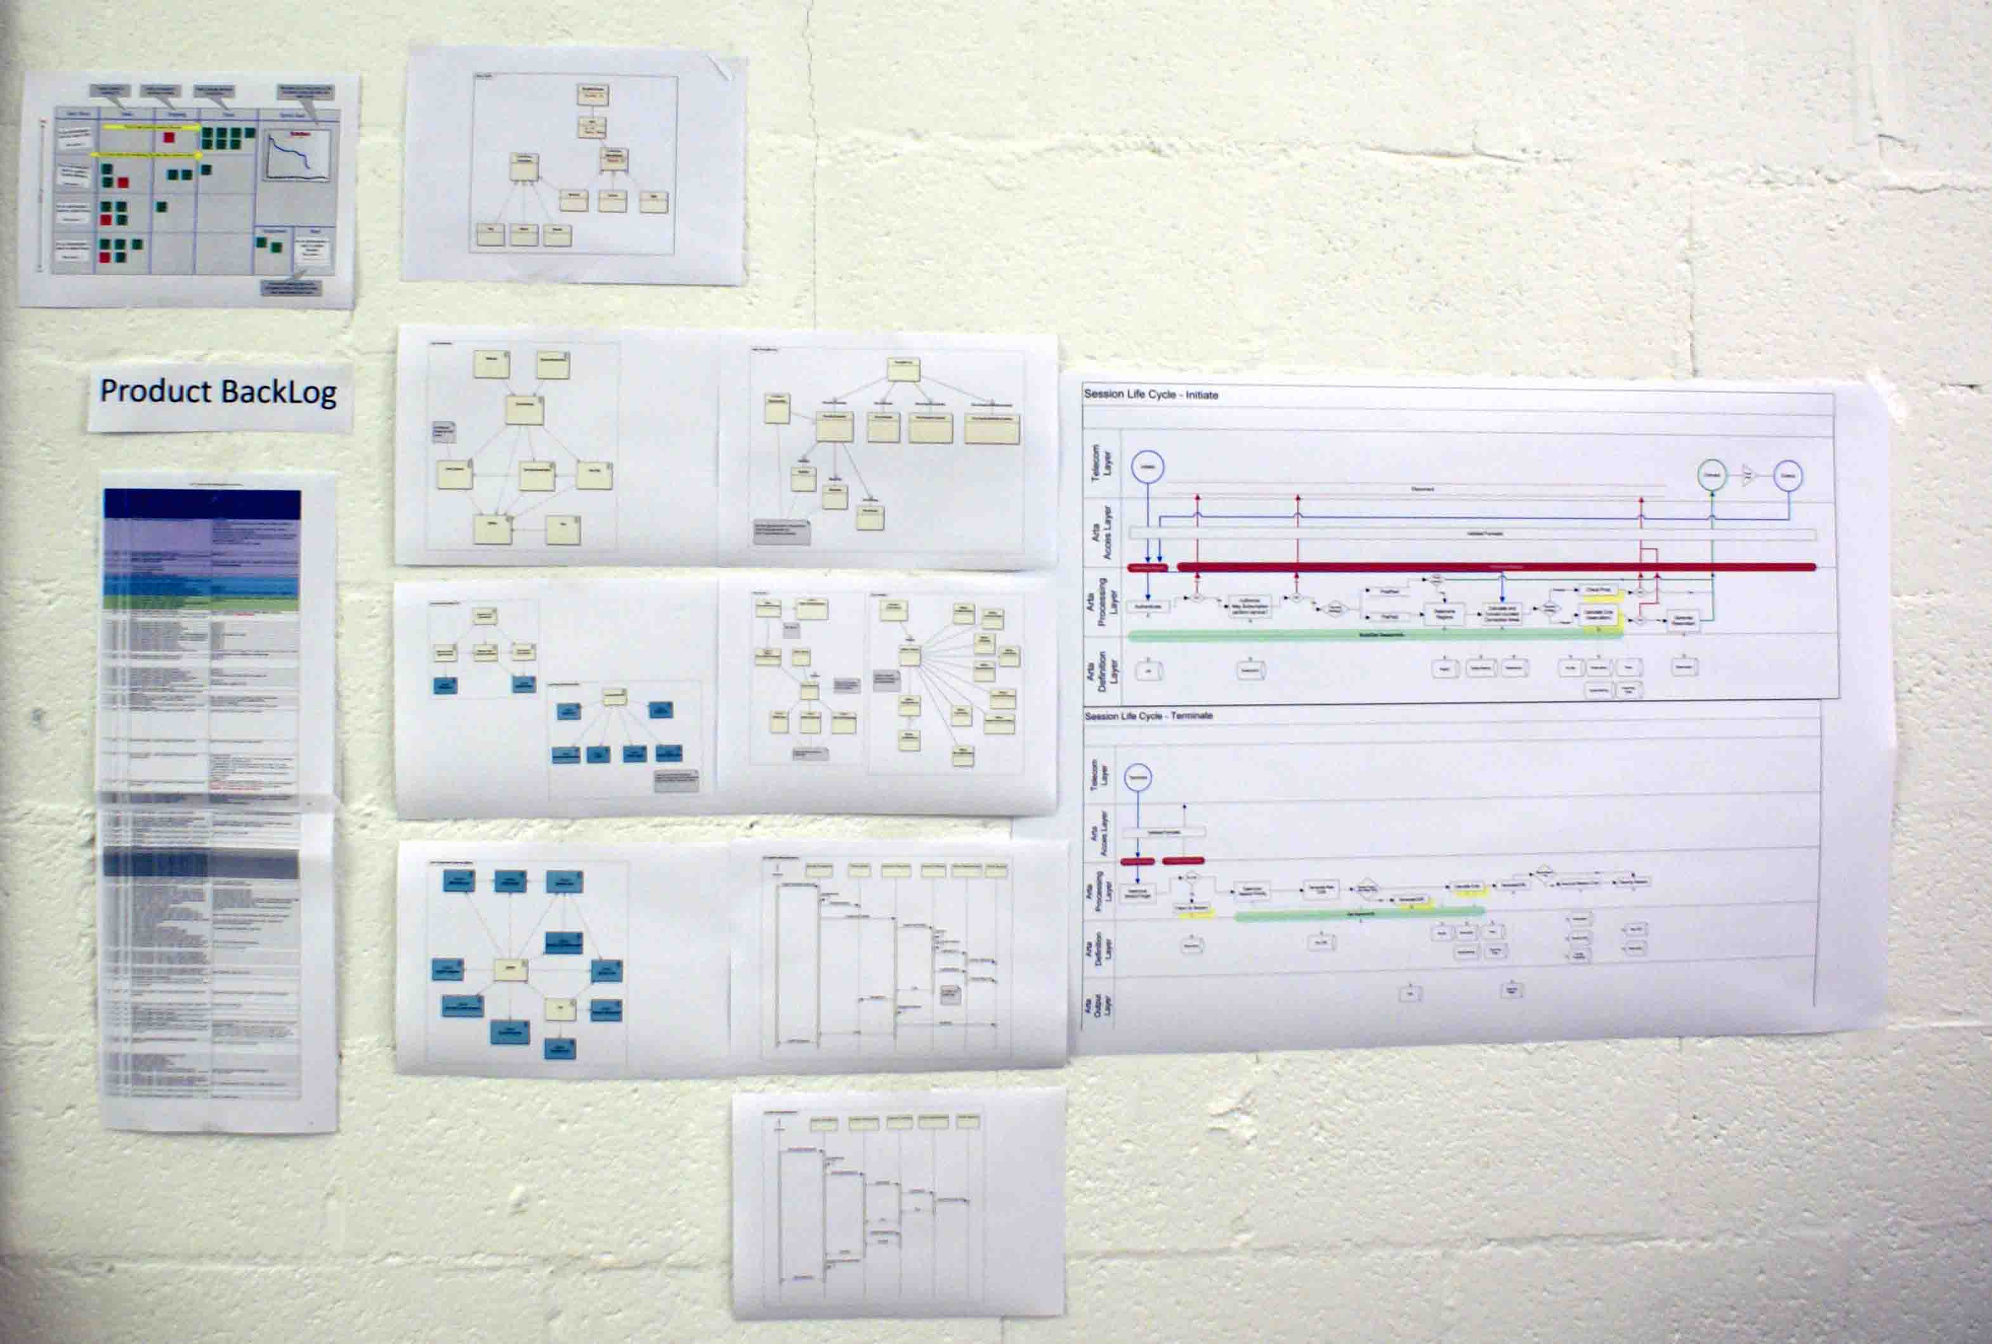
Artilium: Informative Workspace

Slide 6
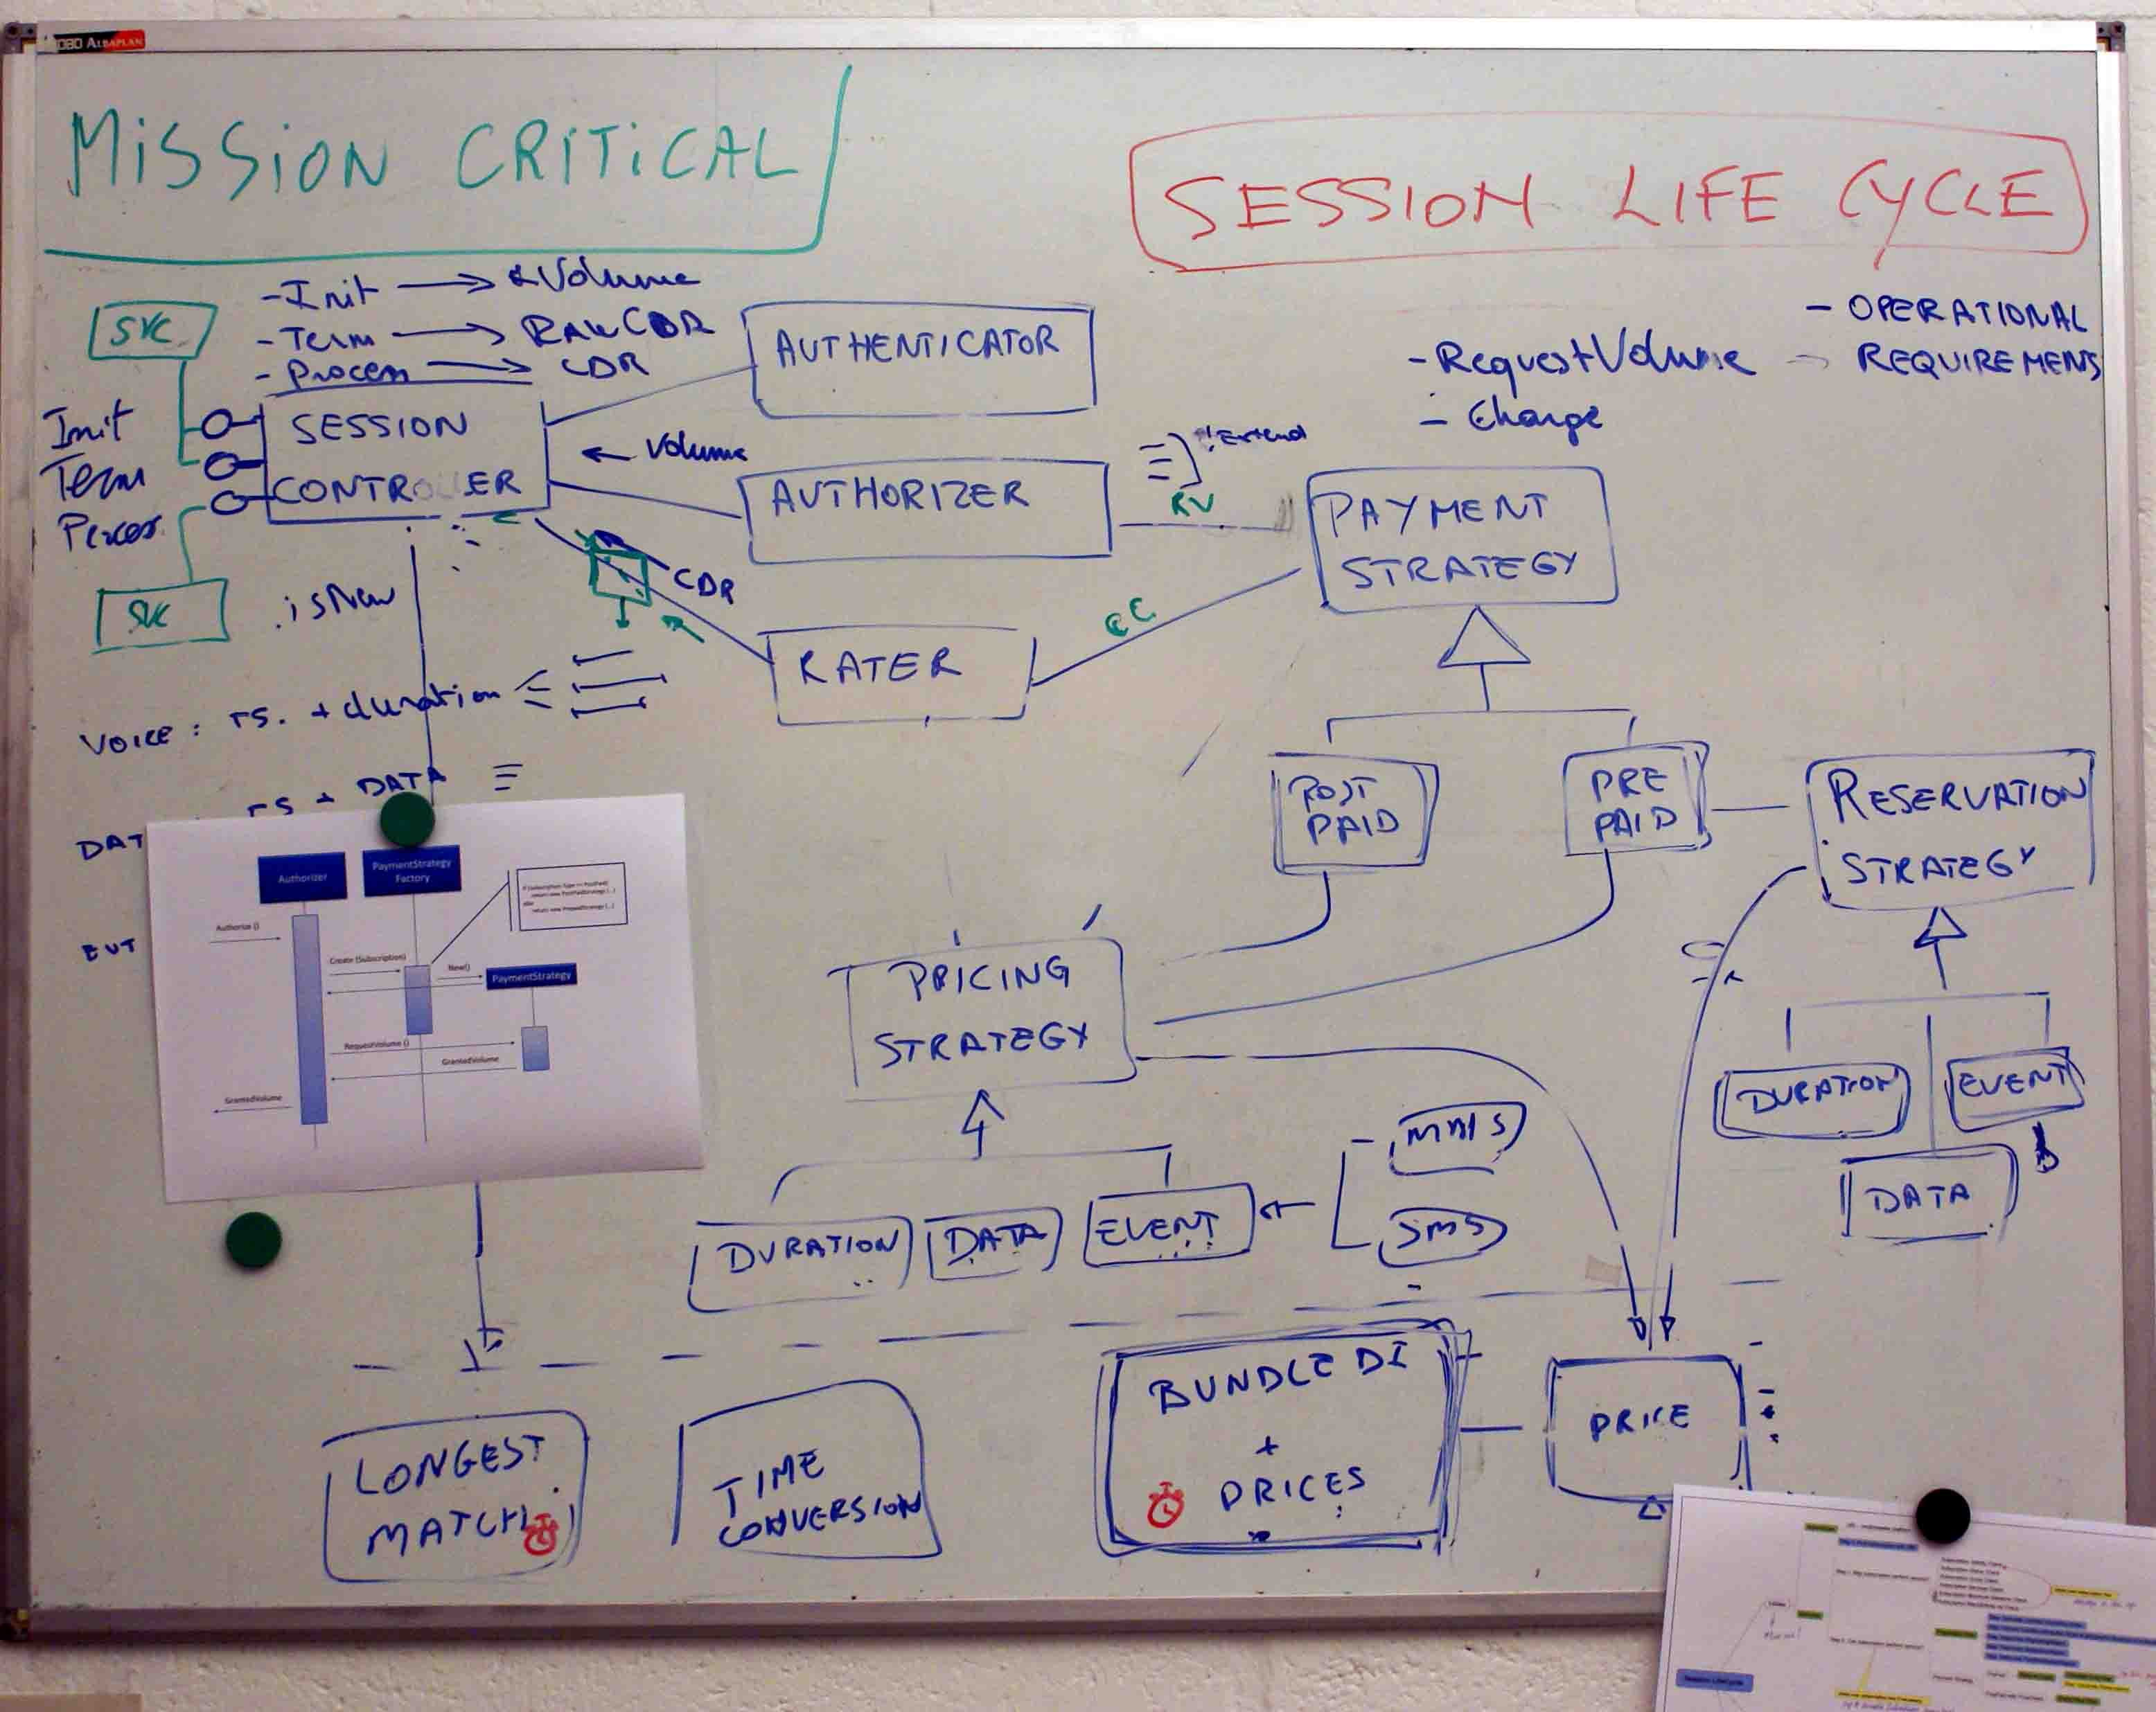
Artilium: Informative Workspace

Slide 7
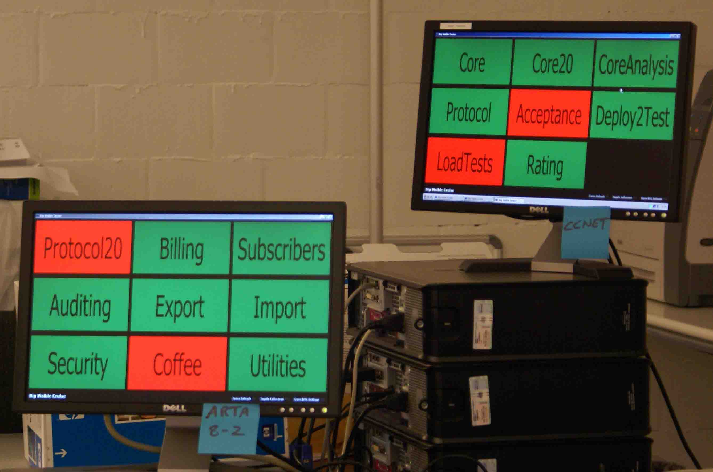
Artilium: Informative Workspace

Slide 8
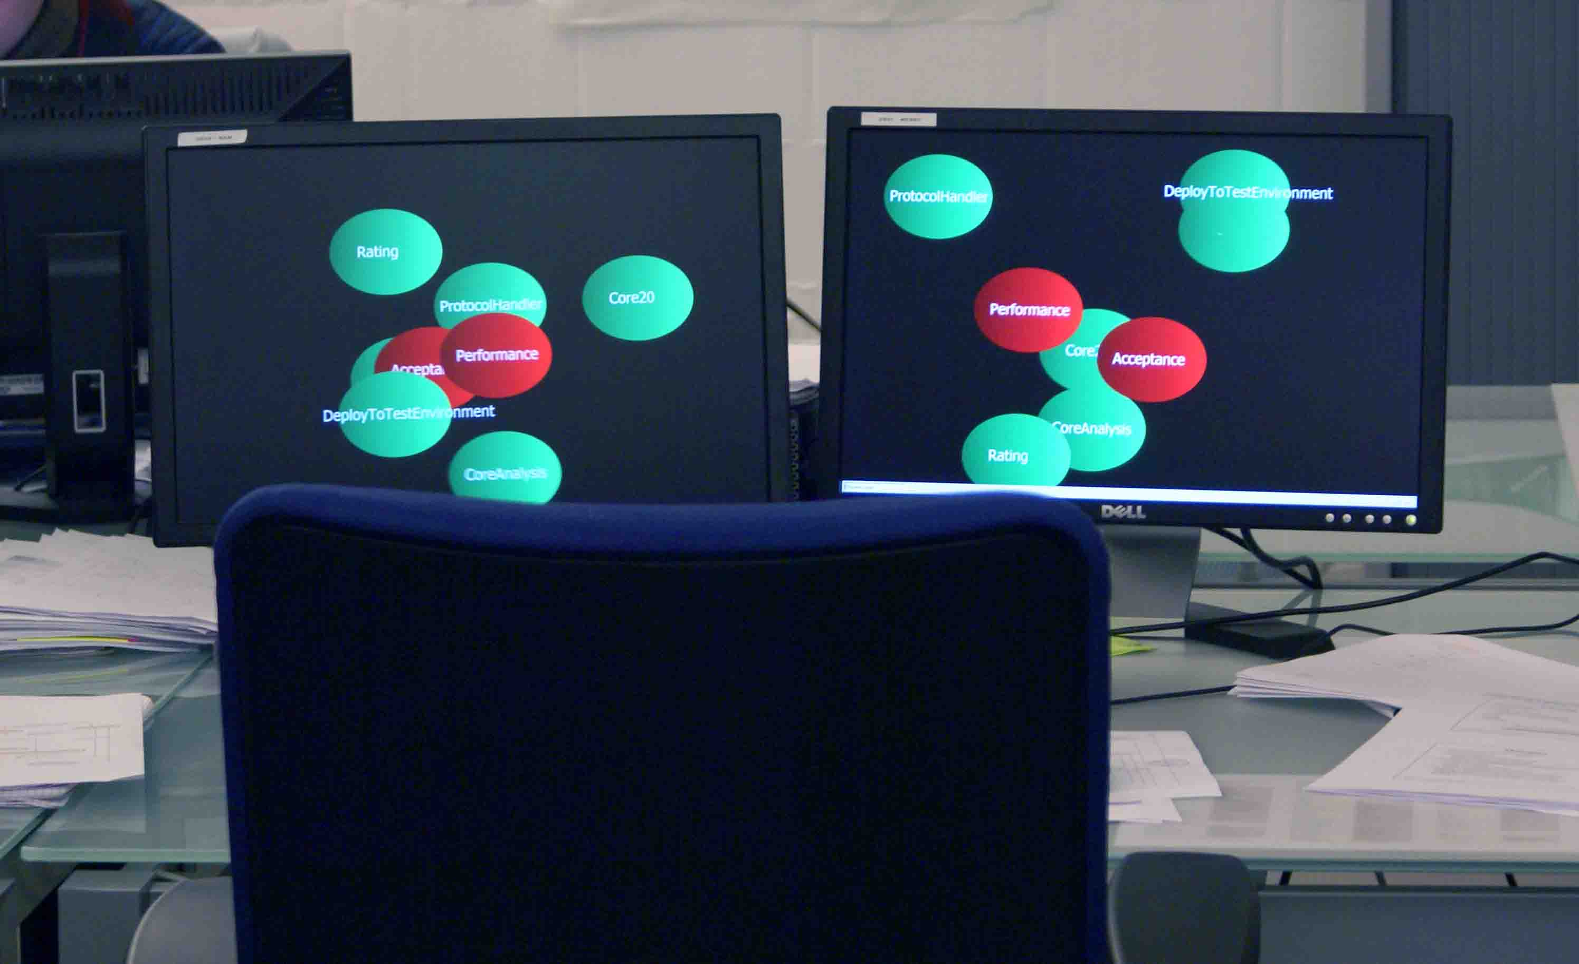
Artilium: Informative Workspace

Slide 9
Artilium: Continuous Improvement
From no build to full build
From BDUF to incremental design
Adding tasks to the scrum board
4 week sprints to 2 week sprints
...
Retrospectives rules

Slide 10
Artilium: People
Mixed team
How new members are introduced
How coaches became team members

