Slide 1
The Agile Manifesto
Individuals and interaction | over | Processes and tools
Working software | over | Comprehensive documentation
Customer collaboration | over | Contract negotiation
Responding to change | over | Following a plan
Craftmanship | over | Crap

Slide 2
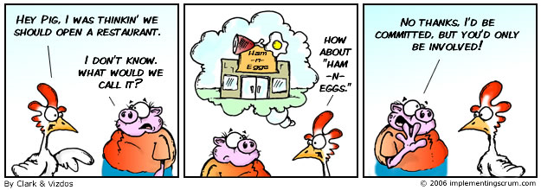
SCRUM
Roles
Chicken and Pigs
Ham and Eggs
A day’s work for a chicken, a lifetime commitment for a pig.

Slide 3
SCRUM: Roles
Chicken
Users
Stakeholders
Managers
Pigs
Scrum master
Product owner
Team

Slide 4
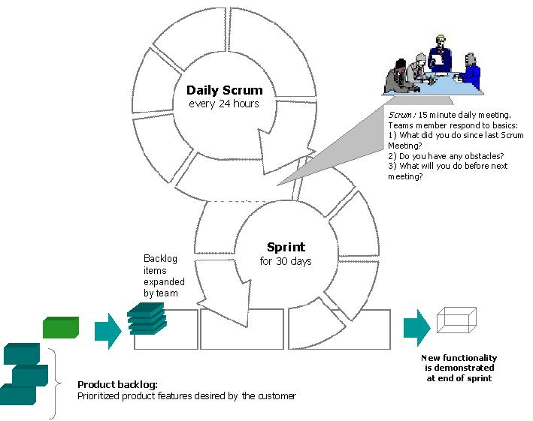
SCRUM: Phases of an iteration

Slide 5
XP: Values
Communication
Simplicity
Feedback
Continuous Integration
Informative Workspace
Courage
Respect
Sustainable Pace

Slide 6
XP: Activities
Designing
Spiking
TDD
Incremental design
Coding
Pair programming
Refactoring
Collective code ownership

