Slide 1

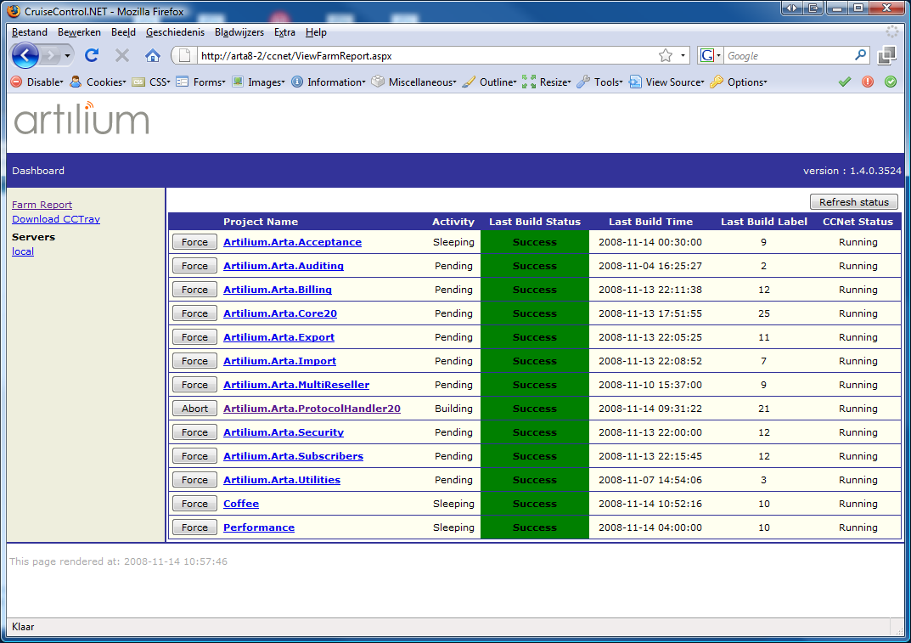
CruiseControl.NET

Slide 2
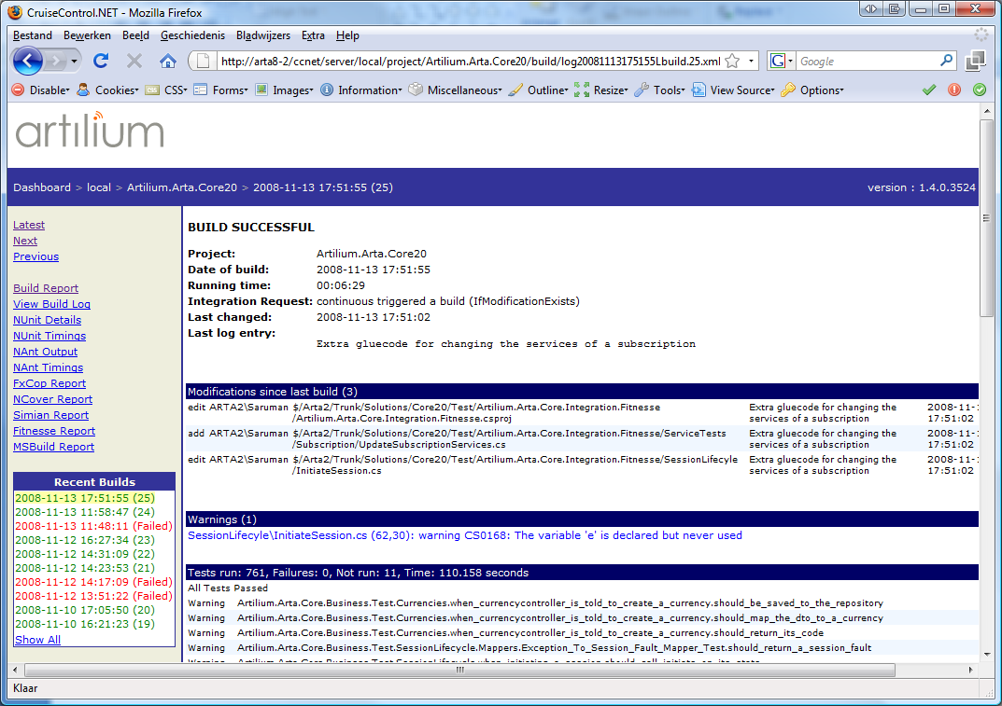
CruiseControl.NET

Slide 3
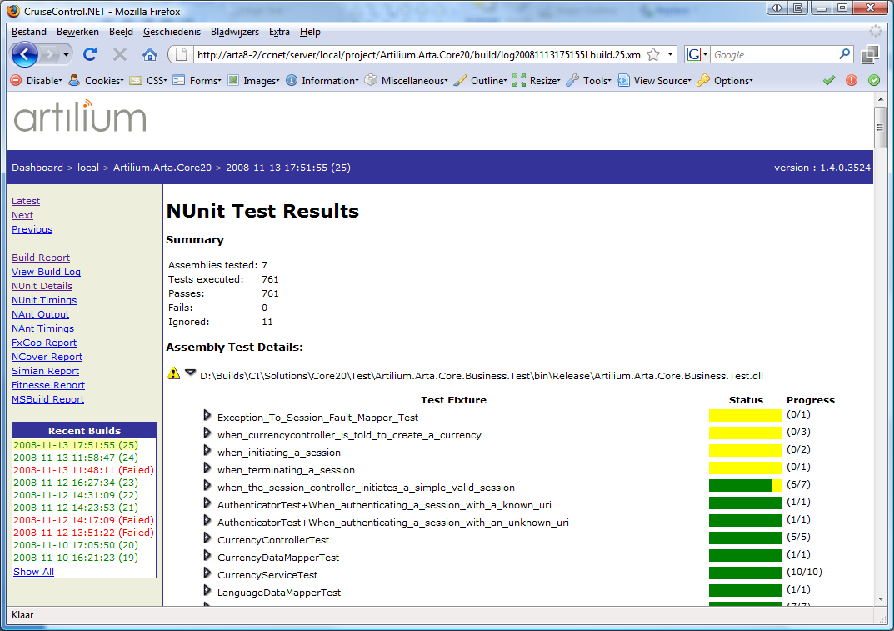
CruiseControl.NET

Slide 4
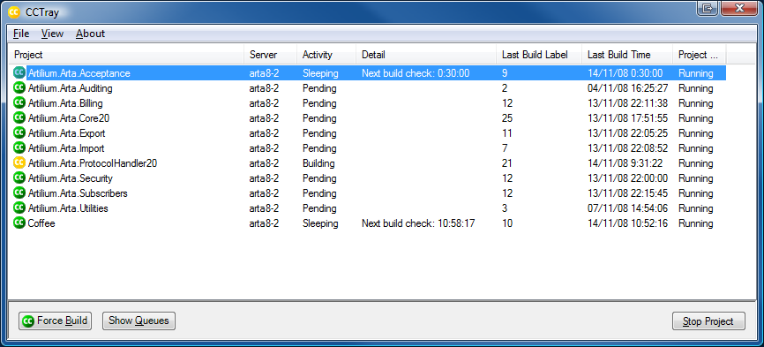

CCTray
Build Failed
Build Failed Again
Build Succeeded

