Slide 1
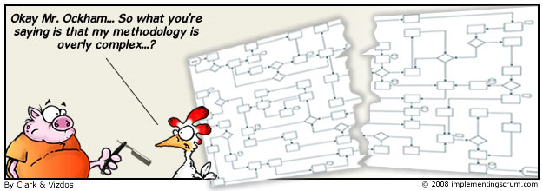
Agile.net
Experiences of the Artilium project

Slide 2



Agile principles...
... applied on...
... with Microsoft technologies?

