Slide 1
The Agile Manifesto
Individuals and interaction | over | Processes and tools
Working software | over | Comprehensive documentation
Customer collaboration | over | Contract negotiation
Responding to change | over | Following a plan
Craftmanship | over | Crap

Slide 2
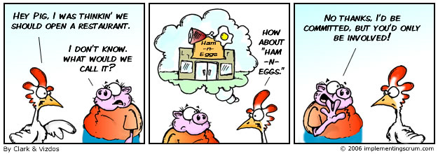
SCRUM
Roles
Chicken and Pigs
Ham and Eggs
A day’s work for a chicken, a lifetime commitment for a pig.

Slide 3

SCRUM Role: Product Owner
representative of all stakeholders
focus = business side of the product
carries the product vision to the team
formalizes the product backlog
prioritizes it by business value

Slide 4

SCRUM Role: Team
does everything to win the game
– to deliver the product.
cross-functional
self-organising
needs to understand the vision
delivers product increments
Notes:
The team is cross-functional. That means the full know-how to realize the product is located in the team.
The team needs to understand the vision and Sprint Goals of the Product Owner in order to deliver potentially shippable product increments.

Slide 5

SCRUM Role: Scrummaster
Coach and facilitator of the team
Improves the productivity
training plan for the team
Retrospectives
Impediment Backlog
controls the scrum process
protects the team
collaborates with product owner
Notes:
The Scrum Master is the coach and facilitator of the team.
He improves the productivity. He always has a training plan for the team – the Impediment Backlog.
The Scrum Master controls the “inspect and adapt” cycles of Scrum. He protects the team and works with the Product Owner to maximize the return on investment.
He takes care that the agile ideals are understood and respected by all stakeholders.

Slide 6
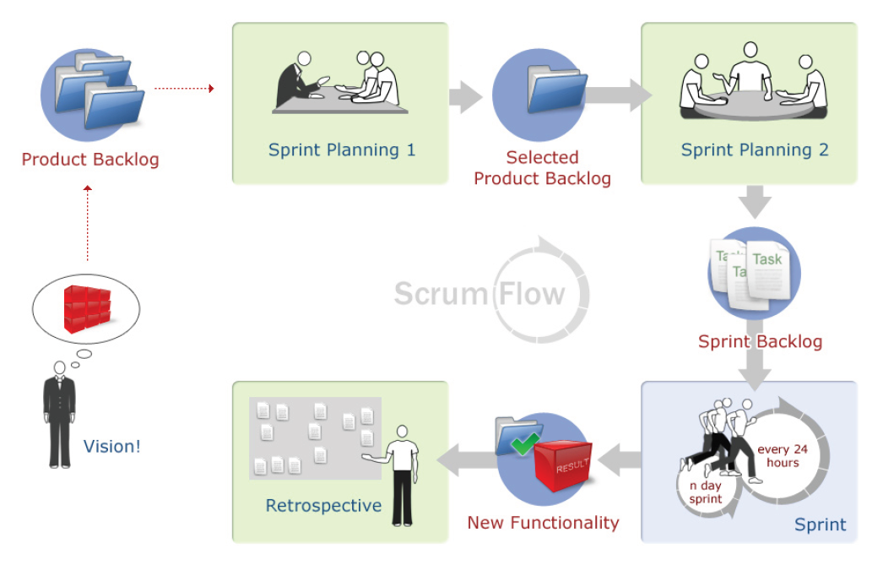
SCRUM: Phases of an iteration

Slide 7
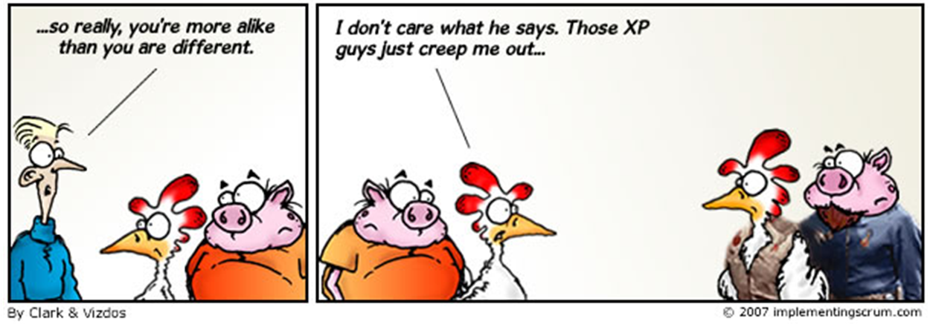
You can’t have an agile company without
agile engineering practices
XP, anyone?

Slide 8
XP: Values
Communication
Simplicity
Feedback
Continuous Integration
Informative Workspace
Courage
Respect
Sustainable Pace

Slide 9
XP: Activities
Designing
Spiking
TDD
Incremental design
Coding
Pair programming
Refactoring
Collective code ownership

