Slide 1
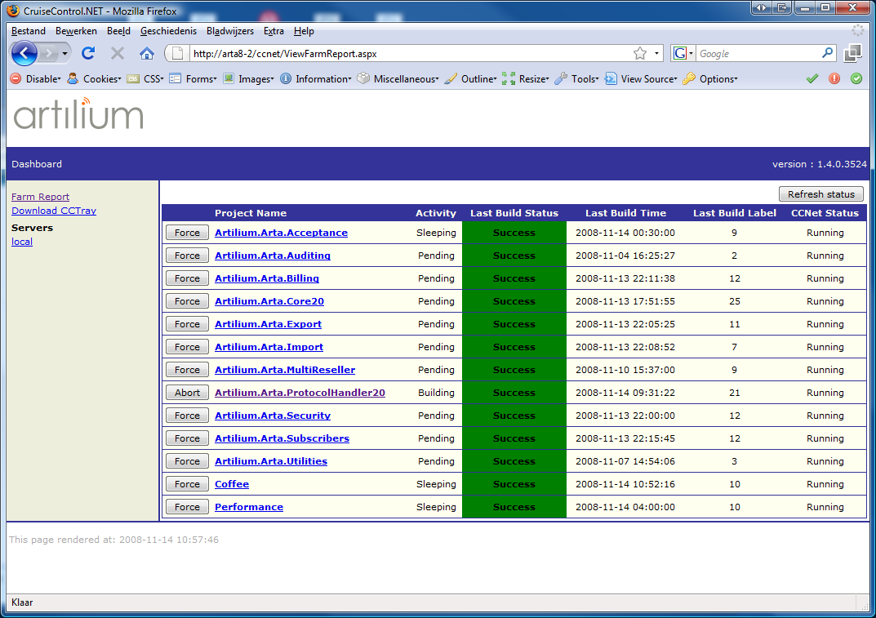
CruiseControl.NET

Slide 2
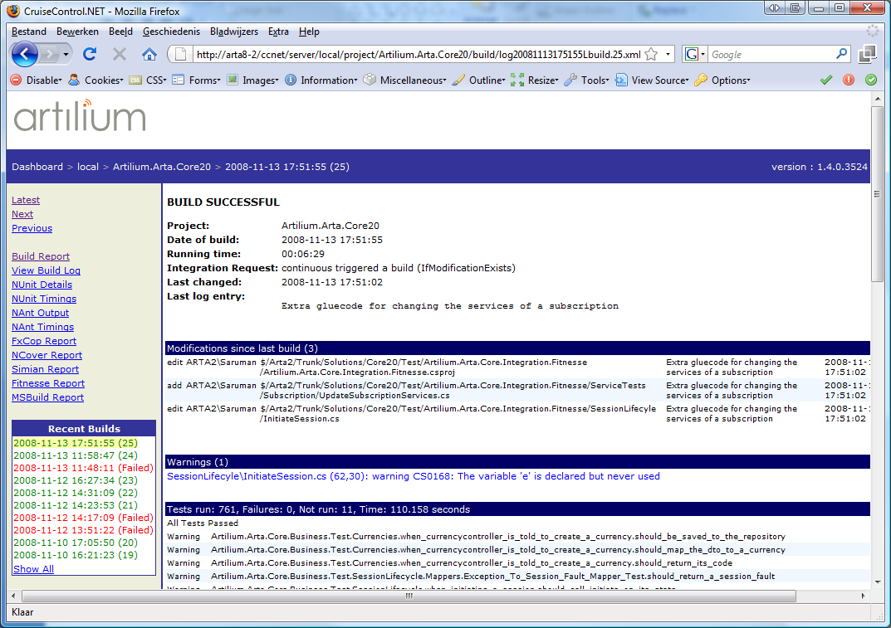
CruiseControl.NET

Slide 3
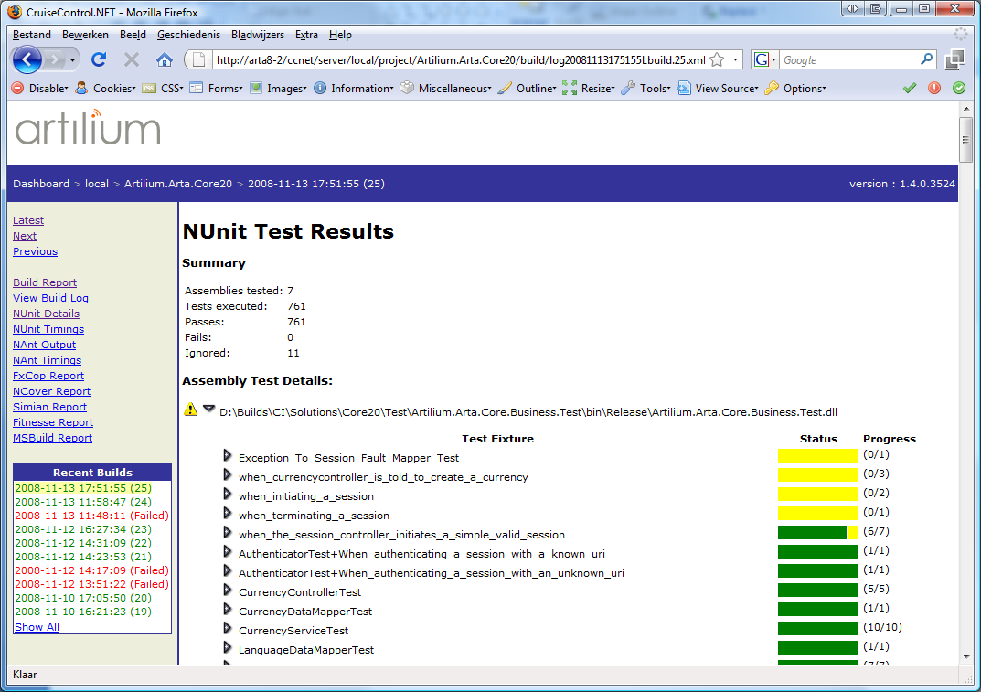
CruiseControl.NET

Slide 4
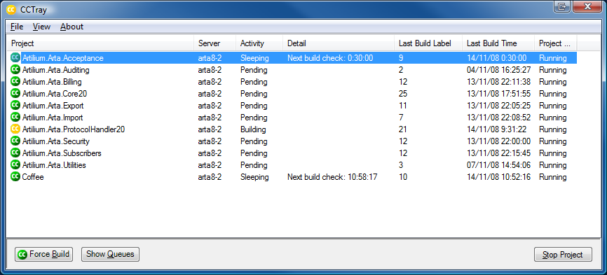

CCTray
Build Failed
Build Failed Again
Build Succeeded

Slide 5
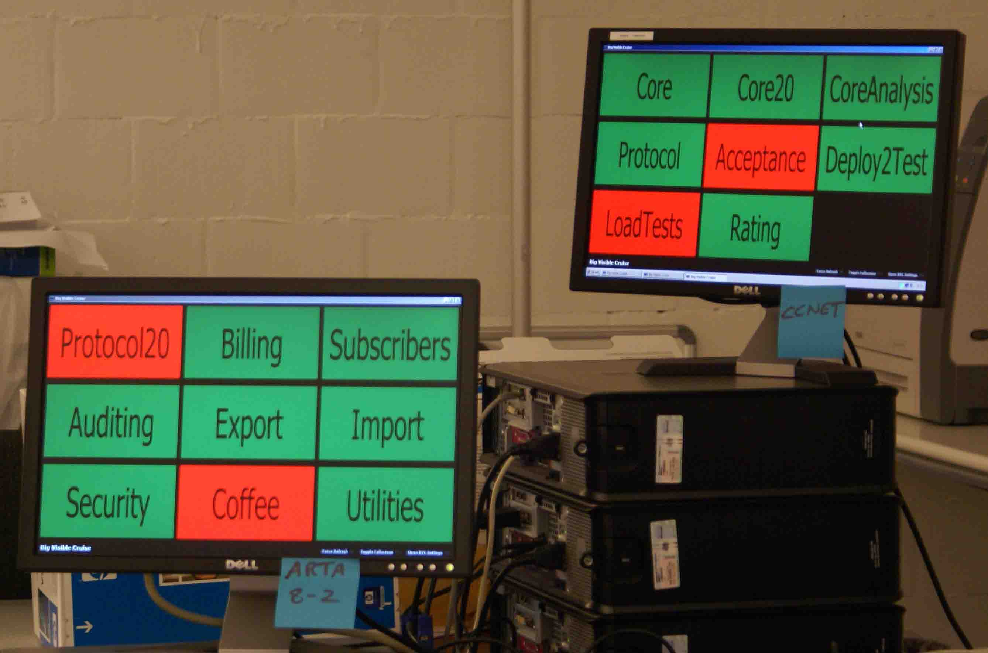
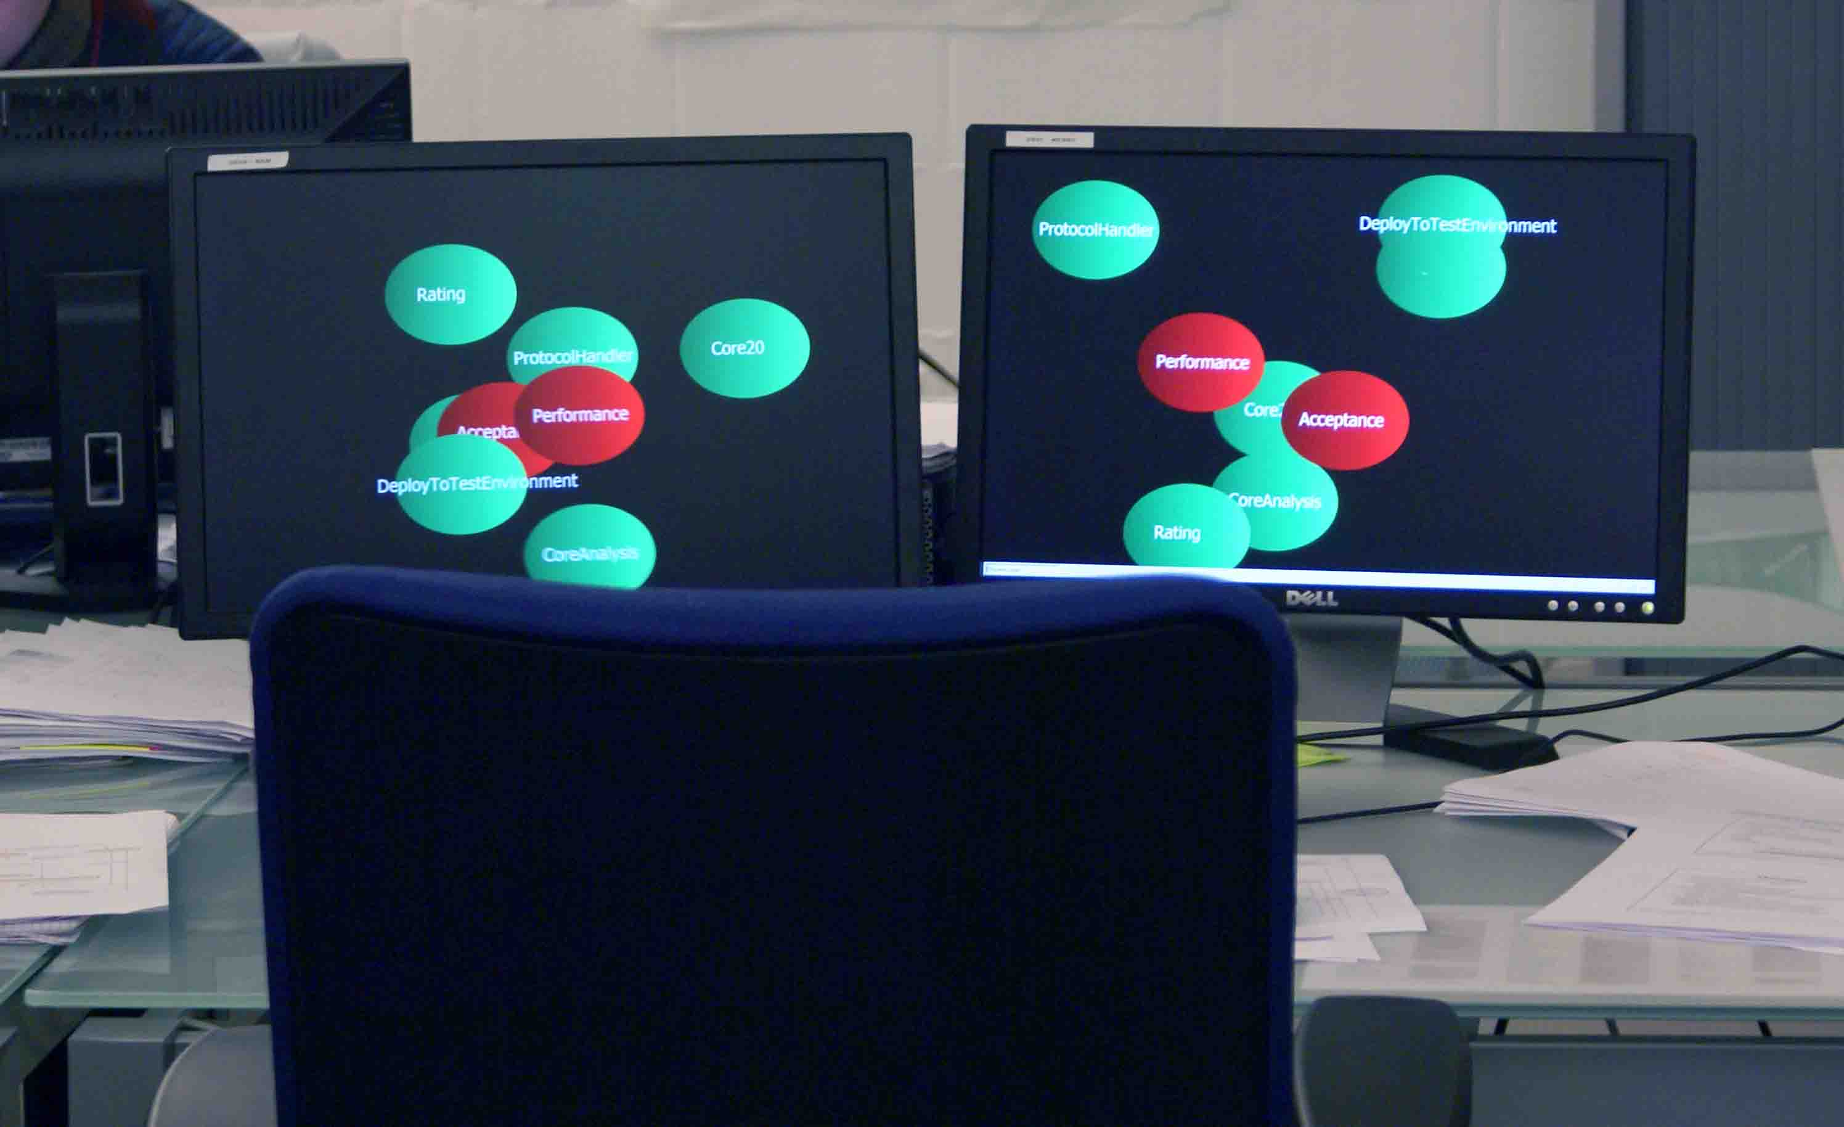
Big Visual Cruise and screen saver

