Slide 1

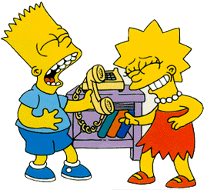
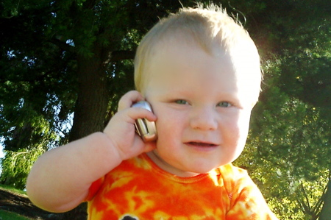
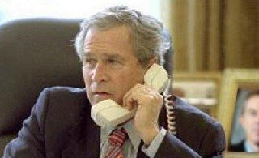
Applying agile to

Slide 2
Artilium: People
Mixed team: Cronos and Artilium devs
Continuous flow of people
Arrival: introduction
Departure: know how is kept in the team
Project start with junior devs
How coaches became team members

Slide 3
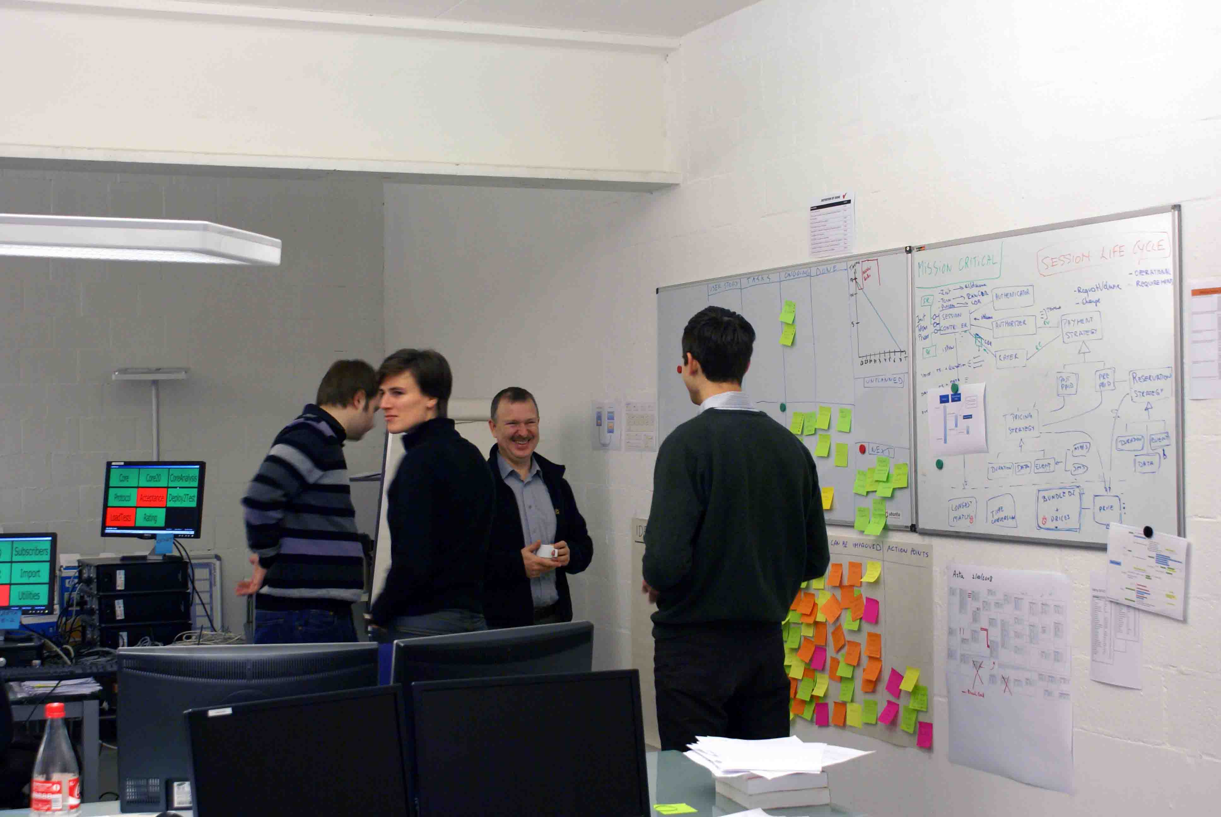
Artilium: Daily standup

Slide 4
Artilium: Continuous Improvement
From no build to full build
Dev PC
Tester PC
Source Control
Latest build
Funct
Tests
Latest stable release
CI
Load Tests

Slide 5
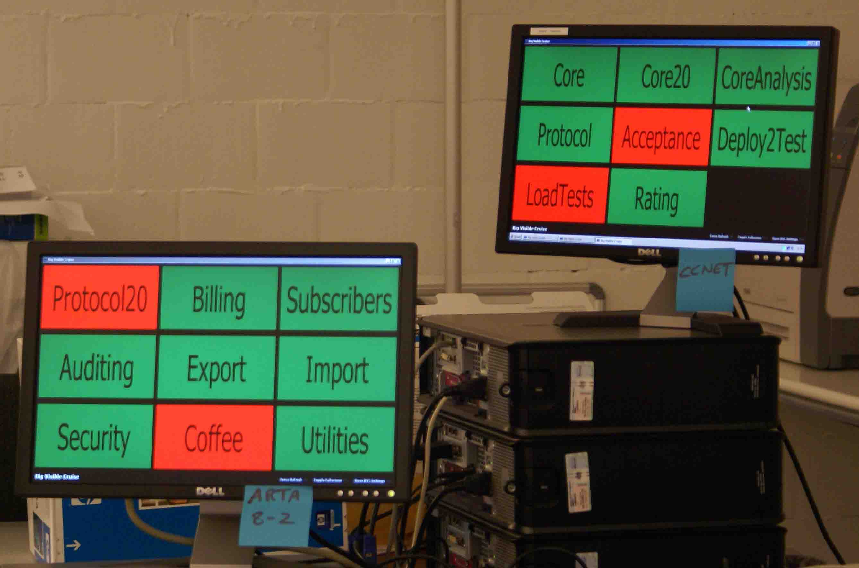
Artilium: Informative Workspace

Slide 6
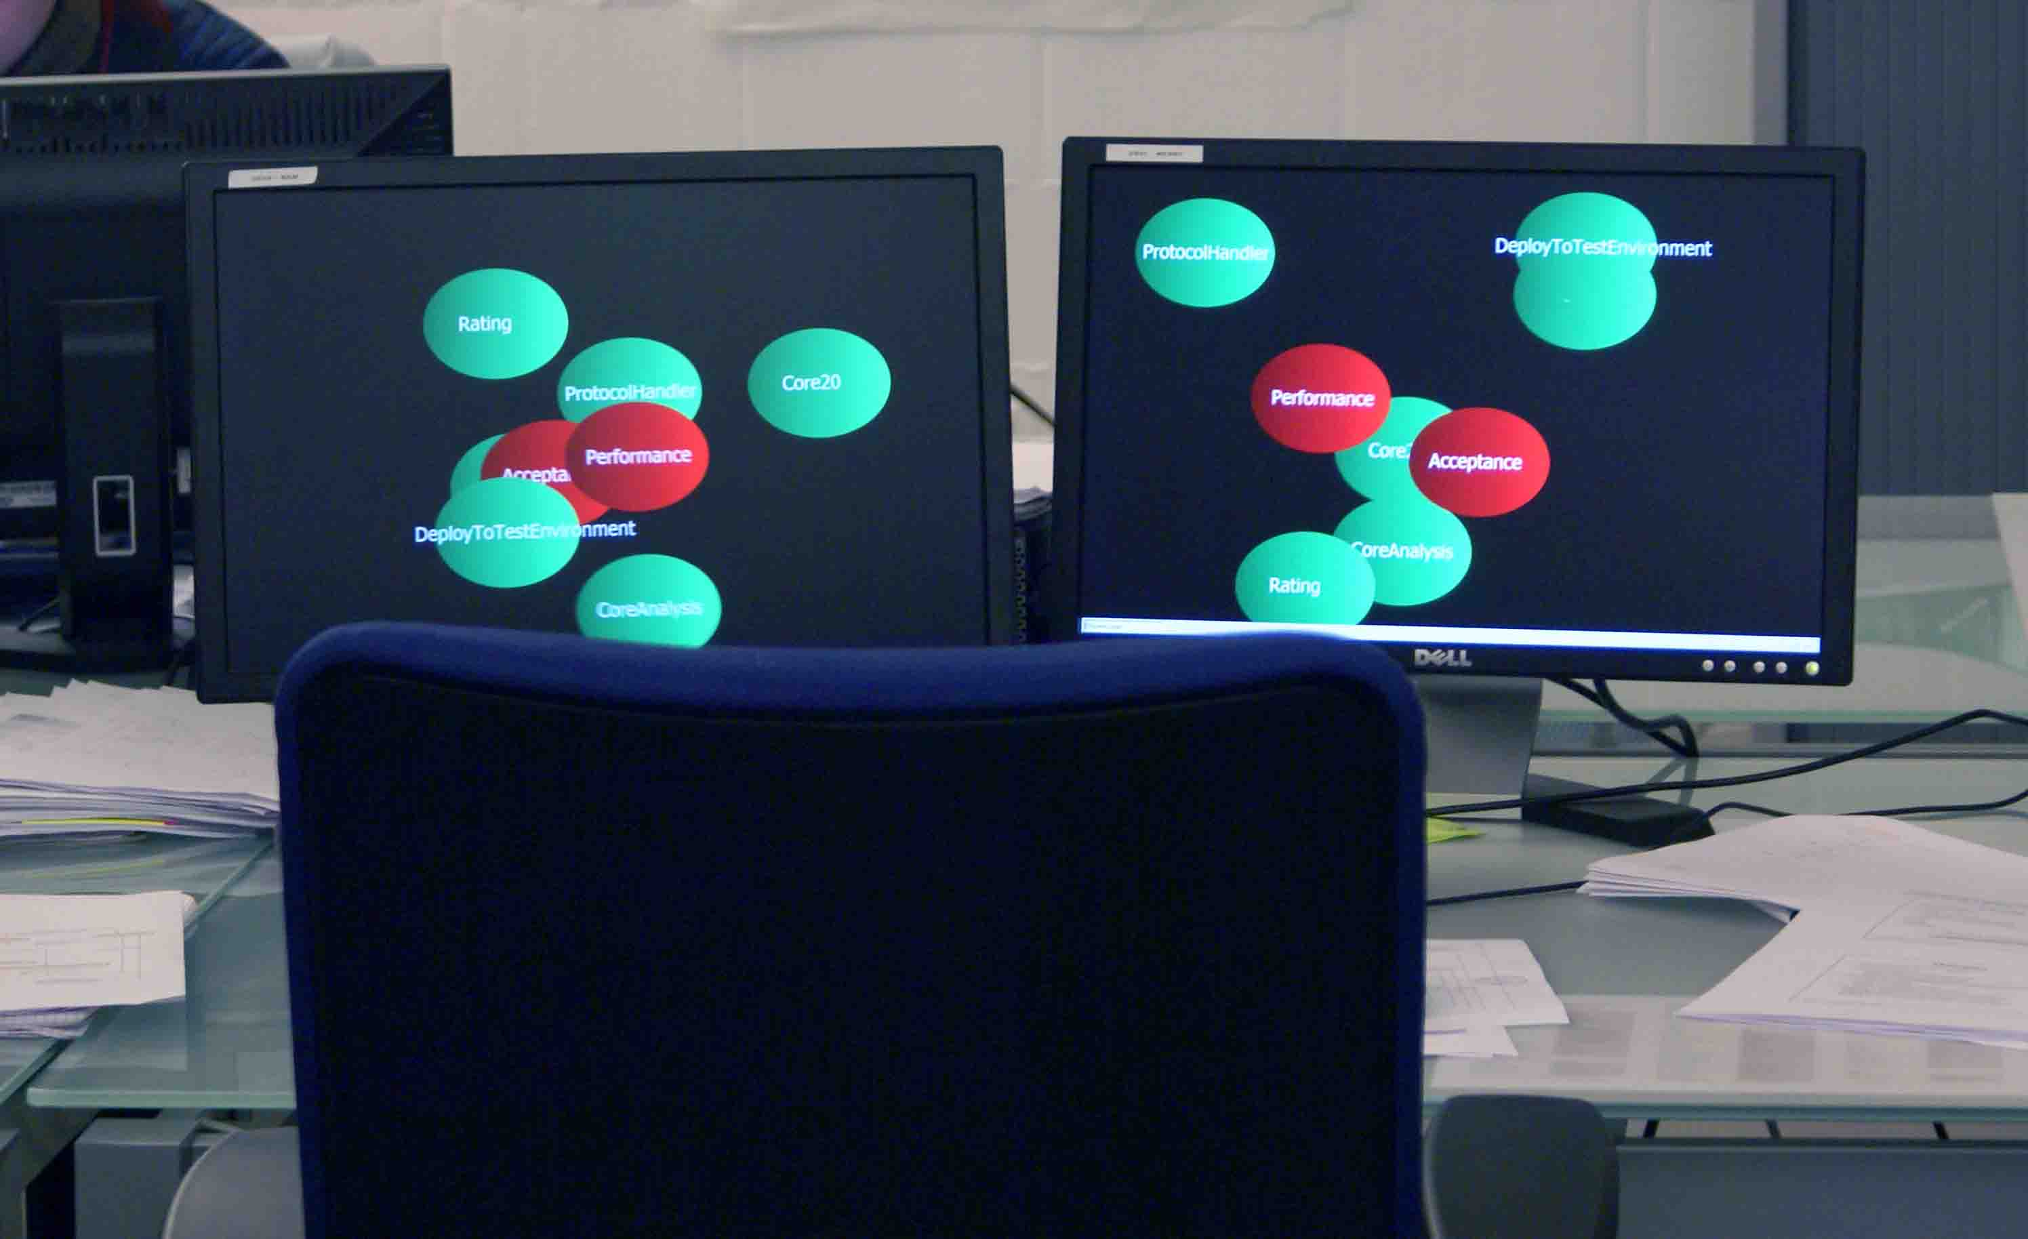
Artilium: Informative Workspace

Slide 7
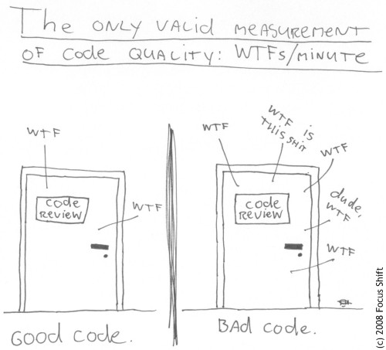
Artilium: Continuous Improvement
From no build to full build
From BDUF to incremental design

Slide 8
Artilium: Continuous Improvement
From no build to full build
From BDUF to incremental design
Adding tasks to the scrum board

Slide 9
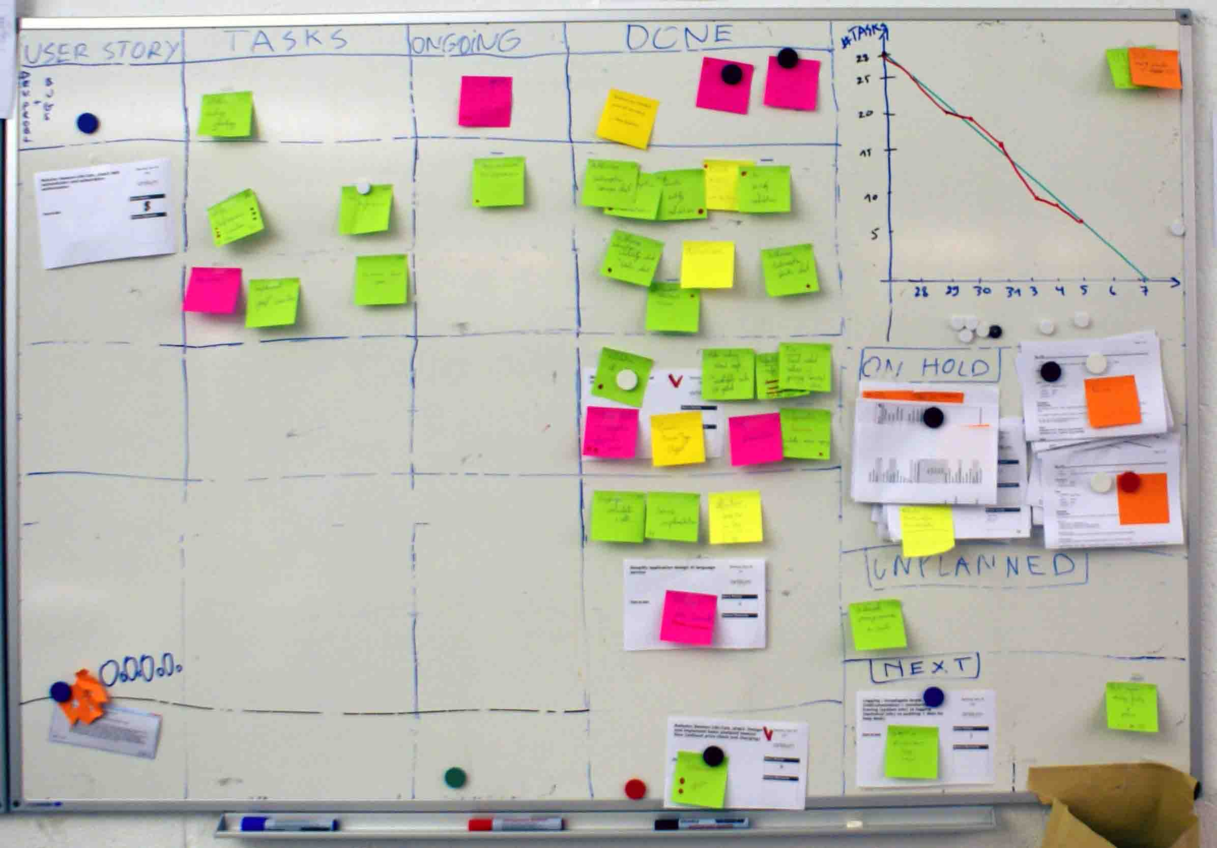
Artilium: Story Board
Story
Task
Task

Slide 10


Artilium: Continuous Improvement
From no build to full build
From BDUF to incremental design
Adding tasks to the scrum board
4 week sprints to 2 week sprints

Slide 11
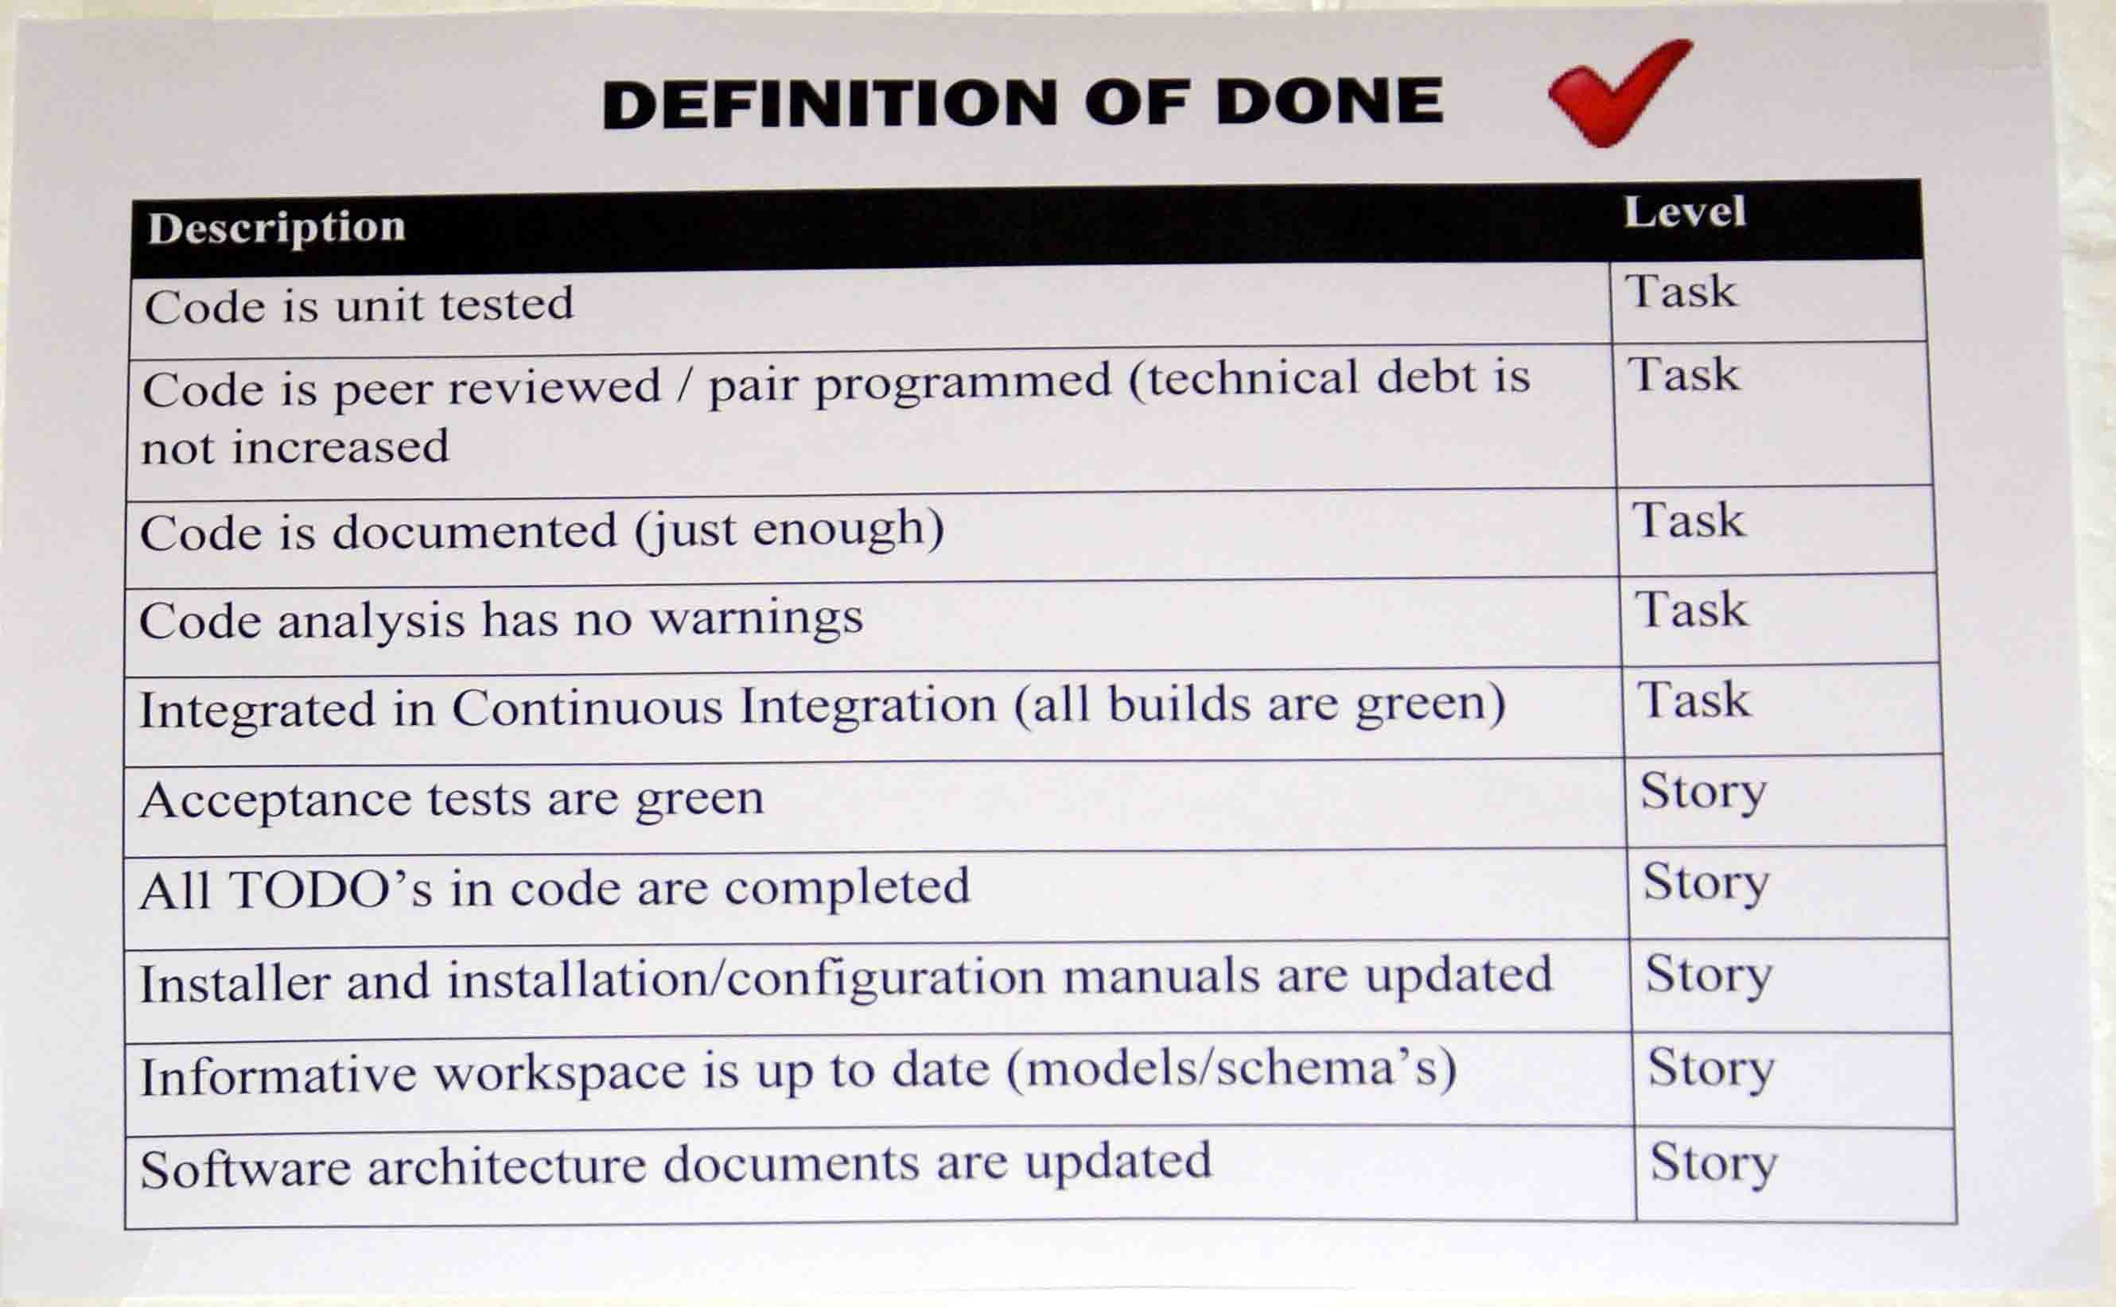
Artilium: Continuous Improvement
From no build to full build
From BDUF to incremental design
Adding tasks to the scrum board
4 week sprints to 2 week sprints
Definition of DONE

Slide 12
Artilium: Continuous Improvement
From no build to full build
From BDUF to incremental design
Adding tasks to the scrum board
4 week sprints to 2 week sprints
Definition of DONE
Retrospectives rulez !

Slide 13
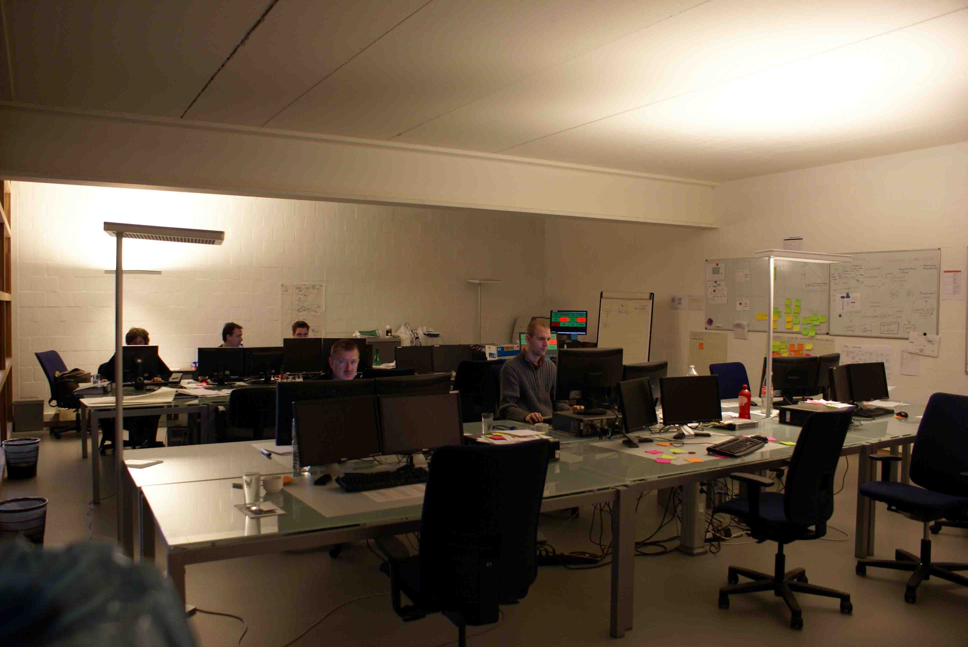
Artilium: Team Room

Slide 14
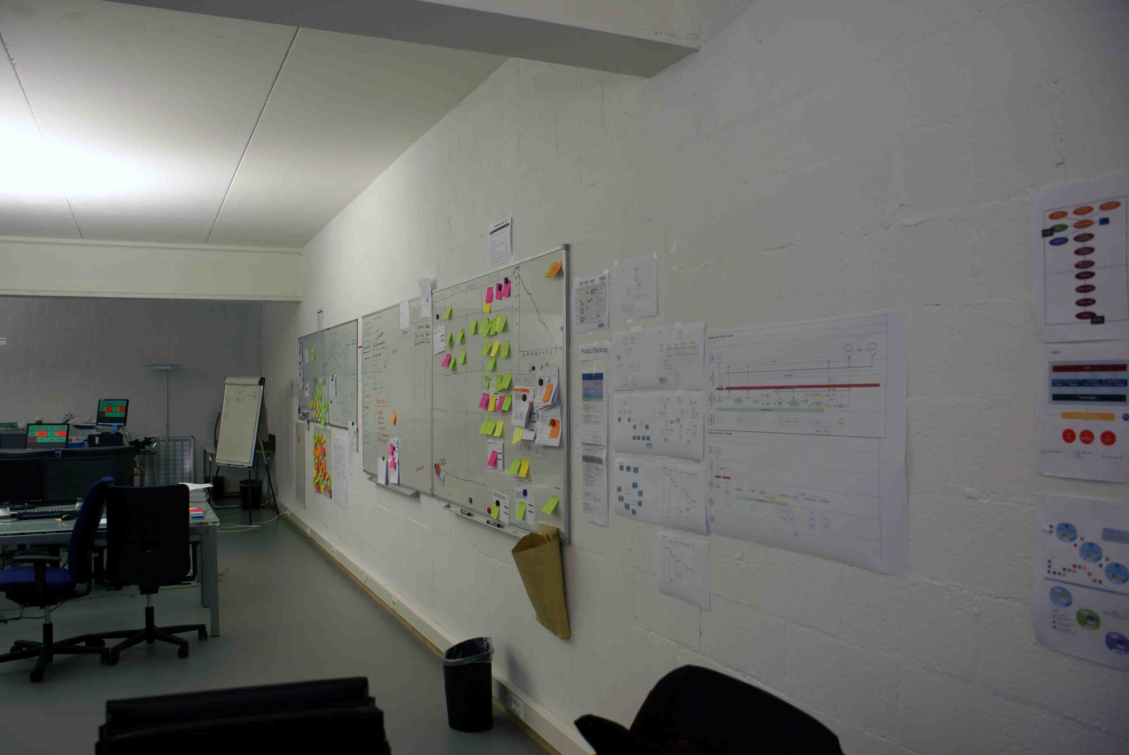
Artilium: Team Room

Slide 15
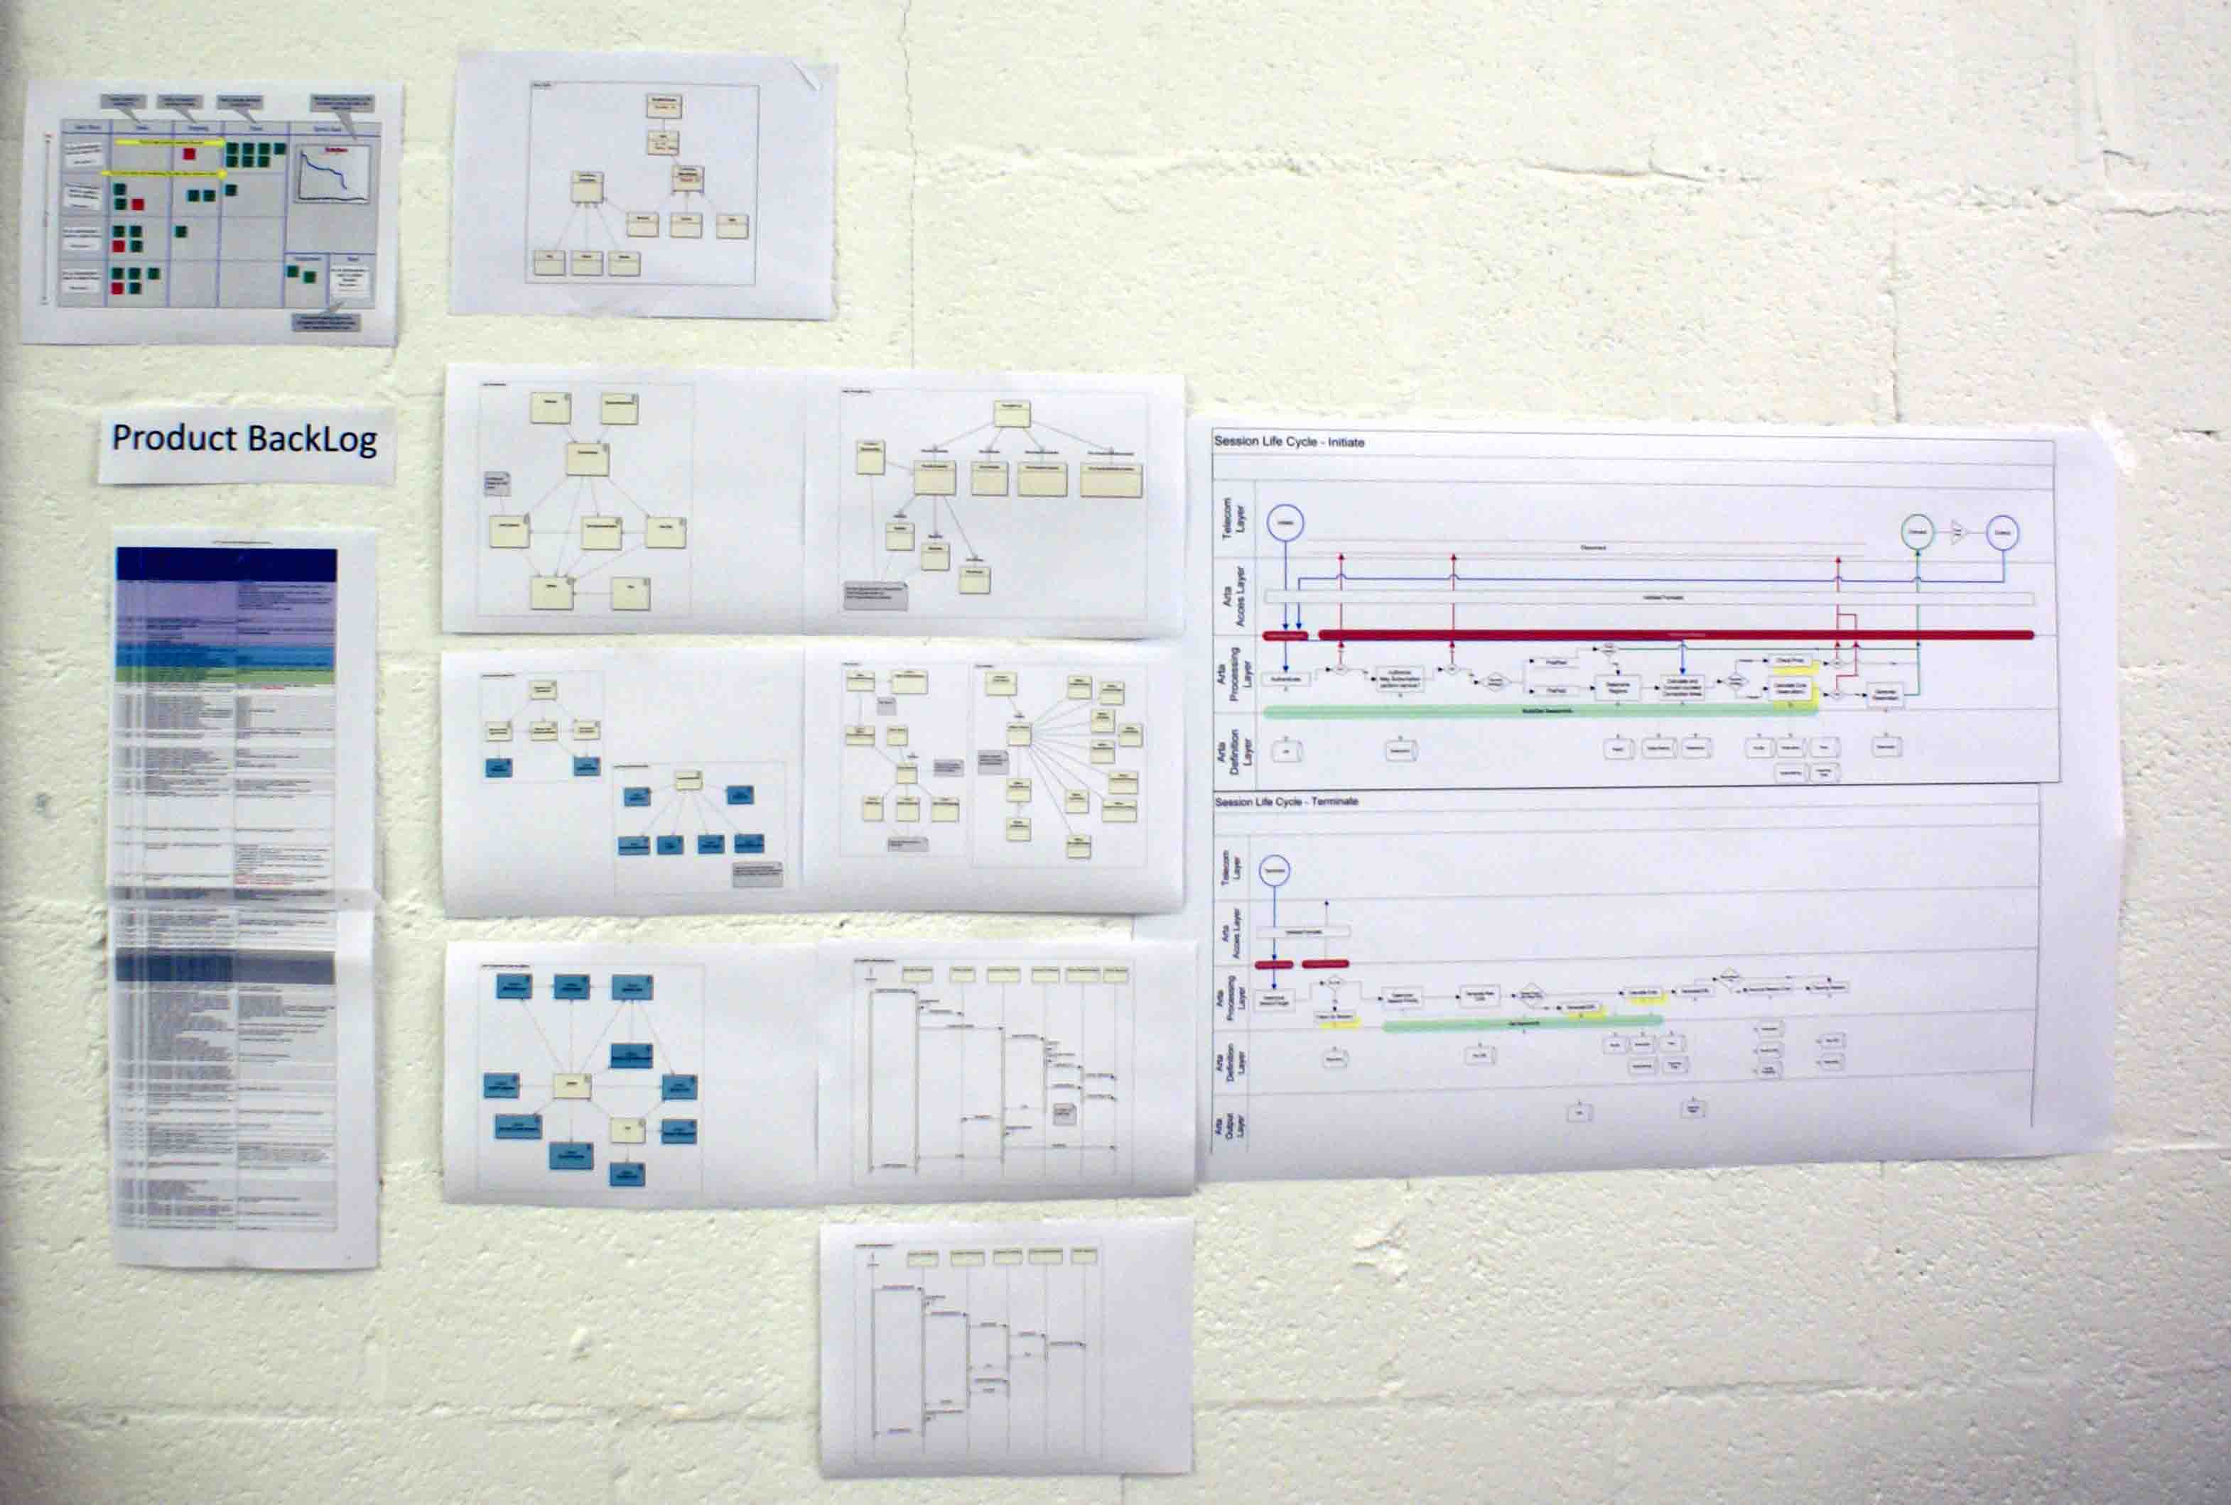
Artilium: Informative Workspace

Slide 16
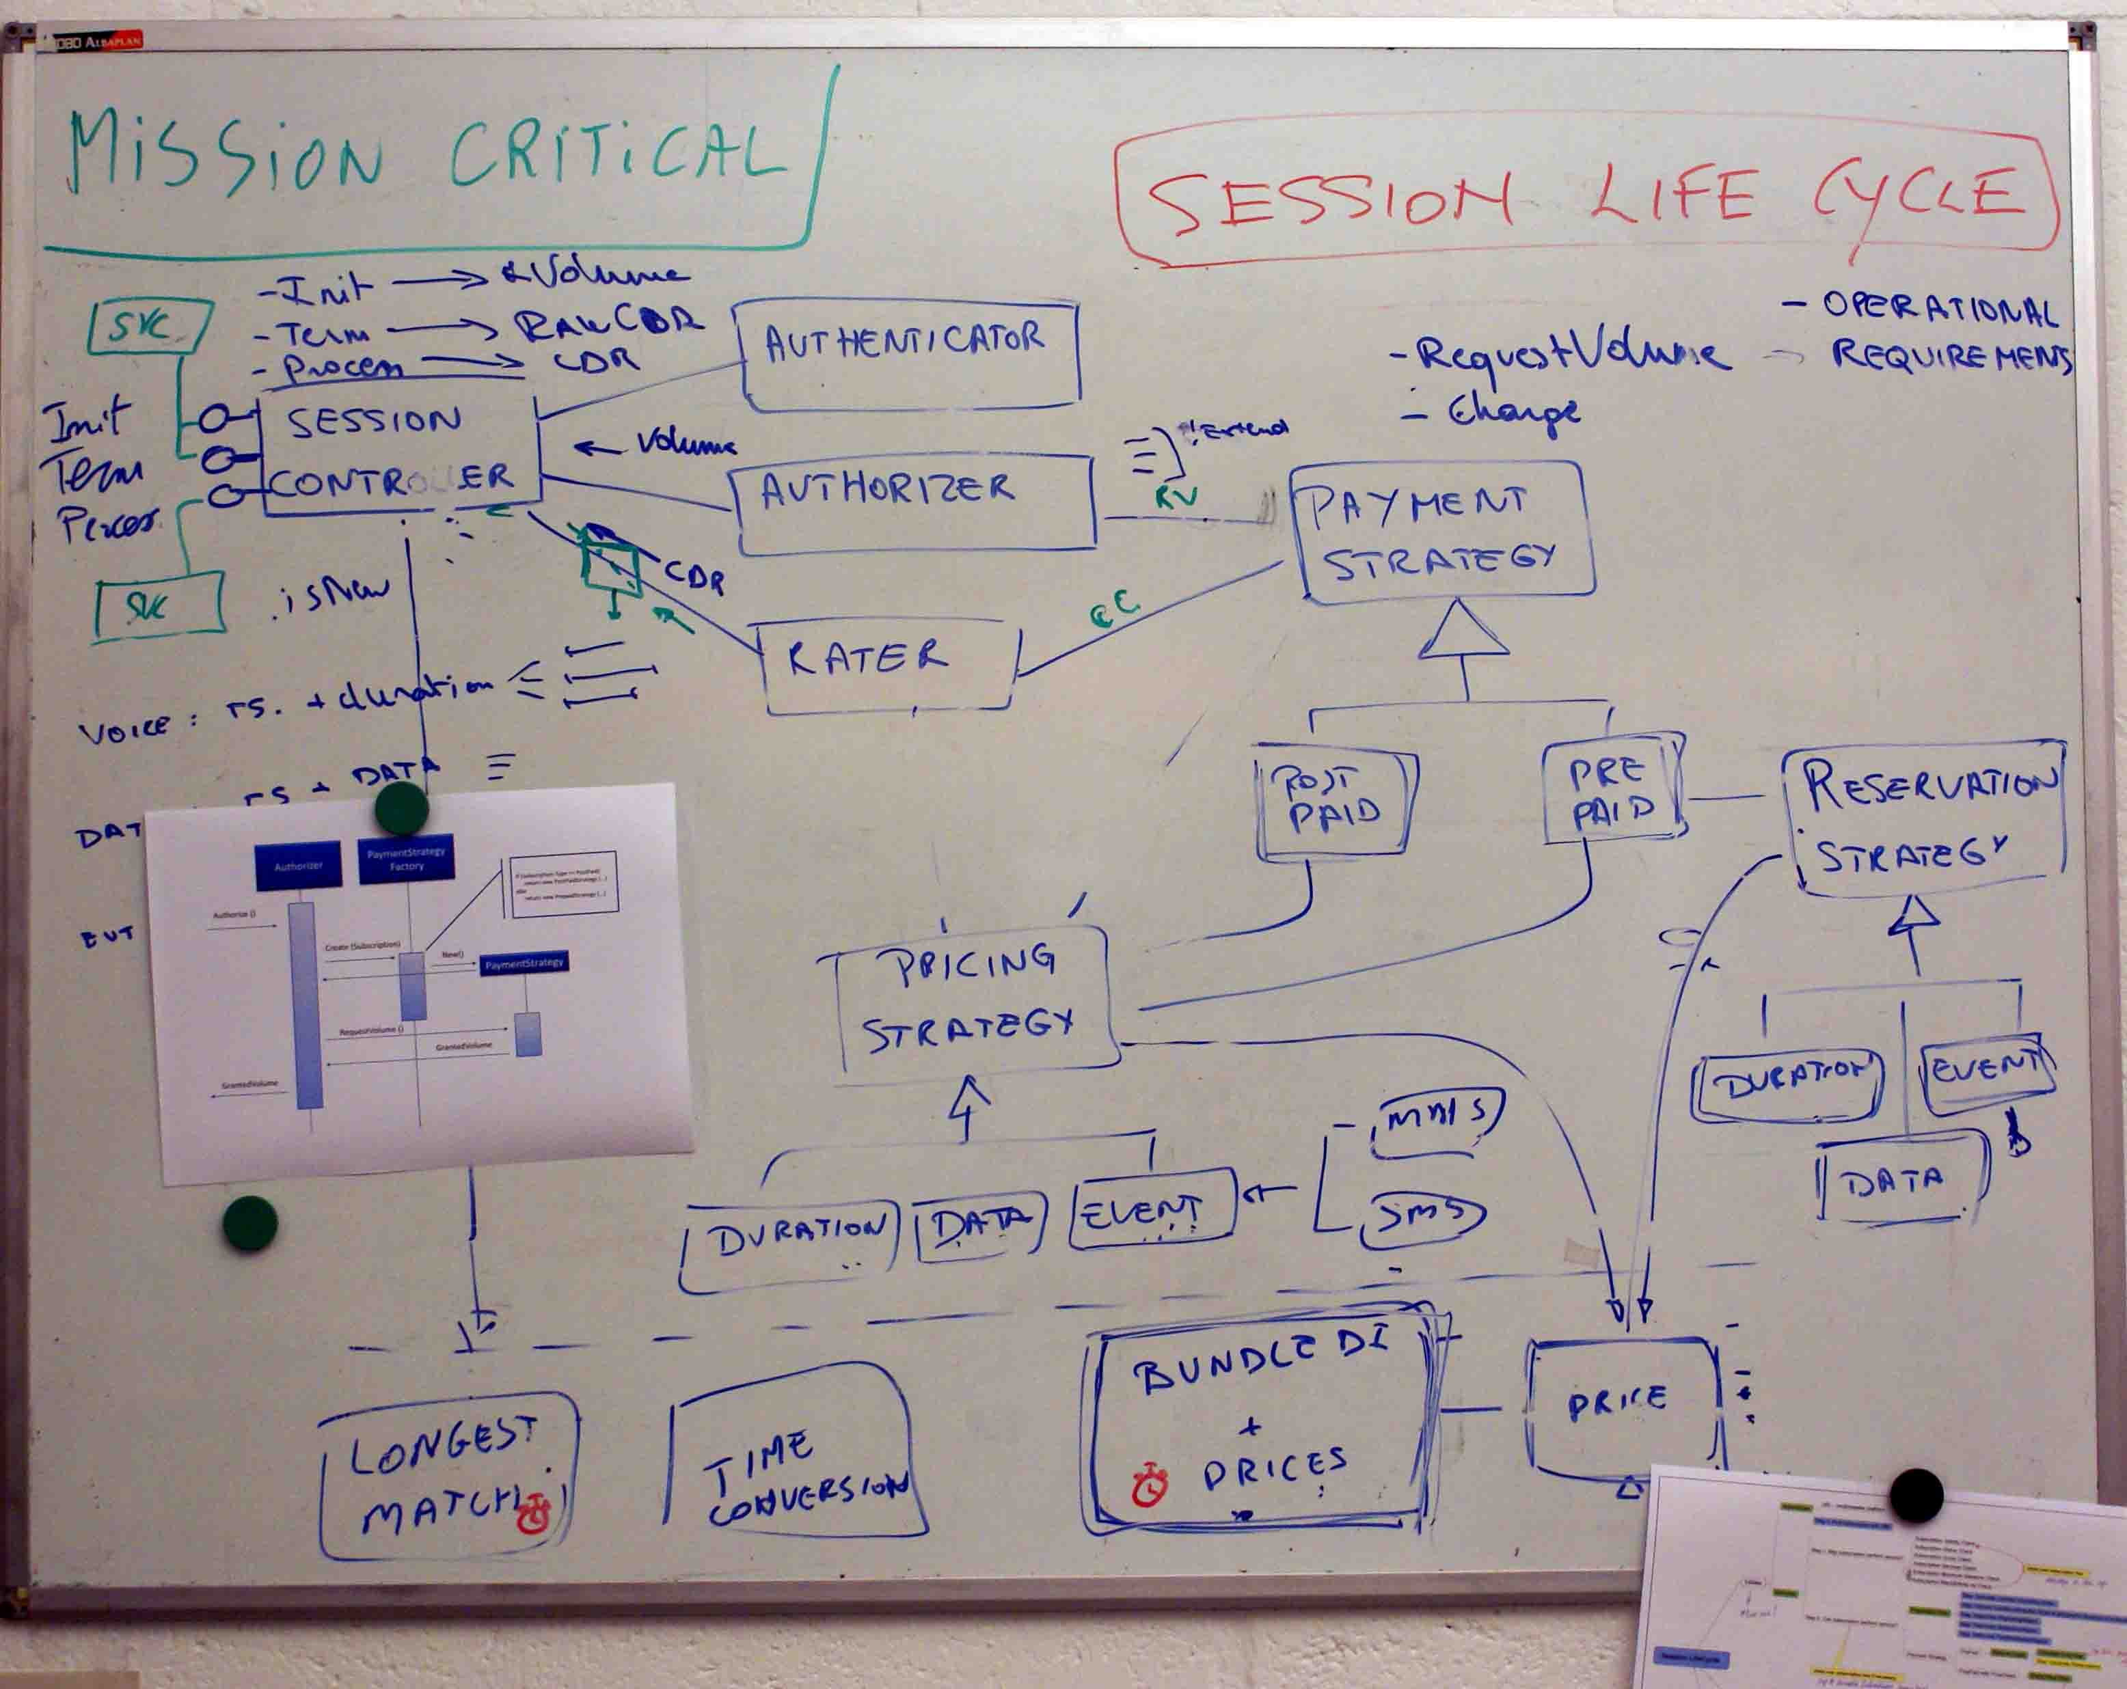
Artilium: Informative Workspace

