Slide 1


Agile in the .NET World

Slide 2
Agile in the .NET World
.NET Development Environment
.NET Development LifeCycle
.NET Coding Tools

Slide 3
Development Environment
IDE
  Visual Studio 2008
Tooling/Add-on
  Resharper 4.0
  NUnit
  Rhino Mocks
  MSBuild
  Enterprise Architect
  …
Libraries
  NHibernate 2.0
  Spring.NET 1.2
  Microsoft Enterprise Library 4.0
Database
  SQL Server 2005
Team Foundation Server
    Portal
    Version Control
    Issue/workitem tracking
    Build management
    Process guidance

Slide 4
Development Environment...
IDE
  Visual Studio Express Editions
  SharpDevelop
Tooling / Add-on
  TestDriven.NET
  Reflector
  ANTS profiler
  dotTrace
  GhostDoc
Version Control
  SubVersion
  TortoiseSVN
Libraries
  Castle Project

Slide 5
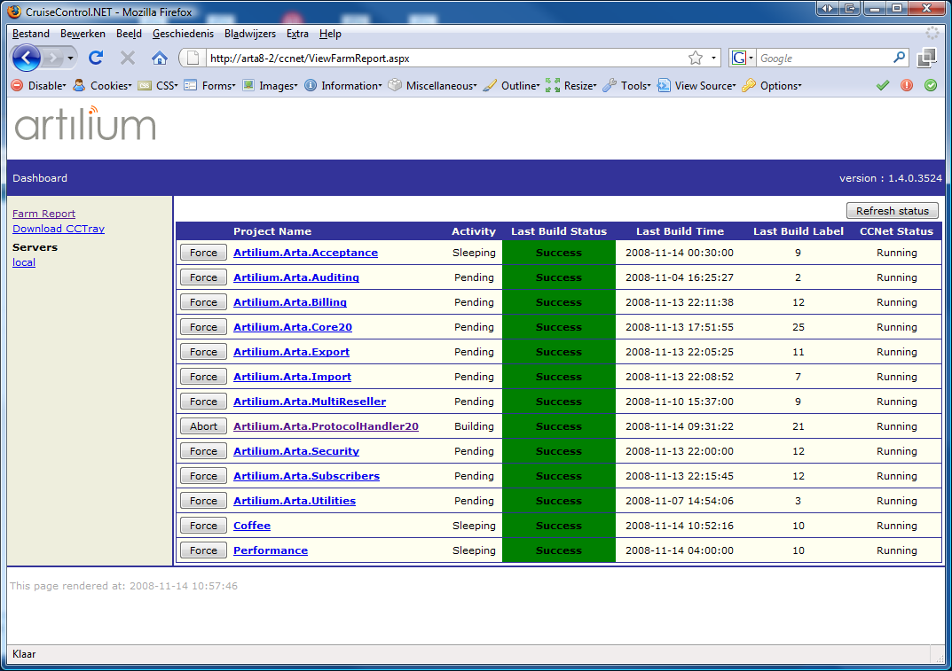
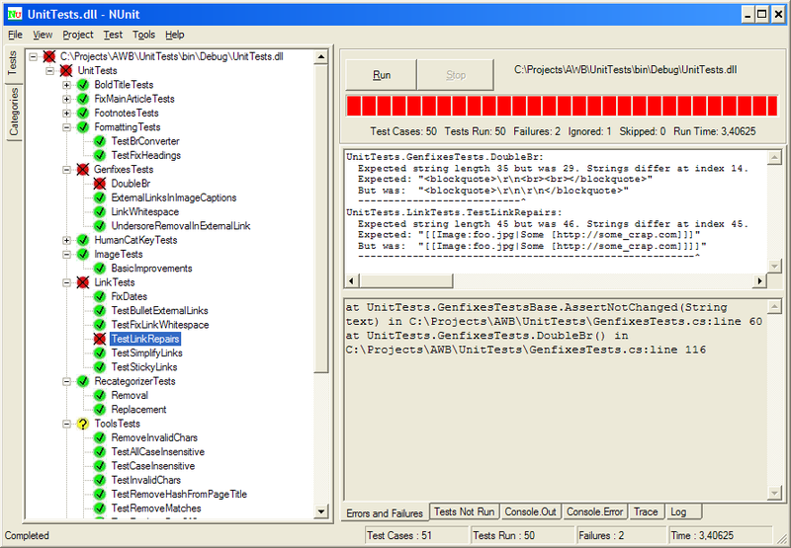
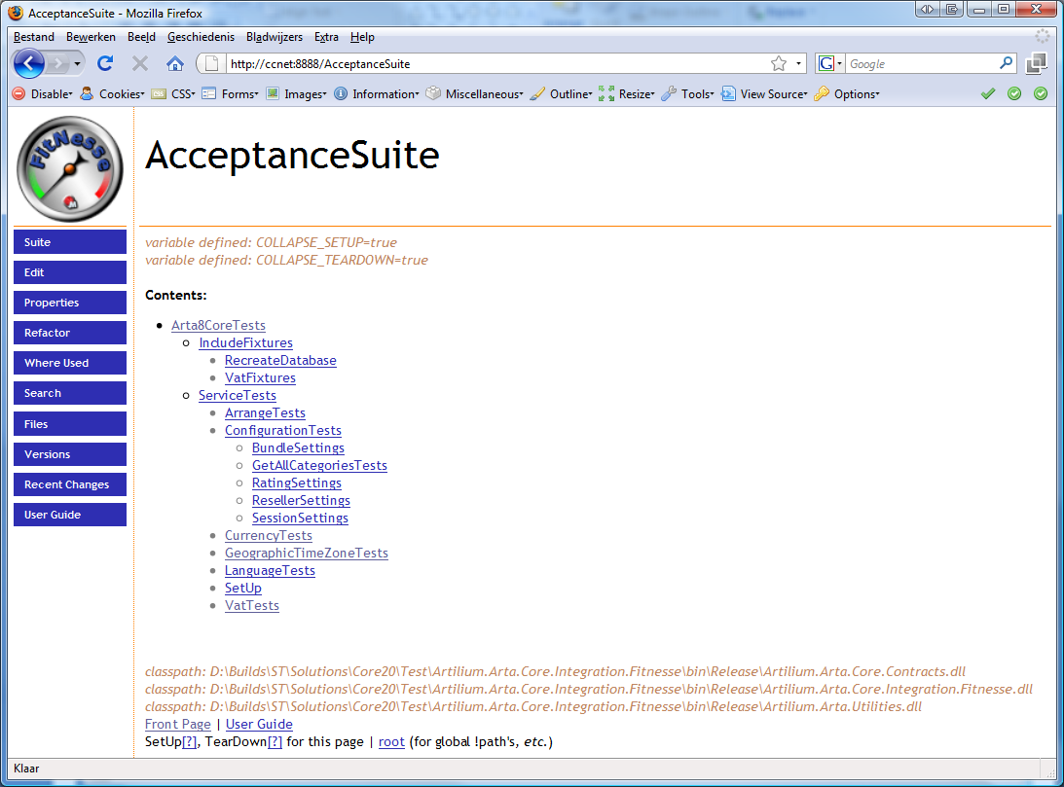
Development Lifecycle
Continuous Integration
  CruiseControl.NET
    CCTray
    Big Visible Cruise
    Screen Saver
  NDepends
  NCover
  NUnit
Testing
  NUnit (resharper integration)
    Unit testing
    Integration testing
Acceptance testing
  SoapUI
  Fitness
Notes:
CruiseControl.NET
Triggered by check-in
Get Latest Version
Compile
Unit testing
Acceptance Testing
Last successful build
Deployment other environments
Load testing

