Slide 1
The Agile Manifesto
Individuals and interaction | over | Processes and tools
Working software | over | Comprehensive documentation
Customer collaboration | over | Contract negotiation
Responding to change | over | Following a plan
Craftmanship | over | Crap
Notes:
Individuals and interactions over processes and tools. Teams of people build software systems, and to do that they need to work together effectively – including but not limited to programmers, testers, project managers, modelers, and your customers. Who do you think would develop a better system: five software developers and with their own tools working together in a single room or five low-skilled “hamburger flippers” with a well-defined process, the most sophisticated tools available, and the best offices money could buy? If the project was reasonably complex my money would be on the software developers, wouldn’t yours? The point is that the most important factors that you need to consider are the people and how they work together because if you don’t get that right the best tools and processes won’t be of any use. Tools and processes are important, don’t get me wrong, it’s just that they’re not as important as working together effectively. Remember the old adage, a fool with a tool is still a fool. As Fred Brooks points out in The Mythical Man Month, this can be difficult for management to accept because they often want to believe that people and time, or men and months, are interchangeable.
Working software over comprehensive documentation. When you ask a user whether they would want a fifty page document describing what you intend to build or the actual software itself, what do you think they’ll pick? My guess is that 99 times out of 100 they’ll choose working software. If that is the case, doesn’t it make more sense to work in such a manner that you produce software quickly and often, giving your users what they prefer? Furthermore, I suspect that users will have a significantly easier time understanding any software that you produce than complex technical diagrams describing its internal workings or describing an abstraction of its usage, don’t you? Documentation has its place, written properly it is a valuable guide for people’s understanding of how and why a system is built and how to work with the system. However, never forget that the primary goal of software development is to create software, not documents – otherwise it would be called documentation development wouldn’t it?
Customer collaboration over contract negotiation. Only your customer can tell you what they want. Yes, they likely do not have the skills to exactly specify the system. Yes, they likely won’t get it right the first. Yes, they’ll likely change their minds. Working together with your customers is hard, but that’s the reality of the job. Having a contract with your customers is important, having an understanding of everyone’s rights and responsibilities may form the foundation of that contract, but a contract isn’t a substitute for communication. Successful developers work closely with their customers, they invest the effort to discover what their customers need, and they educate their customers along the way.
Responding to change over following a plan. People change their priorities for a variety of reasons. As work progresses on your system your project stakeholder’s understanding of the problem domain and of what you are building changes. The business environment changes. Technology changes over time, although not always for the better. Change is a reality of software development, a reality that your software process must reflect. There is nothing wrong with having a project plan, in fact I would be worried about any project that didn’t have one. However, a project plan must be malleable, there must be room to change it as your situation changes otherwise your plan quickly becomes irrelevant.
Craftsmanship over Crap.
From this you can probably tell that my talk was primarily about behaving professionally, and writing clean code. This should not be a big surprise since I just finished writing a book entitled Clean Code .
The problem with my proposal is that it is not a balanced value statement. In the other four statements we value the second item. We just value the first item more. But in my proposed addition, we simply don’t value crap at all.
So I hereby change my original proposal, which was made for dramatic effect, to:
Craftsmanship over Execution
Most software development teams execute, but they don’t take care. We value execution, but we value craftsmanship more.

Slide 2
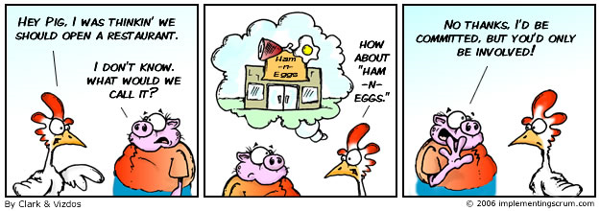
SCRUM
Roles
Chicken and Pigs
Ham and Eggs
A day’s work for a chicken, a lifetime commitment for a pig.

Slide 3

SCRUM Role: Product Owner
representative of all stakeholders
focus = business side of the product
carries the product vision to the team
formalizes the product backlog
prioritizes it by business value

Slide 4

SCRUM Role: Team
does everything to win the game
– to deliver the product.
cross-functional
self-organising
needs to understand the vision
delivers product increments
Notes:
The team is cross-functional. That means the full know-how to realize the product is located in the team.
The team needs to understand the vision and Sprint Goals of the Product Owner in order to deliver potentially shippable product increments.

Slide 5

SCRUM Role: Scrummaster
Coach and facilitator of the team
Improves the productivity
training plan for the team
Retrospectives
Impediment Backlog
controls the scrum process
protects the team
collaborates with product owner
Notes:
The Scrum Master is the coach and facilitator of the team.
He improves the productivity. He always has a training plan for the team – the Impediment Backlog.
The Scrum Master controls the “inspect and adapt” cycles of Scrum. He protects the team and works with the Product Owner to maximize the return on investment.
He takes care that the agile ideals are understood and respected by all stakeholders.

Slide 6
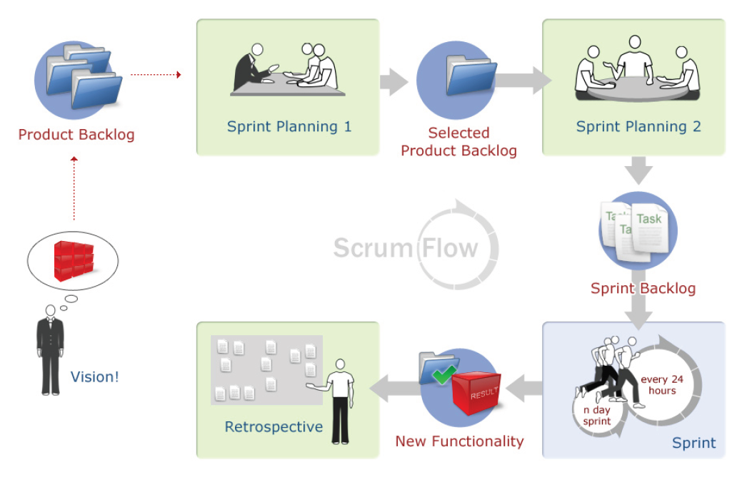
SCRUM: Phases of an iteration

Slide 7
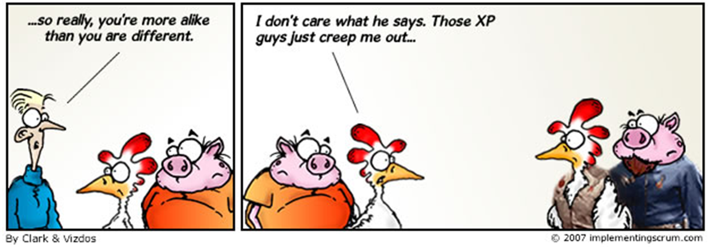
You can’t have an agile company without
agile engineering practices
XP, anyone?

Slide 8
XP: Values
Communication
Simplicity
Feedback
Continuous Integration
Informative Workspace
Courage
Notes:
Embracing Change
One of XP's goals is to make it okay (both culturally and practically) to make changes at any stage in the project. All modern software processes recognize that change is an inevitable part of any project: as an understanding of the customer's requirements improves, new use cases are identified (or old ones removed); or sudden changes in the business environment might change the course of the project. In a well designed, highly modular system, it is possible to take these changes in our stride. By tracing a proposed change from the requirements down through the architecture to the low-level design, we can calculate pretty accurately how much the change will cost. Then the customer can make an informed decision about whether or not to go ahead with the change.
XP takes this a step further, by attempting to make change a good thing: to "embrace change".
The cost of change rising exponentially over time
(Source: Extreme Programming Explained, Kent Beck)
In the software engineering world, it is widely understood that the cost of change increases as any project progresses. In the beginning, few resources have been committed. Later on not only have resources been expended but the interactions of thousands of decisions have increased the complexity of making changes. Nevertheless, XPers claim to have found a way to flatten the Cost of Change curve.
As Kent Beck says in Extreme Programming Explained:
"This is one of the premises of XP. It is the technical premise of XP. If the cost of change rose slowly over time, you would act completely differently from how you do under the assumption that costs rise exponentially."
Kent is right when he says that modern tools are helping to reduce the cost of change. However, the curve is by no means flattened, and it could be argued that it never will be.
In addition, there is a fundamental aspect of Cost of Change that Kent appears to have missed. I have been wracking my brains to try and understand if XP really takes this into account, but I can't see it. The problem is this:
Once you have written something, no matter how cheaply you did it, it cost something to write. If you want to change it for something else, nothing can change the fact that you spent time writing the code that must now be changed (or even scrapped entirely). Even if the change is inexpensive, the cost of writing the first version must still be taken into account. Put another way: you can do a U-turn in system functionality or design, but not in time.
I think the reason why I have been unable to find a specific answer to this paradox, is because all of XP is about answering it. Its four Values are there to try and bring down the cost of making changes. The four Values are in turn supported by twelve Rules (or thirteen, depending where you look).
If the combined Values really work, then the cost of making a thousand changes in direction is offset by the apparent surge in productivity that we get from: Communication, Simplicity, Feedback and Courage.
XP Value: Communication
XP makes a big issue about its core value of Communication. This is wonderful, as communication is definitely a key factor to the success of any project, XP or otherwise.
Unfortunately, XP also makes a big issue about not doing any documentation (or at least very little, or none at all). I think this is partly why XP has such a broad appeal amongst earnest young programmers. After all, documentation really sucks, right? Just like homework always sucked.
XP Value: Simplicity
XP promotes a throwaway approach to source code (i.e. write, toss, rewrite). And so, through countless waves of throwaway code, the design gradually (hopefully) starts to evolve. To counter this time-consuming, high risk approach, we are encouraged to keep everything simple. The theory is that if you are constantly re-evaluating where the project needs to go, then you might lose only a week or two down any particular design blind alley.
From Extreme Programming Explained again:
"XP is making a bet. It is betting that it is better to do a simple thing today and pay a little more tomorrow to change it if it needs it, than to do a more complicated thing today that may never be used anyway."
Better still, don't bet! If you have planned, architected and designed properly, you are much less likely to have to throw any work away.
In fact, the above quote is playing down the amount of rewriting that takes place. To justify this approach, Kent uses the example of a general purpose dialog for displaying text. He explains that a programmer needed to display a message dialog, but decided to make the dialog multi-purpose "in case anyone else would like to use it." Two days were then spent writing the "smart dialog", after which the requirements had changed and it wasn't needed anyway. This is a fine example, and of course it would have been much better to simply write a single dialog to display that one message (probably one line of code). Nobody else had asked for a multi-purpose dialog, after all. This example is used as the basis for Kent's Simplicity Value, i.e. only code what you need.
Of course, you don't need to be doing XP to do that. The main difference is that without XP, you would have a proper design, hence you would know simply by checking the design whether anyone else was going to need the same dialog. It's then possible to make a pretty intelligent decision about whether the time spent coding a "smart dialog" is justified. With XP, you just can't do that because tomorrow's design doesn't exist yet. You're still coding it.
Component re-use is a wonderful thing. Spurious re-usability "just in case" is a waste of time. So if we know that we are going to be programming precisely to a design, coding up the requirements and nothing more, then why do we need XP's Simplicity Value?
To be fair, this Value is a useful one, in the sense that it makes the programmer slam on the brakes before they write something they don't need to. It's common sense to keep everything as simple as possible, i.e. never over-engineer. A common example is to produce a "framework" due to some unknown, hypothetical future requirement. If the requirement isn't there now, don't code for it.
It is, however, possible to take this rule too far. XP uses constant refactoring to "shape" the design as you go along. In other words, you don't just code to the requirements (and nothing but the requirements), you take a much more myopic approach, and code to just the piece of code that you are working on right now.
Later, even during the same project iteration, maybe even the following day, when you need to write something else that must interface with the same piece of code, or re-use it in some other way, you need to rewrite it. The old piece of code is simply thrown away. The day or two that was spent writing it is wasted.
I would suggest the following reworked version of the XP Simplicity Value for non-XP projects:
1. Design only what is in the requirements. Anything extra is unpaid work, and you probably won't receive any thanks from the customer when the project is delayed due to a bonus feature that they didn't even ask for. QA won't be too pleased either. Don't write a framework for the future (unless the requirements ask for it). If it's in the requirements, question it and suggest that it be removed. Chances are that by next year there'll be a Java API that does what your framework-in-waiting does anyway.
2. Program only what is in the design.
3. (For QA) - Test only what is in the requirements. If you see anything extra, reject it and demand its instant removal from the software.
At first glance this is not that different to XP's approach. However, XP takes things a lot further by also applying the YAGNI (You Ain't Gonna Need It) mantra to its design philosophy. This process is described in (among other places) Chapter 26 of Extreme Programming Explored. The result (as described above) is that in XP you end up writing code which you know is going to be rewritten later.
XP Value: Feedback
XP values feedback as a way of determining the current state of the system. For example (from Extreme Programming Explained, regarding scoping of user stories):
"The business people say, "I had no idea that was so expensive. Just do this one third of it. That will do fine for now."
This is a remarkably naive, idealistic approach. The problem with the above example is that business people generally do not react reasonably to comments such as "That's too difficult." They want something specific done by a certain date.
Customer negotiation is a tricky business, and is not limited to XP projects. The difference with XP is that customer negotiation is arranged so that it runs throughout the project, and is fundamental to the way the process works at every stage. Due to the nature of XP's contracts, contract negotiation effectively takes place every time a programmer talks to the on-site customer.
I would suggest that your programmers are probably not the best people to handle the finer points of customer negotiations. On the other hand, programmers are, for the most part, very good at programming.
In XP Explained, Kent also tells us that: "Optimism is an occupational hazard of programming. Feedback is the treatment."
This is surprising given the patently optimistic, idealistic nature of XP.
Feedback also involves "early production", i.e. getting an early iteration of the project into the customer's hands as soon as possible, and then frequently feeding the customer new product updates (every one to three weeks) as development progresses. This provides valuable feedback from customer to programmer.
Apparently most projects have the opposite strategy. In describing "most projects", Kent postulates:
"The thinking seems to go, 'As soon as the system is in production, you can no longer make 'interesting' changes, so keep the system in development as long as possible.' "
What projects are these exactly? I've never encountered a project where the customer (or the production team) wanted it to take as long as possible. Perhaps they're talking about C3...
Of course, early feedback is an essential part of the project mix. Releasing actual production builds once a week is a bit over the top though. You can receive useful feedback from the customer without going through this time-consuming rigmarole of production releases (for more thoughts on this, see my article Fear of Non-Progress).
XP Value: Courage
Everybody could do with a good dose of courage every now and again. Of course, courage as described in XP is not the same as, say, storming an embassy full of armed terrorists. That's an inherently scary thing to do, even in a game of Counterstrike. I would imagine that the real thing would be pant-wettingly scary.
Nevertheless, to perform XP, you need courage.
In all seriousness, I think there is something very right in this particular Value. Kent describes an example project in which an architecture was discovered to be flawed, and fixing one defect caused another one. The team was right to fix the architectural flaw, which took several days of concentrated effort.
Another example of Kent's does make me slightly uneasy, however: he talks about throwing code away. He suggests that if the end of the day is coming and the code is "a little out of control", it should be scrapped.
This is also described by William Wake in Extreme Programming Explored, as "going home clean". He adds:
"Go home at 5PM... Notice that nothing is hanging over your head: everything you've done for the day is integrated or tossed."
At first I couldn't quite put my finger on what it was that made this suggestion seem so wrong. On the surface, it seems like a nice and courageous attitude: if the code is wrong, just "toss it" and start from scratch the next day. One day of wasted coding isn't going to matter, after all (although add it to the 300 other wasted days, and it begins to feel very courageous. Now multiply those 301 days by 8, if you have a team of 8 programmers, and suddenly you realize your XP project is positively overflowing with courage).
Then the actual problem hit me. It's actually a general problem with XP, and its "throwaway" approach to production code. The programmers are encouraged to write with an attitude of "I'll just start coding and see what happens." If they end up writing garbage, it doesn't matter because they can just throw it away, go home clean, and start again tomorrow. Same goes for the design. Let it evolve, and see where it goes. The collective consciousness of the XP team will nudge the so-called design to some place or other. When it's there, if it's wrong then we'll just collectively nudge it somewhere else.
To quote Kent again:
"Maybe you have three design alternatives. So, code a day's worth of each alternative, just to see how they feel. Toss the code and start over on the most promising design."
This approach is also central to XP's concept of an evolving 'design'. So, it is possible (and common) to go down some long term design blind alleys. It's possible because you are required to take a myopic view of what you are creating, and to only code for one piece of functionality at a time. Don't you dare think ahead, boy! As a result, Kent's "three design alternatives" might unknowingly be played out over a much longer term than a few days. They won't be planned for, because each design would have been assumed to be the right one.
Wouldn't it be easier, and kinder to the soul, to just concentrate on getting it right first time? It is possible, and (like XP's rules) is an acquired skill. You just need to be good at what you do, as with any skilled vocation. You need some aptitude and imagination. You don't have to create something to know whether it is going to work or not. Just think ahead, factor in as much as you can without losing sight of your goal.
It can be done. In fact many programmers and designers do this regularly. So, just what is it that XP is trying so hard to fix?

Slide 9
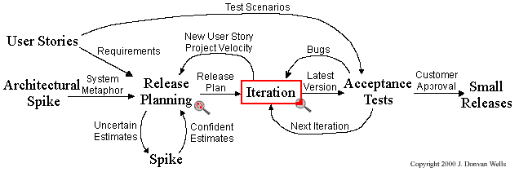
XP: Project

Slide 10
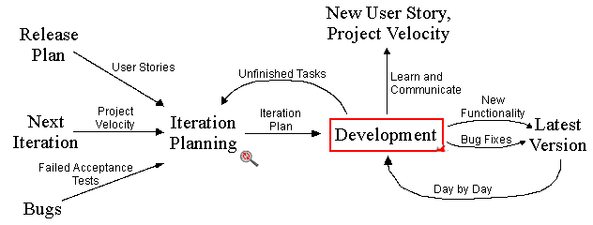
XP: Iteration

Slide 11
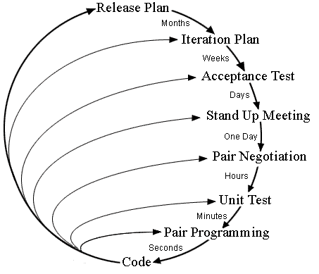
XP: Feedback loops

Slide 12
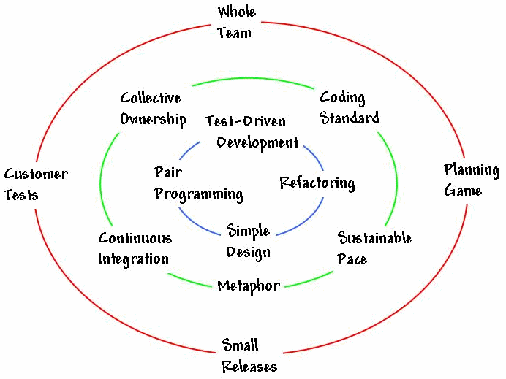
XP: Practices
Notes:
Whole Team
All the contributors to an XP project sit together, members of one team. This team must include a business representative -- the "Customer" -- who provides the requirements, sets the priorities, and steers the project. It's best if the Customer or one of her aides is a real end user who knows the domain and what is needed. The team will of course have programmers. The team may include testers, who help the Customer define the customer acceptance tests. Analysts may serve as helpers to the Customer, helping to define the requirements. There is commonly a coach, who helps the team keep on track, and facilitates the process. There may be a manager, providing resources, handling external communication, coordinating activities. None of these roles is necessarily the exclusive property of just one individual: Everyone on an XP team contributes in any way that they can. The best teams have no specialists, only general contributors with special skills.
Planning Game
XP planning addresses two key questions in software development: predicting what will be accomplished by the due date, and determining what to do next. The emphasis is on steering the project -- which is quite straightforward -- rather than on exact prediction of what will be needed and how long it will take -- which is quite difficult. There are two key planning steps in XP, addressing these two questions:
Release Planning is a practice where the Customer presents the desired features to the programmers, and the programmers estimate their difficulty. With the cost estimates in hand, and with knowledge of the importance of the features, the Customer lays out a plan for the project. Initial release plans are necessarily imprecise: neither the priorities nor the estimates are truly solid, and until the team begins to work, we won't know just how fast they will go. Even the first release plan is accurate enough for decision making, however, and XP teams revise the release plan regularly.
Iteration Planning is the practice whereby the team is given direction every couple of weeks. XP teams build software in two-week "iterations", delivering running useful software at the end of each iteration. During Iteration Planning, the Customer presents the features desired for the next two weeks. The programmers break them down into tasks, and estimate their cost (at a finer level of detail than in Release Planning). Based on the amount of work accomplished in the previous iteration, the team signs up for what will be undertaken in the current iteration.
These planning steps are very simple, yet they provide very good information and excellent steering control in the hands of the Customer. Every couple of weeks, the amount of progress is entirely visible. There is no "ninety percent done" in XP: a feature story was completed, or it was not. This focus on visibility results in a nice little paradox: on the one hand, with so much visibility, the Customer is in a position to cancel the project if progress is not sufficient. On the other hand, progress is so visible, and the ability to decide what will be done next is so complete, that XP projects tend to deliver more of what is needed, with less pressure and stress.
Customer Tests
As part of presenting each desired feature, the XP Customer defines one or more automated acceptance tests to show that the feature is working. The team builds these tests and uses them to prove to themselves, and to the customer, that the feature is implemented correctly. Automation is important because in the press of time, manual tests are skipped. That's like turning off your lights when the night gets darkest.
The best XP teams treat their customer tests the same way they do programmer tests: once the test runs, the team keeps it running correctly thereafter. This means that the system only improves, always notching forward, never backsliding.
Small Releases
XP teams practice small releases in two important ways:
First, the team releases running, tested software, delivering business value chosen by the Customer, every iteration. The Customer can use this software for any purpose, whether evaluation or even release to end users (highly recommended). The most important aspect is that the software is visible, and given to the customer, at the end of every iteration. This keeps everything open and tangible.
Second, XP teams release to their end users frequently as well. XP Web projects release as often as daily, in house projects monthly or more frequently. Even shrink-wrapped products are shipped as often as quarterly.
It may seem impossible to create good versions this often, but XP teams all over are doing it all the time. See Continuous Integration for more on this, and note that these frequent releases are kept reliable by XP's obsession with testing, as described here in Customer Tests and Test-Driven Development.
Simple Design
XP teams build software to a simple design. They start simple, and through programmer testing and design improvement, they keep it that way. An XP team keeps the design exactly suited for the current functionality of the system. There is no wasted motion, and the software is always ready for what's next.
Design in XP is not a one-time thing, or an up-front thing, it is an all-the-time thing. There are design steps in release planning and iteration planning, plus teams engage in quick design sessions and design revisions through refactoring, through the course of the entire project. In an incremental, iterative process like Extreme Programming, good design is essential. That's why there is so much focus on design throughout the course of the entire development.
Pair Programming
All production software in XP is built by two programmers, sitting side by side, at the same machine. This practice ensures that all production code is reviewed by at least one other programmer, and results in better design, better testing, and better code.
It may seem inefficient to have two programmers doing "one programmer's job", but the reverse is true. Research into pair programming shows that pairing produces better code in about the same time as programmers working singly. That's right: two heads really are better than one!
Some programmers object to pair programming without ever trying it. It does take some practice to do well, and you need to do it well for a few weeks to see the results. Ninety percent of programmers who learn pair programming prefer it, so we highly recommend it to all teams.
Pairing, in addition to providing better code and tests, also serves to communicate knowledge throughout the team. As pairs switch, everyone gets the benefits of everyone's specialized knowledge. Programmers learn, their skills improve, they become more valuable to the team and to the company. Pairing, even on its own outside of XP, is a big win for everyone.
Test-Driven Development
Extreme Programming is obsessed with feedback, and in software development, good feedback requires good testing. Top XP teams practice "test-driven development", working in very short cycles of adding a test, then making it work. Almost effortlessly, teams produce code with nearly 100 percent test coverage, which is a great step forward in most shops. (If your programmers are already doing even more sophisticated testing, more power to you. Keep it up, it can only help!)
It isn't enough to write tests: you have to run them. Here, too, Extreme Programming is extreme. These "programmer tests", or "unit tests" are all collected together, and every time any programmer releases any code to the repository (and pairs typically release twice a day or more), every single one of the programmer tests must run correctly. One hundred percent, all the time! This means that programmers get immediate feedback on how they're doing. Additionally, these tests provide invaluable support as the software design is improved.
Design Improvement
Extreme Programming focuses on delivering business value in every iteration. To accomplish this over the course of the whole project, the software must be well-designed. The alternative would be to slow down and ultimately get stuck. So XP uses a process of continuous design improvement called Refactoring, from the title of Martin Fowler's book, "Refactoring: Improving the Design of Existing Code".
The refactoring process focuses on removal of duplication (a sure sign of poor design), and on increasing the "cohesion" of the code, while lowering the "coupling". High cohesion and low coupling have been recognized as the hallmarks of well-designed code for at least thirty years. The result is that XP teams start with a good, simple design, and always have a good, simple design for the software. This lets them sustain their development speed, and in fact generally increase speed as the project goes forward.
Refactoring is, of course, strongly supported by comprehensive testing to be sure that as the design evolves, nothing is broken. Thus the customer tests and programmer tests are a critical enabling factor. The XP practices support each other: they are stronger together than separately.
Continuous Integration
Extreme Programming teams keep the system fully integrated at all times. We say that daily builds are for wimps: XP teams build multiple times per day. (One XP team of forty people builds at least eight or ten times per day!)
The benefit of this practice can be seen by thinking back on projects you may have heard about (or even been a part of) where the build process was weekly or less frequently, and usually led to "integration hell", where everything broke and no one knew why.
Infrequent integration leads to serious problems on a software project. First of all, although integration is critical to shipping good working code, the team is not practiced at it, and often it is delegated to people who are not familiar with the whole system. Second, infrequently integrated code is often -- I would say usually -- buggy code. Problems creep in at integration time that are not detected by any of the testing that takes place on an unintegrated system. Third, weak integration process leads to long code freezes. Code freezes mean that you have long time periods when the programmers could be working on important shippable features, but that those features must be held back. This weakens your position in the market, or with your end users.
Collective Code Ownership
On an Extreme Programming project, any pair of programmers can improve any code at any time. This means that all code gets the benefit of many people's attention, which increases code quality and reduces defects. There is another important benefit as well: when code is owned by individuals, required features are often put in the wrong place, as one programmer discovers that he needs a feature somewhere in code that he does not own. The owner is too busy to do it, so the programmer puts the feature in his own code, where it does not belong. This leads to ugly, hard-to-maintain code, full of duplication and with low (bad) cohesion.
Collective ownership could be a problem if people worked blindly on code they did not understand. XP avoids these problems through two key techniques: the programmer tests catch mistakes, and pair programming means that the best way to work on unfamiliar code is to pair with the expert. In addition to ensuring good modifications when needed, this practice spreads knowledge throughout the team.
Coding Standard
XP teams follow a common coding standard, so that all the code in the system looks as if it was written by a single -- very competent -- individual. The specifics of the standard are not important: what is important is that all the code looks familiar, in support of collective ownership.
Metaphor
Extreme Programming teams develop a common vision of how the program works, which we call the "metaphor". At its best, the metaphor is a simple evocative description of how the program works, such as "this program works like a hive of bees, going out for pollen and bringing it back to the hive" as a description for an agent-based information retrieval system.
Sometimes a sufficiently poetic metaphor does not arise. In any case, with or without vivid imagery, XP teams use a common system of names to be sure that everyone understands how the system works and where to look to find the functionality you're looking for, or to find the right place to put the functionality you're about to add.
Sustainable Pace
Extreme Programming teams are in it for the long term. They work hard, and at a pace that can be sustained indefinitely. This means that they work overtime when it is effective, and that they normally work in such a way as to maximize productivity week in and week out. It's pretty well understood these days that death march projects are neither productive nor produce quality software. XP teams are in it to win, not to die.
Conclusion
Extreme Programming is a discipline of software development based on values of simplicity, communication, feedback, and courage. It works by bringing the whole team together in the presence of simple practices, with enough feedback to enable the team to see where they are and to tune the practices to their unique situation.

