Slide 1
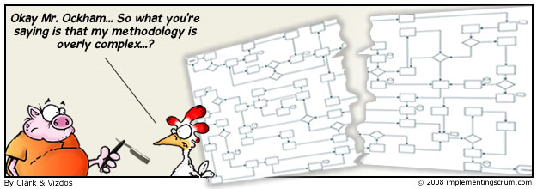
Agile.net
Applied on the Artilium project

Slide 2
The Agile Manifesto
Individuals and interaction | over | Processes and tools
Working software | over | Comprehensive documentation
Customer collaboration | over | Contract negotiation
Responding to change | over | Following a plan
Craftmanship | over | Crap

Slide 3
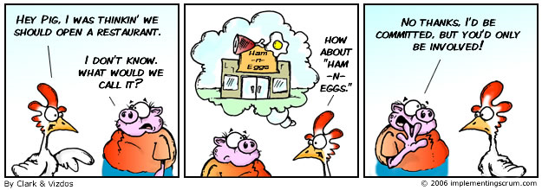
SCRUM
Roles
Chicken and Pigs
Ham and Eggs
A day’s work for a chicken, a lifetime commitment for a pig.

Slide 4
SCRUM: Roles
Chicken
Users
Stakeholders
Managers
Pigs
Scrum master
Product owner
Team

Slide 5
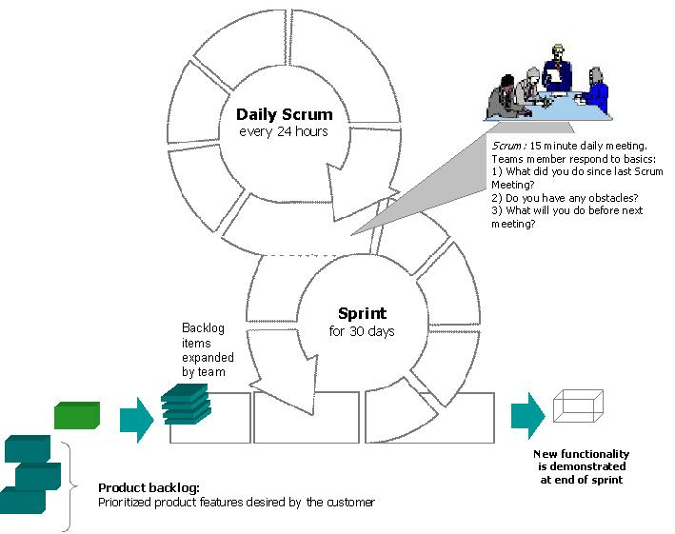
SCRUM: Phases of an iteration

Slide 6
XP: Values
Communication
Simplicity
Feedback
Continuous Integration
Informative Workspace
Courage
Respect
Sustainable Pace

Slide 7
XP: Activities
Designing
Spiking
TDD
Incremental design
Coding
Pair programming
Refactoring
Collective code ownership

Slide 8

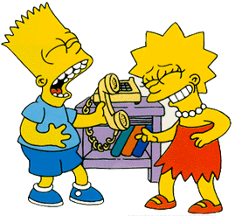

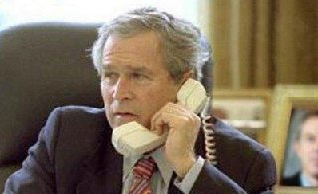
Applying agile.net to

Slide 9
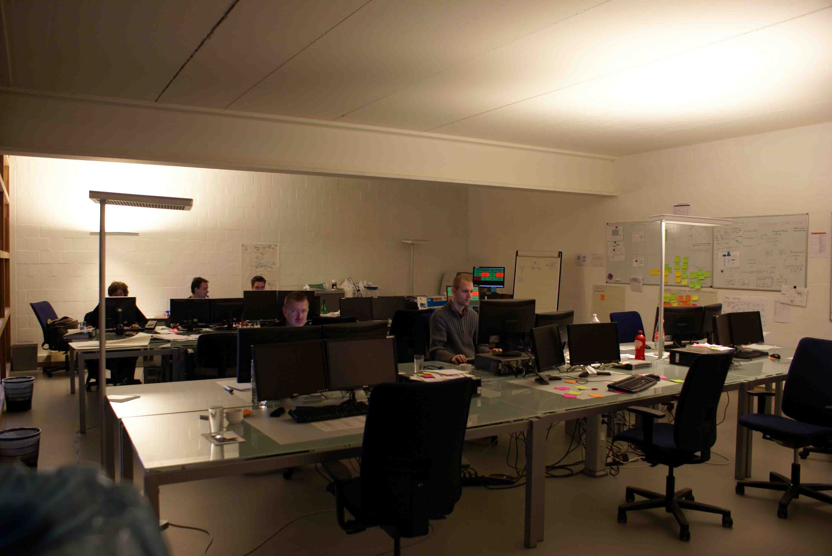
Artilium: Team Room

Slide 10
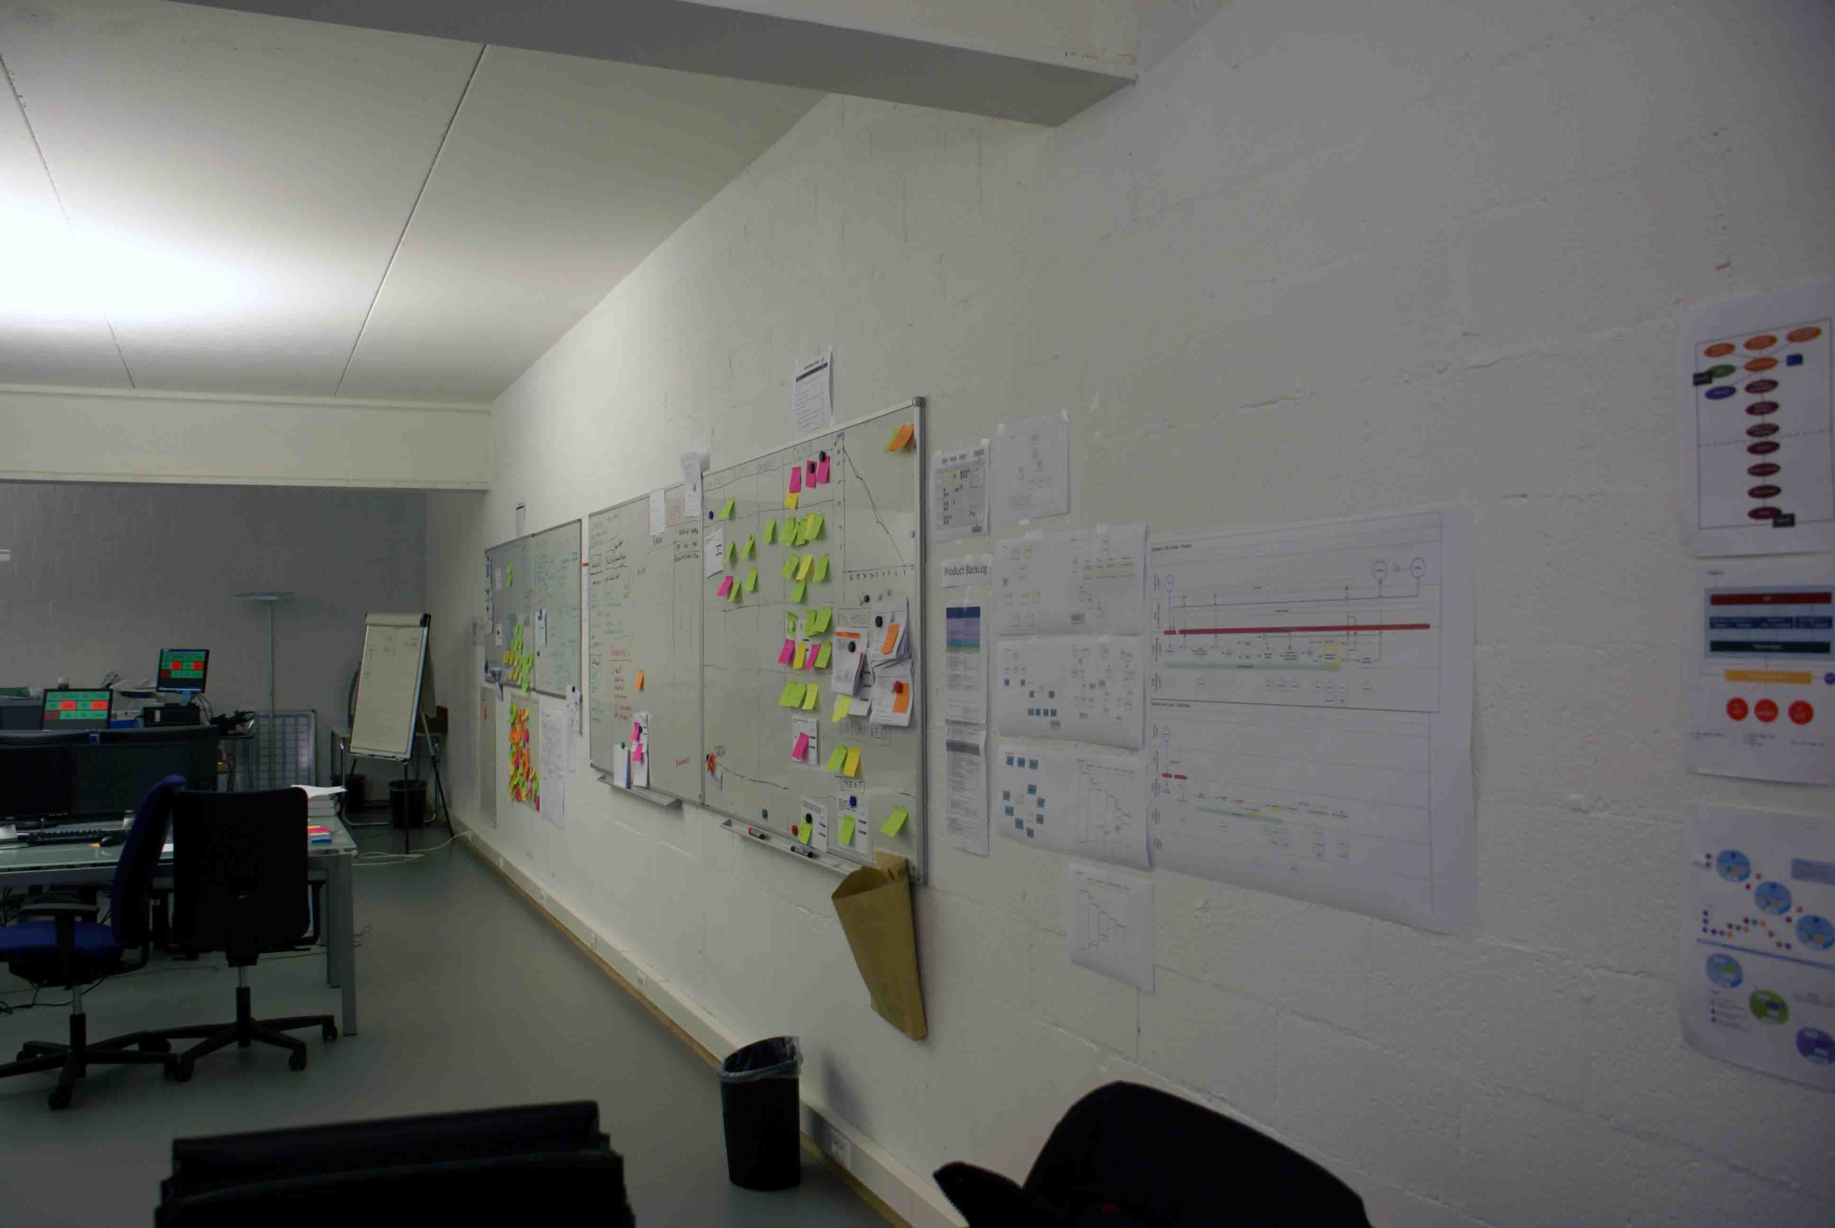
Artilium: Team Room

Slide 11
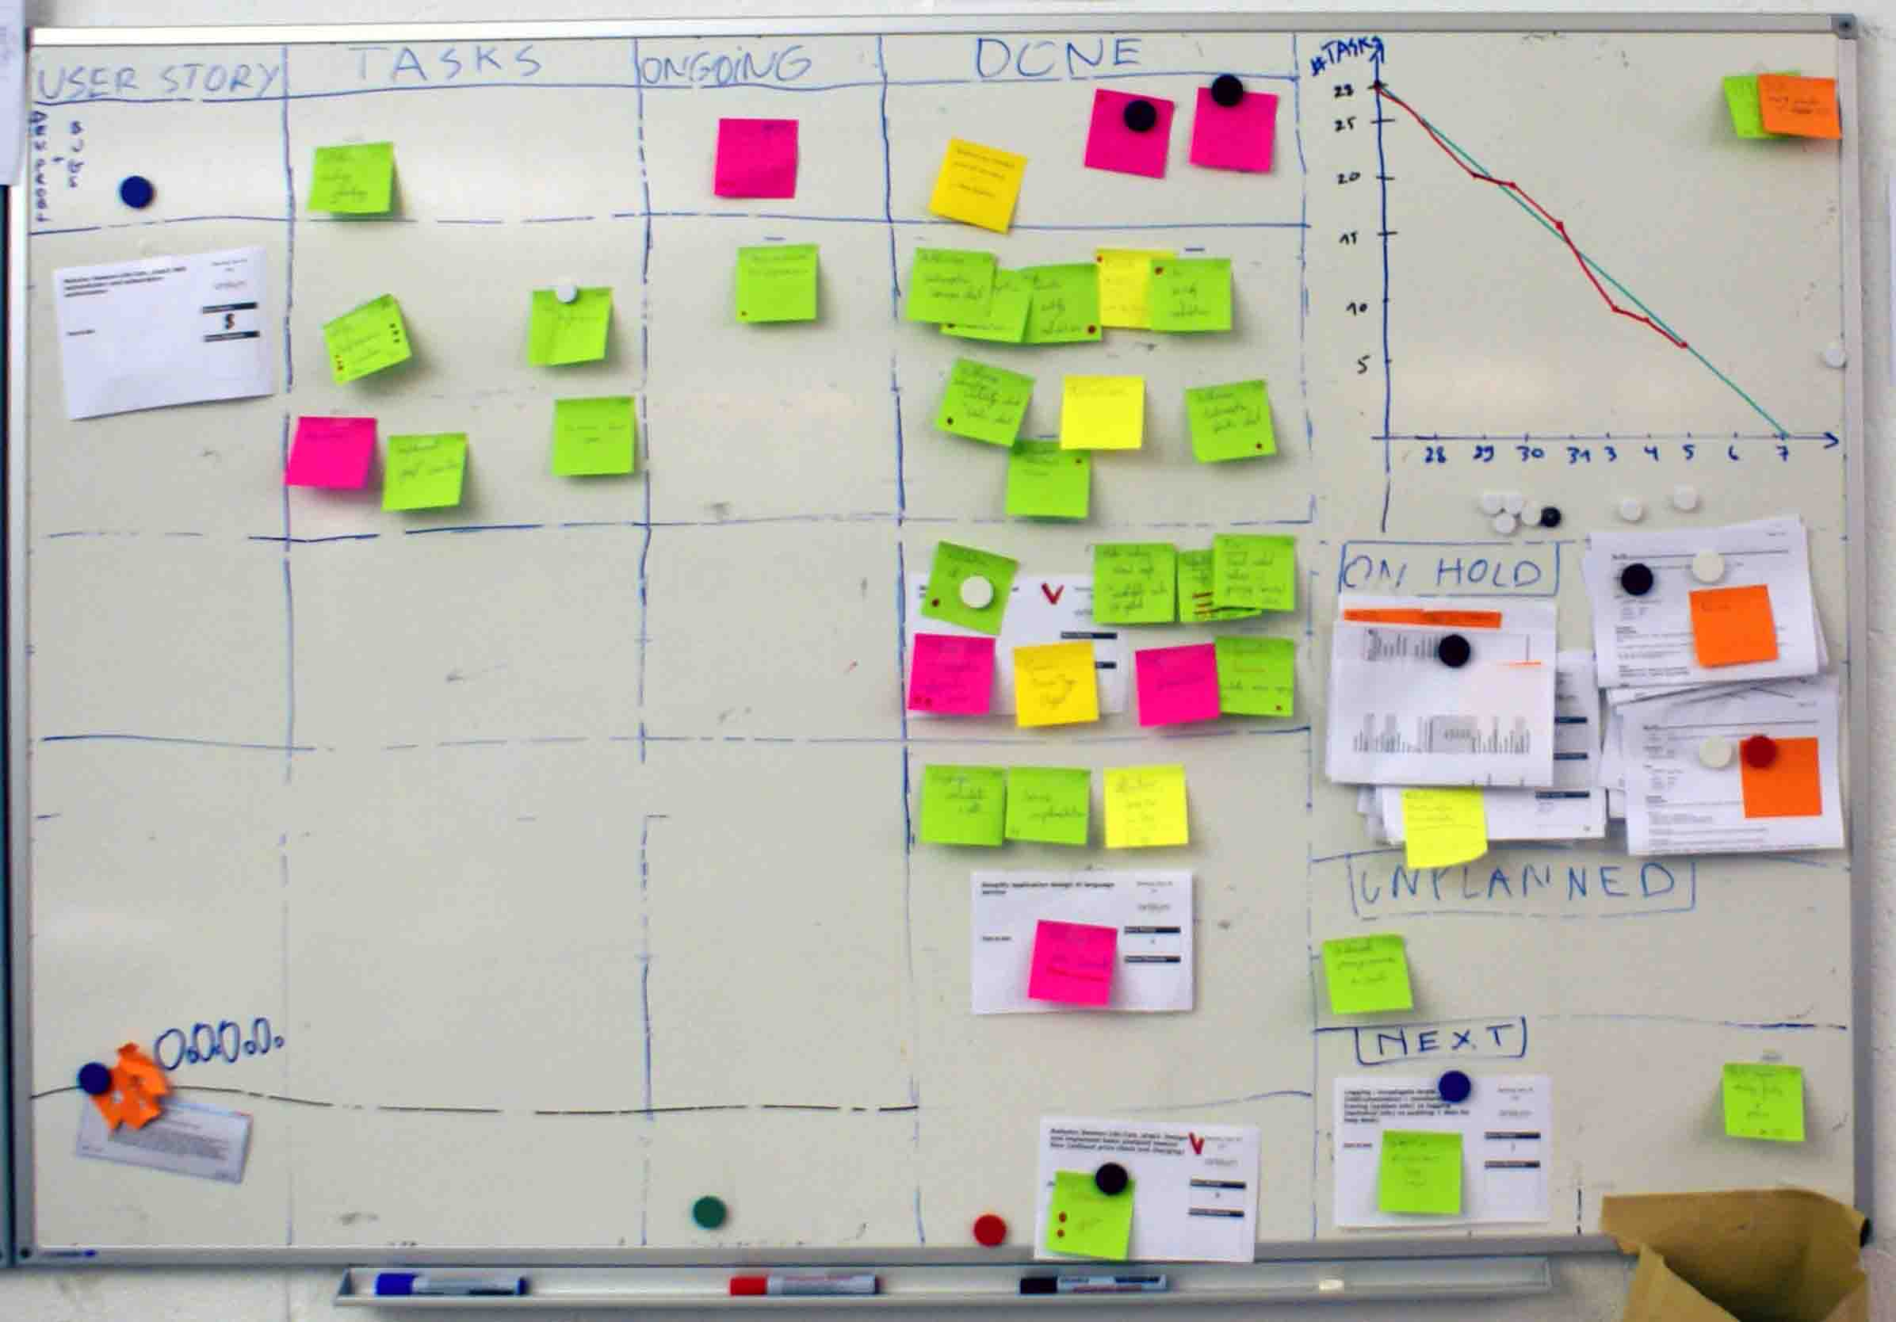
Artilium: Story Board

Slide 12
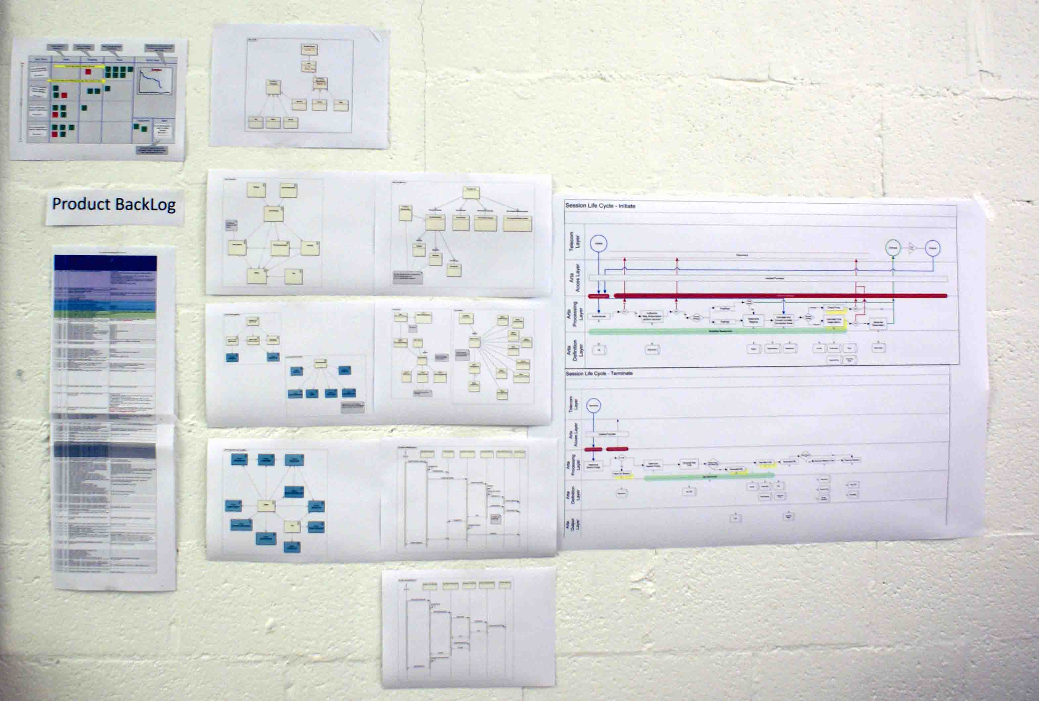
Artilium: Informative Workspace

Slide 13
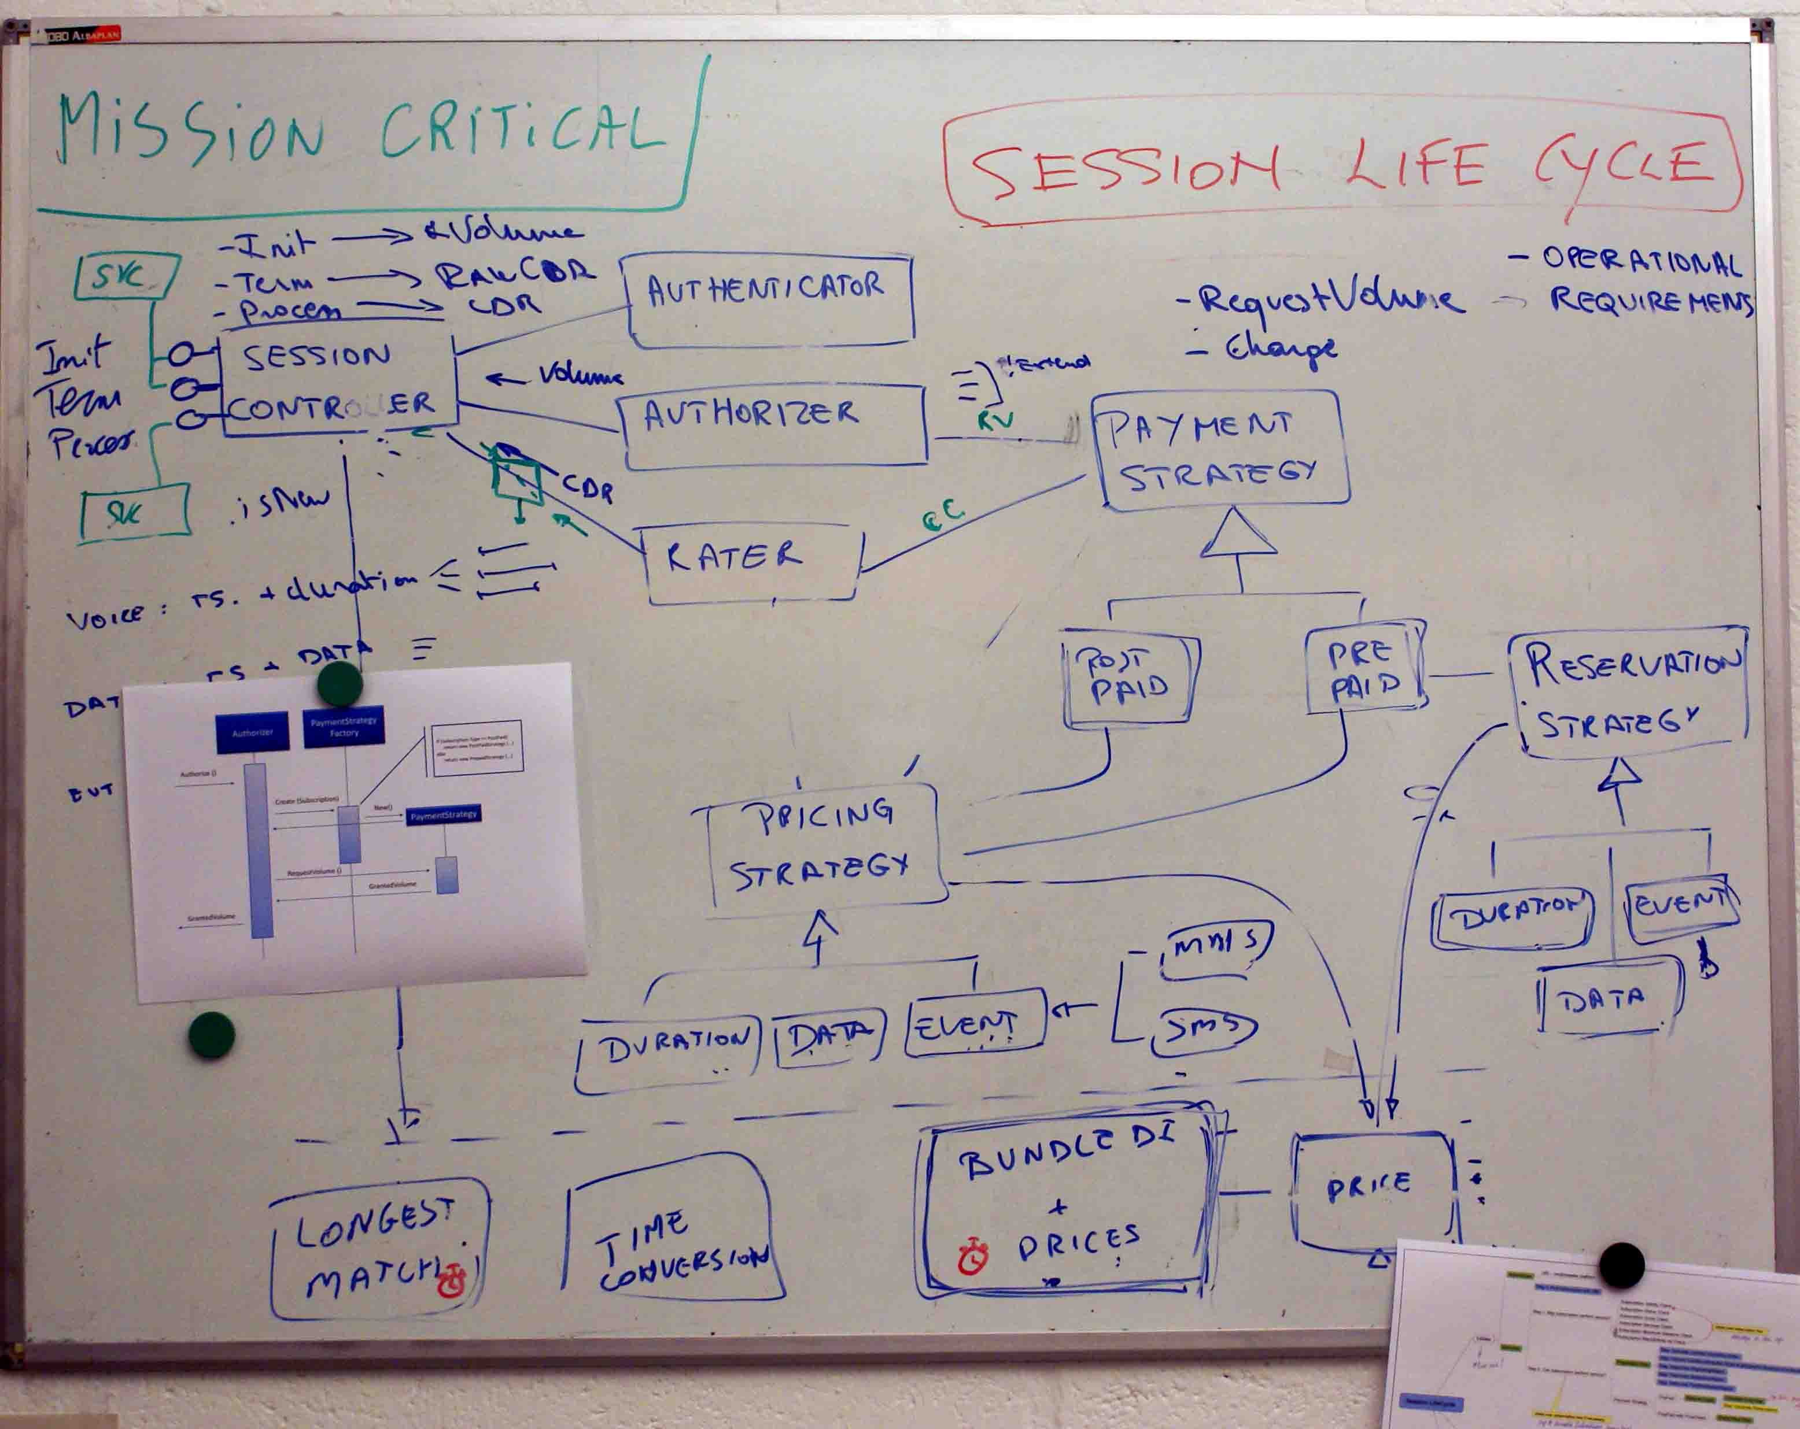
Artilium: Informative Workspace

Slide 14
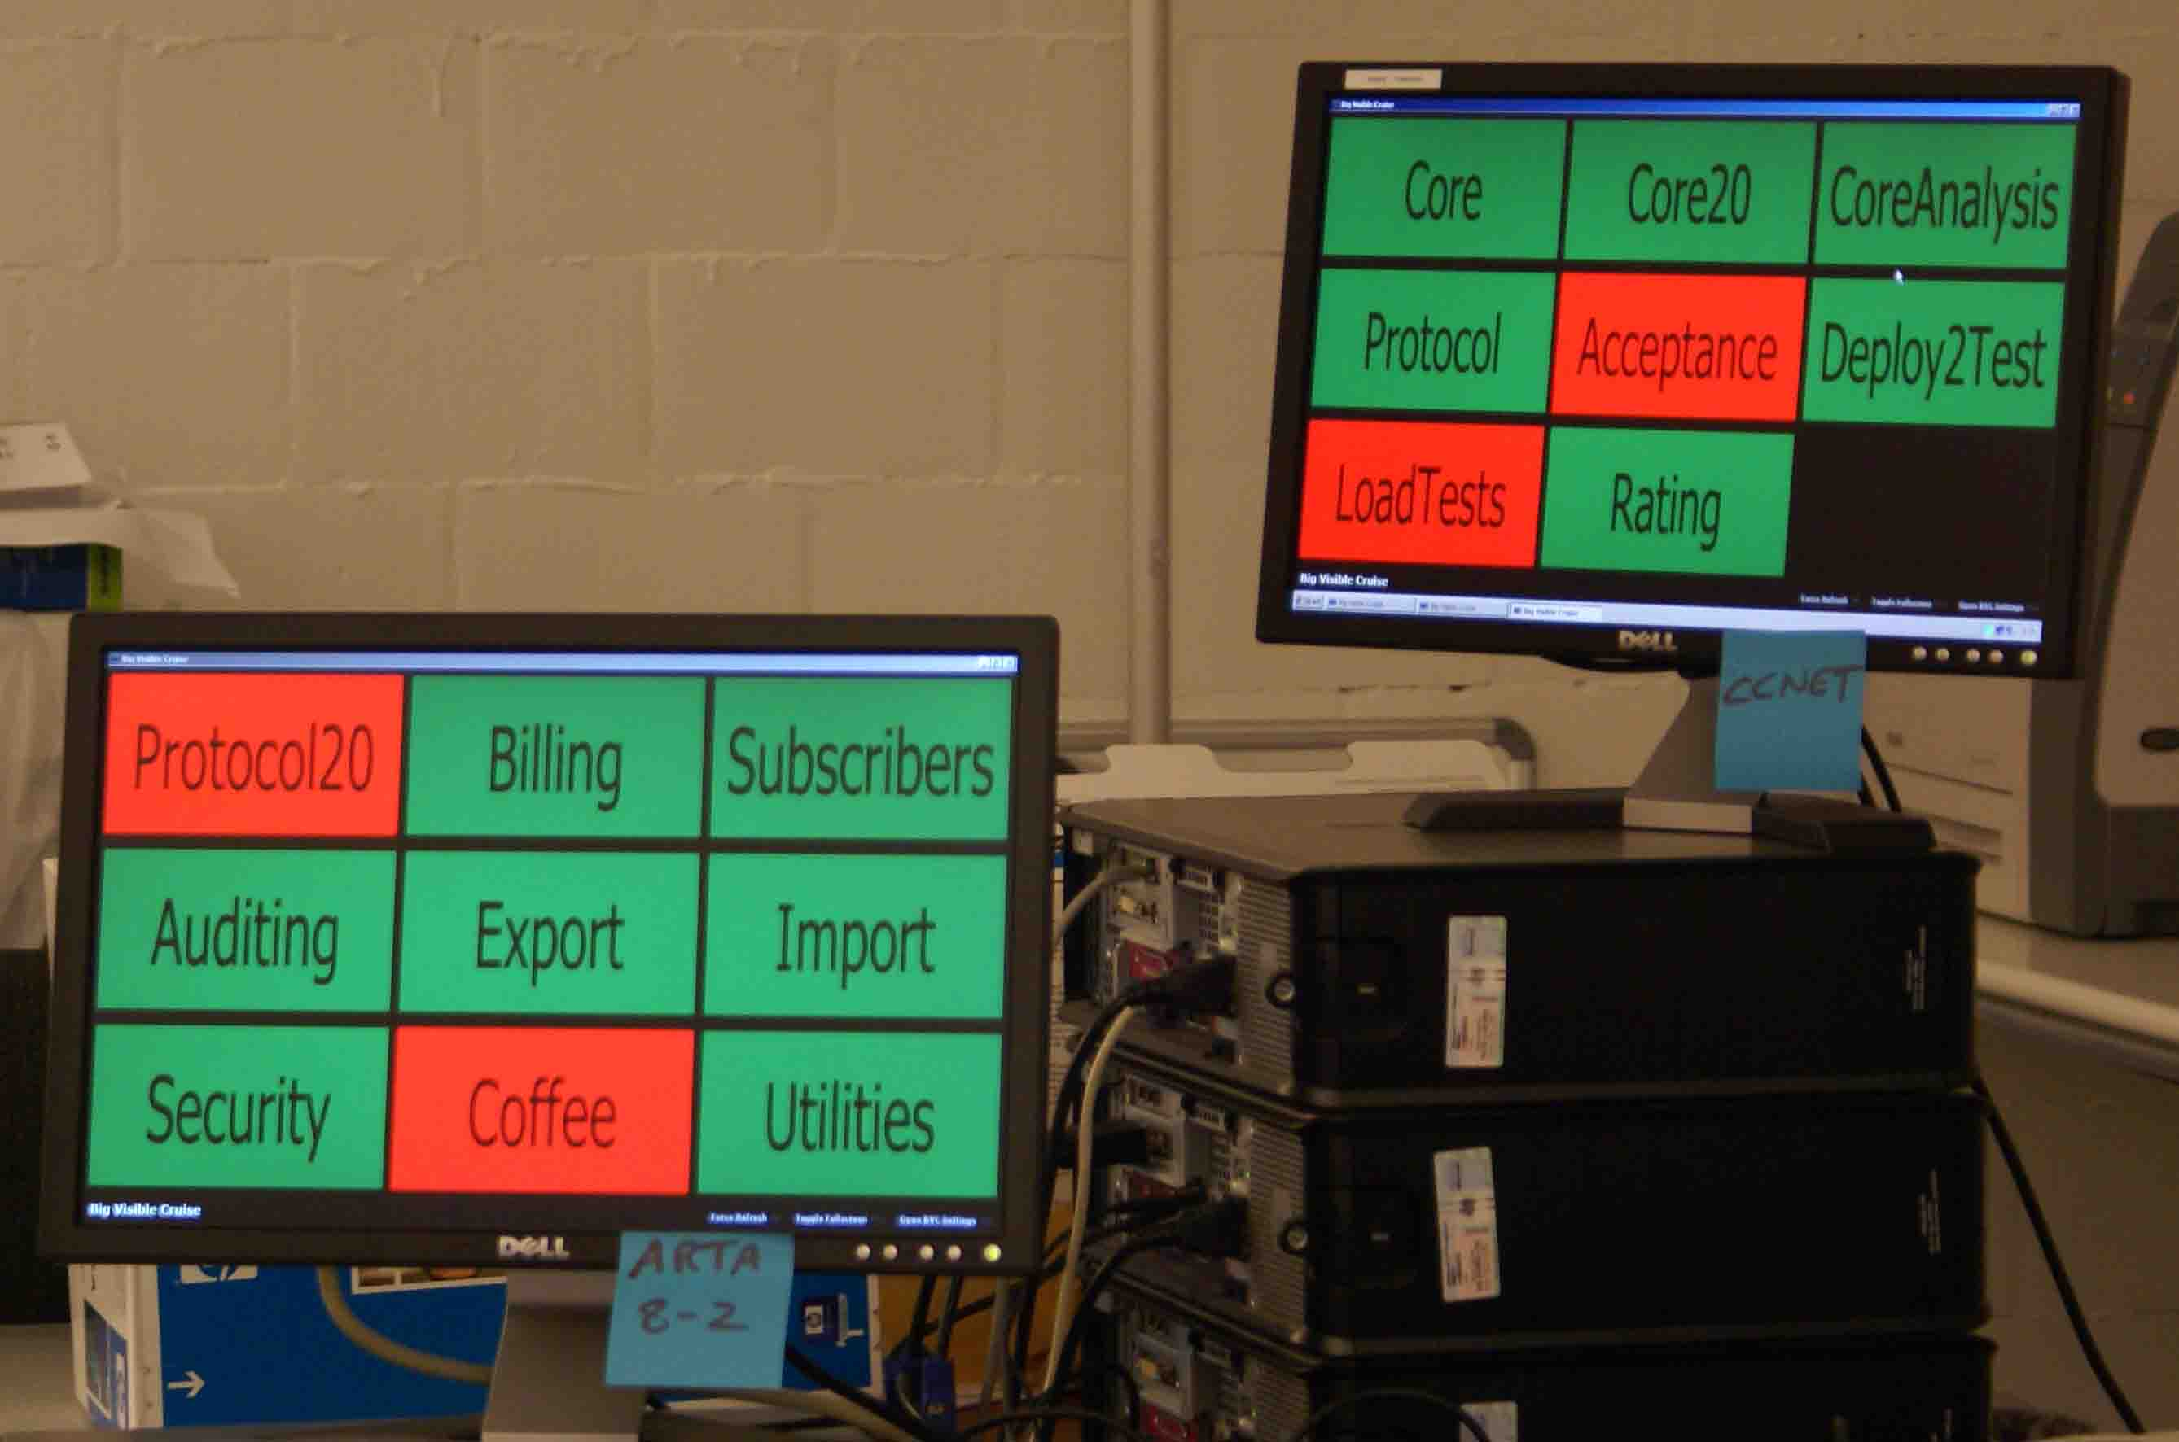
Artilium: Informative Workspace

Slide 15
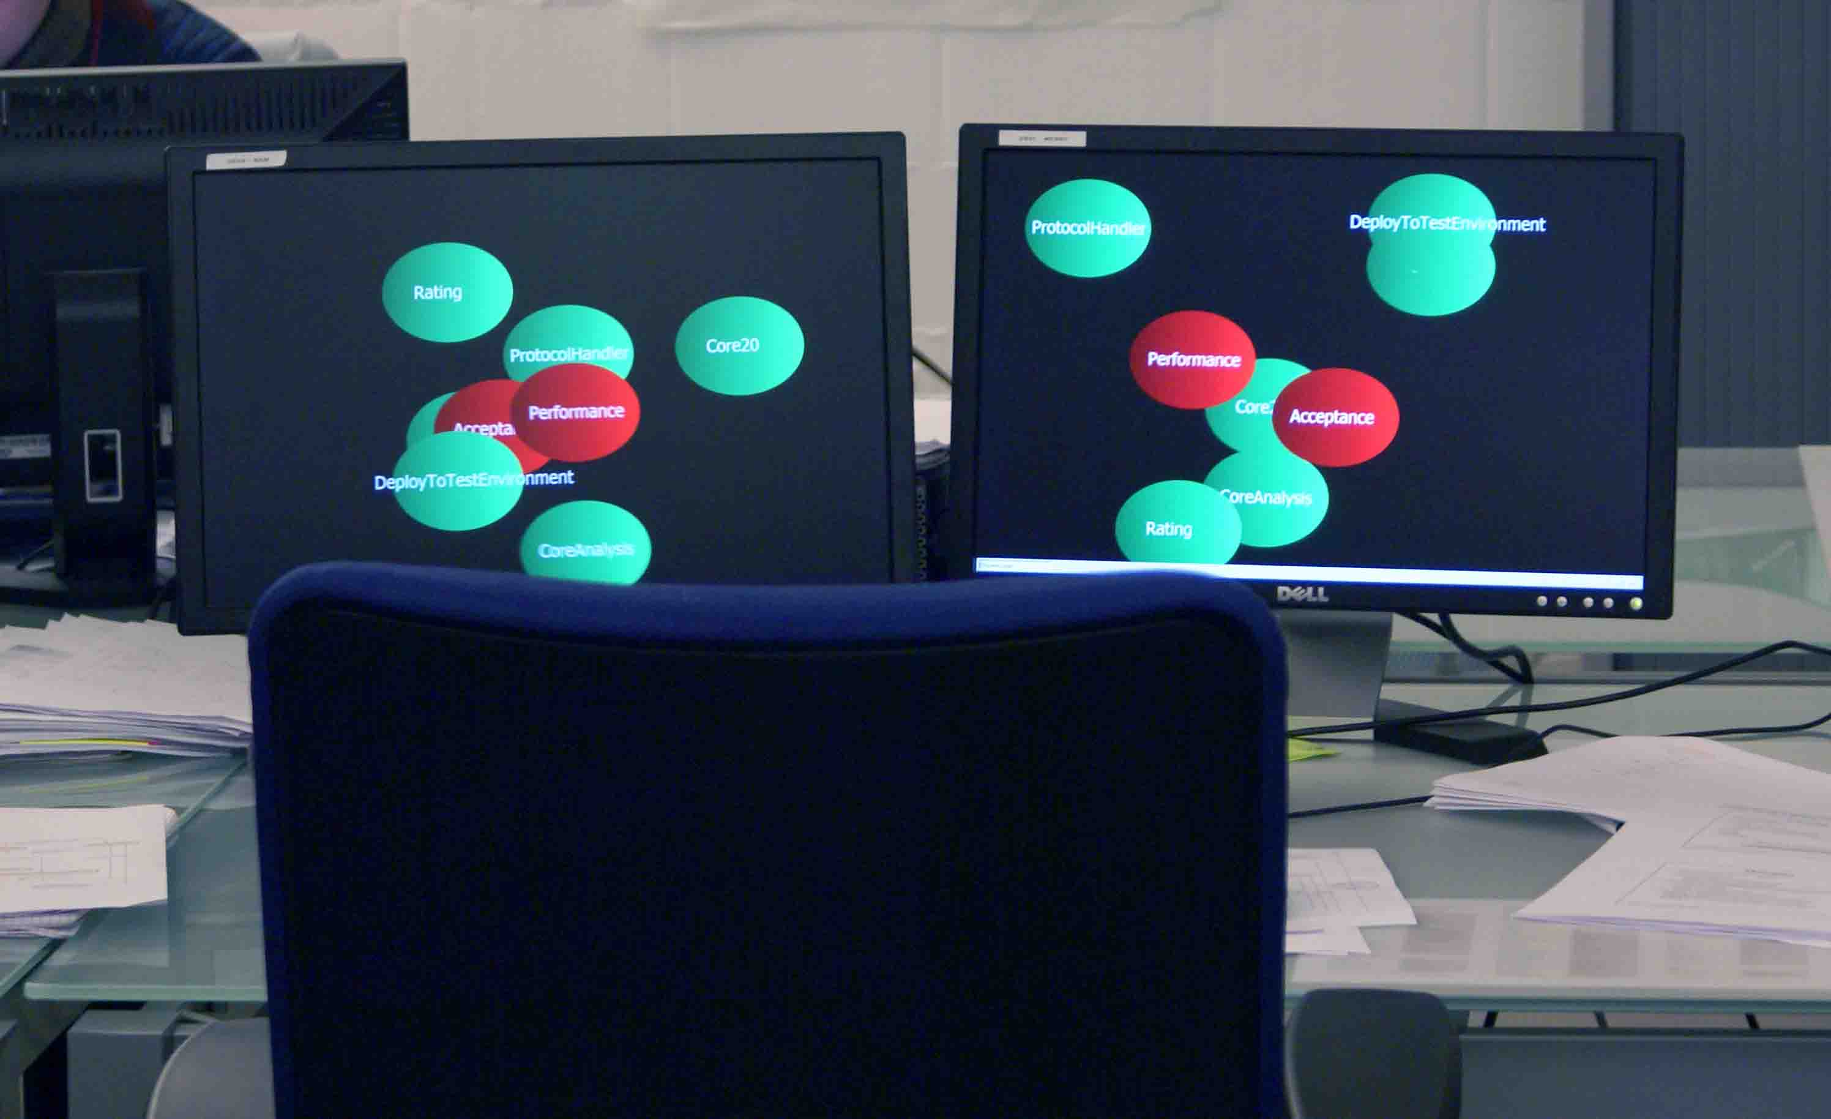
Artilium: Informative Workspace

Slide 16
Artilium: Continuous Improvement
From no build to full build
From BDUF to incremental design
Adding tasks to the scrum board
4 week sprints to 2 week sprints
...
Retrospectives rules

Slide 17
Artilium: People
Mixed team
How new members are introduced
How coaches became team members

Slide 18
.net: Development Environment

Slide 19
.net: Development Lifecycle

Slide 20
.net: CodeingTools

