Slide 1
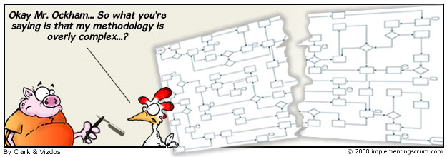
Agile.net
Experiences of the Artilium project

Slide 2
Agile.net
Agile principles
Agile applied to the Artilium project
Agile in the .Net world

