Slide 1

Agile in the .NET World

Slide 2

Agile in the .NET World
Communication
Microsoft Sharepoint Services (TFS)
Test Driven Development
Design for extendibility
Design for testability
Continuous Integration
Build Server
Auto Testing
Acceptance Testing
Automated

Slide 3





Test Driven Development
IDE
Visual Studio 2008 & C# 3.0
Productivity enhancement
Resharper 4.1
Unit testing
NUnit 2.4
Rhino Mocks 3.5 (C# 3.0)
Frameworks
NHibernate 1.2 (2.0)
Spring.NET 1.2

Slide 4

Test Driven Development
Demo
TTD – AAA Style
Resharper
Rhino Mocks

Slide 5
.NET Development Tooling
IDE
Visual Studio 2005
Visual Studio Express
Productivity
GhostDoc
Mocking
Rhino Mocks 3.4 (C# 2.0)
Moq
Dependency Injection
Windsor (castle project)
Ninject
StructureMap
Analysis
Reflector
NDepends
NCover
Version Control
SubVersion
TortoiseSVN
General
MS Enterprise Library 4.0
Log4Net
Quartz.NET
Notes:
NMock 2.0 – from Jmock, currently outdated

Slide 6

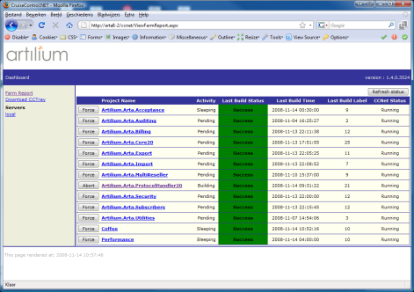
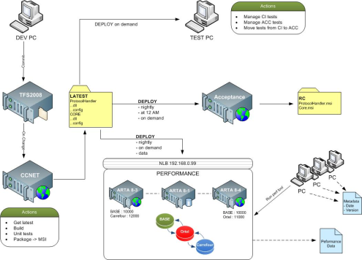
Continuous Integration
Build
Triggered by check-in
Get Latest Version
Compile
Create Database
Testing
Unit testing
Acceptance Testing
Load/performance testing
Reporting/Notification
WebUI
CCTray, Big Visual Cruise,

Slide 7
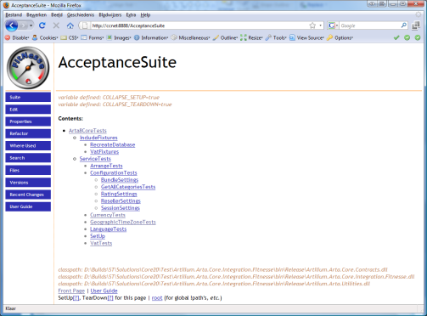
Acceptance Testing
Fully Automated
Driven by CruiseControl.NET
Tooling
SoapUI
Fitness Framework for Integrated Testing
Notes:
FIT:
Acceptance tests by customers
Automation
Readability and Test Cases
Executable Requirements
Above Unit Tests

Slide 8
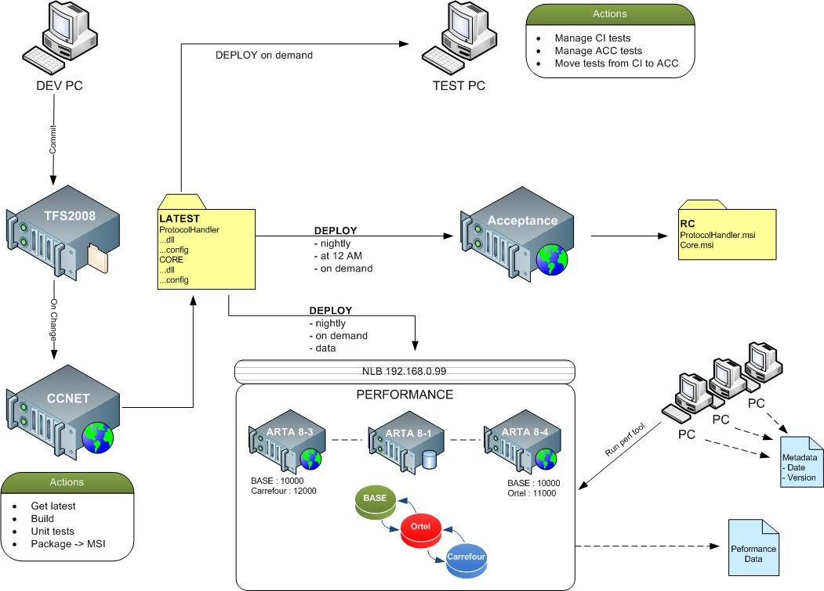
Artilium build environment

Slide 9
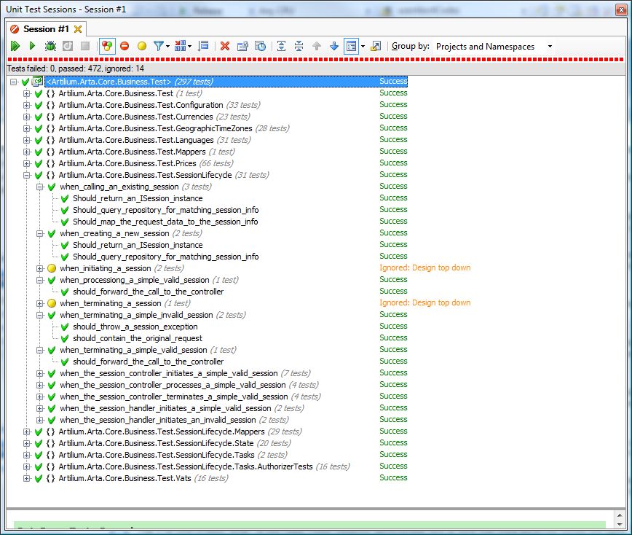
Unit Test Naming convention

Slide 10
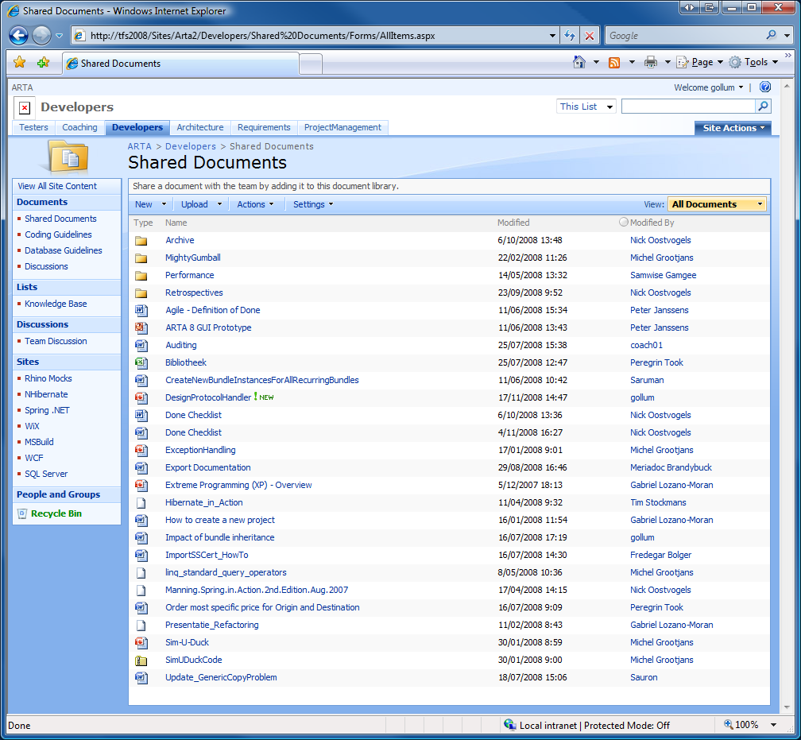
FTS Portal

