Slide 1

Agile in the .NET World

Slide 2
Agile in the .NET World
.NET Development Environment
.NET Development LifeCycle
.NET Coding Tools

Slide 3
Development Environment
IDE
Visual Studio 2008
Tooling/Add-on
Resharper 4.0
NUnit
Rhino Mocks
MSBuild
Enterprise Architect
…
Libraries
NHibernate 2.0
Spring.NET 1.2
Microsoft Enterprise Library 4.0
Database
SQL Server 2005
Team Foundation Server
Portal
Version Control
Issue/workitem tracking
Build management
Process guidance

Slide 4
Development Environment...
IDE
Visual Studio Express Editions
SharpDevelop
Tooling / Add-on
TestDriven.NET
Reflector
ANTS profiler
dotTrace
GhostDoc
Version Control
SubVersion
TortoiseSVN
Libraries
Castle Project

Slide 5
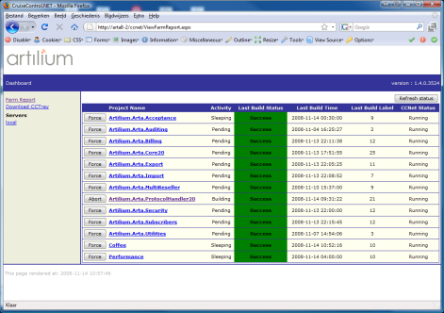
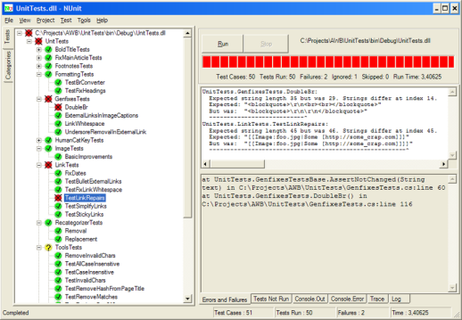
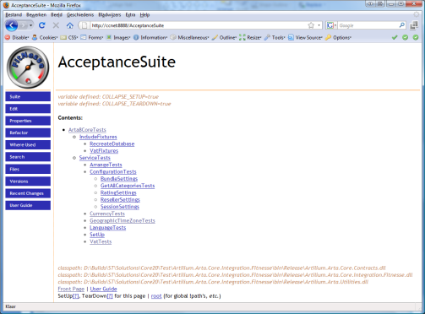
Development Lifecycle
Continuous Integration
CruiseControl.NET
CCTray
Big Visible Cruise
Screen Saver
NDepends
NCover
NUnit
Testing
NUnit (resharper integration)
Unit testing
Integration testing
Acceptance testing
SoapUI
Fitness
Notes:
CruiseControl.NET
Triggered by check-in
Get Latest Version
Compile
Unit testing
Acceptance Testing
Last successful build
Deployment other environments
Load testing

Slide 6
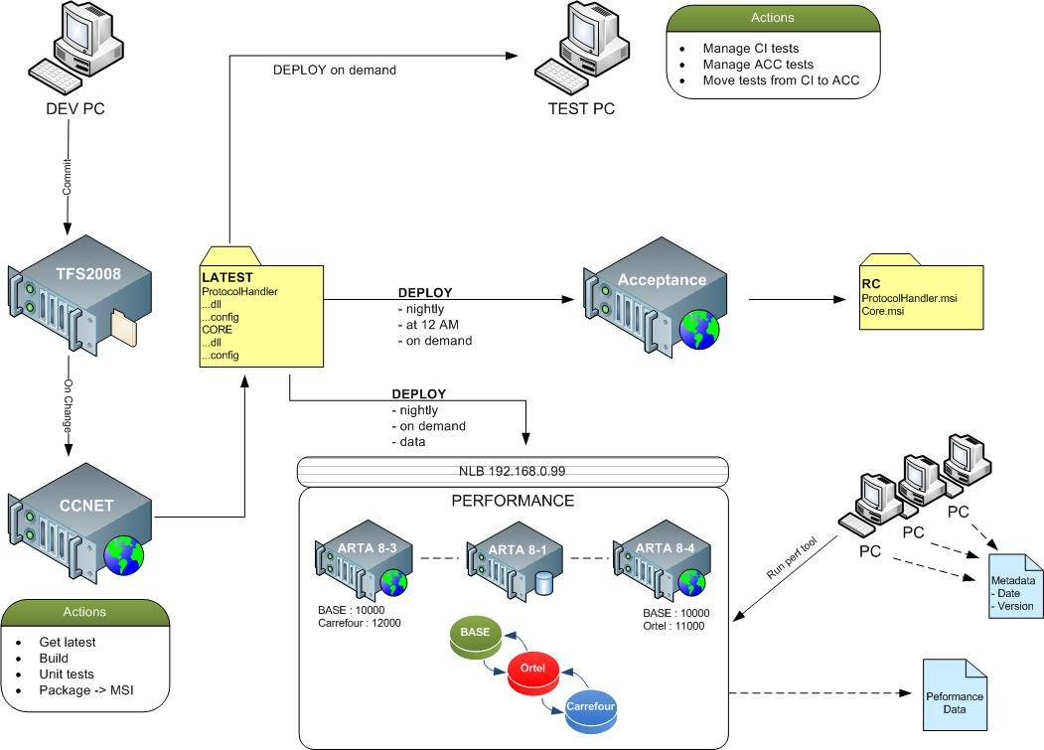
Artilium build environment

Slide 7
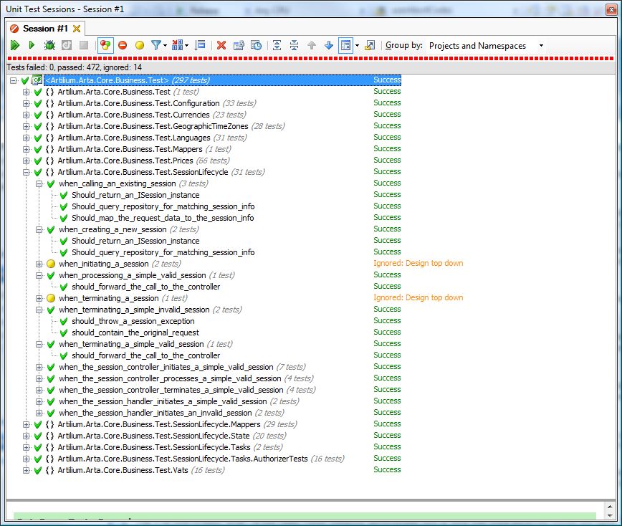
Unit Test Naming convention

Slide 8
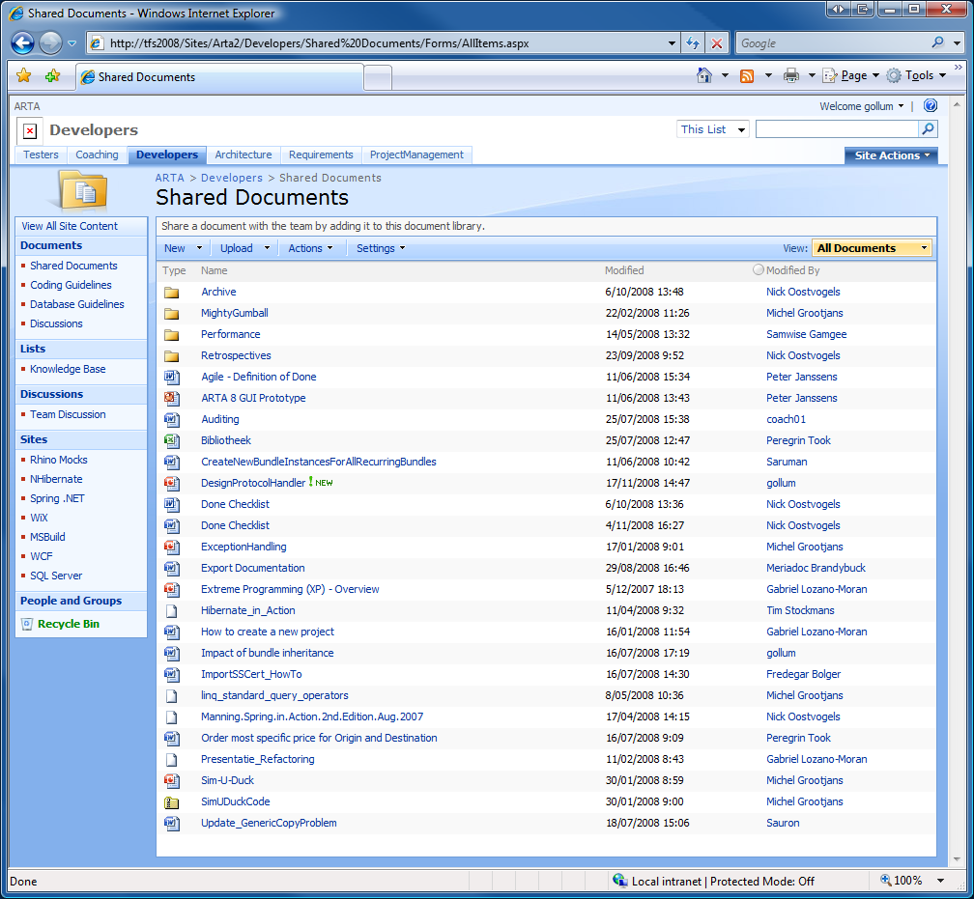
FTS Portal

