Slide 1
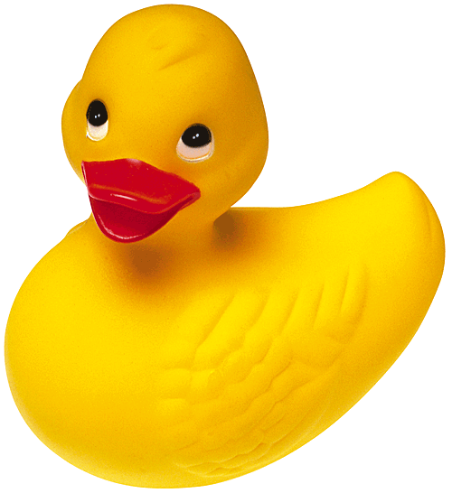
Sim-U-Duck
Welcome to Design Patterns

Slide 2
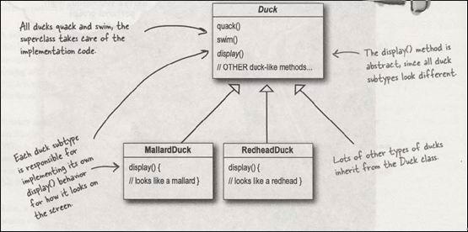
Simple Sim-U-Duck design
By Joe the programmer

Slide 3
A new requirement
Ducks must be able to fly!

Slide 4
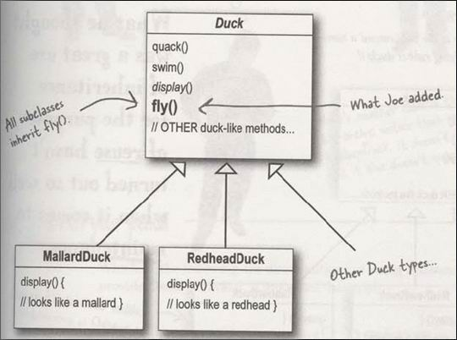
A new requirement
Ducks must be able to fly!

Slide 5
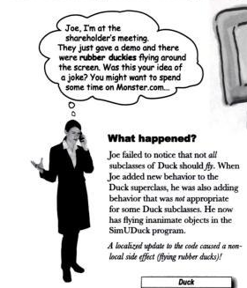
Something went wrong...

Slide 6
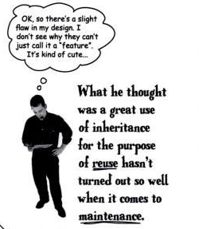
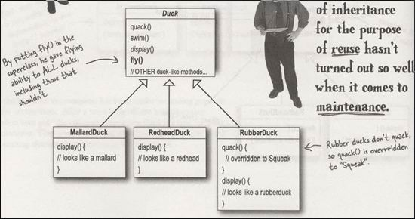
Something went wrong...

Slide 7
Alternatives
Duck
Display() //abstract
Quack(){//quack}
Fly(){//fly}
Override methods in subclasses
MallardDuck : Duck
RedheadDuck : Duck
Display() {//mallard duck}
Display() {//redhead duck}
RubberDuck : Duck
Display() {//rubber duck}
Quack(){//squeak}
Fly(){
//override do nothing
}
DecoyDuck : Duck
Display() {//decoy duck}
Quack(){//do nothing}
Fly(){
//override do nothing
}

Slide 8
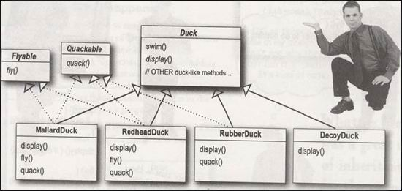
Alternatives
Create interfaces Flyable and Quackable

Slide 9
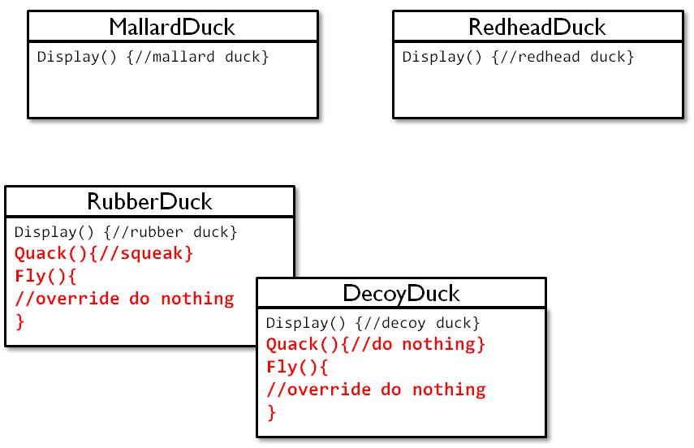
New requirement: 48 duck classes!

Slide 10
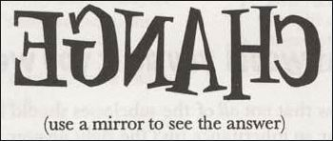
The one constant in software development

Slide 11
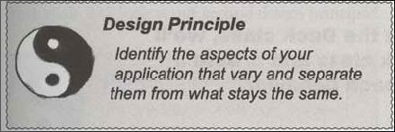
Design principle N° 1

Slide 12
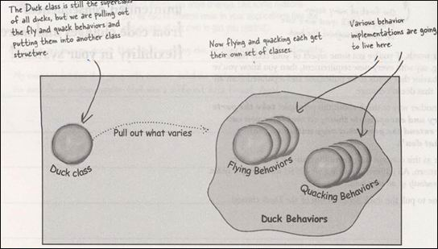
Separating what changes from what stays the same

Slide 13
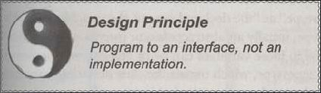
Designing the Duck behaviors
Design Principle N° 2

Slide 14
Designing the Duck behaviors
<<interface>>
FlyBehavior
Fly()
FlyWithWings
FlyNoWay
Fly() {
//implements duck flying
}
Fly() {
//do nothing – can’t fly
}

Slide 15
Implementing the Duck behaviors
<<interface>>
FlyBehavior
Fly()
FlyWithWings
FlyNoWay
Fly() {
//implements duck flying
}
Fly() {
//do nothing – can’t fly
}
<<interface>>
QuackBehavior
Quack()
Quack
Squeak
MuteQuack
Quack() {
//implements duck quacking
}
Quack() {
//rubber duckie squeak
}
Quack() {
//do nothing – can’t quack
}

Slide 16
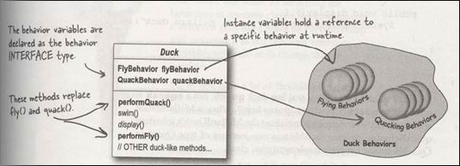
Integrating the Duck Behavior

Slide 17
