Slide 1
Information Systems in Health Care
Lesson 10 – Winter Term 2014

Slide 2
Agenda
Database programming in PHP
Object-oriented programming in PHP
Projects

Slide 3
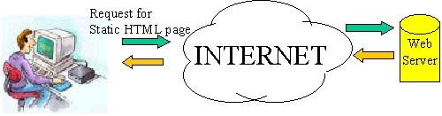

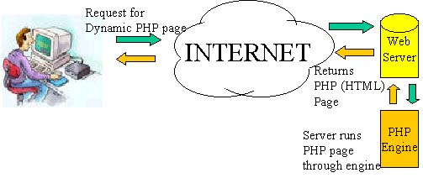

Accessing a MySQL database from PHP
http://databaze.fbmi.cvut.cz/yourlogin/login.html
MySQL Server

Slide 4
Accessing a MySQL database
Prepare the database
http://databaze.fbmi.cvut.cz/mysql
CREATE TABLE user ( user_id int AUTO_INCREMENT, user_name varchar(60), user_login varchar(60), user_password varchar(60), user_department_id int, PRIMARY KEY (user_id) );
INSERT INTO user (user_name, user_login, user_password, user_department_id) VALUES ('administrator', 'admin', 'admin', 1), ('MUDr. Pavel Janda', 'janda', 'janda', 2), ('MUDr. Jana Novakova', 'novakova', 'nova123', 2)
Connect to the database system
$db_connector= mysql_connect("localhost", “yourlogin", “yourpassword" );
Control database connection
if (!$db_connector) { die(‘Connection failed: ' . mysql_error()); }
Setup UTF8 charset for e.g. Czech special characters
mysql_query("SET CHARACTER SET utf8");
Connect to the database
mysql_select_db(“yourlogin");

Slide 5
Accessing a MySQL database
Selecting data from a database
$query = "SELECT * FROM user WHERE user_login ='" . $login . "' AND user_password = '" . $heslo . "'";
$rs = mysql_query($query);
Controlling selected data
if (!$rs) { echo "Could not execute query: $query"; }
Storing selected data to an associative array
$row = mysql_fetch_assoc($rs)
Displaying results
echo ‘Login successful. Homepage for ' . $row['user_name'];
print ‘Login unsuccessful. Wrong login or password!';

Slide 6

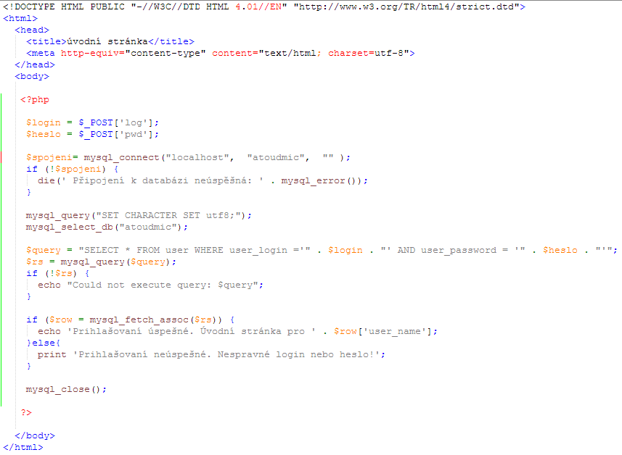
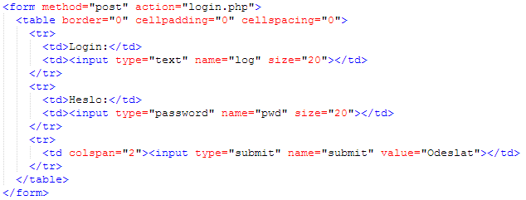
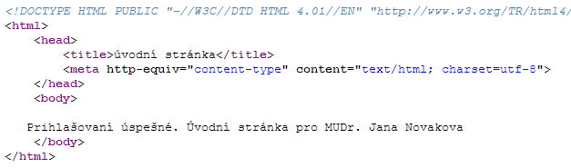
Accessing a MySQL database
login.html
login.php
login.php
MySQL Server

Slide 8
Programming Classes in PHP
A class can be defined anywhere in a PHP file
class class_name{ }
Attributes and operators of a class
class class_name{ $attribute = “ …”; function operator($parameter){ $this->attribute = $parameter; } }
Object creation
$object_name = new class_name();
Calling an operation
$object_name->operator(“Hello”);
$object_name->attribute = “Hello”;

Slide 9
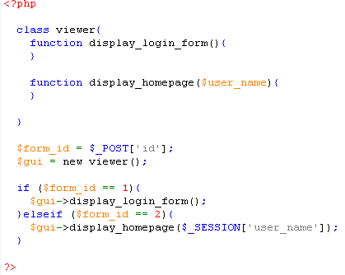
Classes in PHP
class.viewer.php
http://databaze.fbmi.cvut.cz/yourlogin/lclass.viewer.php?id=1
http://databaze.fbmi.cvut.cz/yourlogin/login.html

Slide 10
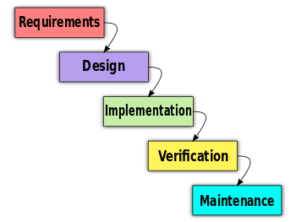
Software development process

Slide 11
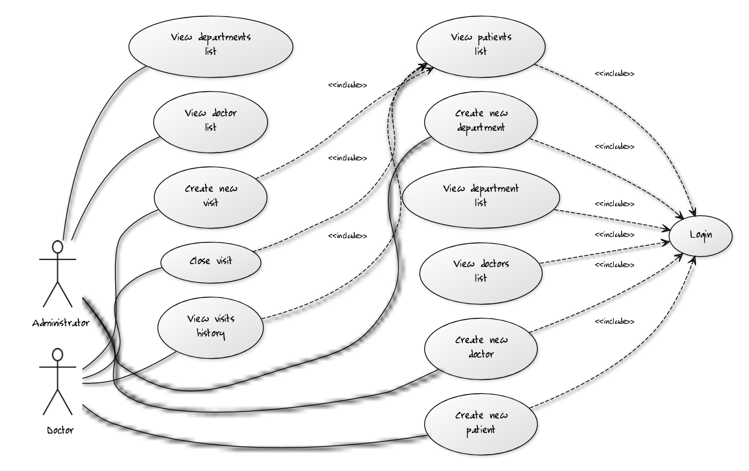
Requirements analysis
http://yuml.me/diagram/scruffy/usecase/draw

Slide 12
Design
MySQL Server

Slide 13
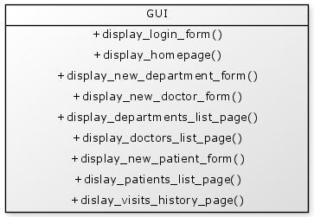
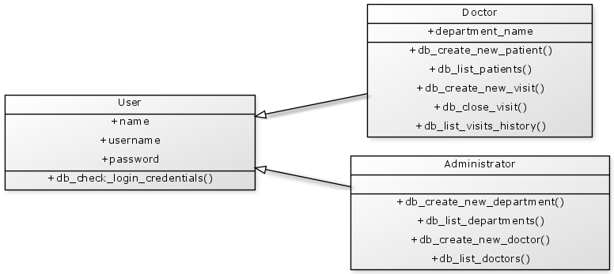
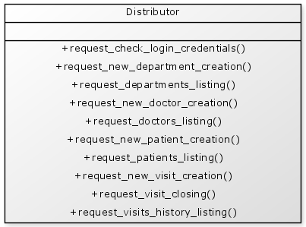
class.doctor.php
class.user.php
class.administrator.php
class.viewer.php
class.distrubutor.php
http://yuml.me/diagram/scruffy/class/draw

Slide 14
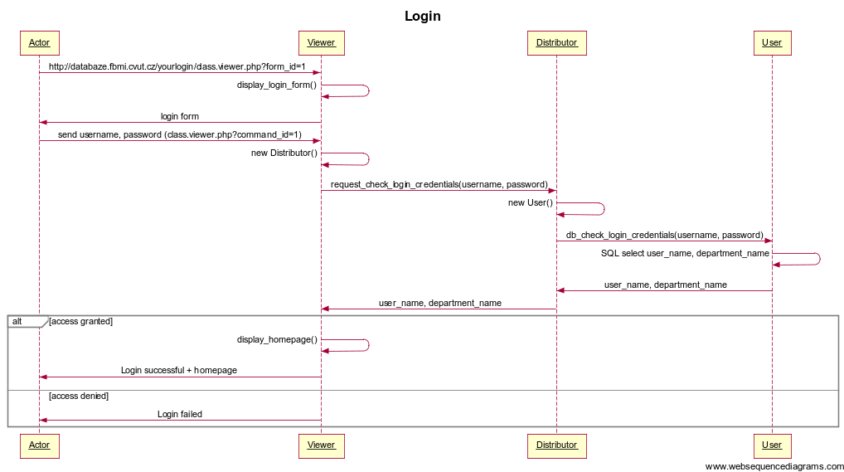
Implementation – login – UML sequence diagram
https://www.websequencediagrams.com

Slide 15
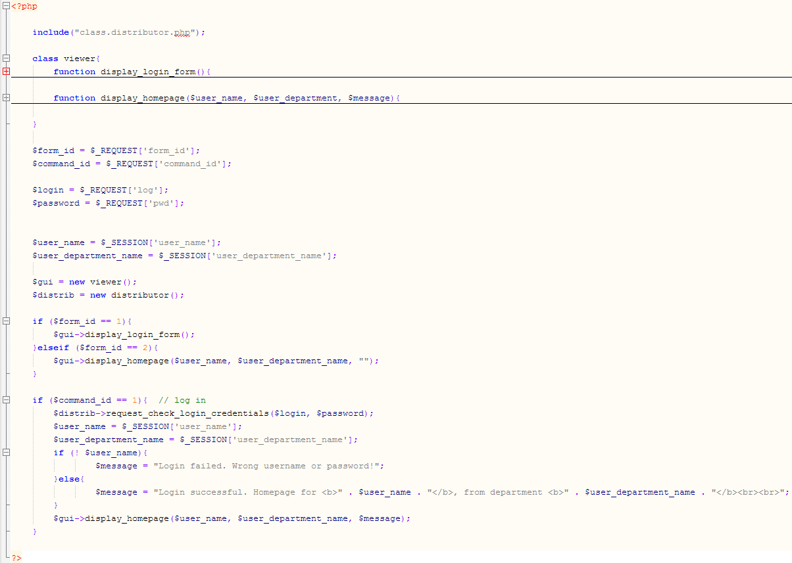
Implementation – login - class.viewer.php

Slide 16
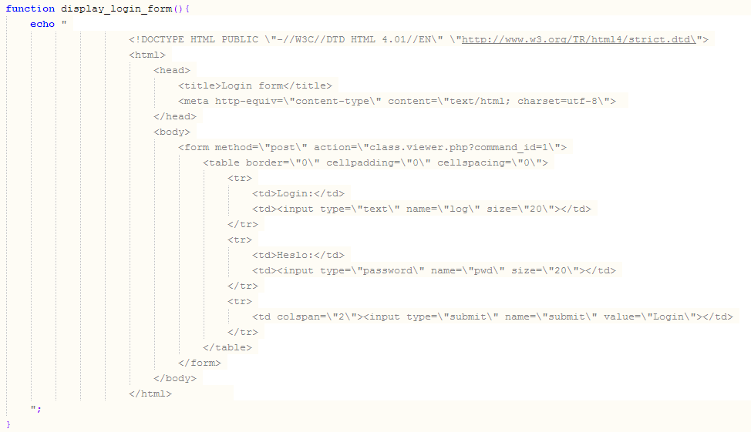
Implementation – login - class.viewer.php

Slide 17
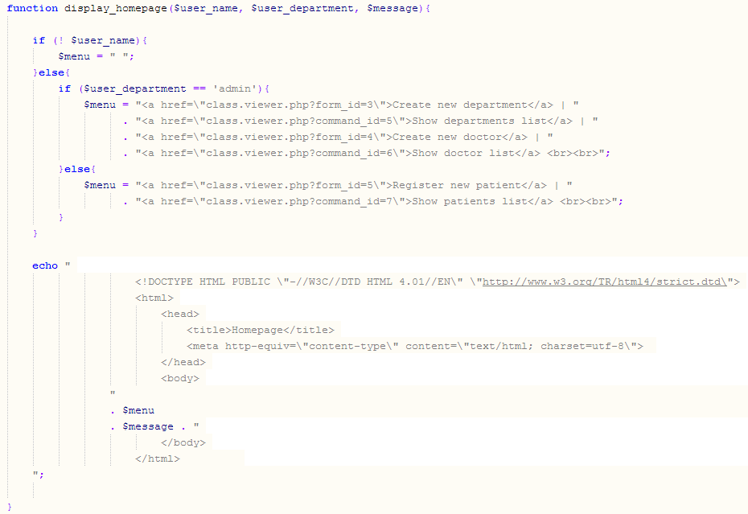
Implementation – login - class.viewer.php

Slide 18
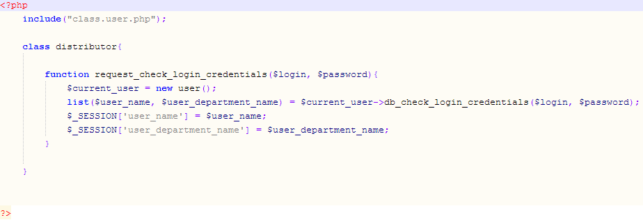
Implementation – login - class.distributor.php

Slide 19
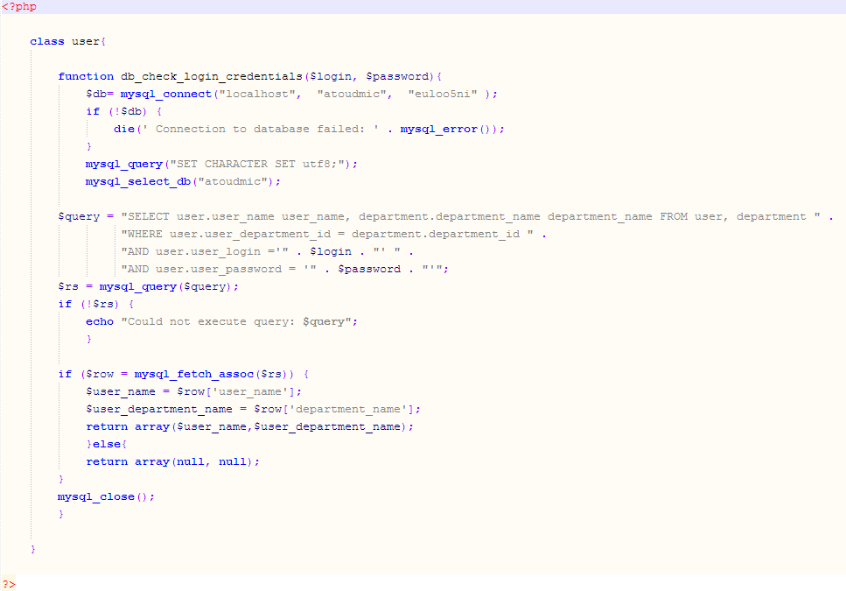
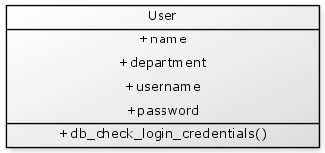
Implementation – login - class.user.php

Slide 20
Test – login
Prepare the database
http://databaze.fbmi.cvut.cz/mysql
CREATE TABLE user ( user_id int AUTO_INCREMENT, user_name varchar(60), user_login varchar(60), user_password varchar(60), user_department_id int, PRIMARY KEY (user_id) );
INSERT INTO user (user_name, user_login, user_password, user_department_id) VALUES ('administrator', 'admin', 'admin', 1), ('MUDr. Pavel Janda', 'janda', 'janda', 2), ('MUDr. Jana Novakova', 'novakova', 'nova123', 2);
CREATE TABLE department ( department_id int AUTO_INCREMENT, department_name varchar(60), PRIMARY KEY (department_id) );
INSERT INTO department(department_name) VALUES ('admin'), ('pediatr')
Login as administrator or doctor
http://databaze.fbmi.cvut.cz/yourlogin/class.viewer.php?form_id=1

Slide 21
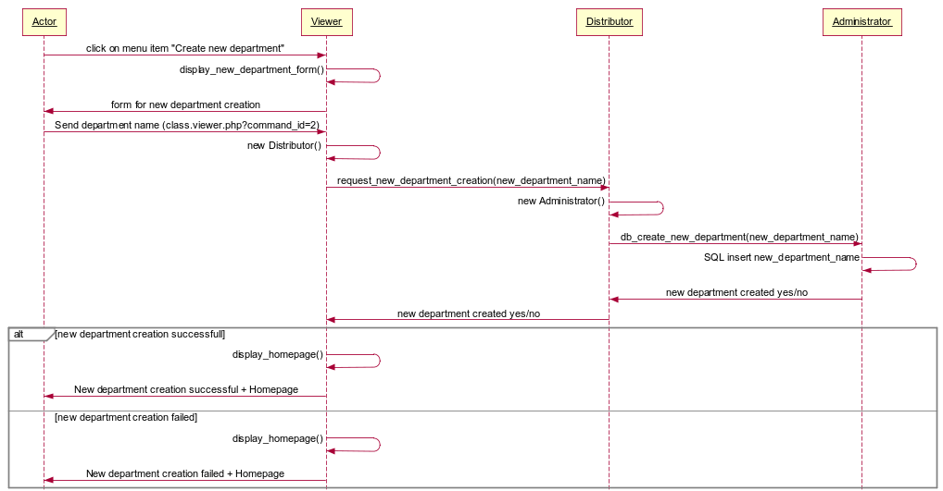
Implementation – create new department – UML sequence diagram

Slide 22
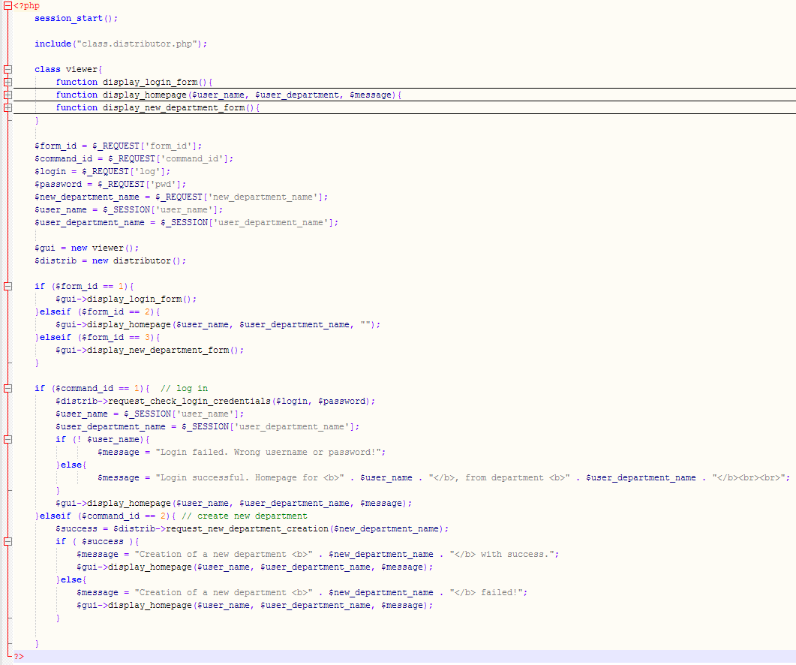
Implementation – create new department – class.viewer.php

Slide 23
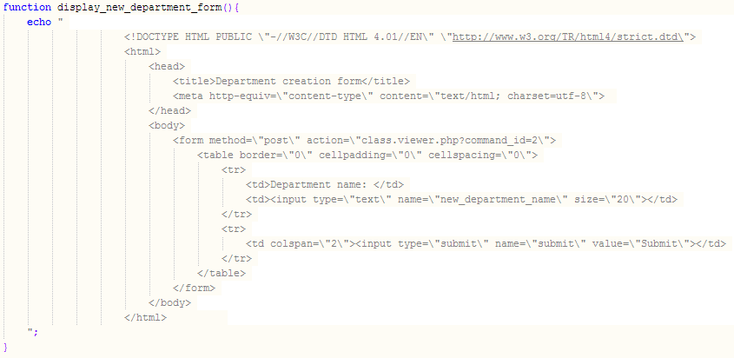
Implementation – create new department – class.viewer.php

Slide 24
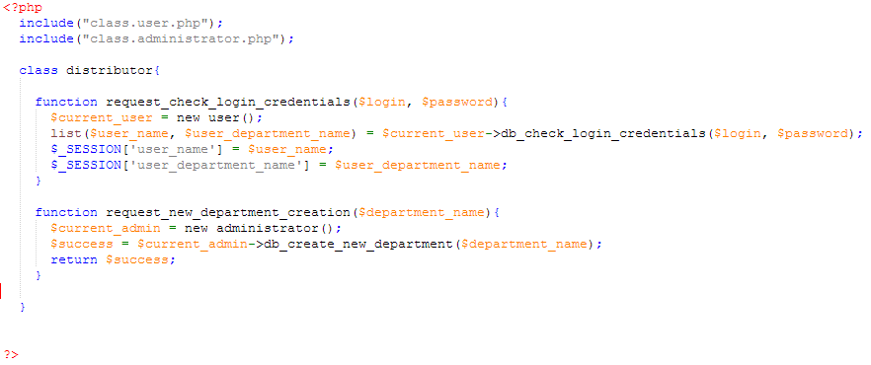
Implementation – create new department – class.distributor.php

Slide 25
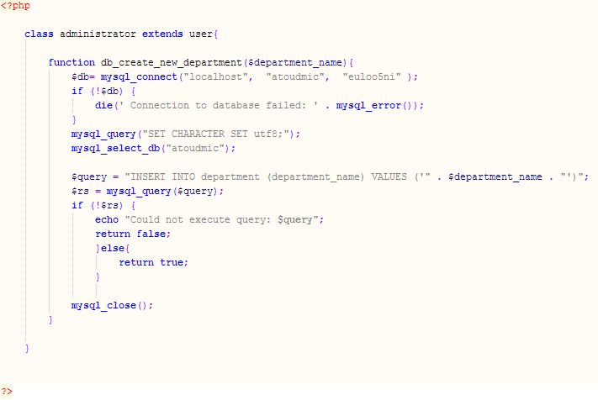
Implementation – create new department – class.administrator.php

Slide 26
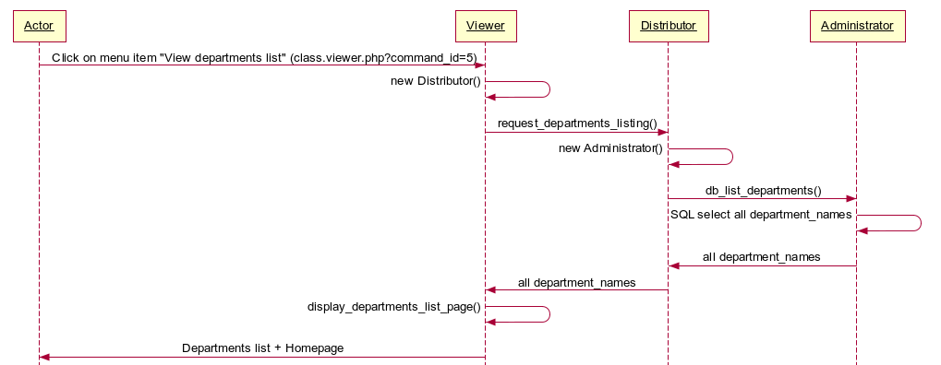
Implementation – view departments list – UML class diagram

Slide 27
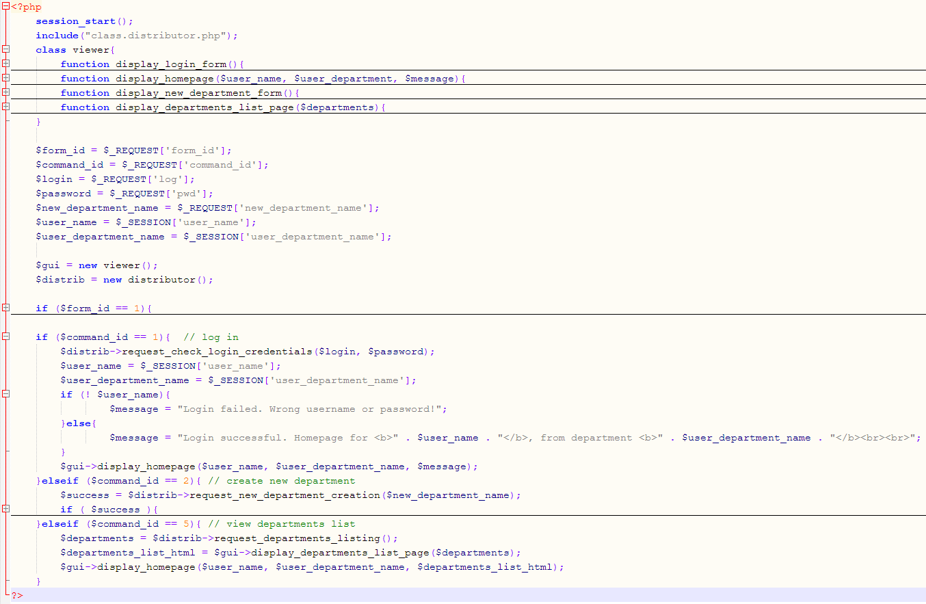
Implementation – view departments list – class.viewer.php

Slide 28
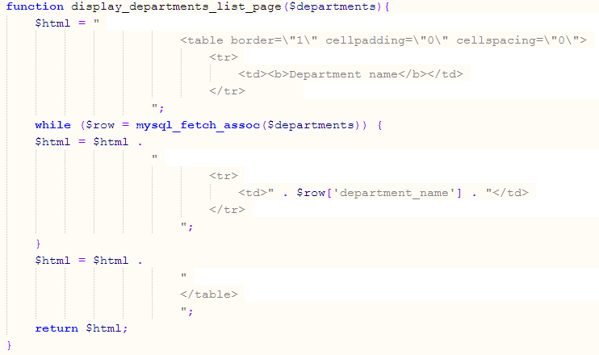
Implementation – view departments list – class.viewer.php

Slide 29
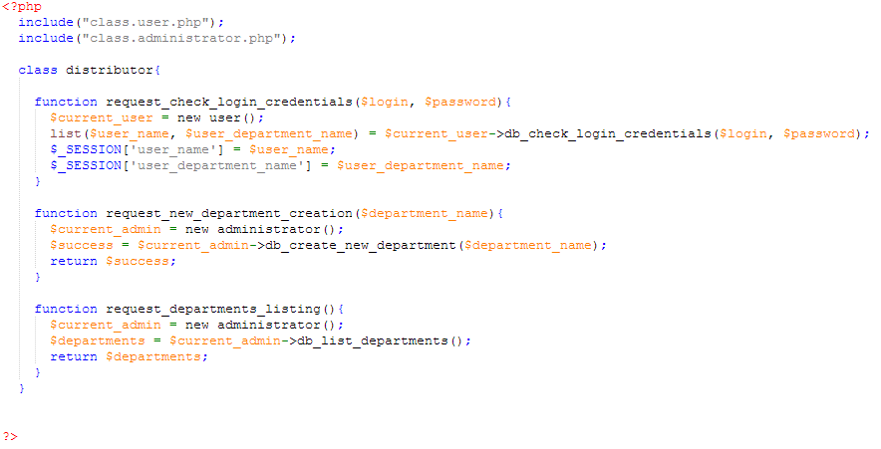
Implementation – view departments list – class.distributor.php

Slide 30
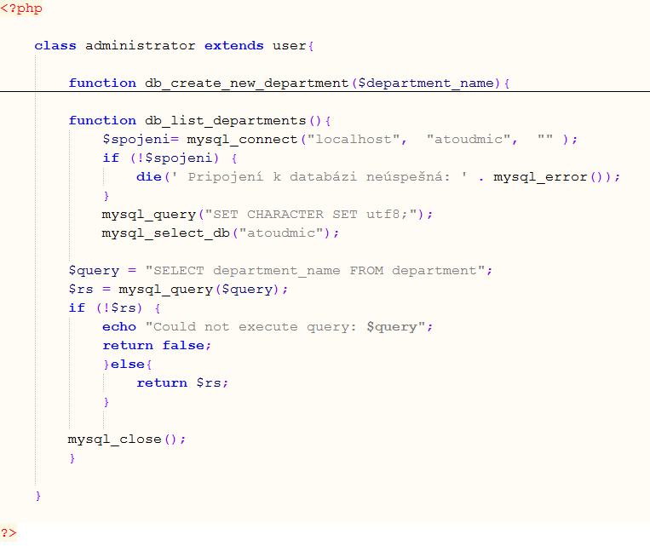
Implementation – view departments list – class.administrator.php

Slide 31
Implementation status
√
√
√

Slide 32
Syllabus of lectures and tutorials
 |  | Lectures (45 min) | Tutorials (45 min)
Lesson 1 | Sep 30 | Medical Informatics and IS definition | OpenEMR
Lesson 2 | Oct 7 | HW infrastructure of IS | OpenEMR
Lesson 3 | Oct 14 | Operation systems | GaiaEHR
Lesson 4 | Oct 21 | Databases of IS | SQL
Lesson 5 | Oct 28
Lesson 6 | Nov 4 | Clinical oriented IS | SQL
Lesson 7 | Nov 11 | Decision support systems Medical data coding | OpenMRS
Lesson 8 | Nov 18 | Phase and IS development principles | UML
Lesson 9 | Nov 25 | Standard implementation methodology | Programing in HTML and PHP
Lesson 10 | Dec 2 | Standard implementation methodology | Programing in PHP and MySQL
Lesson 11 | Dec 9 | Data and communication standards | OpenMRS
Lesson 12 | Dec 16 | Final exam
Lesson 13 | Jan 20 | Presentation of practical project

Slide 33
Requirements for grade
Attendance to ALL lessons
In case of non-attendance, provide a valid reason
30 points from homework
1 homework per week
3 points per homework
The homework is an essay about the topics covered in the lecture
20 points from practical projects
4 points for analyzing your own information system
10 points for implementing your own information system
4 points for testing your own information system
2 points for presenting your own information system
50 points from final exam
30 points about the lectures
20 points about the tutorials

