Slide 1
Information Systems in Health Care
Lesson 11 – Winter Term 2014

Slide 2
Agenda
HL7
Android
Project

Slide 3
Data Communication Standards
Most patient information is stored in disparate systems across the healthcare community
Health Level 7 (HL7) is an international standard for the transmission of medical data
MSH (Message Header) Key
MSH|^~\&|FORMENTRY|AMRS|HL7LISTENER|AMRS|20050217152845||ORU^R01|?|P|2.5|1||||||||||1^AMRS-ELDORET^http://schemas.openmrs.org/2006/FormEntry/formId^URI
^~\&
Encoding characters
^ ? component separator
~ ? repetition separator
\ ? escape character
& ? subcomponent separator
FORMENTRY
Sending Application
AMRS
Sending Facility
HL7LISTENER
Receiving Application
AMRS
Receiving Facility
20050217152845|
Date/Time of Message (YYYYMMDDHHMMSS)
Security (not necessary)
ORU^R01
Message Type (ORU = Unsolicited Transmisstion of an observation message)

Slide 4
Data Communication Standards
PID (Patient Identification) Key
PID|||1MT^0^M10||Patient^Jonny^Dee^DR|Patient^Momma^Thee^MS|20040101000000|M||B|555 Johnson Road^Apt. 555^Indianapolis^IN^46202^USA|||||||||||Indianapolis, IN|||||||||||||||||TRIBE CODE
Set-ID, Patient ID, Alternate Patient ID
Patient^Jonny^Dee^DR
Family Name (Patient)
Given Name (Jonny)
Second / Middle Name (Dee)
Suffix ()
Prefix (DR)
20040101000000
Date/Time of Birth (YYYYMMDDHHMMSS)
M
Administrative Sex
PV1 (Patient Visit) Key
PV1|1|O|^^^^^MTRH^1^AMRS|2|||1^Mamlin^Joseph^^^^^^^8^M10^^AMRS|||||||||||||||||||||||||||||||||||||20050217140000|||||||V
ORC (Common Order Segment)
ORC|RE||||||||20050221130000|1^Enterer^Ima^^^^^AMRS
OBX / NM (Observation Result, Numeric Datatype) Key
OBX|3|NM|5089^WEIGHT (KG)^DCT||25|kg|20-300|L|||F|||20050217204000

Slide 5
Data Communication Standards
most patient information is stored in disparate systems across the healthcare community
Health Level 7 (HL7) is an international standard for the transmission of medical data
PID (Patient Identification) Key
PID|||1MT^0^M10||Patient^Jonny^Dee^DR|Patient^Momma^Thee^MS|20040101000000|M||B|555 Johnson Road^Apt. 555^Indianapolis^IN^46202^USA|||||||||||Indianapolis, IN|||||||||||||||||TRIBE CODE
Set-ID, Patient ID, Alternate Patient ID
Patient^Jonny^Dee^DR
Family Name (Patient)
Given Name (Jonny)
Second / Middle Name (Dee)
Suffix ()
Prefix (DR)
20040101000000
Date/Time of Birth (YYYYMMDDHHMMSS)
M
Administrative Sex

Slide 6
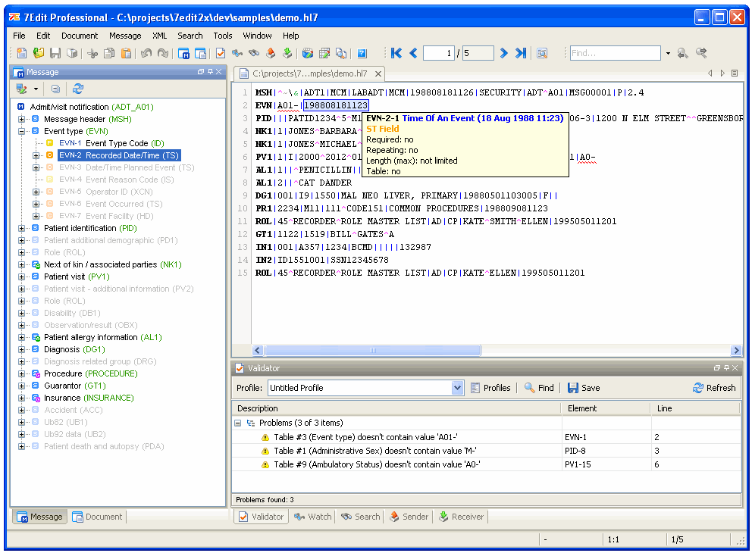
http://7edit.com

Slide 7
Introduction to Android
Android is a mobile operating system based on the Linux kernel and currently developed by Google.
Android is designed for touchscreen mobile devices such as smartphones, tablets, televisions, wrist watches
Android is the most widely used mobile OS and, as of 2013, the highest selling OS overall.

Slide 8
Development environment
Your Computer
JDK
Eclipse ADT
Emulator
SmartPhone
Android
Java Development Kit (JDK)
Eclipse ADT
Emulator

Slide 9
Java Development Kit
Current version
Check the current version of Java with the command line
java –version
Installation
Donwload JDK6 (http://www.oracle.com/technetwork/java/javase/downloads/java-archive-downloads-javase6-419409.html#jdk-6u45-oth-JPR)
Registration on oracle.com is obligatory
You need the 32bit version
Install JDK6, e.g. in C:\Program Files\Java\jdk1.6.0_45
When prompted, install JRE6, e.g. in C:\Program Files\Java\jre6

Slide 10
Eclipse ADT
Installation of ADT
Donwload Eclipse ADT (http://developer.android.com/sdk/index.html)
Version 32bit is needed
It is a zipped file
Unzip Eclipse ADT, e.g. to C:\adt-bundle-windows-x86-20140702
Installation of the emulator
Open the folder C:\adt-bundle-windows-x86-20140702\eclipse
Start eclipse.exe
Click on SDK Manager
Click on ‚Deselect All‘
Select ARM EABI under Android 4.4.2 (API19)
Click on Install 1 package, then Accept and Install
At the end, restart Eclipse

Slide 11

Eclipse - Configuration
Configuration Eclipse
Open the folder C:\adt-bundle-windows-x86-20140702\eclipse
Start eclipse.exe
Enter the path to a workspace as an empty or new folder, e.g. C:\dev\nis
In Menu Windows-Preferences-Java-Installed JRE, add the JRE6 folder
Configuration of the emulator
Click on the Android Virtual Device Manager
Click on Create
Endter AVD name Nexus
Choose Device Nexus 7, Target Android 4.4.2, CPU Android ARM
Enter Hardware keyboard, Skin with dynamic hw control, RAM 1024, Internal storage 512, SD Card 512
Click on Start
It can take a while for Android to start on the emulator

Slide 12
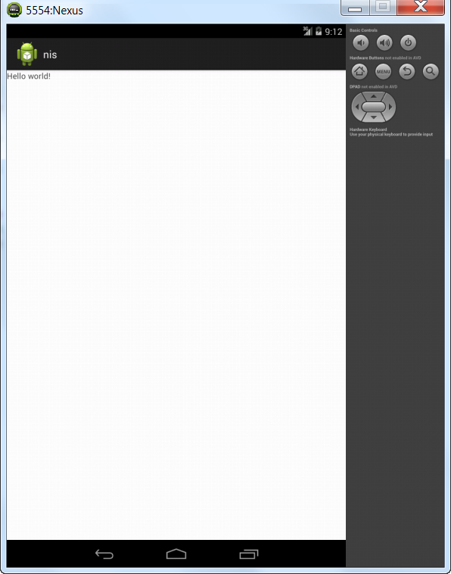
Eclipse – First project
Your first project
Click File – New – Android Application Project
Enter Application name HelloWorld, Min API 9, Target API 19, Compile with API 19
Enter Package name com.example.helloworld
In the last page, select Empty Activity
Leave the default settings
Test your project
Open src - com.example.helloworld - MainActivity.java
Click on Run
Choose Android Application
Choose Nexus emulator
(Eclipse allows to run a project on an Android phone connected via USB as well, see http://developer.android.com/tools/extras/oem-usb.html)

Slide 13
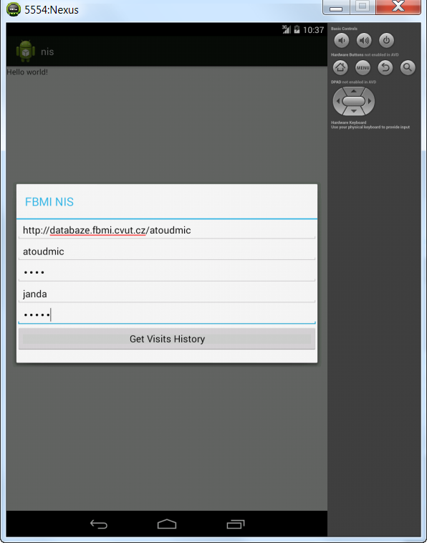
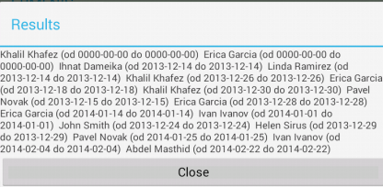
Eclipse – base project health care IS
Prepare the Eclipse workspace for your IS
Unzip NIS_Android.zip, which was sent to you via email
File – Import – Android – Existing Android Code into Workspace
Browse – choose the folder wher you unzipped NIS_Android.zip
Choose the project nis (do not select appcompat_v7)
Check copy project into workspace
Click on Finish (a new project nis will appear in the workspace)
Prepare the web server
With a text editor, update your database credentials in getDataForAndroid.php
Copy getDataForAndroid.php to your web server
Test your IS project
Open nis – src – cz.cvut.fbmi.nis - MainActivity.java
Click on Run

Slide 14
Eclipse – orientation in the workspace
Structure of the workspace
There are three projects: HelloWorld (your first Android projekt), nis (health care IS project), appcompat_v7 (library project for backward compatibility with older versions of Android devices)
Code structure - src – cz.cvut.fbmi.nis
MainActivity.java
Main page of the application
Initialize GUI and data
Structure of the user interface – res - layout
activity_main.xml
Layout of the main page
login.xml
Layout of the page for entering login information
Results.xml
Layout of the results page

Slide 15
Project NIS – MainActivity.java
Dialog for login
final Dialog dialog = new Dialog(MainActivity.this);
dialog.setContentView(R.layout.login);
dialog.setTitle("FBMI NIS");
dialog.show();
Login.xml
<EditText
android:id="@+id/editTextUserNameToLogin"
android:layout_width="match_parent"
android:layout_height="wrap_content"
android:hint="Doctor user name"
android:ems="10" >
</EditText>
<EditText
android:id="@+id/editTextPasswordToLogin"
android:layout_width="match_parent"
android:layout_height="wrap_content"
android:ems="10"
android:inputType="textPassword"
android:hint="Doctor password"/>
<Button
android:id="@+id/buttonSignIn"
android:layout_width="fill_parent"
android:layout_height="wrap_content"
android:text="Get Visits History" />

Slide 16
Project NIS – MainActivity.java
Button Get Visits History
Button btnSignIn=(Button)dialog.findViewById(R.id.buttonSignIn);
Data input
final EditText editTextUserName=(EditText)dialog.findViewById(R.id.editTextUserNameToLogin);
final EditText editTextPassword=(EditText)dialog.findViewById(R.id.editTextPasswordToLogin);
String doctorUserName=editTextUserName.getText().toString();
String doctorPassword=editTextPassword.getText().toString();
Dynamic
btnSignIn.setOnClickListener
String visitsHistory = getVisitsHistory(doctorUserName, doctorPassword, facultyUserName, facultyPassword,facultyUrl);
Login.xml
<EditText
android:id="@+id/editTextUserNameToLogin"
android:layout_width="match_parent"
android:layout_height="wrap_content"
android:hint="Doctor user name"
android:ems="10" >
</EditText>
<EditText
android:id="@+id/editTextPasswordToLogin"
android:layout_width="match_parent"
android:layout_height="wrap_content"
android:ems="10"
android:inputType="textPassword"
android:hint="Doctor password"/>
<Button
android:id="@+id/buttonSignIn"
android:layout_width="fill_parent"
android:layout_height="wrap_content"
android:text="Get Visits History" />

Slide 17
Project NIS – MainActivity.java - getVisitsHistory
HTTP communication
HttpPost httppost = new HttpPost(facultyUrl + "/getDataForAndroid.php?log=" + doctorUserName + "&pwd=" + doctorPassword);
httppost.addHeader(BasicScheme.authenticate(new UsernamePasswordCredentials(FacultyUserName, FacultyPassword), "UTF-8", false));
HttpResponse response = httpclient.execute(httppost);
String data = inputStreamToString(response.getEntity().getContent()).toString();
http://database.fbmi.cvut.cz/vaslogin/getDataForAndroid.php
<?php
$login = $_REQUEST['log'];
$password = $_REQUEST['pwd'];
$query = "SELECT patient.name patient_name, visit.start visit_start, visit.end visit_end FROM user, visit, patient " ."WHERE user.user_id = visit.doctor_id " . "AND visit.patient_id = patient.id " . "AND user.user_login ='" . $login . "' " . "AND user.user_password = '" . $password . "'";
$result = mysql_query($query);
if (!$result) { echo "Could not execute query: $query";}
$data = '';
while($row=mysql_fetch_assoc($result)){
$data=$data . $row['patient_name'] . " (od " . $row['visit_start'] . " do " . $row['visit_start'] . ") \n ";
}
mysql_close($con);
echo $data;
?>

Slide 18
Project NIS – MainActivity.java
Dialog for displaying results
final Dialog dialogResults = new Dialog(MainActivity.this);
dialogResults.setContentView(R.layout.results);
dialogResults.setTitle("Results");
final TextView textViewResult=(TextView)dialogResults.findViewById(R.id.textViewResult);
textViewResult.setText(visitsHistory);
Results.xml
<TextView
android:id="@+id/textViewResult"
android:layout_width="fill_parent"
android:layout_height="wrap_content"
android:singleLine="false"
android:maxLines="100"
/>
<Button
android:id="@+id/buttonClose"
android:layout_width="fill_parent"
android:layout_height="wrap_content"
android:text="Close" />

Slide 19
Syllabus of lectures and tutorials
 |  | Lectures (45 min) | Tutorials (45 min)
Lesson 1 | Sep 30 | Medical Informatics and IS definition | OpenEMR
Lesson 2 | Oct 7 | HW infrastructure of IS | OpenEMR
Lesson 3 | Oct 14 | Operation systems | GaiaEHR
Lesson 4 | Oct 21 | Databases of IS | SQL
Lesson 5 | Oct 28
Lesson 6 | Nov 4 | Clinical oriented IS | SQL
Lesson 7 | Nov 11 | Decision support systems Medical data coding | OpenMRS
Lesson 8 | Nov 18 | Phase and IS development principles | UML
Lesson 9 | Nov 25 | Standard implementation methodology | Programing in HTML and PHP
Lesson 10 | Dec 2 | Standard implementation methodology | Programing in PHP and MySQL
Lesson 11 | Dec 9 | Data and communication standards | Android, 7Edit
Lesson 12 | Dec 16 | Final exam
Lesson 13 | Jan 20 | Presentation of practical project

Slide 20
Requirements for grade
Attendance to ALL lessons
In case of non-attendance, provide a valid reason
30 points from homework
1 homework per week
3 points per homework
The homework is an essay about the topics covered in the lecture
20 points from practical projects
4 points for analyzing your own information system
10 points for implementing your own information system
4 points for testing your own information system
2 points for presenting your own information system
50 points from final exam
30 points about the lectures
20 points about the tutorials

