Slide 1
Information Systems in Health Care
Michel Kana, Ph.D.
Lesson 2 – Winter Term 2014

Slide 2
Schedule
Syllabus of lectures and tutorials
Pre-test
Medical Informatics and IS definition
OpenEMR
Conclusion

Slide 3
Syllabus of lectures and tutorials

Slide 4
Syllabus of lectures and tutorials
 |  | Lectures (45 min) | Tutorials (45 min)
Lesson 1 | Sep 23 | Class introduction
Lesson 2 | Sep 30 | Medical Informatics and IS definition | OpenEMR
Lesson 3 | Oct 7 | HW infrastructure of IS | OpenEMR
Lesson 4 | Oct 14 | Operation systems and databases of IS | GaiaEHR electronic health records
Lesson 5 | Oct 21 | Clinical oriented IS | GaiaEHR electronic health records
Lesson 6 | Oct 28 | Decision support systems | OpenMRS
Lesson 7 | Nov 4 | Medical data coding | OpenMRS
Lesson 8 | Nov 11 | Data and communication standards | Analysis and design with UML
Lesson 9 | Nov 18 | Heterogeneous and regional IS integration | Databases in MySQL
Lesson 10 | Nov 25 | Phase and IS development principles | Databases in MySQL
Lesson 11 | Dec 2 | Standard implementation methodology | Programing in PHP
Lesson 12 | Dec 9 | Health care IS management and support | Programing in PHP
Lesson 13 | Dec 16 | Presentation of practical projects and final exam

Slide 5
Requirements for grade
Attendance to ALL lessons
In case of non-attendance, provide a valid reason
30 points from homework
1 homework per week
3 points per homework
The homework is an essay about the topics covered in the lecture
20 points from practical projects
5 points for analyzing your own information system
10 points for implementing your own information system
5 points for presenting your own information system
Guidelines will be given in lesson 8
50 points from final exam
30 points about the lectures
20 points about the tutorials

Slide 6
Pre-test

Slide 7
Medical Informatics and IS definition

Slide 8
The Framework of Information Systems in Healthcare
Health informatics is an interdisciplinary field covered by the international classification standard ICS 35.240.80
Health care: prevention, diagnosis and treatment of diseases
Information science: storage and retrieval information
Computer science: automatic computation of information
Health informatics deals
with methods, techniques, devices and resources
for the acquisition, storage, processing, retrieval and use
of information
to support decision and actions, and improves patient outcomes
Synomyms of health informatics are
Health information systems, health care informatics, healthcare informatics, medical informatics, nursing informatics, clinical informatics, biomedical informatics

Slide 9
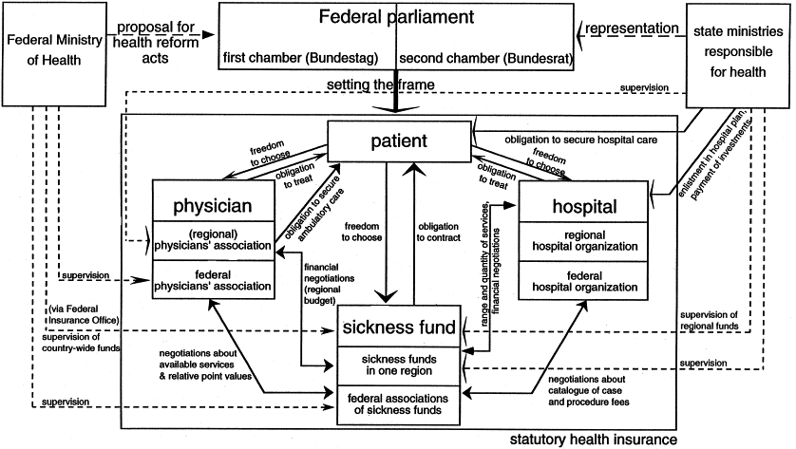
Roles and responsabilities in healthcare
Ref.: Advances in Health Care Management, Dr. Leonard H. Friedman

Slide 10
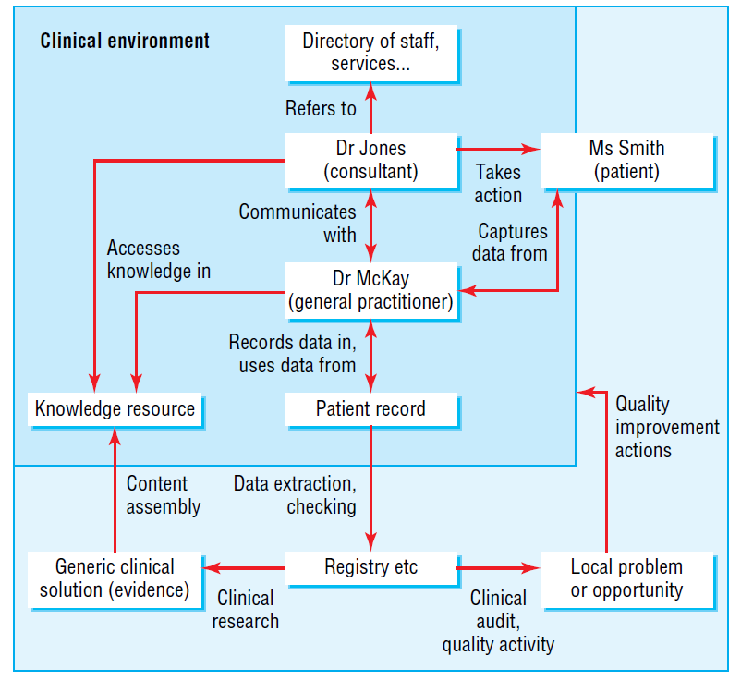
Information in health care
Patient data
Medical knowledge
Directory information
Ref.: ABC of Health Informatics, University of Dundee

Slide 11
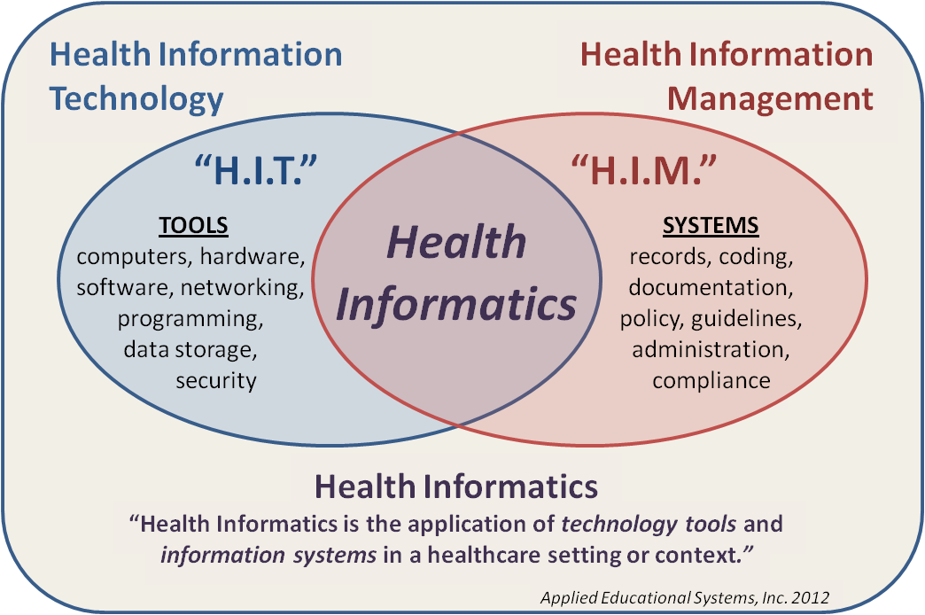
Information systems in health care

Slide 12
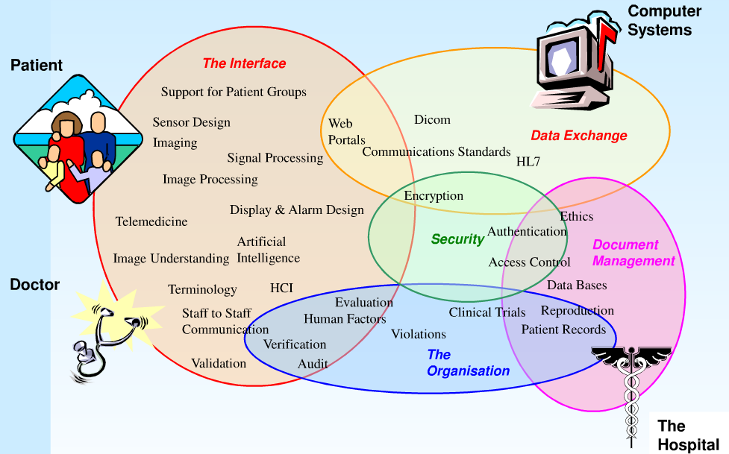
Information systems in health care
Ref.: The University of Manchester, Imaging science and biomedical engineering

Slide 13
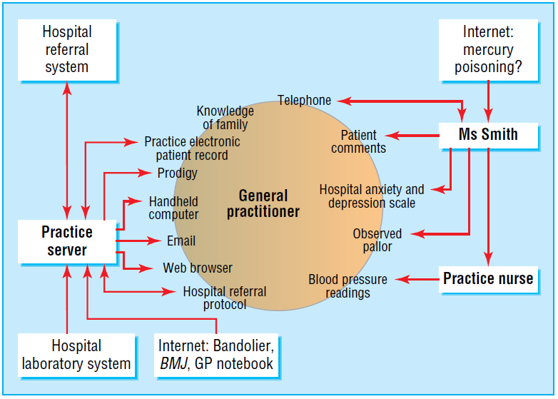
Information systems in health care
Ref.: ABC of Health Informatics, University of Dundee

Slide 14
Types of information systems in health care
Electronic health record (EHR) is the systematic collection, processing and sharing of health information in electronic form.
Medical practice management software (PMS) is a set of tools for helping health provider in their day-to-day operations in a medical practice.
Computerized provider order entry (CPOE) in an ordering and fulfillment system for medical practitioner instructions for the treatment of patients.
Clinical decision support system (CDSS) is a real-time tool for diagnostic and treatment recommendations. CDSS may be used as part of CPOE and EHR.
Picture archiving and communications system (PACS) captures and integrates diagnostic and radiological images such as x-ray, MRI and CT.
Electronic materials management (EMM) tracks and manages inventory of medical supplies, pharmaceuticals, and other materials.
Telemedicine software provides communications and transmission of health information between patient and healthcare provider.

Slide 15
OpenEMR

Slide 16
What is OpenEMR?
OpenEMR is an electronic health record (EHR) and medical practice management software.
Features
Patient demographics
Patient scheduling
Patient portal
Electronic medical records
Prescriptions
Clinical decision support
Medical billing
Reports
Multilanguage support
Security
Free: Open Source under GNU General Public License

Slide 17
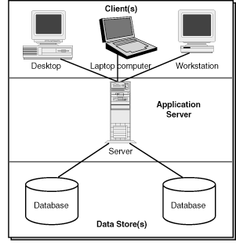
OpenEMR Architecture
OpenEMR is a web-based 3-tier application
The client sends a request using a web browser
The web and application server receives a processes the request
The database server executes queries against a database

Slide 18
Our OpenEMR PlayGround
http://demo.open-emr.org:2099/openemr
Tutorial
Adding a patient
Using the calendar
Setting up a quaterly schedule
Making appointments
Opening a new encounter for first visit
Entering family history, brief description, alergies
Entering system checks, vitals
Adding a fee sheet
Making a prescription
Adding a medical issue (problem)
Associate medical issue and encounter
Adding Immunization

Slide 19
Our OpenEMR PlayGround
http://demo.open-emr.org:2099/openemr
Tutorial
Adding patient notes and sending messages
Creating a referral transaction
Using patient portal
Enabling access
Resetting password
Viewing reports

Slide 20
Homework
Provide an organization chart of health care in your country
Graphical overview
Description of roles and responsabilities
Description of information flow between entities
Describe a software development methodology of your choice
Send your essay as editable document (e.g. MS Word format) by Oct 5

Slide 21
Plan for next week
HW infrastructure of IS
OpenEMR: billing, reporting, clinical decision rules, Configuration.

