Slide 1
Information Systems in Health Care
Michel Kana, Ph.D.
Lesson 3 – Winter Term 2014

Slide 2
Schedule
Review of previous lecture
Hardware Infrastructure of IS
OpenEMR
Conclusion

Slide 3
Review of the previous lecture

Slide 4
Types of information systems in health care
Electronic health record (EHR)
systematic collection, processing and sharing of health information in electronic form.
Medical practice management software (PMS)
set of tools for helping health provider in their day-to-day operations in a medical practice.
Computerized provider order entry (CPOE)
ordering and fulfillment system for medical practitioner instructions for the treatment of patients.
Clinical decision support system (CDSS)
real-time tool for diagnostic and treatment recommendations. CDSS may be used as part of CPOE and EHR.
Picture archiving and communications system (PACS)
captures and integrates diagnostic and radiological images such as x-ray, MRI and CT.
Electronic materials management (EMM)
tracks and manages inventory of medical supplies, pharmaceuticals, and other materials.
Telemedicine software
provides communications and transmission of health information between patient and healthcare provider.

Slide 5
Hardware Infrastructure in Information Systems

Slide 6
Hardware components in a computer
A computer consists of hardware, software and BIOS
The Hardware consists of the physical components
Input: keyboard, mouse, scanner, microphone, touch screen
Output: monitor, printer, speakers
Input/Output: CD/DVD drives, disk drives, LAN, Wireless cards
Box: motherboard, CPU, RAM, video card
The Software consists of all programs used for performing tasks.
The BIOS is the boundary between hardware and software.

Slide 7
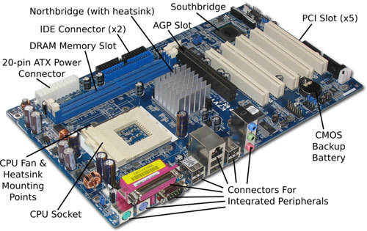

Slide 8
Hardware in computer networks
A computer network is a group of two or more computers connected electronically for data exchange.
Wired technology: twisted pair wire, coaxial cable, optical fiber
Wireless technology: radio, cellular, infrared
Hardware components in a computer network
Network interface controller (NIC) allows the computer to accept a network cable. It has a unique Media Access Control (MAC) address
Hubs repeat a network signal over multiple ports
Switches are intelligent hubs
Routers are devices that connects two or more computer networks
Firewalls are network devices that control network security and access rules
Network topologies
Bus, star, ring, mesh, tree

Slide 9
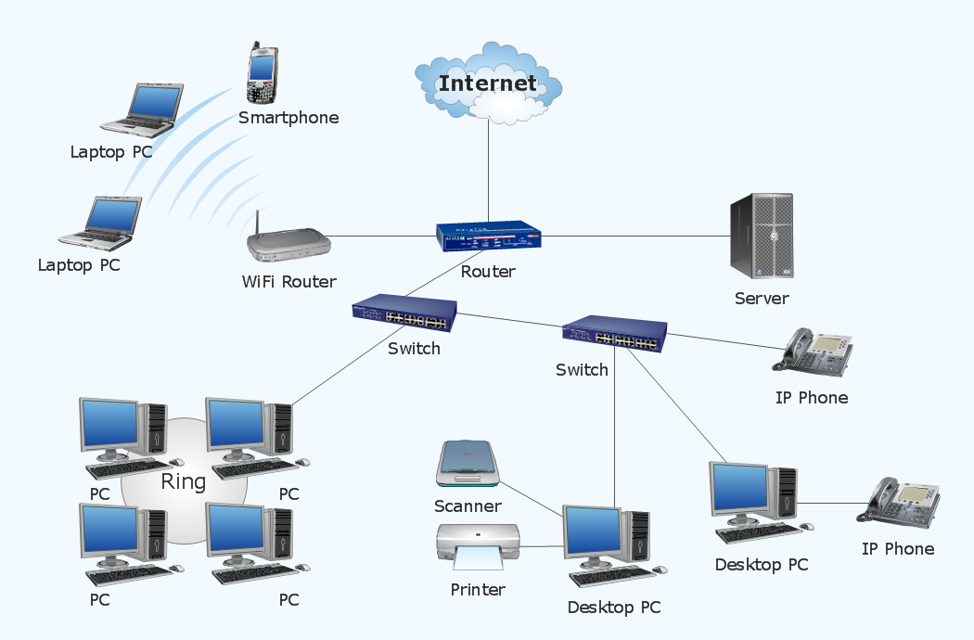

Slide 10
Protocols in computer networks
A communication protocol is a set of formal rules for data exchange between computers in a network
TCP/IP (Transmission Control Protocol/Internet Protocol) is a widely used protocol
Physical layer: implements rules for transmission in basic networking hardware (e.g. network adapters, hubs, modems)
Internet layer: provides rules for hosts identification using IP addresses and packets routing over distinct networks
Transport layer: implements rules for end-to-end data communication channel
Application layer: implements high-level protocols for specific network services

Slide 11
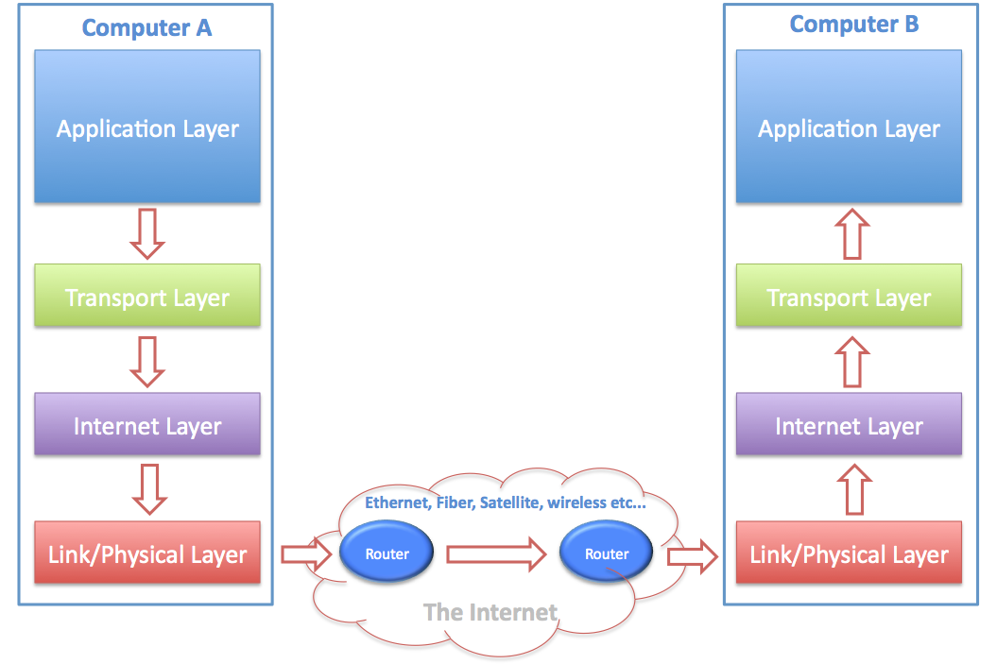
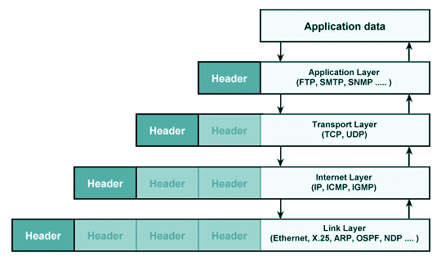
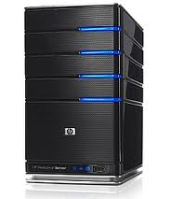
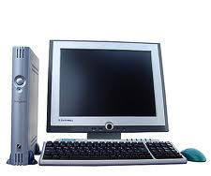

Slide 12
Clients and Servers in computer networks
A server is a network system (hardware and software) that responds to requests from other systems, called clients
Types of servers
Web server provides access to web pages
Database server provides access to databases
Application server provides remote execution of programs
Mail server provides service for sending and receiving emails
File server provides remote access to files (e.g. FTP, SMB)
Name server provides translation services between domain names and IP addresses
Print server provides remote access to printers

Slide 13
OpenEMR

Slide 14
What is OpenEMR?
OpenEMR is an electronic health record (EHR) and medical practice management software.
Features
Patient demographics
Patient scheduling
Patient portal
Electronic medical records
Prescriptions
Clinical decision support
Medical billing
Reports
Multilanguage support
Security
Free: Open Source under GNU General Public License

Slide 15
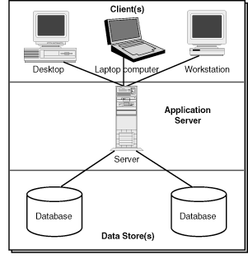
OpenEMR Architecture
OpenEMR is a web-based 3-tier application
The client sends a request using a web browser
The web and application server receives a processes the request
The database server executes queries against a database

Slide 16
OpenEMR: basics
Adding a patient
Fill demographics, insurance
Using the calendar
Setting up a weekly schedule for the provider
Making appointments
Opening a new encounter for first visit
Entering family history, brief description, alergies, life style, medications
Entering system checks, vitals
Adding a fee sheet
Making a prescription
Adding a medical issue (problem)
Associate medical issue and encounter
Adding Immunization

Slide 17
OpenEMR: basics
Adding patient notes and sending messages
Creating a referral transaction
Using patient portal
Enabling access
Resetting password
Viewing reports

Slide 18
OpenEMR: Billing
Opening a new encounter for your established patient
Adding a fee sheet for a comprehensive visit and a diagnosis
Associate the encounter with patient‘s medical issue
Enter the primary insurance of your patient
Basic billing
View all billable encounters for your patient
Select today‘s encounter and generates a X12 claim for sending to the insurance company
View billing status

Slide 19
Homework
Provide a comparative overview of computer data storage technologies
RAM and ROM memories
IDE, SATA, eSATA, USB hard disks
CD, DVD disks
Network-attached storage (NAS)
Redundancy with RAID
Suggest 5 scenarios where a client-server architecture is used (e.g. your web browser Firefox and the web server www.google.com)
Which protocols are used on the application level?
Which IP addresses are used?
Through which network nodes are data packets routed between client and server?
Send your essay as editable document (e.g. MS Word format) by Oct 12

Slide 20
Plan for next week
Operation systems and databases of IS
GaiaEHR electronic health records

