Slide 1
Information Systems in Health Care
Michel Kana, Ph.D.
Lesson 4 – Winter Term 2014

Slide 2
Schedule
Operation systems
GaiaEHR
Conclusion

Slide 3
Operation systems

Slide 4
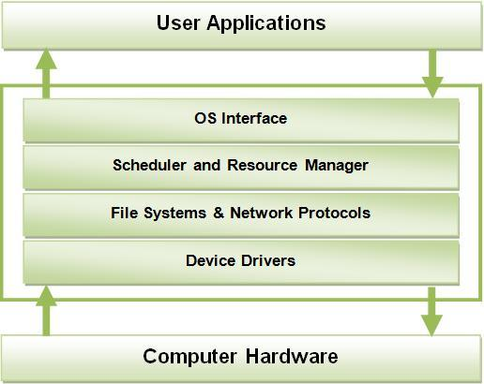
Operating systems
An Operating System (OS) is a program which acts as an interface between computer system users (& their software) and the computer hardware (& the BIOS).
An OS provides services for
Processor Management
Memory Management
File Management
Device Management
Concurrency Control

Slide 5

A simple program segment with no hardware consideration
A more sophisticated program segment with hardware consideration
Hardware response
Machine Language
OS
c = a + b ;
LDAA $80 → Loading the number at memory location 80
LDAB $81 → Loading the number at memory location 81
ADDB → Adding these two numbers
STAA $55 → Storing the sum to memory location 55

Slide 6
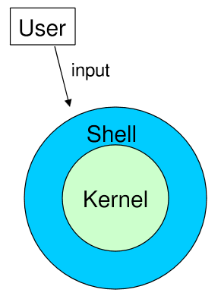
Operating systems - Linux
Linux is an operating system
Linux is described as kernel & shell
The kernel controls the hardware (CPU, RAM, hard disks, etc.)
The Shell is the interface between the user and the kernel
Linux supports multi-tasking
The directory structure starts with the root „/“
Important directories are /bin, /mnt, /home, /var, /etc
Linux distributions: Red Hat, Debian, SuSE, Mandrake
Basic commands
cd, ls, touch, cp, rm, pwd, mkdir, rmdir, cat, ps

Slide 7
Operating systems - Linux
Tutorial
Download PuTTy remote client
Connect to a linux server, port 22
Create a subdirectory ‚clinic‘
mkdir clinic
Change to the newly created subdirectory
cd clinic
Create a patients directory file (name and age)
vi patients.txt
ESC+i for editing
ESC+:+wq for saving and exiting
Display the content of the file
cat patients.txt

Slide 8
Operating systems - Linux
Tutorial
Display only the patients names
awk '{print $1;}' patients.txt
Find patients older than 40 years
awk '$2>40' patients.txt
Calculate the average patient age
awk 'BEGIN {totalAge=0; countPatient=0;} {totalAge=totalAge+$2; countPatient=countPatient+1;} END {print "Average patient age is ",totalAge/countPatient;} ' patients.txt
Find the oldest patient

Slide 9
GaiaEHR

Slide 10
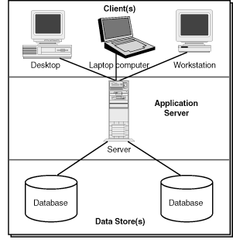
GaiaEHRArchitecture
GaiaEHR is a web-based 3-tier application
The client sends a request using a web browser
The web and application server receives a processes the request
The database server executes queries against a database

Slide 11
GaiaEHR
http://gaiaehr.org/demo/ (admin/pass)
Tutorial
Create a new patient
Enter demographics, contact, provider, employment, primary insurance with the employer as subscriber
Manage patient pool area
Add the patient to the arrival log
Move the patient to the triage, and to physician area
Open a new encounter for first visit
Enter a brief description, alergies
Enter system checks, vitals
Add current vaccines, allergies, medial problems, medications and past surgeries
Checkout the encounter
Open a new encounter for establish patient
Enter a brief description
Create a prescription, an immunoglobulin laboratory order, a chest x-ray order
Checkout the encounter
Move the patient to the checkout area
Schedule your patient for next Tuesday
Send a message to another health provider in your clinic
Print a clinical report, an immunization registry report and a billing report

Slide 12
Homework
Compare two Linux distributions of your choice.
Name 5 different operating systems and for each of them, a healthcare information system that can run on the top.
What are the major differences in operating systems on smartphones and those on personal computers regarding:
Memory and storage management
Processes and threads management
Multi-users management
Graphical user interface
Send your essay as editable document (e.g. MS Word format) by Oct 19

Slide 13
Plan for next week
Databases

