Slide 1
Information Systems in Health Care
Michel Kana, Ph.D.
Lesson 5 – Winter Term 2014

Slide 2
Schedule
Database theory
Database design
SQL

Slide 3
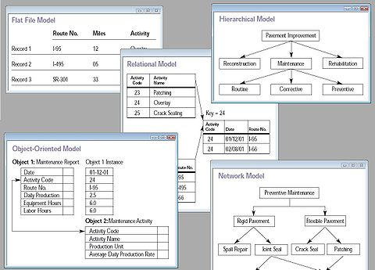
Database theory
A database is an information system for storing, processing and retrieving data.
Hierarchical database
Network database
Relational database
Object-oriented database
Zdroj. Wikipedia.org

Slide 4
Relational database
USER
USER_ID | NAME | AGE
1 | Jana | 18
2 | Pavel | 25
3 | Jan | 42
4 | Aja | 45
5 | Radek | 19
6 | Radka | 17
Table name
row
column

Slide 5
Relational database
USER
USER_ID | Number
NAME | Text
AGE | Number
USER (USER_ID number, NAME text, AGE number)

Slide 6
Relational database – primary key
A primary key is a column or a group of column that uniquely identify the data in a table row.
USER
USER_ID | NAME | AGE
1 | Jana | 18
2 | Pavel | 25
3 | Jan | 42
4 | Aja | 45
5 | Radek | 19
6 | Radka | 17
INVOICE
INVOICE_ID | USER_ID | VALUE
1 | 1 | 400
2 | 1 | 100
3 | 6 | 800
4 | 5 | 300
5 | 6 | 200
6 | 4 | 400

Slide 7
Relational database – foreign key
USER
USER_ID | NAME | AGE
1 | Jana | 18
2 | Pavel | 25
3 | Jan | 42
4 | Aja | 45
5 | Radek | 19
6 | Radka | 17
A foreign key links one or more columns of a table with columns of a foreign table.
INVOICE
INVOICE_ID | USER_ID | VALUE
1 | 1 | 400
2 | 1 | 100
3 | 6 | 800
4 | 5 | 300
5 | 6 | 200
6 | 4 | 400

Slide 8
Database design
Indentify tables, columns, primary keys and foreign keys
Data requirements for a hospital health care system:
Team A
Each patient can have one or more insurances
Team B
There are two types of patient health records: department health records and ambulatory health records
Team C
A health records folder contains one or more health records of the same patient
A patient can have several health records folders
Team D
A health record folder can be borrowed by a department, a doctor or another hospital
There is a history about who borrowed which folders

Slide 9
Database design
Team A
Each patient can have one or more insurances
PATIENT (PATIENT_ID, PATIENT_NAME, PATIENT_AGE, PATIENT_GENDER)
INSURANCE (INSURANCE_ID, INSURANCE_NAME)
PATIENT_INSURANCE (PATIENT_ID, INSURANCE_ID)
Team B
There are two types of patient health records: department health records and ambulatory health records
RECORD_TYPE (RECORD_TYPE_ID, RECORD_TYPE_NAME)
RECORD (RECORD _ID, PATIENT_ID, RECORD _TYPE_ID, RECORD _DATE)
Team C
A health records folder contains one or more health records of the same patient. A patient can have several health records folders
FOLDER (FOLDER_ID, FOLDER_NAME, PATIENT_ID)
FOLDER_RECORD (FOLDER _ID, RECORD _ID)
Team D
A health record folder can be borrowed by a department, a doctor or another hospital
BORROWER_TYPE (BORROWER_TYPE_ID, BORROWER_TYPE_NAME)
BORROWER (BORROWER_ID, BORROWER _TYPE_ID, BORROWER _NAME)
There is a history about who borrowed which folders
HISTORY (HISTORY_ID, BORROWER_ID, FOLDER_ID, HISTORY_DATE)

Slide 10
SQL
Structured Query Language is a declarative language that serves the following purposes:
Data structure definition
CREATE
ALTER
DROP
Data manipulation
Storing data
INSERT
Actualizing data
UPDATE
Deleting data
DELETE
Querying data
SELECT
Database administration
Managing access rights
GRANT
Managing transactions
START TRANSACTION, COMMIT, ROLLBACK

Slide 11
SQL – Data Definition Language
Database definition
CREATE DATABASE db_name;
Table definition
CREATE TABLE table_name (column_name1 column_type1, column_name2 column_type2, … PRIMARY KEY (column_name1, …) );
Data types: INT, VARCHAR(length), DATE
Primary key: PRIMARY KEY
Create the database BMT_DB
Team A – Table definition
PATIENT (PATIENT_ID, PATIENT_NAME, PATIENT_AGE, PATIENT_GENDER)
INSURANCE (INSURANCE_ID, INSURANCE_NAME)
PATIENT_INSURANCE (PATIENT_ID, INSURANCE_ID)
Team B – Table defintion
RECORD_TYPE (RECORD_TYPE_ID, RECORD_TYPE_NAME)
RECORD (RECORD _ID, PATIENT_ID, RECORD _TYPE_ID, RECORD _DATE)
Team C – Table definition
FOLDER (FOLDER_ID, FOLDER_NAME, PATIENT_ID)
FOLDER_RECORD (FOLDER _ID, RECORD _ID)
Team D – Table definition
BORROWER_TYPE (BORROWER_TYPE_ID, BORROWER_TYPE_NAME)
BORROWER (BORROWER_ID, BORROWER _TYPE_ID, BORROWER _NAME)
HISTORY (HISTORY_ID, BORROWER_ID, FOLDER_ID, HISTORY_DATE)

Slide 12
SQL – Data Definition Language
Create the database BMI_DB
CREATE DATABASE BMI_DB;
Team A
CREATE TABLE patient ( patient_id INT PRIMARY KEY, patient_name VARCHAR(80), patient_age INT, patient_gender INT );
CREATE TABLE insurance ( insurance_id INT PRIMARY KEY, insurance_name VARCHAR(160));
CREATE TABLE patient_insurance ( patient_id INT, insurance_id INT, PRIMARY KEY (patient_id, insurance_id) );
Team B
CREATE TABLE record_type ( record_type_id INT PRIMARY KEY, record_type_name VARCHAR(30) );
CREATE TABLE record ( record_id INT PRIMARY KEY, patient_id INT, record _type_id INT, record _date DATE );
Team C
CREATE TABLE folder ( folder_id INT PRIMARY KEY, folder_name VARCHAR(80), patient_id INT );
CREATE TABLE folder_record ( folder_id INT, record_id INT, PRIMARY KEY (folder_id, record_id) );
Team D
CREATE TABLE borrower_type ( borrower_type_id INT PRIMARY KEY, borrower_type_name VARCHAR(80) );
CREATE TABLE borrower ( borrower_id INT PRIMARY KEY, borrower _type_id INT, borrower _name VARCHAR(160) );
CREATE TABLE history ( history_id INT PRIMARY KEY, borrower_id INT, folder_id INT, history_date DATE );

Slide 13
SQL – Data Manipulation Language
Storing data
INSERT INTO table_name (column_name1, column_name2, …) VALUES (value_column1, value_column2, …);
Team A – store a patient with 1 health insurance and a patient with 2 health insurances
PATIENT (PATIENT_ID, PATIENT_NAME, PATIENT_AGE, PATIENT_GENDER)
INSURANCE (INSURANCE_ID, INSURANCE_NAME)
PATIENT_INSURANCE (PATIENT_ID, INSURANCE_ID)
Team B – store a department health record and an ambulatory health record for both patients
RECORD_TYPE (RECORD_TYPE_ID, RECORD_TYPE_NAME)
RECORD (RECORD _ID, PATIENT_ID, RECORD _TYPE_ID, RECORD _DATE)
Team C – store 2 health records folders for each patient
FOLDER (FOLDER_ID, FOLDER_NAME, PATIENT_ID)
FOLDER_RECORD (FOLDER _ID, RECORD _ID)
Team D – store 1 doctor and two loans of a health records folder for each patient
BORROWER_TYPE (BORROWER_TYPE_ID, BORROWER_TYPE_NAME)
BORROWER (BORROWER_ID, BORROWER _TYPE_ID, BORROWER _NAME)
HISTORY (HISTORY_ID, BORROWER_ID, FOLDER_ID, HISTORY_DATE)

Slide 14
SQL – Data Manipulation Language
Team A
INSERT INTO patient (patient_id, patient_name, patient_age, patient_gender) VALUES (1, 'Jakub Janda', 25, 'male');
INSERT INTO insurance (insurance_id, insurance_name) VALUES (1, 'Všeobecná zdravotní pojišťovna');
INSERT INTO patient_insurance (patient_id, insurance_id) VALUES (1, 1);
Team B
INSERT INTO record_type (record_type_id, record_type_name) VALUES (1, 'oddělení'), (2, 'ambulantní');
VALUES INSERT INTO record (record _id, patient_id, record _type_id, record _date) VALUES (1, 1, 1, now());
Team C
INSERT INTO folder (folder_id, folder_name , patient_id) VALUES (1, 'Složka záznamů pro Jakuba Jandu', 1);
INSERT INTO folder_record (folder _id, record _id) VALUES (1, 1);
Team D
INSERT INTO borrower_type (borrower_type_id, borrower_type_name) VALUES (1, 'oddělení'), (2, 'lékař'), (3, 'nemocnice');
INSERT INTO borrower (borrower_id , borrower _type_id, borrower _name ) VALUES (1, 2, 'MUDr. Jan Malík');
INSERT INTO history (history_id , borrower_id, folder_id, history_date) VALUES (1, 1, 1, now());

Slide 15
SQL – Data query
Querying data
SELECT column_name1, column_name2, … FROM table_name [WHERE conditions] [GROUP BY column_name1, column_name2, …] [HAVING conditions] [ORDER BY column_name1, column_name2, …] [LIMIT row_count];
Team A
Total number of patients
Insurance of patient Jakub Janda
Folders borrowed by doctor MUDr. Malík
Team B
Total number of male patients
Ambulantory health records of patient Jakub Janda
All patients without folders
Team C
Folders which were borrowed by a hospital
Oldest patient
Last date when a folder of patient Klára Bíla was borrowed
Team D
Number of health insurances for patient Ludmila Černa
All health records for patient Jana Hezka
All loans of health records for patient Švejk which were made by doctors and hospitals
PATIENT (PATIENT_ID, PATIENT_NAME, PATIENT_AGE, PATIENT_GENDER)
INSURANCE (INSURANCE_ID, INSURANCE_NAME)
PATIENT_INSURANCE (PATIENT_ID, INSURANCE_ID)
RECORD_TYPE (RECORD_TYPE_ID, RECORD_TYPE_NAME)
RECORD (RECORD _ID, PATIENT_ID, RECORD _TYPE_ID, RECORD _DATE)
FOLDER (FOLDER_ID, FOLDER_NAME, PATIENT_ID)
FOLDER_RECORD (FOLDER _ID, RECORD _ID)
BORROWER_TYPE (BORROWER_TYPE_ID, BORROWER_TYPE_NAME)
BORROWER (BORROWER_ID, BORROWER _TYPE_ID, BORROWER _NAME)
HISTORY (HISTORY_ID, BORROWER_ID, FOLDER_ID, HISTORY_DATE)

Slide 16
SQL – Data query
PATIENT (PATIENT_ID, PATIENT_NAME, PATIENT_AGE, PATIENT_GENDER)
INSURANCE (INSURANCE_ID, INSURANCE_NAME)
PATIENT_INSURANCE (PATIENT_ID, INSURANCE_ID)
RECORD_TYPE (RECORD_TYPE_ID, RECORD_TYPE_NAME)
RECORD (RECORD _ID, PATIENT_ID, RECORD _TYPE_ID, RECORD _DATE)
FOLDER (FOLDER_ID, FOLDER_NAME, PATIENT_ID)
FOLDER_RECORD (FOLDER _ID, RECORD _ID)
BORROWER_TYPE (BORROWER_TYPE_ID, BORROWER_TYPE_NAME)
BORROWER (BORROWER_ID, BORROWER _TYPE_ID, BORROWER _NAME)
HISTORY (HISTORY_ID, BORROWER_ID, FOLDER_ID, HISTORY_DATE)
Team A
Total number of patients select count(*) from patient
Insurance of patient Jakub Janda select insurane.insurance_name from insurance, patient, patient_insusurance where insurance.insurance_id = patient_insurance.insurance_id and patient_insurance.patient_id = patient.patient_id and patient.patient_name = 'Jakub Janda‘
Folders borrowed by doctor MUDr. Malík select folder.folder_name from folder, borrower, history where folder.folder_id = history.folder_id and history.borrower_id = borrower.borrower_id and borrower.borrow_name = 'MUDr. Malik‘

Slide 17
SQL – Data query
PATIENT (PATIENT_ID, PATIENT_NAME, PATIENT_AGE, PATIENT_GENDER)
INSURANCE (INSURANCE_ID, INSURANCE_NAME)
PATIENT_INSURANCE (PATIENT_ID, INSURANCE_ID)
RECORD_TYPE (RECORD_TYPE_ID, RECORD_TYPE_NAME)
RECORD (RECORD _ID, PATIENT_ID, RECORD _TYPE_ID, RECORD _DATE)
FOLDER (FOLDER_ID, FOLDER_NAME, PATIENT_ID)
FOLDER_RECORD (FOLDER _ID, RECORD _ID)
BORROWER_TYPE (BORROWER_TYPE_ID, BORROWER_TYPE_NAME)
BORROWER (BORROWER_ID, BORROWER _TYPE_ID, BORROWER _NAME)
HISTORY (HISTORY_ID, BORROWER_ID, FOLDER_ID, HISTORY_DATE)
Team B
Total number of male patients select * from patient where gender='male'
Ambulantory health records of patient Jakub Janda select record.* from record, record_type, patient where record.record_type_id = record_type.record_type_id and record.patient_id = patient.patient_id and record_type.record_type_name = 'ambulantní‘ and patient.patient_name = 'Jakub Janda‘
All patients without folders select patient.patient_name, count(*) from folder, patient where folder.patient_id = patient.patient_id group by patient.patient_name having count(*)=0

Slide 18
SQL – Data query
PATIENT (PATIENT_ID, PATIENT_NAME, PATIENT_AGE, PATIENT_GENDER)
INSURANCE (INSURANCE_ID, INSURANCE_NAME)
PATIENT_INSURANCE (PATIENT_ID, INSURANCE_ID)
RECORD_TYPE (RECORD_TYPE_ID, RECORD_TYPE_NAME)
RECORD (RECORD _ID, PATIENT_ID, RECORD _TYPE_ID, RECORD _DATE)
FOLDER (FOLDER_ID, FOLDER_NAME, PATIENT_ID)
FOLDER_RECORD (FOLDER _ID, RECORD _ID)
BORROWER_TYPE (BORROWER_TYPE_ID, BORROWER_TYPE_NAME)
BORROWER (BORROWER_ID, BORROWER _TYPE_ID, BORROWER _NAME)
HISTORY (HISTORY_ID, BORROWER_ID, FOLDER_ID, HISTORY_DATE)
Team C
Folders which were borrowed by a hospital select folder.* from folder, borrower, borrower_type, history where folder.folder_id = history.folder_id and history.borrower_id = borrower.borrower_id and borrower. borrower_type_id = borrower_type. borrower_type and borrower_type. borrower_type_name = 'nemocnice‘
Oldest patient select * from patient order by patient_age desc limit 1
Last date when a folder of patient Klára Bíla was borrowed select max(history.date) from history, folder, patient where history.folder_id = folder.fodler_id and folder.patient_id = patient.patient_id and patient.patient_name = 'Klara Bila‘

Slide 19
SQL – Data query
PATIENT (PATIENT_ID, PATIENT_NAME, PATIENT_AGE, PATIENT_GENDER)
INSURANCE (INSURANCE_ID, INSURANCE_NAME)
PATIENT_INSURANCE (PATIENT_ID, INSURANCE_ID)
RECORD_TYPE (RECORD_TYPE_ID, RECORD_TYPE_NAME)
RECORD (RECORD _ID, PATIENT_ID, RECORD _TYPE_ID, RECORD _DATE)
FOLDER (FOLDER_ID, FOLDER_NAME, PATIENT_ID)
FOLDER_RECORD (FOLDER _ID, RECORD _ID)
BORROWER_TYPE (BORROWER_TYPE_ID, BORROWER_TYPE_NAME)
BORROWER (BORROWER_ID, BORROWER _TYPE_ID, BORROWER _NAME)
HISTORY (HISTORY_ID, BORROWER_ID, FOLDER_ID, HISTORY_DATE)
Team D
Number of health insurances for patient Ludmila Černa select count(*) from insurance, patient where insurance.insurance_id = patient.insurance_id and patient.patient_name = 'Ludmila Cerna‘
All health records for patient Jana Hezka select * from record, patient where record.patient_id = patient.patient_id and patient.patient_name = 'Jana Hezka'
All loans of health records for patient Švejk which were made by doctors and hospitals select * from history, borrower, borrower_type, patient, folder where history.borrower_id = borrower.borrower_id and borrower.borrower_type_id = borrower_type.borrower_type_id and history.folder_id = folder.folder_id and folder.patient_id = patient.patient_id and borrower_type.borrower_type_name in ('doctor', 'hospital') and patient.patient_name = 'Svejk'

Slide 20
Database Systems
Commercial database systems
Oracle
Informix Dynamic Server
Microsoft SQL Server
IBM DB2
Sybase, Teradata, SQL Anywhere
Open source database systems
MySQL
PostgreSQL
Firebird
Ingres

Slide 21
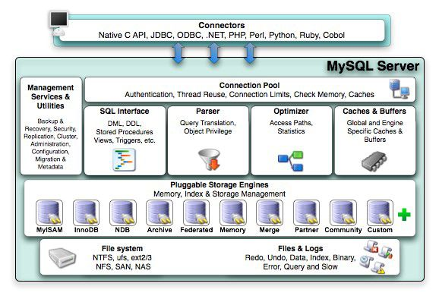
Database system MySQL
Source. mysql.com

Slide 22
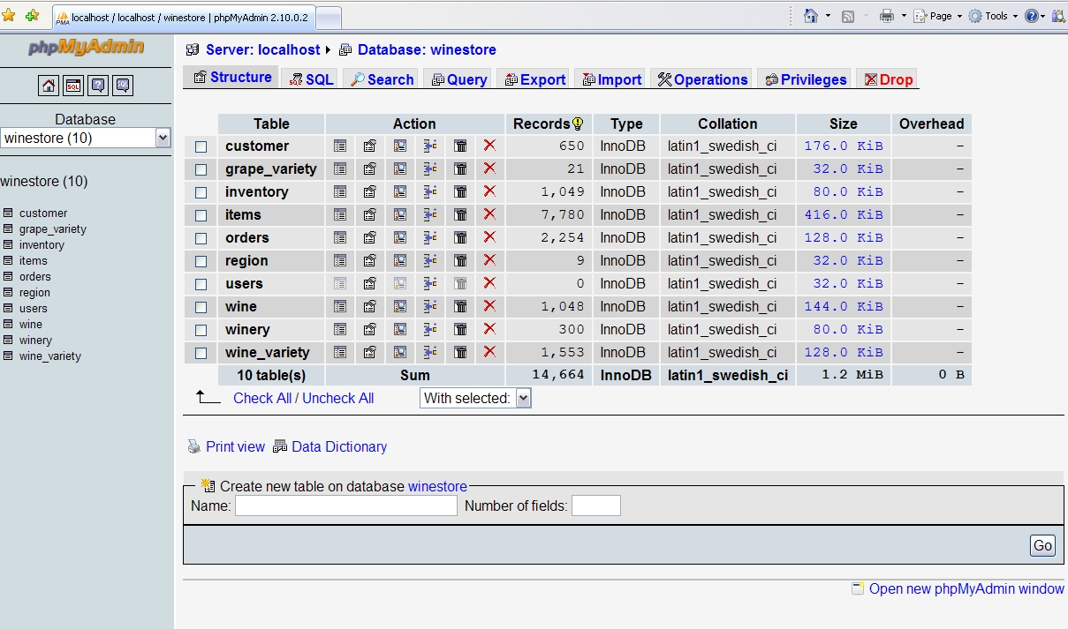
Database system MySQL - phpMyAdmin
Source. mysql.com

Slide 23
Homework
webstu.fbmi.cvut.cz – personal server
databaze.fbmi.cvut.cz – server for this homework
Account activation:
FTP Connection (create your working directory):
Your PC -> ftp://databaze.fbmi.cvut.cz
Use your faculty login and password
Open the admin web page
http://databaze.fbmi.cvut.cz/yourlogin
Click on the link Vytvořit databázi for creating your database
Your should receive an email on your faculty account with login details to MySQL

Slide 24
Homework
Create and insert illustrative data into the following tables in your faculty or personal database
PATIENT (PATIENT_ID, PATIENT_NAME, PATIENT_AGE, PATIENT_GENDER)
INSURANCE (INSURANCE_ID, INSURANCE_NAME)
PATIENT_INSURANCE (PATIENT_ID, INSURANCE_ID)
RECORD_TYPE (RECORD_TYPE_ID, RECORD_TYPE_NAME)
RECORD (RECORD _ID, PATIENT_ID, RECORD _TYPE_ID, RECORD _DATE)
FOLDER (FOLDER_ID, FOLDER_NAME, PATIENT_ID)
FOLDER_RECORD (FOLDER _ID, RECORD _ID)
BORROWER_TYPE (BORROWER_TYPE_ID, BORROWER_TYPE_NAME)
BORROWER (BORROWER_ID, BORROWER _TYPE_ID, BORROWER _NAME)
HISTORY (HISTORY_ID, BORROWER_ID, FOLDER_ID, HISTORY_DATE)
Write SQL queries for the following tasks and run them against your database:
Folders with the highest number of ambulantory records for pacient Klara Novakova
Hospital with the highest number of rentals of folders for patients younger than 30 years old
Insurance with 100 or more folder rentals made by doctors
Records older than 10 days for pacients insured at VZP. For each record, display the total number of folders where the record appears, the total number of departments who rent those folders, the total number of rentals of those folders
Send an export of your database together with the queries by Oct 26
Install OpenMRS on your Laptop

