Slide 1
Information Systems in Health Care
Michel Kana, Ph.D.
Lesson 6 – Winter Term 2014

Slide 2
Schedule
Clinical Information Systems
SQL

Slide 3
Purpose of clinical information systems
The principal function of clinical information systems is to facilitate patient care.
identifying, classifying, understanding, and resolving medical problems
recall observations, inform others, instruct students,
gain knowledge, monitor performance, justify intervention.
Clinical information systems are
becoming integral components of healthcare services,
replacing the established paper based system of records.
Clinical information systems are applicable for
Small medical practices
Larger medical practices
Medical complexes such as hospitals

Slide 4
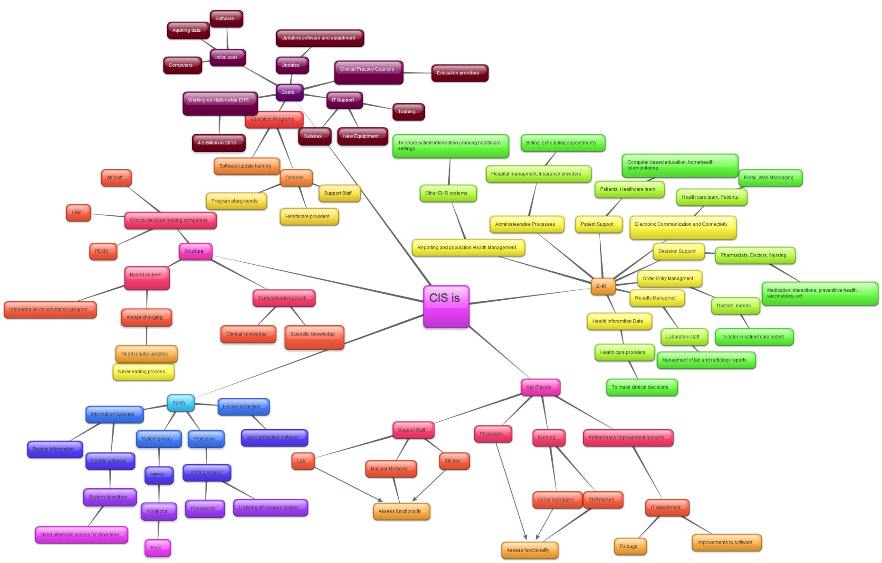
http://jenmcglasson.files.wordpress.com/2012/04/new-sheet_1gyrp7xt1.jpg
http://ashleighmalcolmrn.files.wordpress.com/2012/04/ashleigh_malcolm_cis_mind_mapping.jpg
http://ednurse511.files.wordpress.com/2012/04/new-sheet_6k8ik2.jpg

Slide 5
Components of clinical information systems
Electronic health record (EHR)
Component for the systematic and electronic collection, processing and sharing of health information in electronic form.
Computerized provider order entry (CPOE)
Component for electronically entering treatment or medication orders and tracking their fulfillment for the treatment of patients.
Clinical decision support system (CDSS)
Real-time interactive tool to assist heath care provider in their diagnostic and treatment decisions.
Results management component
Component for managing departments and medical results including laboratory, microbiology, pathology, radiology.
Picture archiving and communications system (PACS) is a part of results management
It captures and integrates diagnostic and radiological images such as x-ray, MRI and CT.

Slide 6
Components of clinical information systems
Medical practice management software (PMS)
Set of tools for helping healthcare providers in their day-to-day operations in a medical practice.
Electronic communication and connectivity
Component for allowing the electronic communication between health care providers and the exchange of integrated heath record among different heath care systems (e.g. pharmacies)
Administrative process component
Component that provides electronic means for scheduling and billing patients, claiming insurances, managing material and human resources, generating reports.
Electronic materials management (EMM) is a part of administrative process component.
It tracks and manages inventory of medical supplies, pharmaceuticals, and other materials.
Patient support
Component for patient education and self-monitoring (e.g. home monitoring systems, telemedicine)
Reporting and population health management
Component for sharing patient health information among healthcare settings within programs targeted to a defined population that aim to improve health outcomes

Slide 7
Key Players of clinical information systems
Patients
Health care providers
Physicians
Primary care physician (treats basic medical conditions)
Surgeons (specializes in cutting into patients to diagnose, treat, and cure medical problems)
Hospitalists (works with other doctors to provide patient care 24-hours a day, seven days a week)
Mid-level providers
Physician assistants (practice medicine according to the needs and wishes of a supervising doctor or surgeon)
Advanced practice nurses (registered nurses who in addition has achieved an advanced level of education and training, i.e. at least a master's degree)
Nurse practitioner, surgical nurses, nurse anesthetists, midwife
Nursing personal
Registered nurses (graduated from a two to four years state-approved nursing school program in the diagnoses and treatment of a range of common medical conditions and illnesses)
Licensed practical/vocational nurses (has completed a practical nursing program, which usually offers around one year of nursing training)

Slide 8
Key Players of clinical information systems
Administration
Directors
Supervisors
Medical transcriptionists (types information from doctors' notes and patient records into official reports)
Medical coder, biller or specialist (works on accurate records management, billing and insurance processing)
Social workers, receptionists, office administrators, cleaning staff
Computer services
IT professionals
Technical support
Students

Slide 9
Safety in clinical information systems
Storage
Hard disks, RAID systems, network attached storage
Backup and recovery systems
Systems for copying and archiving of computer data for the purpose of restoring to the original after a data loss event.
Encryption systems
Systems for encoding data in such a way that only authorized parties can read it (confidentiality).
Data is encoded using an encryption key and decoded using a secret decryption key.
There are symetric-key and public-key schemes.
Encryption can be applied to data on storage and to data in-transit over computer networks.
Electronic signatures
Digital signatures demonstrates the authenticity of a digital message or document and its sender.
Security systems
Firewall prevents unauthorized or unwanted communications between computer networks or hosts.
Anti-Virus are software that prevent, detect and remove malware.
Patient privacy
Access control and monitoring
HIPPA (Health Insurance Portability and Accountability Act) gives the right to privacy to individuals from age 12 through 18
Electronic identification and authentication

Slide 10
Costs of clinical information systems
Initial costs
Hardware
Software
Data
IT support
Salaries
Hardware maintenance
Software updates
Training
Education programs
Initial trainings
Software updates training

Slide 11
A case study - VistA
The Veterans Health Information Systems and Technology Architecture (VistA) is an enterprise-wide clinical information system
It provides care to over 8 million patients (veterans), employing 180,000 medical personnel and operating 163 hospitals, over 800 clinics, and 135 nursing homes.
It is the most familiar and widely used EHR in the U.S.
It consists of nearly 160 integrated software modules for clinical care, financial functions, and infrastructure.
http://sourceforge.net/projects/openvista/
http://medsphere.com/
http://worldvista.org/

Slide 12
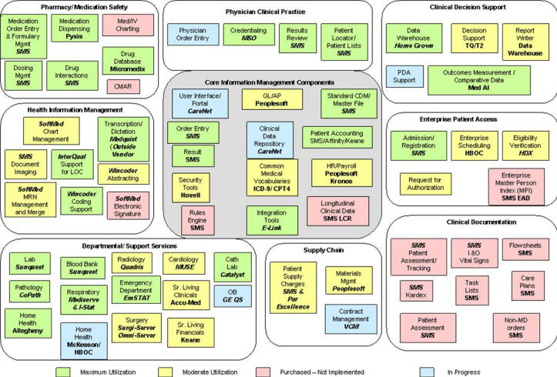
http://gunston.gmu.edu/healthscience/740/ElectronicHealthRecordEHREMR.asp

Slide 13
A case study - VistA
VistA components
Accounts Receivable, Consolidated Mail, Outpatient Pharmacy, Controlled Substances, Current Procedural Terminology (CPT), Diagnostic Related Group (DRG), Grouper Drug Accountability/Inventory, Interface, Duplicate Record Merge: Patient Merge, Event Capture, Medications, Inpatient Medications - Intravenous Inpatient Medications - Unit Dose, Integrated Billing, Laboratory, Laboratory Electronic Data Interchange, Lexicon Utility, Master Patient Index, Master Patient Index/Patient Demographics, National Drug File, Outpatient Pharmacy, Patient Information Management Systems (Admission, Discharge, Transfer, Registration), Pharmacy Benefits Management, Pharmacy Data Management, Radiology/Nuclear Medicine, and Scheduling
Adverse Reaction Tracking, Authorization/Subscription Utility, Automated Information Collection System (AICS), Automated Medical information Exchange (AMIE), Automatic Replenishment/Ward Stock, Clinical Reminders, Consults/Request Tracking, CPRS, Dietetics, Generic Code Sheet, Health Summary, Integrated Funds Distribution, Control Point Activity, Accounting and Procurement (IFCAP), Patient Care Encounter, Problem List, Text Integration, Utilities, and Vitals/Measurements
Equipment/Turn-In, Request Fee Basis, Hepatitis C Extract, Home Based Primary Care, Immunology Case Registry, Incident Reporting, Intake and Output, Library, Medicine Clinical Services, Mental Health, Minimal Patient Dataset, Network Health Exchange, Nursing, Occurrence Screen, Oncology, Patient Identification Card, Personnel and Accounting Integrated Data, Pharmacy Prescription Practices, Police and Security, Primary Care Management Module, Prosthetics, Quality: Audiology And Speech Analysis And Reporting, Record Tracking, Resident Assessment Instrument/Minimum Data Set, Risk Assessment (Surgery), Social Work, Spinal Cord Dysfunction, Surgery, Survey Generator, Visual Impairment Service Team, Voluntary Timekeeping, and Women's Health

Slide 14
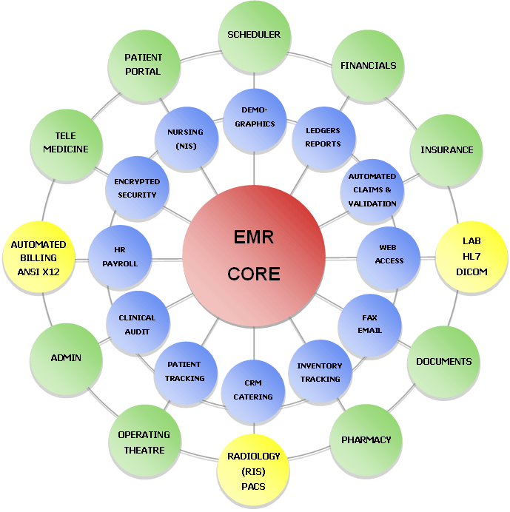
Case study - MDTotal
Appointment Multiple Scheduler, Payment Source Management, Demographics, Automated Integrated Billing, Electronic Claims Processing, Direct Electronic Billing (X12 EDI), E-Fax Prescriptions, ID & Insurance Card Scan, Prescription Call-In, Patient Photo ID, Dynamic Patient Search, Referral Letters, Document Management, Account Management, Expense Management, Referrals Management, Recall Management, Patient Education, Front Office Management, Back Office Management, Administrative Management, Appointment Reminders, Room Status Display, Patient Visit Status, Recalls, Room Availability, Lab Orders / Results (HL7), Secure Inter-office Mail, Room Management, HIPAA Compliant, E-Checkin, Pathology Tracking, Cancer Tracking, Kiosk Registration, Data Backup / Restore, Multiple Site Capable, Web Pre-Registration, Multiple Schedules, Platforms: Windows / Mac / Linux
http://www.mdtotal.com

Slide 15
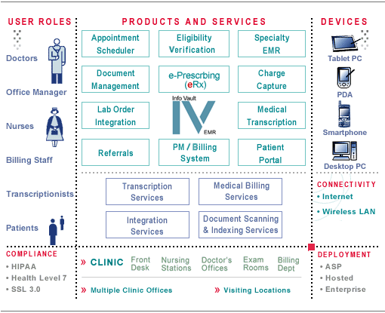
Case study - InfoVault
http://www.central-voice.com/products/emr/infovault_emr.html

Slide 16
SQL
Create and insert illustrative data into the following tables in your faculty or personal database
PATIENT (PATIENT_ID, PATIENT_NAME, PATIENT_AGE, PATIENT_GENDER)
INSURANCE (INSURANCE_ID, INSURANCE_NAME)
PATIENT_INSURANCE (PATIENT_ID, INSURANCE_ID)
RECORD_TYPE (RECORD_TYPE_ID, RECORD_TYPE_NAME)
RECORD (RECORD _ID, PATIENT_ID, RECORD _TYPE_ID, RECORD _DATE)
FOLDER (FOLDER_ID, FOLDER_NAME, PATIENT_ID)
FOLDER_RECORD (FOLDER _ID, RECORD _ID)
BORROWER_TYPE (BORROWER_TYPE_ID, BORROWER_TYPE_NAME)
BORROWER (BORROWER_ID, BORROWER _TYPE_ID, BORROWER _NAME)
HISTORY (HISTORY_ID, BORROWER_ID, FOLDER_ID, HISTORY_DATE)
Write SQL queries for the following tasks and run them against your database:
Folders with the highest number of ambulantory records for patient Klara Novakova
Hospital with the highest number of rentals of folders for patients younger than 30 years old
Insurance with 100 or more folder rentals made by doctors
Records older than 10 days for pacients insured at VZP. For each record, display the total number of folders where the record appears, the total number of departments who rent those folders, the total number of rentals of those folders

Slide 17
Homework
Make a component-based comparison of OpenEMR, GaiaEHR, OpenMRS, VistA, InfoVault and InfoBank (focusing on Electronic health record, Computerized provider order entry, Clinical decision support system, Results management component, Medical practice management software, Electronic communication and connectivity, Administrative process component, Patient support, Reporting and population health management).
Define at least 20 concepts found in clinical information systems (e.g. visit, encounter, ePrescription, demographics, etc.)
Send your essay as editable document (e.g. MS Word format) by Nov 9

Slide 18
Plan for next week
Decision support systems, Medical data coding
OpenMRS

