Slide 1
Information Systems in Health Care
Michel Kana, Ph.D.
Lesson 7 – Winter Term 2014

Slide 2
Schedule
Decision Support Systems
Medical Data Coding
OpenMRS
Conclusion

Slide 3
Decision Support Systems

Slide 4
What are clinical decision rules?
A clinical prediction rule or clinical decision rule, is a method that quantifies information from the history, examination, and basic laboratory results towards the diagnosis, prognosis and response to treatment in a specific patient.
Benefits of clinical decision rules
increase the accuracy of clinicians’ diagnostic and prognostic assessments.
reduce the uncertainty in decision making in medical practice.
Types of clinical decision rules
drug-interaction checking
preventive care reminders
adverse drug event detection

Slide 5
Components of clinical decision rules
Triggers
Events that cause a decision support rule to be invoked, e.g. prescribing a drug, ordering a laboratory test, entering a new problem on the problem list.
Input data
Data elements used by a rule to make inferences, e.g. laboratory results, patient demographics, or patient’s problem list
Interventions:
Possible actions a decision support module can take, e.g. sending a message to a clinician, showing a guideline, logging that an event took place
Offered choices
Choice that users of a clinical can make, e.g. a rule that fired because a physician entered an order for a drug the patient is allergic to might allow the clinician to cancel the new order, choose a safer alternative drug, or override the alert and keep the order as written but provide an explanation.

Slide 6
Example of clinical decision rules
Monitoring patients for hypokalemia while they are taking digoxin
Triggers
A new potassium value is stored in the electronic health record.
The new potassium value is checked against a reference range (to determine whether the patient is hypo-, hyper-, or normokalemic)
If hypokalemia is detected, the medication list is checked to determine whether the patient was on digoxin. If so, the rule is triggered.
Input data
Potassium value from laboratory results
Reference range of potassium value
Patient’s medication list
Interventions:
The decision support module sends a message to the responsible physician
Offered choices
Adding potassium supplementation
Reducing digoxin intake
Discontinuing digoxin intake

Slide 7
Computing techniques used in CDSS
Rule-based (expert) systems
System where knowledge of human experts is captured in form of IF-THEN rules.
Artificial neural networks
Non-knowledge-based adaptive systems that use machine learning to learn from experiences and recognize patterns in clinical information
Bayesian networks
Knowledge-based systems that show probabilistic causal relationships between sets of variables, e.g. diseases and symptoms.
Model based systems
Systems that uses individualized computational models of human pathophysiology to model the dynamics of a wide variety of tissues and organs.
Data mining and machine learning
Systems that use a large database of existing cases in order to make probabilistic decisions, e.g. analyzing response of patients similar to current patient to decide upon the best treatment.
Genetic algorithms
Non-knowledge-based systems that use iterative processes for finding an optimal solution based on patient data.

Slide 8
OpenEMR: Clinical Decision Rules
http://demo.open-emr.org:2107/openemr/
Components of a rule
Demographics filter criteria: specify to which patients the rule applies
Clinical targets: define the clinical value that triggers the rule
Actions: specify the desired outcome targeted by the rule
Reminder type: specifies where an alert pops-up when the rule is active
Example
Search for a patient where the Tobacco Use Assessment rule is due
Enter patient‘s current tobacco life style
Verify that the Tobacco Cessation Intervention rule is now due
Enter the results of the intervention

Slide 9
Medical Data Coding

Slide 10
What is medical data coding
Medical data coding is the administrative activity to analyze patients’ medical records and translate the written documentation into universally accepted, industry-standard medical codes using a medical classification system.
Codes are used for diagnosis, procedures, medication
A medical classification system is a common language for describing medical data
Statistical classifications defines medical data using clinical concepts and categories
International Classification of Diseases (ICD-9)
Nomenclatures defines medical data using clinical concepts without categorization
Anatomical Therapeutic Chemical Classification System (ATC)

Slide 11
Methodology of medical data coding
Purpose of medical data coding
submit claims to third party payer for reimbursement
gather statistical information
quality review
benchmarking measurement
Steps in medical data coding
Abstraction: medical information is analyzed from various sources (clinical notes, laboratory results, radiology results, etc.)
Assignment: appropriate codes are assigned using a medical classification system
Review: check the assigned code against the medical documentation and the clinical setup

Slide 12
OpenEMR: ICD-9 Diagnosis
http://smsos.fbmi.cvut.cz/openemr
Administration -> Codes

Slide 13
OpenMRS

Slide 14
OpenMRS
OpenMRS is a software platform and a reference application over which electronic medical records (EMR) systems can be built upon.
Features
tool for gathering patient information in encounters (in clinic or hospital visits), observations in those encounters, and notes.
summaries, reports, graphs and views critical for statistical analysis of disease progression and/or treatment effectivity
the world’s largest international collaboration in health care software
Data is gathered and stored using concepts, which are question-answer information which can be entered in a form.
The concept dictionary remains open and generic

Slide 15
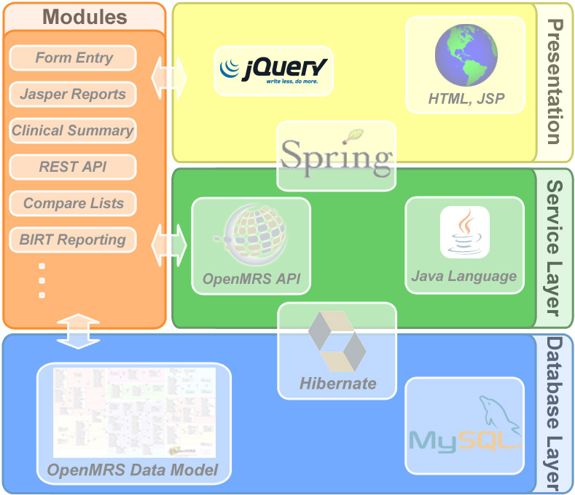
OpenMRS Architecture
Presentation layer
Web-based user interface
Modules
Self-contained packaged components
Service layer
API for modules development
Database layer
MySQL
Connectors
Java Spring and Hibernate.

Slide 16
OpenMRS
http://smsos.fbmi.cvut.cz:8080/openmrs
Tutorial
Create a new patient
Enter demographics, contact, provider, etc.
Start a visit and open a new encounter
Enter a brief description, alergies
Enter system checks, vitals
Add current vaccines, allergies, medial problems, medications
Close the visit
Schedule your patient for next Tuesday

Slide 17
Homework
Elaborate on the computing techniques underlying clinical decision support systems (Rule-based (expert) systems, Artificial neural networks, Bayesian networks, Model based systems, Data mining, Genetic algorithms).
Create your own clinical decision rule in your OpenEMR test system following the below guidelines:
http://open-emr.org/wiki/images/c/ca/Clinical_Decision_Rules_Manual.pdf
Send your essay as editable document (e.g. MS Word format) by Nov 16

Slide 18
Syllabus of lectures and tutorials
 |  | Lectures (45 min) | Tutorials (45 min)
Lesson 1 | Sep 30 | Medical Informatics and IS definition | OpenEMR
Lesson 2 | Oct 7 | HW infrastructure of IS | OpenEMR
Lesson 3 | Oct 14 | Operation systems | GaiaEHR
Lesson 4 | Oct 21 | Databases of IS | SQL
Lesson 5 | Oct 28
Lesson 6 | Nov 4 | Clinical oriented IS | SQL
Lesson 7 | Nov 11 | Decision support systems Medical data coding | OpenMRS
Lesson 8 | Nov 18 | Data and communication standards | OpenMRS
Lesson 9 | Nov 25 | Phase and IS development principles | UML
Lesson 10 | Dec 2 | Standard implementation methodology | Programing in PHP and MySQL
Lesson 11 | Dec 9 | Standard implementation methodology | Programing in PHP and MySQL
Lesson 12 | Dec 16 | Presentation of practical project and final exam

Slide 19
Plan for next week
Data and communication standards
OpenMRS

