Slide 1
Information Systems in Health Care
Michel Kana, Ph.D.
Lesson 8 – Winter Term 2014

Slide 2
Schedule
Analysis of software systems
Software development process
Requirements analysis with UML
Object-oriented modeling with UML
Design of software systems
Software architecture
User interface design
Design of computing logic

Slide 3
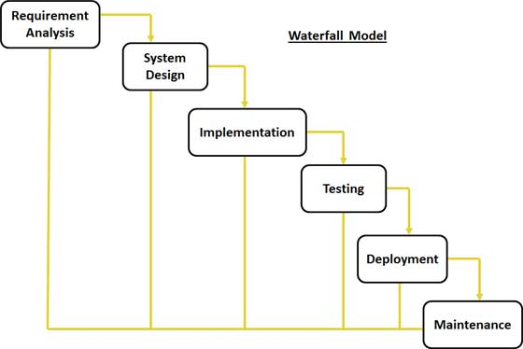
Waterfall software process
Requirement Gathering and analysis: All possible requirements of the system to be developed are captured in this phase and documented in a requirement specification doc.
System Design: The requirement specifications from first phase are studied in this phase and system design is prepared. System Design helps in specifying hardware and system requirements and also helps in defining overall system architecture.
Implementation: With inputs from system design, the system is first developed in small programs called units, which are integrated in the next phase. Each unit is developed and tested for its functionality which is referred to as Unit Testing.
Integration and Testing: All the units developed in the implementation phase are integrated into a system after testing of each unit. Post integration the entire system is tested for any faults and failures.
Deployment of system: Once the functional and non functional testing is done, the product is deployed in the customer environment or released into the market.
Maintenance: There are some issues which come up in the client environment. To fix those issues patches are released. Also to enhance the product some better versions are released. Maintenance is done to deliver these changes in the customer environment.

Slide 4
Requirements analysis
Consider the following requirements for a hospital information system.
An administrator should have access to the system. He should be able to create new hospital departments and new doctors. Each doctor is assigned to a department. Doctors can log into the system and should be able to create new patients, given their name, age and birth number. Doctors should be able to create a new visit, when a patient has to be hospitalized. The visit start date is recorded. A patient is hospitalized in the doctor’s department. Doctors can end the visit by entering a visit end date corresponding to the time when the patient leaves the hospital. Doctors can view patients’ list and visits history.

Slide 5
Requirements analysis - actors
Actors are internal or external agents who interact with the system.
An administrator should have access to the system. He should be able to create new hospital departments and new doctors. Each doctor is assigned to a department. Doctors can log into the system and should be able to create new patients, given their name, age and birth number. Doctors should be able to create a new visit, when a patient has to be hospitalized. The visit start date is recorded. A patient is hospitalized in the doctor’s department. Doctors can end the visit by entering a visit end date corresponding to the time when the patient leaves the hospital. Doctors can view patients’ list and visits history.

Slide 6
Requirements analysis – use cases
A Use Case describes a scenario of interaction between the actors and the system.
An administrator should have access to the system. He should be able to create new hospital departments and new doctors. Each doctor is assigned to a department. Doctors can log into the system and should be able to create new patients, given their name, age and birth number. Doctors should be able to create a new visit, when a patient has to be hospitalized. The visit start date is recorded. A patient is hospitalized in the doctor’s department. Doctors can end the visit by entering a visit end date corresponding to the time when the patient leaves the hospital. Doctors can view patients’ list and visits history.

Slide 7
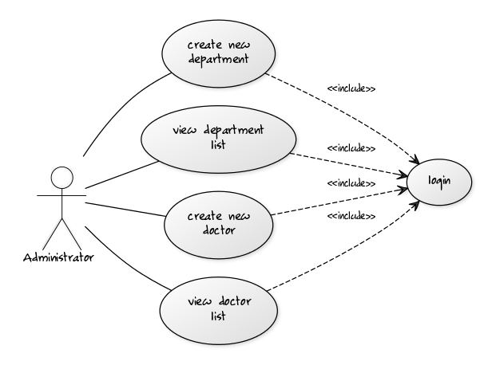
Requirements analysis – use cases
Actor Administrator
login
create a new department
view departments list
create a new doctor
view doctors list
UML Use Case Diagram

Slide 8
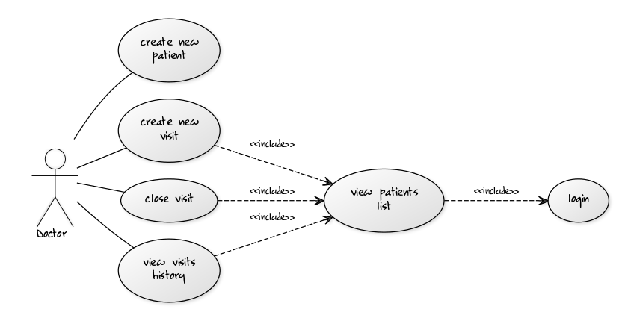
Requirements analysis – use cases
Actor Doctor
Log in
Register a new patient
View list of patients
Create a new visit in hospital
End a visit
View list of hospitalizations

Slide 9
System design – objects and classes
An Object is an independent entity characterized by its attributes and operations. A Class is a collection of objects that share a common structure and behaviour.
An administrator should have access to the system. He should be able to create new hospital departments and new doctors. Each doctor is assigned to a department. Doctors can log into the system and should be able to create new patients, given their name, age and birth number. Doctors should be able to create a new visit, when a patient has to be hospitalized. The visit start date is recorded. A patient is hospitalized in the doctor’s department. Doctors can end the visit by entering a visit end date corresponding to the time when the patient leaves the hospital. Doctors can view patients’ list and visits history.

Slide 10
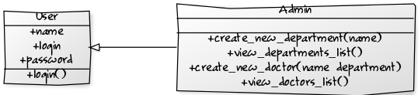
System design – classes
User
Atributes:
name
login
password
Operations
login
Administrator
Operations
Create a new hospital department
View list of departments
Create a new doctor
View list of doctors
UML Class Diagram

Slide 11
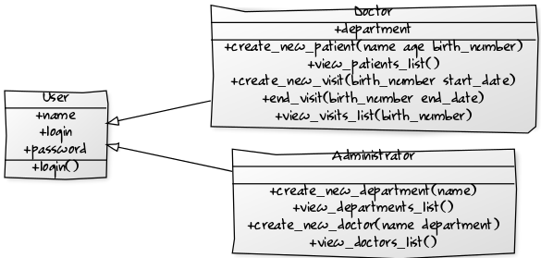
System design – classes
User
Atributes:
name
login
password
Operations
login
Doctor
Atributes:
Department
Operations
Create a new hospital department
View list of departments
Create a new doctor
View list of doctors
UML Class Diagram

Slide 12
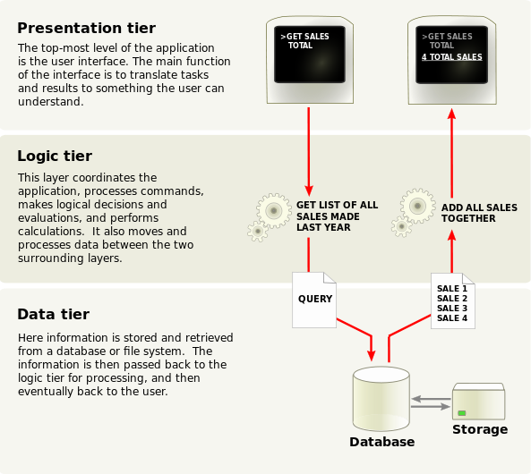
System design – architecture

Slide 13
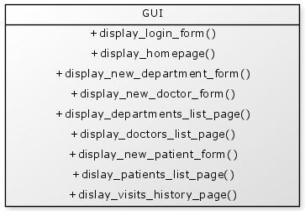
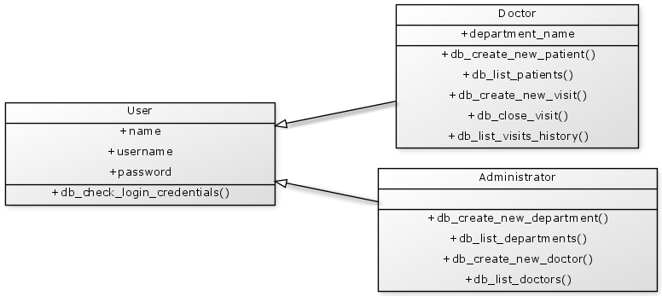
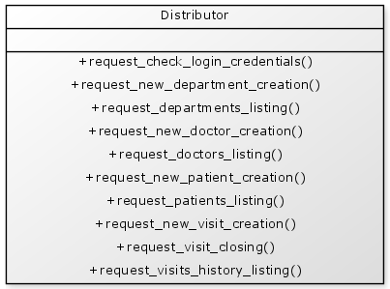
Presentation tier
Data tier
Logic tier

Slide 14
System design – user interface
Administrator
Login form
Home page
Hospital department creation form
Doctor creation form
Departments listing page
Doctors listing page
System messages
Doctor
Login form
Home page
Patient registration form
Patients listing page with options for starting and ending hospitalization
Hospitalizations listing page
System messages

Slide 15
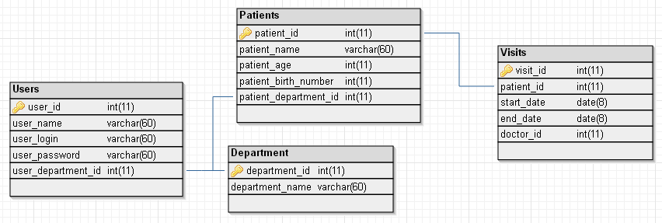
System design – database
User
check login credentials
returns the name of the user found in the table User(name, username, password, department) for a given username and password
Administrator
create new department
insert a new record in the table Department (department_id, department_name)
list departments
returns the content of the table Department (department_id, department_name)
create new doctor
insert a new record in the table Doctor (doctor_id, doctor_name, department_name)
list doctors
returns the content of the table Doctor (doctor_id, doctor_name, department_name)
Doctor
create new patient
insert a new record in the table Patient (patient_name, patient_age, patient_birth_number)
list patients
returns the content of the table Patient (patient_name, patient_age, patient_birth_number)
create new visit
insert a new record in the table Visits (patient_birth_number, start_date, end_date, doctor_id)
End visit
Update the end_date in the table Visits (patient_birth_number, start_date, end_date, doctor_id)
list patient visits
returns the content of the table Visits (patient_birth_number, start_date, end_date, doctor_id) for a given patient

Slide 16
System design – application logic - administrator
login
create an object from the class GUI and display the login form
get credentials (username and password) from the login form
create an object from the class User and verify access rigths
create an object from the class GUI and display the home page if access is granted or a system message if not
create a new hospital department
create an object from the class GUI and display the department creation form
get the department name from the department creation form
create an object from the class Administrator and store the name of the new department
create an object from the class GUI and display the departments listing page
view list of hospital departments
create an object from the class Administrator and fetch the list of departments
create an object from the class GUI and display the departments listing page
create a new doctor
create an object from the class GUI and display the doctor creation form
get the doctor name and doctor department from the doctor creation form
create an object from the class Administrator and store the name and department of the new doctor
create an object from the class GUI and display the doctor listing page
view list of doctors
create an object from the class Administrator and fetch the list of doctors
create an object from the class GUI and display the doctors listing page

Slide 17
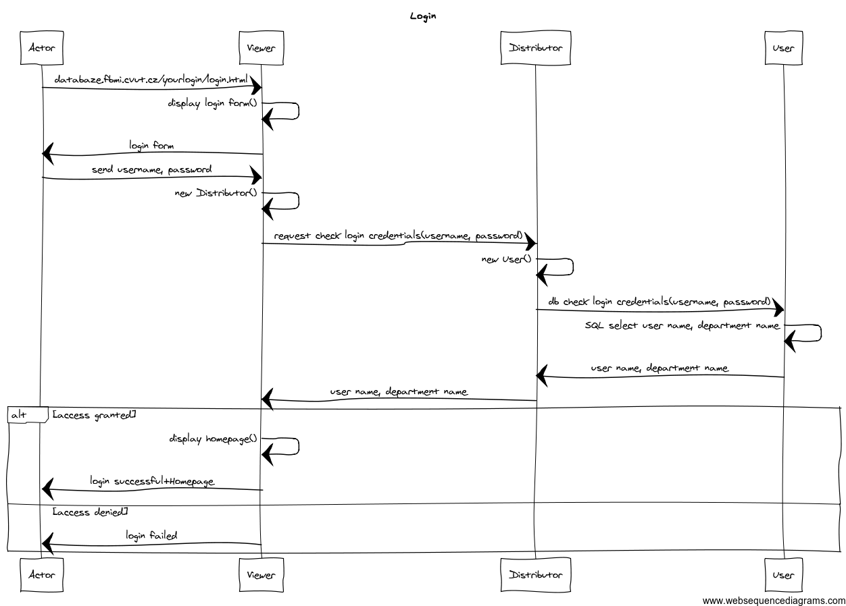

Slide 18
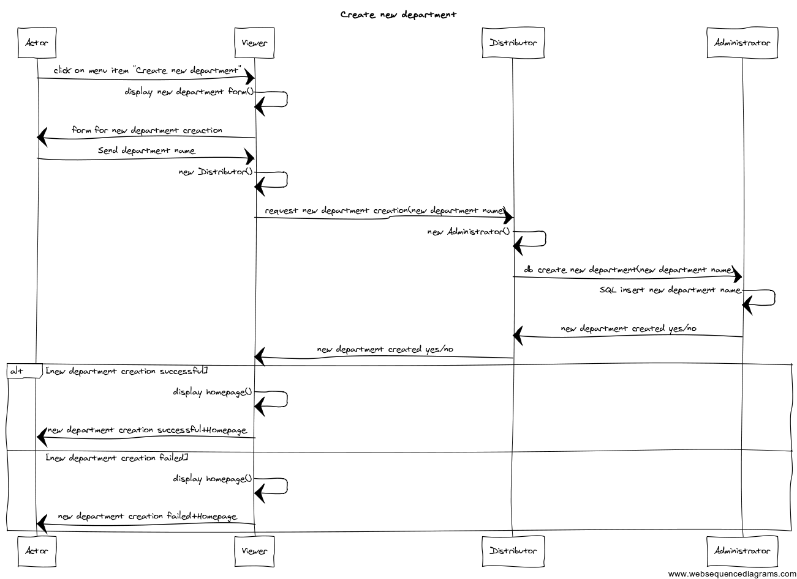

Slide 19
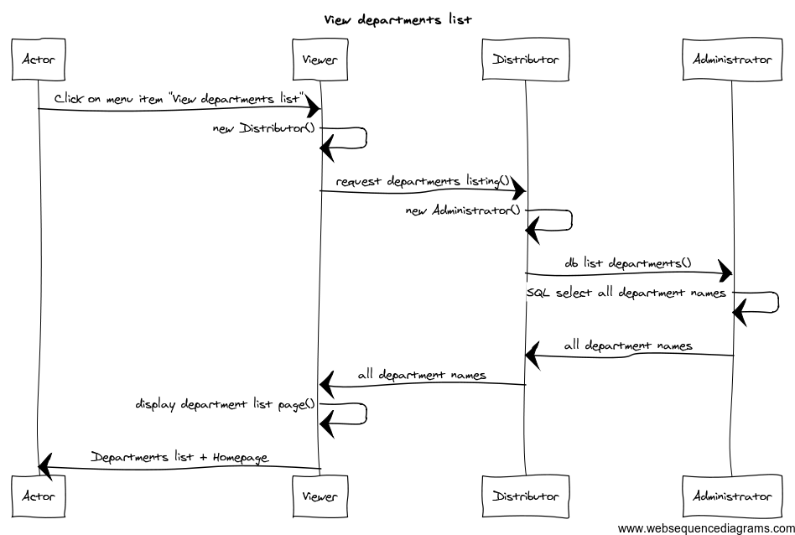

Slide 20
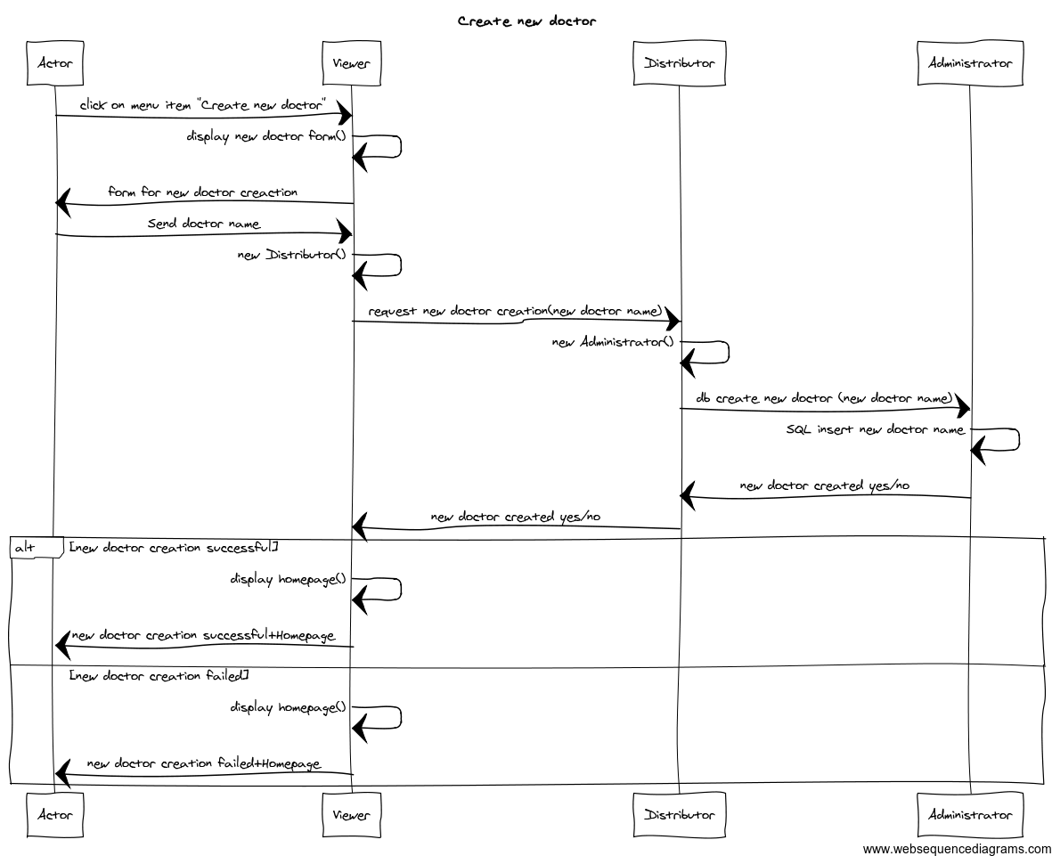

Slide 21
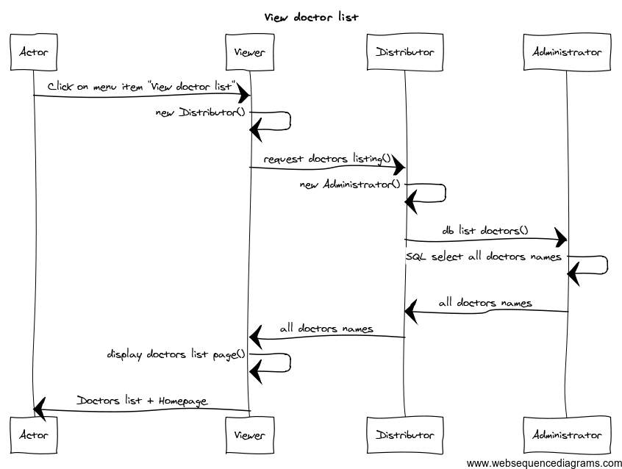

Slide 22
System design – application logic - doctor
create a new patient
create an object from the class GUI and display the patient creation form
get the patient name, age, birth number from the patient creation form
create an object from the class Doctor and store the name, age, birth number for the new patient
create an object from the class GUI and display the patients listing page
view list of patients
create an object from the class Doctor and fetch the list of patients
create an object from the class GUI and display the patients listing page
create a new visit
create an object from the class GUI and display the patients listing page
get the patient birth number of the selected patient from the patients listing page
create an object from the class Doctor and store a new visit for the given patient
create an object from the class GUI and display the visits history page for the given patient
view list of visits
create an object from the class GUI and display the patients listing page
get the patient birth number of the selected patient from the patients listing page
create an object from the class Doctor and fetch the list of visits for the given patient
create an object from the class GUI and display the visits history page for the given patient
end a visit
create an object from the class GUI and display the patients listing page
get the patient birth number of the selected patient from the patients listing page
create an object from the class Doctor and update visit for the given patient
create an object from the class GUI and display the patients listing page

Slide 23
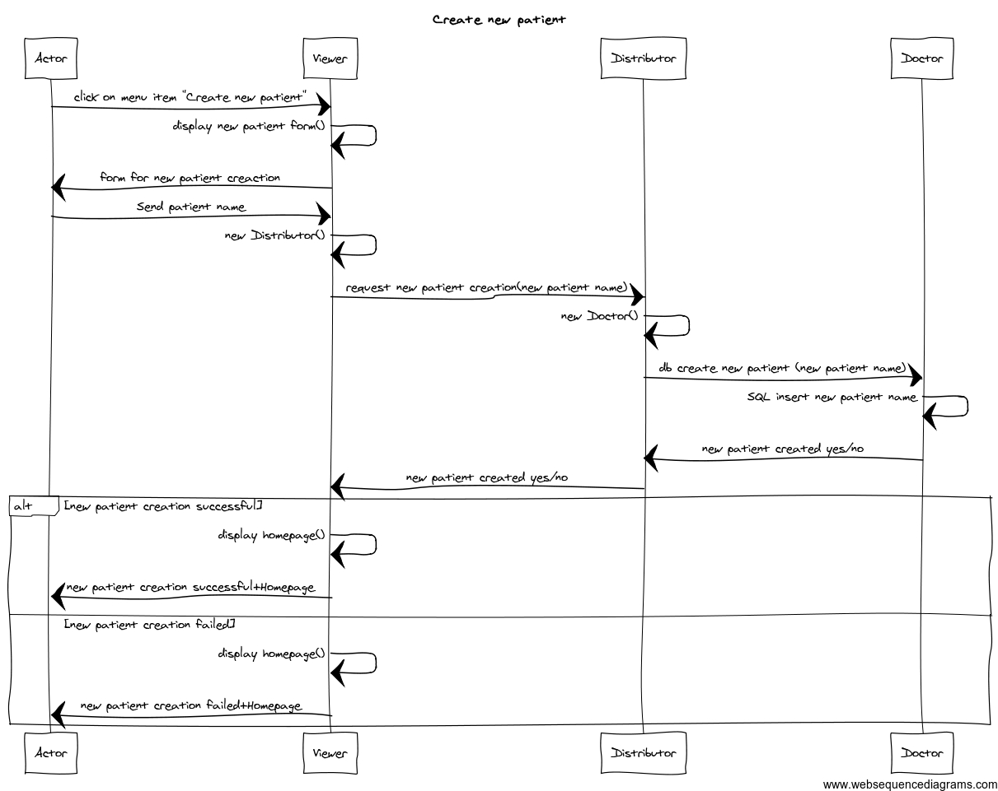

Slide 24
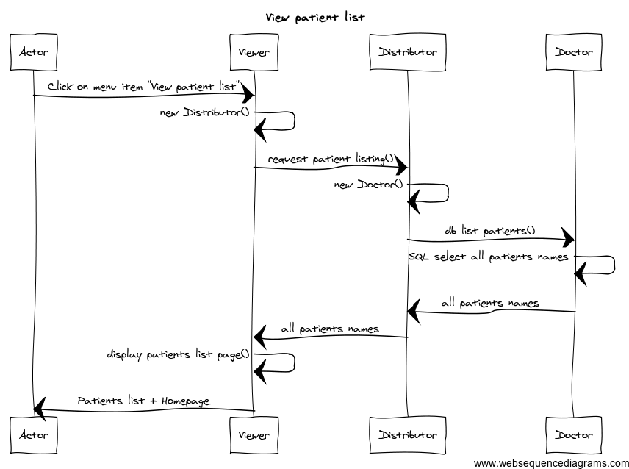

Slide 25
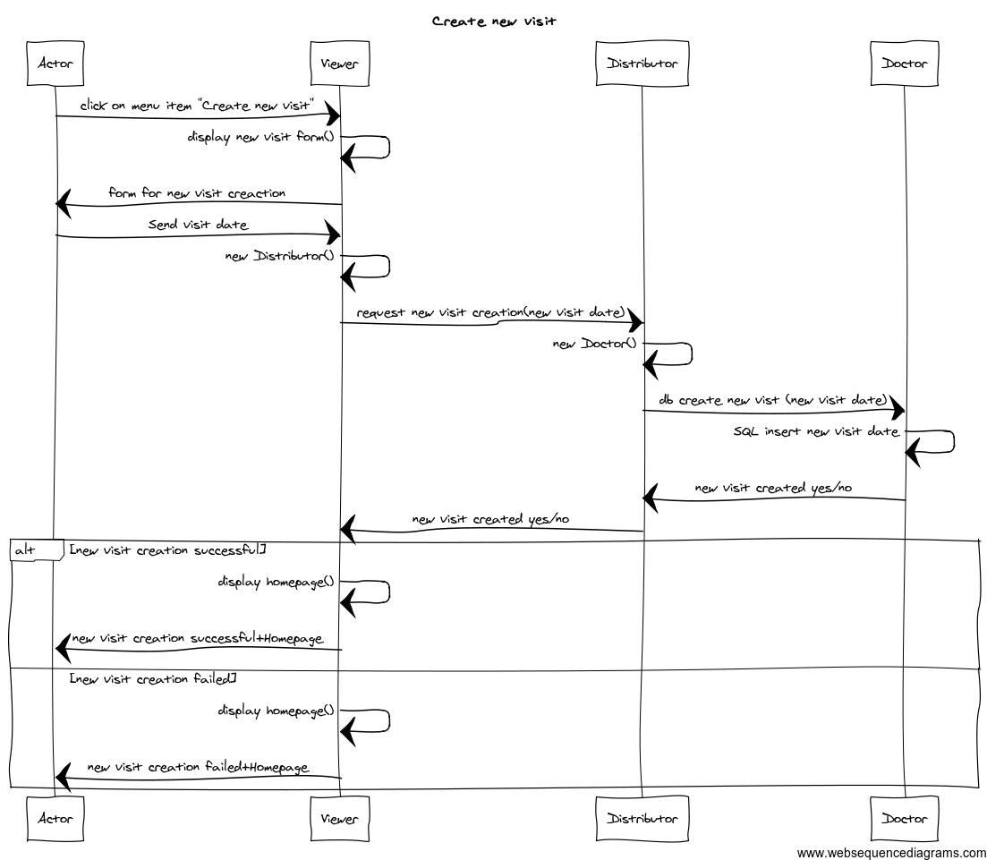

Slide 26
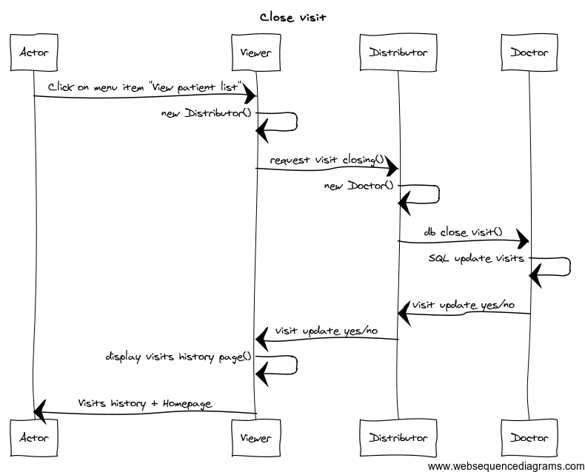

Slide 27
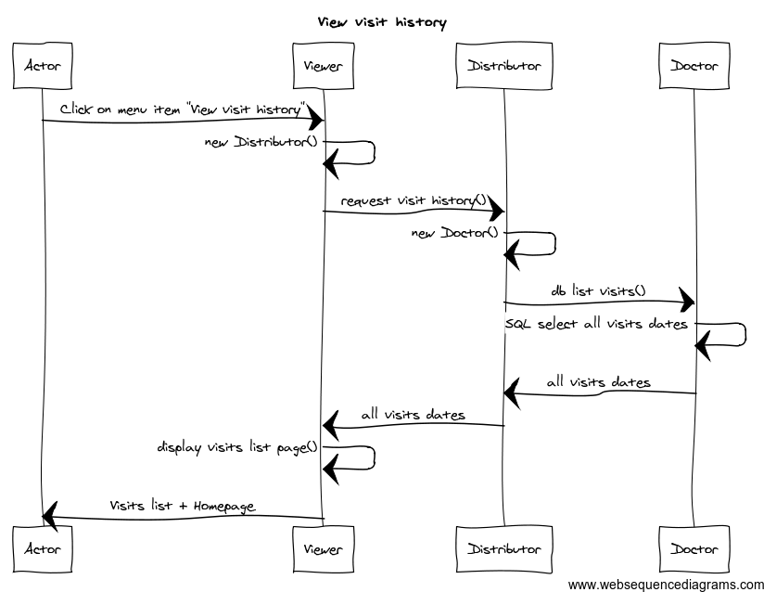

Slide 28
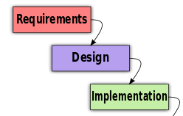
class.doctor.php
class.user.php
class.administrator.php
class.viewer.php
class.distrubutor.php
http://yuml.me/diagram/scruffy/class/draw

Slide 29

Implementation – Presentation tier
Class for user interface: class.viewer.php
Operations
display_login_form()
display_homepage()
display_new_department_form()
display_new_doctor_form()
display_departments_list_page()
display_doctors_list_page()
display_system_message()
display_new_patient_form()
display_patients_list_page()
display_patient_visits_page()
class.doctor.php
class.user.php
class.viewer.php
class.administrator.php
class.distrubutor.php

Slide 30
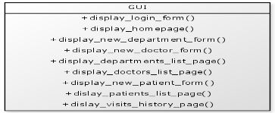
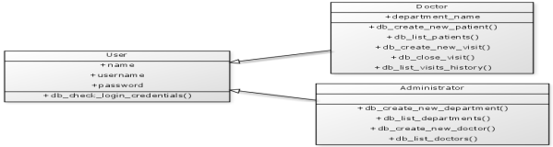
Implementation – Logic tier
Class for computation logic: class.distributor.php
Operations
request_check_login_credentials($login, $password)
request_new_department_creation($department_name)
request_departments_listing()
request_new_doctor_creation($doctor_name, $department_name)
request_doctors_listing()
request_new_patient_registration($patient_name, $patient_age, $patient_birth_number)
request_patients_listing()
request_patient_receiving($patient_birth_number, $arrival_date)
request_patient_release($patient_birth_number, $departure_date)
request_patient_visits_listing($patient_birth_number)
class.doctor.php
class.user.php
class.viewer.php
class.administrator.php
class.distrubutor.php

Slide 31
Implementation – Data tier
Class for data persistence for all users: class.user.php
Operation
db_check_login_credentials($login, $password)
Class for data persistence for administrative tasks: class.administrator.php
Operations
db_create_new_department($department_name)
db_list_departments()
db_ create_new_doctor($doctor_name, $department_name)
db_ list_all_doctors()
Class for data persistence for clinical tasks: class.doctor.php
Operations
db_ register_new_patient($patient_name, $patient_age, $patient_birth_number)
db_ list_all_patients()
db_ receive_patient($patient_birth_number, $arrival_date)
db_ release_patient($patient_birth_number, $departure_date)
db_ list_all_patient_visits($patient_birth_number

Slide 32
Homework
Deploy the hospital information system studied in the lecture to your Apache/PHP/MySQL installation.
Create a new database called nis in your MySQL system
Open a SQL console and execute the queries found in database.sql
Edit the connection.php and change the database user name ($databaseusername) and password ($databasepassword) if required
Copy the .php files to the web directory of your Apache installation
Test the application http://localhost/class.viewer.php?form_id=1
Login admin/admin or janda/janda

Slide 33
Syllabus of lectures and tutorials
 |  | Lectures (45 min) | Tutorials (45 min)
Lesson 1 | Sep 30 | Medical Informatics and IS definition | OpenEMR
Lesson 2 | Oct 7 | HW infrastructure of IS | OpenEMR
Lesson 3 | Oct 14 | Operation systems | GaiaEHR
Lesson 4 | Oct 21 | Databases of IS | SQL
Lesson 5 | Oct 28
Lesson 6 | Nov 4 | Clinical oriented IS | SQL
Lesson 7 | Nov 11 | Decision support systems Medical data coding | OpenMRS
Lesson 8 | Nov 18 | Phase and IS development principles | UML
Lesson 9 | Nov 25 | Standard implementation methodology | Programing in HTML and PHP
Lesson 10 | Dec 2 | Standard implementation methodology | Programing in PHP and MySQL
Lesson 11 | Dec 9 | Data and communication standards | OpenMRS
Lesson 12 | Dec 16 | Presentation of practical project and final exam

Slide 34
Plan for next week
HTML, PHP

