Slide 1
Information Systems in Health Care
Lesson 9 – Winter Term 2014

Slide 2
Agenda
HTML
PHP

Slide 3
Introduction to HTML
HyperText Markup Language is a language for creating webpages in the internet.
Structure of a web page in HTML
<!DOCTYPE HTML PUBLIC "-//W3C//DTD HTML 4.01//EN" "http://www.w3.org/TR/html4/strict.dtd"> <html>
<head>
</head>
<body>
</body>
</html>

Slide 4
Development environment for HTML
Your computer
Text editor
FTP client
Web browser
Web server Apache
databaze.fbmi.cvut.cz/yourlogin
FTP Server
- ftp://databaze.fbmi.cvut.cz
HTML coding in the editor
Connection to FTP
Your computer -> ftp://databaze.fbmi.cvut.cz
Enter your faculty login and password
Upload HTML file
Open the page in a browser
http://databaze.fbmi.cvut.cz/yourlogin/soubor.html

Slide 5
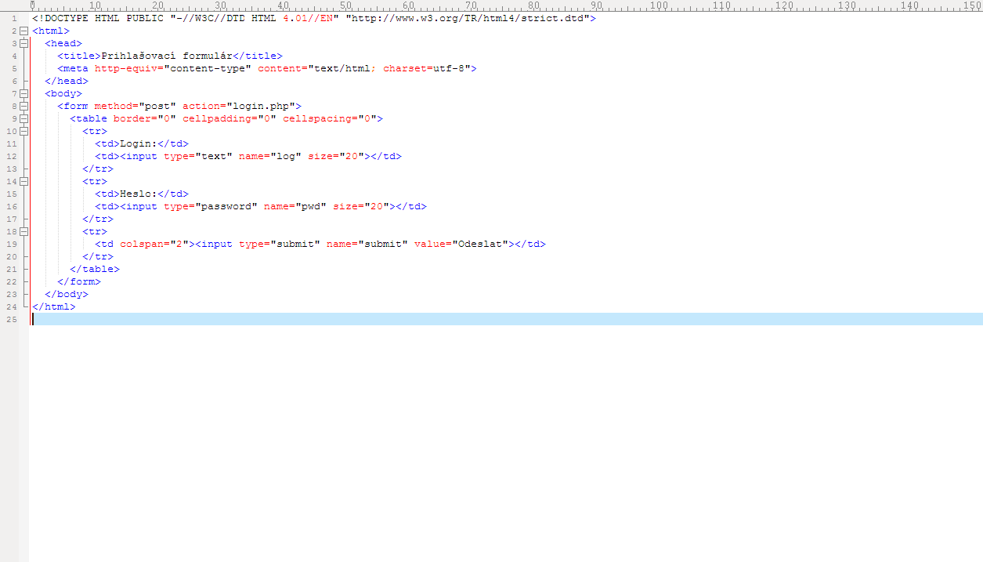

HTML – login form
login.html

Slide 6
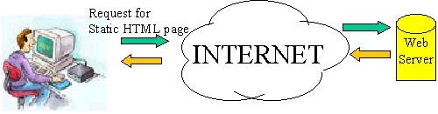
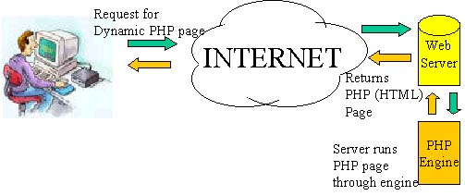

Introduction to PHP
Hypertext preprocessor (originally Personal Home Page) is a server-based programming language for developing dynamic web pages.
http://databaze.fbmi.cvut.cz/yourlogin/login.html

Slide 7
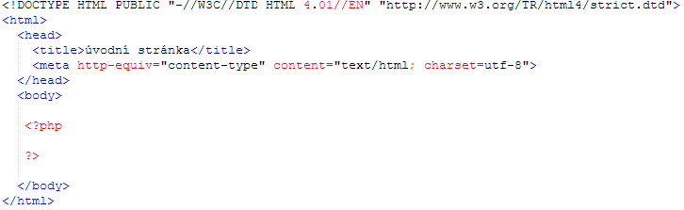
Úvod do PHP – Vlastnosti jazyku
PHP file is a text file that contains PHP code
PHP code starts with <?php
PHP code ends with ?>
PHP file can contains HTML code

Slide 8
Properties of the PHP language
Variables are defined using $
$number = 100;
$string = “Hello, world" ;
Displaying the content of a variable
echo $number;
echo $string;
String concatenation with .
$username = "student" ;
$message = “Hello, " . $username;
Mathematic operations: /, *, +, -, % (modulo)
$number = $number % 5 + $number * 10 - $number / 9;
Operators for comparison: == , >= , <= , !=, <>, ===
Logical operators: &&(and) || (or), ! (negace),
Conditional and control statements
if ($number > 0) { --- }
if ($number > 0) { --- } elseif ($number > -10) { --- }
while ($number <= 0) { --- }
do { --- } while ($number <= 0)
for ($i = 1; $i <= 10; $i++) { --- }

Slide 9
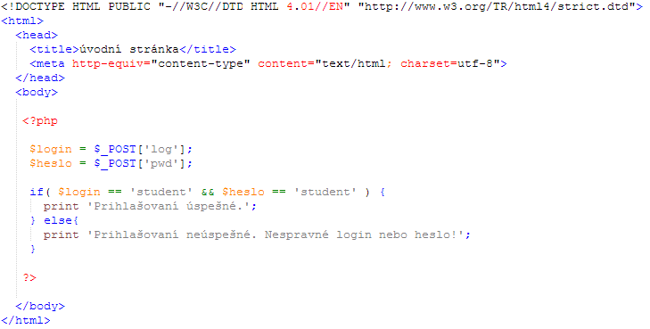
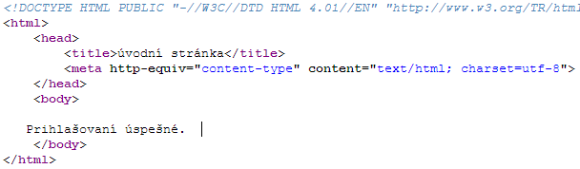
Working with web forms in PHP
Data entered by web users are accessed via the variable $_POST
$_POST['log']
login.html
login.php
login.php

Slide 10
Accessing a MySQL database from PHP
http://databaze.fbmi.cvut.cz/yourlogin/login.html
MySQL Server

Slide 11
Accessing a MySQL database
Prepare the database
http://databaze.fbmi.cvut.cz/mysql
CREATE TABLE user ( user_id int AUTO_INCREMENT, user_name varchar(60), user_login varchar(60), user_password varchar(60), user_department_id int, PRIMARY KEY (user_id) );
INSERT INTO user (user_name, user_login, user_password, user_department_id) VALUES ('administrator', 'admin', 'admin', 1), ('MUDr. Pavel Janda', 'janda', 'janda', 2), ('MUDr. Jana Novakova', 'novakova', 'nova123', 2)
Connect to the database system
$db_connector= mysql_connect("localhost", “yourlogin", “yourpassword" );
Control database connection
if (!$db_connector) { die(‘Connection failed: ' . mysql_error()); }
Setup UTF8 charset for e.g. Czech special characters
mysql_query("SET CHARACTER SET utf8");
Connect to the database
mysql_select_db(“yourlogin");

Slide 12
Accessing a MySQL database
Selecting data from a database
$query = "SELECT * FROM user WHERE user_login ='" . $login . "' AND user_password = '" . $heslo . "'";
$rs = mysql_query($query);
Controlling selected data
if (!$rs) { echo "Could not execute query: $query"; }
Storing selected data to an associative array
$row = mysql_fetch_assoc($rs)
Displaying results
echo ‘Login successful. Homepage for ' . $row['user_name'];
print ‘Login unsuccessful. Wrong login or password!';

Slide 13

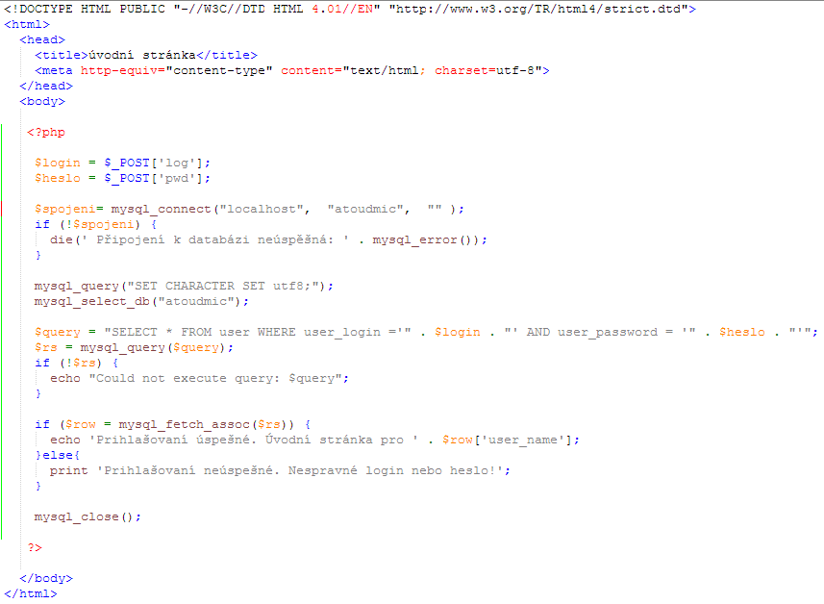
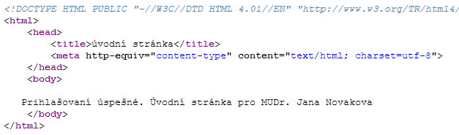
Accessing a MySQL database
login.html
login.php
login.php
MySQL Server

Slide 14
Programming Classes in PHP
A class can be defined anywhere in a PHP file
class class_name{ }
Attributes and operators of a class
class class_name{ $attribute = “ …”; function operator($parameter){ $this->attribute = $parameter; } }
Object creation
$object_name = new class_name();
Calling an operation
$object_name->operator(“Hello”);
$object_name->attribute = “Hello”;

Slide 15
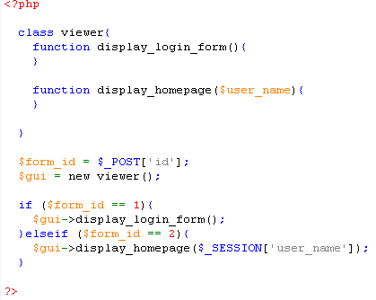
Classes in PHP
class.viewer.php
http://databaze.fbmi.cvut.cz/yourlogin/lclass.viewer.php?id=1
http://databaze.fbmi.cvut.cz/yourlogin/login.html

Slide 16
Homework
Write a PHP program with the following characteristics
A HTML form where user can enter a patient name, age and gender
A PHP code that stores the patient data to a database table
A PHP code that displays the list of all patients from the table
Java Server Page (JSP) is another server-side language for programming dynamic web pages.
Highlight major similarities and differences between PHP and JSP
Send your solution before Nov 29

