Slide 1
Modelling and Simulation Practices
Practice 1 - SS 2014 – Daniela Müllerová

Slide 2
What do we do in today's practice?
Organization of practices
Entrance test
Why modeling and simulation?
Foundations of Mathematics
Introduction to Matlab
Introduction to Simulink
Summary

Slide 3
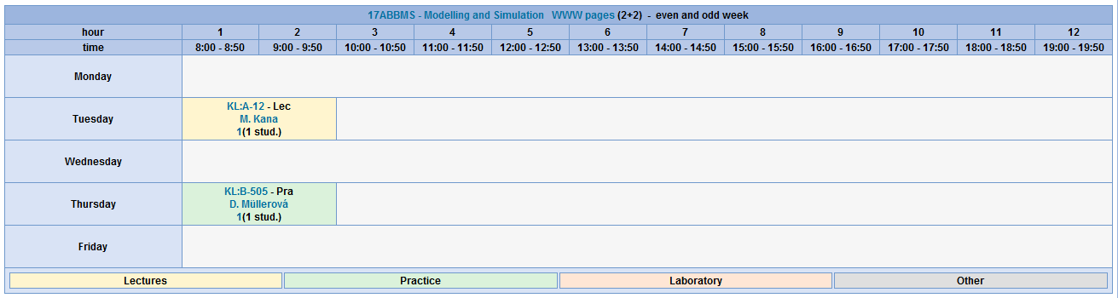
What are practices organized?
Biomedical Technician BMT (17ABBMS)
1 group
2 students
13 practices x 1.5 hours

Slide 4
What you should already know?
Biomedical Technician BMT (17ABBMS)
Linear Algebra and Differential Calculus
Integral Calculus
Programming in Matlab
Introduction to Signals and Systems

Slide 5
What will you practice throughout the semester?
17ABBMS
Population models
Compartmental models
Tem Project
1. hour
Introduction to Matlab/Simulink
5. hour
1 - compartmental models
10. hour
Design of own model
2. hour
Models for single species populations
6. hour
More - compartmental models
11. hour
Implementation of own model
3. hour
Models for two species populations
7. hour
Pharmacokinetics
12. hour
The simulation own model
4. hour
Epidemiology models
8. hour
Identification of model parameters
13. hour
The final presentation
Obtaining credit of exercises
Maximum 40 points can be obtained from practices. It is necessary obtain 20 points to the credit.
Up to 11 points can be obtained for active participation in practices (1 point per hour).
Up to 15 points can be obtained for a credit test, which will take place on the 9th hour.
Up to 14 points can be obtained for a credit test, which will take place in the 13th hour.

Slide 6
Entrance test

Slide 7
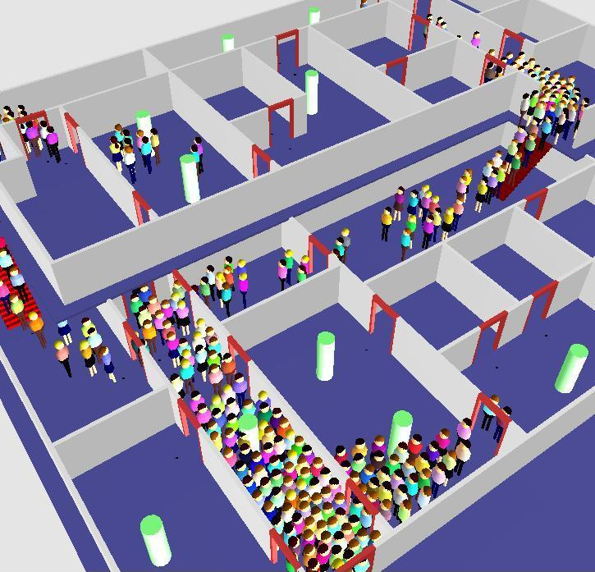
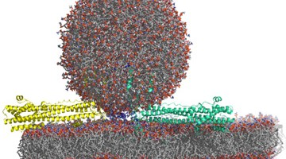
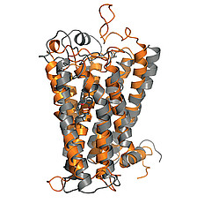
Why modeling and simulation?
bims.virginia.edu
biozentrum.unibas.c
herd.typepad.com

Slide 8
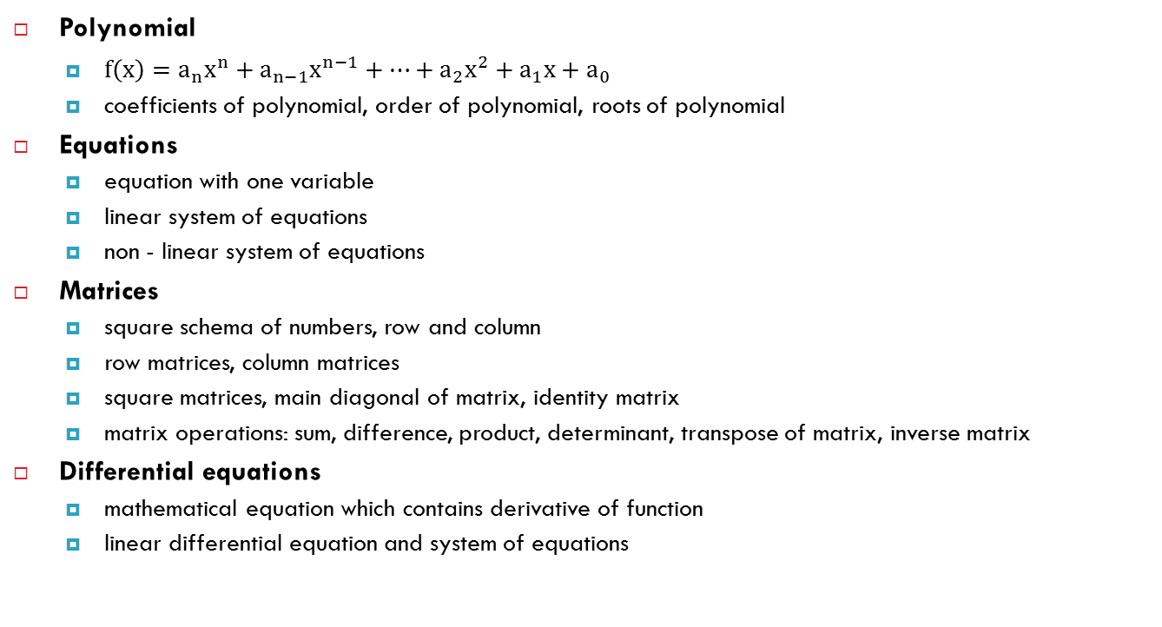
Foundations of Mathematics
Polynomial
$f\left(x\right)=a_{n}x^{n}+a_{n−1}x^{n−1}+…+a_{2}x^{2}+a_{1}x+a_{0}$
coefficients of polynomial, order of polynomial, roots of polynomial
Equations
equation with one variable
linear system of equations
non - linear system of equations
Matrices
square schema of numbers, row and column
row matrices, column matrices
square matrices, main diagonal of matrix, identity matrix
matrix operations: sum, difference, product, determinant, transpose of matrix, inverse matrix
Differential equations
mathematical equation which contains derivative of function
linear differential equation and system of equations

Slide 9
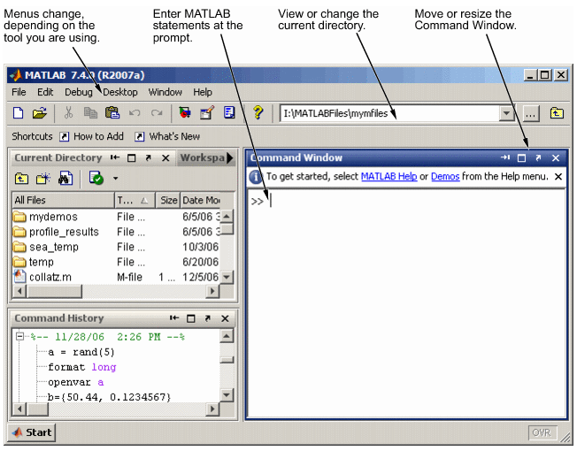
Introduction to Matlab
interactive programming environment
counting with matrices
plotting 2D and 3D graphs of function
implementation of algorithms
analysis and presentation of data
creating an application, including the user interface

Slide 10
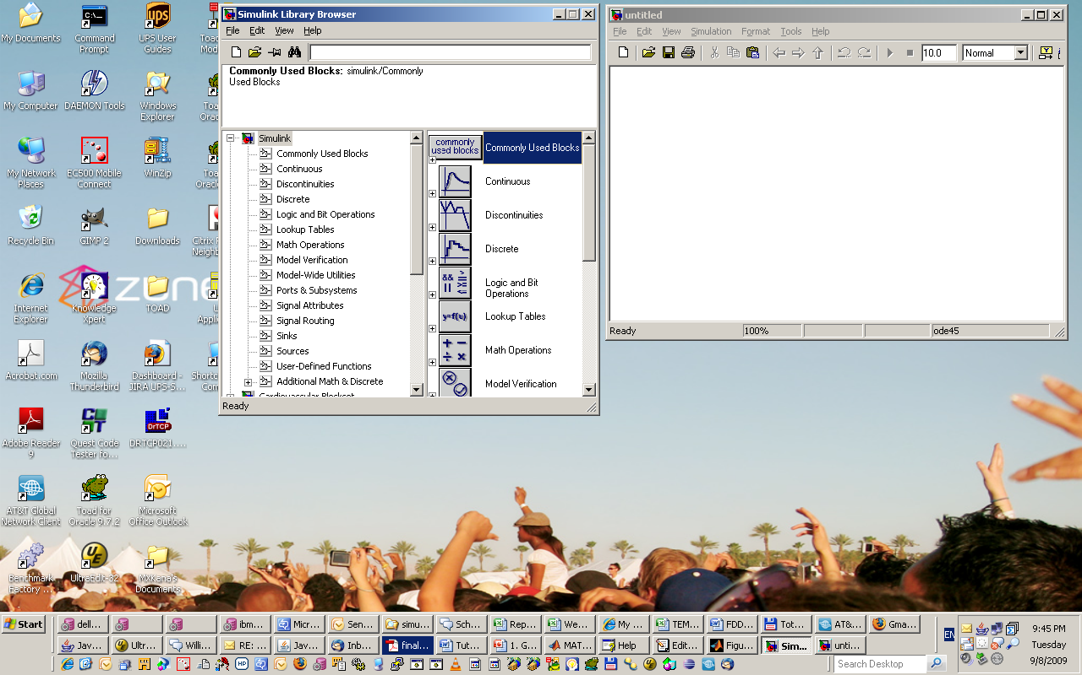
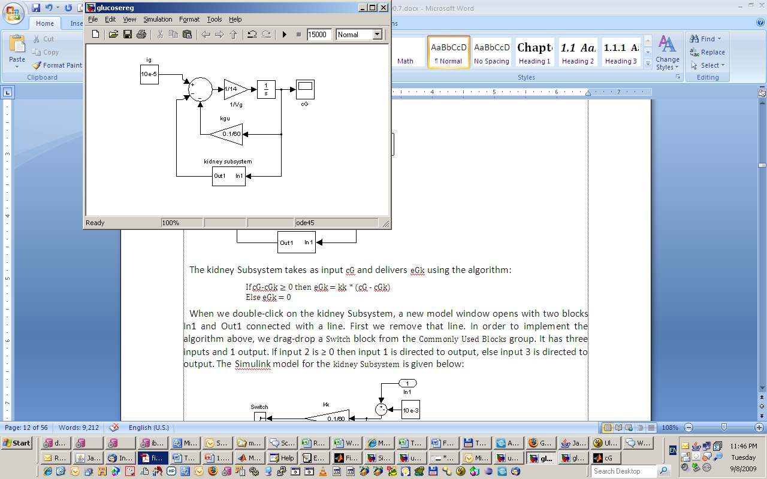
Introduction to Simulink
environment for the simulation of dynamic systems using block diagram
offer libraries of signal sources, basic continuous, discrete and nonlinear blocks and blocks for displaying and saving signals

Slide 11
Summary of today's practice
[Organization of practices]
13 hours with Matlab and Simulink, the basics of modeling and the creation of a own model.
To obtain the credit you need 20 points.
11 points can be obtained for active participation in the practices. 29 points can be obtained for the test, which will take place on the 9. an hour and 13. an hour.
[Foundations of Mathematics]
Polynomials, equations, matrices
[Matlab, Simulink]
Matlab is an interactive Programming environment for computing with matrices, plotting graphs of functions, implementation of algorithms, analysis and presentation of data, creating applications.
Simulink is an environment for the simulation of dynamic systems using block diagram.
[What is next?]
Next week we will continue with Simulink models of single species populations..

