Slide 1
Modelling and Simulation Practices
Practice 2 - SS 2014 – Daniela Müllerová

Slide 2
What do we do in today's practice?
Corrections of entrance test
Summary of the previous exercise
Malthus population model
Logistic population model
Discrete models of single species populations
Summary

Slide 3
Corrections of entrance test

Slide 4
Summary of the previous practice
[Foundations of Mathematics]
Coefficients of polynomial, order of polynomial, roots of polynomial
Equation with one variable, linear system of equations, non - linear system of equations
Square schema of numbers, row and column
Linear differential equation and system of equations
[Matlab and Simulink]
Matlab is an interactive pprogramming environment for computing with matrices, plotting graphs of functions, implementation of algorithms, analysis and presentation of data
Simulink is an environment for the simulation of dynamic systems using block diagram

Slide 5
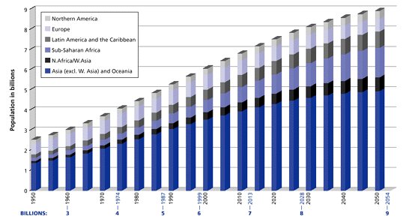
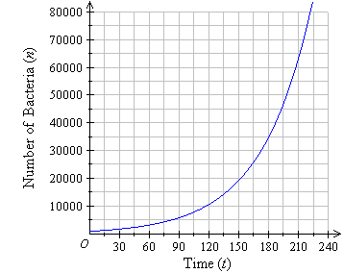
Models of single species populations
Basic problems
Model changes in number of inhabitants due to the interaction of organisms with the environment, with individuals of their own kind, and with other types of organisms

Slide 6
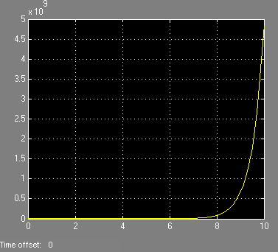
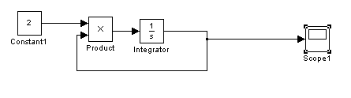
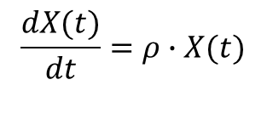
Malthus model
Population is a group of individuals of a particular species.
The population is expressed by its size (number of individuals, 𝑋).
Difference decrease and increase in the population is stable in time.
Effect of environment isn´t changed at the time.
The birth rate is marked by symbol ρ.
$$\frac{dX(t)}{dt}=ρ∙X(t)$$

Slide 7
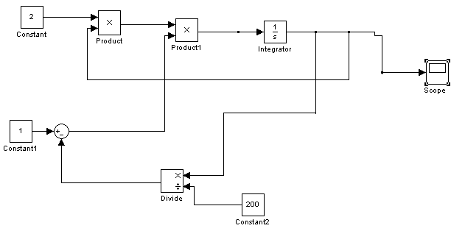
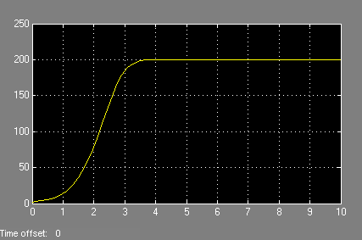
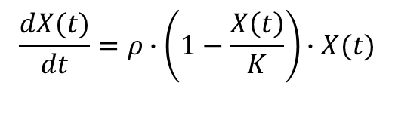
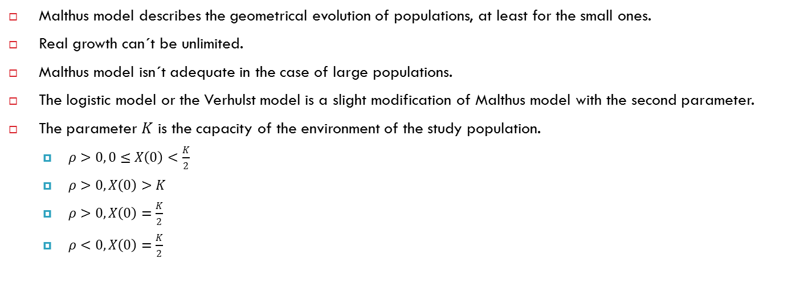
Logistic model
Malthus model describes the geometrical evolution of populations, at least for the small ones.
Real growth can´t be unlimited.
Malthus model isn´t adequate in the case of large populations.
The logistic model or the Verhulst model is a slight modification of Malthus model with the second parameter.
The parameter 𝐾 is the capacity of the environment of the study population.
$ρ>0, 0≤X\left(0\right)<\frac{K}{2}$
$ρ>0, X\left(0\right)>K$
$ρ>0, X\left(0\right)=\frac{K}{2}$
$ρ<0, X\left(0\right)=\frac{K}{2}$
$$\frac{dX(t)}{dt}=ρ∙\left(1−\frac{X\left(t\right)}{K}\right)∙X(t)$$

Slide 8
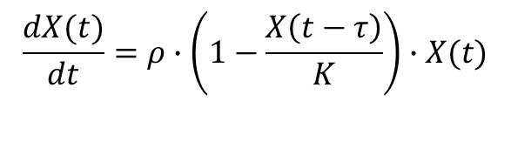
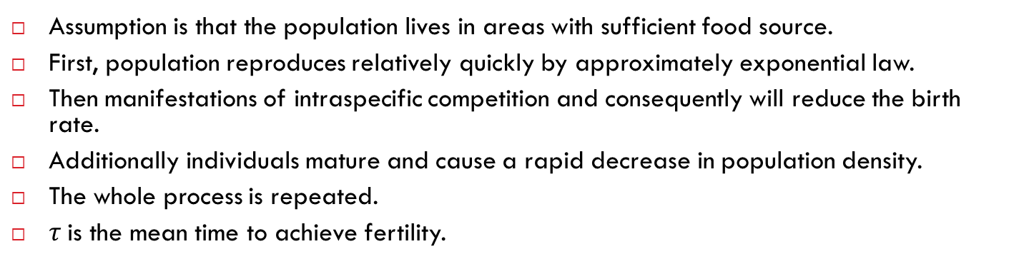
Logistic model with delay
Assumption is that the population lives in areas with sufficient food source.
First, population reproduces relatively quickly by approximately exponential law.
Then manifestations of intraspecific competition and consequently will reduce the birth rate.
Additionally individuals mature and cause a rapid decrease in population density.
The whole process is repeated.
$τ$is the mean time to achieve fertility.
$$\frac{dX(t)}{dt}=ρ∙\left(1−\frac{X\left(t−τ\right)}{K}\right)∙X(t)$$

Slide 9
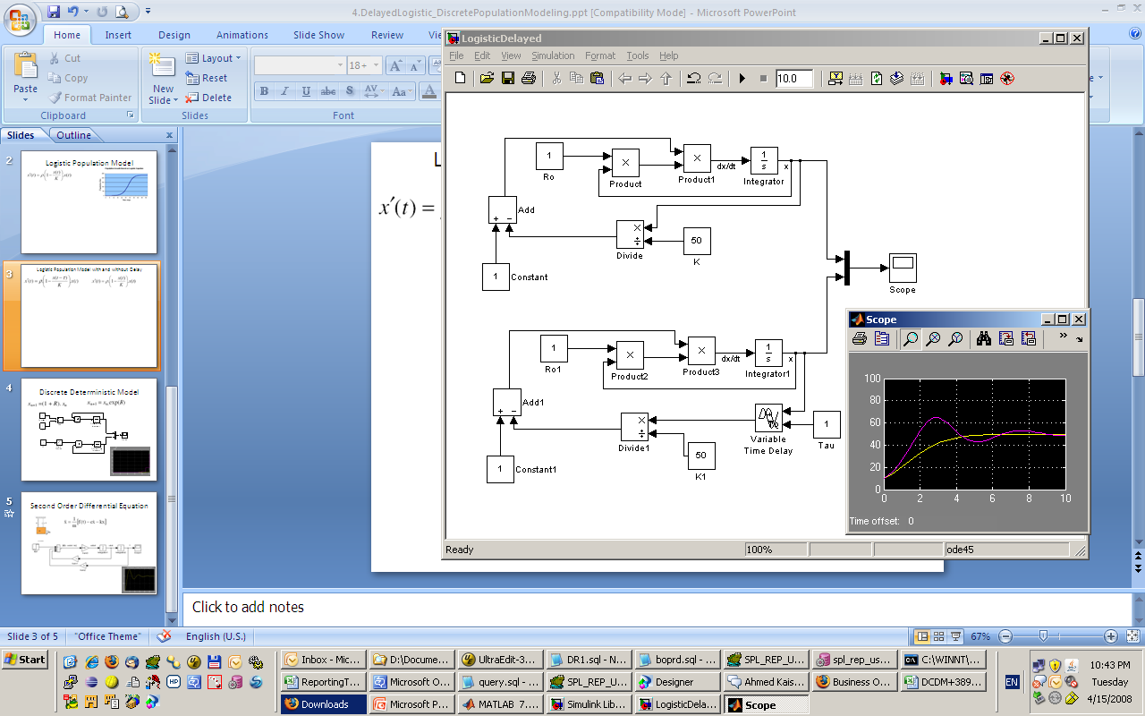
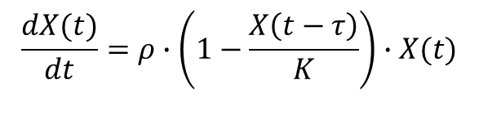
Logistic model with delay
$$\frac{dX(t)}{dt}=ρ∙\left(1−\frac{X\left(t−τ\right)}{K}\right)∙X(t)$$

Slide 10


Discrete models of single species populations
A generation living in a population with each other do not overlap.
Number of individuals in the next generation is determined by a function only of the number of individuals in the previous generation.
Intervals 𝑇 can be different lengths - in primitive organisms, this period may be relatively short, in higher organisms, it is usually one year.
𝑅 is the rate of propagation of the population, such as the number of offspring per one parent.
$$X_{n+T}=\left(1+R\right)∙X_{n}$$
$$X_{n+T}=e^{R}∙X_{n}$$

Slide 11
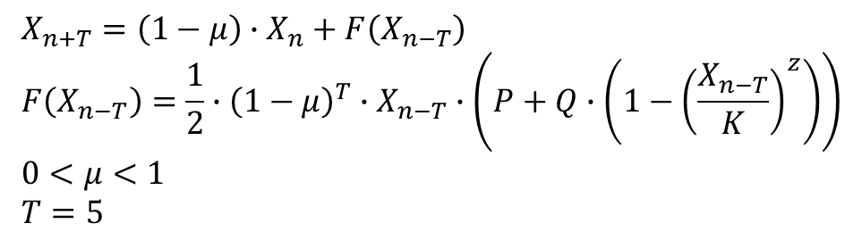
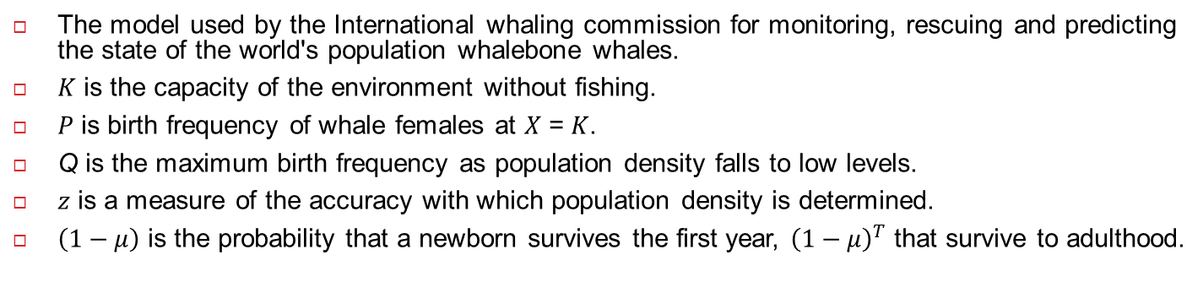
Discrete models of populations with delay
The model used by the International whaling commission for monitoring, rescuing and predicting the state of the world's population whalebone whales.
𝐾 is the capacity of the environment without fishing.
𝑃 is birth frequency of whale females at 𝑋 = 𝐾.
Q is the maximum birth frequency as population density falls to low levels.
𝑧 is a measure of the accuracy with which population density is determined.
$\left(1−μ\right)$ is the probability that a newborn survives the first year, ${\left(1−μ\right)}^{T}$ that survive to adulthood.
$$X_{n+T}=\left(1−μ\right)∙X_{n}+F\left(X_{n−T}\right) \\ F\left(X_{n−T}\right)=\frac{1}{2}∙{\left(1−μ\right)}^{T}∙X_{n−T}∙\left(P+Q∙\left(1−{\left(\frac{X_{n−T}}{K}\right)}^{z}\right)\right) \\ 0<μ<1 \\ T=5$$

Slide 12
Summary of today's practice
[Population models]
Model changes in number of inhabitants due to the interaction of organisms with the environment, with individuals of their own kind, and with other types of organisms.
Malthus model: growth is unlimited
Logistic model: capacity of the environment of the study population
Logistic model with delay: mean time to reach reproductive
Discrete models: the number of individuals in the next generation is determined by functions only the number of individuals in the previous generation.
[What is next?]
Next week we will continue with model of two species populations.

