Slide 1
Modelling and Simulation Practices
Practice 4 - SS 2014 – Daniela Müllerová

Slide 2
What do we do in today's practice?
Summary of the previous practice
Two species populations models of predator - prey
Two species populations models with competition
Two species populations models with cooperation
Epidemiology models
Summary

Slide 3
Summary of the previous practice
[Population models]
Population models with age structure
Two species populations models of predator - prey: Lotka – Volterra

Slide 4
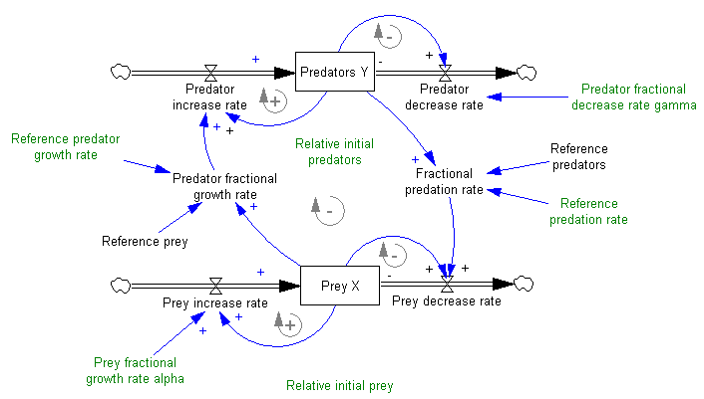
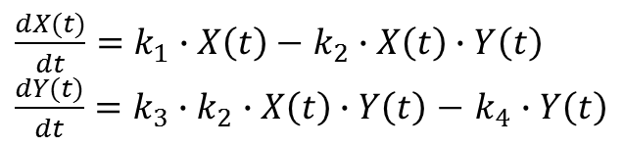
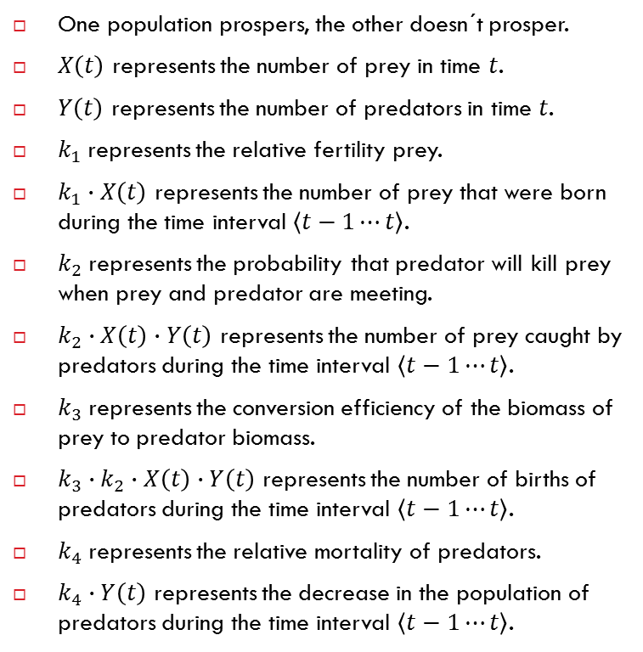
Two species populations models of predator - prey
One population prospers, the other doesn´t prosper.
$X\left(t\right)$ represents the number of prey in time $t$.
$Y\left(t\right)$ represents the number of predators in time $t$.
$k_{1}$represents the relative fertility prey.
$k_{1}∙X\left(t\right)$ represents the number of prey that were born during the time interval $\left\langle t−1⋯t\right\rangle$.
$k_{2}$represents the probability that predator will kill prey when prey and predator are meeting.
$k_{2}∙X\left(t\right)∙Y\left(t\right)$ represents the number of prey caught by predators during the time interval $\left\langle t−1⋯t\right\rangle$.
$k_{3}$represents the conversion efficiency of the biomass of prey to predator biomass.
${k_{3}∙k}_{2}∙X\left(t\right)∙Y\left(t\right)$ represents the number of births of predators during the time interval $\left\langle t−1⋯t\right\rangle$.
$k_{4}$represents the relative mortality of predators.
$k_{4}∙Y\left(t\right)$ represents the decrease in the population of predators during the time interval $\left\langle t−1⋯t\right\rangle$.
$\frac{dX(t)}{dt}=k_{1}∙X\left(t\right)−$ $k_{2}∙X\left(t\right)∙Y\left(t\right)$
$\frac{dY(t)}{dt}={k_{3}∙k}_{2}∙X\left(t\right)∙Y\left(t\right)$ $−$ $k_{4}∙Y\left(t\right)$

Slide 5
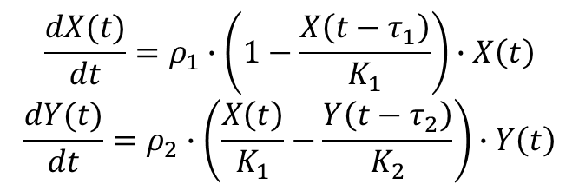
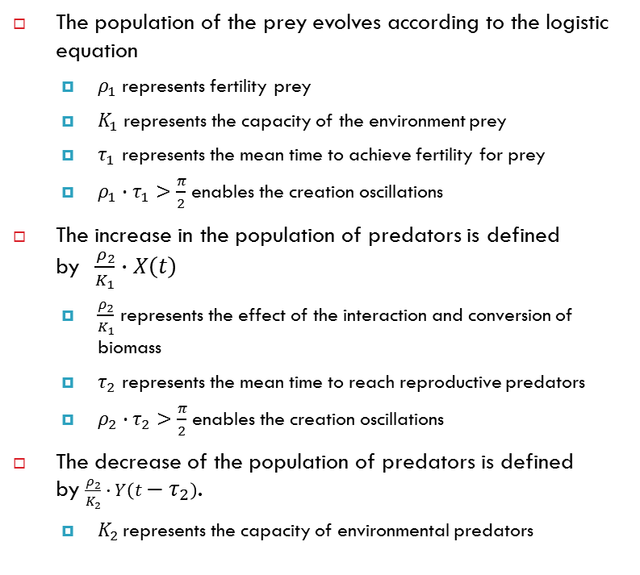
Two species populations models of predator - prey with delay
The population of the prey evolves according to the logistic equation
$ρ_{1}$represents fertility prey
$K_{1}$represents the capacity of the environment prey
$τ_{1}$ represents the mean time to achieve fertility for prey
${ρ_{1}∙τ}_{1}>\frac{π}{2}$enables the creation oscillations
The increase in the population of predators is defined by$\frac{ρ_{2}}{K_{1}}∙X\left(t\right)$
$\frac{ρ_{2}}{K_{1}}$ represents the effect of the interaction and conversion of biomass
$τ_{2}$ represents the mean time to reach reproductive predators
${ρ_{2}∙τ}_{2}>\frac{π}{2}$enables the creation oscillations
The decrease of the population of predators is defined by $\frac{ρ_{2}}{K_{2}}∙Y\left(t−τ_{2}\right)$.
$K_{2 }\text{represents}$ the capacity of environmental predators
$$\frac{dX(t)}{dt}=ρ_{1}∙\left(1−\frac{X\left(t−τ_{1}\right)}{K_{1}}\right)∙X\left(t\right)$$
$$\frac{dY(t)}{dt}=ρ_{2}∙\left(\frac{X\left(t\right)}{K_{1}}−\frac{Y\left(t−τ_{2}\right)}{K_{2}}\right)∙Y\left(t\right)$$

Slide 6
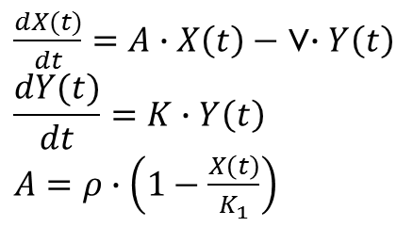
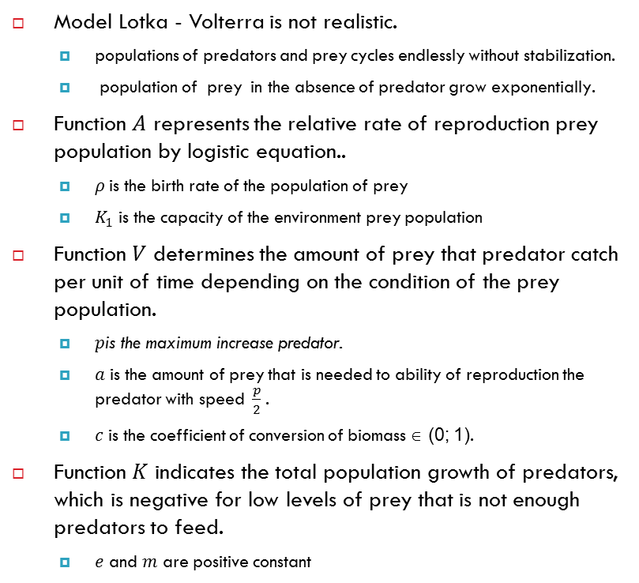
Kolmogorov models of predator - prey
Model Lotka - Volterra is not realistic.
populations of predators and prey cycles endlessly without stabilization.
population of prey in the absence of predator grow exponentially.
Function 𝐴 represents the relative rate of reproduction prey population by logistic equation..
$ρ$is the birth rate of the population of prey
$K_{1}$ is the capacity of the environment prey population
Function 𝑉 determines the amount of prey that predator catch per unit of time depending on the condition of the prey population.
$p\text{is} \text{the} \text{maximum} \text{increase} \text{predator}$.
$a$ is the amount of prey that is needed to ability of reproduction the predator with speed $\frac{p}{2}$.
$c$ is the coefficient of conversion of biomass ∈ (0; 1).
Function 𝐾 indicates the total population growth of predators, which is negative for low levels of prey that is not enough predators to feed.
$e$ and $m$ are positive constant
$\frac{dX(t)}{dt}=A∙X\left(t\right)−$ V$∙Y\left(t\right)$
$$\frac{dY(t)}{dt}=K∙Y\left(t\right)$$ $A$ $=ρ∙\left(1−\frac{X\left(t\right)}{K_{1}}\right)$ $$V=\frac{p∙X\left(t\right)}{c∙\left(a+X\left(t\right)\right)} \\ K=e∙V−m$$
Equation of Kolmogorov model

Slide 7
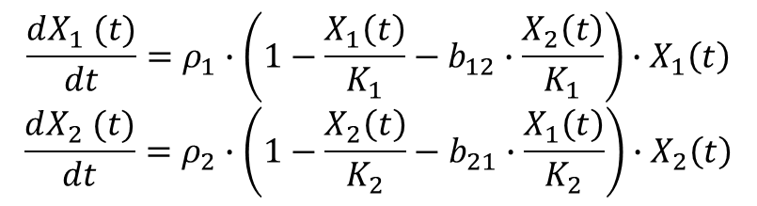
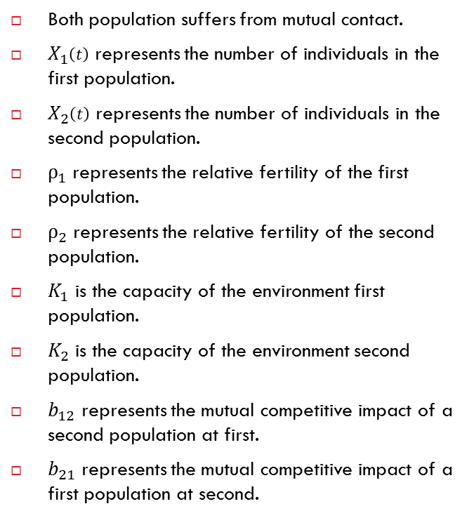
Two species populations models with competition
Both population suffers from mutual contact.
$X_{1}\left(t\right)$ represents the number of individuals in the first population.
$X_{2}\left(t\right)$ represents the number of individuals in the second population.
$ρ_{1}$represents the relative fertility of the first population.
$ρ_{2}$represents the relative fertility of the second population.
$K_{1}$ is the capacity of the environment first population.
$K_{2}$ is the capacity of the environment second population.
$b_{12}$ represents the mutual competitive impact of a second population at first.
$b_{21}$ represents the mutual competitive impact of a first population at second.
$$\frac{dX_{1} (t)}{dt}=ρ_{1}∙\left(1−\frac{X_{1}\left(t\right)}{K_{1}}−b_{12}∙\frac{X_{2}\left(t\right)}{K_{1}}\right)∙X_{1}\left(t\right)$$
$$\frac{dX_{2} (t)}{dt}=ρ_{2}∙\left(1−\frac{X_{2}\left(t\right)}{K_{2}}−b_{21}∙\frac{X_{1}\left(t\right)}{K_{2}}\right)∙X_{2}\left(t\right)$$

Slide 8
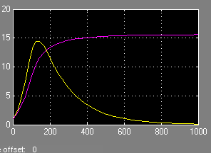
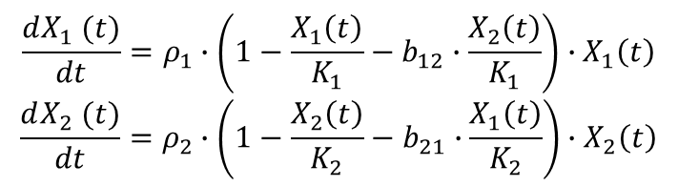
Two species populations models with competition
$$\frac{dX_{1} (t)}{dt}=ρ_{1}∙\left(1−\frac{X_{1}\left(t\right)}{K_{1}}−b_{12}∙\frac{X_{2}\left(t\right)}{K_{1}}\right)∙X_{1}\left(t\right)$$
$$\frac{dX_{2} (t)}{dt}=ρ_{2}∙\left(1−\frac{X_{2}\left(t\right)}{K_{2}}−b_{21}∙\frac{X_{1}\left(t\right)}{K_{2}}\right)∙X_{2}\left(t\right)$$

Slide 9
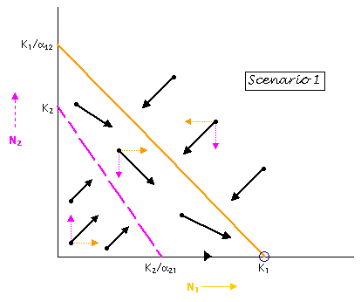
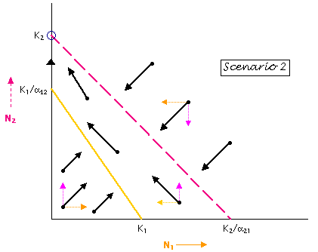
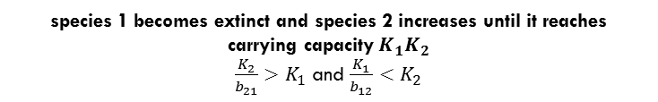
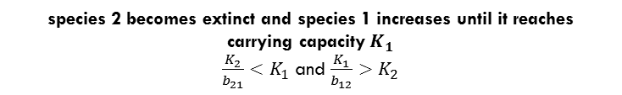
Two species populations models with competition
species 2 becomes extinct and species 1 increases until it reaches carrying capacity$K_{1}$
$\frac{K_{2}}{b_{21}}<K_{1}$ and $\frac{K_{1}}{b_{12}}>K_{2}$
species 1 becomes extinct and species 2 increases until it reaches carrying capacity$K_{1}K_{2}$
$\frac{K_{2}}{b_{21}}>K_{1}$ and $\frac{K_{1}}{b_{12}}<K_{2}$
Source: http://www.tiem.utk.edu/~gross/bioed/bealsmodules/competition.html

Slide 10
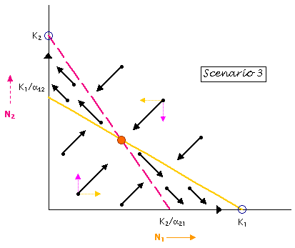
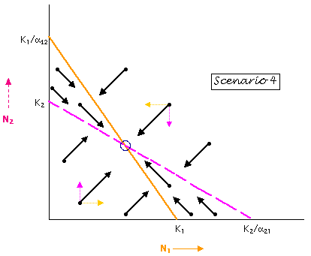

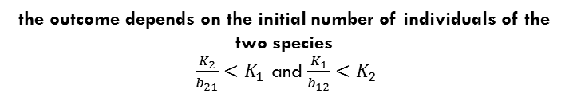
Two species populations models with competition
the outcome depends on the initial number of individuals of the two species
$\frac{K_{2}}{b_{21}}<K_{1}$ and $\frac{K_{1}}{b_{12}}<K_{2}$
Coexist of both species
$\frac{K_{2}}{b_{21}}>K_{1}$ and $\frac{K_{1}}{b_{12}}>K_{2}$
Source: http://www.tiem.utk.edu/~gross/bioed/bealsmodules/competition.html

Slide 11
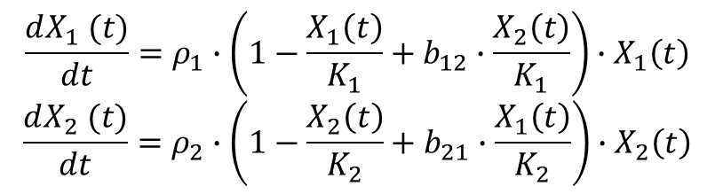
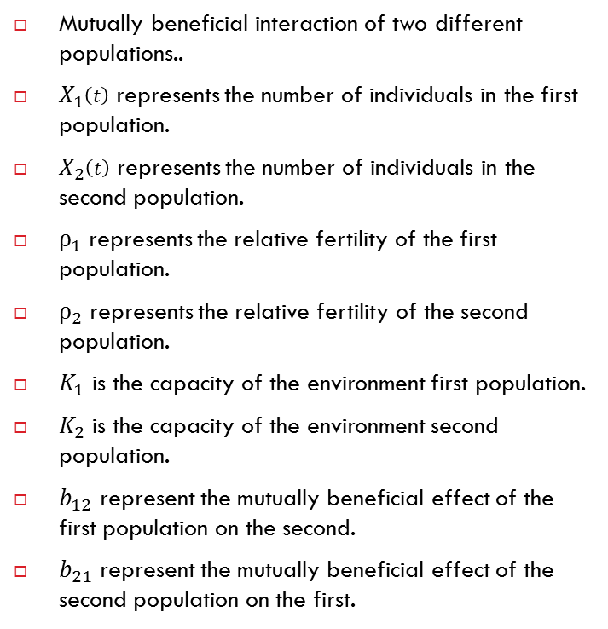
Two species populations models with cooperation
Mutually beneficial interaction of two different populations..
$X_{1}\left(t\right)$ represents the number of individuals in the first population.
$X_{2}\left(t\right)$ represents the number of individuals in the second population.
$ρ_{1}$represents the relative fertility of the first population.
$ρ_{2}$represents the relative fertility of the second population.
$K_{1}$ is the capacity of the environment first population.
$K_{2}$ is the capacity of the environment second population.
$b_{12}$ represent the mutually beneficial effect of the first population on the second.
$b_{21}$ represent the mutually beneficial effect of the second population on the first.
$$\frac{dX_{1} (t)}{dt}=ρ_{1}∙\left(1−\frac{X_{1}\left(t\right)}{K_{1}}+b_{12}∙\frac{X_{2}\left(t\right)}{K_{1}}\right)∙X_{1}\left(t\right)$$
$$\frac{dX_{2} (t)}{dt}=ρ_{2}∙\left(1−\frac{X_{2}\left(t\right)}{K_{2}}+b_{21}∙\frac{X_{1}\left(t\right)}{K_{2}}\right)∙X_{2}\left(t\right)$$

Slide 12
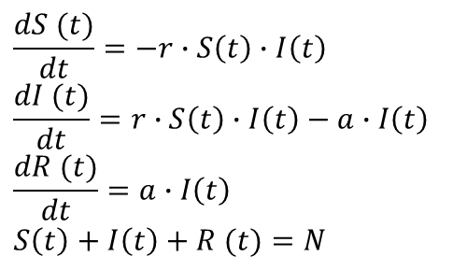
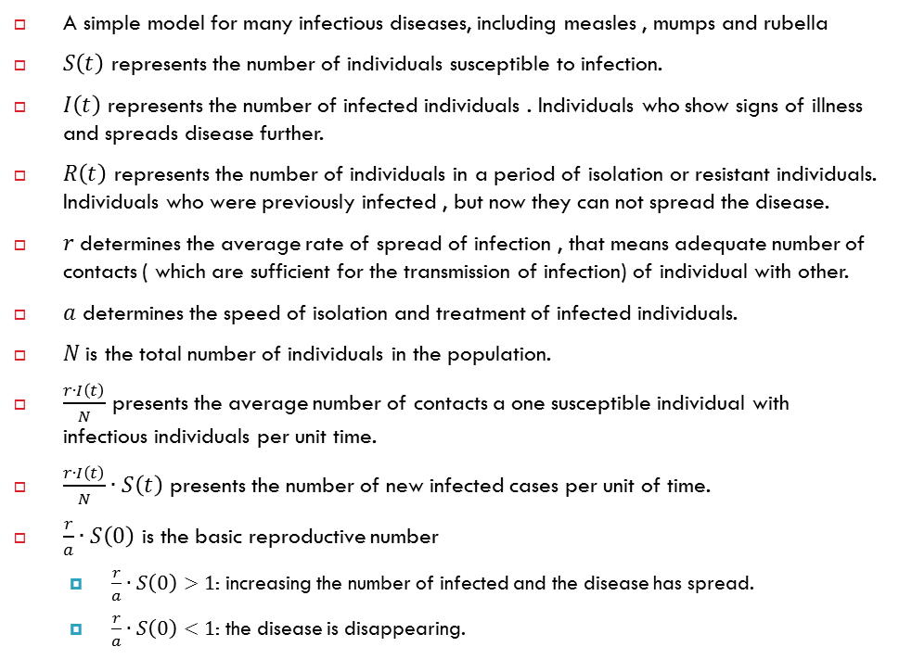
Epidemiology models - SIR
A simple model for many infectious diseases, including measles , mumps and rubella
$S\left(t\right)$ represents the number of individuals susceptible to infection.
$I\left(t\right)$ represents the number of infected individuals . Individuals who show signs of illness and spreads disease further.
$R\left(t\right)$ represents the number of individuals in a period of isolation or resistant individuals. Individuals who were previously infected , but now they can not spread the disease.
$r$determines the average rate of spread of infection , that means adequate number of contacts ( which are sufficient for the transmission of infection) of individual with other.
$a$ determines the speed of isolation and treatment of infected individuals.
$N$ is the total number of individuals in the population.
$\frac{r∙I\left(t\right)}{N}$ presents the average number of contacts a one susceptible individual with infectious individuals per unit time.
$\frac{r∙I\left(t\right)}{N}∙S\left(t\right)$ presents the number of new infected cases per unit of time.
$\frac{r}{a}∙S\left(0\right)$ is the basic reproductive number
$\frac{r}{a}∙S\left(0\right)>1$: increasing the number of infected and the disease has spread.
$\frac{r}{a}∙S\left(0\right)<1$: the disease is disappearing.
$$\frac{dS (t)}{dt}=−r∙S\left(t\right)∙I\left(t\right)$$
$$\frac{dI (t)}{dt}=r∙S\left(t\right)∙I\left(t\right)−a∙I\left(t\right)$$
$$\frac{dR (t)}{dt}=a∙I\left(t\right)$$
$$S\left(t\right)+I\left(t\right)+R (t)=N$$

Slide 13
Summary of today's practice
[Population models]
Two species populations models of predator – prey: Lotka– Volterra with delay, Kolmogorov model
Two species populations models with competition
Two species populations models with cooperation
Epidemiology models.
[What is next?]
Next week we will continue with compartment models.

